Slide 1
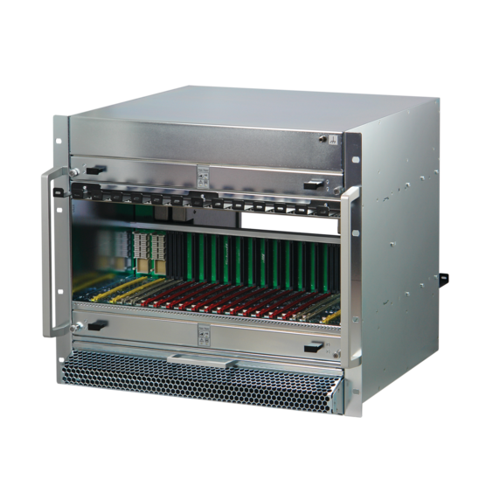
Next Generation MTCA.4
from a Crate point of view
Christian Ganninger
12-2022

Slide 2
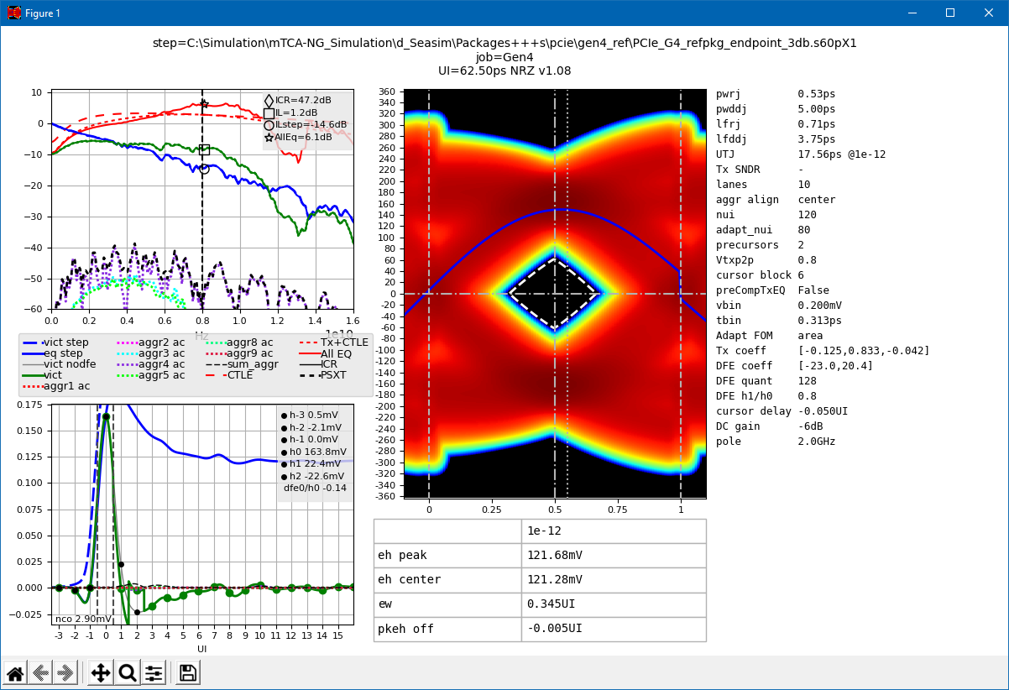
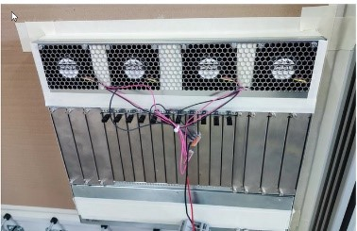
Next Generation MicroTCA
The PICMG NextGen MTCA working group defines MTCA.0 Rev 3
NEW FEATURES
Supports PCI Express Gen 4 & 5
Supports 100 Gb Ethernet (100GBASE-KR4)
New Base MCH with new management features and higher power to support 100 GbE or PCIe Gen 4 or Gen 5 switch hub
Power Module with 110 W modification for MCH and CU channels
Split MCH and 2 kW crate power to be defined later

Slide 3
MTCA Rev 3 Backplane
Signal Integrity, compatibility and differences

Slide 4
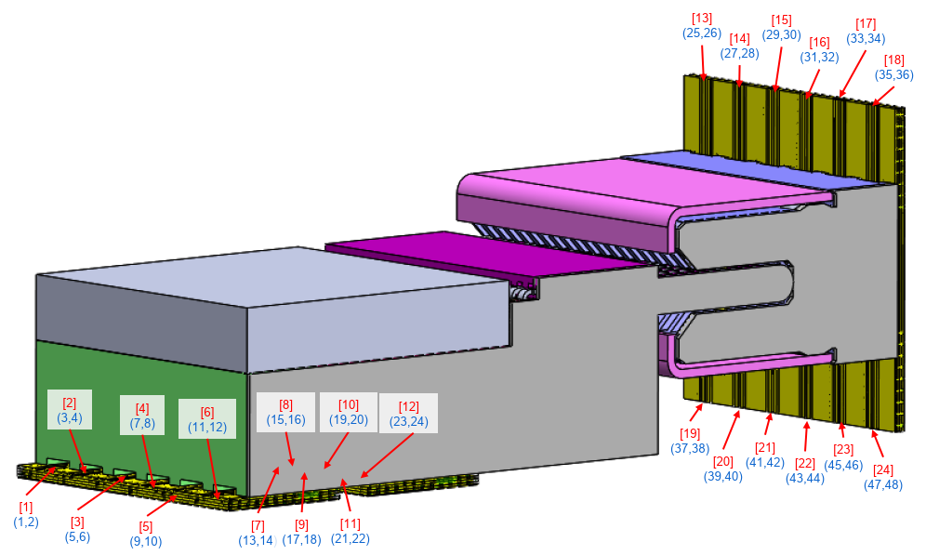
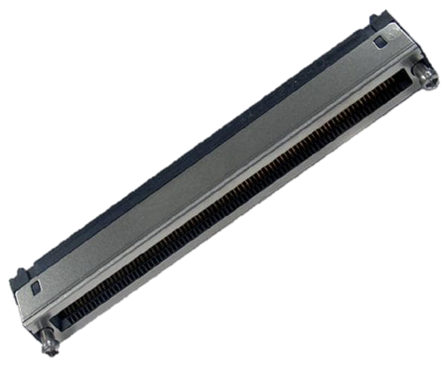
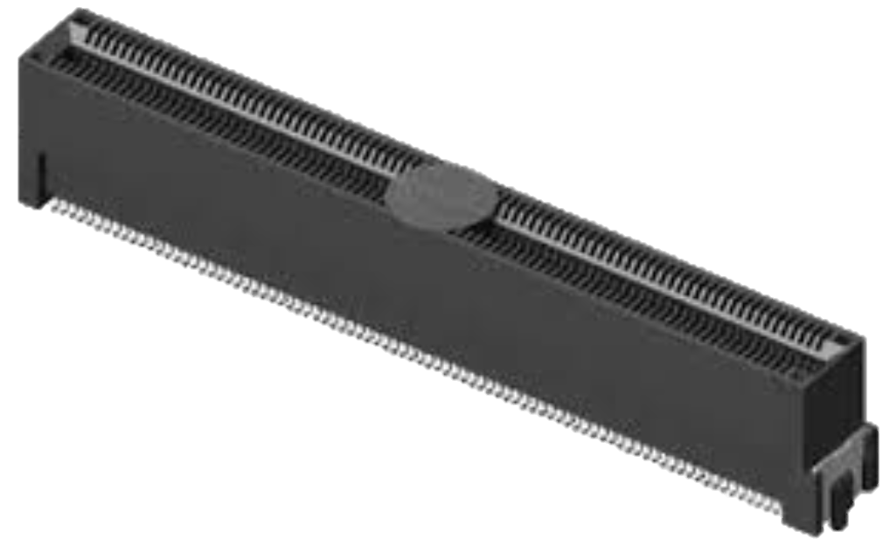
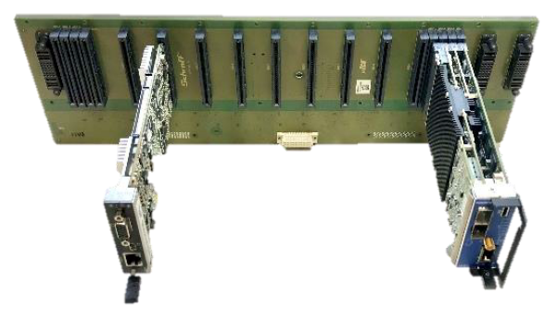
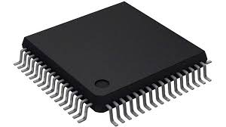
Signal Integrity
Improved connectors for higher transfer rates from Yamaichi and Amphenol (backplane and MCH-plug tongue 2 / 4)
Downward compatible to all AMC cards, new backplane footprint
Data transmission channel from PCI-SIG and IEEE divided into sections
Limits defined for MCH’s, AMC’s and Backplane
New low loss materials for boards and backplane required
i.e. for AMC’s: Isola Tachyon100G (typ. Dk 3.02 Df 0.0021 @10GHz)
i.e. for backplane: Elite Material EM-891K (typ. Dk 3.1 Df 0.0024 @10GHz)
Rx/Tx Chip
Tx/Rx Chip
transmission channel

Slide 5
Signal Integrity - In
Updated Trace lengths required to match the higher transfer rates
AMC/MCH card: Backplane:
min trace length: 35mm min trace length: 60mm (100mm for HUB channels) max trace length: 127mm max trace length: 250mm
MCH’s must move to the middle of the crate -> “crowded” routing in the MCH area
PM
PM
MCH
AMC
AMC
AMC
AMC
AMC
AMC
AMC
AMC
AMC
AMC
AMC
AMC
MCH
PM
PM
PM
PM
AMC
AMC
AMC
AMC
AMC
AMC
MCH
MCH
AMC
AMC
AMC
AMC
AMC
AMC
PM
PM

Slide 6
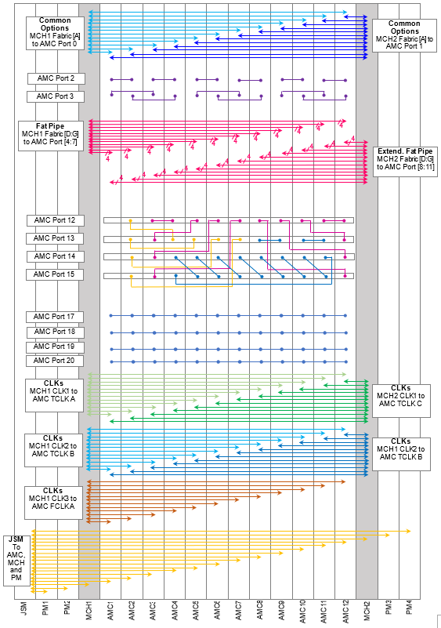
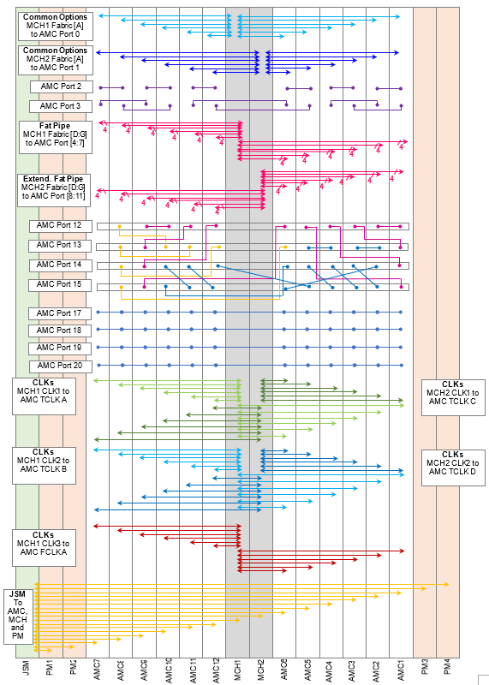
Backplane Topology Proposal
New MCH location requires to find new optimized routing strategy
Optimized AMC module order is:
7-8-9-10-11-12-MCH1-MCH2-6-5-4-3-2-1
Topology proposal:
Physical module interconnects would be (except Port 14 & 15) similar
Logical module position differs
“Daisy Chain Return Channel” (Port 14 & 15) will be different to achieve max. trace length < 250 mm
Current topology
NEW topology

Slide 7
MTCA.4 Crate
How updates in MTCA.0 Rev3 affect the MTCA.4 Crate Power and Cooling

Slide 8
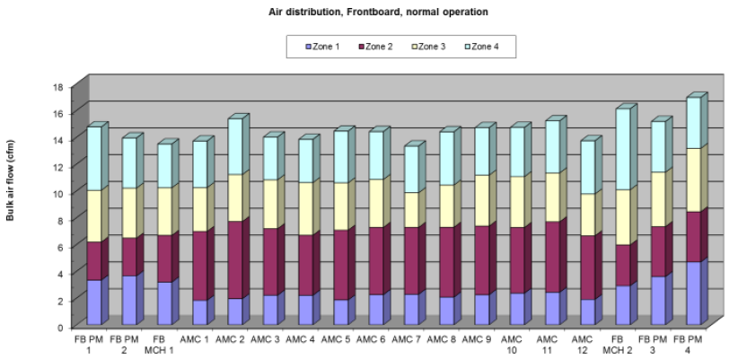
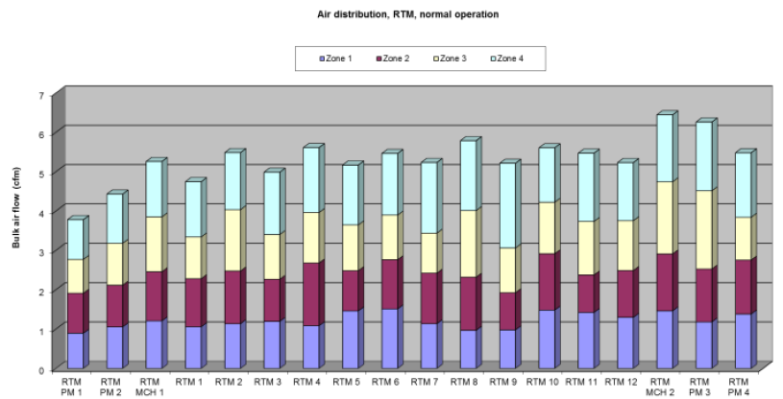
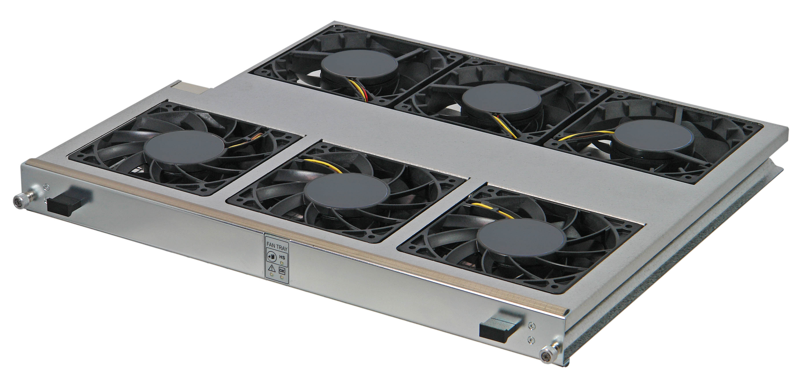
Current nVent SCHROFF MTCA.4 Crate
Sample: nVent SCHROFF 12 Slot MTCA.4 Crate 11850-026
AMC slot 1: 24.3 m³/h
cooling capability (at ΔT=12k)
Is equivalent to 88 W cooling capability for the Slot
RTM slot 7: 12.1 m3/h
cooling capability (at ΔT=12k)
Is equivalent to 44 W cooling capability for the Slot
MTCA.0 Rev3: Cooling Unit Power Channel enhancement: 80 W -> 110 W
Already using the strongest 120 mm, 12 V DC fans available in the front
Rear fans will be upgraded to improve air flow in the RTM section
No cooling improvement of front card cage possible with current System architecture

Slide 9
Outlook to 2 kW Crate
Future Option

Slide 10
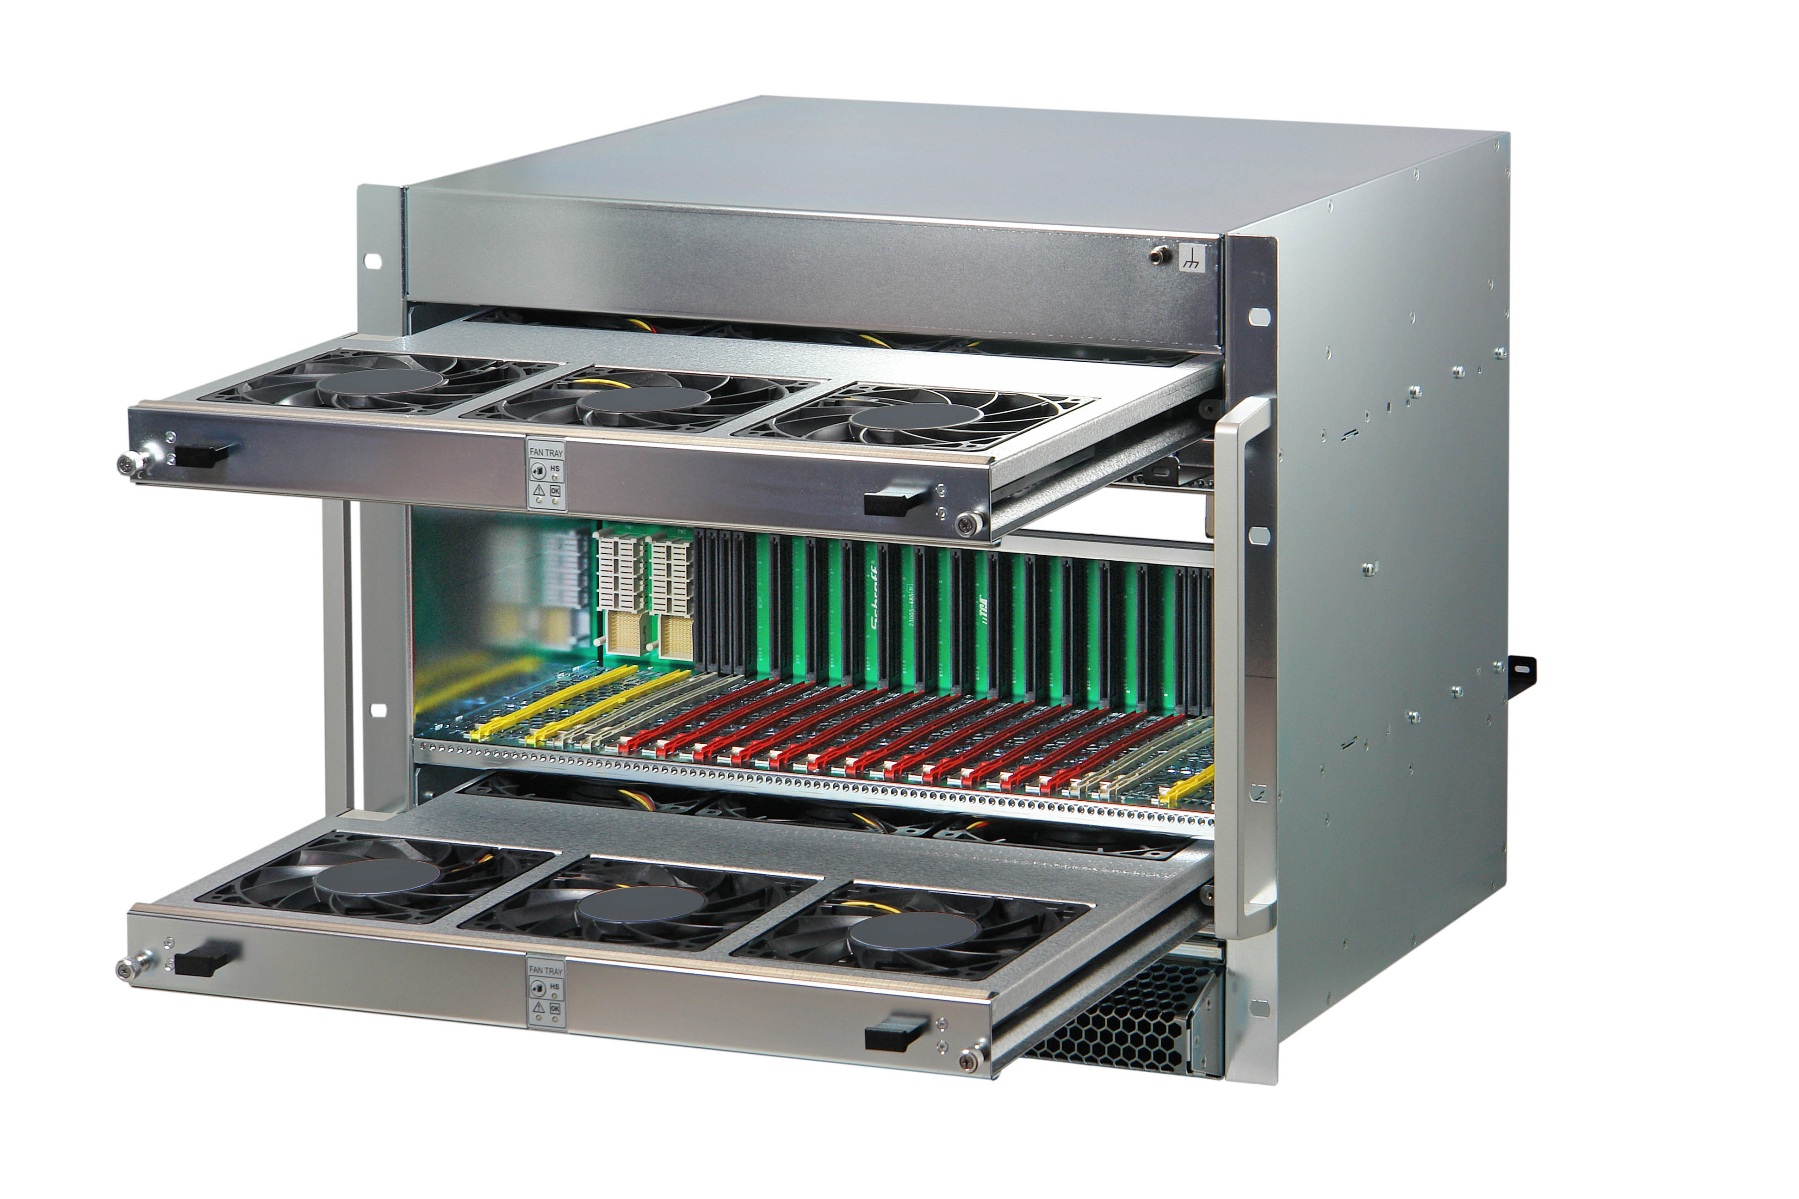
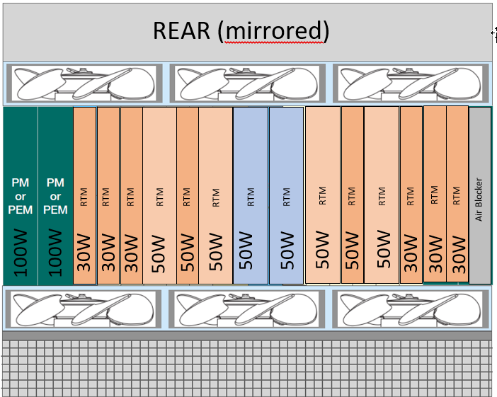
Simulation model: 12 Slot MTCA.4 Crate
Several cooling configurations have been considered and simulated
Push-Pull cooling, similar to existing 12-Slot crate
Pull cooling (fans at air exhaust at the top rear of the crate), without air guidance
Pull cooling (fans at air exhaust at the top rear of the crate), with air guidance
Constraints
Max. power consumption per Cooling Unit 200 W
Use of 12 V fans to stay compatible with 12V PP
Simulation model

Slide 11
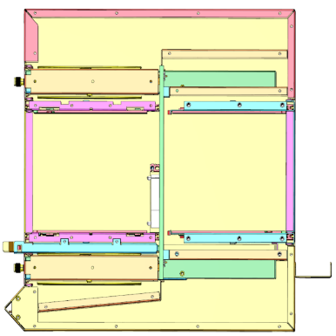
Going beyond the current Power Limits
Simulation have been carried out to determine the cooling capabilities with different fan configurations
Total electrical power in the shelf limited to 2000W
Cooling load scenarios:
All electrical power consumed on the AMCs -> Front card cage: 2000 W cooling -> Rear Card cage: 0 W cooling
RTMs consume max. power of 30 W / 50 W -> Front card cage: 1500 W cooling -> Rear Card cage: 500 W cooling
Mixed cooling load -> Front card cage: 1500 W – 2000 W cooling -> Rear Card cage: 0 W … 500 W cooling
Chassis cooling system needs to be able to handle all configuration
1500 W
-
2000 W
0 W
-
500 W
2000 W
0 W
1500 W
500 W

Slide 12
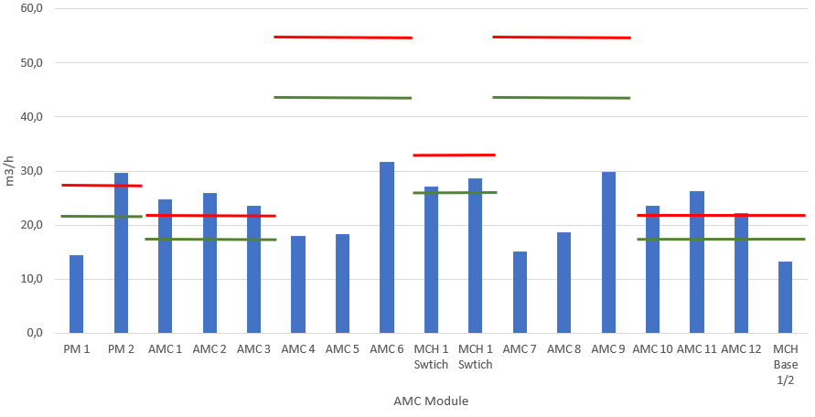
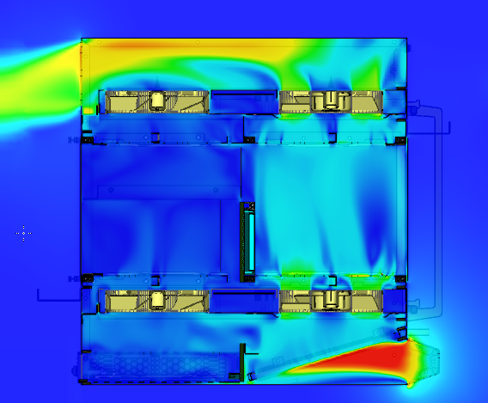
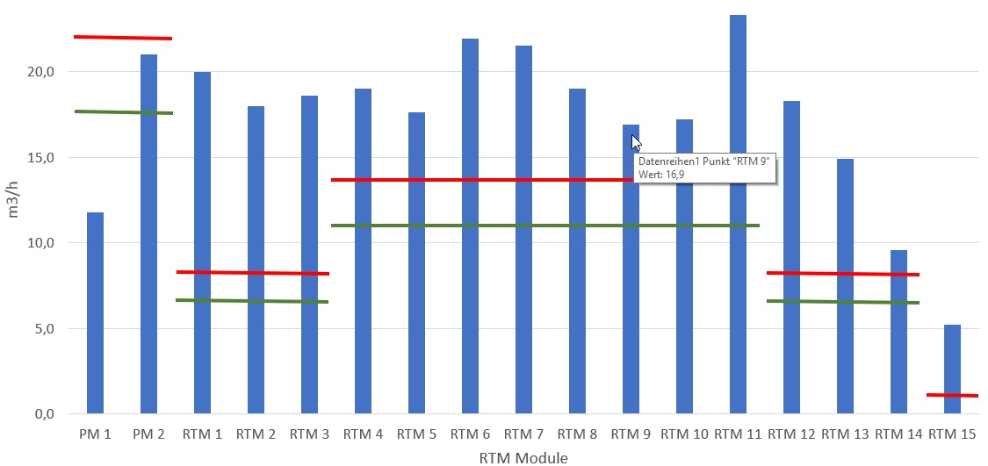
Simulation result, Push-Pull
Push-Pull cooling, Air flow distribution per slot, like existing 12-Slot crate
Front Modules
Rear Modules
Required air flow with ΔT 12K
Required air flow with ΔT 15K
Crate side view

Slide 13
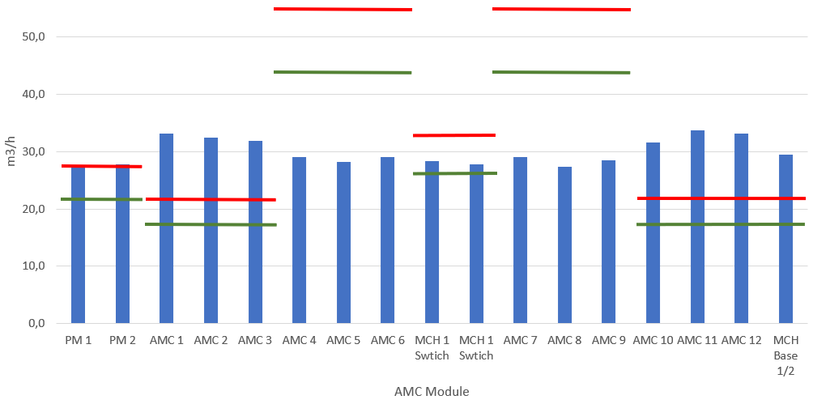
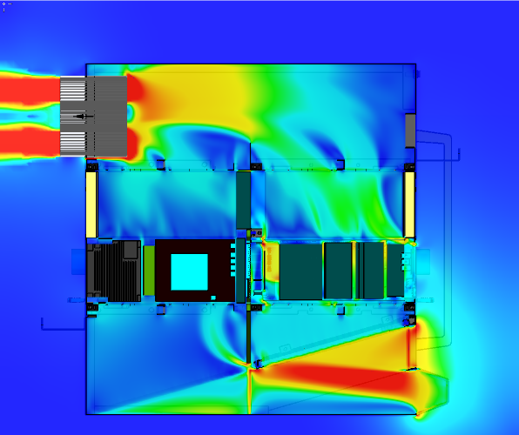
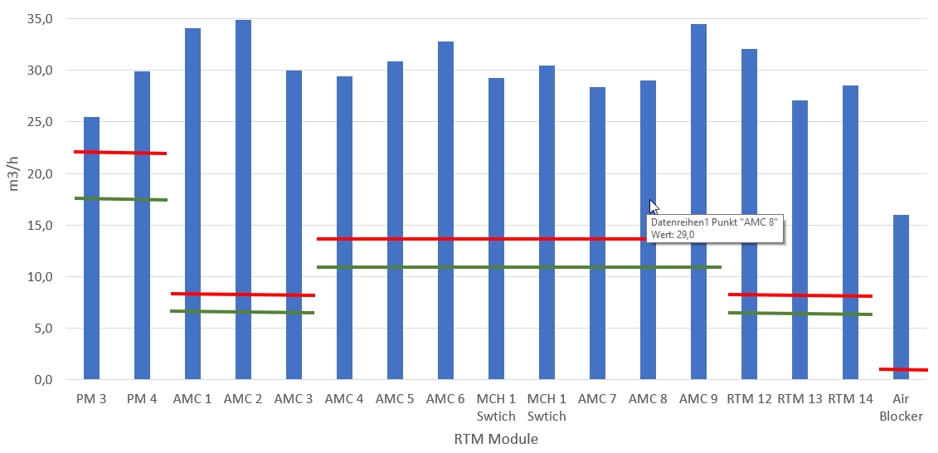
Simulation result, Pull, without air guidance
Pull cooling (fans at air exhaust at the top rear of the crate), without air guidance
Front Modules
Rear Modules
Required air flow with ΔT 12K
Required air flow with ΔT 15K
Crate side view

Slide 14
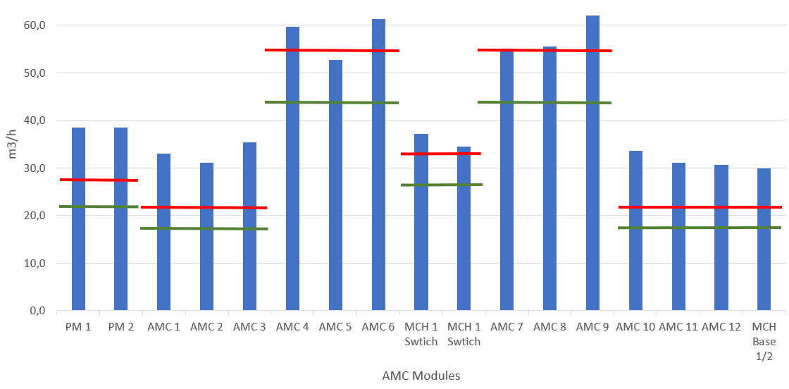
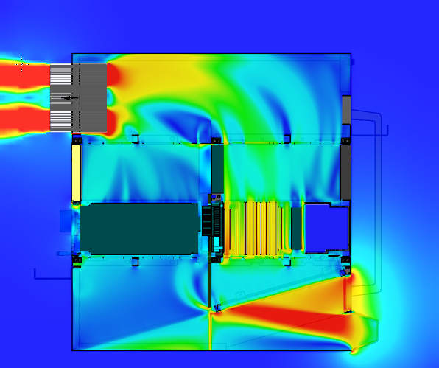
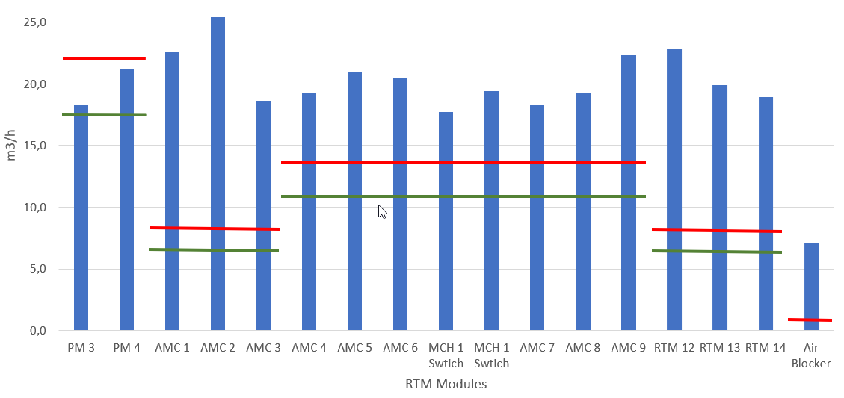
Simulation result, Pull, with air guidance
Pull cooling (fans at air exhaust at the top rear of the crate), with air guidance
Front Modules
Required air flow with ΔT 12K
Rear Modules
Required air flow with ΔT 15K
Crate side view

Slide 15
Thank You!

