Slide 1
Upgrade of the Injection Kicker Control System utilizing MicroTCA at the Spallation Neutron Source
Alan Justice
Hardware System Engineer
Spallation Neutron Source
Oak Ridge National Laboratory

Slide 2
What will be covered today
SNS requirements
Motivation for Upgrade
Technical Requirements
Design Details
Testing/Production Results
Questions/Comments

Slide 3
Operations Envelope – Injection Kicker Operations
5.23.5.2.6 Target – Peak Beam Pulse Intensity
  5.23.5.2.6.1 As the beam power is increased above 100 kW, automatic beam shut-off controls will be implemented on the RTBT magnet currents, RTBT beam loss monitor thresholds, and Ring injection kicker waveforms. Note that not all beam shut-off controls need to be fully implemented prior to high power operations. Power limits due to partial implementation of the Errant Beam Control Plan detailed below will be determined on a case-by-case basis.
  The injection kicker magnet readback current waveforms will be monitored, and if the waveforms stray outside of pre-defined windows, the MPS system will trip off the beam.

Slide 4
Motivation to upgrade
Waveform Monitor
  Lecroy Waverunner 64Xi utilized for the waveform monitoring are obsolete
  Lecroy Waverunner 64Xi was not a fail-safe implementation and therefore a different solution was desirable
Waveform Generator
  Yokogawa System that provides waveforms are obsolete.
    Yokogawa WE400 is obsolete and there is no direct replacement
    Yokogawa WE7121 is used to generate waveforms and this is the functionality that needs replicated
  Yokogawa has experienced failures and spares are a concern
    On 9/30/20, the Yokogawa System Reached a “No-Spare” Condition

Slide 5
Basic Requirements
Waveform Monitor
  Monitor all 8 injector waveforms at 60 Hz
    Sampling frequency shall be 1 MHz or higher
    Monitoring window shall be at least 5 ms to cover the critical period of the cycle
    Monitoring must be synchronized to the SNS Timing System
  MPS Functionality
    Report a faulted condition to the MPS when any of these waveforms is not operating within its defined window settings
    Window setting to include the rising edge, flattop, and falling edges
Waveform Generator
  Generate a 5msec waveform for each Injection kicker (8 channels)
    Based on waveform provided by physics/operations
  Waveforms must be synchronized to the SNS Timing System
    Triggered on user selectable event with settable delay

Slide 6
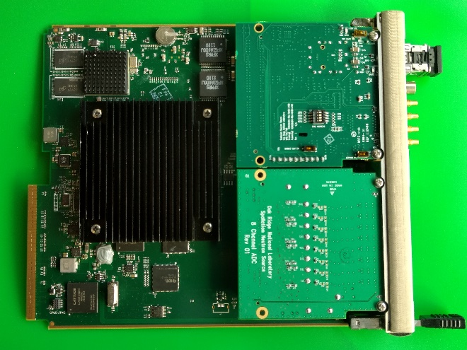
Waveform Monitor – Hardware Details
LeCroy Scope
GT&FS
IOC
MCH
AMC
FMC
MPS/Timing
FMC Slot 0
LeCroy Scope
Diagnostic
LeCroy Scope
WFM
FMC
8-Ch ADC
FMC Slot 1
LeCroy Scope
Diagnostic
LeCroy Scope
WFM
  Lecroy Scope Solution:
  - 5 LeCroy Scopes for monitoring, displaying and output to MPS.
  - External Timing Gating
  - Windows based scopes – Not Real-time
  Single AMC Card Solution:
    - 8-Channel ADC (2.5 MSps)
    - Single Link interface
    - 12 user-defined interrupts
    Dual-channel DMA

Slide 7
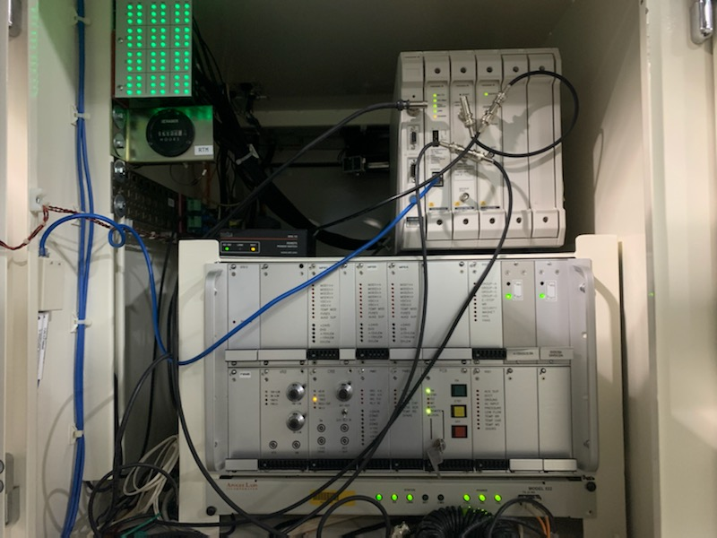
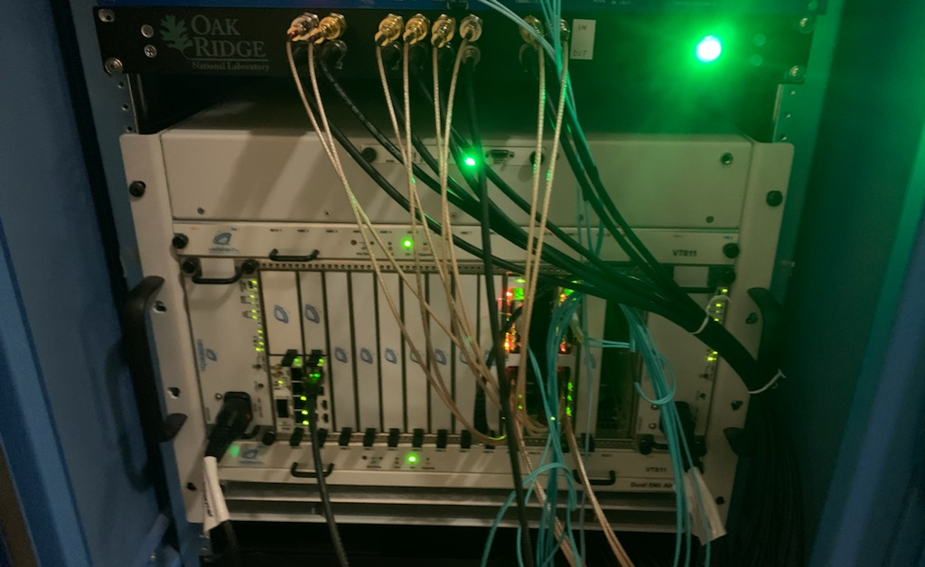
Waveform Generator – Hardware Details
Distributed Controllers – Yokogawa WE400
Timing Provided from Single IOC (Ring PS IOC2)
Centralized Controllers – MicroTCA (Vadatech AMC502)
Timing Provided from MicroTCA IOC

Slide 8
Design Details – Waveform Monitor Firmware

Slide 9
Design Details – Waveform Generator Firmware

Slide 10
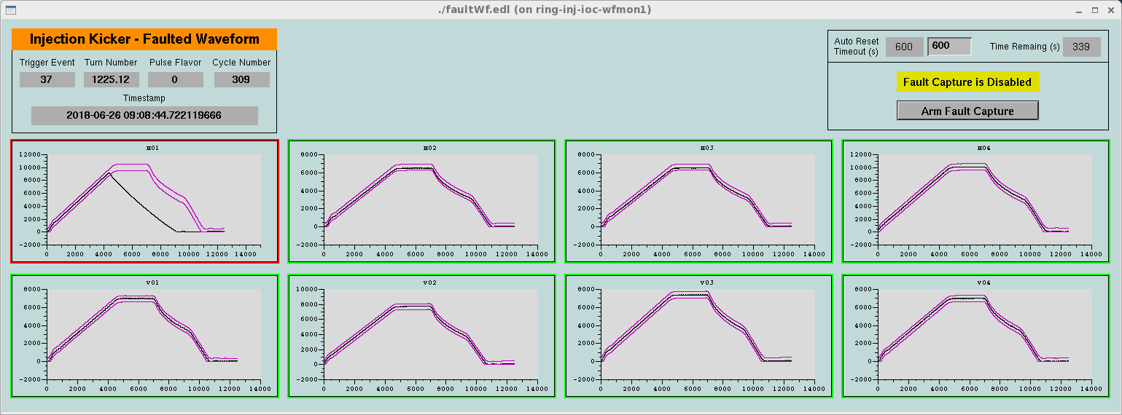
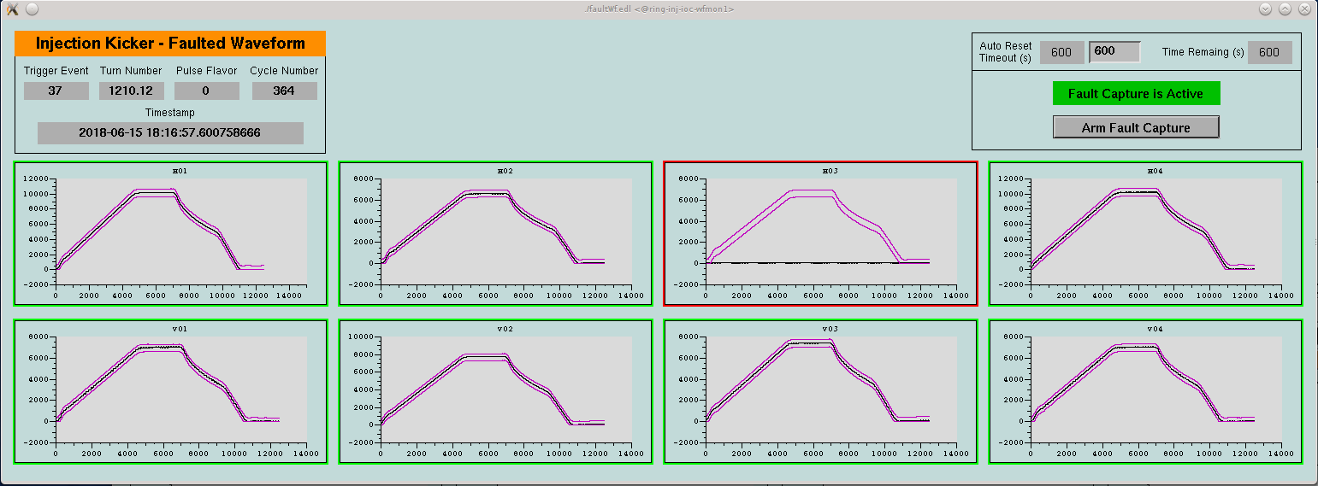
System Verification
Fault generated for testing
Fault during production

Slide 11
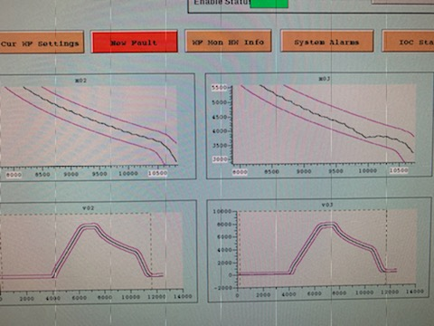
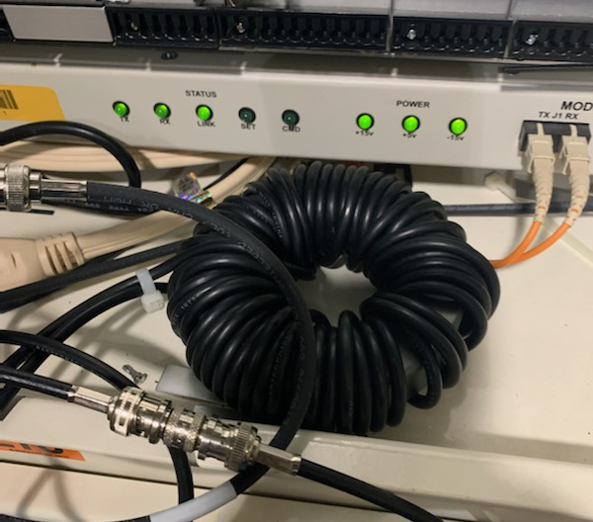
Waveform Generator Noise Issues
AP shift showed noise present on the waveforms
Power supply SME suggested applying toroids to the cables.

Slide 12
Conclusion
The MicroTCA based Injection Kicker systems have been a huge success for SNS.
Addressed critical obsolescence issues
Added functionality and are done in fail-safe implementation
Future upgrades are planned to increase functionality further

Slide 13
Questions/Comments

Slide 14
Backup Slides

Slide 15
Design Details – System Overview
Primary Function: Drive 5-Millisecond Waveform Upon Receipt of Timing System-Based Trigger
4-Step Process:
  CPU downloads unique 12500-point waveform for each channel to WfmGen’s SRAM memory
  CPU configures WfmGen to generate trigger based on Event and delay
  Upon receipt of trigger, WfmGen logic sequences through the memory at a rate of 2.5 MSPS; memory data drives the DACs.
  Amplifier provides gain of 10 to achieve 0-10V range.
EPICS
Timing
PCIe
CPU
WfmGen
WfmGen
Timing
Interface
FMC
Timing
Interface
FMC
4-Channel
DAC
FMC
4-Channel
DAC
FMC
8-Channel
Amplifier
(G=10)

