Slide 1




MTCA.4 Tutorial - Basics
Introduction in xTCA
December 2022
Ralf Waldt
Field Application Engineer
nVent SCHROFF
schroff.nvent.com
nVent Schroff
YouTube.com/nVentSCHROFF

Slide 2
Agenda
What is xTCA?
Specifications Overview
ATCA Features
AMC Features
MTCA.0 Features
MTCA.4
    Initial Requirements
    Mechanical Features
    Module sizes
    Keying
    Backplane
    Management extensions compared to MTCA.0
    Hot Swap Transition States
    Cooling
    Redundancy
    MTCA.4.1
MTCA Workshop Desy 2022

Slide 3
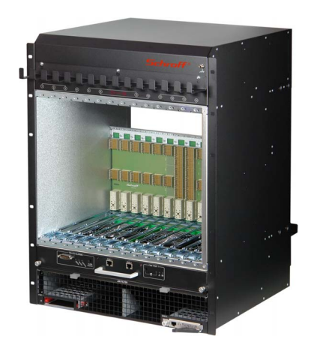
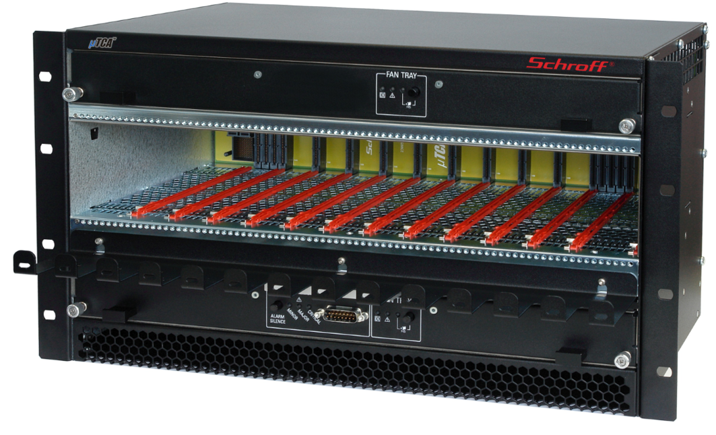
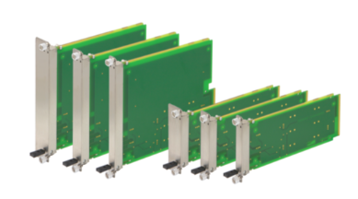
What is xTCA?
xTCA
ATCA
MTCA
Advanced
Telecom
Computing
Architecture
AMC
Micro
Telecom
Computing
Architecture
Advanced
Mezzanine
Card
MTCA Workshop Desy 2022

Slide 4
ATCA
Overview
Specification initially targeted to the Telco Industry
Features required for the new standard:
  System Availability 99.999% (~5 min/year)
  System throughput to 2 Tb/s (full mesh)
  Port data rate to 40 Gb/s (4 x 10Gb/s), today 100Gb/s
  Management, monitoring and control!
  Software infrastructure providing APIʼs, etc.!
Introduced in 2002
MTCA Workshop Desy 2022

Slide 5
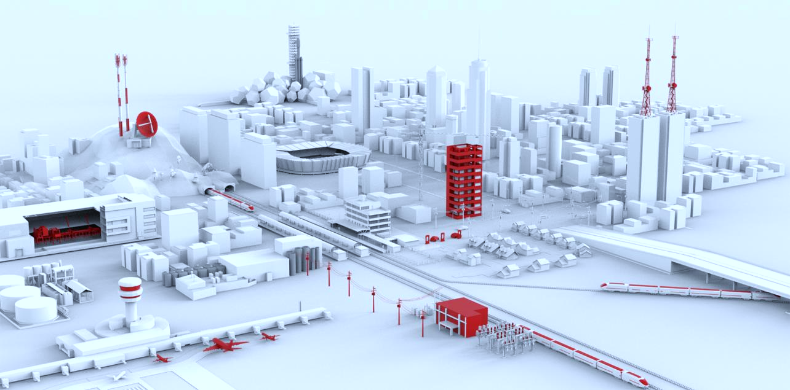

ATCA

Slide 6
ATCA
Specification Family
PICMG 3.1
IRTM.0
Ethernet/Fibre Channel Over PICMG 3.0
Intelligent Rear Transition Module (IRTM) Base
PICMG 3.2
InfiniBand Over PICMG 3.0
PICMG 3.0
AMC.0
AdvancedTCA Base Specification
Advanced Mezzanine Card Base Specification
PICMG 3.3
StarFabric/Advanced Switching for AdvancedTCA Systems
PICMG 3.4
PICMG 3.5
PICMG 3.8
PCI Express and Advanced Switching for AdvancedTCA Systems
Serial RapidIO for AdvancedTCA Systems
AdvancedTCA Rear Transition Module Zone 3A
MTCA Workshop Desy 2022

Slide 7
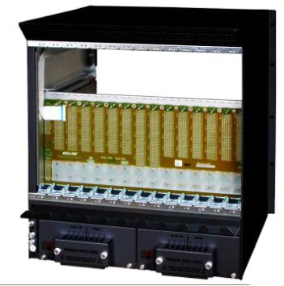
ATCA
Shelf Elements
Front View
Rear View
Alarm Board
Backplane
Redundant Fan Trays
Dual redundant Shelf Managers
Power Entry Module (PEM)
MTCA Workshop Desy 2022

Slide 8
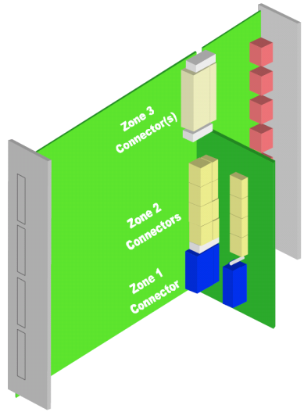
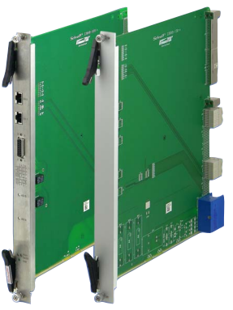
ATCA
Board size and connectors
Front board size 8U x 280
Rear board (RTM) size 8U x 70 mm
  Connects directly to front board
Board width 6HP (1.2”)
Alignment/Key pins
Zone 1: Management and Power
Zone 2: Base Interface and Fabric Interface
Zone 3: Interface to RTM
MTCA Workshop Desy 2022

Slide 9
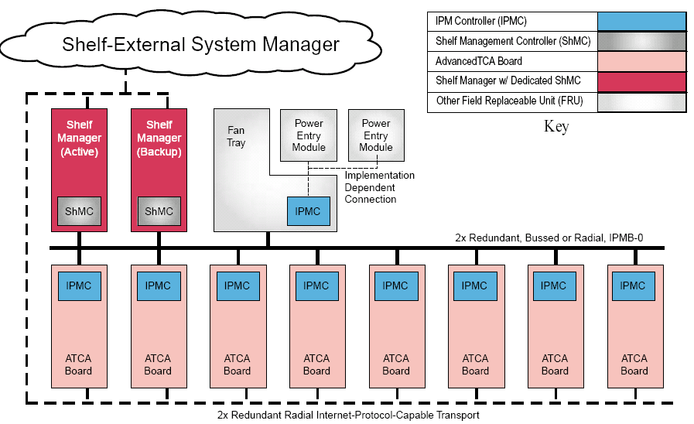
ATCA
Management
Dedicated Shelf Management Controller (ShMC)
ATCA Boards with IPMC
Protocol IPMI (Physical layer I²C-Bus)
Intelligent and Managed FRUs
Bused or Radial IPMB
MTCA Workshop Desy 2022

Slide 10
AMC

Slide 11
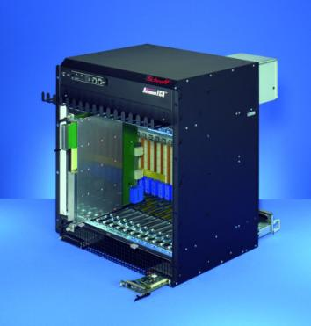
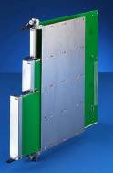
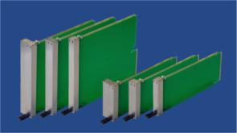
AMC
Initially developed as function extension for ATCA Boards
Fully integrated into the ATCA IPMI management structure
Plugged into a so called ATCA Carrier
Hot Swap capability
AMC Modules
MTCA Workshop Desy 2022

Slide 12
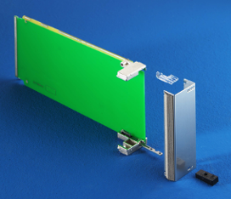
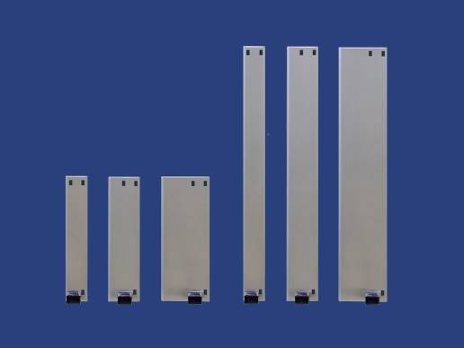

AMC
AMC Module Sizes
6 Standard Sizes:
Depth dimension: 180 mm
Width dimensions: Single and Double
Height dimensions: Compact, Mid-size and Full-size
Double
Single
3HP 4HP 6HP
Compact Mid-size Full-size
3HP 4HP 6HP
Compact Mid-size Full-size
MTCA Workshop Desy 2022

Slide 13
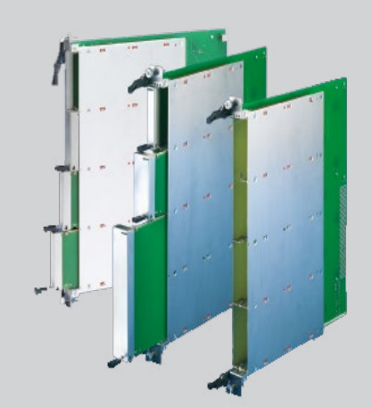
AMC Modules
Carrier IPMC represents the MMC on the AMC as a FRU to the Shelf Manager
Functionality of the Carrier Manager
Management interface to the Shelf Manager
Managing the AMC Modules
MTCA Workshop Desy 2022

Slide 14
MTCA.0

Slide 15

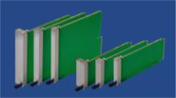
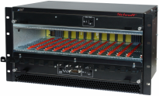
MTCA.0
The basic idea of MTCA is to have a shelf that contains just AMC modules
Backplane directly accepts AMC modules
AMCs are interchangeable between ATCA and MTCA
The infrastructure of a ATCA Carrier was adapted into the MTCA crate (power, management, switching)
No rear I/O, power input and all outputs to the front
ATCA Shelf
AMC Modules
MTCA Crate
MTCA Workshop Desy 2022

Slide 16
MTCA.0
As MicroTCA does not use a Carrier board.
The power, management, clock distribution and switching functionality must be realized onto another device
Management Module: MCH (MTCA Carrier Hub)
  IPMI management
  clock distribution / generation
  Switching functionality
  JTAG slave / master
  Redundant MCHs
Power Module
  12V Payload Power
  3.3V Management Power
  Redundant power modules
Dedicated Slots for these modules are located in the MTCA crate
MTCA Workshop Desy 2022

Slide 17
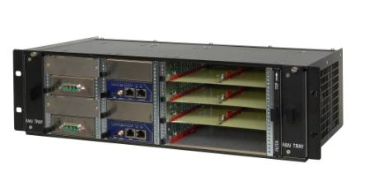
MTCA.0
ATCA Carrier
MTCA Crate
AMC
MMC
Zone 3
Clock distribution
Switching
Zone 2
Carrier
IPMC
AMC
MMC
Current
Limit
Power
Zone 1
Current
Limit
MTCA Workshop Desy 2022

Slide 18
MTCA.0
Terms and Acronyms
MCH MicroTCA Carrier Hub
      Management and switching module
MCMC MicroTCA Carrier Management Controller
      Physical IPMI controller on the MCH
MMC Module Management Controller
      Physical IPMI controller on an AMC
EMMC Enhanced MicroTCA Carrier Management Controller
      Physical IPMI controller on a Cooling Unit and on Power Module
IPMB-0 Intelligent Platform Management Bus 0
      Logical IPMB, physically divided into redundant IPMB-A and IPMB-B
IPMB-L IPMB-Local
      IPMI link between MCH and AMCs
MTCA Workshop Desy 2022

Slide 19
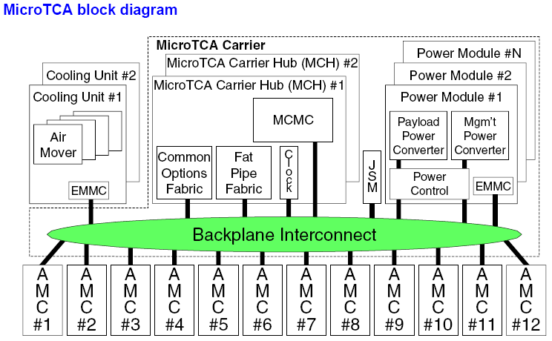
MTCA.0
MTCA Workshop Desy 2022

Slide 20
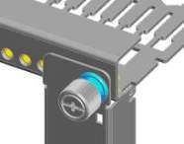
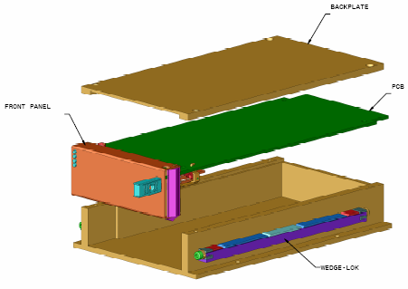
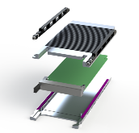
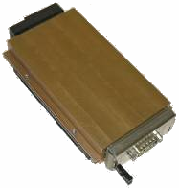
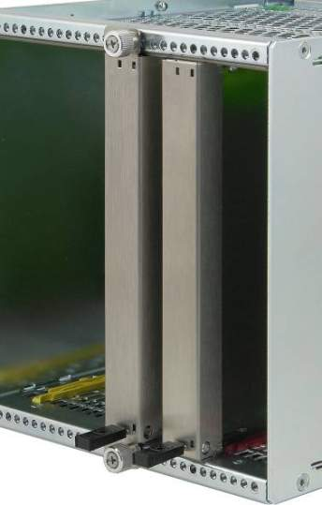
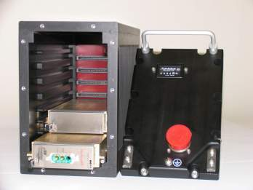
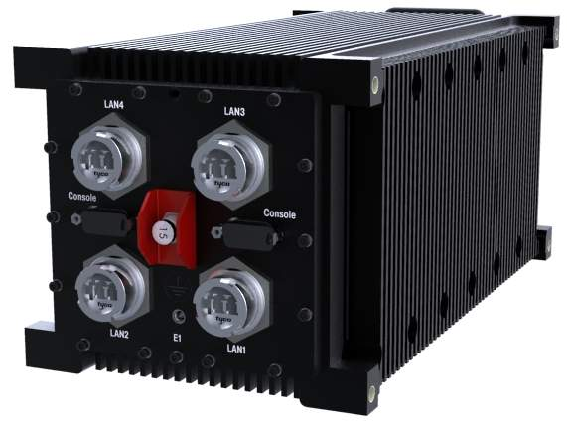
MTCA.1 - 3
MTCA.1
MTCA.2
MTCA.3
AdvancedMC front panel
has to be fastened (screwed)
to the subrack
Hardened Air Cooled MicroTCA
For Telecommunication outdoor and
military air, land and sea applications
Clamshell System for high shock &
vibration requirements
Retainer solution allows forced air flow
through heat sinks
Conduction Cooled MicroTCA
For Telecommunication outdoor and
military air, land and sea applications
Standard AMC board in a clamshell
provides a thermal conduction path to
the thermal interface surfaces of the
chassis sidewall
Front panel
with flange
Additional
retention
screw
MTCA.1
front panel
AdvancedMC.0
front panel
MTCA Workshop Desy 2022

Slide 21
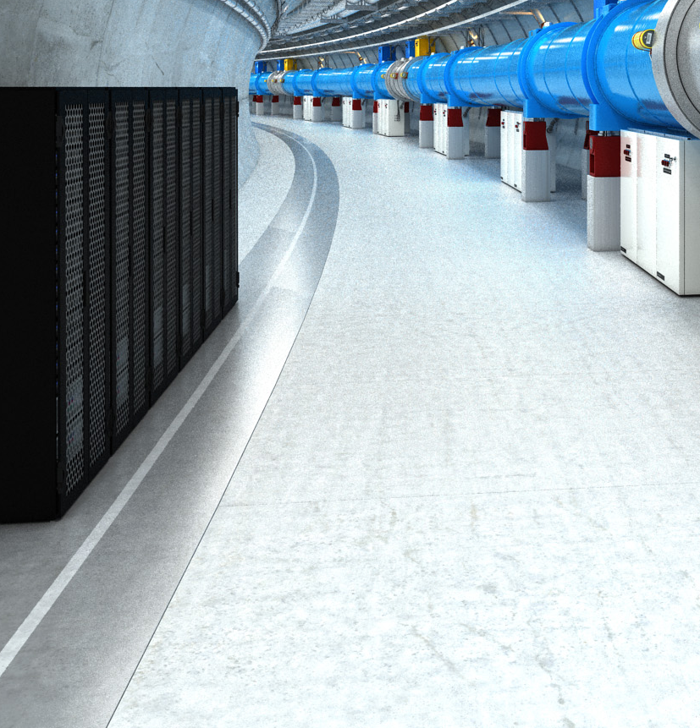
MTCA.4

Slide 22
MTCA.4
Why were extensions needed to the existing MicroTCA specifications?
No Rear Transition Module (RTM) defined for MicroTCA
  Requirement for a large number of I/O cables.
  It makes sense to connect them to the rear of the chassis
Special clock and trigger topology
  MicroTCA.0 specifies 3 Clocks and AMC.0 R2.0 specifies 4 Telecom and 1 Fabric Clock on the AMC Module. Physics applications typically need additional Clocks and Triggers
Sophisticated requirements for the clock and trigger accuracy
  MicroTCA / AMC defines typical telecom clock signals corresponding to PCIe values. Trigger signals are not specified
MTCA Workshop Desy 2022

Slide 23
MTCA.4
Requirements for mechanics and sizes
AMC Module size: Double, Mid-size
  In a 19” wide crate the AMC module size double mid-size allows front configuration of:
    max. 2 MCHs
    max. 4 power units
    max. 12 AMCs
Large MicroRTM real estate
  MicroRTM size approximately the size of the AMC (doubles depth of existing MTCA chassis)
Use front panel mechanics based on Rugged MicroTCA (MTCA.1)
  Need to mechanically attach a module to avoid it being pushed-out by the corresponding module
  Use Rugged MicroTCA retention device
Reuse existing AMC front panels for the MicroRTM
Allowing mounting of mezzanine modules on the rear of the backplane
Optional zone 3 backplane
Define the management of the system
Suggest clocking and backplane topology
MTCA Workshop Desy 2022

Slide 24
MTCA.4
MTCA.0
Micro Telecommunications Computing Architecture Base Specification
MicroTCA Specification Family Tree
MTCA.1
Air Cooled Rugged MicroTCA Specification
MTCA.4
AMC.0
MicroTCA Enhancements for Rear I/O and Precision Timing
Advanced Mezzanine Card Base Specification
MTCA.2
Hardened Air Cooled MicroTCA Specification
MTCA.3
Hardened Conduction Cooled MicroTCA Specification
MTCA Workshop Desy 2022

Slide 25
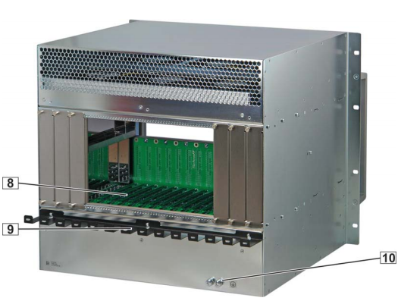
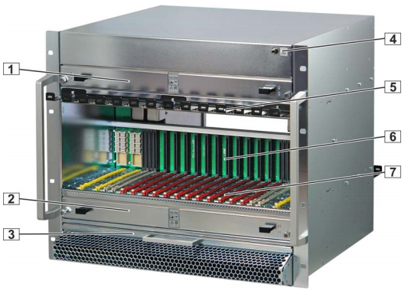
MTCA.4
Typical MTCA.4 Crate
1 Upper Cooling Unit (CU1)
2 Lower Cooling
3 Air filter
4 ESD Wrist Strap Terminal
5 Cable Tray Unit (CU2)
6 Backplane
7 Card cage
8 Rear card cage
9 Cable Tray
10 Ground Terminal
MTCA Workshop Desy 2022

Slide 26
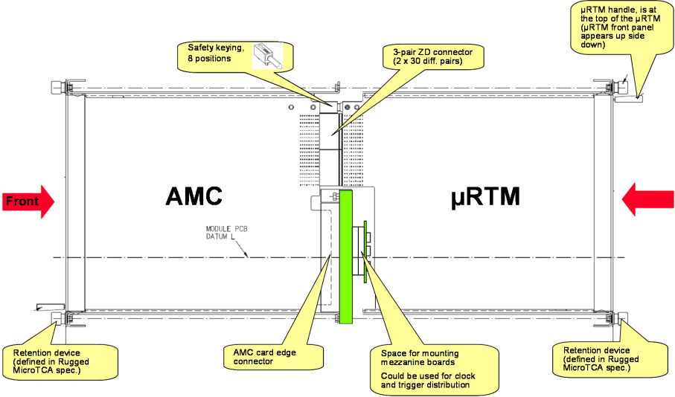
MTCA.4
Features of MTCA.4 shelf with MicroRTM, side view
REAR
MTCA Workshop Desy 2022

Slide 27
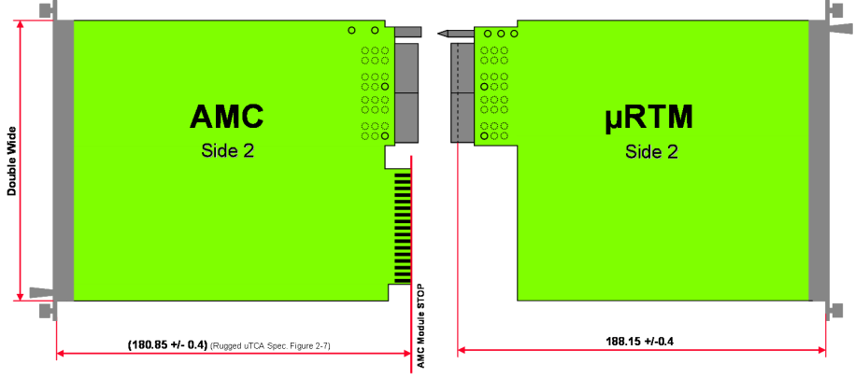
MTCA.4
Module Sizes
MTCA Workshop Desy 2022

Slide 28
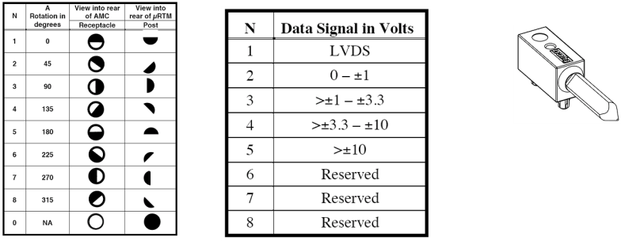
MTCA.4
Alignment and Keying
Mechanical keying prevents a module from being inserted which is not electrically compatible and could cause damage
Eight keying positions are implemented that define the electrical interface
MTCA Workshop Desy 2022

Slide 29
MTCA.4
Front board and MicroRTM power distribution
The total power for a slot (front board and RTM) is supplied through the front board AMC connector
The MicroRTM power is supplied from the front board through the Zone 3 connectors
Total available power for a slot is 80 Watts, the MicroRTM power is limited to 30 Watts
The power required by the MicroRTM is subtracted from the power for the front board
AMC
30 W
80 W
50 W
MTCA Workshop Desy 2022

Slide 30
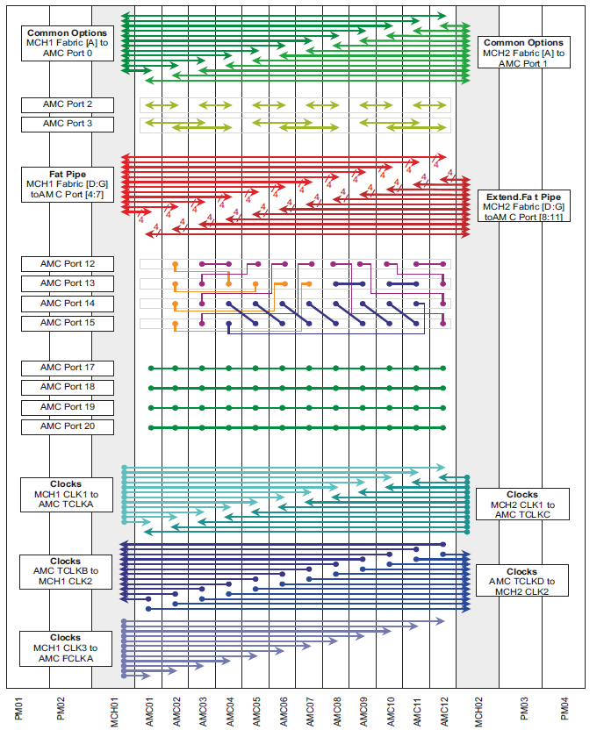
MTCA.4
MTCA.4 Backplane 12-Slots
10GbE
SAS/SATA
PCIe
or
SRIO
1 GbE/
SRIO
Point-to-Point Links
Extended Options
8x M-LVDS Trigger
Clocks
MTCA Workshop Desy 2021

Slide 31
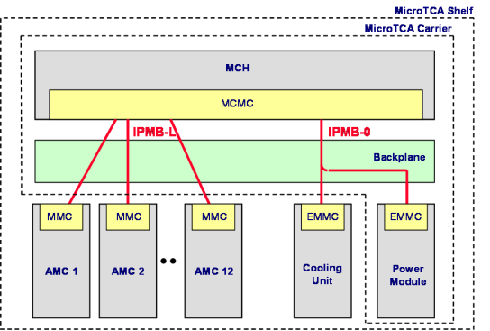
MTCA.4
Management defined in AMC.0 / MTCA.0
IPMB-L
  Connects the MCMC on the MCH to the MMC on the AMC Modules
  Radial architecture
IPMB-0
  Connects the MCMC on the MCH to the EMMC on the PM and CU
  Bused architecture
MTCA Workshop Desy 2021

Slide 32
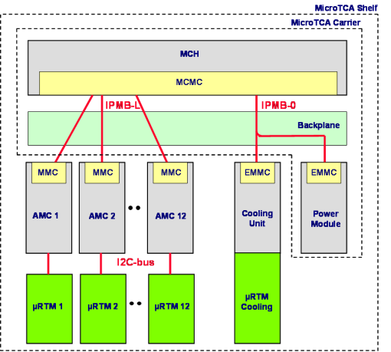
MTCA.4
Management extensions in MTCA.4
IPMB-L
  Connects the MCMC on the MCH to the MMC on the AMC Modules
  Radial architecture
IPMB-0
  Connects the MCMC on the MCH to the EMMC on the PM and CU
  Bused architecture
I2C-Bus
  Connects the AMC to the µRTM
  The µRTM is treated as managed FRU of the AMC
MTCA Workshop Desy 2021

Slide 33
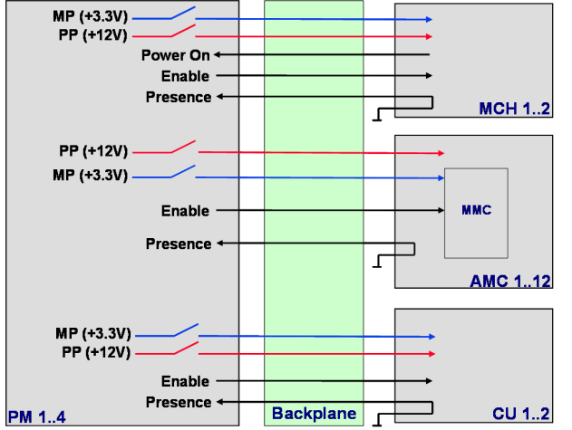
MTCA.4
Control signals as defined per AMC.0 / MTCA.0
MTCA Workshop Desy 2022

Slide 34
MTCA.4
Additional RTM control signals for MTCA.4
MP (+3.3V)
MP (+3.3V)
MP (+3.3V)
PP (+12V)
PP (+12V)
PP (+12V)
Power On
Power On
Power On
Enable
Enable
Enable
Presence
Presence
Presence
MCH 1..2
MCH 1..2
PP (+12V)
PP (+12V)
PP (+12V)
PP (+12V)
MP (+3.3V)
MP (+3.3V)
MP (+3.3V)
MP (+3.3V)
Enable
Enable
MMC
MMC
Presence
Presence
Presence
Presence
µ
µ
RTM
RTM
1..12
AMC 1..12
1..12
AMC 1..12
MP (+3.3V)
MP (+3.3V)
MP (+3.3V)
PP (+12V)
PP (+12V)
EMMC
Enable
Enable
Enable
Presence
Presence
Presence
Front fans
Rear
cooling
Backplane
Rear fans
PM 1..4
Backplane
CU 1..2
CU 1..2
PM 1..4
MTCA Workshop Desy 2022

Slide 35
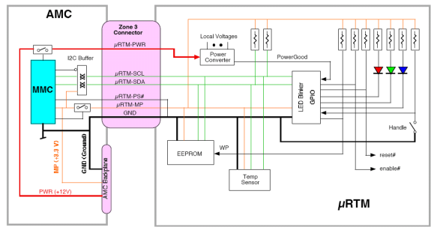
MTCA.4
MicroRTM Management
A management interface is defined on the lower zone 3 connector
Management and power signals:
  µRTM-MP: Management Power for the EEPROM, Temp. Sensor and I/O Expander
  µRTM-PWR: Payload power for the RTM
  µRTM-PS#: RTM Presence signal, grounded on the RTM
  µRTM-SCL/SDR: I²C bus coming from the AMC MMC going to the RTM
MTCA Workshop Desy 2022

Slide 36

MTCA.4
FRU State Transition (simplified)
M3
M4
Activation in Progress
Activation complete
Board
Active
LED off
LED off
Activation command
M7
Handle opened
M2
Communication Lost
M5
Activation Request
M0
Deactivation Request
LED long blink
LED short blink
Board not installed
Handle closed
LED off
Deactivation command
Board inserted
M1
Board extracted
M6
Board
Inactive
Deactivation in Progress
Deactivation complete
LED short blink
LED on
MTCA Workshop Desy 2022

Slide 37
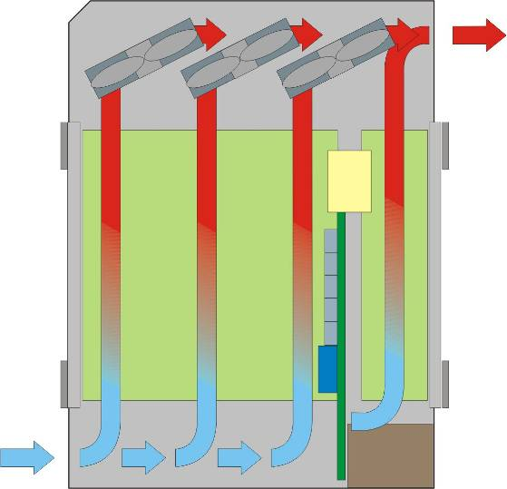
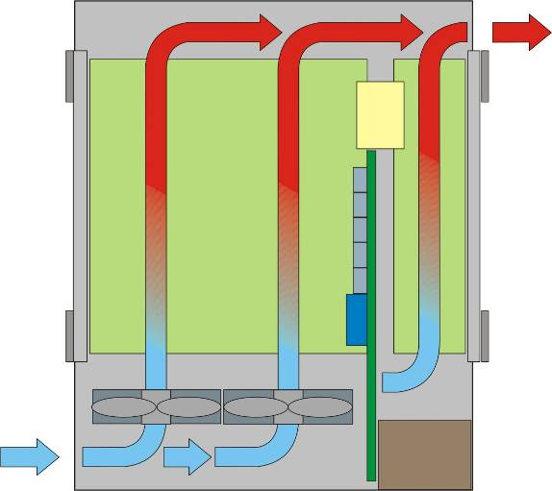
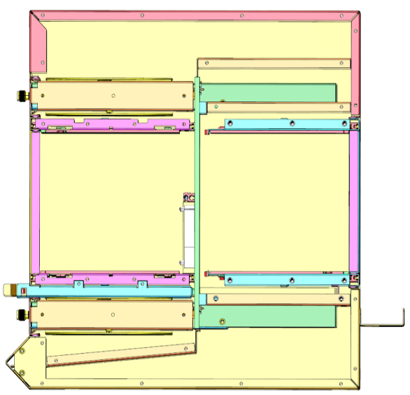
MTCA.4
Cooling concepts
The cooling concept depends on the installation situation of the chassis:
Front-to-rear air flow
Side-to-side air flow
Bottom-to-top air flow
Front-to-side air flow
Fan configuration:
Push
Pull
Push-pull
AMC
RTM
Pull configuration,
Front-to-rear
Push configuration,
Front-to-rear
Push-Pull configuration
Front to rear
AMC
RTM
Push-Pull configuration
Side-to-side
Pull configuration,
bottom-to-top
MTCA Workshop Desy 2022

Slide 38
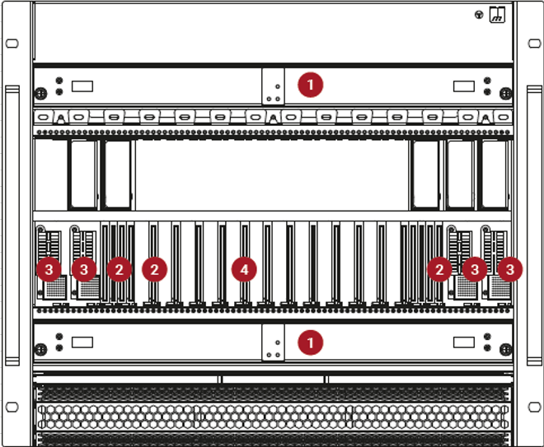
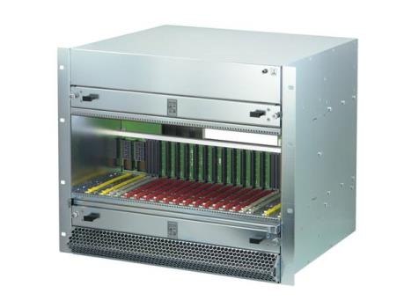
MTCA.4
Redundancy
For high availability applications all modules are redundant:
2 x Cooling Unit (1) in push-pull configuration
2 x MCH (2)
4 x Power Module (3)
IPMB-0:
One logical bus divided into two physical busses: IPMB-A and IPMB-B
MTCA Workshop Desy 2022

Slide 39
MTCA.4
MCH Redundancy
Two MCH: One is Master, One is Redundant
Redundant chassis / shelf FRU Information SEEPROM
Redundancy Interface between the two MCH
Redundancy defined in chassis / shelf FRU information
Chassis / Shelf FRU SEEPROM
Chassis / Shelf FRU SEEPROM
Local I2C-bus
Local I2C-bus
IPMB_L
Clocks
Fabric update channels
Redundancy Interface between the MCHs
MCH 1
MCH 2
MTCA Workshop Desy 2022

Slide 40
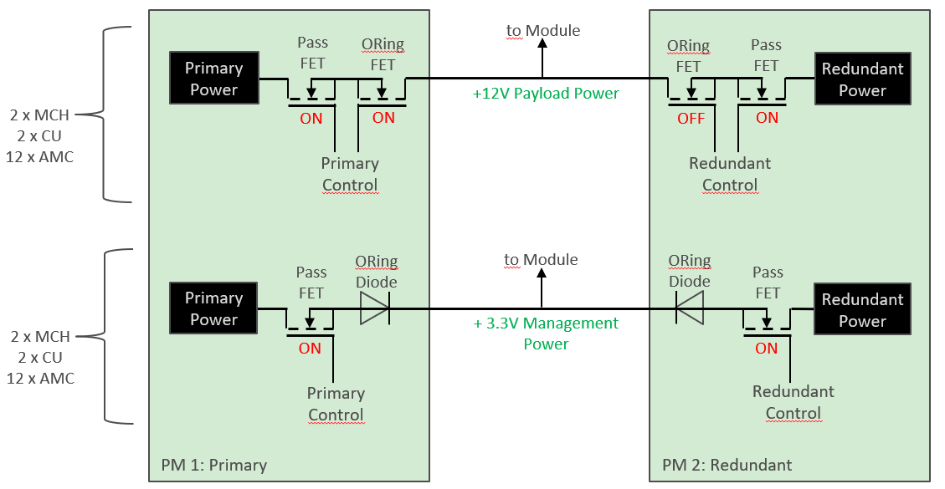
MTCA.4
Power Module Redundancy
Up to 4 Power Modules per chassis
Redundancy mode defined in shelf FRU file
Individual power channel to each module and FRU
MTCA Workshop Desy 2022

Slide 41
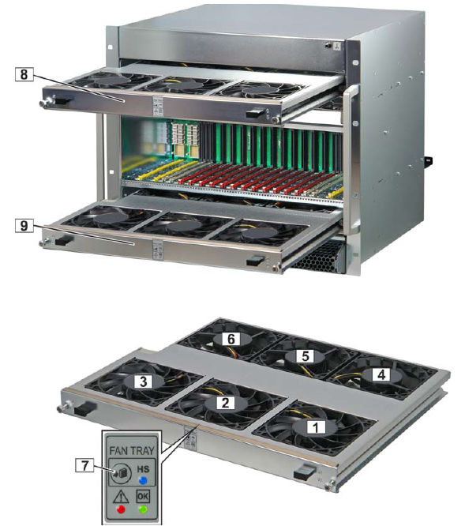
MTCA.4
Cooling Unit Redundancy
Redundant Cooling Units in push-pull configuration
Scenario 1: fan failure
Scenario 2: Cooling Unit replacement
Pull mode
Push mode
1 – 6 Fan
7 Hot Swap bush button
8 CU1
9 CU2
MTCA Workshop Desy 2022

Slide 42
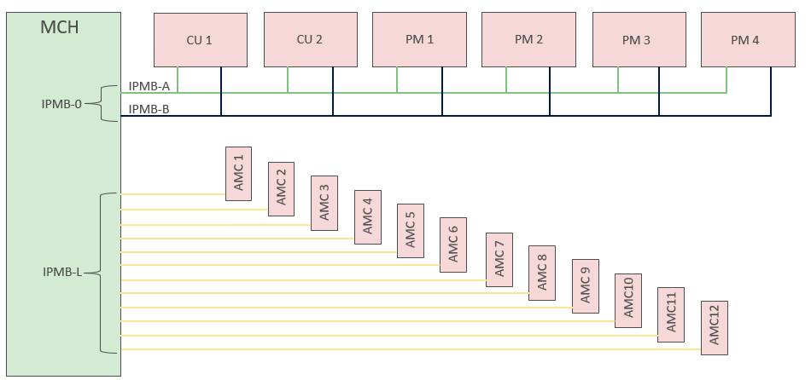
MTCA.4
IPMB redundancy
Individual IPMB-L to each AMC
Redundant logical IPMB-0 to PMs and CUs
MTCA Workshop Desy 2022

Slide 43
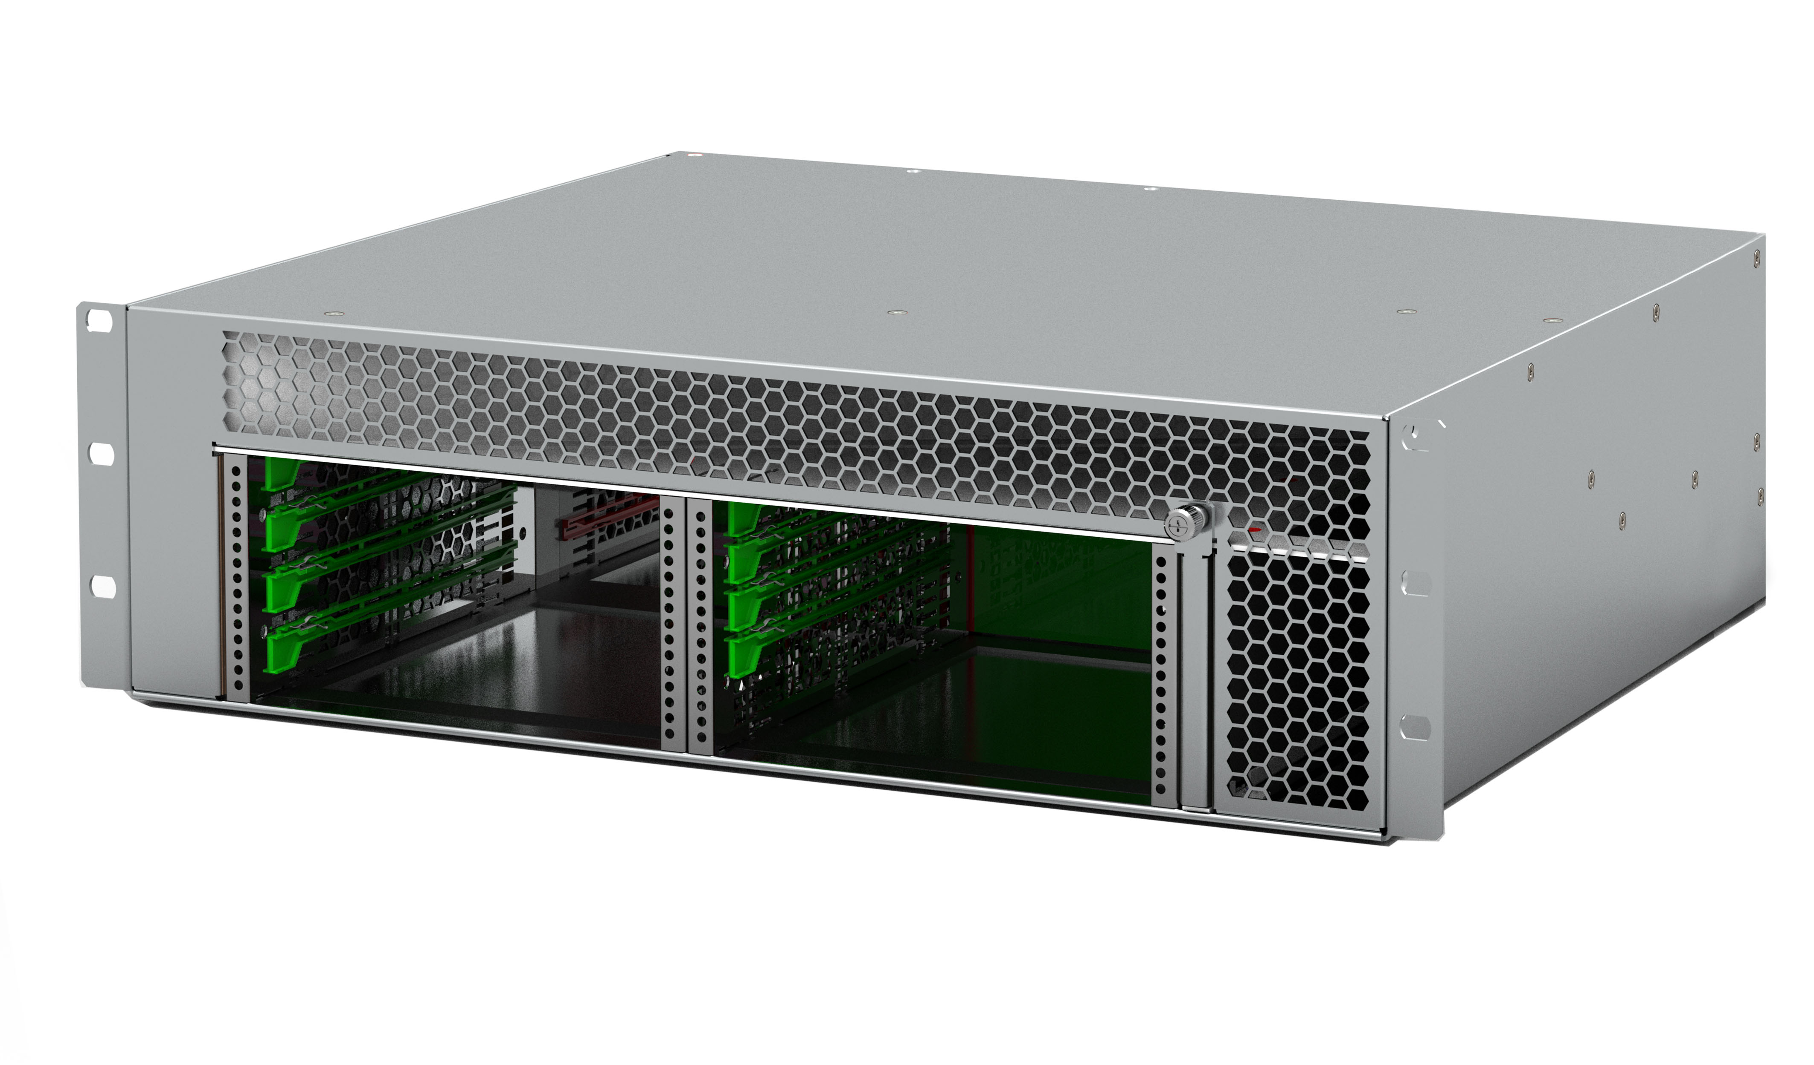
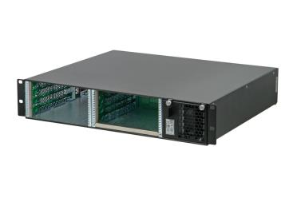
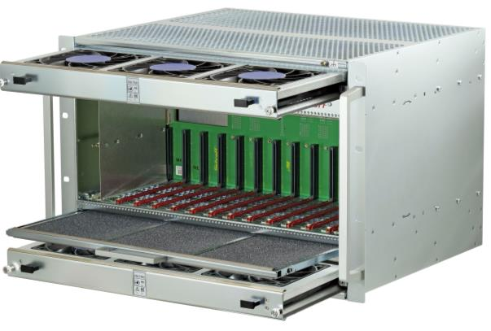

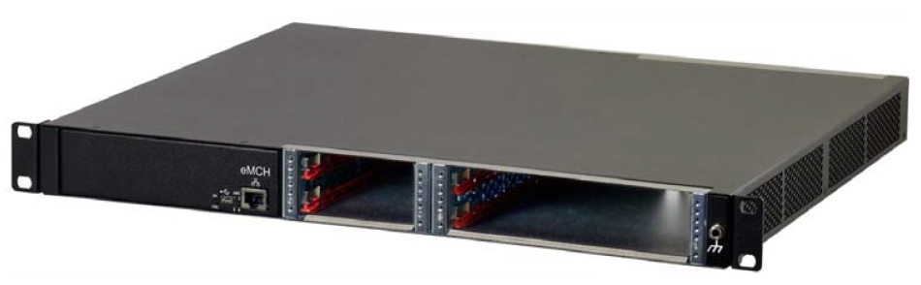
MTCA.4
MTCA.4 Chassis types
Various different MTCA.4 crates available:
Laboratory use
Fully redundant
Compact sizes
Small form factors
Different cooling concepts
Different backplane topologies
MTCA Workshop Desy 2022

Slide 44
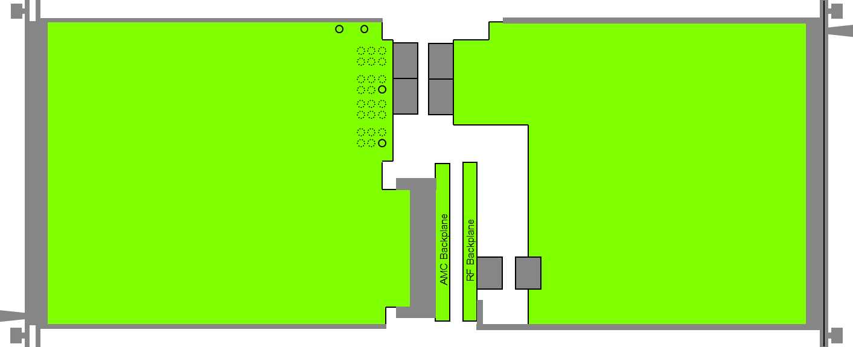
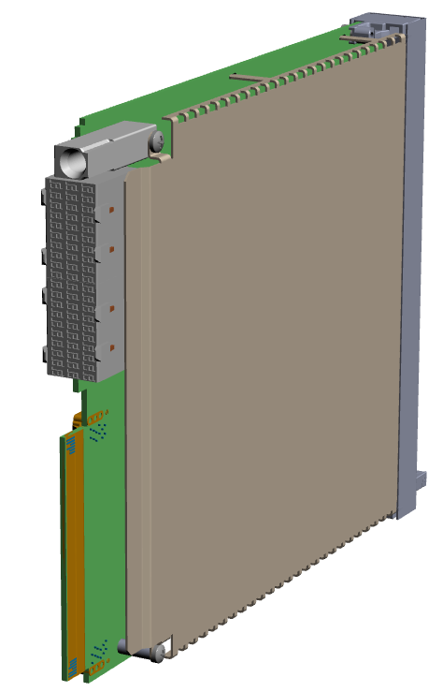
MTCA.4.1
Standardization continued: MTCA.4.1
Definition of a RTM Auxiliary Backplane (MTCA.4.1)
Based on the LLRF backplane
Optional connector usage
Protective mechanical cover for AMC and RTM modules
Protective cover to mechanically protect components
For Side A and Side B
MTCA Workshop Desy 2022

Slide 45




MTCA.4.1
Auxiliary backplane for rear transition modules
Rear power modules
MCH Management Support & Extended Rear Transition Module (MCH-RTM)
RTM Backplane
Location for the RTM backplane in a MTCA.4 shelf
Dimension: Height: 159.5mm
Width: 424.5mm
Thickness: 2mm (backplane) + 2mm (shield extension)
Shield plane
MTCA Workshop Desy 2021

Slide 46
MTCA.4.1
MTCA.4.1 Rear Power Module
The rear power module provides additional power to the RTMs via the RTM backplane
Output power: up to 600W
Dimensions: Double width, full-size but reduced depth due to the connector position on the RTM backplane
Depth: 185,85 mm – distance the AMC backplane to the RTM backplane
MTCA.4.1 MCH-RTM
The MCH-RTM can contain CPU, storage and peripherals which safes space in the AMC area.
Dimensions: Double width, full-size, depth 185,85 mm
MTCA Workshop Desy 2022

Slide 47

Thank you

