Slide 1
Tutorial
MicroTCA Management
“How to become a MicroTCA expert in 35 minutes”
11th MicroTCA Workshop for Research and Industry
DESY, Hamburg
December 6th – 8th, 2022
UNCLASSIFIED

Slide 2
Agenda
About N.A.T.
From ATCA to MTCA - two well connected standards
Why do we need management?
What is behind the management?
How does it work?
What can you do?

Slide 3
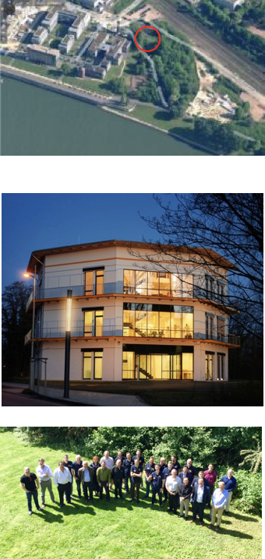
About N.A.T. – who we are
Gesellschaft für Netzwerk- und Automatisierungs-Technologie mit beschränkter Haftung => N.A.T.
Founded in 1990
Proud to provide quality ”made in Germany”
  since more than 30 years by 25 highly professional employees
Privately owned and owner lead business
Own purpose-built building of more than 1,600m² (17,222ft²) with on-site centers for
  hardware and software design
  pre-manufacturing and test + repair

Slide 4
Agenda
About N.A.T.
From ATCA to MTCA - two well connected standards
Why do we need management?
What is behind the management?
How does it work?
What can you do?

Slide 5
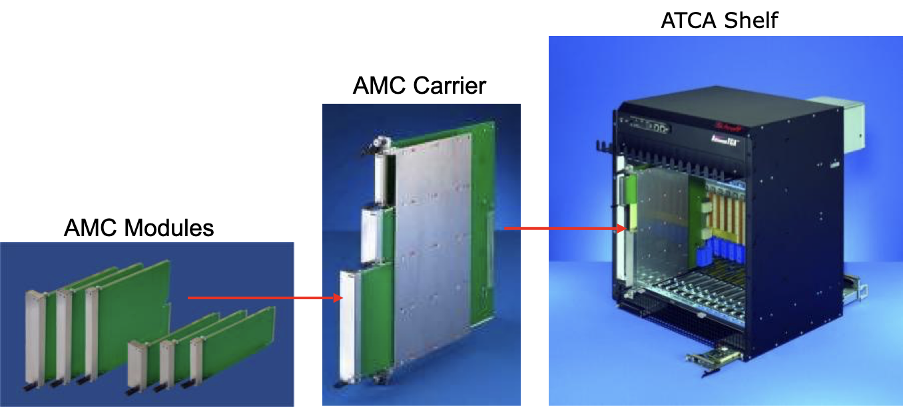
Quick Look At ATCA AMC Modules
Initially developed as function extension for ATCA Boards
Fully integrated into the ATCA IPMI management structure
Plugged into a so called ATCA Carrier
Hot Swap capability

Slide 6
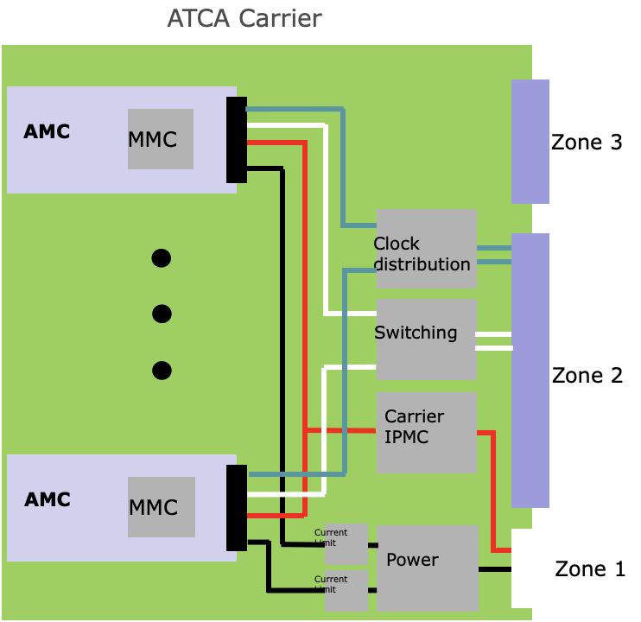
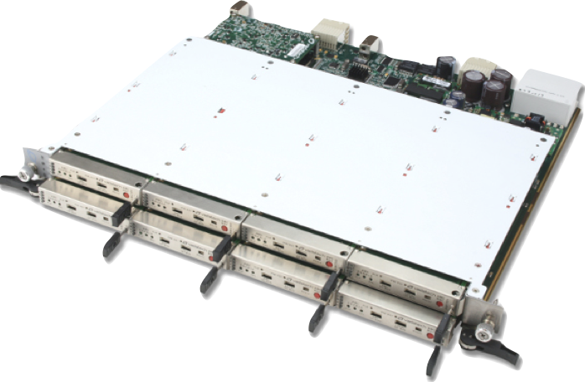
Quick Look At ATCA ATCA carrier – the environment an AMC module lives in
Idea for MTCA: directly plug AMC onto backplane
Requires “virtual carrier” providing
  Power, management, CLK, Switching

Slide 7
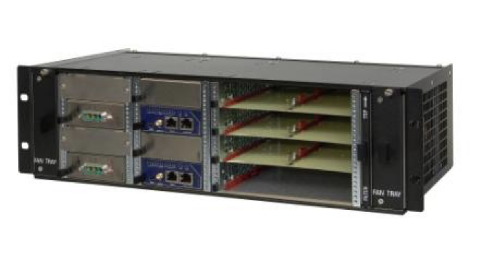
Quick Look At ATCA How to migrate from ATCA to MTCA
“virtual carrier” consists of
  MTCA chassis incl. backplane and CUs
  Power Module
  MCH for management, CLK, switching

Slide 8
Agenda
About N.A.T.
From ATCA to MTCA - two well connected standards
Why do we need management?
What is behind the management?
How does it work?
What can you do?

Slide 9
Management Why do we need it?
“Who” is in my system?
  i.e. list of devices (aka “FRU”)
What capabilities does the FRU have?
  i.e. active connections (AMCs) or RPMs (CUs)
How healthy is my system?
  i.e. sensors for current, voltage, temperature
  i.e. events
How can I talk to my FRUs?
  i.e. manipulation of sensors
How can I service my system?
  i.e. hot-swap FRUs

Slide 10


MTCA.0.1.2.3.4 Infrastructure of a MTCA system
MicroTCA Shelf
MCH
1..2
IPMI
GbE
Switch
PCIe
Switch
Mgmt
Backplane (differential Point to Point)
16
A
M
C
1
A
M
C
2
A
M
C
3
A
M
C
4
A
M
C
5
A
M
C
6
A
M
C
7
A
M
C
8
A
M
C
9
A
M
C
10
A
M
C
11
A
M
C
12
PM
1..4
Front
CU
1..2
Rear
CU
1..2
µ
R
T
M
1
µ
R
T
M
2
µ
R
T
M
3
µ
R
T
M
4
µ
R
T
M
5
µ
R
T
M
6
µ
R
T
M
7
µ
R
T
M
8
µ
R
T
M
9
µ
R
T
M
10
µ
R
T
M
11
µ
R
T
M
12

Slide 11
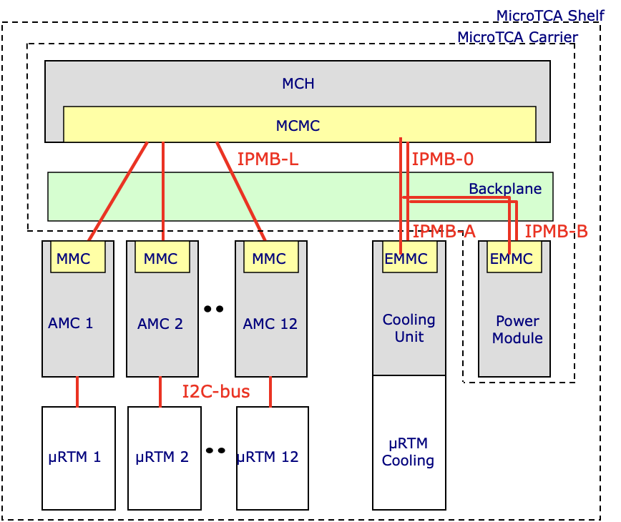
Management in MTCA Physical Connections And Controllers
IPMB-L
  connects the MCMC on the MCH to the MMC on the AMC Modules
  radial architecture
IPMB-0 .1
  connects the MCMC on the MCH to the EMMC on the PMs and CUs
  bussed architecture
I2C-bus
  connects the AMC to its µRTM
  the µRTM is treated as managed FRU of the AMC

Slide 12
Management in MTCA FRU M states
PICMG 3.0 and AMC specifications define FRU states, aka „M states“
  Activation
    FRU proceeds to state M4
  Deactivation
    FRU proceeds to state M1
  Error (coms lost)
    FRU moves to state M7
MCH decides if and when module can reach M4
MMC uses a state machine to control hot-plug/swap procedure
M3
M4
FRU
Deactivation Req.
FRU
Active
LED off
LED off
M7
FRU
Communic. lost
LED
undef.
?
M2
M5
FRU
Activation Req.
FRU
Inactive
LED long
blink
LED short
blink
M0
FRU
Not Installed
LED off
M1
M6
FRU
Inactive
FRU
Deact. In Prog.
LED on
LED short
blink

Slide 13
Operational
Booting
Autonomous mode
CU
♥
♥
MP
PP
IPMB-0
Pres.
Enable
IPMB-0
Operational
Autonomous mode
Booting
Booting
Operational
AC
LEDs:
NAT-MCH
source: Schroff
PM

Slide 14
Operational
CU
♥
♥
FRU-ID
I2C
MP
PP
IPMB-0
IPMB-L
Pres.
Enable
IPMB-0
Operational
FRU-ID
FRU-ID
-48V
Operational
MMC
operational
Operational
LEDs:
LEDs:
NAT-MCH
source: Schroff
AMC
PM

Slide 15
Agenda
About N.A.T.
From ATCA to MTCA - two well connected standards
Why do we need management?
What is behind the management?
How does it work?
What can you do?

Slide 16
Management in xTCA What is behind
Idea of management:
  Hardware supervision by software (remote control and monitoring)
  Intelligent handling of events and actions
  Abstraction of hardware functionality
  Operating system independent
=> I²C (Inter Integrated Circuit)
=> IPMI (Intelligent Platform Management Interface)
Notes:
I²C invented by Philips to attach low speed peripherals
IPMI: message based protocol

Slide 17
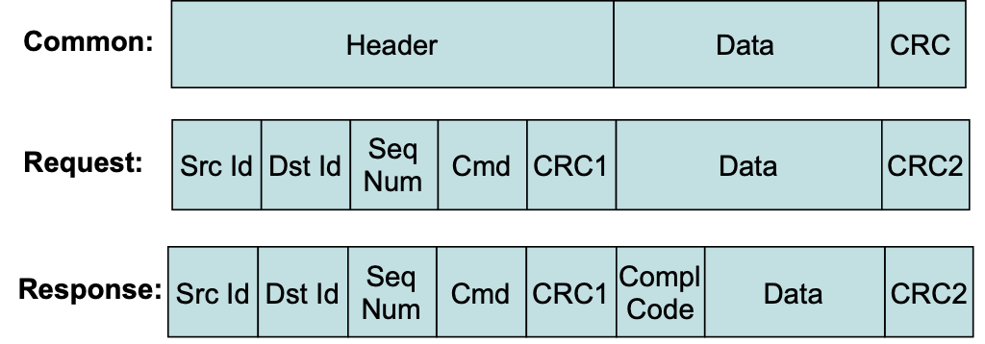
Management in xTCA IPMI
I²C (Inter Integrated Circuit): two wire multi-master capable bus
IPMI protocol
RMCP (Remote Management Control Protocol)
Notes:
I²C invented by Philips to attach low speed peripherals
clock (100kHz) and data
IPMI messages:
Embedded into physical layer protocol
Maximum length: 32 byte
Symetrical protocol: request leads to response
Message verification by CRC
Message retry mechanism
IPMI can be easily embedded in other protocols, i.e. for transport over Ethernet networks

Slide 18
Agenda
About N.A.T.
From ATCA to MTCA - two well connected standards
Why do we need management?
What is behind the management?
How does it work?
What can you do?

Slide 19
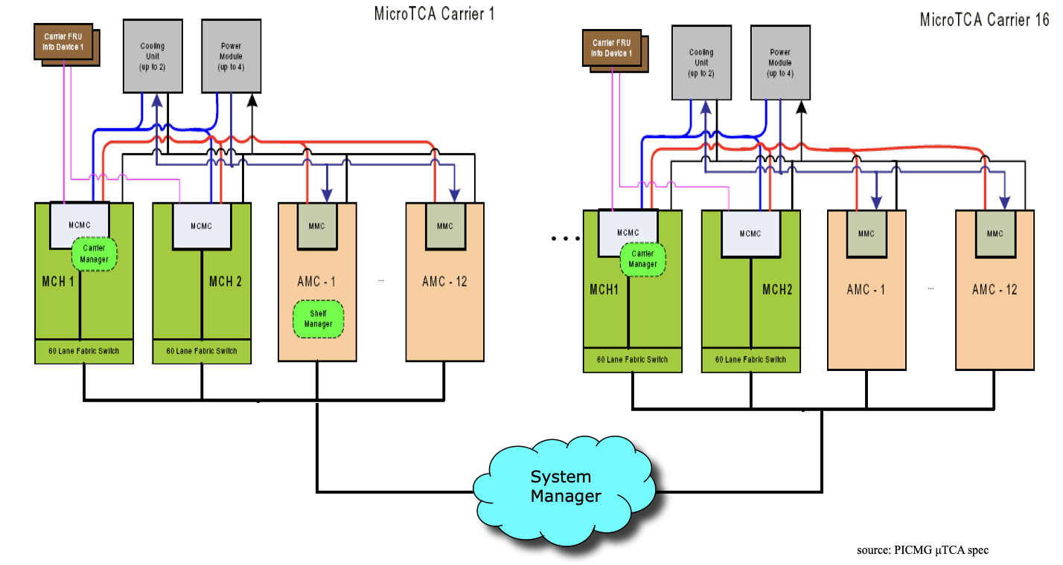
Management in MTCA Management Structure

Slide 20
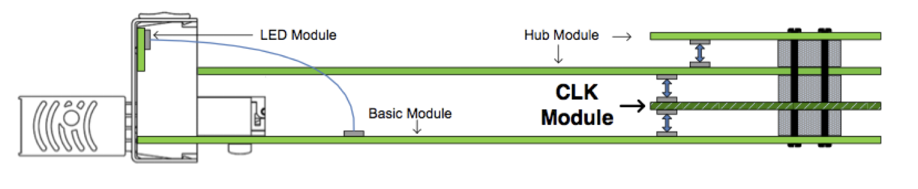
MTCA Carrier Hub (MCH) Adaptable to application demands
4
3
2
1
Basic Module with GbE-Switch to all AMC slots and Management: carrier manager, shelf manager, system manager
Clock Module for CLK #1-3 to all AMC slots
Fat Pipe Hub Module for AMC slots #1-6
Fat Pipe signals for AMC slots #7-12

Slide 21
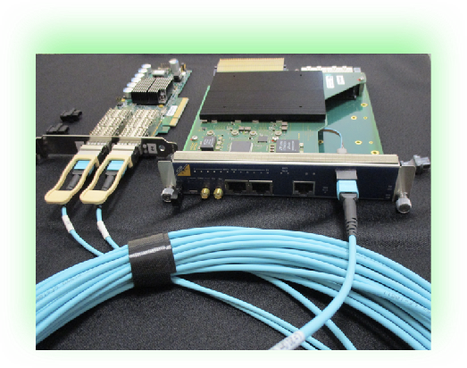
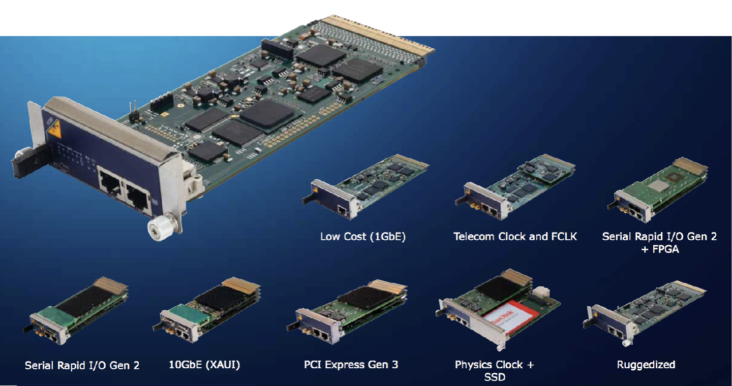
MTCA Carrier Hub (MCH) Adaptable to application demands

Slide 22
Agenda
About N.A.T.
From ATCA to MTCA - two well connected standards
Why do we need management?
What is behind the management?
How does it work?
What can you do?

Slide 23
Management in xTCA What can you do?
“Who” is in my system?
  i.e. list of devices (aka “FRU”)
What capabilities does the FRU have?
  i.e. active connections (AMCs) or RPMs (CUs)
How healthy is my system?
  i.e. sensors for current, voltage, temperature
  i.e. events
How can I interfere with my FRUs?
  i.e. manipulation of sensors
How can I service my system?
  i.e. hot-swap FRUs

Slide 24
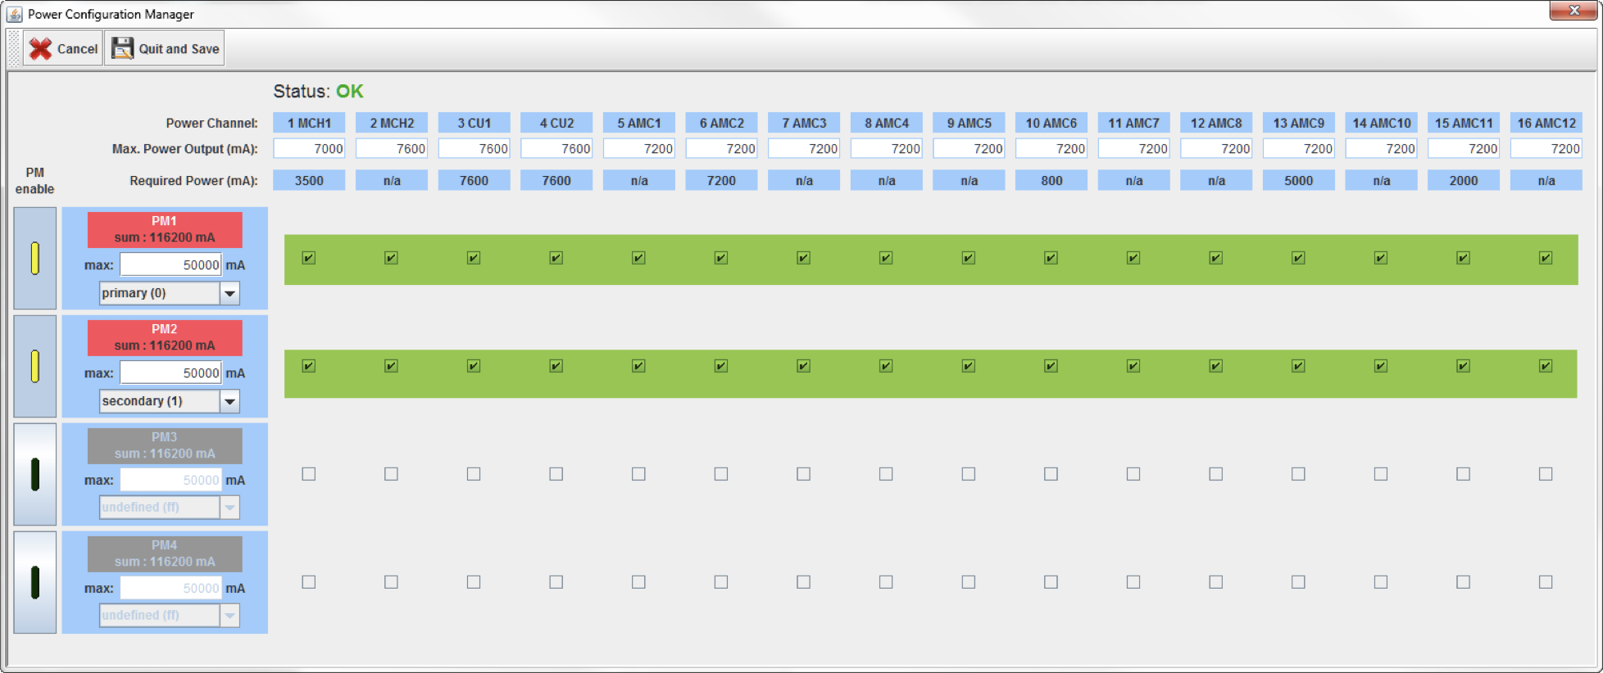
NATview Power Configuration Manager Redundancy

Slide 25
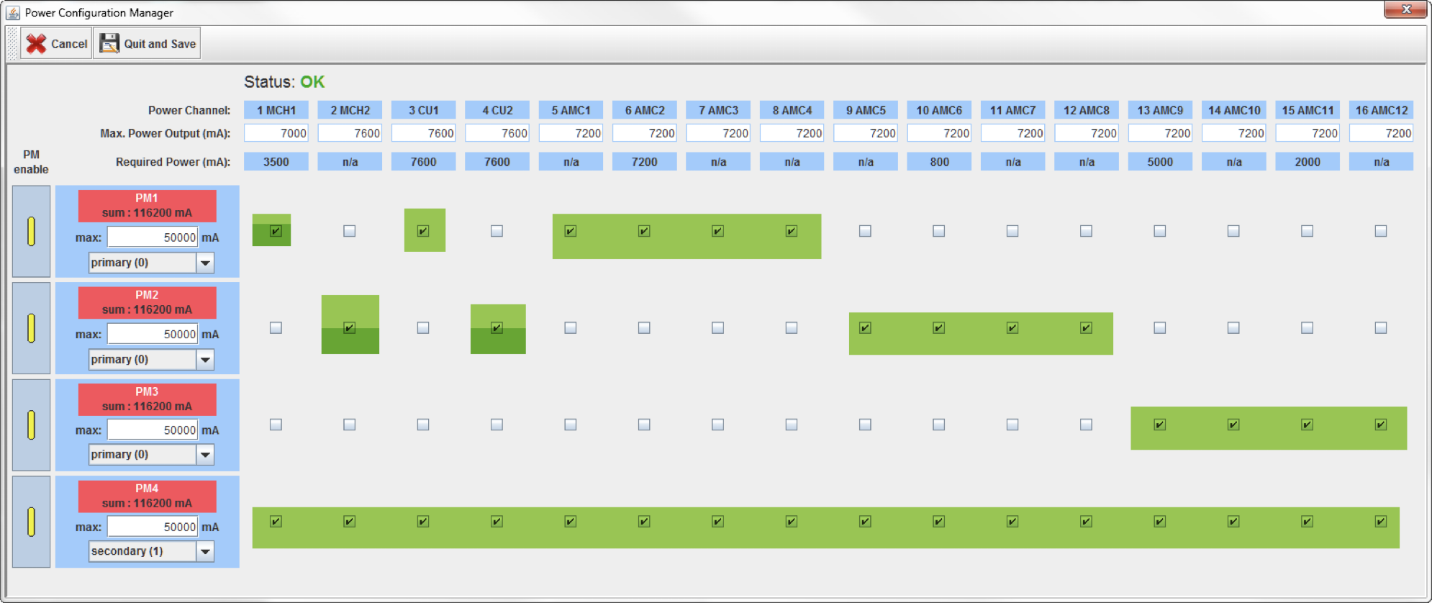
NATview Power Configuration Manager n+1 Redundancy

Slide 26
Important CLI commands of NAT-MCH example and excerpt
imsg_info – lists all IPMI messages supported by MCH
  Prints the implementation status for the supported IPMI messages on the Host (RMCP) interface and can be used to print a list of IPMI messages that are supported by the MCH.
show_ekey - shows results of e-keying process, i.e. all activated connections
show_fru - lists all FRUs in system
show_fruinfo – lists contents for given FRU
show_cu - shows status of all cooling units
show_pm - shows status of all power modules
show_sensorinfo fru_id – shows details for all sensors of given FRU
fan_ctl - allows manual control of cooling units
shutdown fru_id/all – initiates gracefull shutdown of single or all FRUs
fru_start fru_id – initiates gracefull start of given FRU

Slide 27
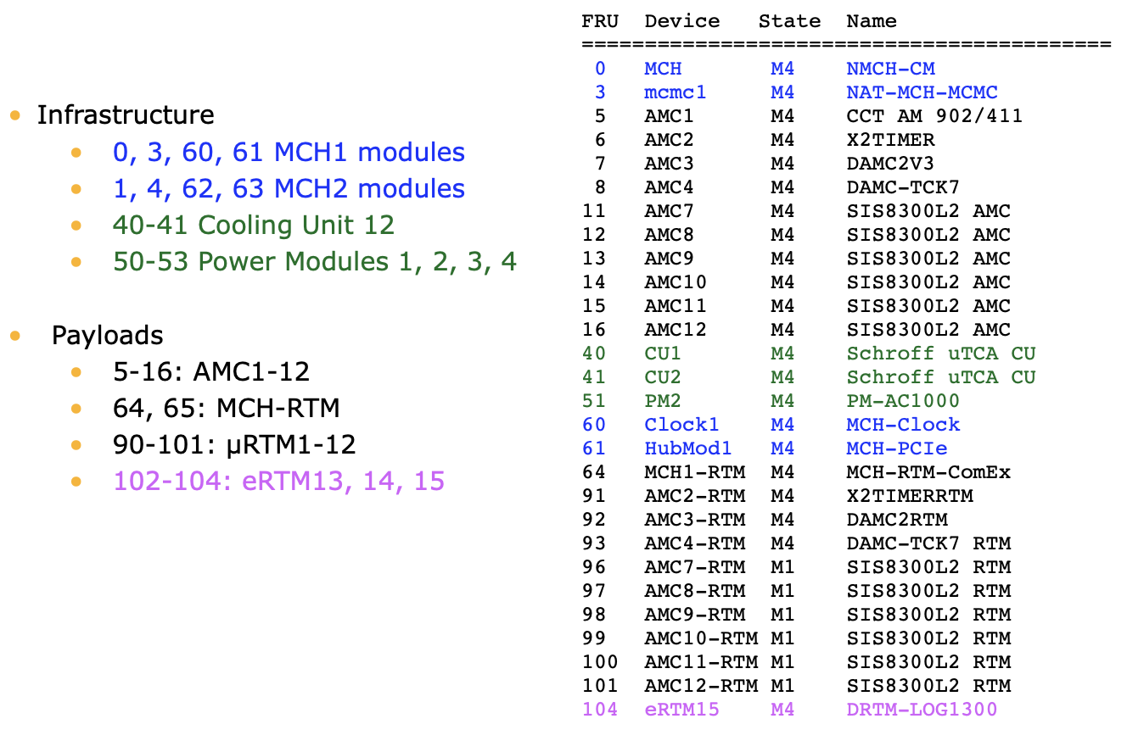
Inventory: show_fru

Slide 28
Summary
About N.A.T.
From ATCA to MTCA - two well connected standards
Why do we need management?
What is behind the management?
How does it work?
What can you do?

Slide 29

Thank you for your attention !
Heiko Körte
Director Sales & Marketing
heiko.koerte@nateurope.com
N.A.T. GmbH
Konrad-Zuse-Platz 9
53227 Bonn, Germany
www.nateurope.com

Slide 30
Repository

Slide 31
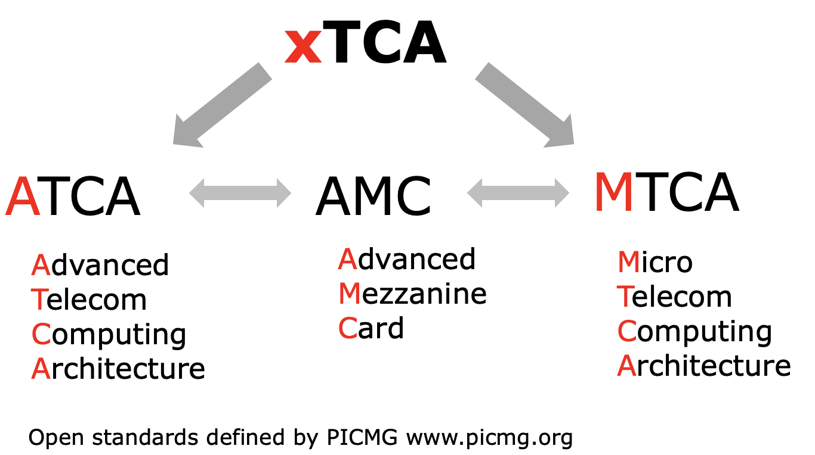
Common Abbreviations ATCA AMC MicroTCA MTCA uTCA µTCA xTCA

Slide 32
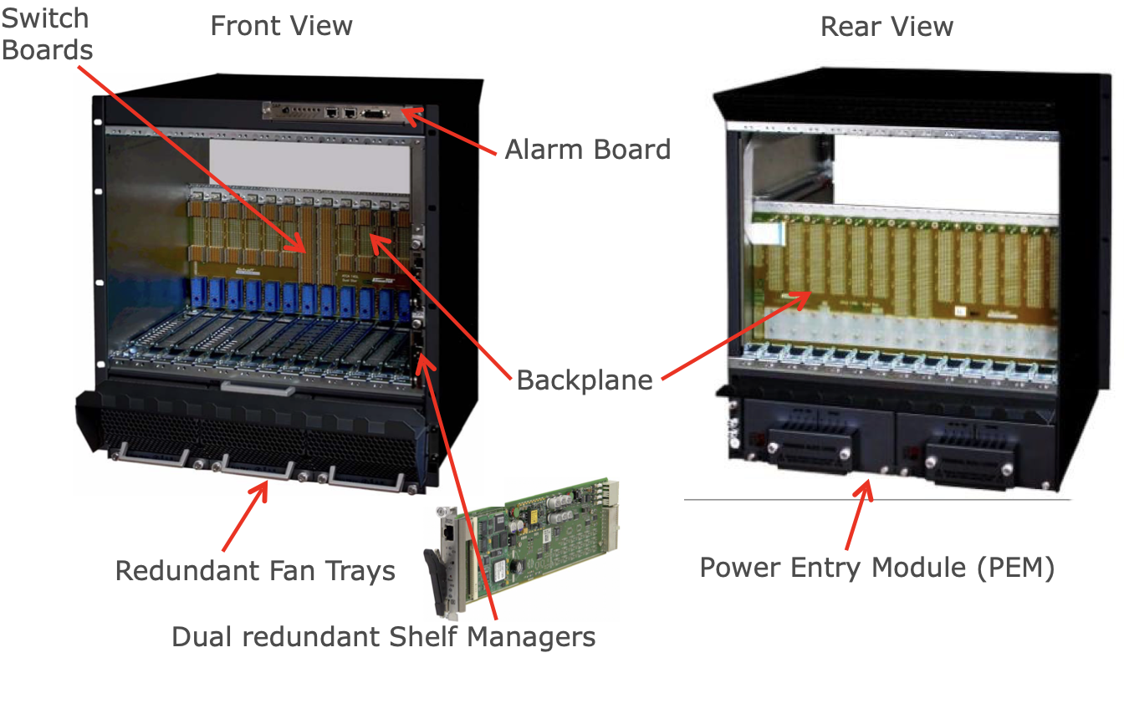
Quick Look At ATCA ATCA Shelf Elements

Slide 33
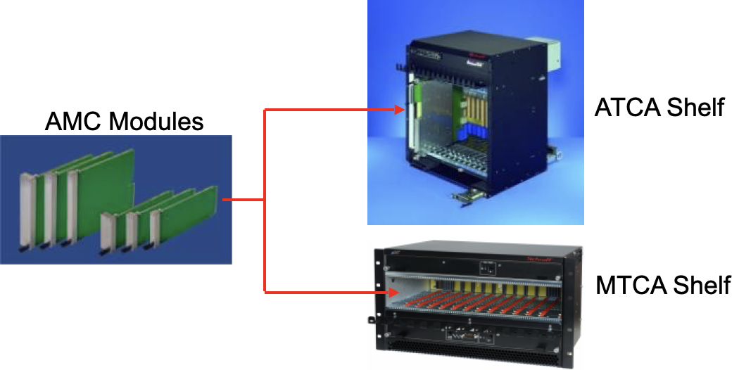
Quick Look At ATCA How to migrate from ATCA to MTCA
The basic idea of MTCA is to have a shelf that contains just AMC modules
Backplane directly accepts AMC modules
AMCs are interchangeable between ATCA and MTCA
The infrastructure of a ATCA Carrier was adapted into the MTCA shelf
(power management switching)
power input and all outputs to the front

Slide 34
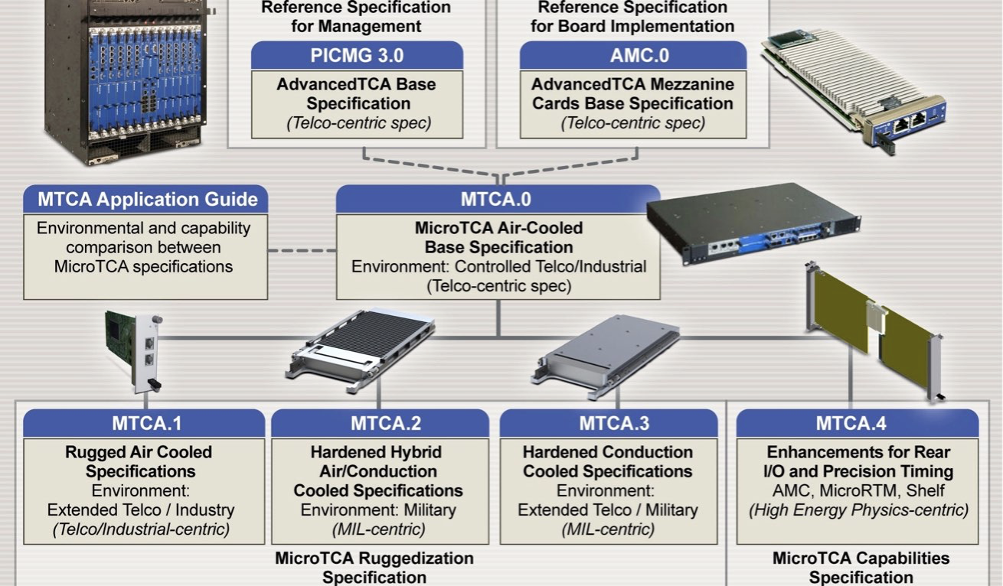
ATCA and MTCA Specifications

Slide 35
Management in xTCA Software structure

Slide 36
Management in xTCA Software structure

Slide 37
Useful numbers to remember FRU and I²C addresses
Device | Site No. | FRU ID | I²C Addr.
MCH-CM (Carrier Mngt.) | 1 | 0 | 0x20
MCMC 1 | 1 | 3 | 0x10
MCMC 2 | 2 | 4 | 0x12
AMC 1-12 AMC 13 | 1-12 13 | 5-16 29 | 0x72-0x88 0xa2
CU 1 CU 2 | 1 2 | 40 41 | 0xA8 0xAA
PM 1 PM 2 PM 3 PM 4 | 1 2 3 4 | 50 51 51 53 | 0xC2 0xC4 0xC6 0xC8
MCH-CLK 1 | 1 | 60 | 0x14
MCH-CLK 2 | 2 | 62 | 0x18
MCH-Hub 1 (PCIe SRIO XAUI) | 1 | 61 | 0x16
MCH-Hub 2 (PCIe SRIO XAUI) | 2 | 63 | 0x1a
MCH-RTM 1 | 1 | 64 | 0x1c
MCH-RTM 2 | 2 | 65 | 0x1e
OEM 1-19 | 1-19 | 60-78 | 0x42-0x66
µRTM 1-12 |  | 90-101 | 0x72 0x74-0x88
Carrier FRU (backplane FRU) | 1 | 253 | 0xA4

Slide 38
Useful numbers to remember FRU and I²C addresses
Device | Site No. | FRU ID | I²C Addr.
AMC13 in MCH 1 slot | 1 | 29 | 0xa2
AMC13 in MCH 2 slot | 2 | 30 | 0xa4
Telco alarm | 1 | 79 | -
Carrier Manager |  | 0 | 0x20
physical Shelf FRU Info 1 |  | 1
physical Shelf FRU Info 2 |  | 2
Reserved for further AMCs |  | 17-28
Reserved for further RTMs |  | 102-124
Reserved |  | 125-127
Local Shelf Manager |  | 128
logical ShM (backplane FRU-Info) |  | 254
Implementation defined |  | 80-89
reserved for OEM modules |  | 66-78
reserved for PM |  | 54-59

