Slide 1
ARES Operation Meeting
Summary of week 30 / 2022
Willi Kuropka, on behalf of the ARES crew

Slide 2
Summary of week 31
 | Mon. 25.07. | Tue. 26.07. | Wed. 27.07. | Thu. 28.07 | Fri. 29.07.
Achievements | MPS PLC card replaced Camera server for FL section screen station implemented Charge map over weekend New release of magnet ML server installed | Start up FL section screen station test Velocity bunching test | Setup for wire scanner at EA Optimizing data acquisition on BLM Longitudinal scan with wire scanner over night | Position stability studies for different cathode laser apertures and auto-alignment params Position in-loop control by correctors and screens Over night stability run | More thorough FL screen test Quad scan test using EA wire scanner
Difficulties |  |  |  | Network issues due to PETRA maintenance Vacuum event at TW2, closed valves

Slide 3
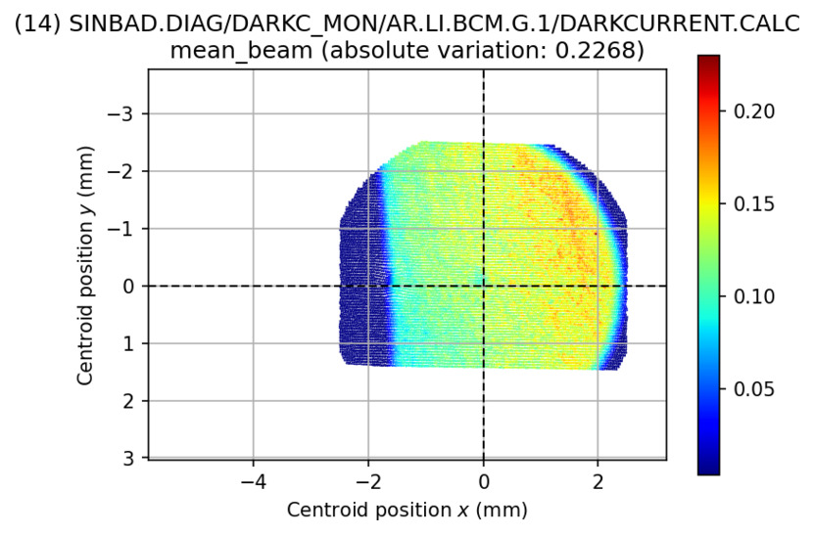
Latest charge map with Mo-plug

Slide 4
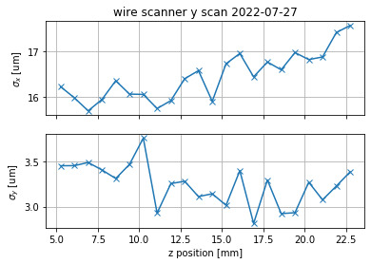
Z scan by wire scanner at EA section

Slide 5
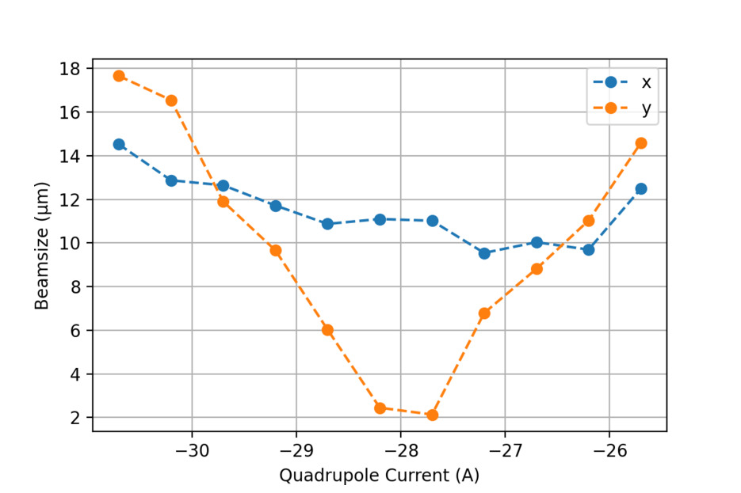
Quad scan using EA wire scanner

Slide 6
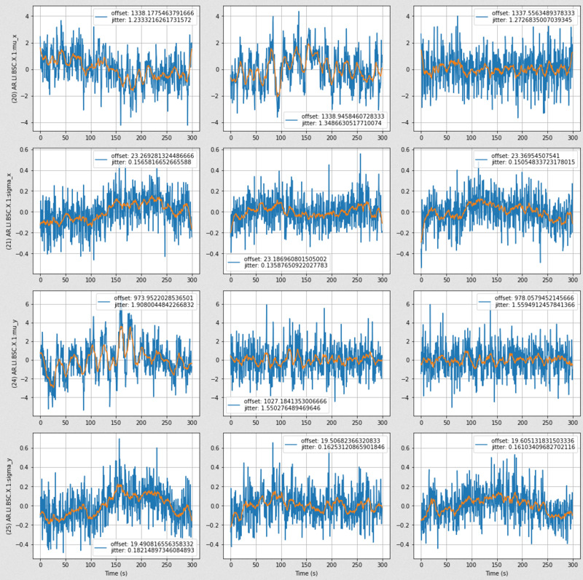
In-loop position control on SH.E2

Slide 7
Plan for the week
Bunch compressor commissioning, dispersion measurement
Adjust FL screen station position and further testing
Continue quad scans at EA wire scanner
STRIDENAS signal chain test and beam test

Slide 8
Schedule
Week 31
Date | Shift Leader
01.08. | Tunnel open
02.08. | Willi
03.08 | Willi
04.08. | Frank
05.08. | Frank
06.08.
07.08.
If you want to learn or join the shift: please give the shift leader a call (BKR 2840 / SINBAD Box 2454)

