Slide 1
Calorimeter Optimization
02-08-2022 mini update
Michal elad

Slide 2
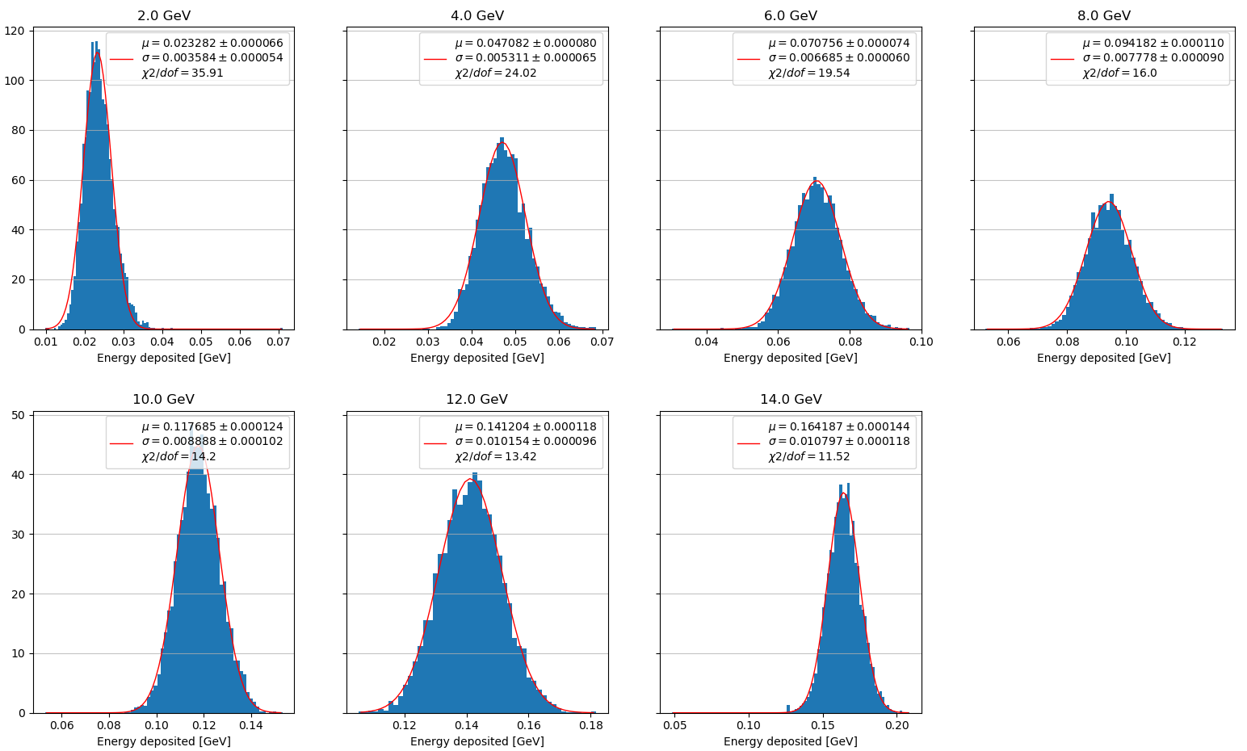
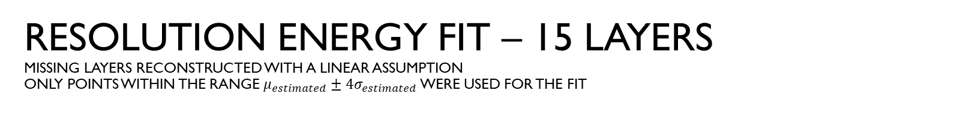
Resolution energy fit – 15 layers missing layers reconstructed with a linear assumption only points within the range $μ_{estimated}±4σ_{estimated}$ were used for the fit

Slide 3
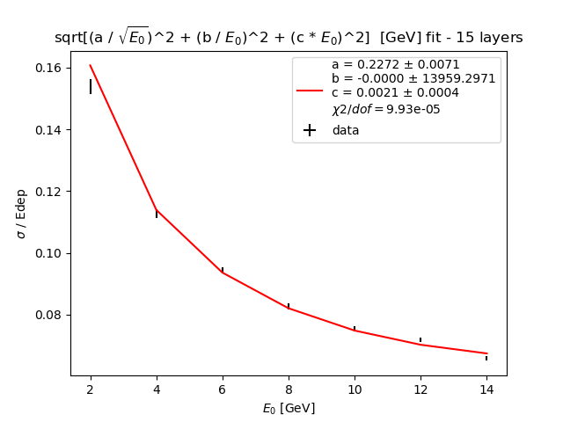
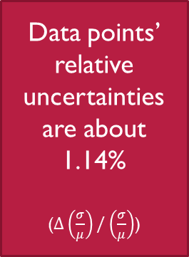
Resolution energy fit – 15 layers missing layers reconstructed with a linear assumption with added uncertainties
Data points’ relative uncertainties
are about 1.14%
($Δ\left(\frac{σ}{μ}\right)/\left(\frac{σ}{μ}\right)$)

Slide 4
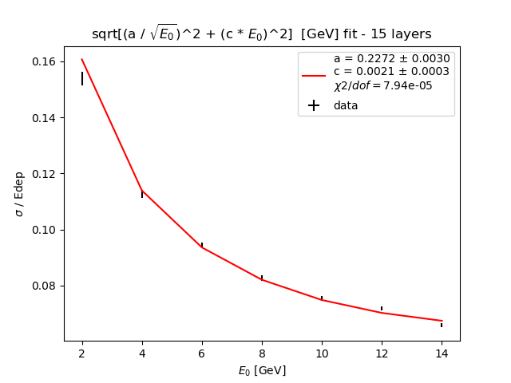
Resolution energy fit – 15 layers missing layers reconstructed with a linear assumption with added uncertainties
Data points’ relative uncertainties
are about 1.14%
($Δ\left(\frac{σ}{μ}\right)/\left(\frac{σ}{μ}\right)$)

Slide 5
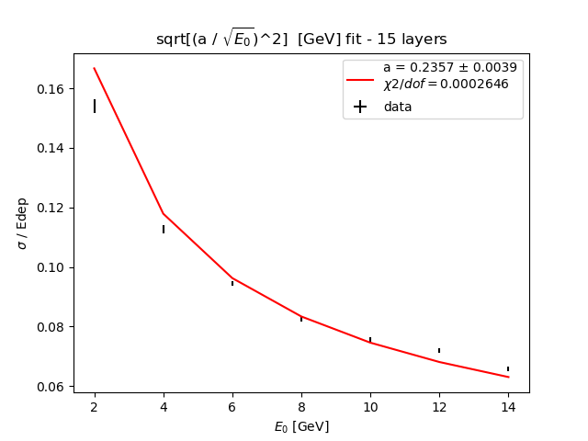
Resolution energy fit – 15 layers missing layers reconstructed with a linear assumption with added uncertainties
Data points’ relative uncertainties
are about 1.14%
($Δ\left(\frac{σ}{μ}\right)/\left(\frac{σ}{μ}\right)$)

