Slide 1
ARES Operation Meeting
Summary of week 31 / 2022
Willi Kuropka, on behalf of the ARES crew

Slide 2
Summary of week 31
 | Mon. 01.08. | Tue. 02.08. | Wed. 03.08. | Thu. 04.08. | Fri. 05.08.
Achievements | STRIDENAS test Adjusting FL section screen station | Optimizing dispersion measurements BC commissioning | Dispersion measurements Wire scanner quad scan BC collimator commissioning | AutoAcc shift STRIDENAS beam test | Wire scanner quad scan STRIDENAS beam test
Difficulties |  |  |  |  | Network issues with a number of doocs servers not reachable – solved by MCS

Slide 3
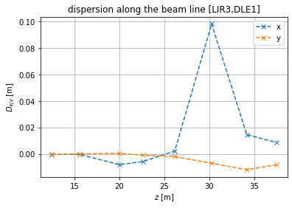
Dispersion measurement along ARES
BC fits ASTRA model well, so far

Slide 4
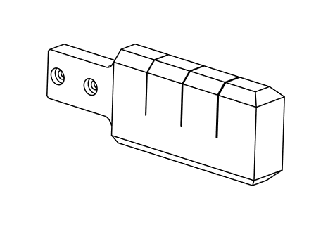
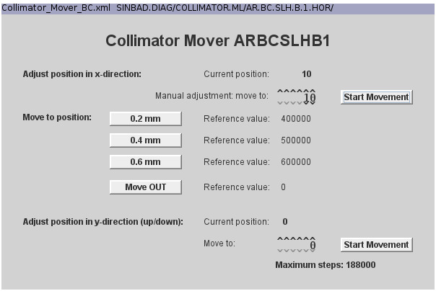
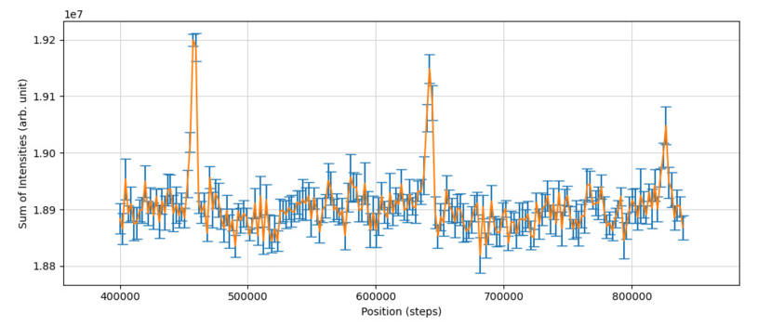
BC shape collimator
All apertures are within reach of the mover, when beam centered on BC.E1
600um,400um,200um slit shapes
Mover steps vs. transmission

Slide 5
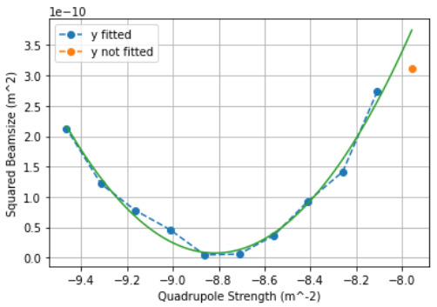
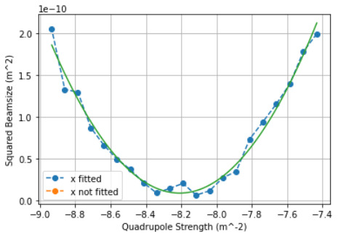
Wire scanner quad scan
preliminary results!
Normalized Emittance = ( 35.07576484833951 pm 14.634820132716161 ) nm
Normalized Emittance = ( 30.351885923301104 pm 5.247839472533824 ) nm

Slide 6
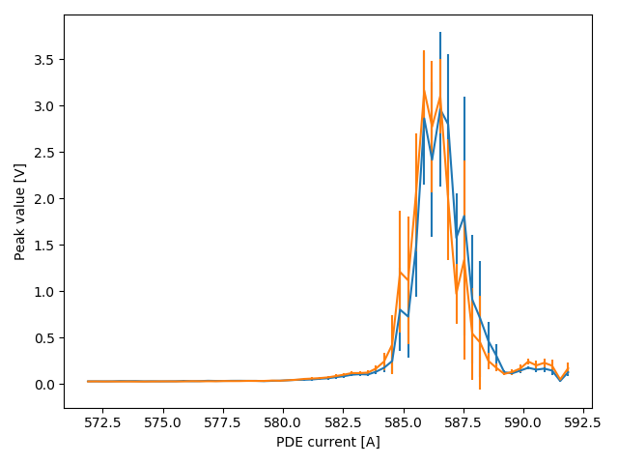
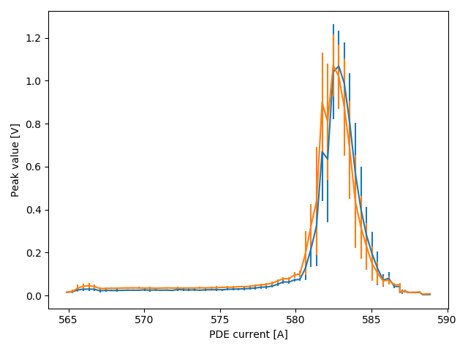
Stridenas beam profile measurements
~150 fC
~70 fC

Slide 7
Plan for the week
Today: Tunnel door at 25d gets door closing mechanism, maybe FL section wire scanner replacement
More wire scanner quad scans
Bunch compressor commissioning
STRIDENAS beam test

Slide 8
Schedule
Week 32
Date | Shift Leader
08.08. | Tunnel open
09.08. | Hannes
10.08 | Willi
11.08. | Hannes
12.08. | Willi
13.08.
14.08.
If you want to learn or join the shift: please give the shift leader a call (BKR 2840 / SINBAD Box 2454)

