Slide 1
Calorimeter Optimization
18-12-2022 update
Michal elad

Slide 2
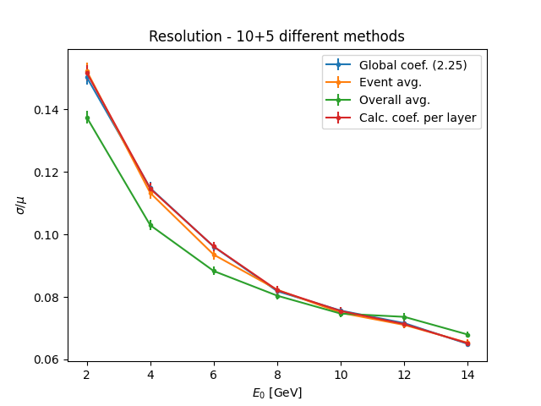
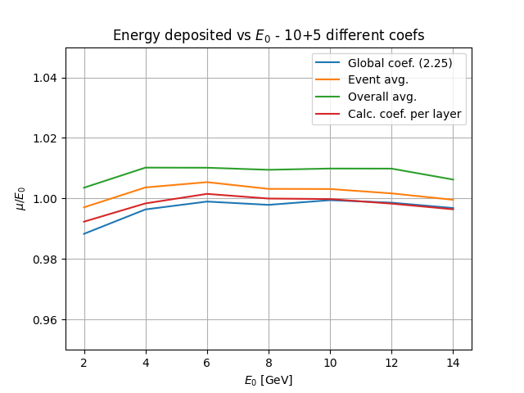
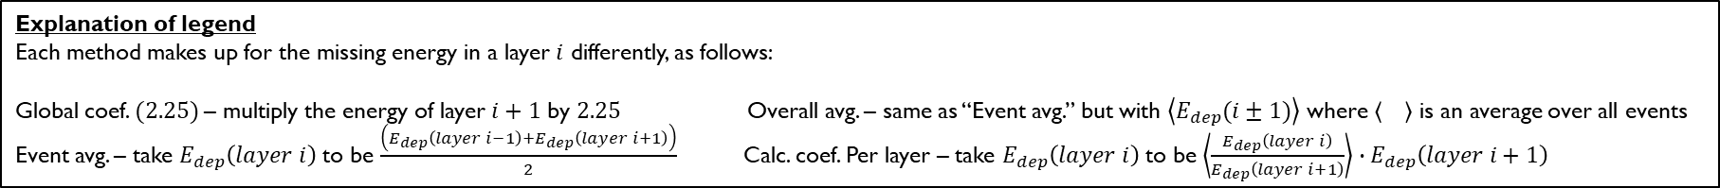
Explanation of legend
Each method makes up for the missing energy in a layer $i$ differently, as follows:
Global coef. $(2.25)$– multiply the energy of layer $i+1$ by $2.25$ Overall avg. – same as “Event avg.” but with $\left\langle E_{dep}(i±1)\right\rangle$ where is an average over all events
Event avg. – take $E_{dep}\left(layer i\right)$ to be $\frac{\left(E_{dep}\left(layer i−1\right)+E_{dep}\left(layer i+1\right)\right)}{2}$ Calc. coef. Per layer – take $E_{dep}\left(layer i\right)$ to be $\left\langle \frac{E_{dep}\left(layer i\right)}{E_{dep}\left(layer i+1\right)}\right\rangle ∙E_{dep}\left(layer i+1\right)$

Slide 3
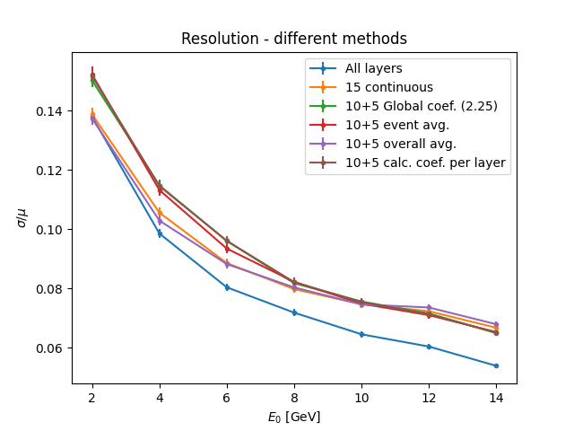
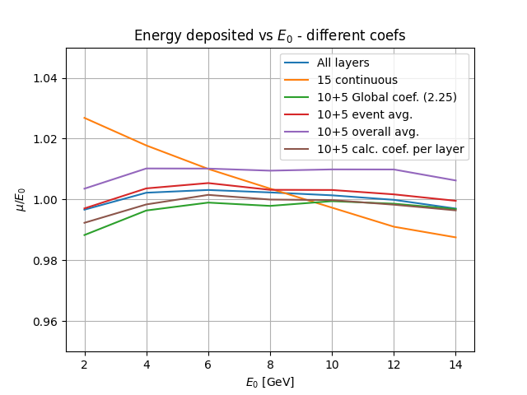

Slide 4
