Slide 1
Calorimeter Optimization
06-11-2022 update
Michal elad

Slide 2
Reminder
Previously, the energy was reconstructed event by event.
Results were reproduced with a reconstruction based on the average of all events (shown in next slides).

Slide 3
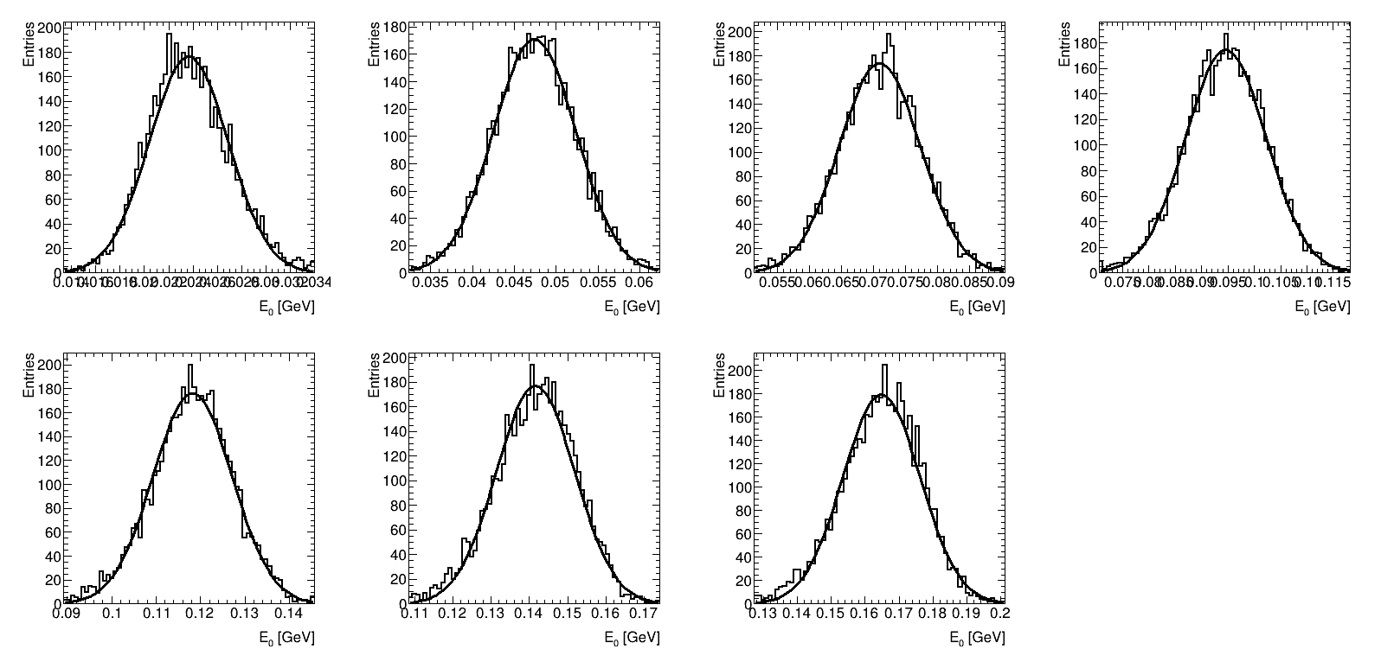


Gaussian fit results
$$Reconstruction by average of layers, μ±3σ$$
$$χ^{2}\backslash dof$$
(from top left)
2 GeV: 1.68
4 GeV: 0.78
6 GeV: 1.16
8 GeV: 0.86
10 GeV: 1.44
12 GeV: 1.88
14 GeV: 1.81

Slide 4
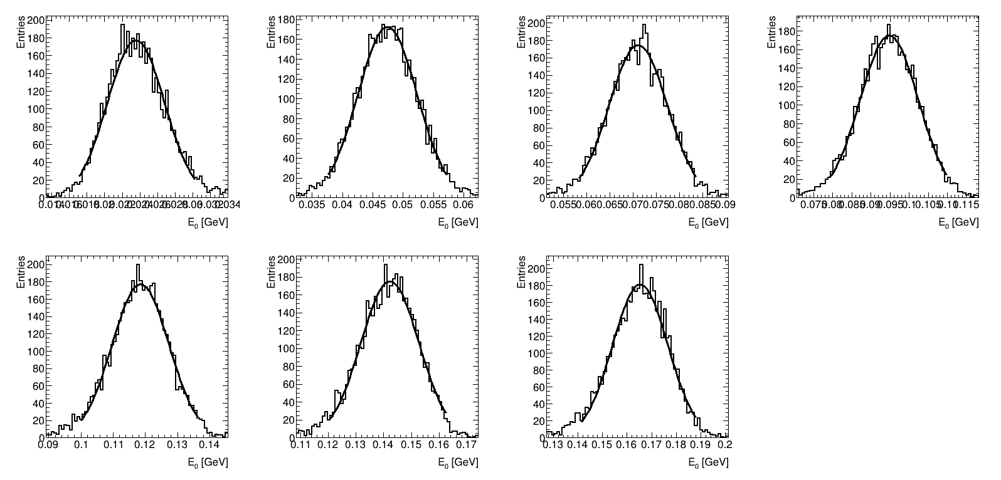


Gaussian fit results
$$Reconstruction by average of layers, μ±2σ$$
$$χ^{2}\backslash dof$$
(from top left)
2 GeV: 1.52
4 GeV: 0.89
6 GeV: 1.09
8 GeV: 0.80
10 GeV: 0.84
12 GeV: 0.97
14 GeV: 1.21

Slide 5
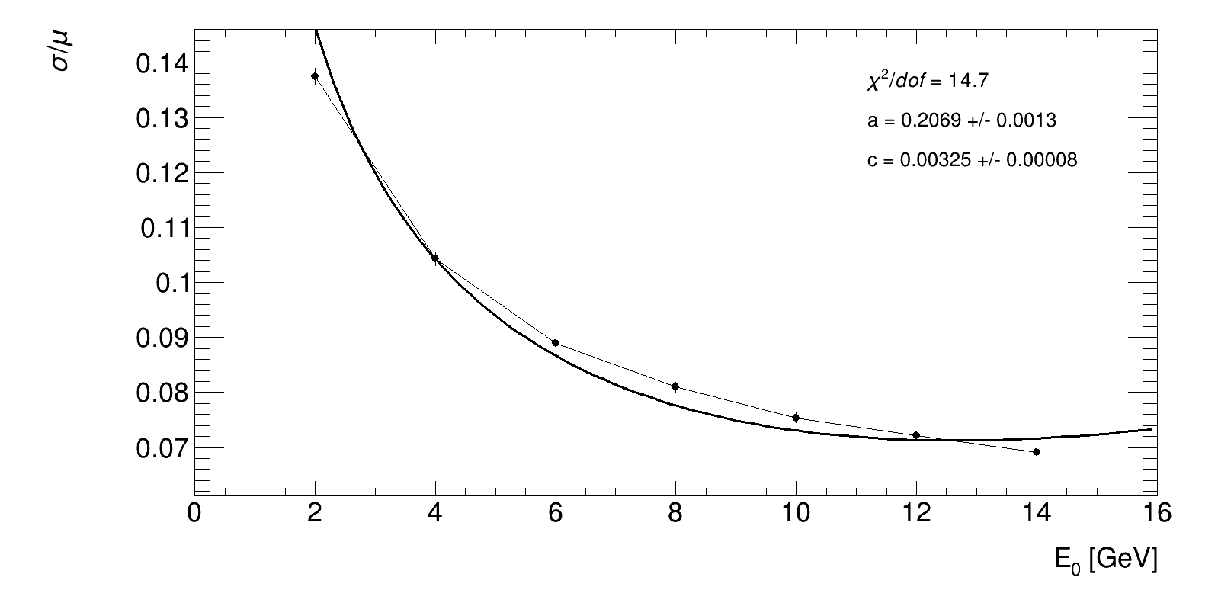


Resolution fit results
$$Reconstruction by average of layers, μ±3σ$$
$$\sqrt{{\left(\frac{a}{\sqrt{E_{0}}}\right)}^{2}+{\left(c∙E_{0}\right)}^{2}}$$

Slide 6
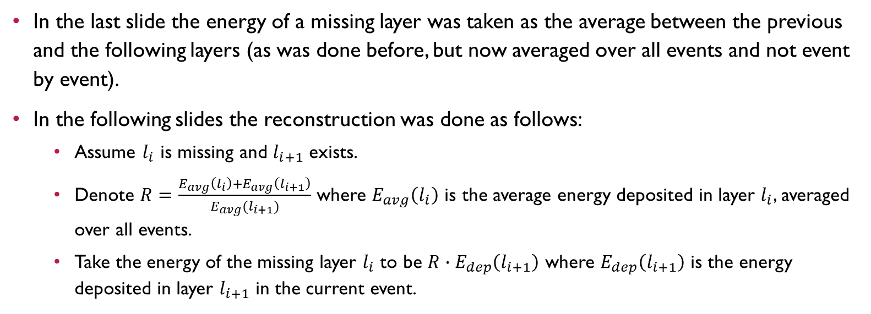
Reminder #2
In the last slide the energy of a missing layer was taken as the average between the previous and the following layers (as was done before, but now averaged over all events and not event by event).
In the following slides the reconstruction was done as follows:
  Assume $l_{i}$ is missing and $l_{i+1}$ exists.
  Denote $R=\frac{E_{avg}\left(l_{i}\right)+E_{avg}\left(l_{i+1}\right)}{E_{avg}(l_{i+1})}$ where $E_{avg}\left(l_{i}\right)$ is the average energy deposited in layer $l_{i}$, averaged over all events.
  Take the energy of the missing layer $l_{i}$ to be $R∙E_{dep}\left(l_{i+1}\right)$ where $E_{dep}\left(l_{i+1}\right)$ is the energy deposited in layer $l_{i+1}$ in the current event.

Slide 7
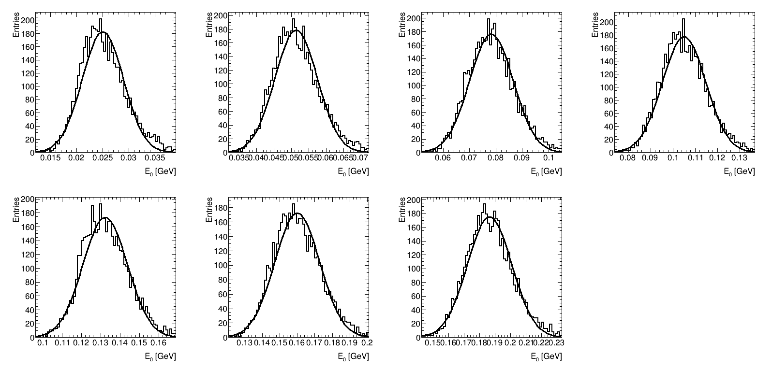


Gaussian fit results
$$Reconstruction by said coefficient, μ±3σ$$
$$χ^{2}\backslash dof$$
(from top left)
2 GeV: 3.69
4 GeV: 3.27
6 GeV: 2.30
8 GeV: 2.08
10 GeV: 2.28
12 GeV: 2.25
14 GeV: 1.85

Slide 8



Gaussian fit results
$$Reconstruction by said coefficient, μ±2σ$$
$$χ^{2}\backslash dof$$
(from top left)
2 GeV: 1.67
4 GeV: 1.58
6 GeV: 1.60
8 GeV: 1.46
10 GeV: 1.92
12 GeV: 1.14
14 GeV: 1.09

Slide 9
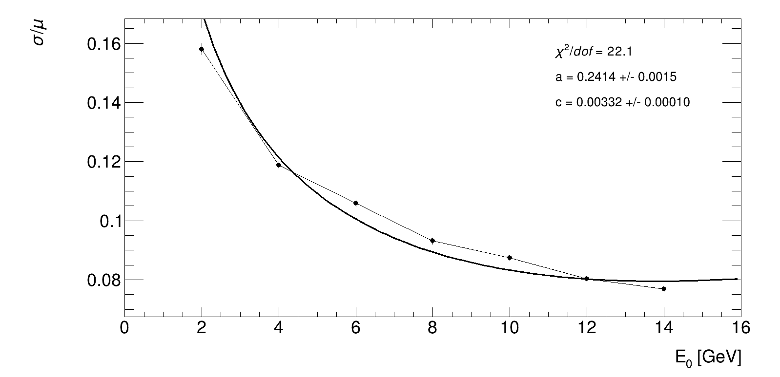

Resolution fit results
$$Reconstruction by said coefficient, μ±3σ$$
$$\sqrt{{\left(\frac{a}{\sqrt{E_{0}}}\right)}^{2}+{\left(c∙E_{0}\right)}^{2}}$$

Slide 10
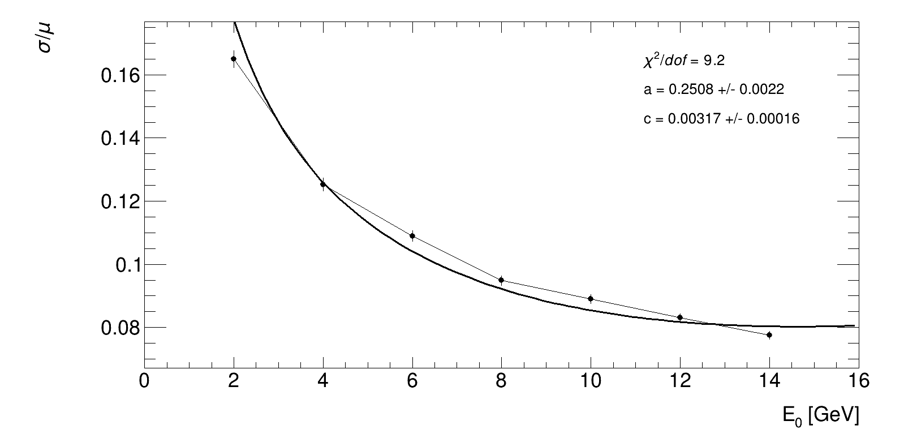

Resolution fit results
$$Reconstruction by said coefficient, μ±2σ$$
$$\sqrt{{\left(\frac{a}{\sqrt{E_{0}}}\right)}^{2}+{\left(c∙E_{0}\right)}^{2}}$$

Slide 11
Conclusion
The reconstruction by the said coefficient makes more sense since it makes use of the energy deposited in the specific event.
However, the reconstruction using a general average (which is the same for all events) still gives better results.
New ideas could be tested..

