Slide 1
Calorimeter Optimization
01-01-2023 update
Michal elad

Slide 2

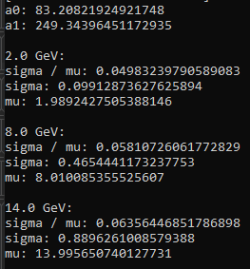

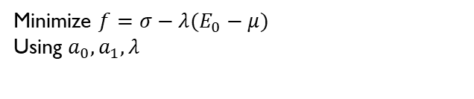
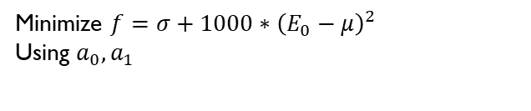
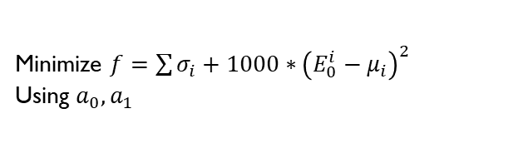
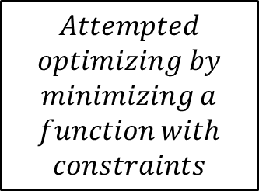

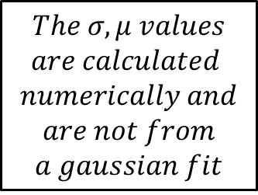
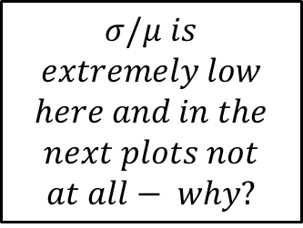
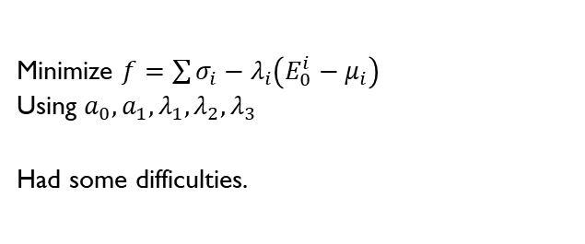
2.0 GeV only
2.0, 8.0, 14.0 GeV
$$New results$$
$$Attempted$$
$$optimizing by$$
$$minimizing a$$
$$function with$$
$$constraints$$
Minimize $f=σ−λ(E_{0}−μ)$
Using $a_{0}, a_{1}, λ$
Minimize $f=\sum{σ_{i}−λ_{i}\left(E_{0}^{i}−μ_{i}\right)}$
Using $a_{0}, a_{1}, λ_{1}, λ_{2}, λ_{3}$
Had some difficulties.
Minimize $f=\sum{σ_{i}+1000∗{\left(E_{0}^{i}−μ_{i}\right)}^{2}}$
Using $a_{0}, a_{1}$
$$The σ, μ values$$
$$are calculated$$
$$numerically and$$
$$are not from$$
$$a gaussian fit$$
Minimize $f=σ+1000∗{\left(E_{0}−μ\right)}^{2}$
Using $a_{0}, a_{1}$
$$σ/μ is$$
$$extremely low$$
$$here and in the$$
$$next plots not$$
$$at all− why?$$

Slide 3
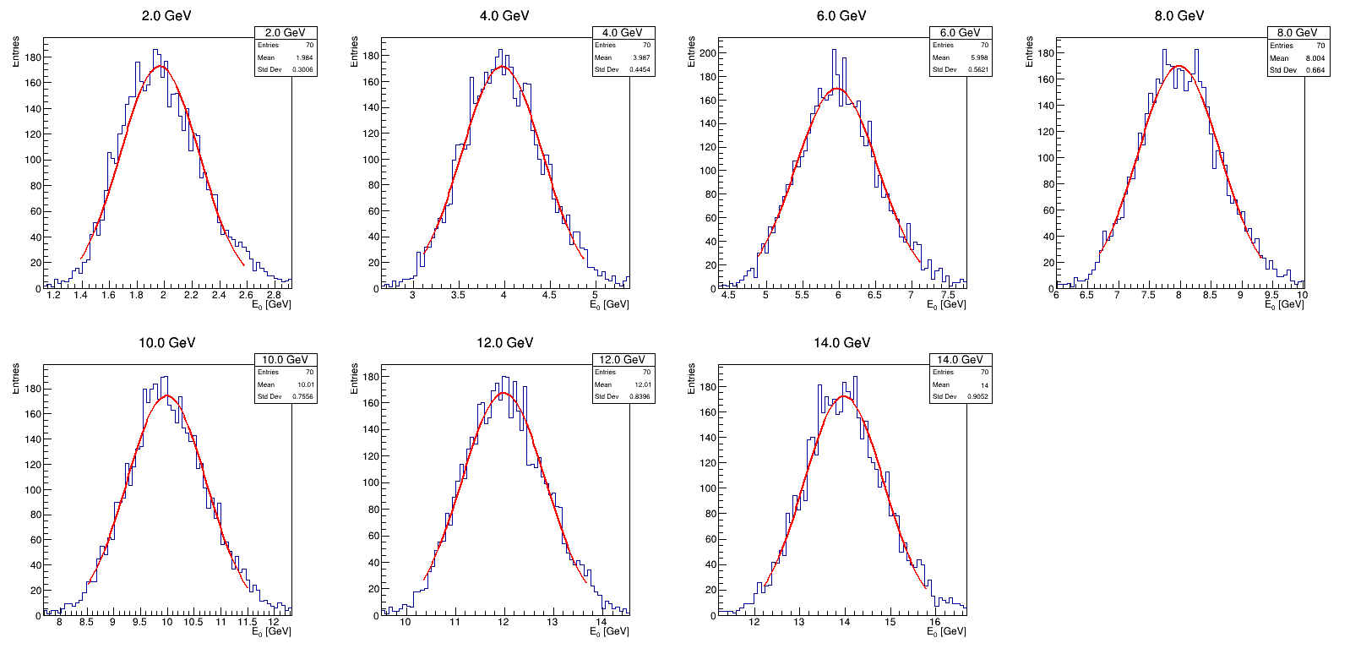
Gaussian fit after using the new coefficients from the minimization – 12+3 layers

Slide 4
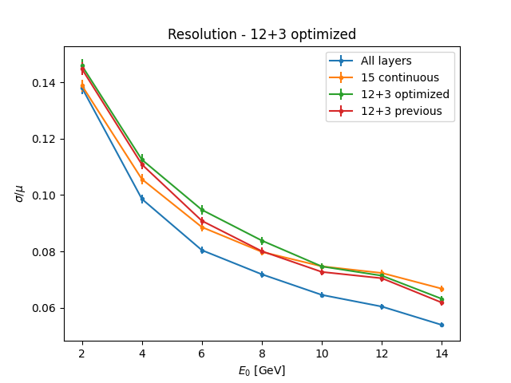
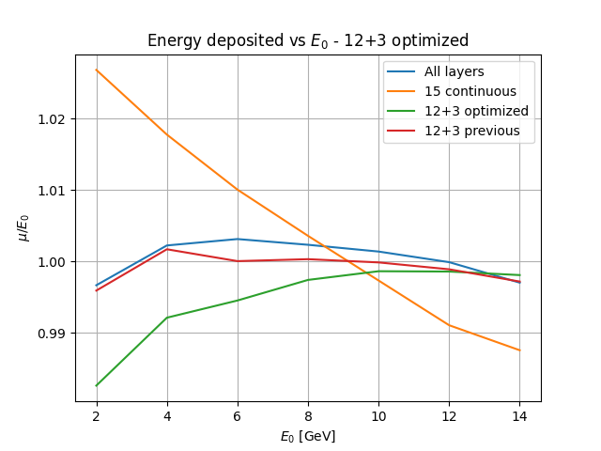
Results using the new coefficients from the minimization – 12+3 layers

