Slide 1
TB 2022
Automatic Alignment Update
23 / 04 / 23

Slide 2
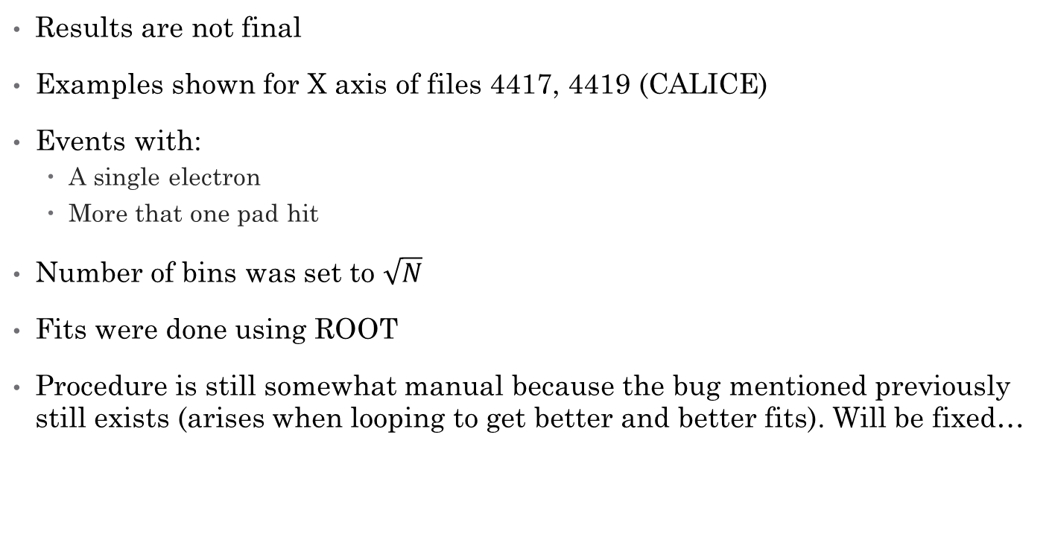
Some initial notes
Results are not final
Examples shown for X axis of files 4417, 4419 (CALICE)
Events with:
  A single electron
  More that one pad hit
Number of bins was set to $\sqrt{N}$
Fits were done using ROOT
Procedure is still somewhat manual because the bug mentioned previously still exists (arises when looping to get better and better fits). Will be fixed…

Slide 3
CALICE
Runs 4417, 4419

Slide 4
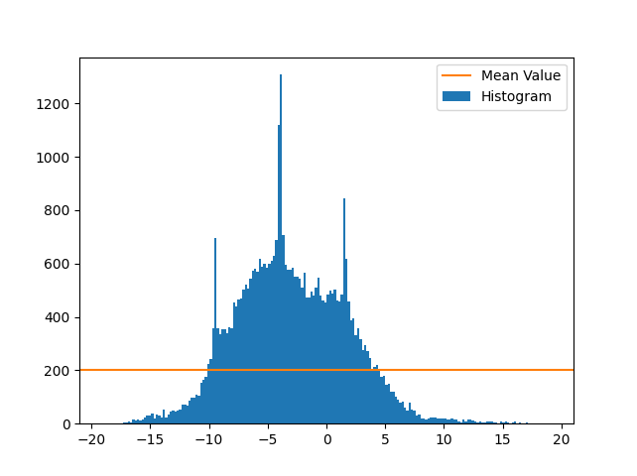
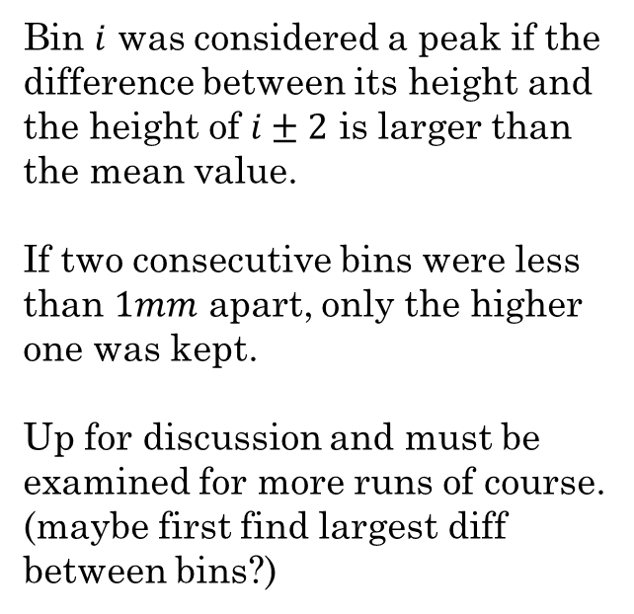
Run 4417 – Full Histogram
Entries
Bin $i$ was considered a peak if the difference between its height and the height of $i±2$ is larger than the mean value.
If two consecutive bins were less than $1mm$ apart, only the higher one was kept.
Up for discussion and must be examined for more runs of course.
(maybe first find largest diff between bins?)
x [mm]

Slide 5
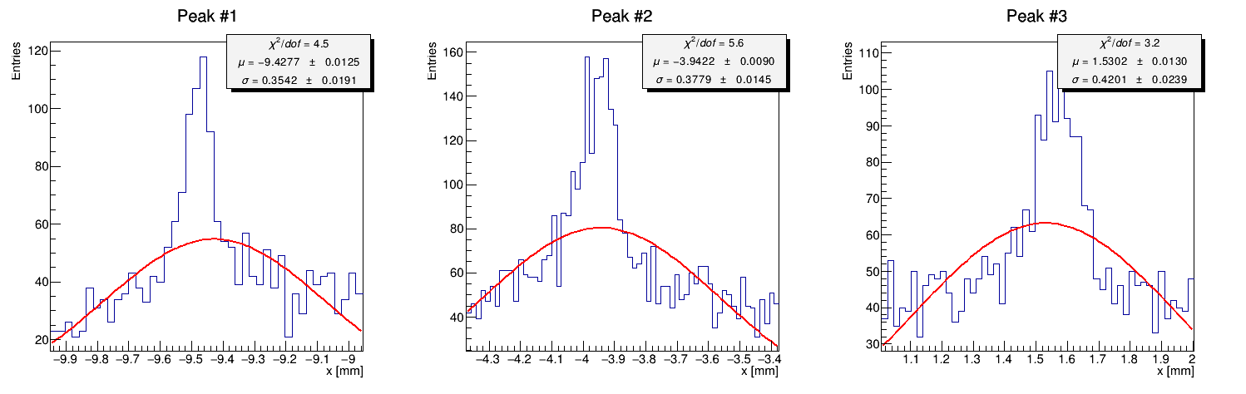

Run 4417 – fit iteration #1
Took the bin of the peak and two on each side (total of 5 bins)
Plotted a new histogram of the region (again with $\#bins=\sqrt{n}$)
Fitted a gaussian

Slide 6
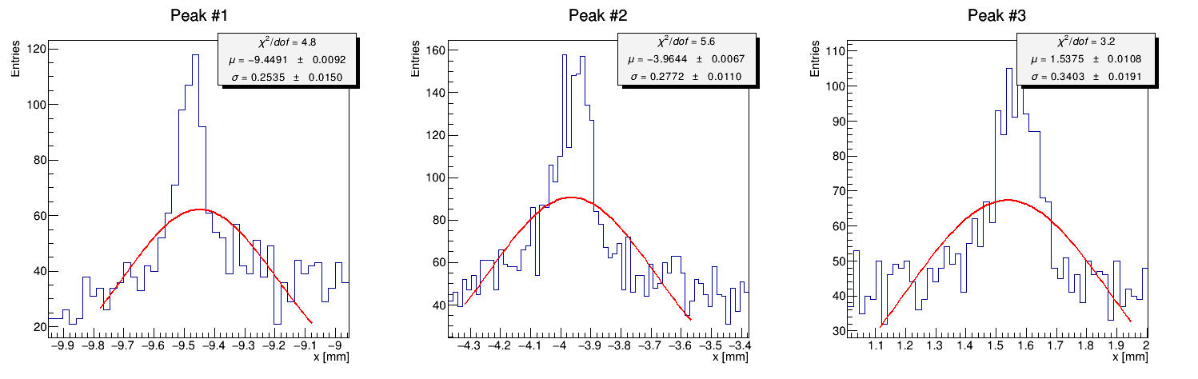

Run 4417 – fit iteration #2
Same exact histograms
Fit limited to $μ±σ$

Slide 7
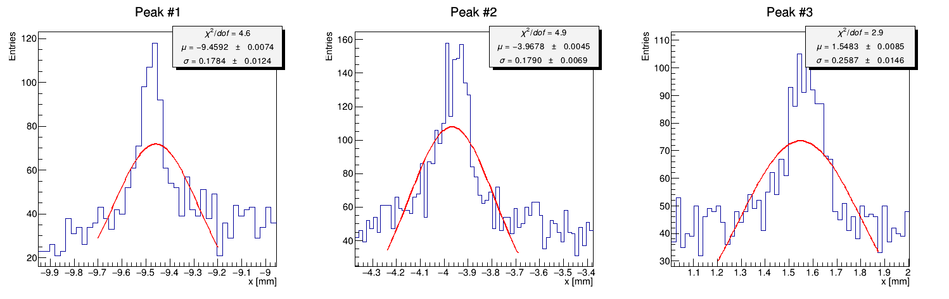

Run 4417 – fit iteration #3
Same exact histograms
Fit limited to new $μ±σ$

Slide 8
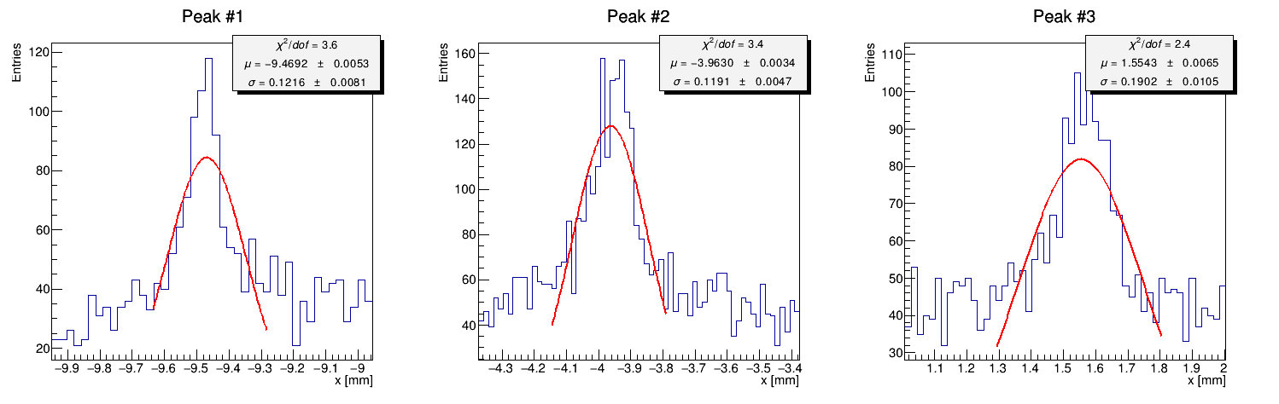
Run 4417 – fit iteration #4
Same procedure as last slides…

Slide 9
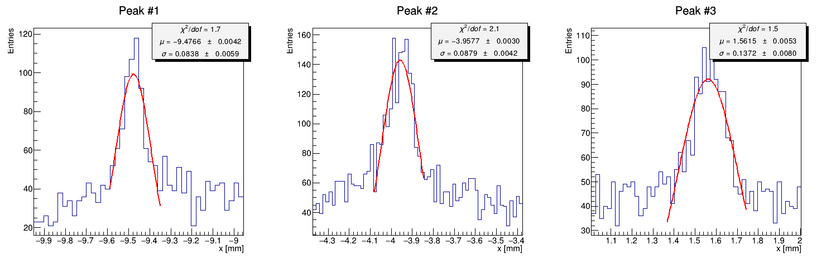
Run 4417 – fit iteration #5
Same procedure as last slides…

Slide 10
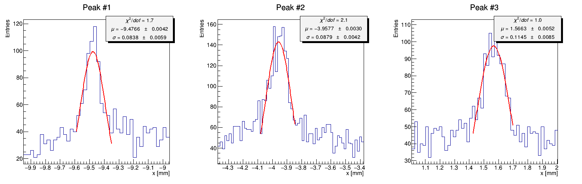

Run 4417 – fit iteration #6
Note that peaks 1 & 2 were not fitted again since $σ<0.1 mm$
Should another halting condition be found?

Slide 11
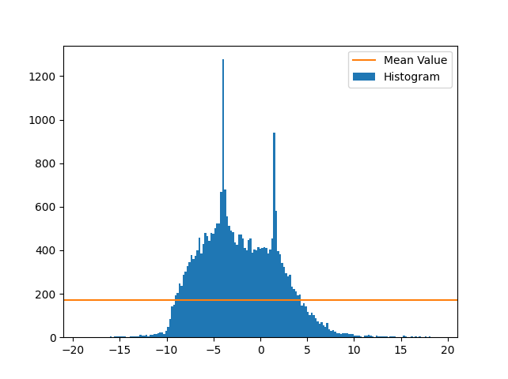
Run 4419 – Full Histogram
Entries
Same logic as explained earlier.
x [mm]

Slide 12
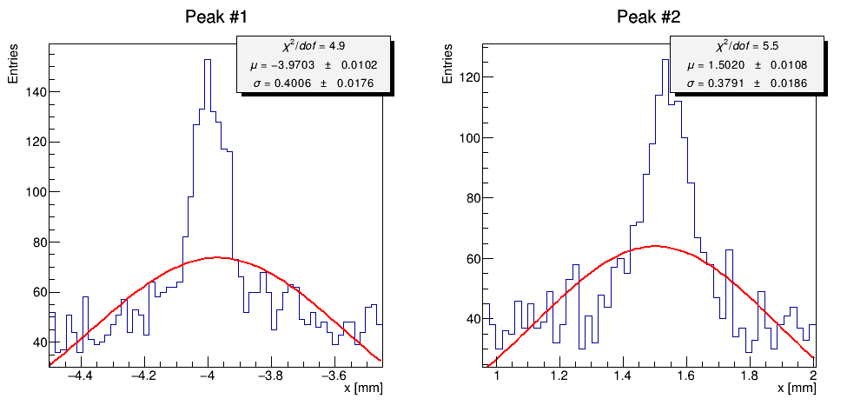
Run 4419 – fit iteration #1

Slide 13
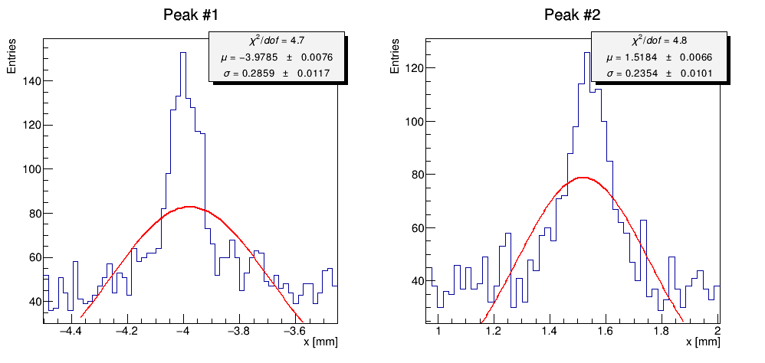
Run 4419 – fit iteration #2

Slide 14
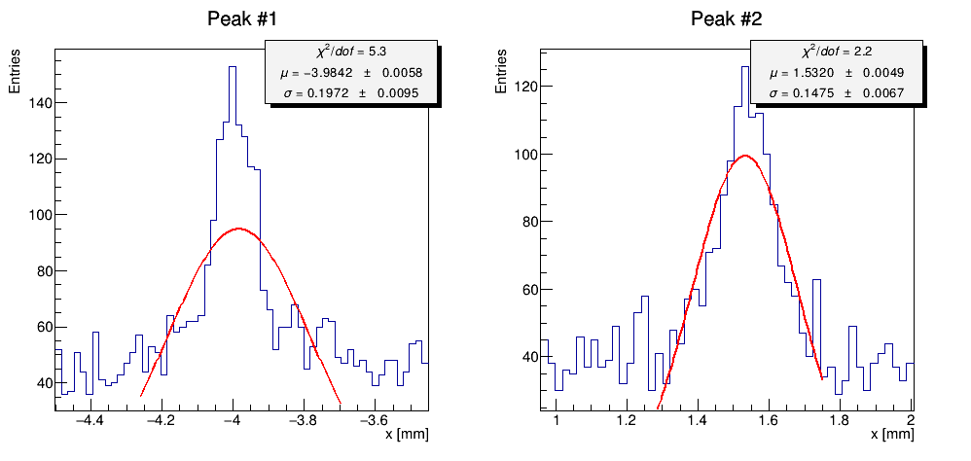
Run 4419 – fit iteration #3

Slide 15
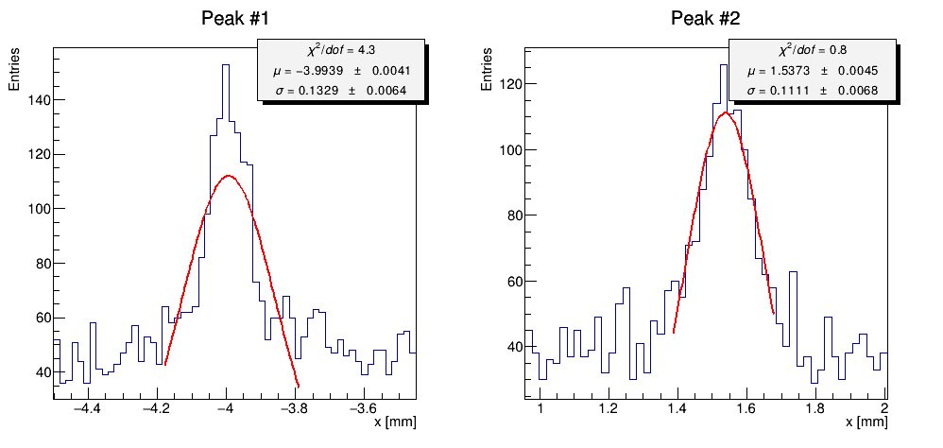
Run 4419 – fit iteration #4

Slide 16
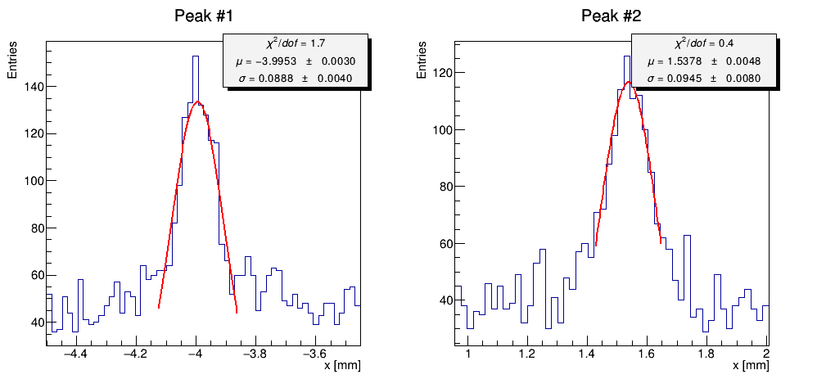
Run 4419 – fit iteration #5
Too Much?

