Slide 1
TB 2022
Automatic Alignment Update
06 / 05 / 23

Slide 2
Some initial notes
Examples shown for X axis of files 4417, 4419 (CALICE)
Events with:
  A single electron
  More than one pad hit
  Only one pad hit on Y axis (leaves us with ~6000 or ~8000 events)

Slide 3
SLIDING WINDOWS

Slide 4
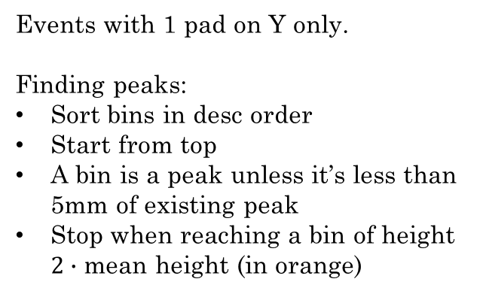
Finding the Number of Peaks
Events with 1 pad on Y only.
Finding peaks:
Sort bins in desc order
Start from top
A bin is a peak unless it’s less than 5mm of existing peak
Stop when reaching a bin of height $2∙$ mean height (in orange)

Slide 5
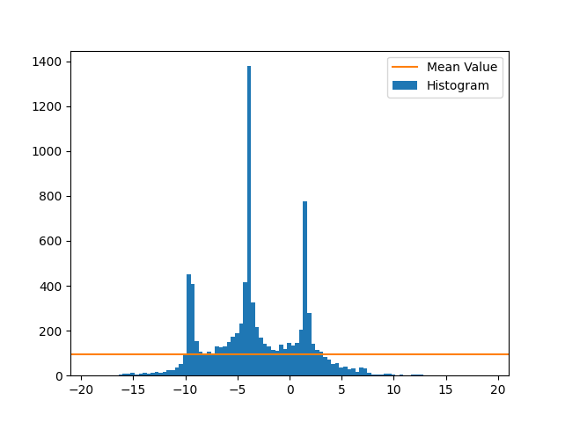
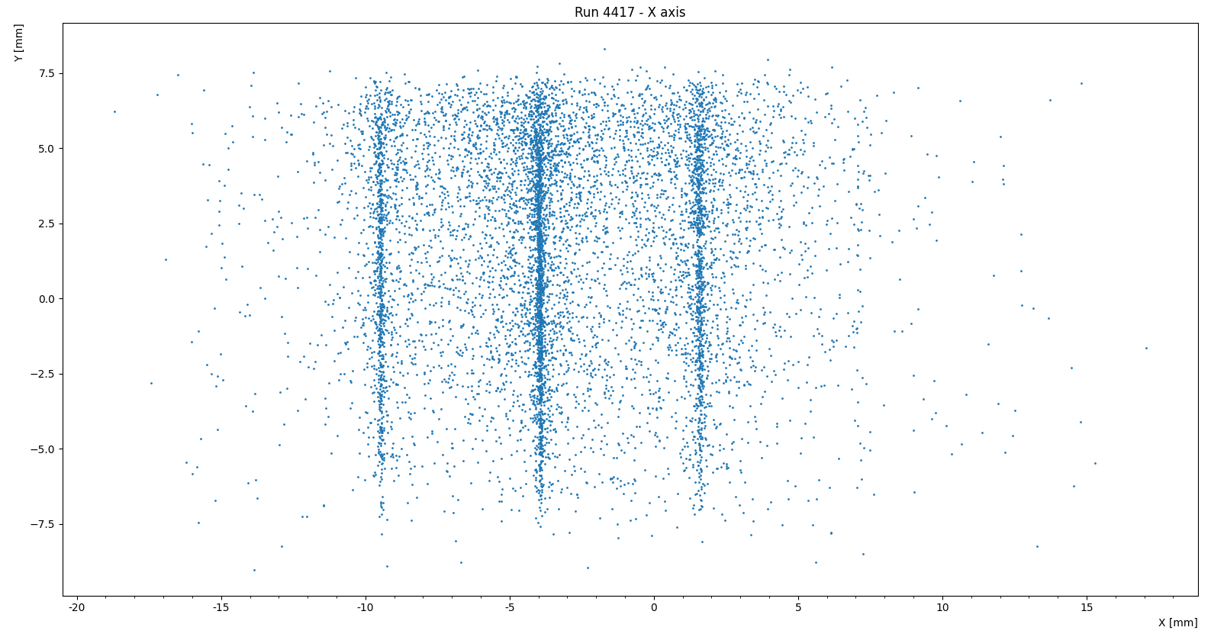
Run 4417 – X axis
Entries
x [mm]

Slide 6
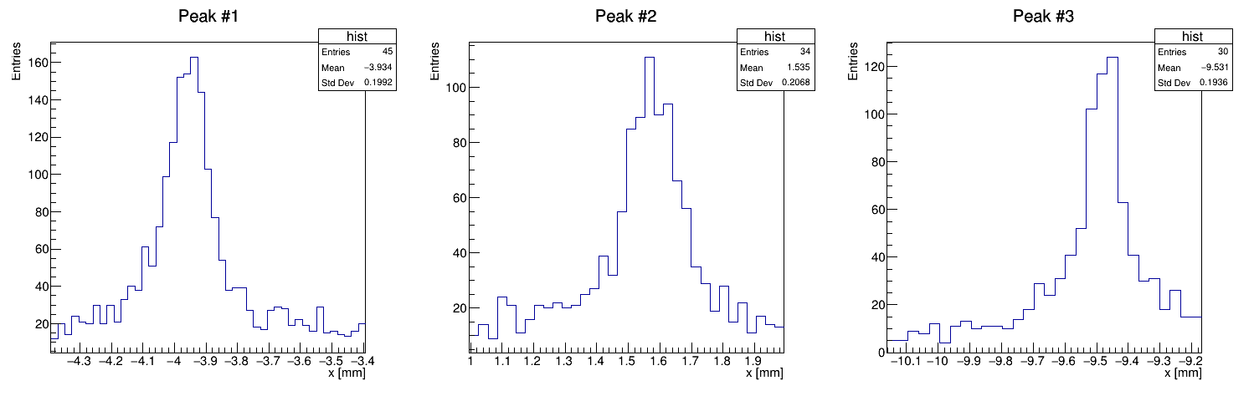
Run 4417 – a close up on the peaks

Slide 7
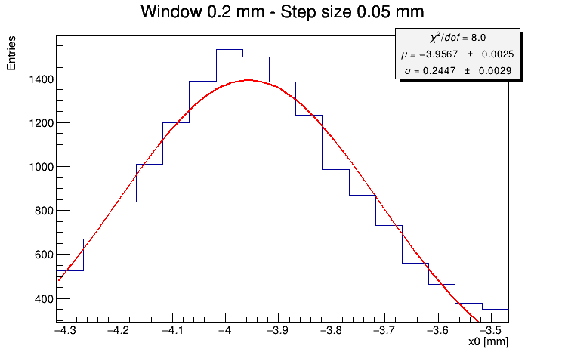
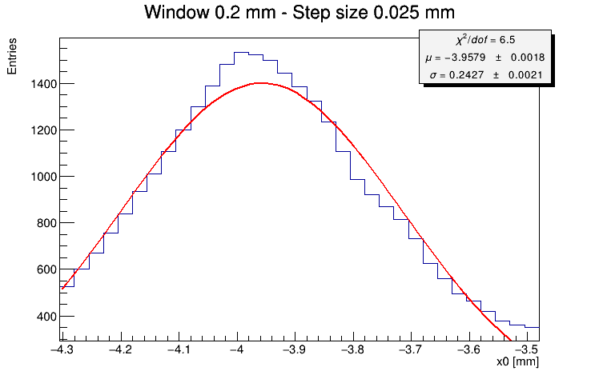
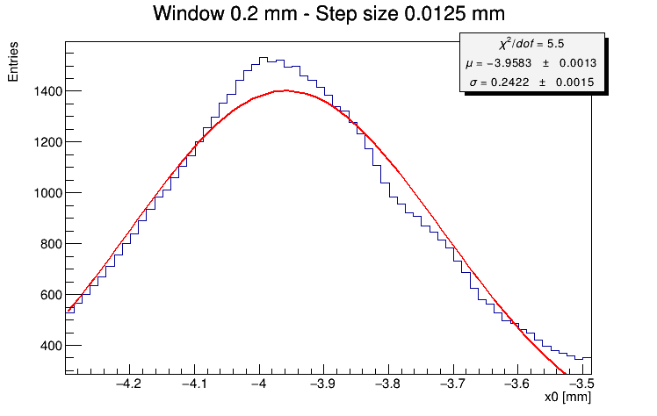

Window Size $200μm$

Slide 8
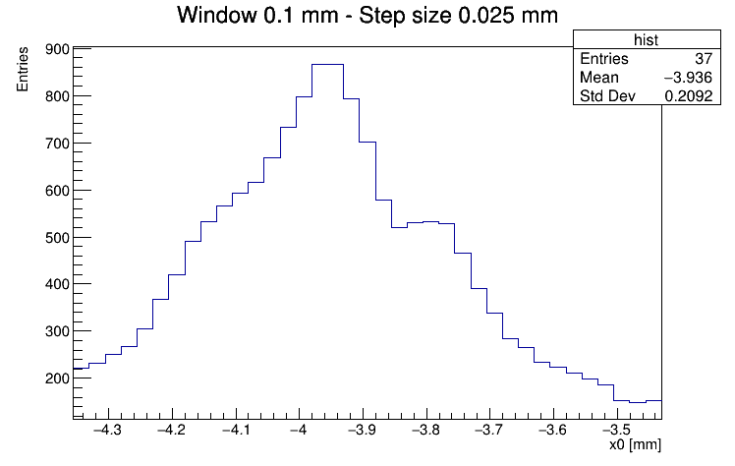
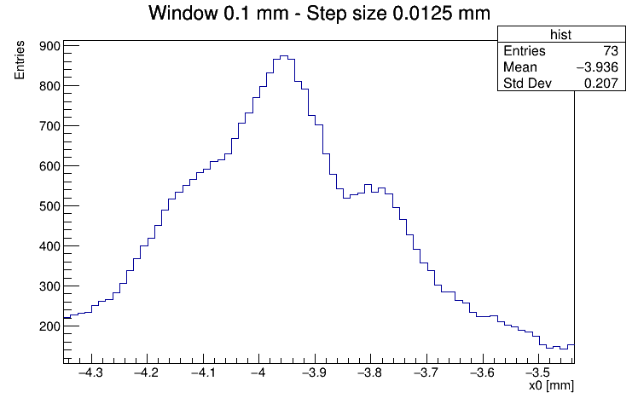
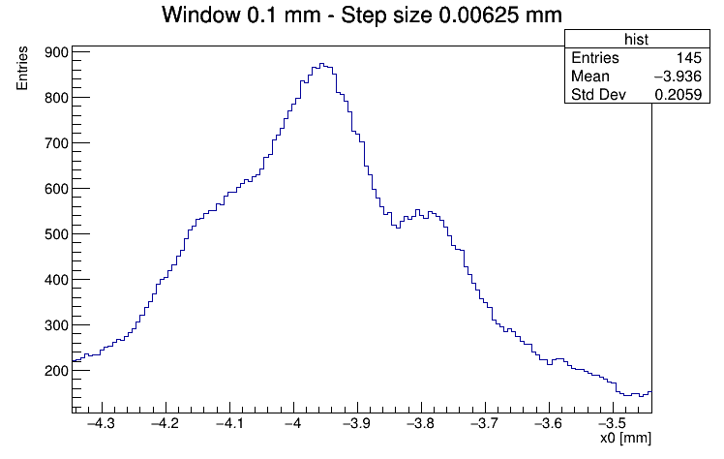

Window Size $100μm$

Slide 9
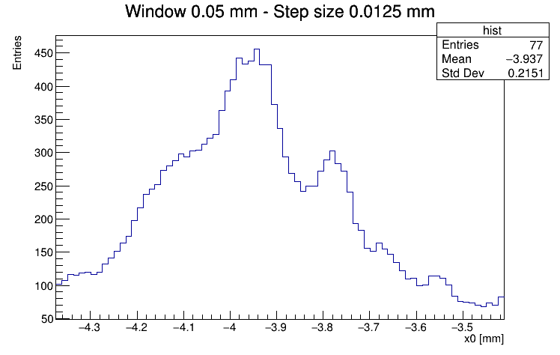
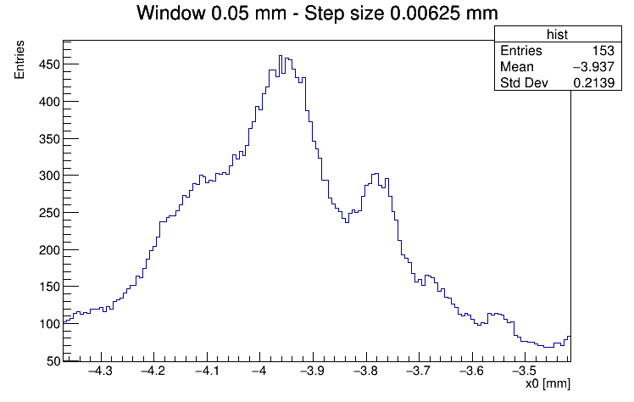
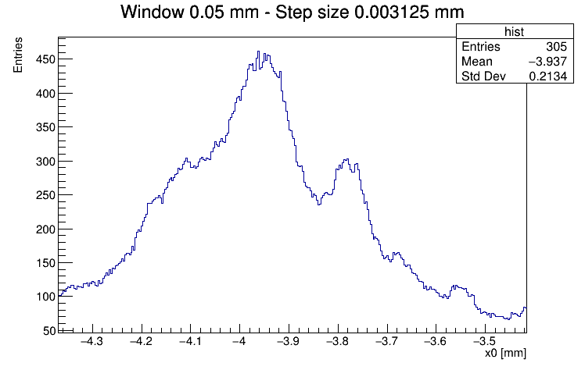

Window Size $50μm$

Slide 10
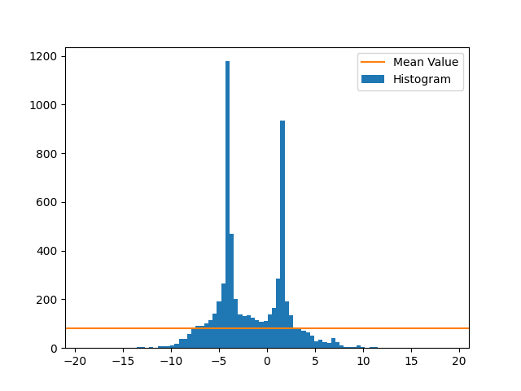
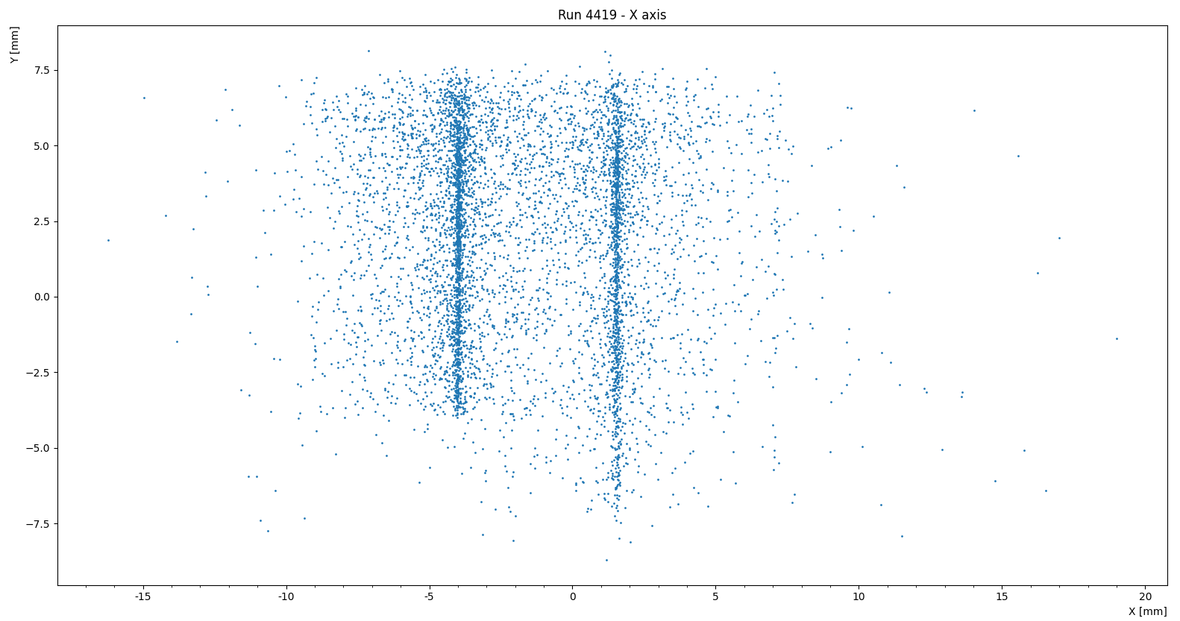
Run 4419 – X axis
Entries
x [mm]

Slide 11
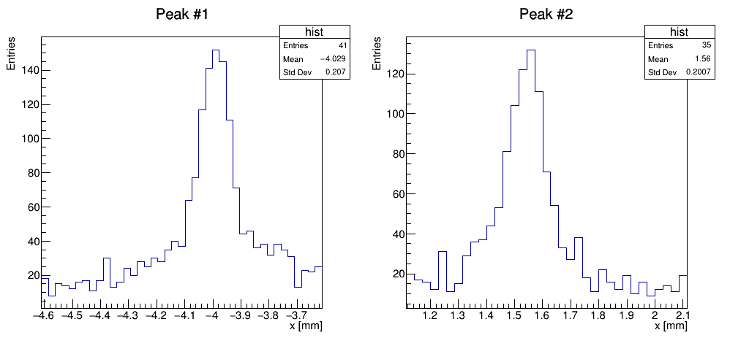
Run 4419 – a close up on the peaks

Slide 12
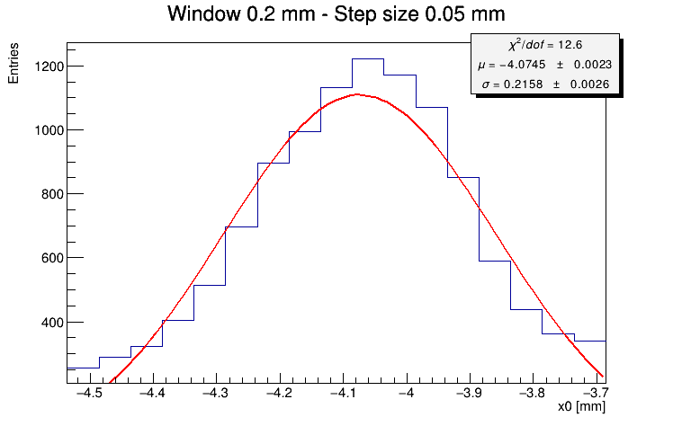
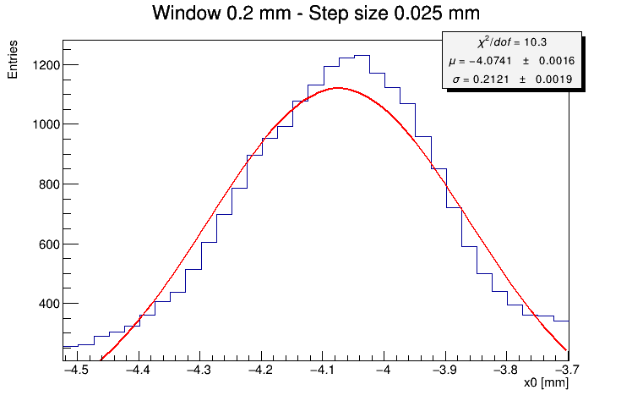
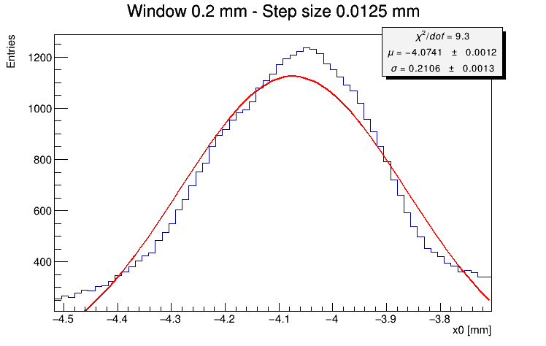
Window Size $200μm$

Slide 13
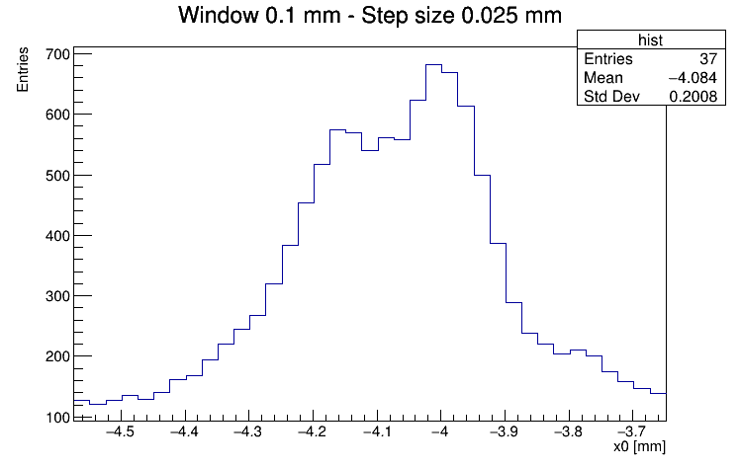
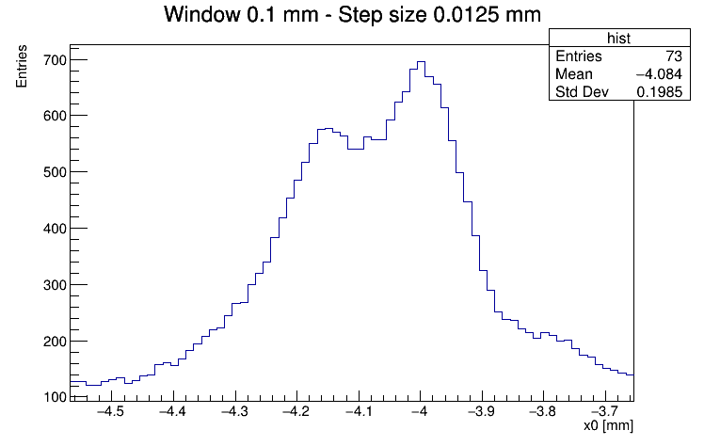
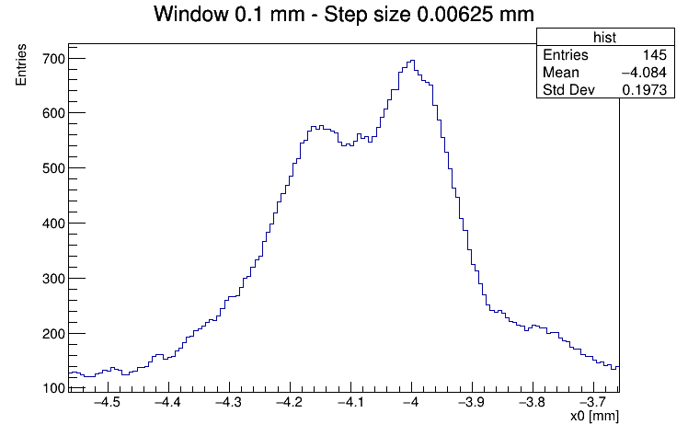
Window Size $100μm$

Slide 14
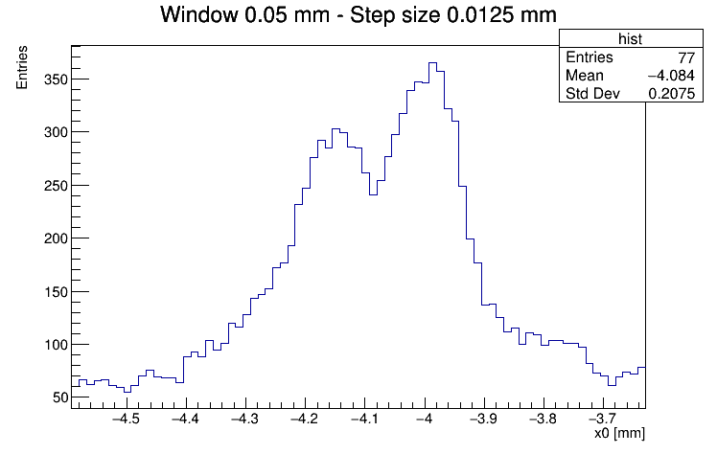
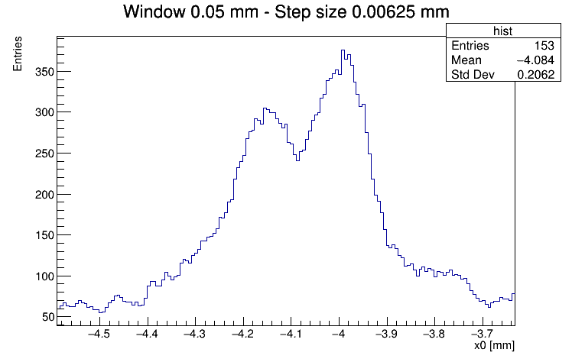
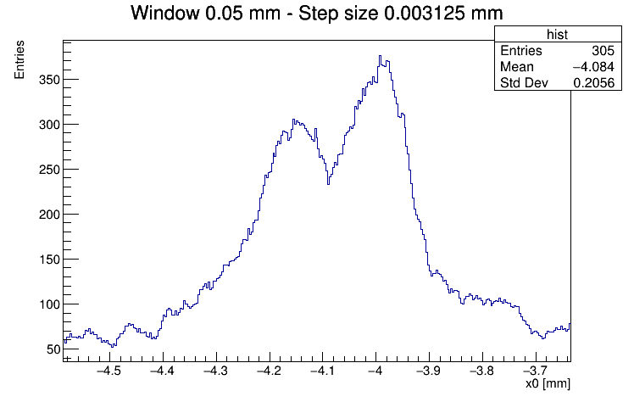
Window Size $50μm$

Slide 15
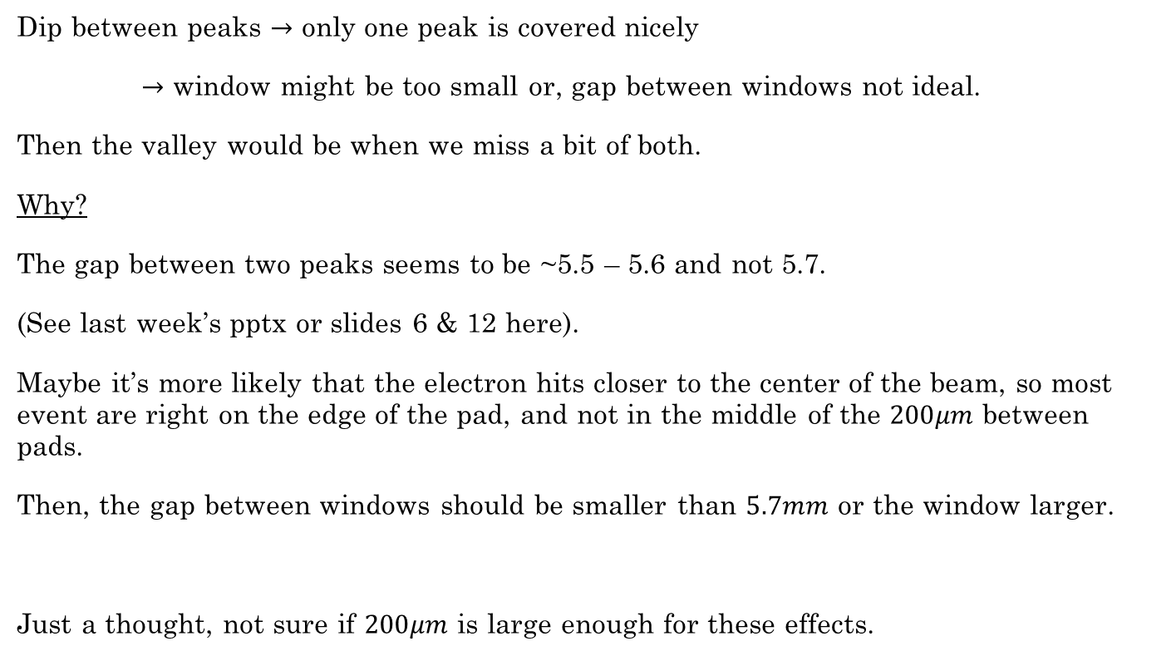
Thoughts about the window size
Dip between peaks $→$ only one peak is covered nicely
$→$ window might be too small or, gap between windows not ideal.
Then the valley would be when we miss a bit of both.
Why?
The gap between two peaks seems to be ~5.5 – 5.6 and not 5.7.
(See last week’s pptx or slides 6 & 12 here).
Maybe it’s more likely that the electron hits closer to the center of the beam, so most event are right on the edge of the pad, and not in the middle of the $200μm$ between pads.
Then, the gap between windows should be smaller than $5.7mm$ or the window larger.
Just a thought, not sure if $200μm$ is large enough for these effects.

Slide 16
Visualization
Data points
Windows
Miss some of both
~5.5 mm
~5.7 mm
Miss on one
Miss on the other
~5.5 mm
~5.5 mm
~5.7 mm
~5.7 mm
Sliding direction

Slide 17
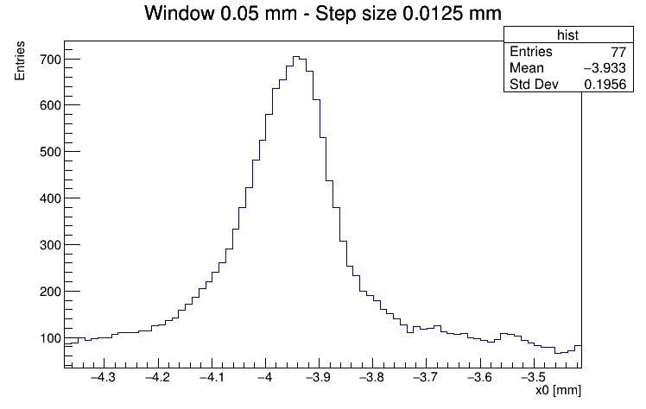
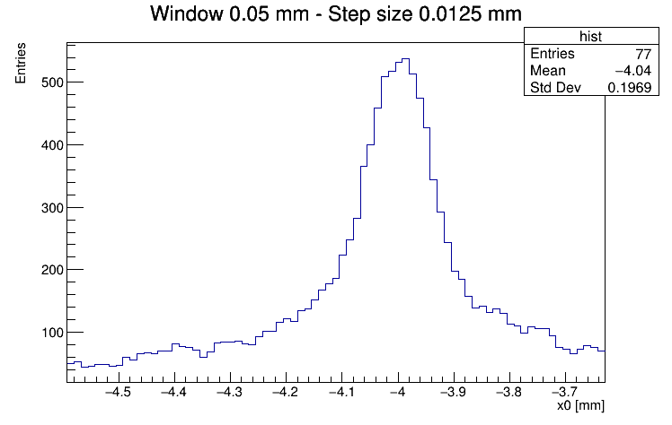

Window Size $50μm$ – second attempt
Gap is now 5.55mm instead of 5.7mm
4417
4419

