Slide 1
Calorimeter Optimization
30-08-2022 update
Michal elad

Slide 2
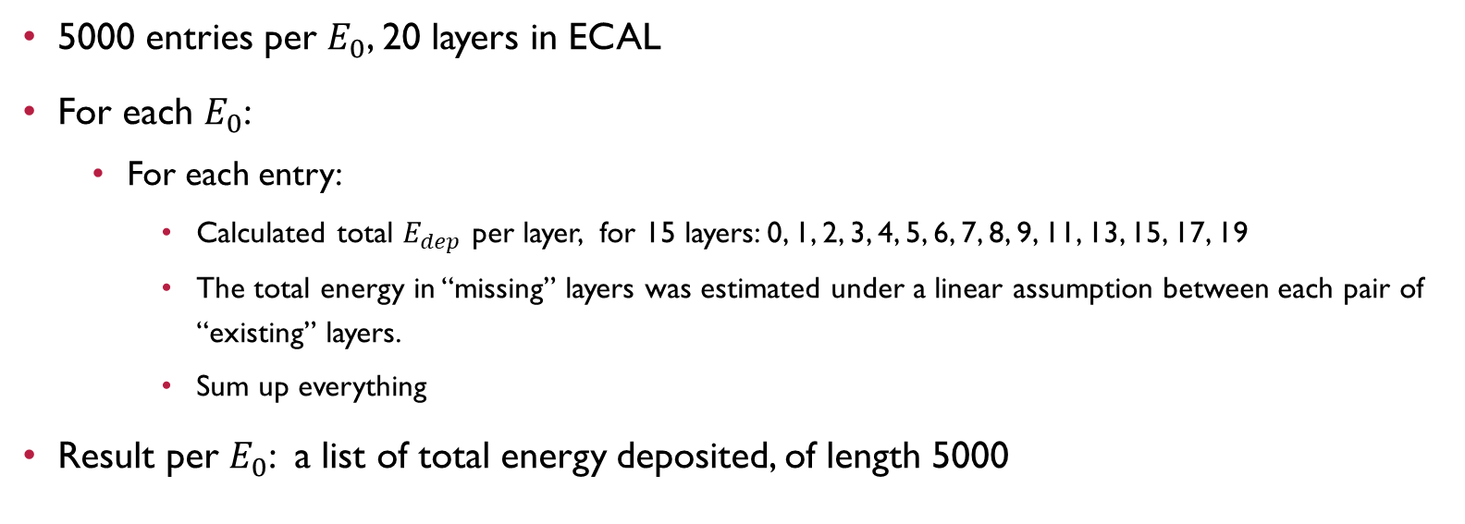
reminder
5000 entries per $E_{0}$, 20 layers in ECAL
For each $E_{0}$:
  For each entry:
    Calculated total $E_{dep}$ per layer, for 15 layers: 0, 1, 2, 3, 4, 5, 6, 7, 8, 9, 11, 13, 15, 17, 19
    The total energy in “missing” layers was estimated under a linear assumption between each pair of “existing” layers.
    Sum up everything
Result per $E_{0}$: a list of total energy deposited, of length 5000

Slide 3
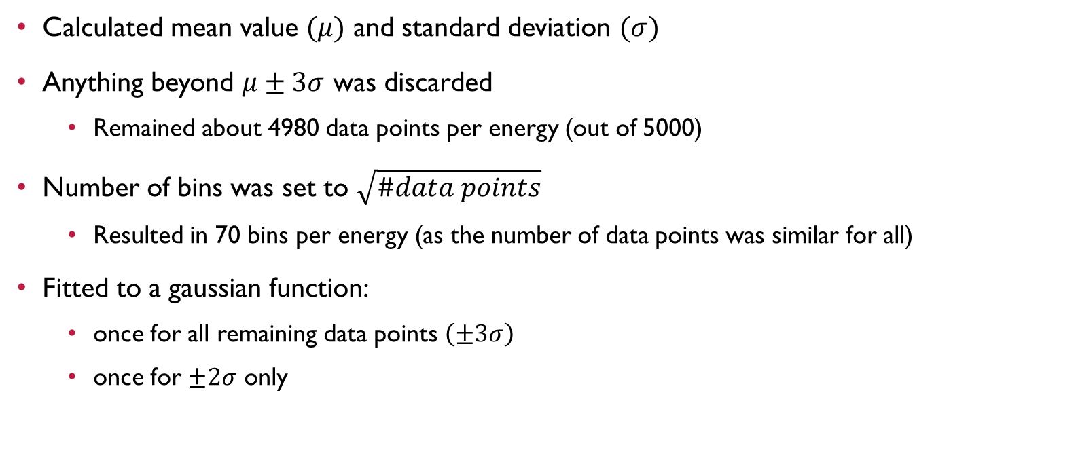
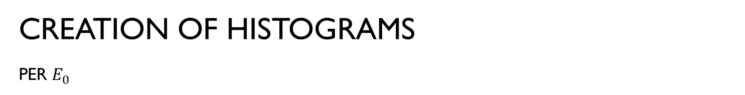
Creation of histograms per $E_{0}$
Calculated mean value $(μ)$ and standard deviation $(σ)$
Anything beyond $μ±3σ$ was discarded
  Remained about 4980 data points per energy (out of 5000)
Number of bins was set to $\sqrt{\#data points}$
  Resulted in 70 bins per energy (as the number of data points was similar for all)
Fitted to a gaussian function:
  once for all remaining data points $\left(±3σ\right)$
  once for $±2σ$ only

Slide 4
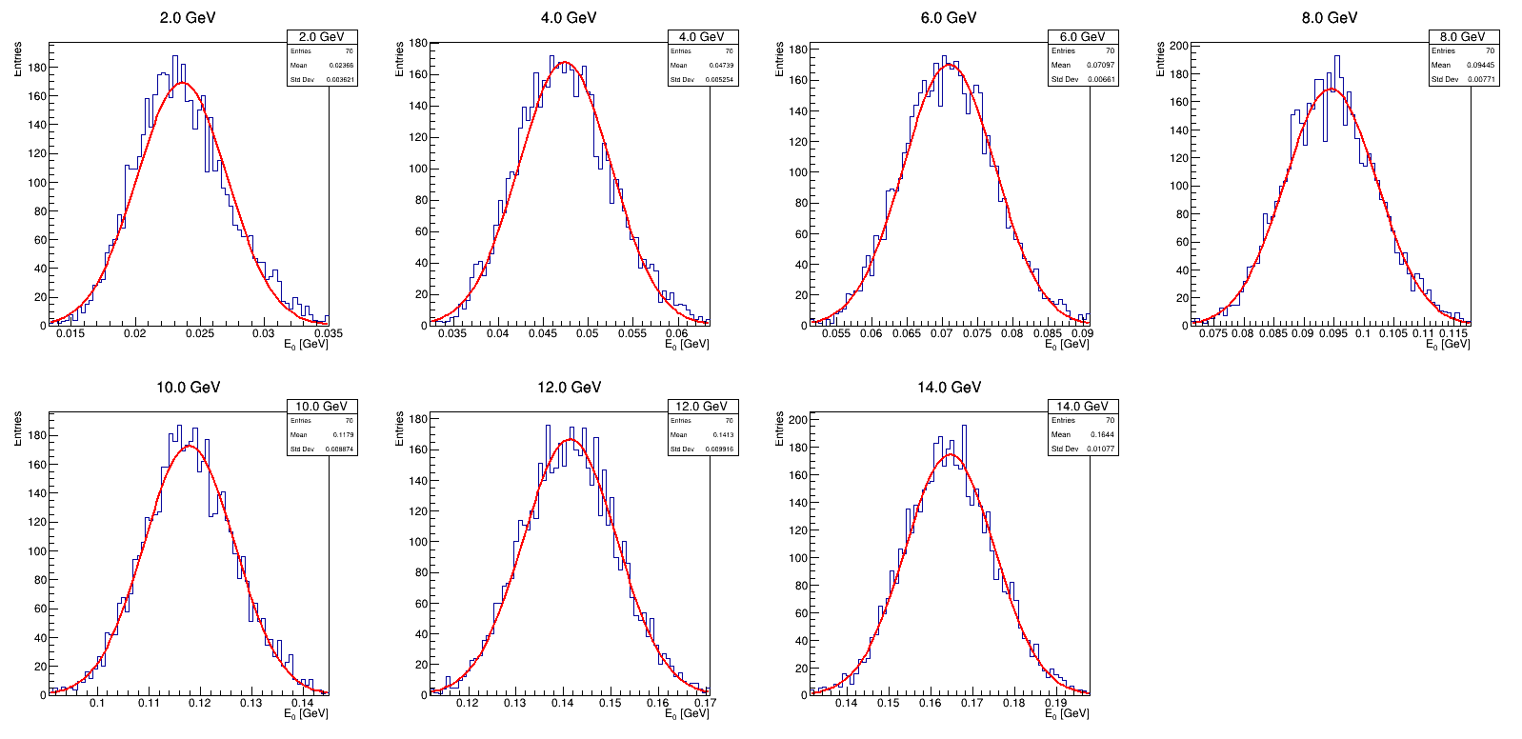
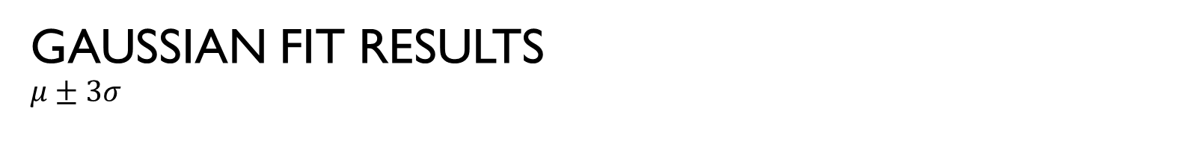

Gaussian fit results
$$μ±3σ$$
$$χ^{2}\backslash dof$$
2 GeV: 2.36
4 GeV: 1.61
6 GeV: 1.08
8 GeV: 1.17
10 GeV: 1.17
12 GeV: 1.16
14 GeV: 1.02

Slide 5
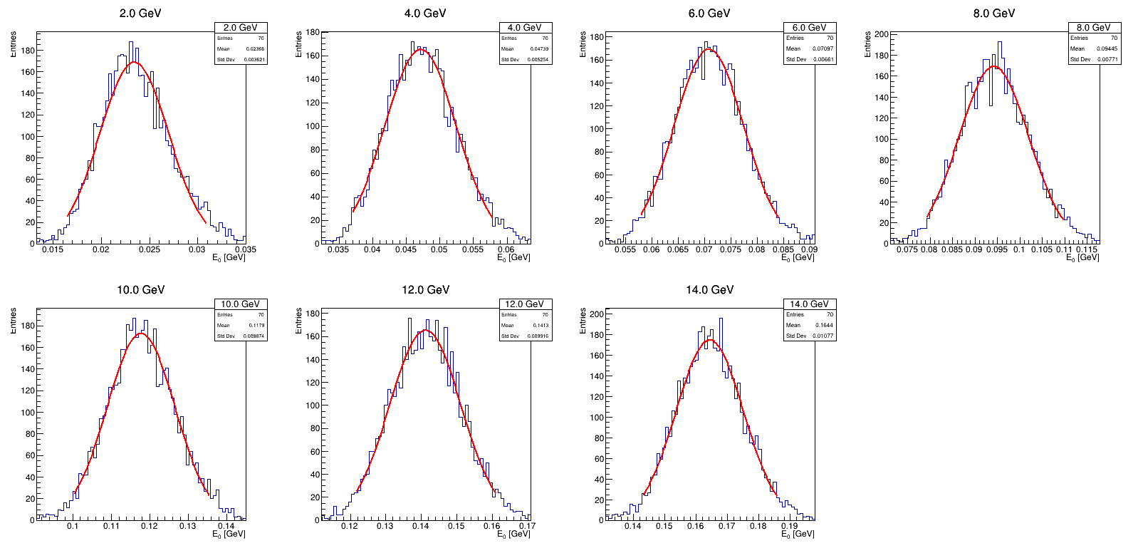
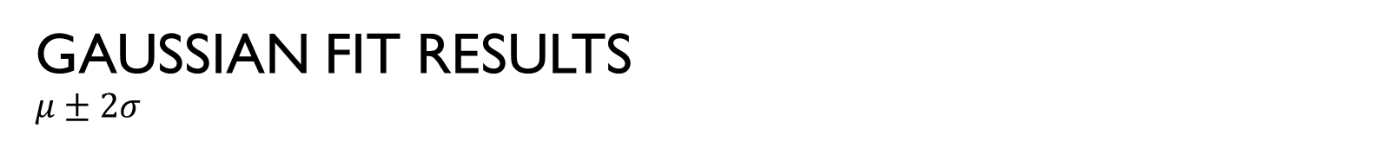

Gaussian fit results
$$μ±2σ$$
$$χ^{2}\backslash dof$$
2 GeV: 1.82
4 GeV: 1.09
6 GeV: 0.83
8 GeV: 1.21
10 GeV: 1.22
12 GeV: 1.14
14 GeV: 0.98

Slide 6
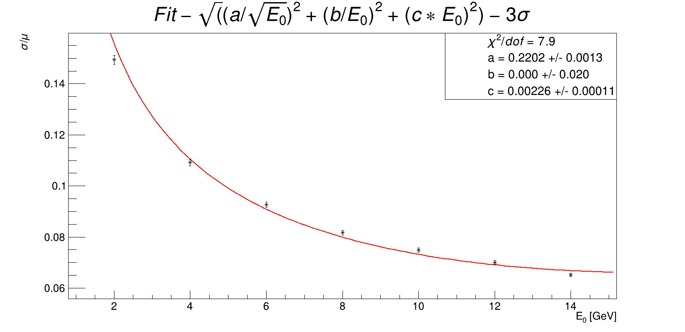
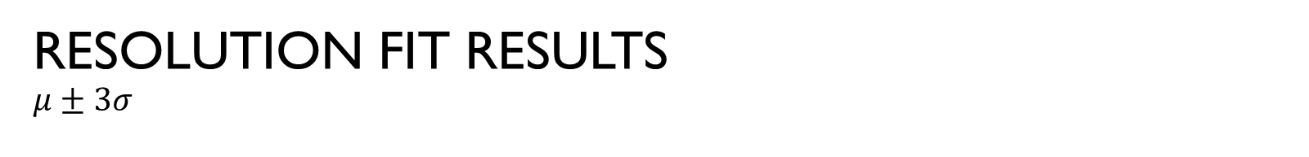
Resolution fit results
$$μ±3σ$$

Slide 7
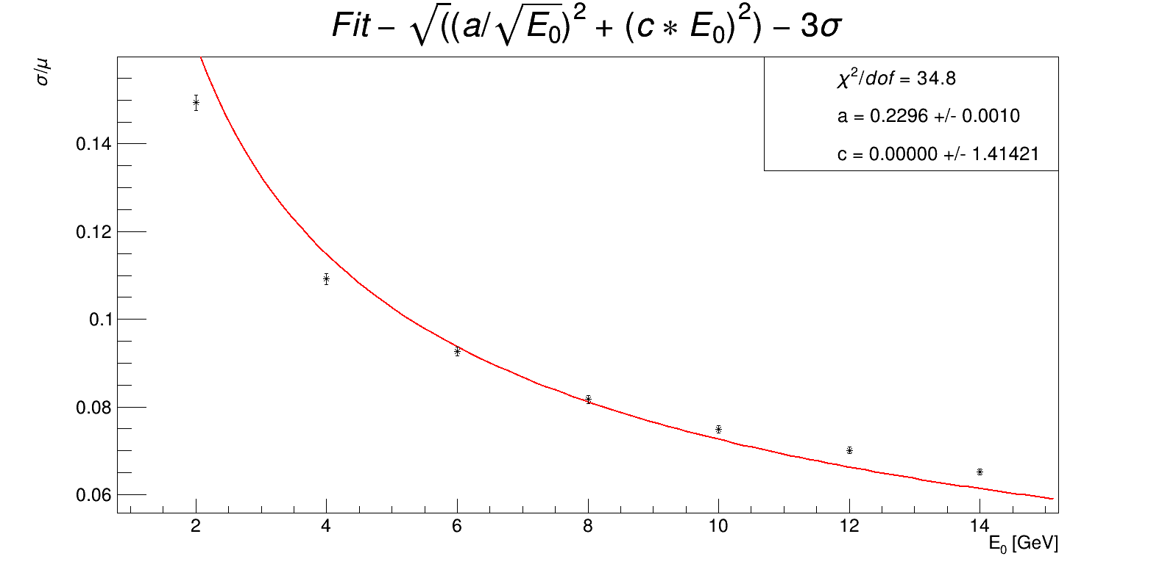
Resolution fit results
$$μ±3σ$$

Slide 8
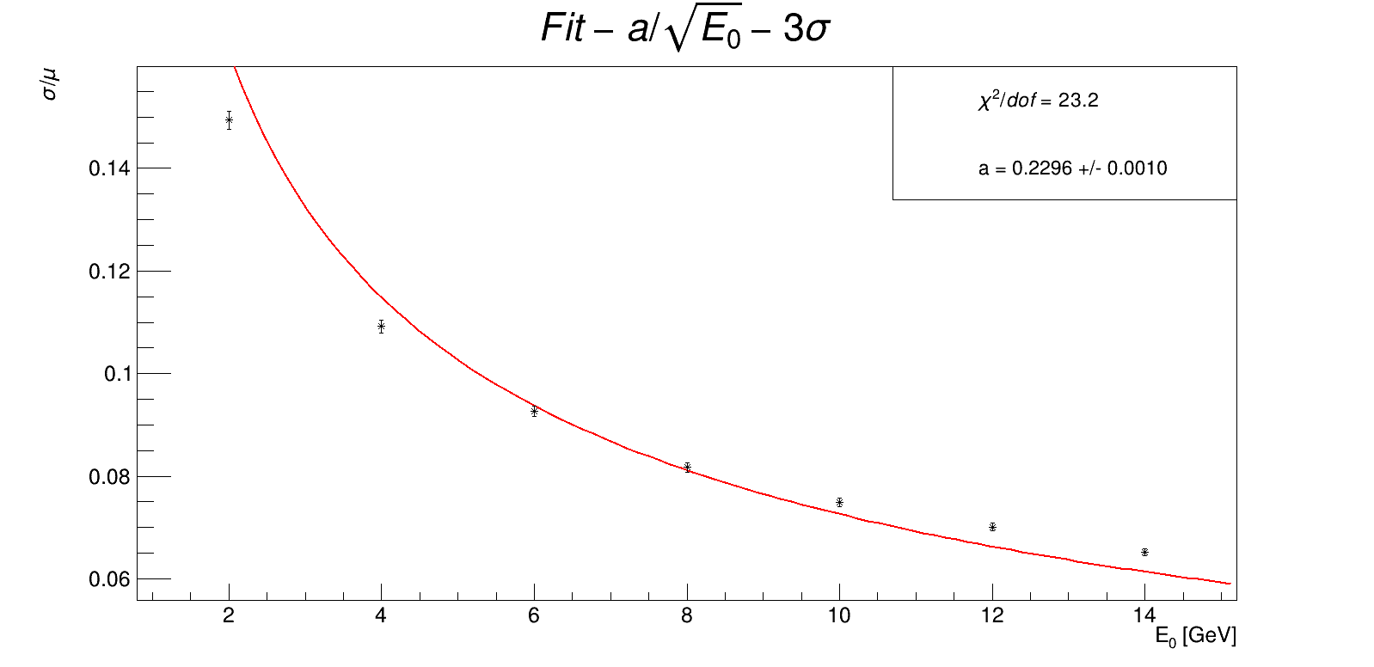
Resolution fit results
$$μ±3σ$$

Slide 9

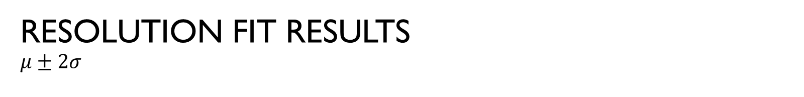
Resolution fit results
$$μ±2σ$$

Slide 10

Resolution fit results
$$μ±2σ$$

Slide 11
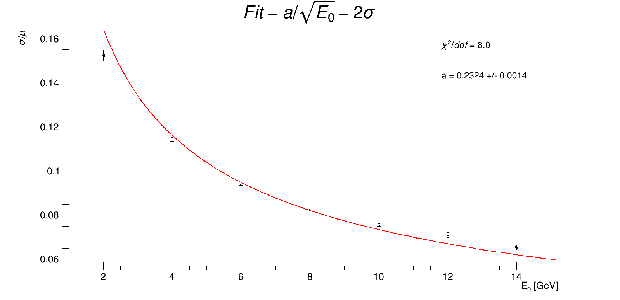
Resolution fit results
$$μ±2σ$$

Slide 12
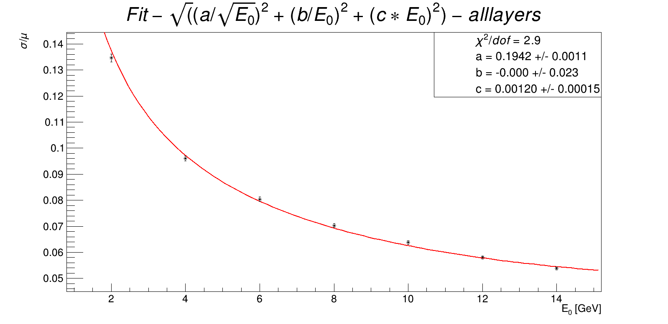

Resolution fit results all layers $(3σ)$ – for reference

Slide 13
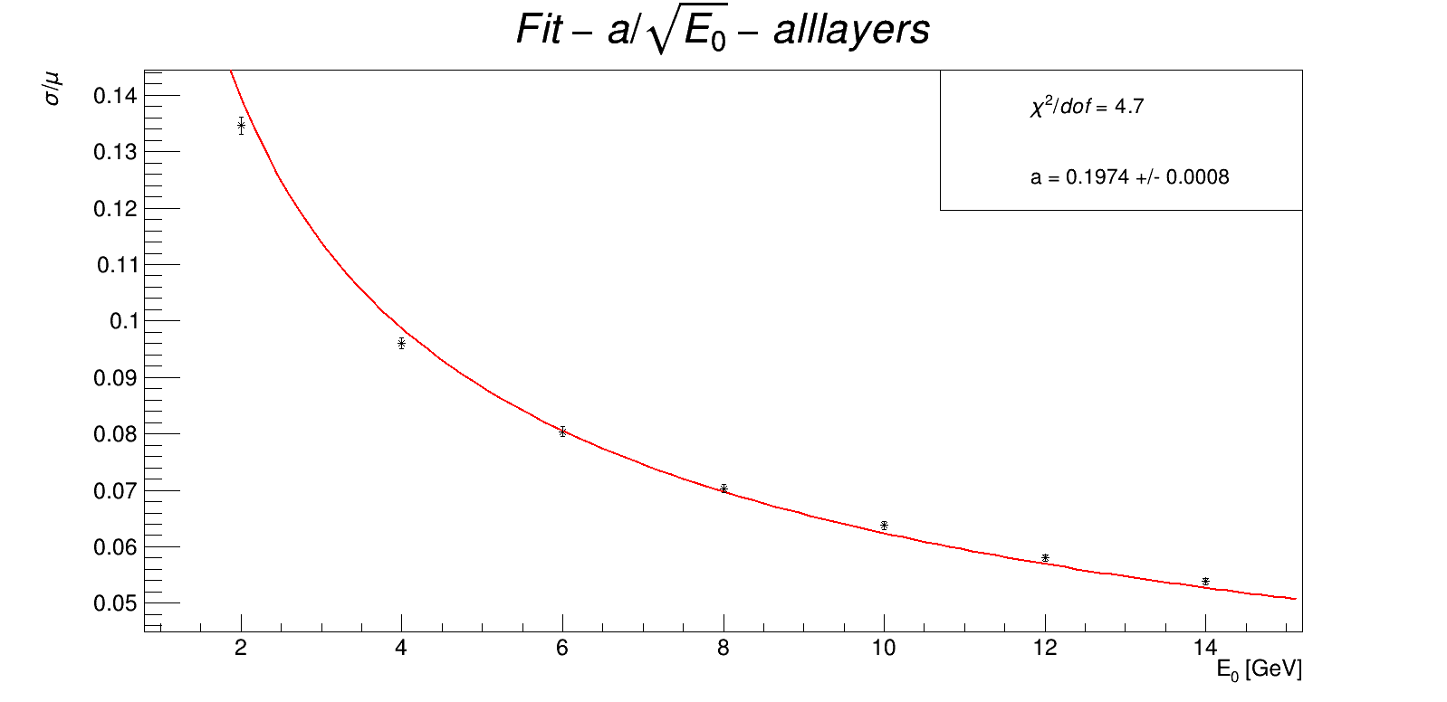
Resolution fit results all layers $(3σ)$ – for reference

