Slide 1
ARES Operation Meeting
Summary of week 32 / 2022
Sonja Jaster-Merz & Hannes Dinter, on behalf of the ARES crew

Slide 2
Summary of week 32
 | Mon. 8th August | Tue. 9th August | Wed. 10th August | Thu. 11th August | Fri. 12th August
Achievements | Installed door closing mechanism to building 25d? MDI work on in-air ICT Adjusted field of view of EAR1 to fit the EA quad triplet aligned state (to be checked with beam) | Start up, load machine state, measure max. momentum phases Stridenas Beam profiles Leakage current vs. beam charge PDE current vs. beam momentum Over night: dispersion measurement with averaging over many scans per screen station | Creating simple drift WP for BC measurements BPM LIBPMG1 is connected again Dispersion measurement for a number of MBHB setpoints Over night: wire quad scan (stopped because of TWS modulator problems) | MIN working on TWS1 modulator Charge map tool bugfixing AA shift cancelled because of TWS1 modulator problem | MIN working on TWS modulators (no beam operation) Modulators were fixed by MIN. Ferrite damping blocks installed at the cables.
Difficulties |  | AREAMQZM3 wrong readback value (280A while switched off), solved by MPC Now AREAMQZM3 has a large RBV deviation (MPC will fix it next Tuesday), have to cycle by hand for now | During night: both TWS modulators fault, TWS2 could be restarted locally, TWS1 to be checked by experts | TWS1 modulator not operational

Slide 3
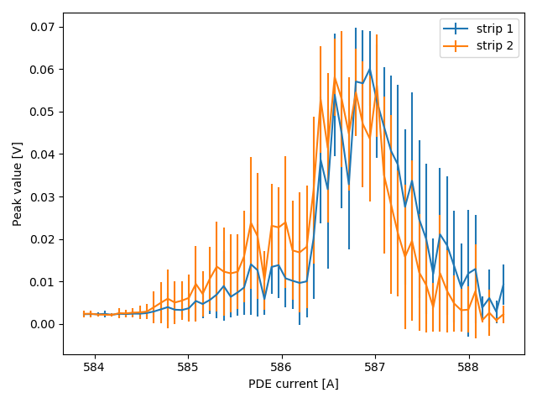
Stridenas beam profile measurement
Estimated charge of 2.5 fC, no beam visible on screen station

Slide 4
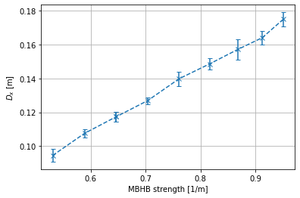
Measured dispersion for a number of MBHB setpoints
Will compare this with the ASTRA model and also give the longitudinal dispersion. The measurement will be continued.

Slide 5
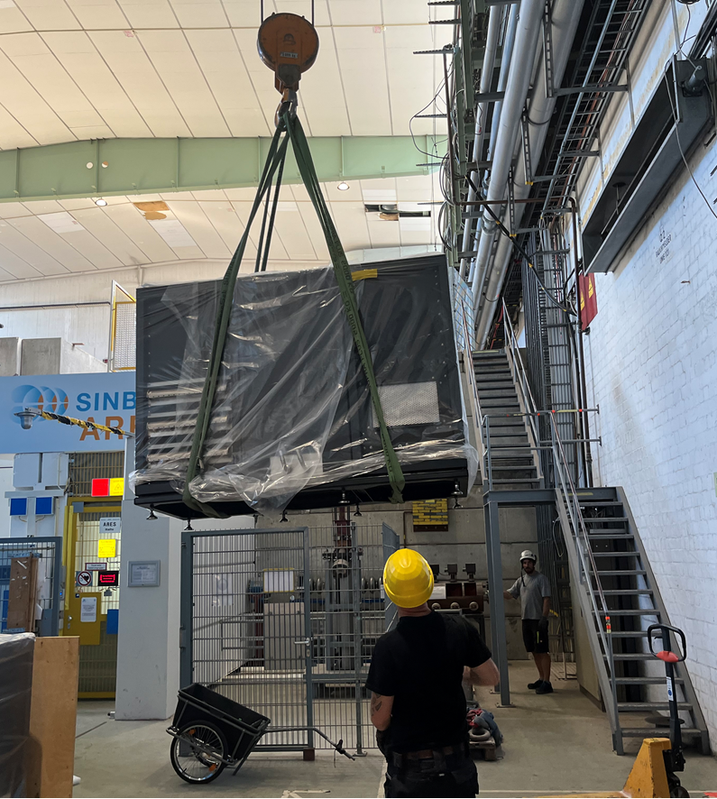
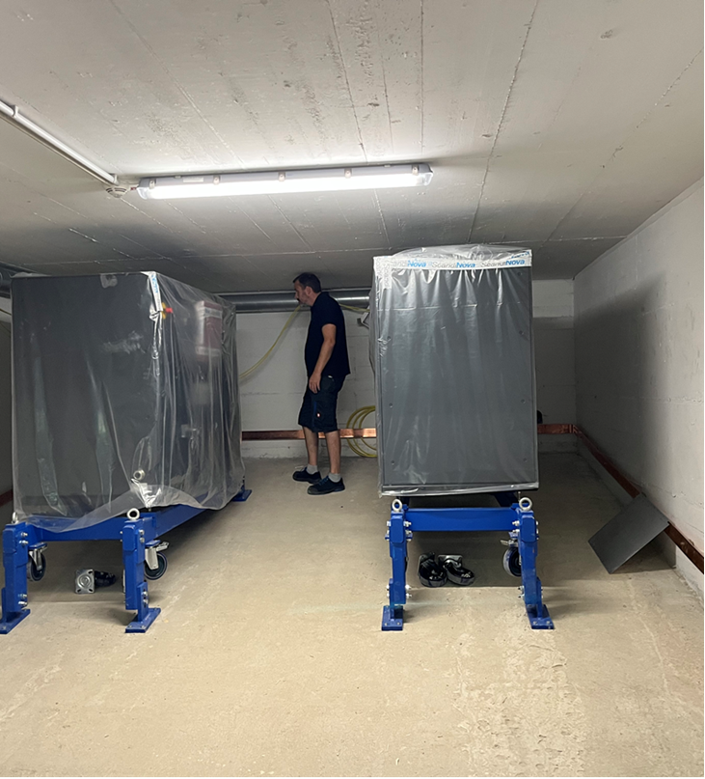
X-band modulators installed

Slide 6
Plans for this week
Software updates on all Windows PCs
JDDD updates
Tuesday: MPC works on EAQZM3 with magnet permission
Wire scanner tests
Stridenas measurements

Slide 7
Schedule
Week 33
Date | Schedule
15.08. | Tunnel open
16.08. | Blae Stacey / Florian Burkart
17.08. | Frank Mayet
18.08. | Sonja Jaster-Merz
19.08. | Hannes Dinter
If you want to learn or join the shift: please give the shift leader a call (BKR 2840 / SINBAD Box 2454)

