Slide 1
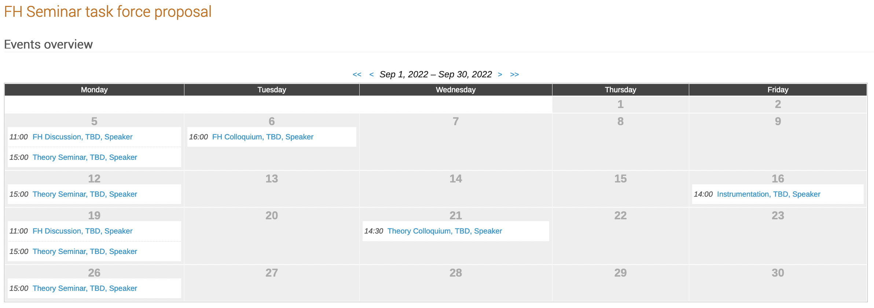
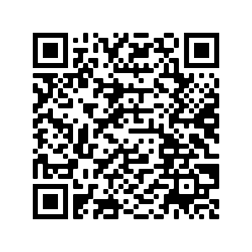
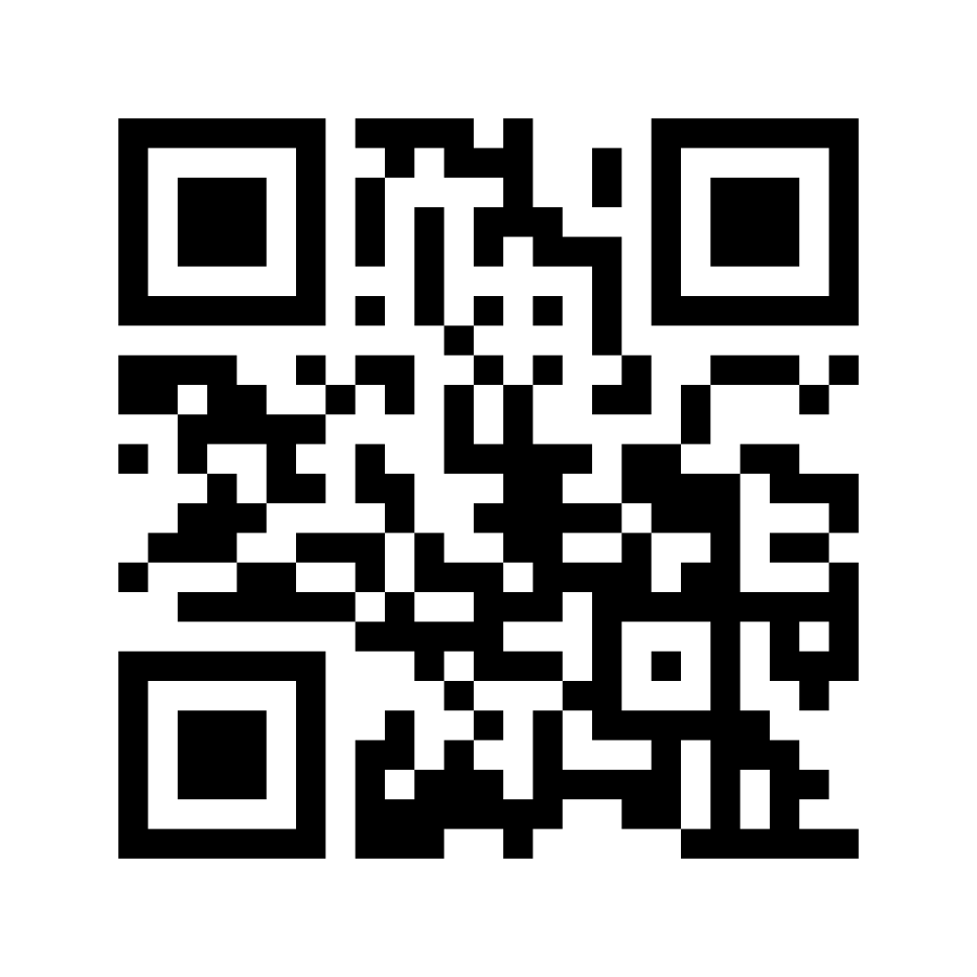
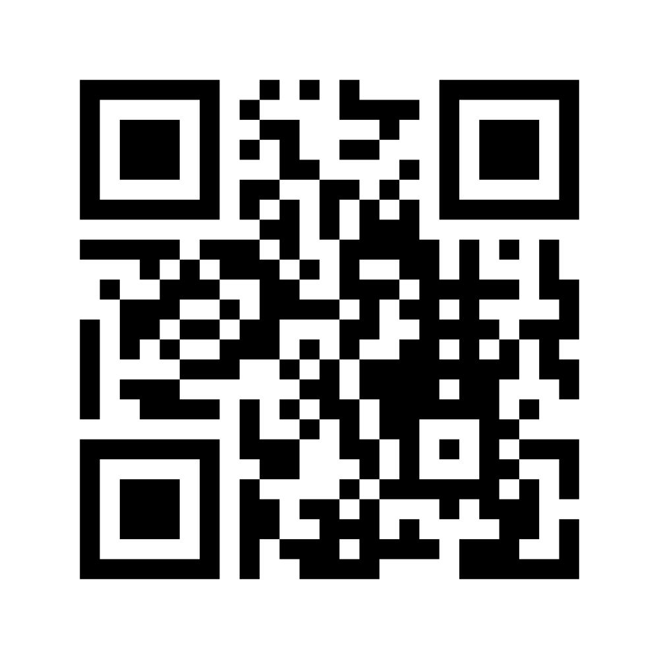
FH seminar program taskforce: first results and open discussion items.
Seminars and colloquia serve to educate, inform and inspire local researchers about scientific developments. The covered topics range from detailed technical discussions to broad overview presentations.
Researchers from different groups discuss across and beyond working group boundaries. At seminar events, individuals have an opportunity to get to know each other and discuss informally. Speakers can gain visibility and advertise their expertise and achievements.
The DESY FH seminar programme should consist of a variety of periodic events targeting different audiences and levels of detail.
Since its initiation, the Seminar Programme Taskforce has met regularly to:
take stock of the current DESY seminar/colloquia programme
collect and discuss requirements of an ideal programme
develop a proposal for updates of the existing programme
develop a proposal for improved communication and announcement of upcoming events
discuss the role of hybrid events in “post-COVID” times
discuss about possible other inputs (e.g. an FH-wide survey and input from other sites)
For more information, see here: https://indico.desy.de/category/937
Mandate
Status
Programme:
We consider the current FH DESY seminar programme as largely successful, comprehensive, coherent and attractive.
Seminars are partially co-organized with other DESY divisions or the UHH, e.g. the DESY FH+AP Colloquium (with AP) and the instrumentation seminar (with FS and UHH). Such collaborations are a plus.
We propose a few small but significant modifications to:
widen the range of topics,
deepen the level of detail,
enhance participation.
Communication:
Propose to manage FH Seminars via one central DESY FH seminar indico page:
The indico calendar view facilitates a simple, synoptic overview of all upcoming and past seminars and could be used for the newsletter and on TV screens in hallways and coffee areas.
Significantly improved level of transparency to
increase seminar attendance,
help chairs balance different seminar events in time and topic,
ensure a limited number of events per week.
Announcements:
via posters and newsletters as before;
via email should be made more coherent (avoid duplicate emails by reviewing/restructuring email lists).
Hybrid seminars:
Pros:
Maximize the number of participants
Useful when seminar rooms are small
Useful for speakers that are unable to travel or live very far away
Hamburg and Zeuthen events could be combined
Cons:
Participants tend to remain in their offices. Discourage this as much as possible.
Less focus, inspiration and communication between participants and speakers.
Competition with hybrid seminars at other institutes.
Propose to a make hybrid test-run with selected events to try the following measures:
Supervisors should act as role models.
Establish “hybrid” communication standards, e.g. self-introduction of people speaking, optimal acoustic equipment in seminar rooms.
Registration to receive the Zoom link for online participation could impose a “symbolic threshold” for those on campus.
https://indico.desy.de/category/682/overview?date=2022-09-19&period=month&detail=event
First results
Draft Indico calendar view
https://indico.desy.de/category/682/overview?date=2022-09-19&period=month&detail=event
Is there interest in a DESY-wide Colloquium, organized jointly by the various DESY divisions? Such an event would only take place once every few months.
Pros:
Better insight in other disciplines on the DESY campus
QU seminar exists, covering already FH/AP, but it excludes M and FS
Cons:
Possibly very large and diverse audience → hard for speakers to optimize presentations
Is the proposed programme complete or should we introduce other possible events, e.g.
TED-talk style presentations (also beyond FH)
in-reach events, also for technical and admin personnel
social events (à la Science Café for all DESY personnel)
Do you have additional suggestions for specific seminars?
Open discussion
We invite for feedback and input of any kind.
Wishes, ideas, and general observations are welcome.
Based on feedback we plan to perform a survey regarding the general DESY FH seminar landscape in the near future.
Feedback wanted
Seminar taskforce: A. Meyer (co-chair), K. Schmidt-Hoberg (co-chair), F. Blekman, M. Diehl, K. Krüger, I. Melzer-Pellmann, K. Mönig, C. Schwanenberger, C. Seitz, S. Spannagel

