Slide 1
Experimentally Restrained Wave Function Method within the Hartree-Fock Formalism
By Sebastian de la Peña Ruiz
Supervisor: Stasis Chuchurka, Stasis Chuchurka, Andrei Benediktovitch, and Nina Rohringer
Theory of Ultrafast X-ray Science (FS-TUXS)
Notes:
Use experimental data to restrain our theoretical model such that they fit with experiments.
Computational work in the field of photon science. Group:
Theory of Ultrafast X-ray Science (FS-TUXS).

Slide 2
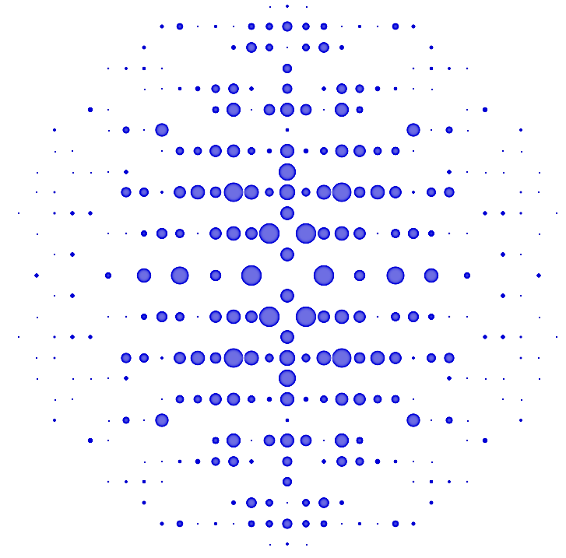
Previous works:
+
Quantum Chemistry
XRD
$$\min\left(\left\langle Ψ\right| \hat{H}\left|Ψ\right\rangle + λ_{1} χ_{XRD}^{2}\left[Ψ\right]\right)$$
Self-consistent combined minimization problem
Jayatilaka, D. & Grimwood, D. J. (2001). Acta Cryst. A57, 76-86.
Notes:
2
And today people even suggest the experimental set-ups which allow combind measurement. But there is no theoretical approch that would perform the same combind self-consistent analyses.
The underlying atomic model to fit XRD data is typically consolidated with XES measurements, but up to date, we are far from generating a unique underlying electronic structure model that self-consistently considers both complementary experimental data. We aim for developing such a unified model.

Slide 3
Motivation:
Develop a general framework in which any experimental parameter can be fitted.
X-ray emission experiments provide us with valuable information about the charge density.
Fitting these observables would allow for improvements even in the simplest models, such as Hartree-Fock.
Notes:
X-ray provide valuable information.
Quantum chemistry needs approximations to work. Sometimes these approximations are too naive and miss very important features of the system, such as electron correlation, or they become computanionaly too heave to be used of médium-sized systems.
We combine these two to make use of experimental data to improve the accuracy of our simplest model, as is the case of Hartree-Fock. Experiments guide the algorithms towards a solution that describes reality more accurately.

Slide 4
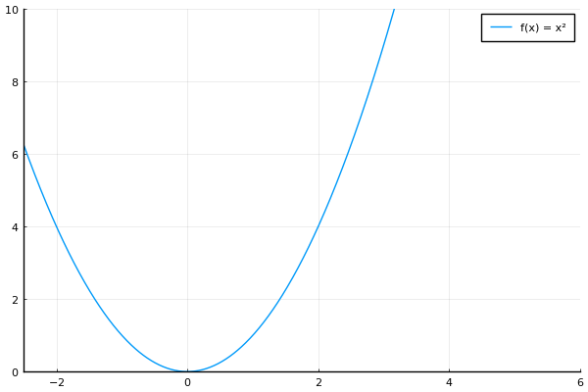
Restrained Minimization:
Theoretical prediction
Empirical observation
Notes:
Basic idea: our model predicts a minimum that does not correspond to reality.

Slide 5
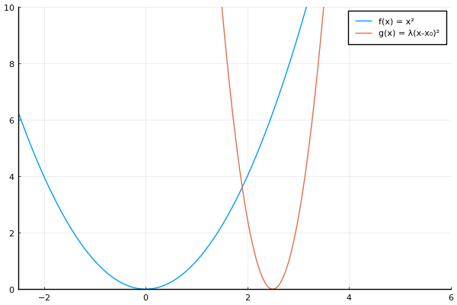
Restrained Minimization:
Theoretical prediction
Empirical observation
Notes:
We include in our model the real value of the observable by hand as a minimization term.

Slide 6
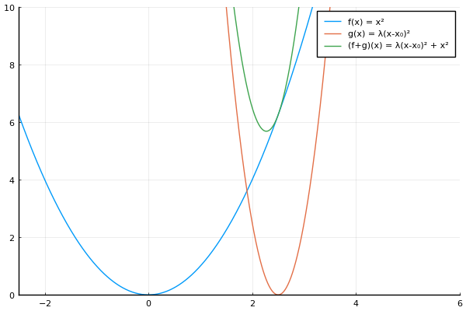
Restrained Minimization:
Fitted prediction
Theoretical
prediction
Empirical observation
Notes:
We solve the problem again, finding a new minimum that will fit better with the experimental value as well as be contained within the theoretical model.

Slide 7
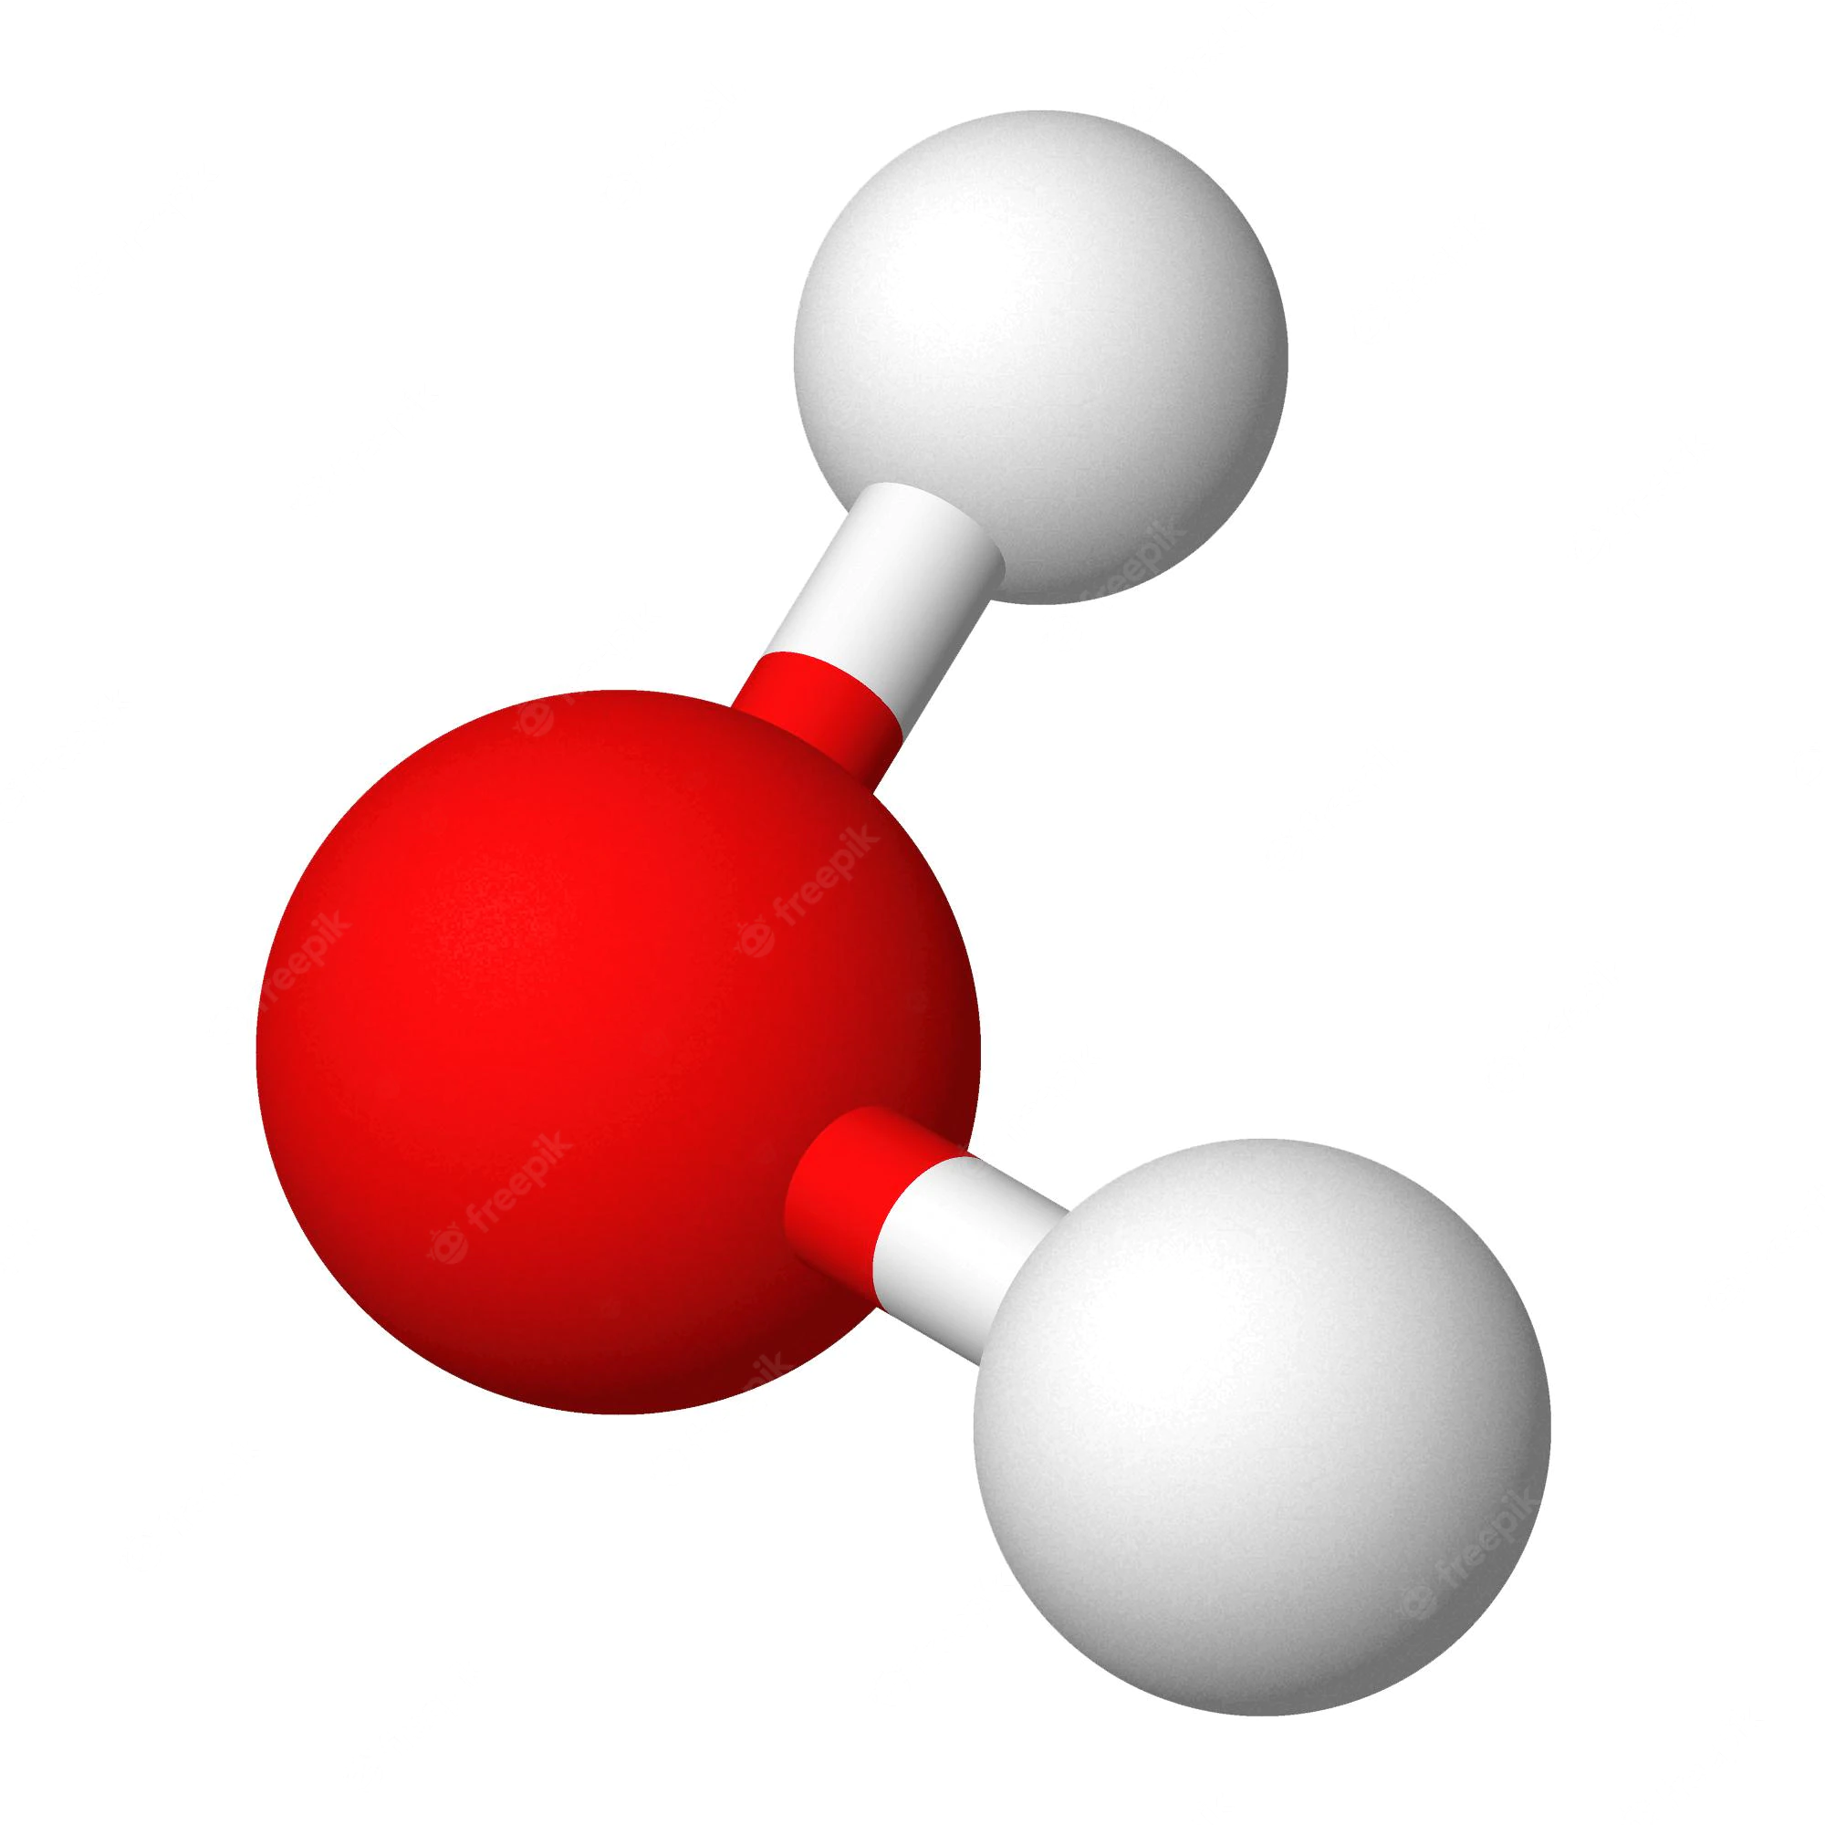
Introduction: X-ray Emission Spectroscopy
Ground state
Ionized initial
Ionized final
X-ray emission
Energy
Dipole transition
X-ray absorption
Time
U.Bergmann, P. Glatzel, Photosynth. Res., 102, 255 (2009)
Notes:
For the case of a molecule (in our case water), there is a process of photo-ionization involving the absorption of an X-ray photon by a core electron, and the subsequent emission of an X-ray by an outer shell electron to fill the hole left behind by the ejected electron.
This photon can be detected and the cross-section can be experimentally obtained.
The cross section is related to the dipole moment of the two ionized states.

Slide 8
Introduction: Hartree-Fock Approximation
Born-Oppenheimer approximation.
Single Slater determinant.
SCF algorithm.
Notes:
Our theoretical model: Hartree-Fock.
Fixed nuclei, single Slater determinant and Self-Consistent Field algorithm.
We need to choose a basis, we perform minimization. Each iteration improves the molecular orbitals.

Slide 9
Improvements to HF:
Maximum Overlap Method to treat excited states.
Spin contamination removal.
Accelerated convergence: DIIS.
Forced orthogonalization between excited states.

Slide 10
Restrained Minimization within Hartree-Fock
Combined minimization
Notes:
Mathematical formalism: we want to fit dipole moment that involves different excited states, thus we need a coupling Hamiltonian that ensures that the dipole moment will be the experimental one. The amplitude of this fitting is controlled by \Lambda.

Slide 11
Restrained Minimization within Hartree-Fock
Notes:
Mathematical formalism: we want to fit dipole moment that involves different excited states, thus we need a coupling Hamiltonian that ensures that the dipole moment will be the experimental one. The amplitude of this fitting is controlled by \Lambda.

Slide 12
Results: Dipole Moment Error Minimization
$5\%$ reduced to $0.3\%$
$9\%$ reduced to $5\%$
Notes:
Error of the fitted dipole moment as a function of Lambda. The error decreases as we smoothly increase the value, but it never reaches absolute 0 and diverges after a certain value of Lambda (overfitting).

Slide 13
Results: Electronic Density
Notes:
Graph representing the electronic density in the 2D plane of the water molecule. The outer parts change more due to the importance of outer orbitals in the determination of the dipole moment.

Slide 14
Results: Molecular Orbitals
Notes:
Outer orbitals comparison between fitted and unfitted ones.

Slide 15
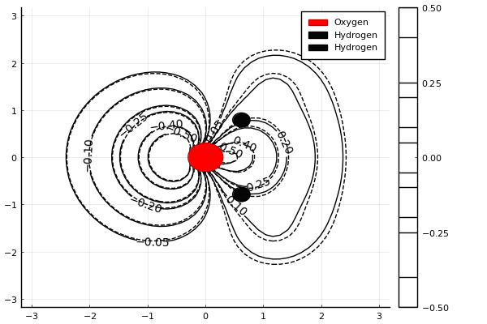
Results: Molecular Orbitals

Slide 16
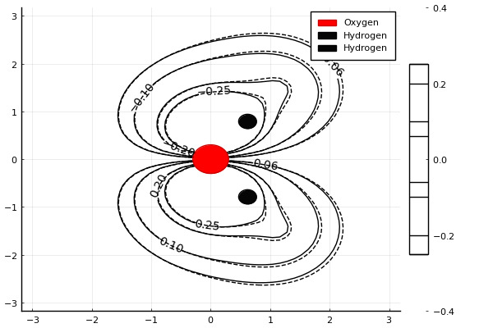
Results: Molecular Orbitals

Slide 17
Conclusions:
It is possible to include experimental fitting using restrained minimization to find corrections to the charge density.
Even for simple models (such as HF) significant corrections can be found.
This method can be extended to other experimental parameters and formalisms.

Slide 18
Thank you for your attention

Slide 19
Improvements to HF: Occupation Criterion
Aufbau Principle: Electrons shall occupy orbitals in order of ascendent orbital energy.
Energy
Notes:
Each molecular orbital has to be filled. Two criteria: Aufbau and MOM. Aufbau is the filling of the lowest orbitals first. Valid for the ground state.

Slide 20
Improvements to HF: Occupation Criterion
Maximum Overlap Method: Electrons shall occupy orbitals in order of descendent overlap with the span of the previous occupied orbitals.
Energy
Energy
SCF iteration
A. T. B. Gilbert, N. A. Besley, and P. M. W. Gill, J. Phys. Chem. A 2008, 112, 13164-13171.
Notes:
For the excited states, this system would end up sinking the excited states into the ground state, so we use MOM instead. We choose the orbitals according to the overlap with the previous occupied orbitals.

Slide 21
Improvements to HF: Spin Contamination
J. S. Andews, D. Jayatilaka, R. G. A. Bone, N. C. Handy, and R. D. Amos, Chem. Phys. Let. 183, 5 (1991) 423-431.
Notes:
In the UHF scheme, spin contamination is an issue: single determinants can stop being eigenstates of the total spin operator S^2 alghough they are eigenstates of Sz. Spin contamination is added by hand into our system by including a new term in the Hamiltonian.

Slide 22
Improvements to HF: DIIS Algorithm
P. Pulay, J. Comp. Chem. 3, 4, (1982) 556-560.
Notes:
In the cases where convergence is an issue, DIIS can be used to minimize the error by using linear combinations of density matrices from previous iterations.

