Slide 1
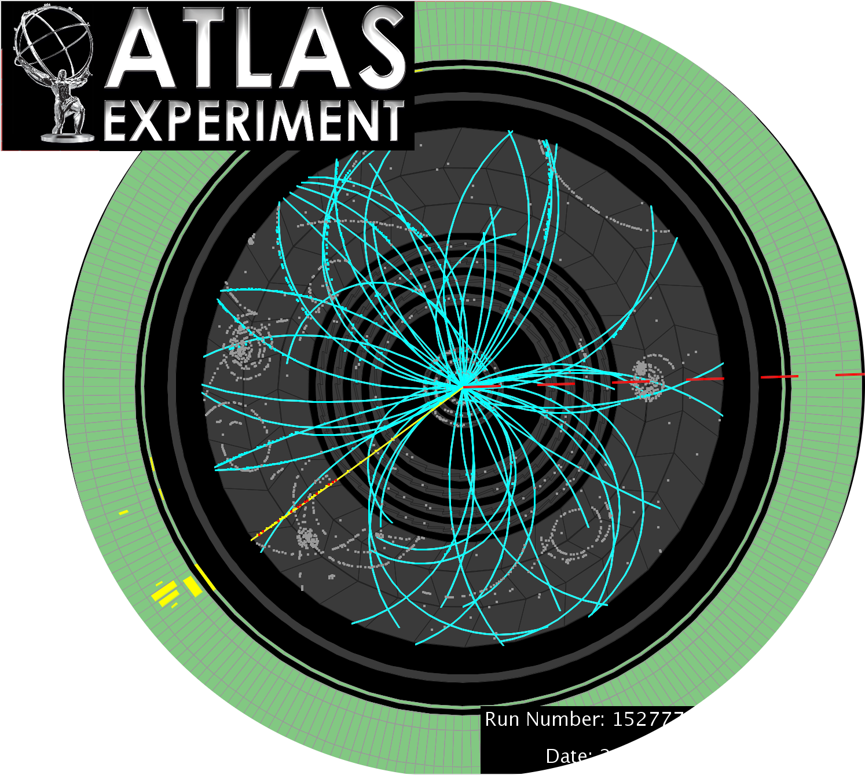
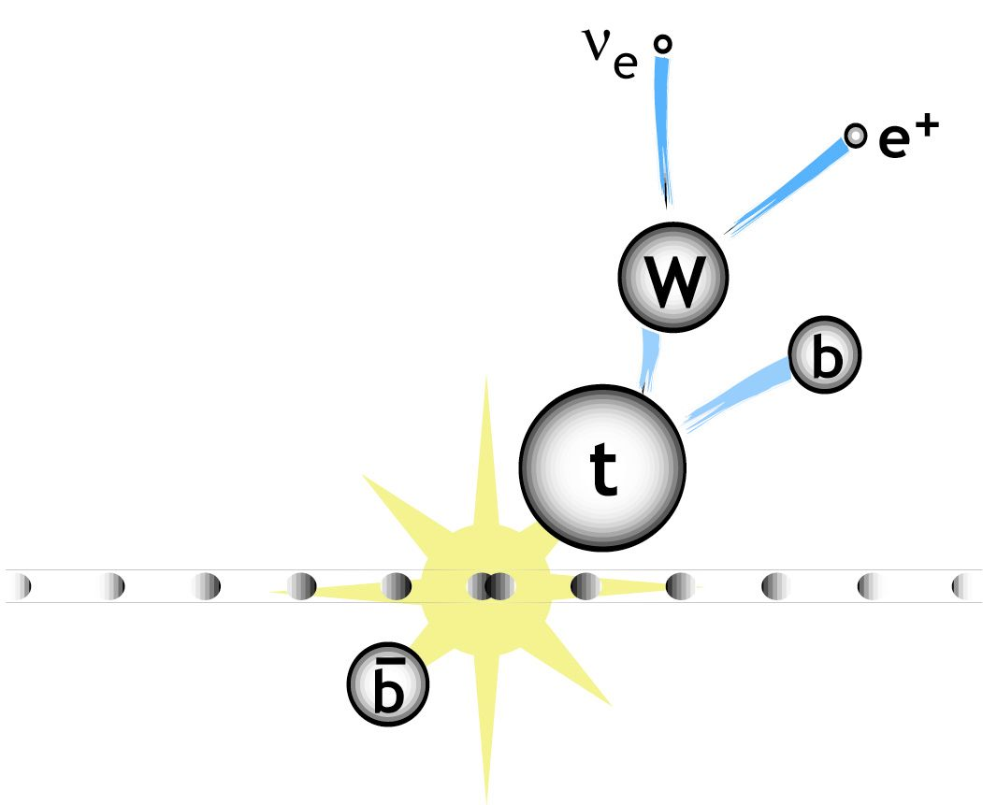
Single-Top Production at the Tevatron and the LHC:
Results and Prospects
Wolfgang Wagner
Bergische Universität Wuppertal
DESY Zeuthen, June 16, 2011
Content:
Introduction / History
Experimental Status
Prospects – Single Top as a Standard Benchmark

Slide 2
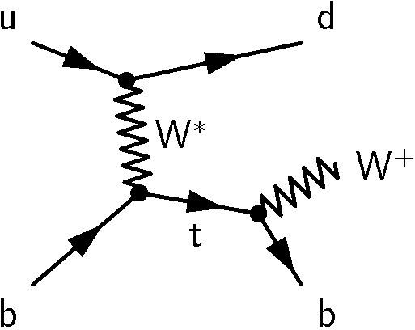
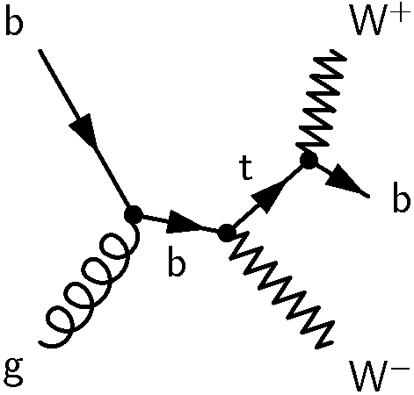
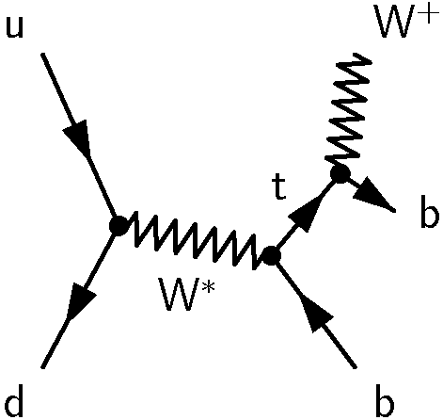
1) Introduction
top-quark production via the weak interaction.
t-channel
associated Wt production
s-channel
cross sections at LHC with √s = 7 TeV (m_{t} = 173 GeV)
64.2 ± 2.6 pb
15.6 ± 1.3 pb
4.6 ± 0.2 pb
cross sections at the Tevatron with √s = 1.96 TeV (m_{t} = 173 GeV)
2.1 ± 0.1 pb
0.25 ± 0.03 pb
1.05 ± 0.05 pb
Calculation by N. Kidonakis: arXiv 1103.2792, 1005.4451, 1001.5034

Slide 3

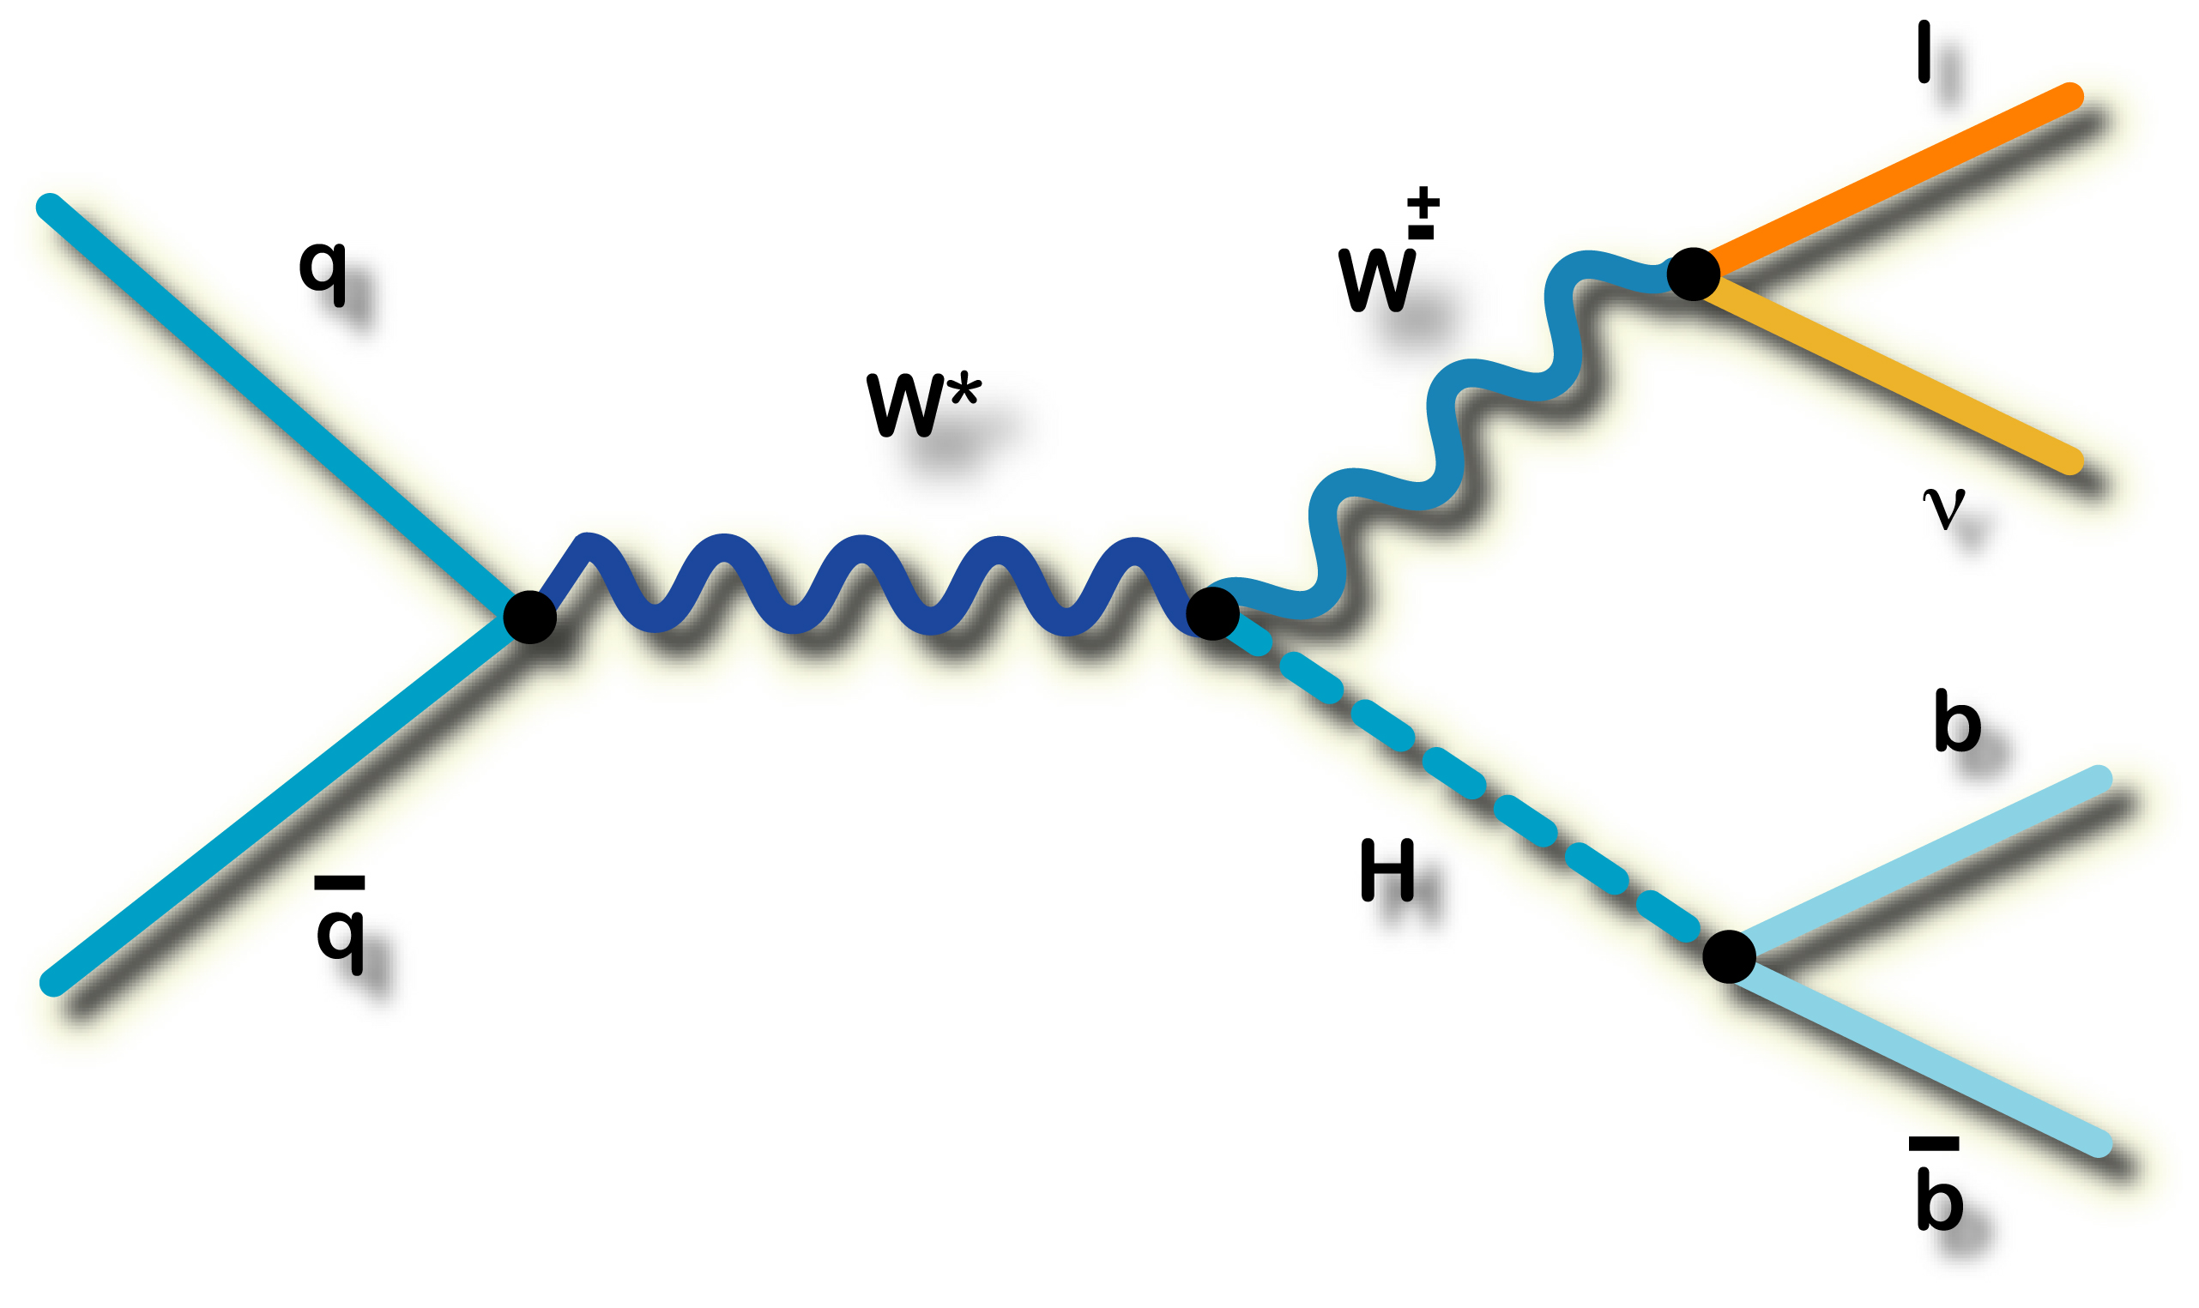
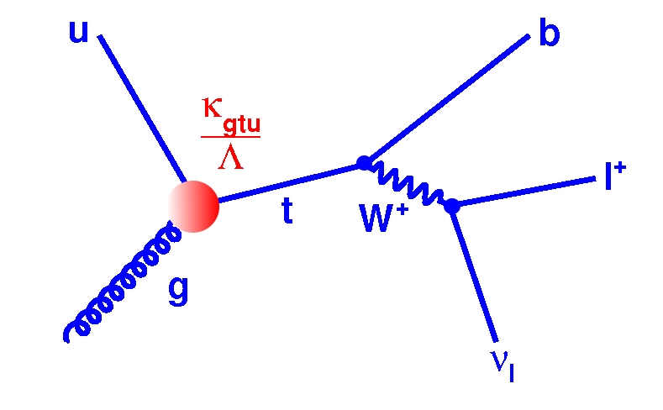
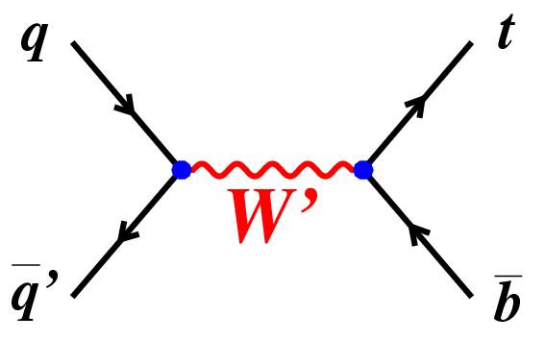
Why look for Single Top-Quarks?
Test of the SM prediction.
  Does it exist? ✔
  Cross section ∝ |V_{tb}|²
  Test unitarity of the CKM matrix, .e.g.
  Hints for existence of a 4th generation ?
  Test of b quark PDF: DGLAP evolution
At the Tevatron:
  Stepping stone to the Higgs.
  Same signature as WH.
  ➔ backgrounds are the same
Test non-SM phenomena
  Search W’ or H⁺ (s-channel signature)
  Search for FCNC, e.g. ug → t
  ...

Slide 4
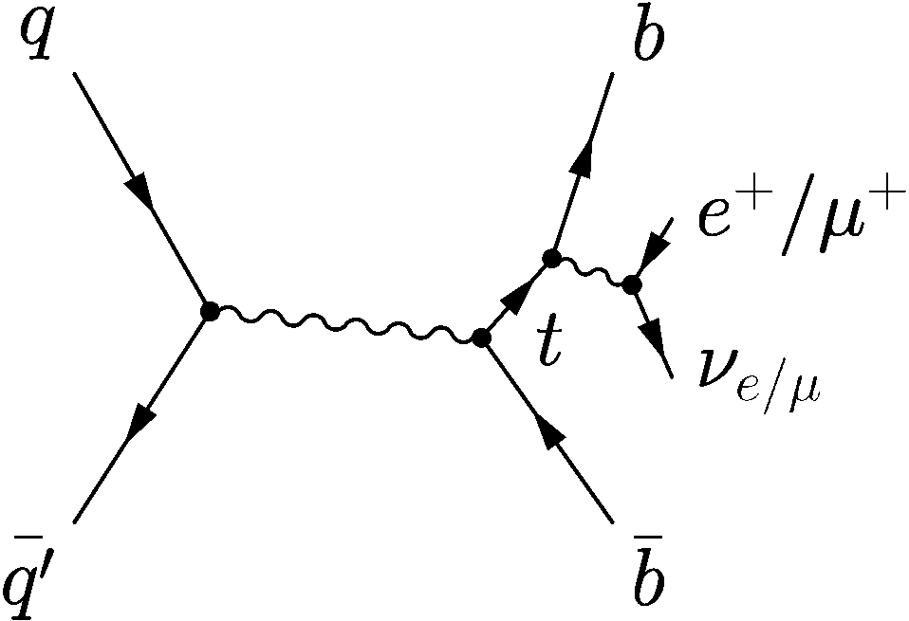
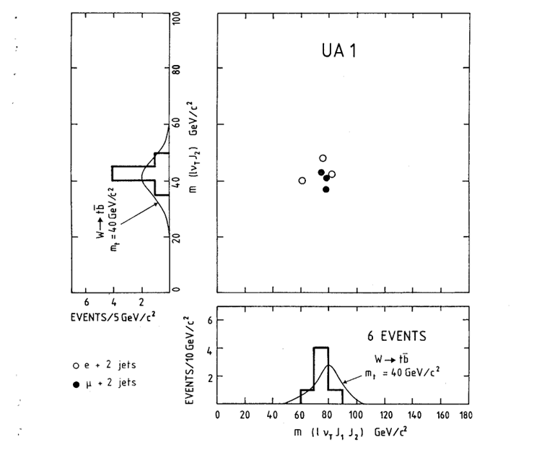
First Attempt to Discover (Single) Top …
… in 1984 by UA1 at CERN SppS
on-shell W boson
excess in M_{lνb} vs. M_{lνbb} scatter plot
compatible with m_{t} = 40 ± 10 GeV
later improved background estimate
→ background very challenging in single top
Phys. Lett. B 147, 493 (1984)

Slide 5
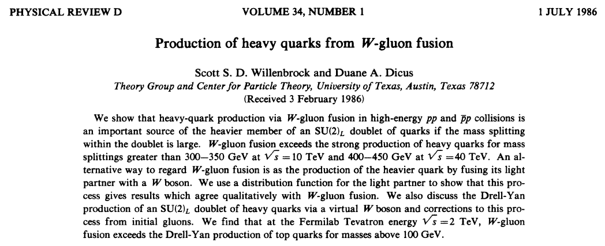
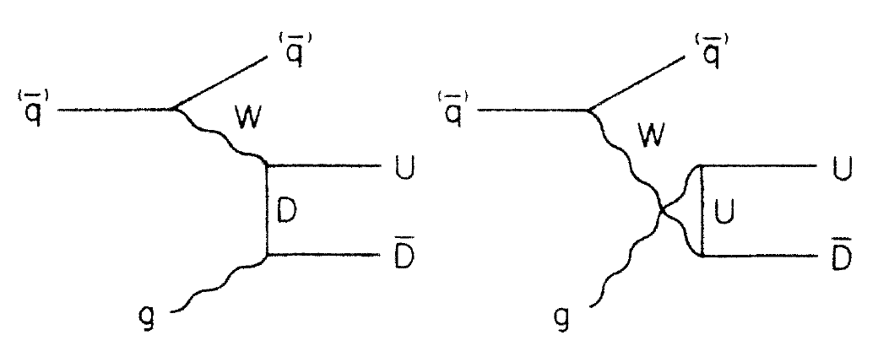
Recognition of the Relevance of the t-Channel

Slide 6
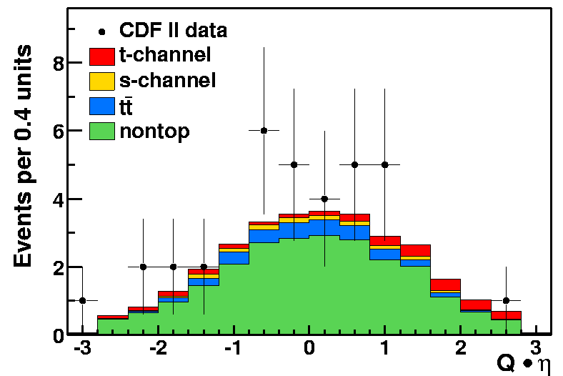
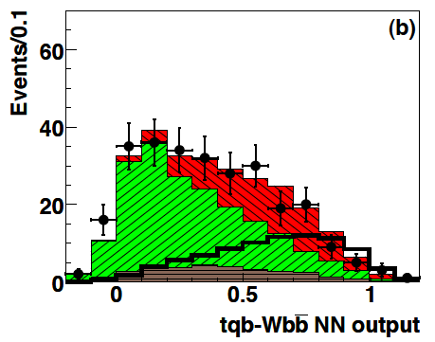
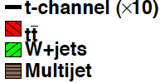
Single-Top Searches in Run I and Early Run II
Run I:
DØ, Phys. Rev. D 63 (2000) 031101
DØ, Phys. Lett. B 517 (2001) 282 – 294
(neural networks)
CDF, Phys. Rev. D 65 (2002) 091102
(H_{T} and Q·η fit)
CDF, Phys. Rev. D 69 (2004) 052003 (neural network)
CDF Run II (2005): Q·η fit
DØ Run II (2007): neural networks
Run II:
CDF, Phys. Rev. D 71 (2005) 012005
(H_{T} and Q·η fit)
DØ, Phys. Lett. B 622 (2005) 265 – 276
(neural networks)
DØ, Phys. Rev. D 75 (2007) 092007
(cut based and neural networks)
➔ cross section limits: 5 to 6 pb

Slide 7
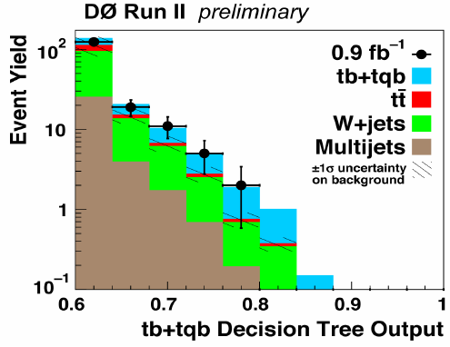
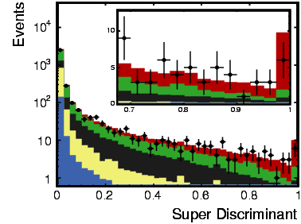
Evidence and Observation for Single-Top Production
Boosted decision tree analysis ( evidence at DØ, 2006)
Combined t-channel + s-channel analysis
Several multivariate analysis techniques.
Combination of analyses (not results).
Very intense checks on kinematic modeling.
Mainly relying on ALPGEN W+jets MC.
Signal models: CompHep (DØ) and MadEvent (CDF)
3.4 σ
Combination of all multivariate analyses
(observation at CDF 2009)
5.0 σ
Evidence Papers
DØ, Phys. Rev. Lett. 98 (2007) 181802, Phys. Rev. D 78 (2008) 012005
CDF, Phys. Rev. Lett. 101 (2008) 252001
Observation Papers
DØ, Phys. Rev. Lett.103 (2009) 092001.
CDF, Phys. Rev. Lett. 103 (2009) 092002,
Phys. Rev. D 81 (2010) 072003,
Phys. Rev. D 82 (2010) 112005.

Slide 8
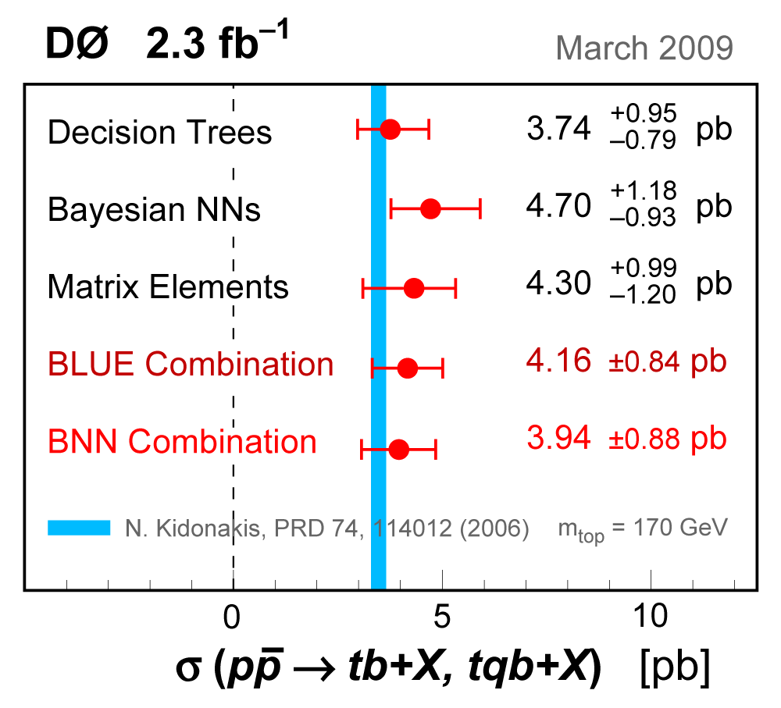
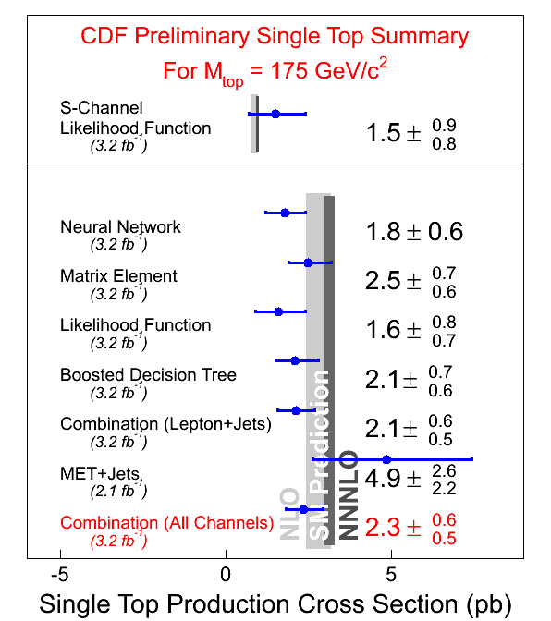
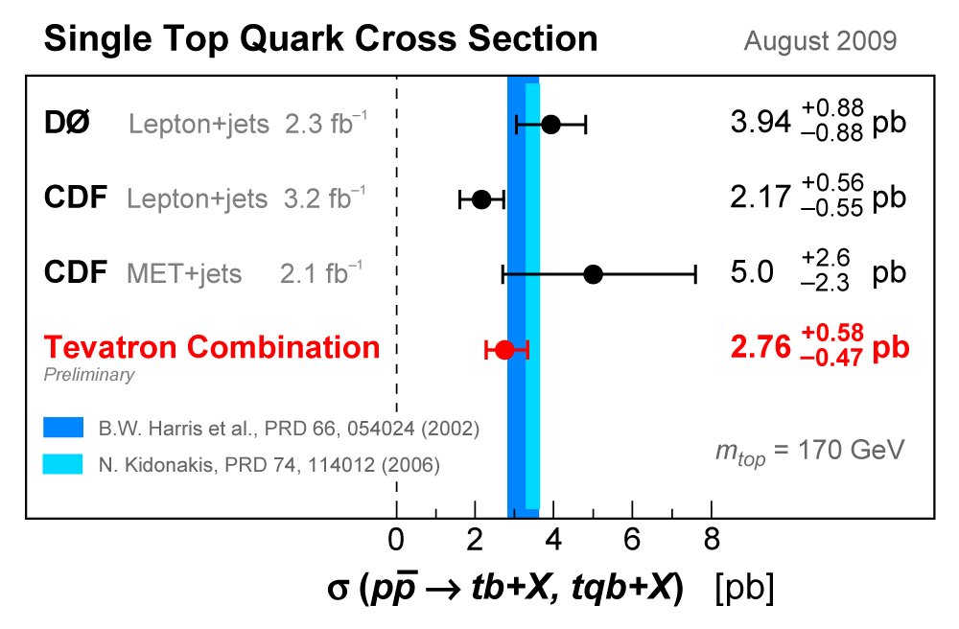
2 Experimental Status
status of Tevatron measurements

Slide 9



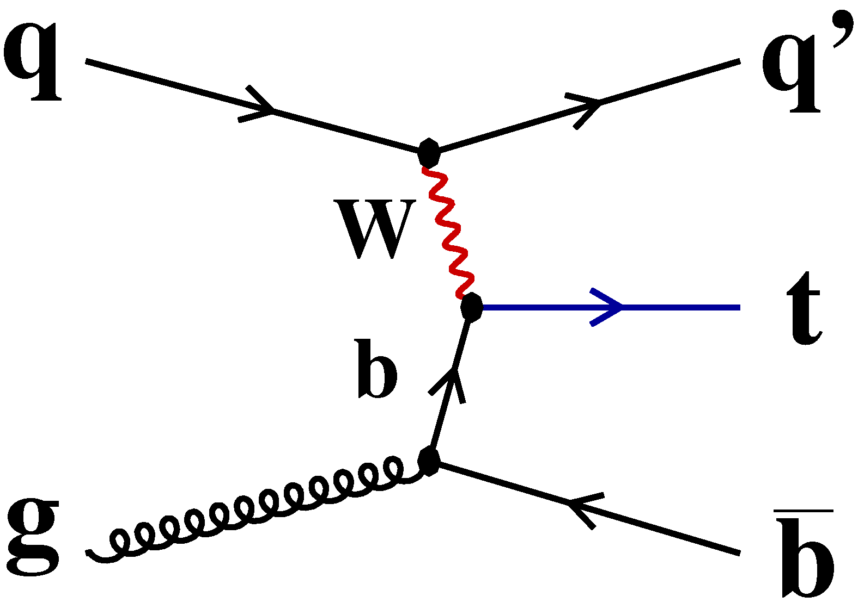
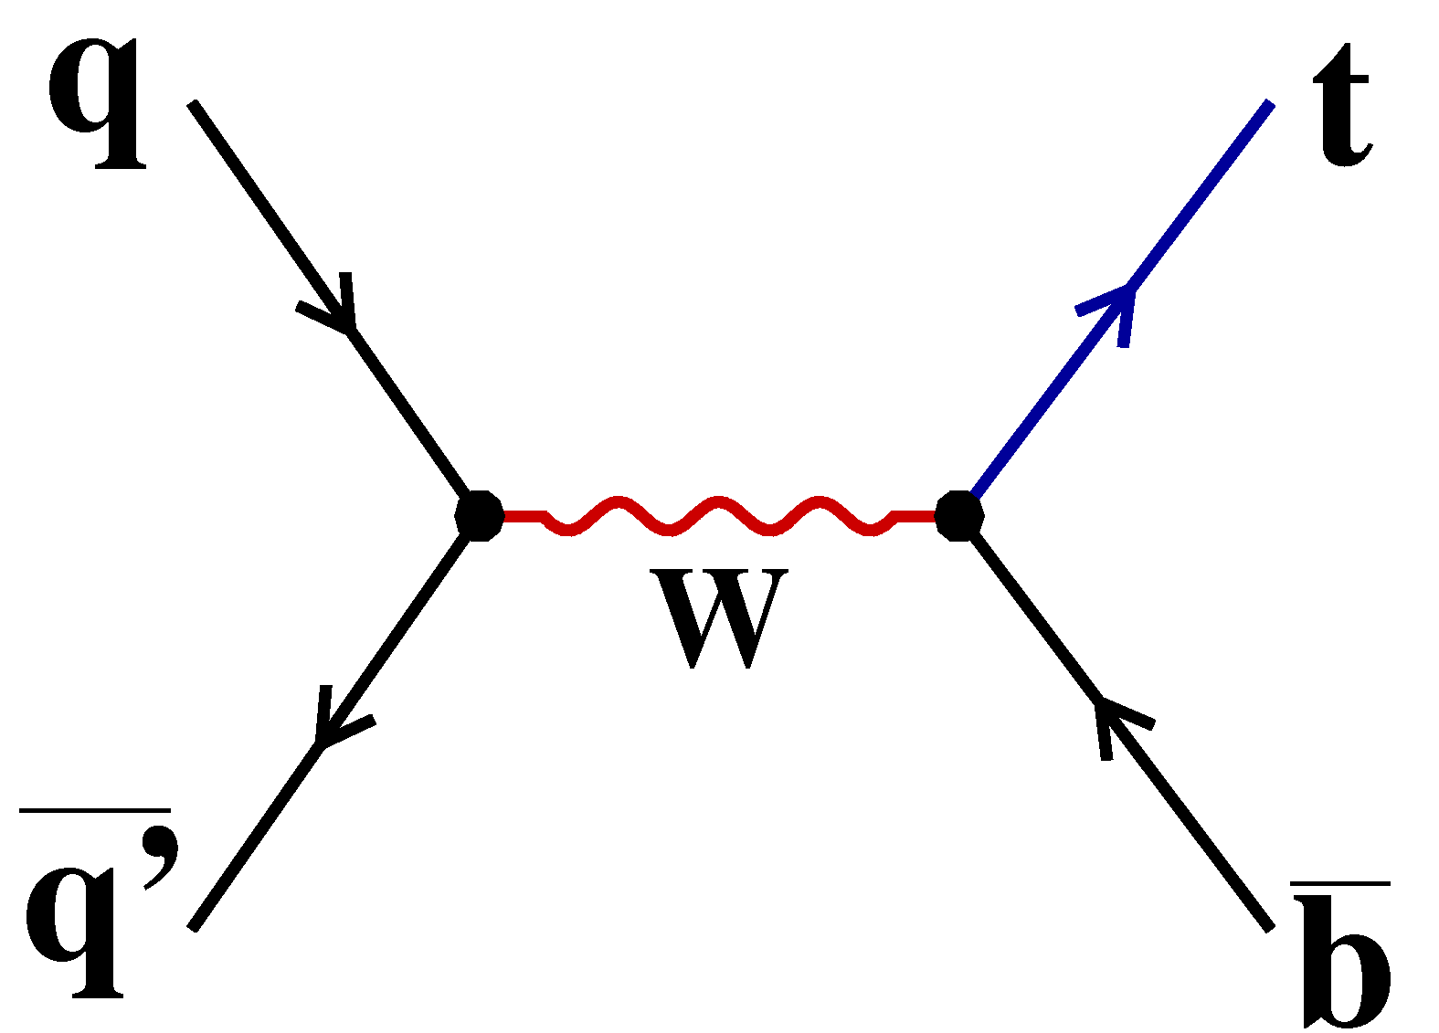
|V_{tb}| Determination
Using cross section result measure |V_{tb}|
Assume Standard Model (V-A) coupling
and |V_{tb}| >> |V_{ts}|, |V_{td}|
(from BR(t →Wb) measurements)‏
|V_{tb}|
|V_{tb}|= 0.88 ± 0.07 (stat+syst) ± 0.07 (theory)
CDF and DØ Collaborations:
arXiv: 0908.2171 [hep-ex]

Slide 10
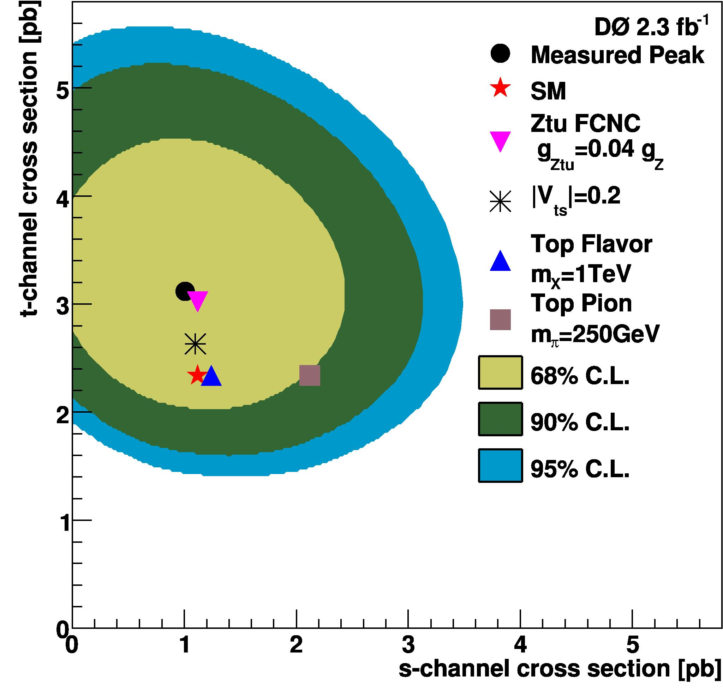
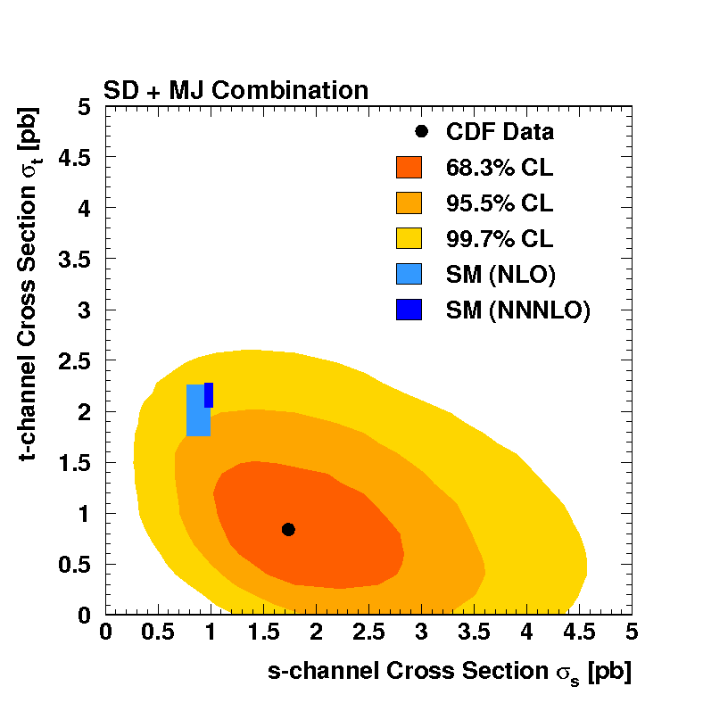
Separation of t-channel and s-channel
Measure σ_{s} and σ_{t} separately
Interesting because s- and t-channels have different sensitivity to BSM models
Train dedicated s-channel and t-channel discriminants and fit 2D
Phys. Rev. D 82 (2010) 112005
Phys. Lett. B 682 (2010) 363 – 369
σ_{t-channel} = 3.14 ^{+ 0.94} pb
σ_{s-channel} = 1.05 ± 0.81 pb
σ_{t-channel} = 0.8 ± 0.4 pb
σ_{s-channel} = 1.8 ^{+0.7} pb
_{− 0.80}
_{−0.5}
ME

Slide 11

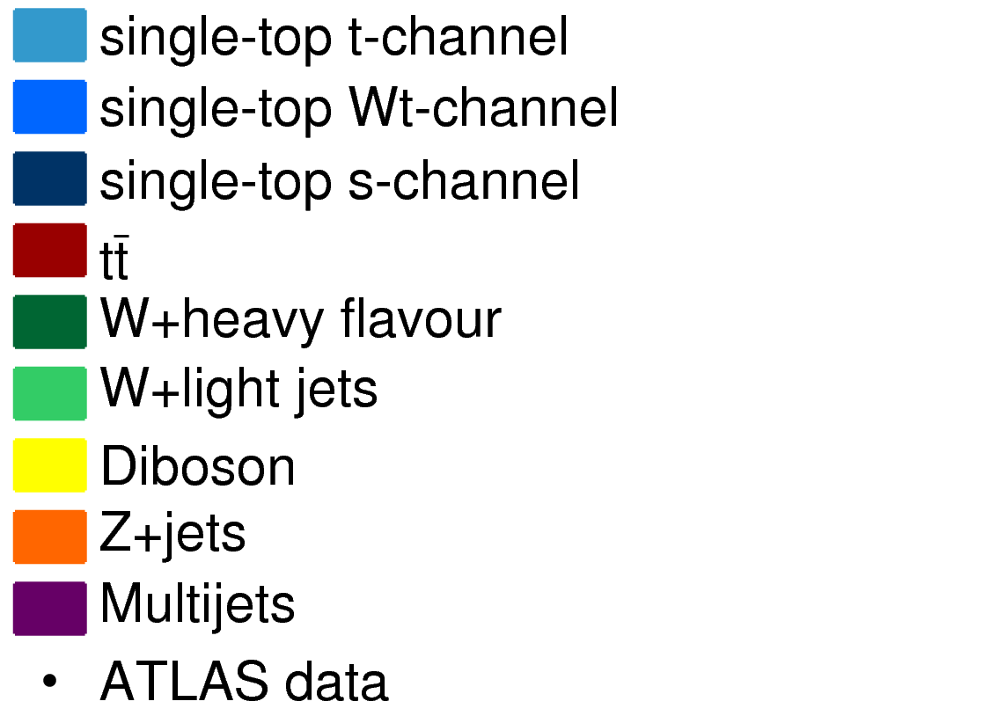
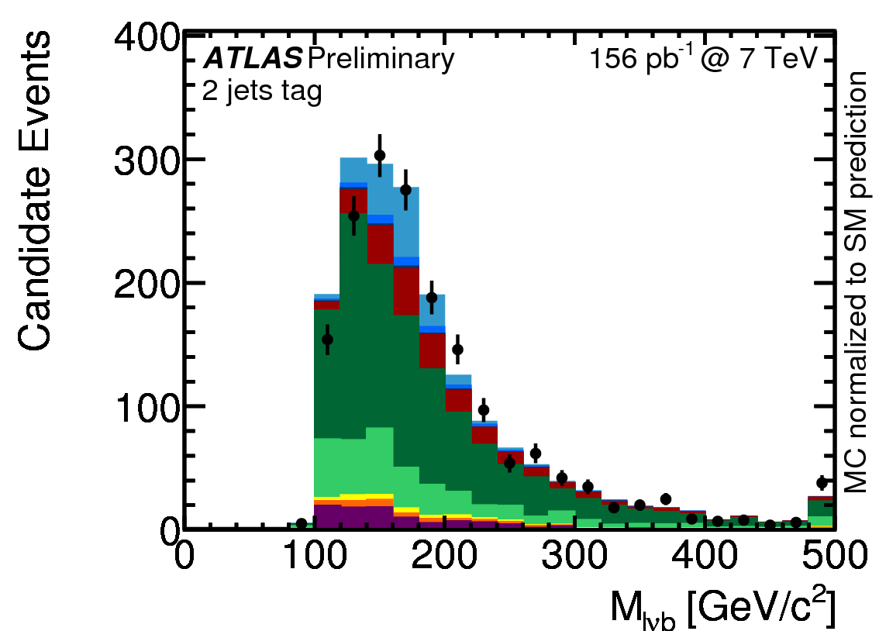
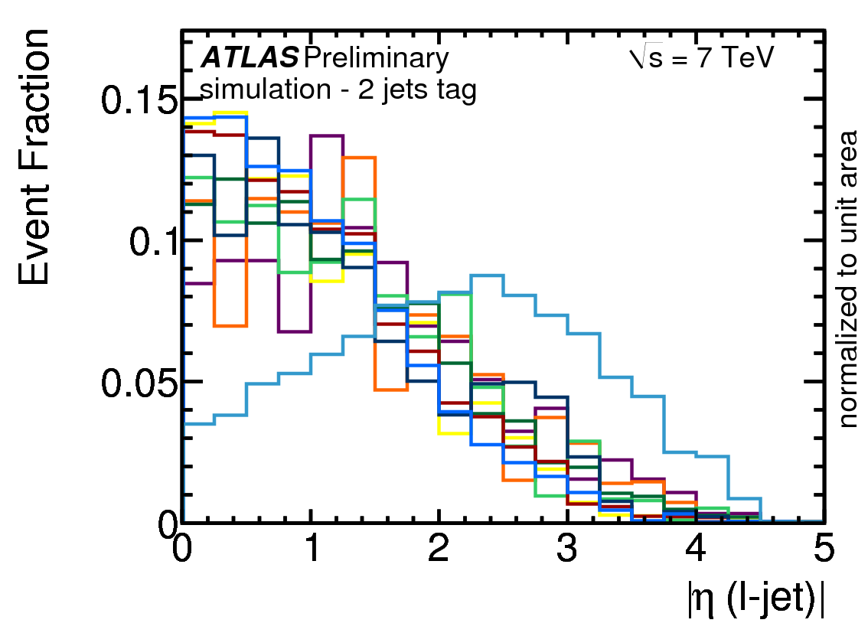
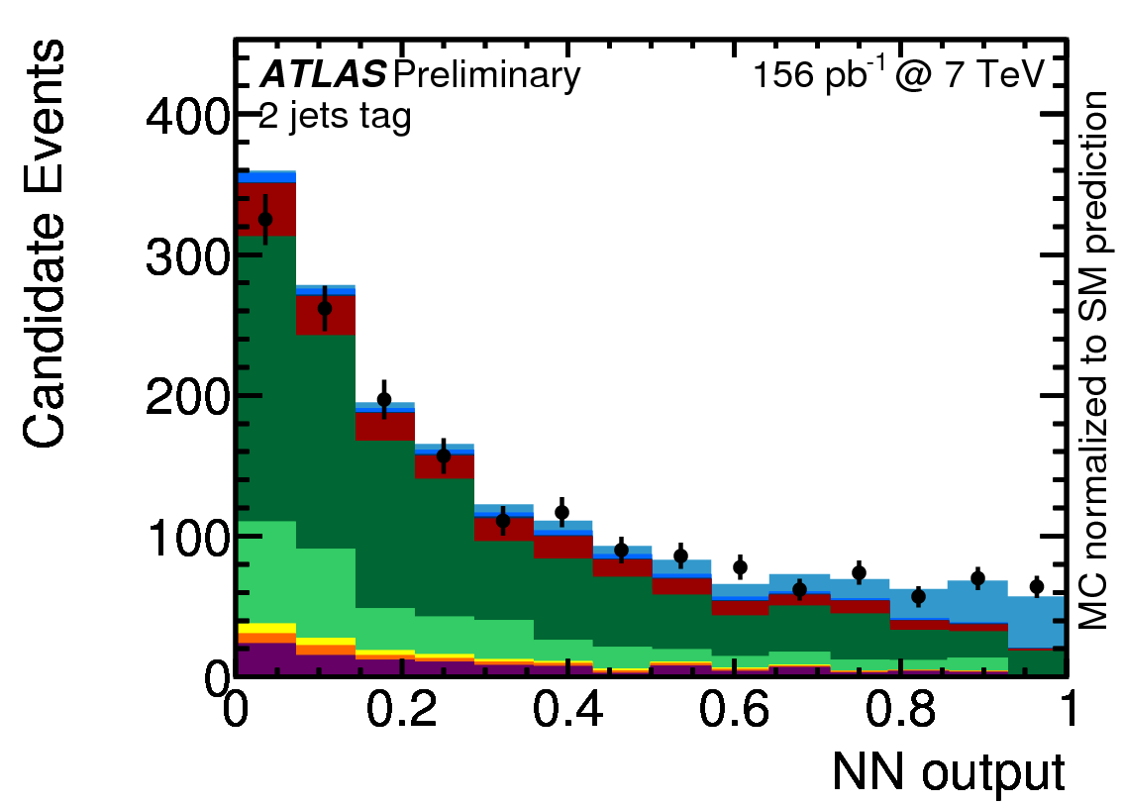
t-Channel Cross Section at ATLAS
Better S/B (= 10.1%) after event selection than at Tevatron (6.9%).
Very good acceptance for forward jets: |η_{det}| < 4.5.
Neural network analysis + cut based as cross check.
ATLAS-CONF-2011-088
Observed significance: 6.2 s.d.
Expected: 5.7 s.d.
σ (t-ch.) = 76 ⁺⁴¹₋₂₁ pb

Slide 12

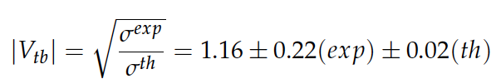

t-Channel Cross Section at CMS
Boosted decision tree analysis
2D-analysis: η(light jet), polarisation angle cos θ (light jet, lepton)_{top r.f.}
χ² combination of results
CMS PAS TOP-10-008
muon
channel
σ (t-ch.) = 84 ± 30 pb
Extraction of |V_{tb}|:
muon
channel
using
NLO prediction in the 5-flavour scheme,
Campbell, Frederix, Maltoni, JHEP 10 (2009) 042.

Slide 13
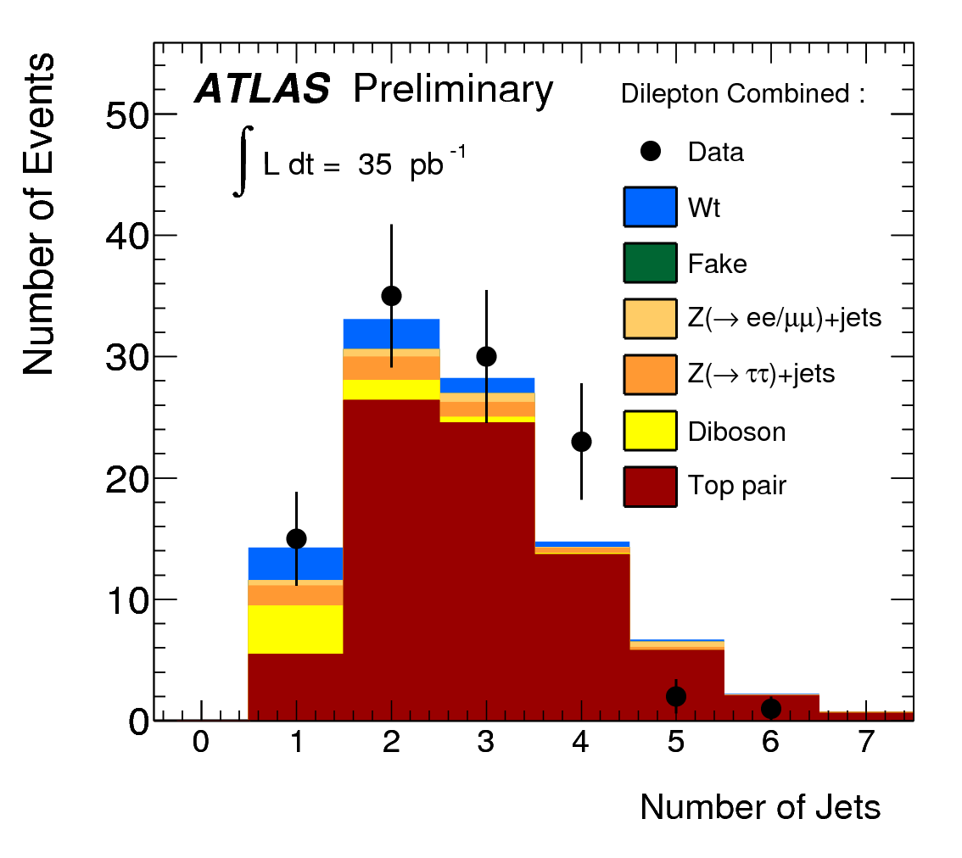
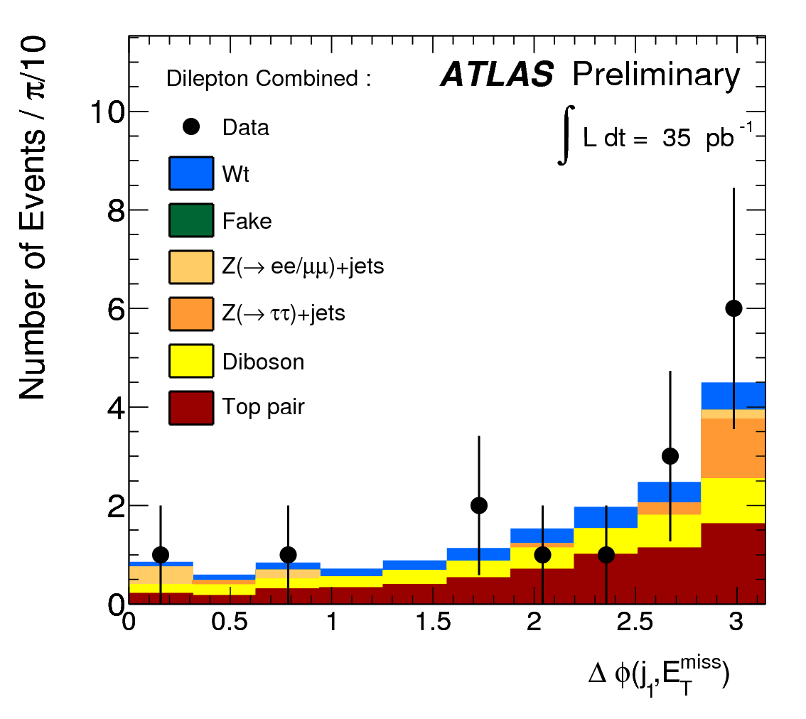
Search for Wt Production
signal region:
1 jet only
ATLAS-CONF-2011-027
Dilepton channel more sensitive than lepton+jets channel.
σ (Wt) < 158 pb at the 95% C.L.

Slide 14
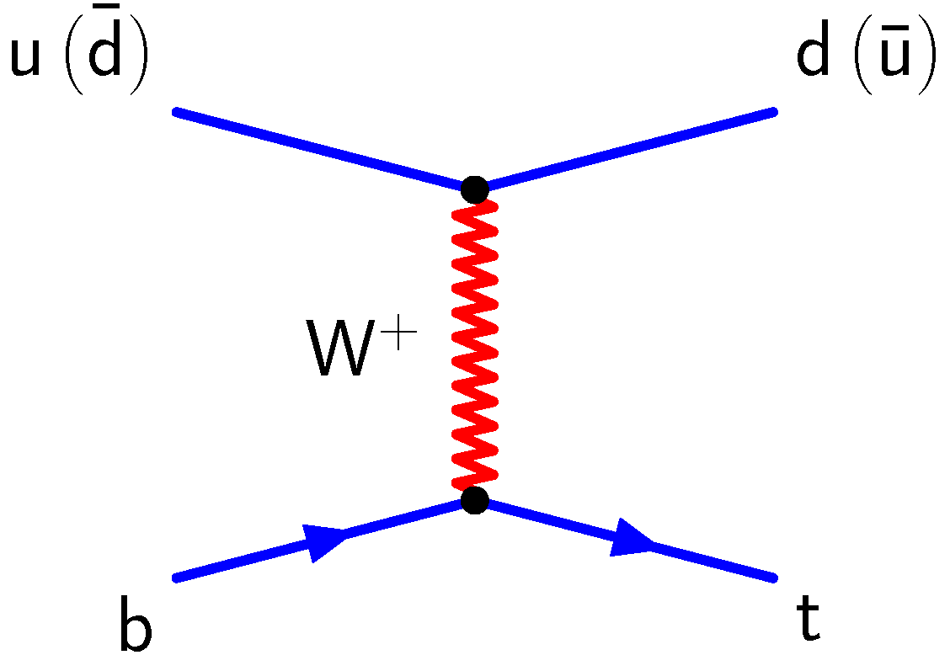
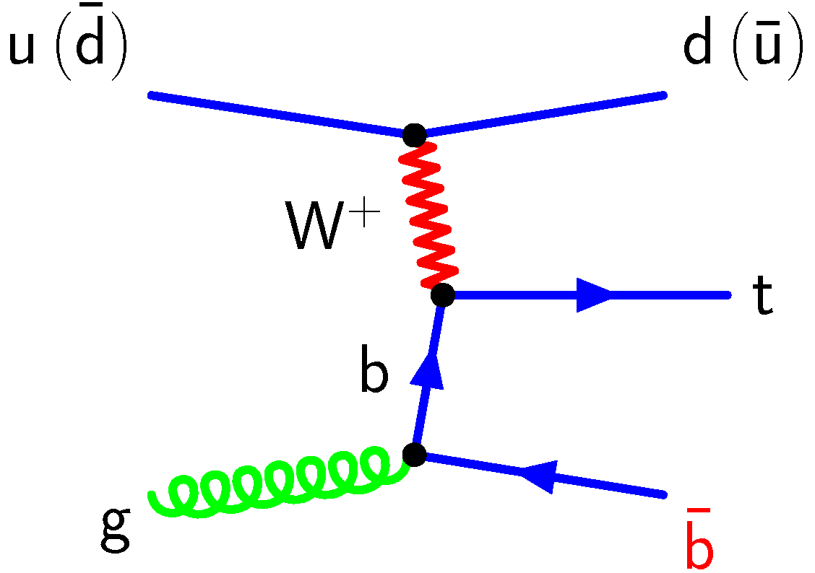
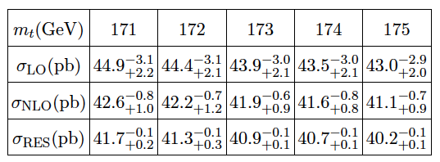
3 Prospects – Single Top as a Benchmark
Theory:
To extract V_{tb} we need the theory cross section as input.
Assume unitarity in 3 generations ➔V_{tb} known,
test other theory aspects
Two issues of recent discussion:
a) 5 flavour vs. 4 flavour scheme
Small effect on total cross section
Relevant for differential cross sections, particularly 2nd b-quark
➔modeling
See calculations: Campbell, Frederix, Maltoni, JHEP 10 (2009) 042.
b) Influence of soft gluon effects: resummation at NNLL level
N. Kidonakis, Phys. Rev. D 83 (2011) 091503 (arXiv 1103.2792), Phys. Rev. D 82 (2010) 054018 (arXiv 1005.4451), Phys. Rev. D 81 (2010) 054028 (arXiv 1001.5034).
H.X. Zhu, C.S. Li, J. Wang, J.J. Zhang, JHEP 1102 (2011) 099 (arXiv:1006.0681), arXiv:1010.4509.

Slide 15
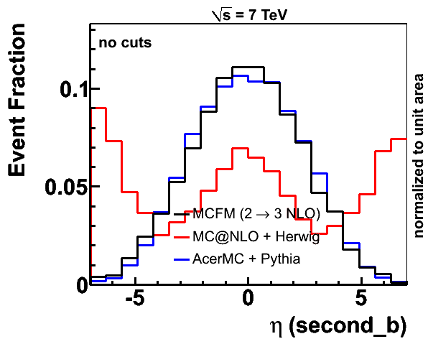
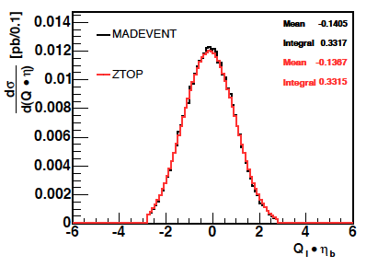
Modeling of Single-Top Events: Example 2nd b Quark
from b-quark structure function
flavour conservation (in strong interaction):
2nd b from shower MC (DGLAP evolution)
Problem in MC@NLO:
Solution:
matching of bu → td and gu → tdb_{bar} processes
→ excessive uncertainty on signal acceptance in ATLAS analysis

Slide 16
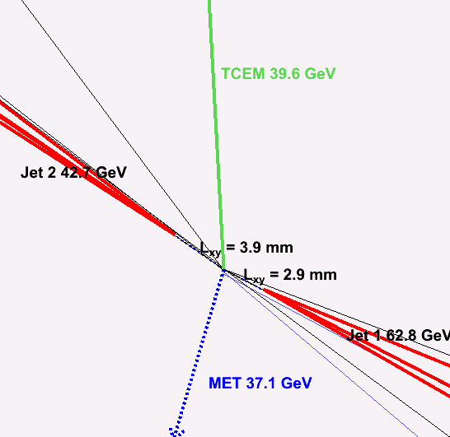
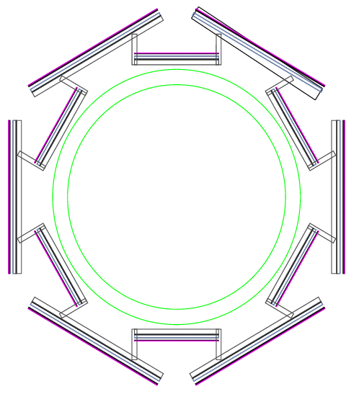
Single-Top: Test Bench for Object ID
Single-top events feature all important objects of high-p_{T} physics:
  electrons
  muons
  missing ET
  jets, especially forward jets
  b-tagging
Backgrounds much more severe for single top than top-pairs
➔ a much better understanding is needed
➔ driving force for new developments, for example:
multijet veto, electron fake event model (CDF, ATLAS), neural network b-tagger (CDF and DØ), forward electron id (CDF), MET+jet trigger for untriggered muons (CDF), forward jet calibrations (ATLAS), …
Source of Uncertainty | Δσ /σ
statistical only | +17% / -16%
JES | +18% / -3%
JER | +4% / -3%
jet reconstruction | 3%
lepton SF | 1%
b-taggging SF | +12% / -9%
light-jet mistagging SF | 2%
Uncertainties due to instrumental sources of ATLAS (PLHC) analysis (ATLAS-CONF-2011-088):

Slide 17
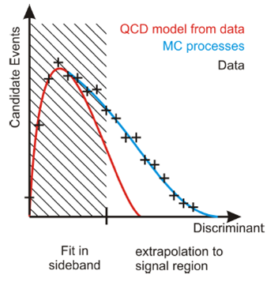
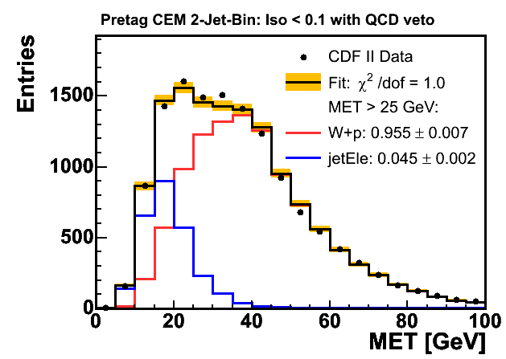
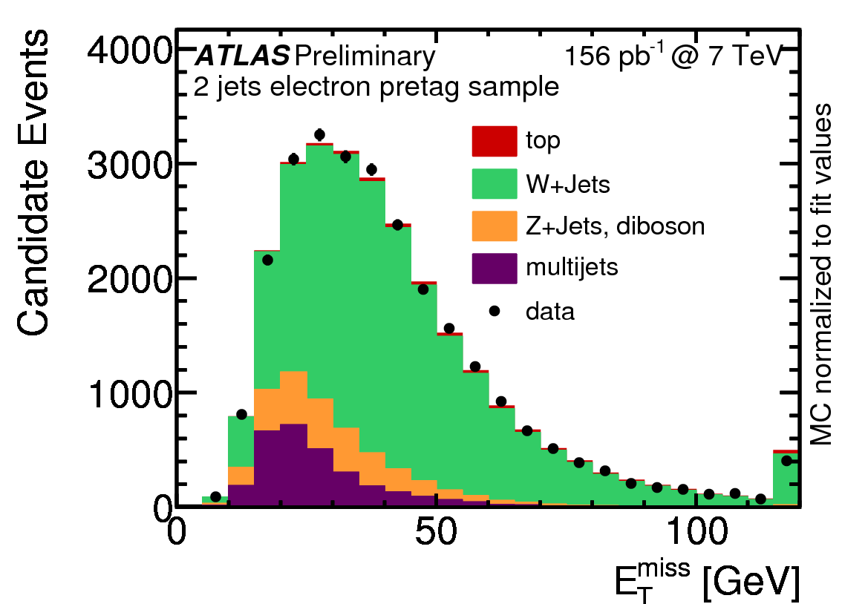
Estimation and Modeling of Multijet Background
pretag data
fit discriminant distribution (e.g. MET) to estimate rate of multijets background
model misidentified multijet background with jet-triggered events (jet-electron model)
full event model to facilitate multivariate analyses

Slide 18
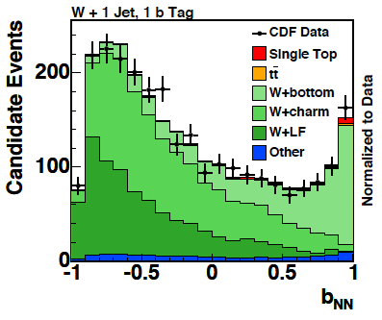
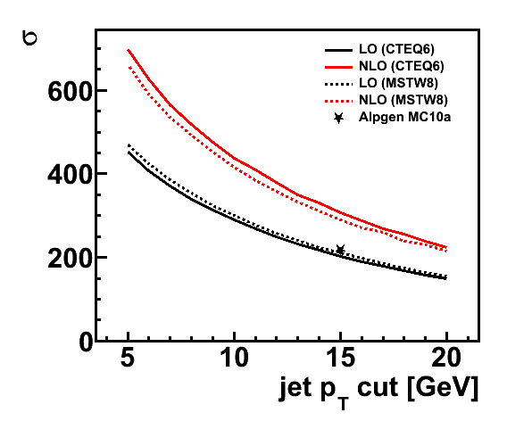
W + Heavy Flavour Jets
Observe more W + heavy flavour events after b-tagging than expected from ALPGEN + tagging efficiency.
True even after normalizing jet-bin-by-jet-bin in the pretag data set.
Unknown higher orders.
Pragmatic resolution:
measure HF scale factors in data
Problem: extrapolation from sideband
Better: simultaneous fit in signal region.
Recently a lot of activity in theory, for example new version of MCFM.
➔get k factor from theory
Fit to NN flavor separator in sideband
K_{HF}=1.4 ± 0.4
Phys. Rev. D 82 (2010) 112005
Wc cross section
MCFM
Work by Dominic Hirschbühl
K_{Wc}=1.52 ± 0.24

Slide 19
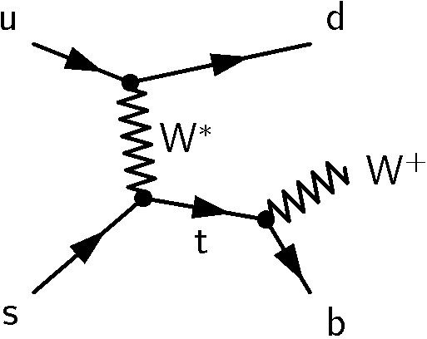
Can we learn about V_{ts} and V_{td} ?
So far consider only production via V_{tb}.
How about production via V_{ts} and V_{td}?
d
in SM: σ_{s} = 0.4% ·σ_{b}
in SM: σ_{d} = 0.1% ·σ_{b}
Need samples of simulated events to compute efficiencies.
Need also to consider different top decay modes (t → sW, t → dW), but low sensitivity due to missing option to flavour-tag.
Limits on |V_{ts}| and |V_{td}| at the 10% level may be possible in the long run.

Slide 20
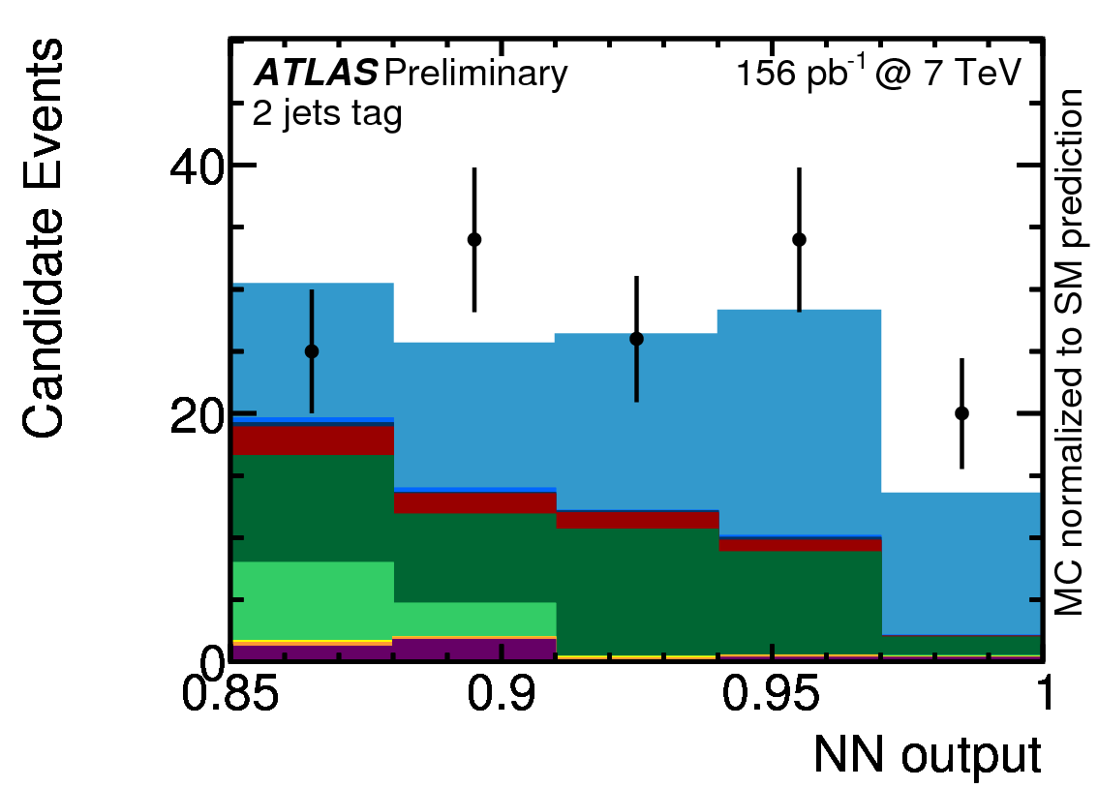
Summary
Tevatron measurements of V_{tb} are still world´s best.
|V_{tb}|= 0.88 ± 0.07 (stat+syst) ± 0.07 (theory)
At LHC, ATLAS (6.2σ) and CMS (3.7σ) have observed t-channel production.
Single top is an important SM benchmark.
  Theory: 4 flavour / 5 flavour scheme
  b-quark PDF
  MC generators: 2nd b quark
  Experimentally: Object ID
  lepton fakes, forward jets, b-tagging
  W+jets: heavy flavour fractions
Important for credible discoveries of “new” physics!

Slide 21
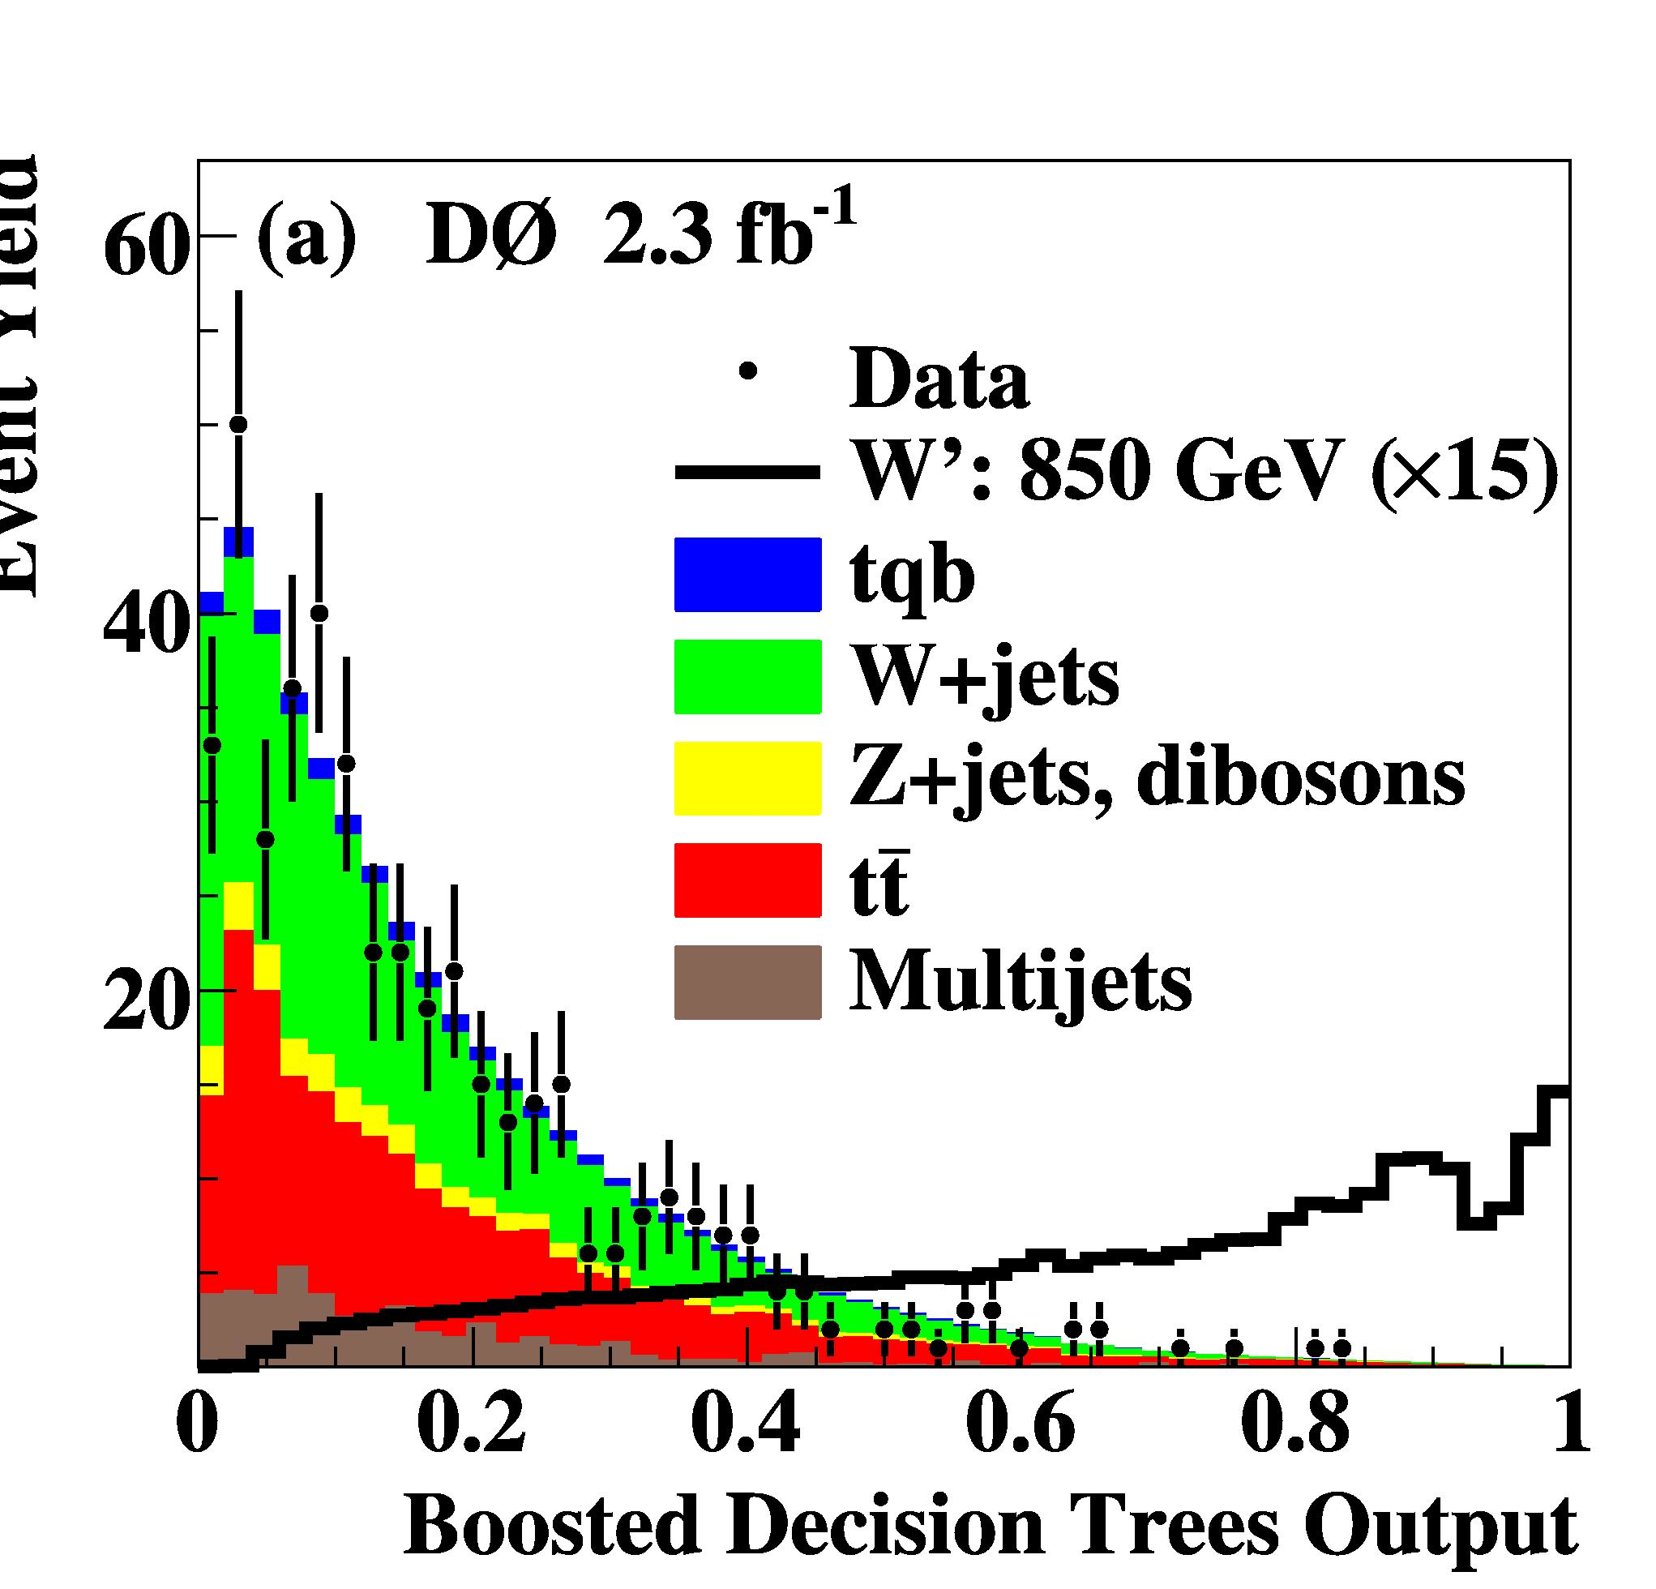
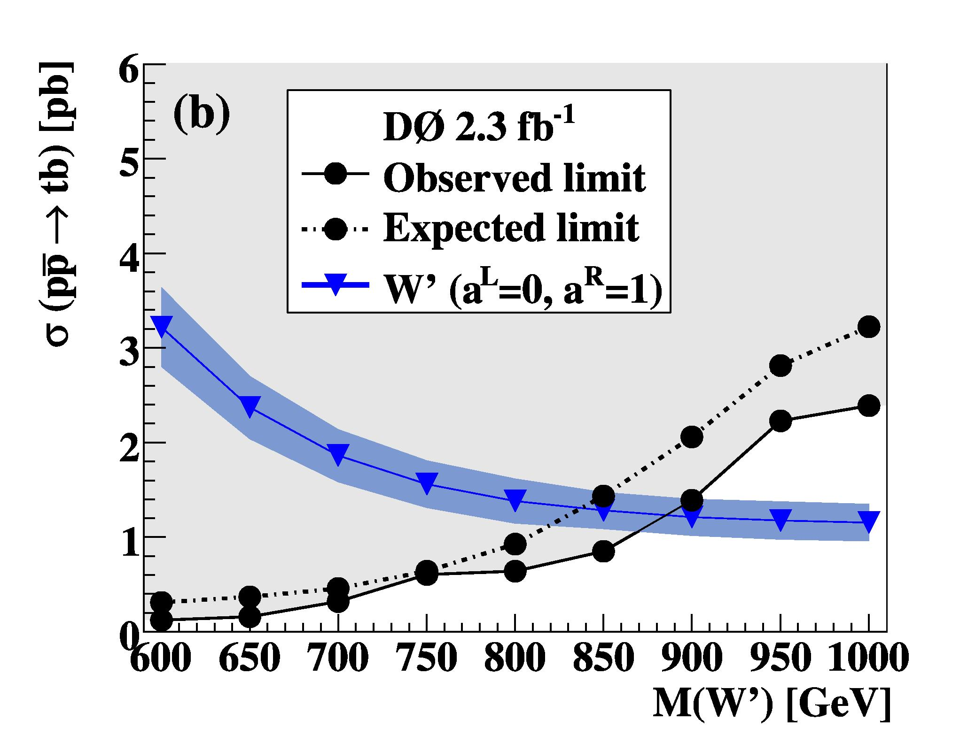
Search for W´ → tb Events
Investigate different left- and right-handed couplings to fermions.
Limits vary based on assumptions of couplings:
m(W´) > 863 .. 916 GeV
Phys. Lett. B 699 (2011) 145 – 150

