Slide 1
GPB Clear testbeam
DAQ monitoring status

Slide 2
Testbeam monitoring
What we expect:
Monitor amplitude, charge and signal width.
Monitor the ratio wrt beam parameters
Plot an average signal (averaged over 10? signals) shape
Status:
The CLEAR team will provide a MATLAB monitoring GUI and data logging
I prepared for them a draft of a script calculating essential signal quantities
I also created a script that plots the quantities for them to use as GUI design guideline

Slide 3
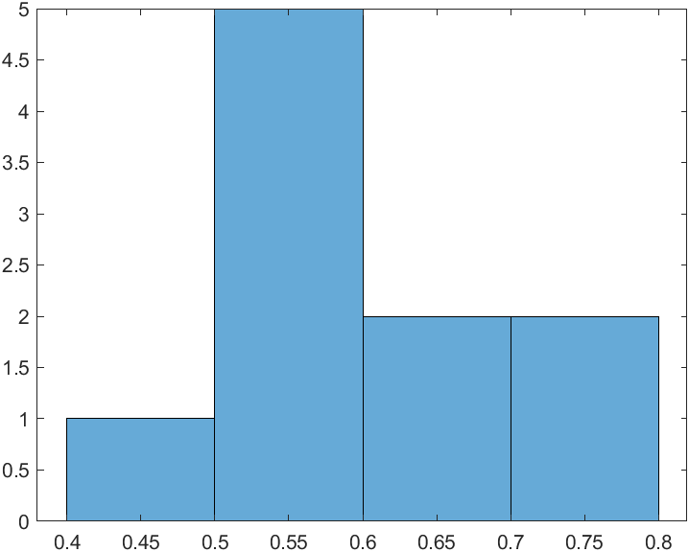
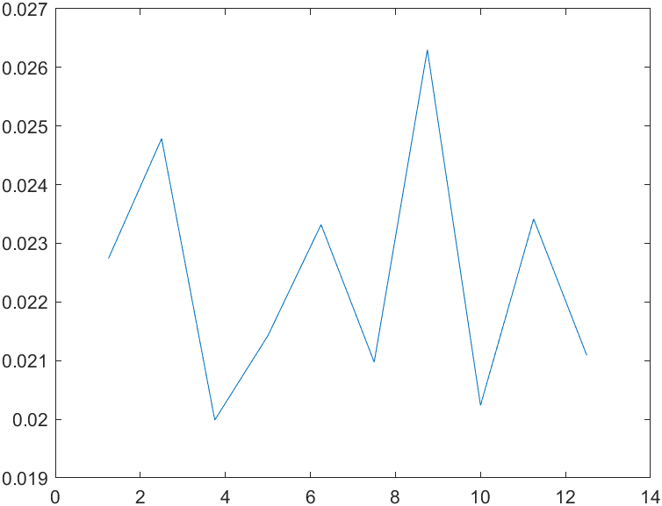
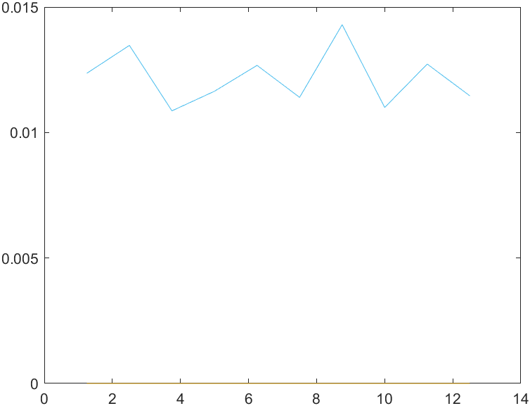
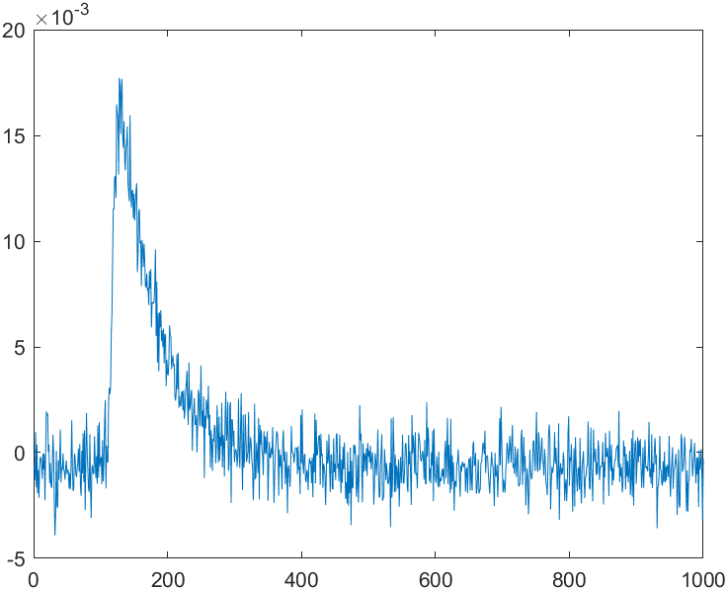
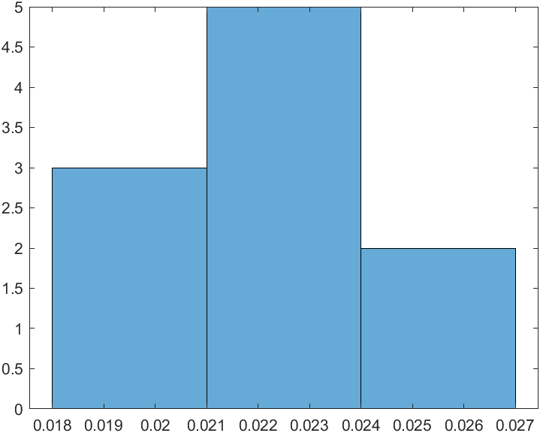
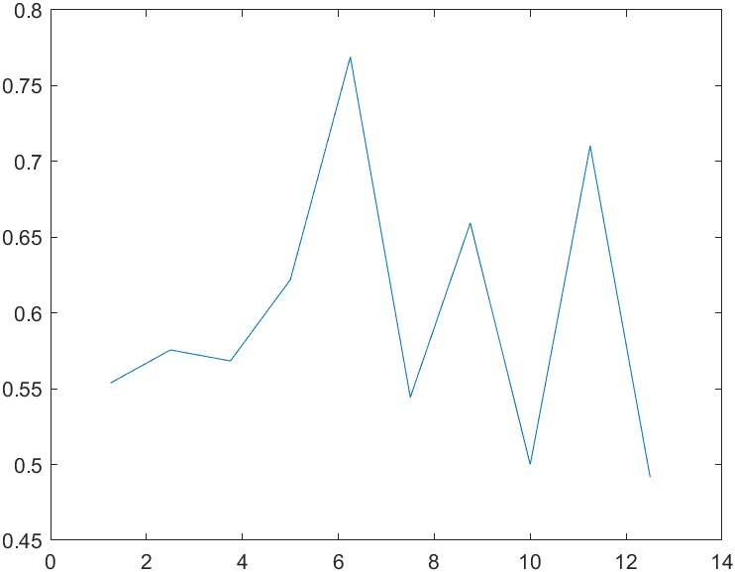
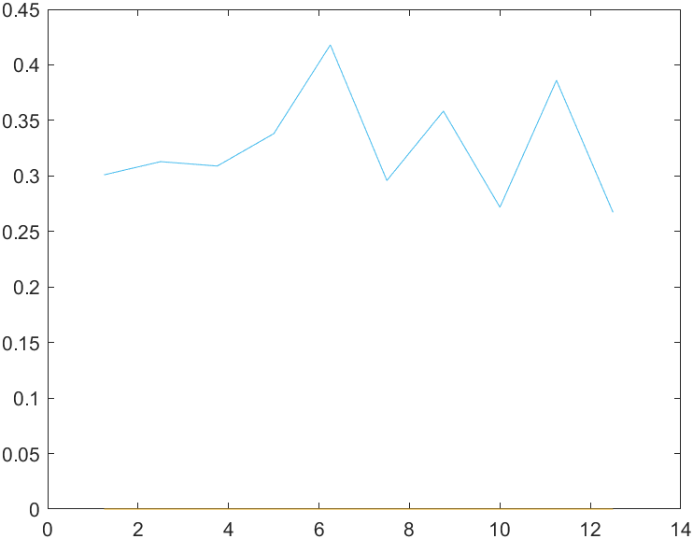
Example plots
We received a sample MATLAB dataset of an optical fiber testbeam
Charge plots
VS time
Distribution
historgram
Ratio to beam intensity
Average signal
Baseline subtracted
Amplitude plots

Slide 4
Status
I sent the CLEAR team the scripts based on their dataset
I am waiting to know if the scripts are ok or if they need something different to integrate
GUI and script integration expected for next week
Questions:
From what I understand we should test 12 channels simultanously, is this correct?
If you have any other thing you need monitored or any other suggestion, let me know

