Slide 1
ARES Operation Meeting
Summary of week 33 / 2022
Blae Stacey, on behalf of the ARES crew

Slide 2
Summary of week 33
 | Mon. 15th August | Tue. 16th August | Wed. 17th August | Thu. 18th August | Fri. 19th August
Achievements | Software updates on all Windows PCs; JDDD updates. | MPC works on EAQZM3 with magnet permission; Ramping up RF; Debugging and testing Marleen’s wire scan tool; Overnight: quad scan measurement in y. | Wire scans; Checking reproducibility of single wire scans and improving reconstruction analysis; Quad scan; Preparing machine for STRIDENAS measurements. | STRIDENAS beam profile measurements (300, 500, 700 fC); Calibration measurements for different sensor bias voltages (300, 240, 180 V); Overnight: quad scan measurement. | Stopped overnight measurement, realigned beam on EAMQZM3 and on EA.A1, and restarted measurement with fewer data points; Quad scan with EAMQZM1 and 2 (QZM3 at compensation current); Ramped down RF. SATURDAY: ARES ramped down for Monday maintenance.
Difficulties |  |  | TWS2 in FAULT – reset using the panel. |  | TWS2 in FAULT – restarted locally SATURDAY: TWS2 modulator again in FAULT, couldn’t be reset locally, turned off.

Slide 3
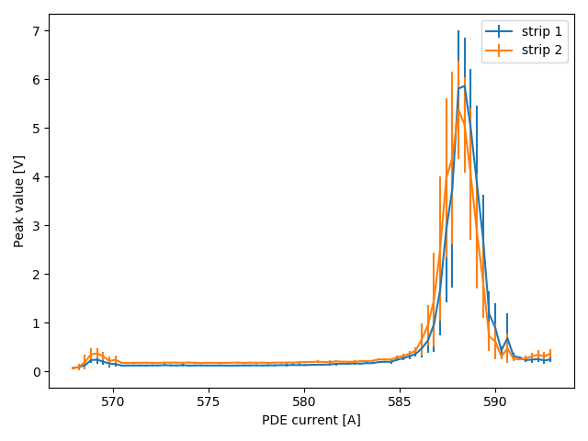
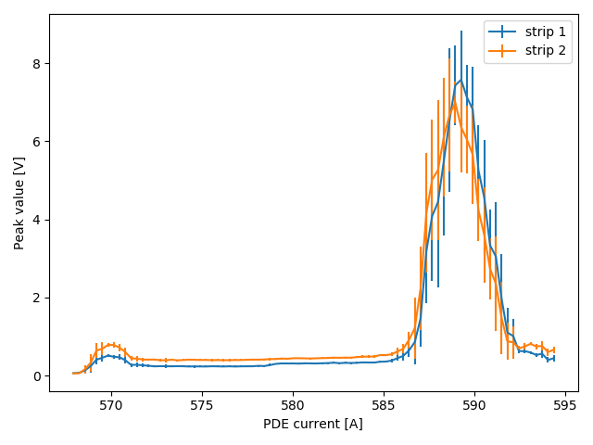
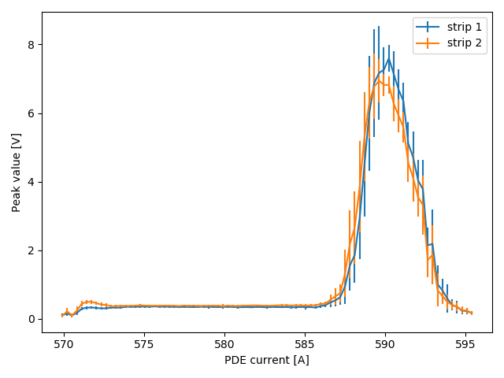
Beam profile measurements with Stridenas detector
300 fC, 300V
500 fC, 300V
700 fC, 240V
PRELIMINARY!
PRELIMINARY!
PRELIMINARY!

Slide 4
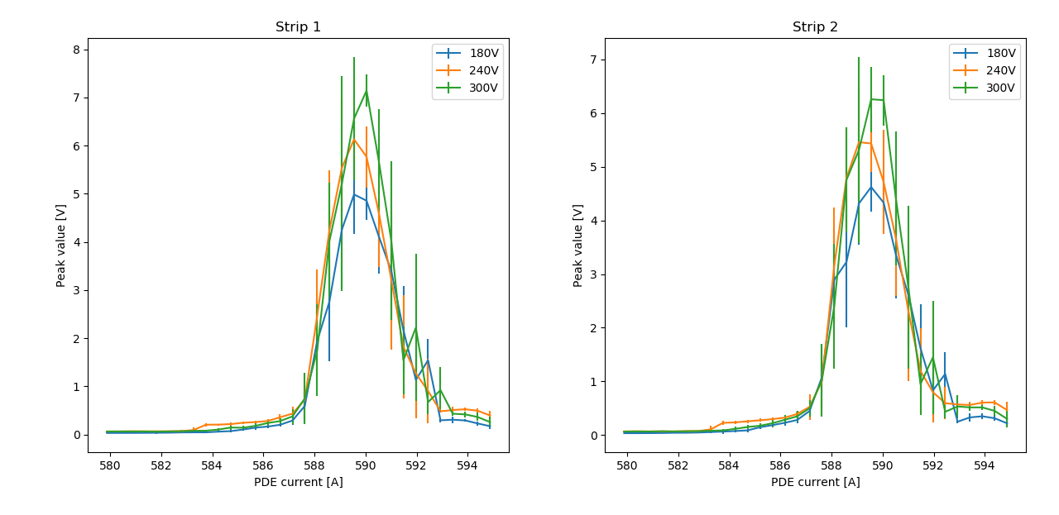
Comparing measured profiles with different sensor bias voltages
PRELIMINARY!

Slide 5
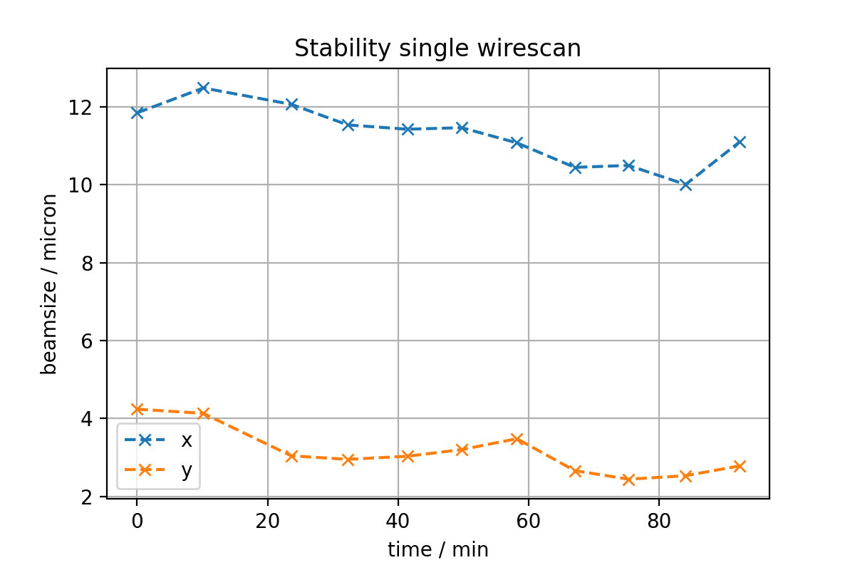
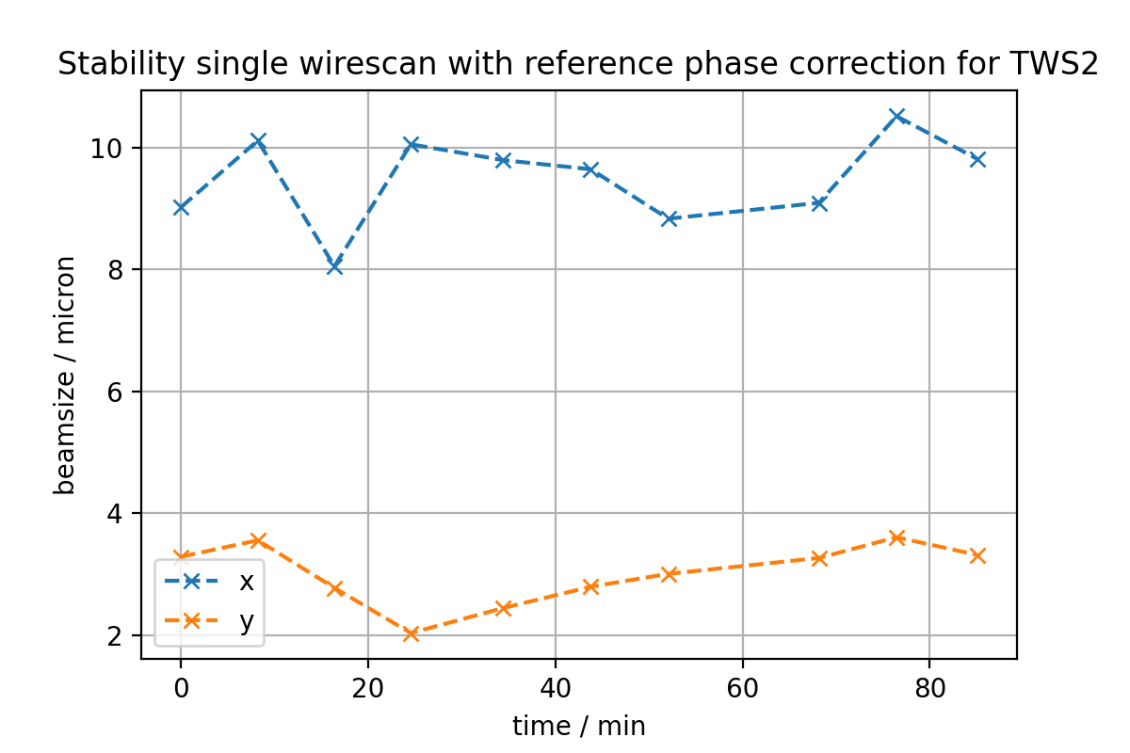
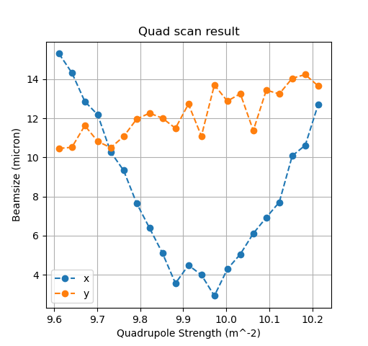
Wire scan and quad scan measurements
Using EAMQZM2

Slide 6
Today
Installation of the in-air ICT – with pre-amplifiers to be tested this week.
MEA&BAU: investigating drainage system for the tunnel
MIN&MPC&MEA: grounding system for the Xband Modulator room.

Slide 7
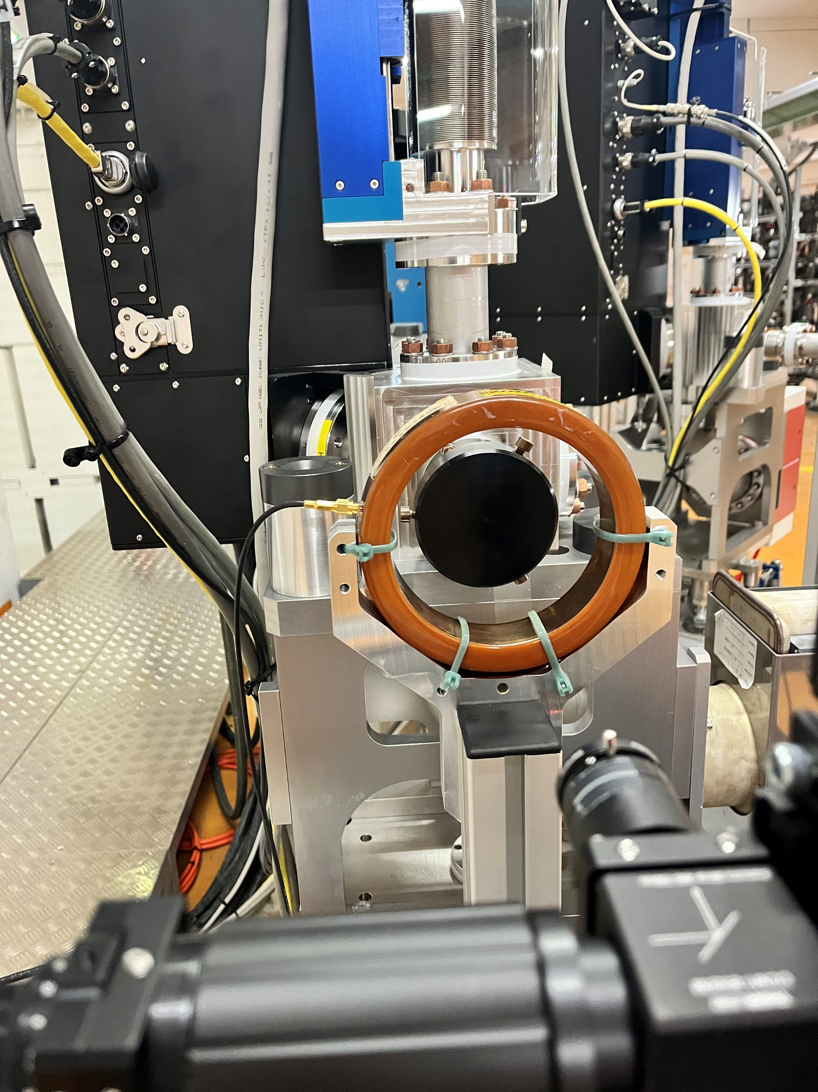
ICT

Slide 8
Plans for this week
Continue quad scans at wire scanner
New DLA structure
ACHIP beam time
AA shift on Thursday
Beam instrumentation test by MDI

Slide 9
Schedule
Week 34
Date | Schedule
22.08. | Tunnel open
23.08. | Frank Mayet
24.08. | Willi Kuropka
25.08. | Hannes Dinter
26.08. | Thomas Vinatier
If you want to learn or join the shift: please give the shift leader a call (BKR 2840 / SINBAD Box 2454)

