Slide 1
Linearly polarized coherent bremsstrahlung beam
A.Potylitsyn
B.King

Slide 2
Coherent Bremsstrahlung Process (CBS)
Sharp peaks occur in the bremsstrahlung spectrum due to a fixed recoil momentum during interaction of ultrarelativistic electrons with nuclei placed in a crystalline lattice (CBS process).
Lattice atoms thermal vibration leads to an appearance of a continuous incoherent component in a CBS spectrum.
Position and monochromaticity of such peaks as well as photon polarization depend on crystal structure, its orientation and photon beam collimation.
A diamond crystal is the uniquely target to produce CBS beams due to high Debye temperature, high thermal conductivity and radiation hardness.

Slide 3
Polarization
For “hard” collimation of the CBS photon beam an incoherent component of the spectrum is much less than coherent one.
Neglecting by an incoherent component the estimation of the maximal linear polarization is following ($E_{g}$ is the CBS peak photon energy, $E_{0}$ is the incident electron energy):
$P_{max}$ $\overset{→}{.} 2 \frac{\left(1−E_{g}/E_{0}\right)}{1+{\left(1−\frac{E_{g}}{E_{0}}\right)}^{2}}$
For $\frac{E_{g}}{E_{0}}=0.75{ P}_{max}$ --> 47%

Slide 4
Orientation
The maximal polarization is achieved for the crystal orientation providing “single-point regime” for which a recoil momentum coincides with the single reciprocal lattice vector {2,2,0}.
If electrons propagate close to the axes <0 0 1> at the angle ϑ much higher than the channelling angle, then the orientation angle ψ relative the (2, 2, 0) plane is determined the CBS peak energy Eg
$$ψ= \frac{a/λ_{e}}{4πγ g_{i}} \frac{E_{g}/E_{0}}{\left(1−E_{g}/E_{0}\right)} ,$$
$a − lattice constant, γ − Lorentz factor, g_{i} − Miller index ,{ λ}_{e}$ - electron Compton wavelength

Slide 5
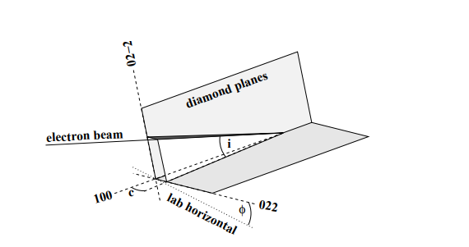
Beam orientation relative to crystallographic axis (scheme)
@K. Livingston
Axes (2 -2 0 )
ϑ
Axes (0 0 1)
ψ
Axes (2 2 0)
Plane of the maximal linear polarization is coincided with crystallographic plane perpendicular to axis (2 -2 0)

Slide 6
Simulation approach
A brief description of the used approach to simulate the CBS beam spectrum and polarization one can find in the book: A.Potylitsyn. Electromagnetic radiation of electrons in periodic structures. Springer, 2011
The main approximations:
Neglecting by electron – electron bremsstrahlung
Carbon formfactor was chosen from the Tomas-Fermi model
Electron multiple scattering (MS) in a crystal target is the same as in amorphous one
Smearing of the CBS peaks due to MS is simulated using 1 – D gaussian angular distribution of the electron beam
Collimation of the incoherent component is calculated as for usual bremsstrahlung (BS) from an amorphous target with a finite thickness

Slide 7
Ideal CBS spectra for different collimation angles ϑc
(2 2 0)
E0 = 4500 MeV,
diamond (2 2 0)
orientation ψ = 1.55 mrad
Blue line – no collimation
Gray line – ϑc = 1/γ
Green line – ϑc = 0.5/γ
Red line – ϑc = 0.2/γ
(4 4 0)
(6 6 0)

Slide 8
CBS peak polarization
E0 = 4500 MeV,
diamond (2 2 0)
orientation ψ = 1.55 mrad
Blue line – no collimation
Gray line – ϑc = 1/γ
Green line – ϑc = 0.5/γ
Red line – ϑc = 0.2/γ
Dashed line: $P_{max}$ = $2 \frac{\left(1−E_{g}/E_{0}\right)}{1+{\left(1−\frac{E_{g}}{E_{0}}\right)}^{2}}$

Slide 9
The first CBS spectral peak for different MS angle ϑms
E0 = 4500 MeV,
diamond (2 2 0)
orientation ψ = 1.55 mrad
collimation angle ϑ = 0.5/ γ
Black line – no MS
Green line – ϑms = 1/γ
Blue line – ϑms = 0.5/γ
Red line – ϑms = 0.25/γ

Slide 10
Polarization of the first CBS peak
E0 = 4500 MeV,
diamond (2 2 0)
orientation ψ = 1.55 mrad
collimation angle ϑ = 0.5/ γ
Black line – no MS
Green line – ϑms = 1/γ
Blue line – ϑms = 0.5/γ
Red line – ϑms = 0.25/γ

Slide 11
Angular BS distribution
A simulation of the CBS polarization for “hard” collimation should take into account an incoherent spectral component correctly.
There is practically no dependence on photon energy in BS angular distribution.
Angular BS distribution may be approximated as:
$\frac{dI}{dΩ}$ = $\frac{1}{πσ_{0}^{2}}exp\left[−\frac{u^{2}}{2σ_{0}^{2}}\right],$
$$u= γθ_{γ}, σ_{0}=0.52$$

Slide 12
Angular distribution of the BS beam from an amorphous target with thickness t
Angular distribution of electron beam due to multiple scattering process:
$$F_{e}\left(θ_{e},t,E_{0}\right)=\frac{1}{2πσ_{e}^{2}}\exp{\frac{{−θ}_{e}^{2}}{2σ_{e}^{2}}}$$
$σ_{e}$= $\frac{13.6\left[MeV\right]\sqrt{t/{2X_{0}}}}{E_{0}\left[MeV \right]}$
$σ_{e}$= $26.6\sqrt{t/{2X_{0}}}$ in units $1/γ$
Convolution of $F_{e}\left(θ_{e},t,E_{0}\right)$ and $\frac{dI}{dΩ}$
FBS$\left(u\right)=\frac{1}{2πσ_{t}^{2}}\exp{\frac{{−u}_{}^{2}}{2σ_{t}^{2}}}$, ${ σ}_{t}^{2}$ = $σ_{0}^{2}+σ_{e}^{2}$

Slide 13
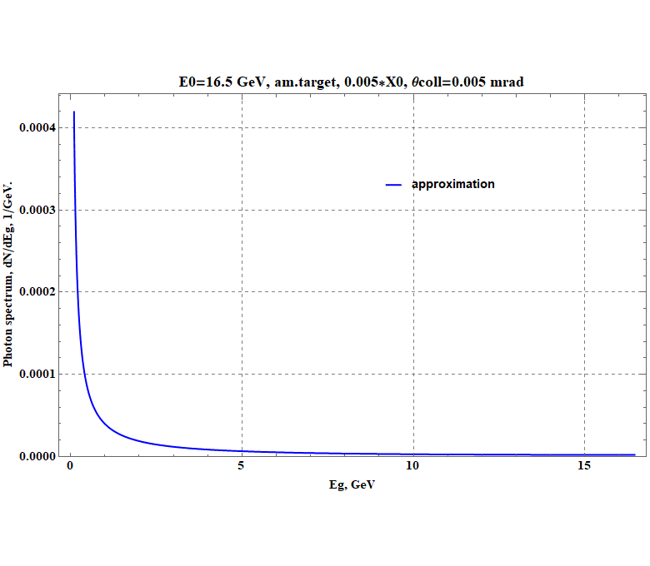
BS photon spectrum (E0 = 16.5 GeV)
After integration over the collimator angular acceptance 0<u<$u_{c}$:
$$\frac{dN_{bs}}{dE_{g}}=\frac{t}{X_{0}∗E_{g}}∗\left(\frac{4}{3}−\frac{4}{3}∗\frac{E_{g}}{E_{0}}+{\left(\frac{E_{g}}{E_{0}}\right)}^{2}\right)∗$$
$$(1−\exp{(−\frac{u_{c}^{2}}{2∗σ_{t}^{2}}}))$$
t = 0.005* $X_{0}$, $E_{0}$ = 16.5 GeV,
$u_{c }$= 0.16/ γ = 0.005 mrad– collimation angle
$σ_{t}^{2}$= $σ_{0}^{2}$+ $σ_{e}^{2} =$ 1.42/γ

Slide 14
CBS intensity spectrum (diamond, 0.6 mm, E0=16.5 GeV, ϑ=8.5 mrad,ψ=2.1mrad, u=0.16)
Fit
$\frac{dN_{cbs}}{dE_{g}}$={0.105-0.105* $\frac{E_{g}}{E_{0}}$ +0.066* ${\left(\frac{E_{g}}{E_{0}}\right)}^{2}$+ 0.4*exp[- ${\left(E_{g}−11.92\right)}^{2}$/2*${0.067}^{2}$] + +0.076*exp[-${\left(E_{g}−13.84\right)}^{2}$/
2* ${0.0485}^{2}$] } –blue line,
Black points – CBS theory

Slide 15
CBS photon spectrum
During fitting procedure there was neglected by CBS peaks with energy higher 14 GeV
$\frac{dN_{cbs}}{dE_{g}}$=$K_{0}${0.105-0.105* $\frac{E_{g}}{E_{0}}$ +0.066* ${\left(\frac{E_{g}}{E_{0}}\right)}^{2}$+ 0.4*exp[- ${\left(E_{g}−11.92\right)}^{2}$/2*${0.067}^{2}$] + +0.076*exp[-${\left(E_{g}−13.84\right)}^{2}$/ 2* ${0.0485}^{2}$] } / $E_{g}$
$${Here K}_{0}=0,000276$$
$$is normalising coefficient to$$
$obtain simulated CBS photon spectrum$in absolute units

Slide 16
Comparison of CBS and BS photon spectra
Target thickness t= 0.005*X0
Diamond t = 0.6 mm
Tungsten t = 0.035 mm
BS spectrum – red line
CBS spectrum – blue line

Slide 17
CBS beam polarization
Fit:
P[$E_{g}$]= 0.5*Exp$(−\left(E_{g}−11,92\right)4$/0,2$4$) + 0.285*Exp$(−\left(E_{g}−13,84\right)4$/0,12$4$)
First two peaks only were fitted
Green points – CBS theory
Blue line - fit

Slide 18
Conclusion
In principle, a polarization of the CBS beam produced by 16.5 GeV electrons may achieve 47 % for photon energy around 12 GeV
For a size of the “effective collimator” compared with an electron beam size the detailed simulation of the CBS beam characteristics is needed
For the CBS beam produced by the XFEL electron beam the measurements of its polarization is very difficult task
Simulation of processes of the energy dissipation in a target, heat transfer, and stresses in a target bulk is planned to be performed in frame of collaboration with Kharkiv team
The “survival time” of the diamond target (as well as the amorphous one) under ultrashort XFEL electron beam with micrometer scale transverse sizes should be determined in real conditions

Slide 19
Thank you for your attention!

Slide 20
Main CBS expressions used for simulations

Slide 21
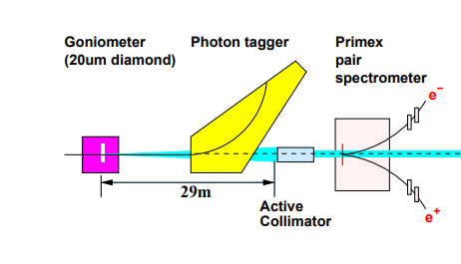
@Vector meson production with linearly polarised photons at Jefferson Lab. K. Livingston Dept of Physics & Astronomy, University of Glasgow, Glasgow G12 8QQ, Scotland
The experimental setup

Slide 22
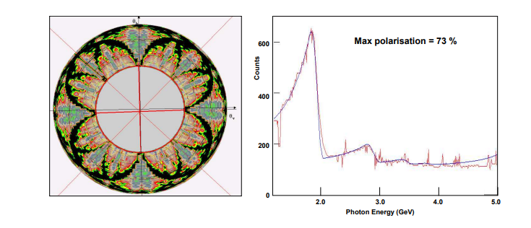
@Vector meson production with linearly polarised photons at Jefferson Lab. K. Livingston Dept of Physics & Astronomy, University of Glasgow, Glasgow G12 8QQ, Scotland
a) Scan with the crystal almost perfectly aligned. b) Coherent bremsstrahlung spectrum obtained online

Slide 23
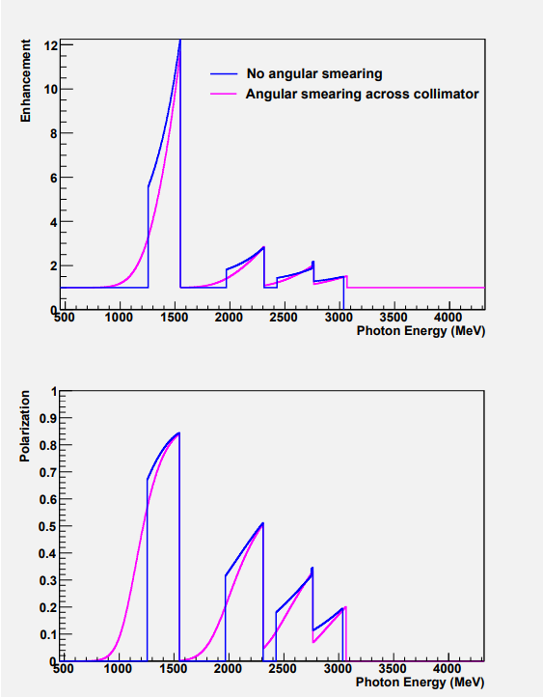
Effect of the finite electron beam emittance
@CLAS NOTE 2011-020 Polarization from Coherent Bremsstrahlung Enhancement (Ken Livingston)
Blue line = ideal case (collimation only)
Magenta line = smoothing due to beam emittance

Slide 24
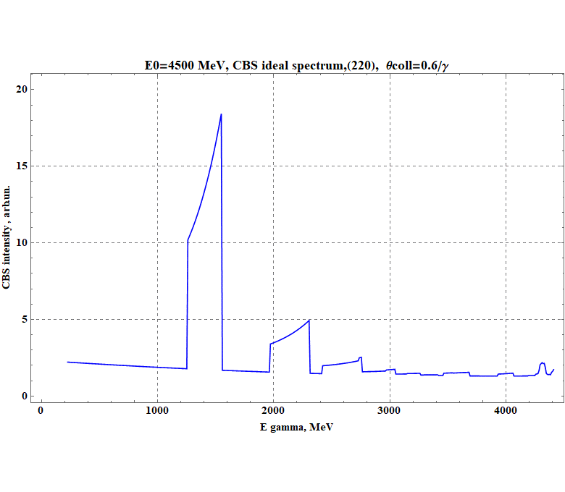
CBS ideal spectrum
Simulations results

Slide 25
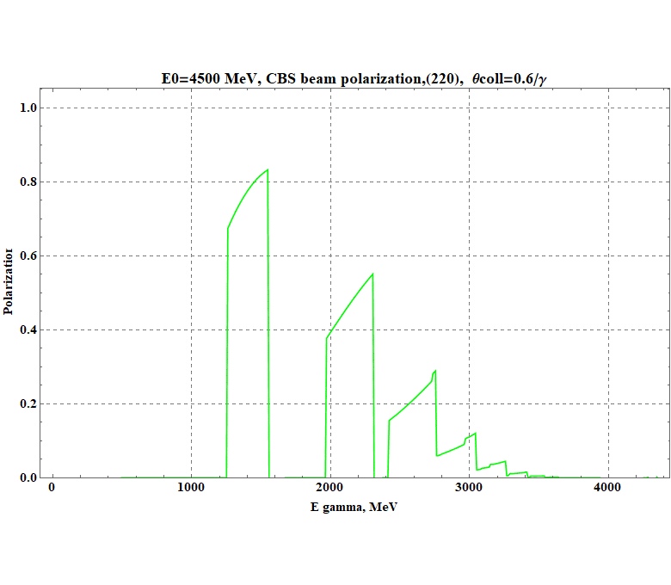
CBS beam polarization (ideal case)
Simulations results

Slide 26
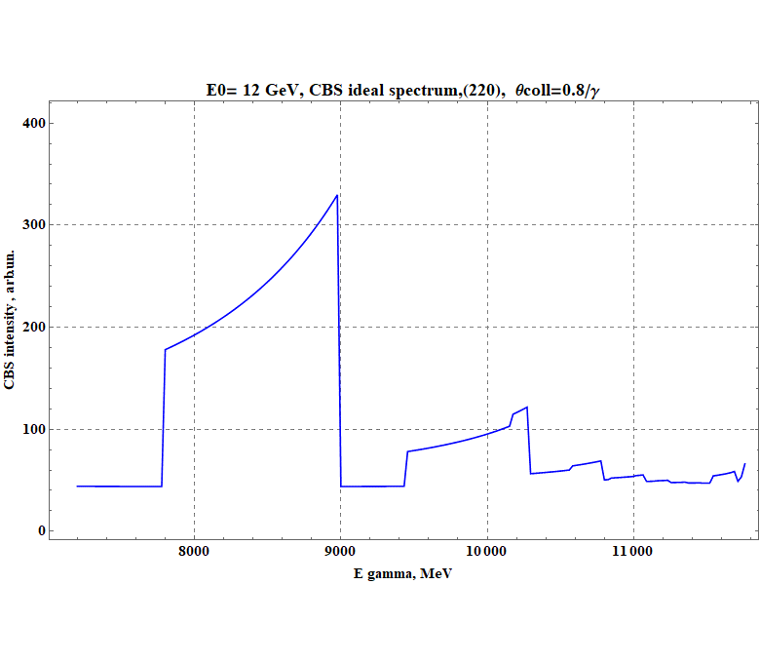
CBS ideal spectrum (first peak)
Simulations results

Slide 27
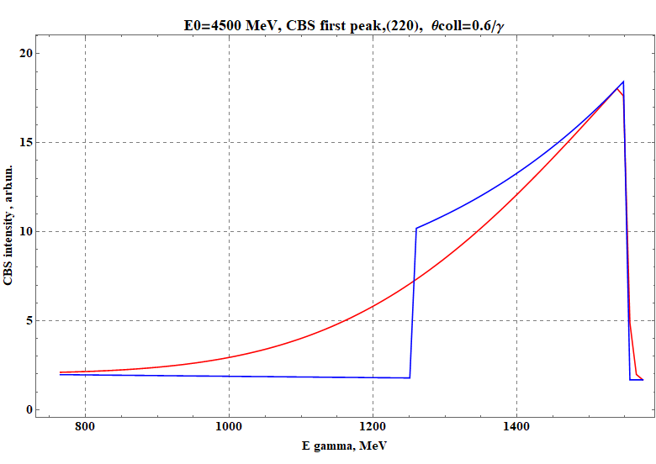
Comparison CBS spectra
Simulations results
Blue line = CBS ideal spectrum
Red line = CBS smoothed spectrum due to beam emittance

Slide 28
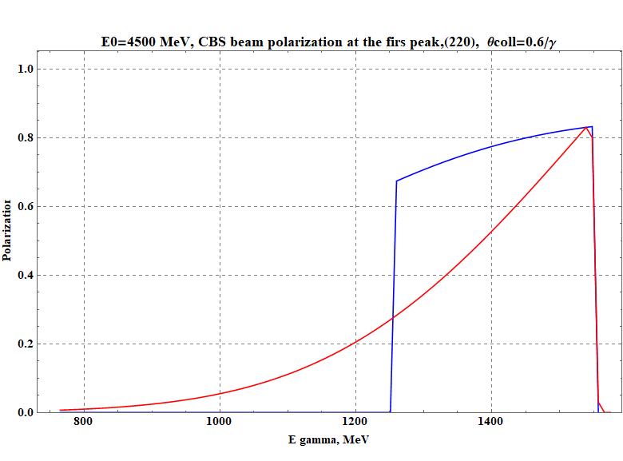
Smoothed polarization
Simulations results
Blue line = polarization (ideal case)
Red line = smoothed polarization due to beam emittance

