Slide 1

Scientific Committee
Wissenschaftlicher Ausschuss
Report by Directorate
DESY in times of crisis
DESY strategy loop
Helmholtz

Slide 2
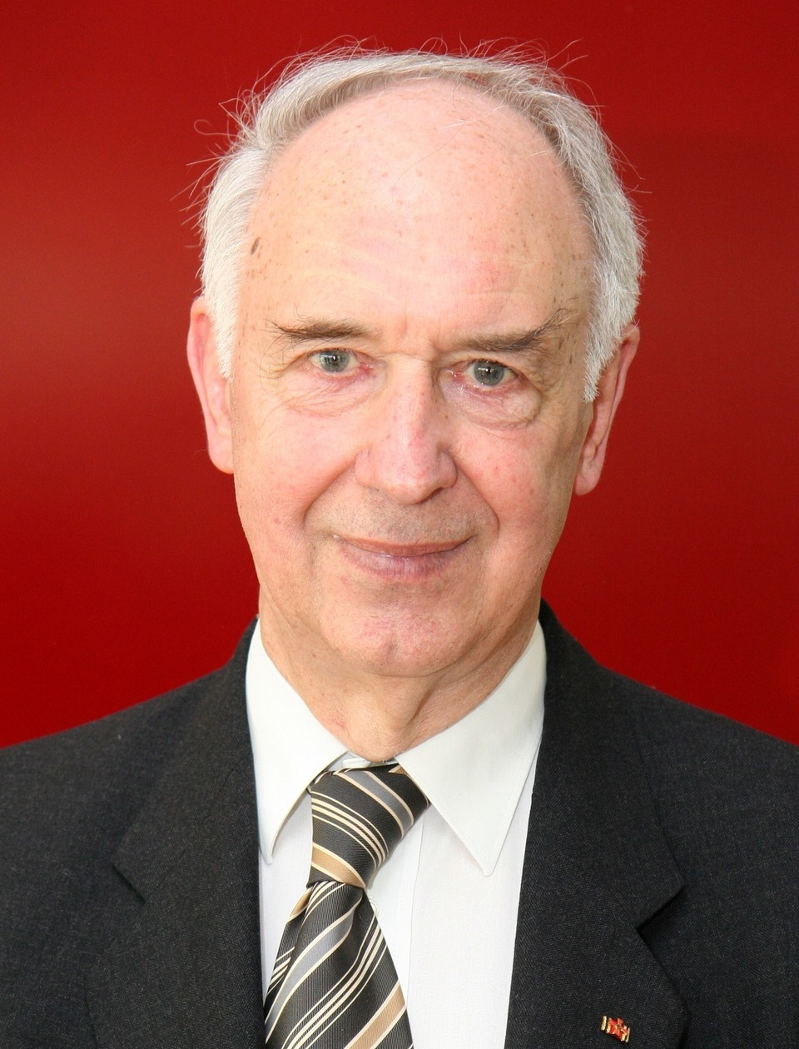
Scientific Committee
Wissenschaftlicher Ausschuss
Volker Sörgel
1931 - 2022

Slide 3
Energie-Krise
Scientific Committee
Wissenschaftlicher Ausschuss

Slide 4
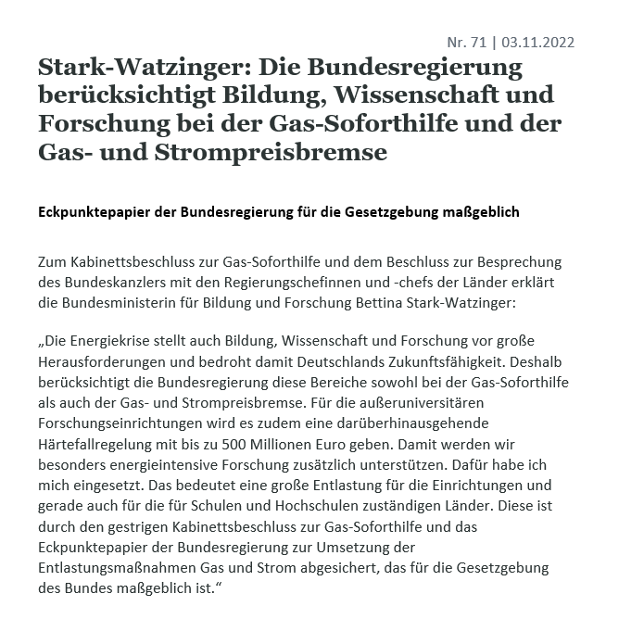
Energie-Krise
Scientific Committee
Wissenschaftlicher Ausschuss
  DESY buys futures in tranches and thus minimizes the price risk (2022: 100 %; 2023: 80 %; 2024: 60 %; 2025: 40 %)
  Extreme price development:
  2022 (Ø HH): 7.03 ct/kWh 2023 (Future, 19.10.) 38.7 ct/kWh
  Purchase of missing 20 % for 2023: futures can still be fixed until the end of November, thereafter procurement possible during the year on the spot market; financing options being explored
  Additional shortage situation possible, emergency shutdown plans have been developed
Power
  Heat Hamburg: reduction in delivery possible (50 %)
  DESY can cover part of the heat demand with waste heat (when accelerators are running) - HGF application submitted for waste heat utilization
District heating (HH)
  Extreme price development (DESY labor price in each case):
  2022: 4.299 ct/kWh 2023: 25.976 ct/kWh
  Supply volume for 2023 reduced by 50 %, compensation
  e.g. via rental of mobile oil heating system
Gas (ZEU)

Slide 5

Scientific Committee
Wissenschaftlicher Ausschuss
Helium und Neon Krise
Approx. 60,000 m³ helium p.a.
required for XFEL, FLASH, small experiments
Shortage and increase in price due to tight supply situation
DESY requirements secured for 2022:
Vendor has delivered only 47,181 m³ so far,
"loan" of 20,000 m³ from CERN
Other shortages: Neon - failure of central producers
in Mariupol and Odessa (world market share 50%)
  Price increase: from 4,500 € to 24,000 € per bottle
  (DESY stock includes 3 to 5 bottles)
  Shortage: delivery times of 6 to 8 weeks

Slide 6


Scientific Committee
Wissenschaftlicher Ausschuss
Inflations-Krise
Annual increase of the DESY budget 2%
Major clash with
general inflation 10%
historically high inflation forecast 2023 8.8 %
- expected Tarifsteigerungen Öffentlicher Dienst: 6-7%
2023: 8,8% vs. 2% means > 6Mio loss in puchasing power
6-7% vs. 2% means severe underfunding of personnel*)
*) must and will make sure that our nextgen scientists and technicians will not be affected too badly !
current HGF interaction with BMBF: „ready for negotiations when collective agreements are known”
OVERALL: 2023-2025: will be very (!) difficult years for the lab
2025+: lab must adjust to tighter budgets
→ need to focus and need to develop a internationally competitive plan
→ will influence the strategy loop

Slide 7
Scientific Committee
Wissenschaftlicher Ausschuss
Baukrise
Construction Cost Explosion:
BKI > 15%
Volatile Campus Development Project 2018-2030
Funding
Construction Projects
all projects see massive
cost explosion !!
major revision necessary
rescue research projects
planning
not yet fully funded
looking for solutions
freeze
removal
→ Girder Assembly Bld.

Slide 8

DESY. Strategy Review Process
Preparation Phase. Re-Boost stable Strategies. Boundary Setting DIR
Creation Phase: New Strategy Elements /
Proposals for Adaptation
Decision Phase: Refine Strategy
Finalize Strategy Update
Communicate Changes
Decision Point 1:
Boundaries
  Boards
Decision Points 2, 3, 4:
Topic specific
Preparation /
Set-up
Strategy WS 1
04.-05.07.22
2 Days
Check Progress Prepare Woodstock
0,5 Day
Strategy WS 2
03.2023
2 Days
  Directors
1
2
Implementation:
Communication
Initiatives / Programs
Monitoring
Info on Process (17.06)
Info on Results (3h)
„Woodstock“
„Woodstock Update“
Small work-teams
develop fact-sheets / proposals on selected
topics defined by DIR
Cross-functional work-groups develop proposals on selected topics defined by DIR
Sharpen DESY Mission
WA members
Departmt.
„All hands meeting“
Info on Results (tbd)
1,5 – 2 Days
0,5 Day
DESY
ALL
“DESY 2030 Strategy
achievements Breakfasts”
BV
20.06.
1-1½ h
0,5 Day
Support
Mar/Apr
2022
May
2022
June
2022
July
2022
Sep/Oct
2022
Nov/Dec
2022
Jan/Feb
2023
Mar
2023
Apr
2023
May/Jun
2023
Notes:
2./3. Juni 2022 - Wissenschaftlicher Rat (WR)
14./15. Juni 2022 - Stiftungsrat (SR)
17. Juni 2022 - WA Sitzung
20. Juni 2022 - Belegschaftsversammlung
5./6. Juli 2022 Strategie-WS 1
24./25. November 2022 - Wissenschaftlicher Rat (WR)
12./13. Dezember 2022 - Stiftungsrat (SR)
19. Dezember 2022 - Belegschaftsversammlung (BV)
(WA im Herbst noch nicht terminiert)
25./26. Mai 2023 - Wissenschaftlicher Rat 29./30. Juni 2023 - Stiftungsrat
23./24. November 2023 - Wissenschaftlicher Rat 11./12. Dezember 2023 - Stiftungsrat

Slide 9


DESY.
Time Table
DESY.
2021
2022
2023
2024
2025
2026
2027
DESY Strategie
Loop 2022/23
für PoF V
Dosch
Laufzeit-Ende
PETRA IV
Genehmigung
O. Wiestler Amtszeit endet
Helmholtz
Vorbereitung
PoF V
Vereinbarung
auf
KPIs und
Verfahren
Einfrieren
Aufgabenstellung
Definition von
Prüfungsaus-
schüssen
Daten
Organisation von
Bewertungen
Statusberichte
für wissenschaft-
liche Bewertungen
Wissenschaftl.
Review
Strategischer
Review
Finanzierungs-
Empfehlungen
Helmholtz-Senat

Slide 10
DESY. Strategie Loop 2022/23
Status of Loop Process
Reports from Working Groups on selected issues which have update needs: fact sheets
August Meeting Directorial Bord
Topics:
FH: onsite experiments, testbeams, detector R&D, IT-Computing
FS: FLASH, CMWS, Imaging Strategy, Nanoscience, Life Science (CryoEM)
M: PITZ/ARES, UED/REGAE
V: Talentmanagement
Narrow financial future corridors → focus on mission-critical structures and activities
→ revisit of DESY contributions/participation in international projects
→ reach out for external funding (PITZ, REGAE, ARES,….)
→ revisit technical and admin support units („make or buy“)

Slide 11
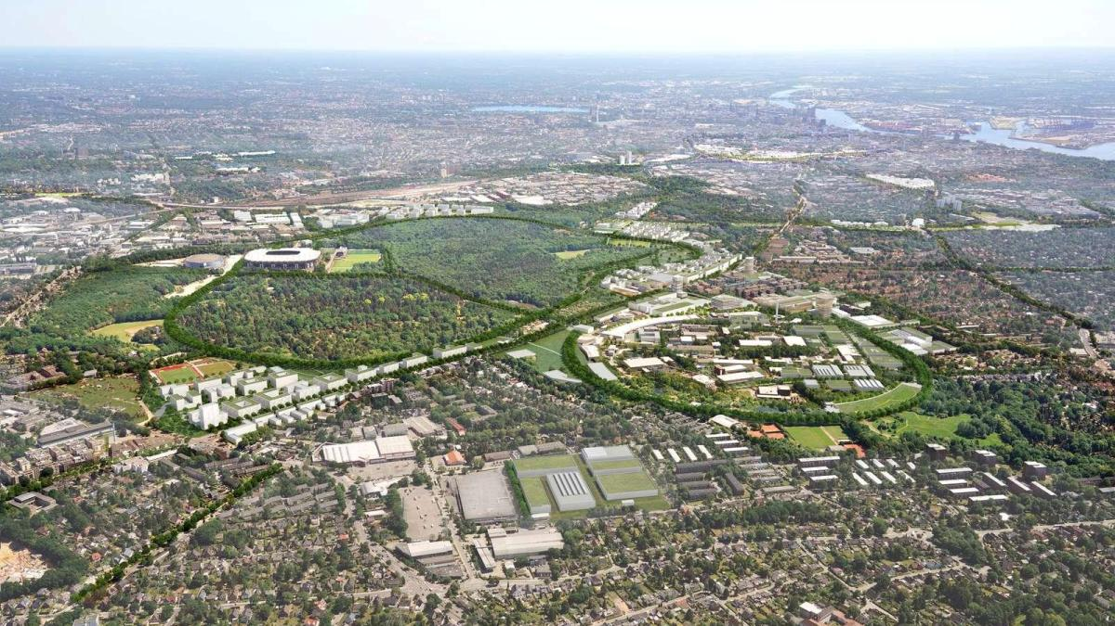



DESY. Strategie Loop 2022/23
Das
Forschungs-
Innovations-
Ökosystem
des 21. Jh.
Transformations-
Projekt
Onsite-
Experimente
Teilchenphysik
PETRA IV
Matter
Materials
Life
DESY seeks:
Decision 2023
Start 2024
Das
Nationale
Analytikzentrum
„X-rays · Lasers · Electrons
Accelerators
by Design“
Neue Fenster
in die
Quanten-Welt
Dunkle Materie
Gravitationswellen
Quantenkontrolle
Quantentechnologie
DZA
Quanten-
-Materie
-Materialien
-Sensing
-Computing
Plasma-
Beschleunigung
DESY Kernaufgabe
→ strengthen ARD
weltoffen
nachhaltig
divers
Forschungsbereiche
Beschleuniger · Photonen · Teilchen · Astroteilchen

Slide 12


PETRA IV - Central Component of the Solution Ecosystem
Tackling the climate crisis
Fight cancer
Enabling a true circular economy
Prevention and
Combat
Infections
Science and high-tech environment
DESY, Helmholtz
Politics and administration
Parliament, Government
Sustainable
Production processes
Reduction of the
Pollution and
Environmental damage
PETRA IV
Clean industry
Economics
Company and economy
Technology Sovereignty

Slide 13


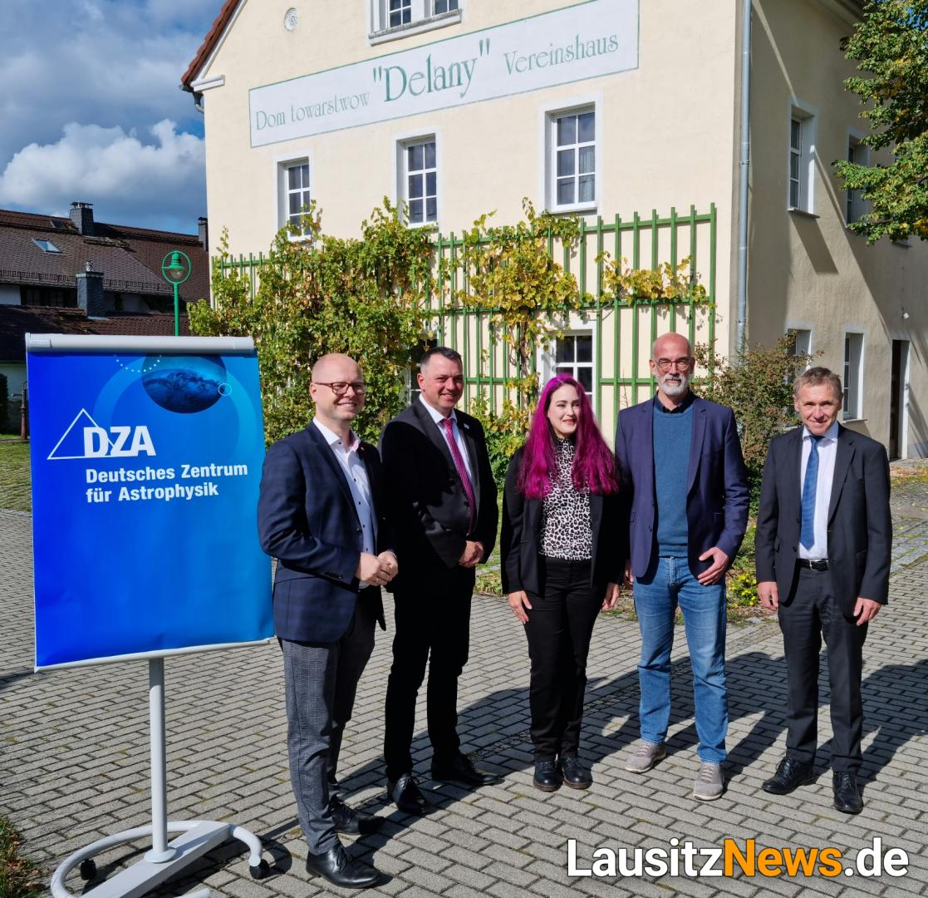
Scientific Committee
Wissenschaftlicher Ausschuss
„Deutsches Zentrum für Astrophysik“ approved
Huge success by DESY-ESA
New element in the DESY strategy process
New role of Zeuthen site ?
ET

Slide 14
Scientific Committee
Wissenschaftlicher Ausschuss
Helmholtz
DDL in Helmholtz Senate: no decision → remains on the list
LK II Remote Proposal: DESY-HZB-HZDR
no funding in POF IV
LK II 2023/24: LK II Reservemittel (35 Mio)
ex ante increase by 5% (= 3,5 Mio/y DESY)
Demonstrator: 12 Mio approved:
DESY-HZB project robotic-remote-AI-catalysis beamline

