Slide 1
ARES operation meeting, Monday 5th September
by the ARES shift crew

Slide 2
Summary of KW 35
 | Monday 29th August | Tuesday 30th August | Wednesday 31st August | Thursday 1st September | Friday 2nd September
Achievements | * Tunnel open for maintenance day | * MDI ICT tests * Investigation on TWS2 power reading chain * Preparation for quad/wire scan | * Quad/wire scan * BPM commissioning (calibration data acquired) | * AA shift: Testing agents adn routines with new screen station → All fine * BPM commissioning | * MSK work in tunnel → attenuator replaced * MSK work in tunnel → attenuator replaced * Quad/wire scan
Perturbating events | - | * Network issues from time to time * TWS2 cannot ramp up above 50 MV → problem in reading chain | * TWS2 alarm server not updated before quad/wire scan | - | * Attenuator died again 1 ½ hour after replacement → New one suited for more power installed
Notes | - | - | * TWS2 still not at nominal power | - | -

Slide 3
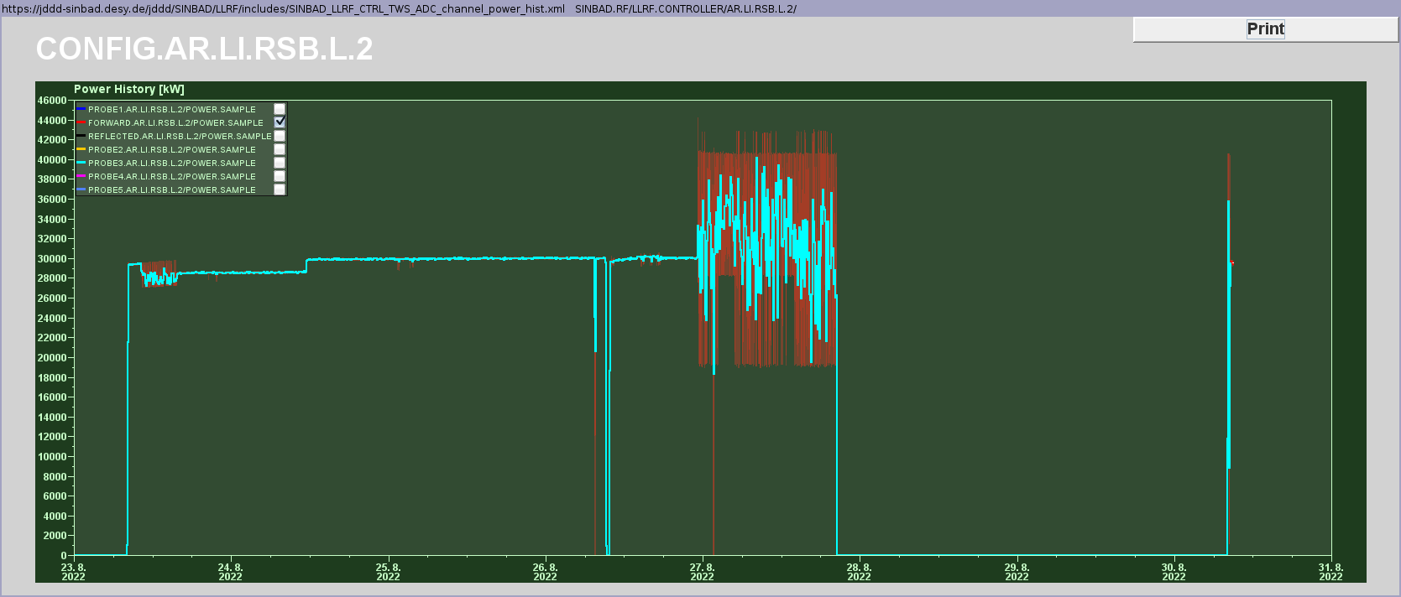
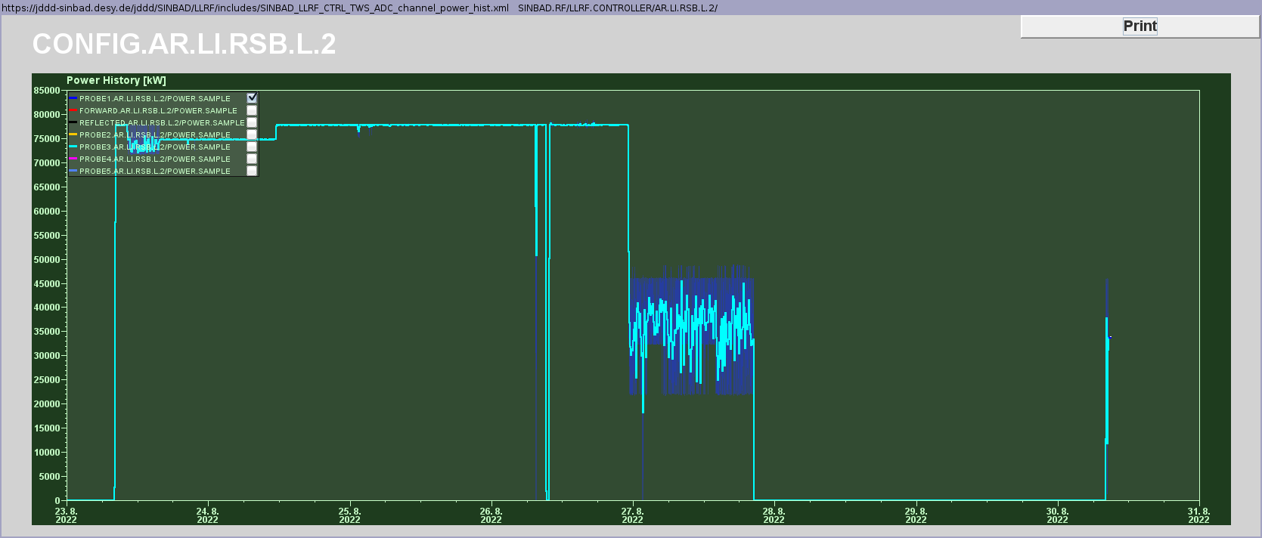
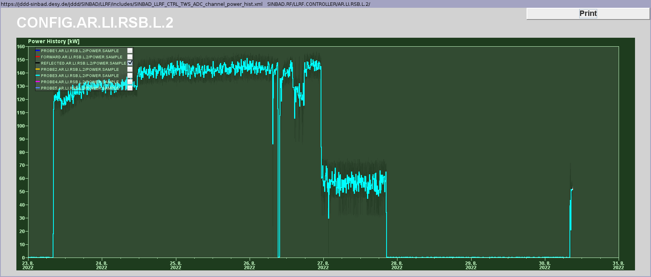
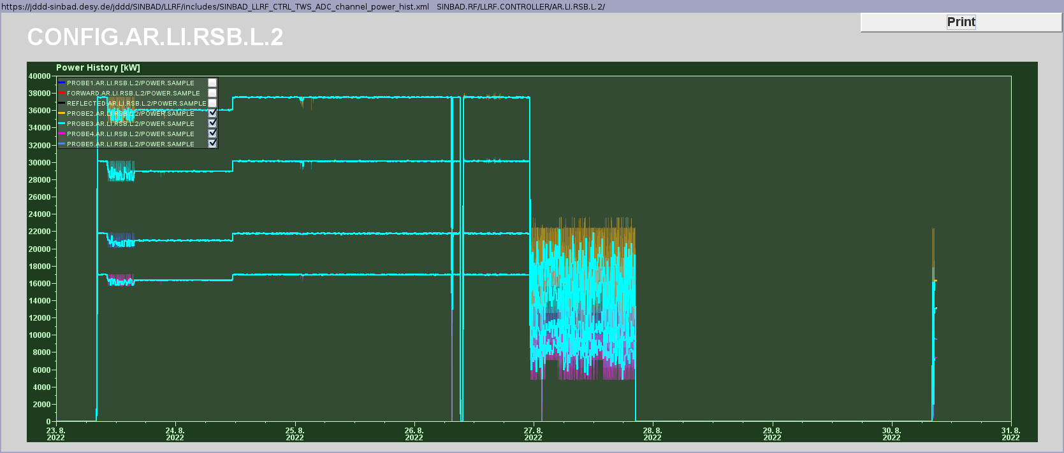
TWS2 forward power issue
All power signals dropped except the forward one → Ulrich tool was preventing to reach SP 76. An attenuator of the reading chain was damaged and has been replaced 2 times by the MSK colleagues (now a high-power version is in place).

Slide 4
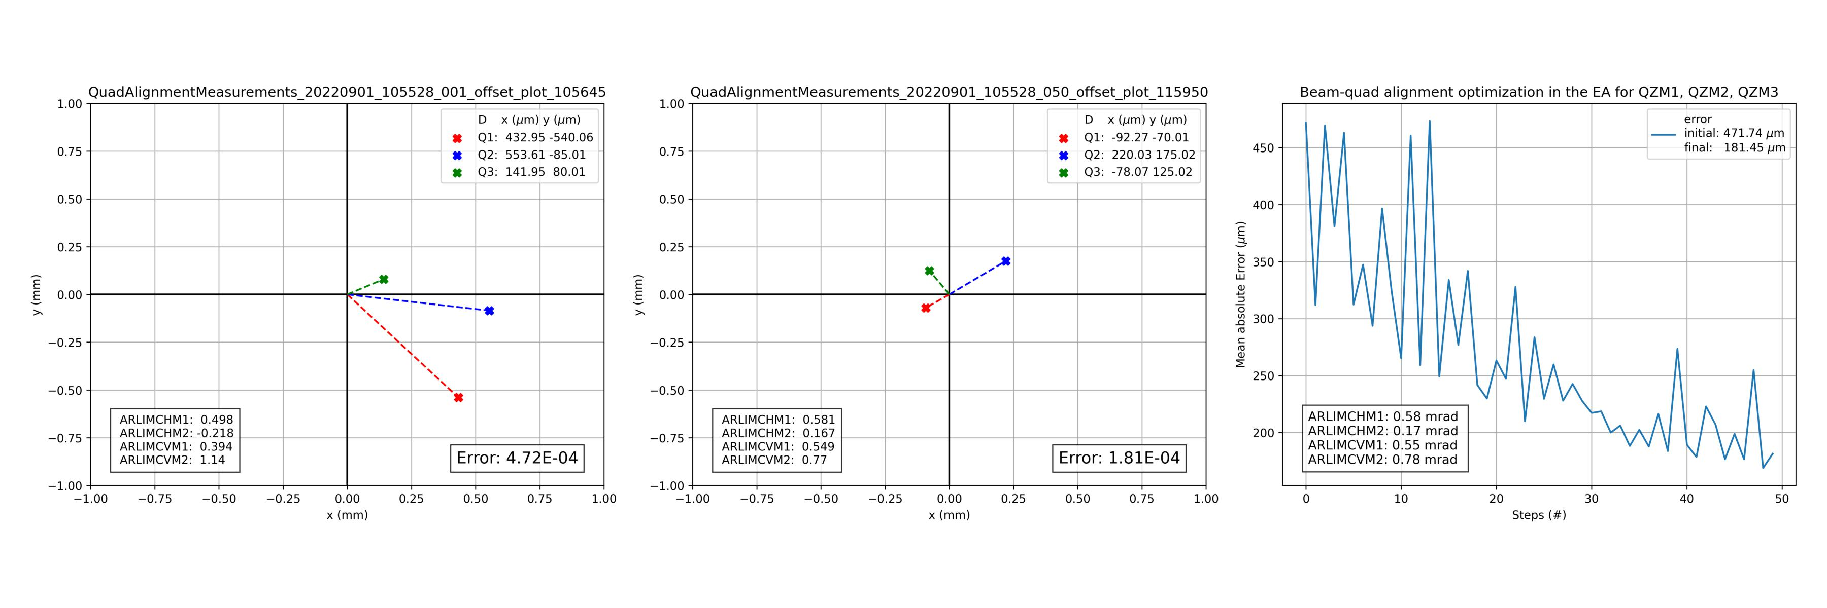
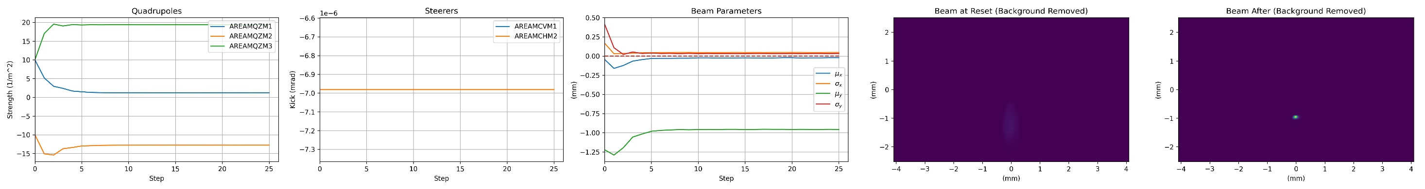
AA shift
Routine for beam/quad alignment and agent for beam optimization tested with the new screen station settings → All is working as expected.

Slide 5
Plan for KW 36
Work on Monday:
Exchange of the gun precision water cooling pump in the cellar.
BAU works in the XBand cellar and drainage system in the tunnel.
BPMs:
Read-out fully installed. First tests last week with charge up to 2.5 pC.
Dedicated Beam time on Tuesday afternoon and Wednesday morning.
ACHIP:
DLA assembly foreseen for Monday morning
Wednesday afternoon remove table
Chamber opening on Thursday by MVS
Pump-down and re-installation of table on Friday

Slide 6
Schedule
Week 36
Date | Shift leader
5.9. | Florian (Tunnel open)
6.9. | Frank
7.9. | Hannes (morning), Florian (Tunnel work)
8.9. | Florian (Tunnel work)
9.9. | Florian (Tunnel work)
If you want to learn or join the shift: please give the shift leader a call (BKR 2840 / SINBAD Box 2454)

