Slide 1
ARES Operation Meeting
Summary of week 36 / 2022
Florian Burkart, on behalf of the ARES crew

Slide 2
Short Summary
MON:
Maintenance: BAU (cellar), MIN (modulator software), MKK (gun water pump exchange), preparation of laser table.
TUE:
Restart. Wirescanner measurements, BPM commissioning
WED:
BPM commissioning
From WED lunch time:
shutdown

Slide 3
Shutdown
Crane the laser table, issues with crane (broken wire in the control), luckily we have a second one!
Installation of MVS
Slow venting of the chamber

Slide 4
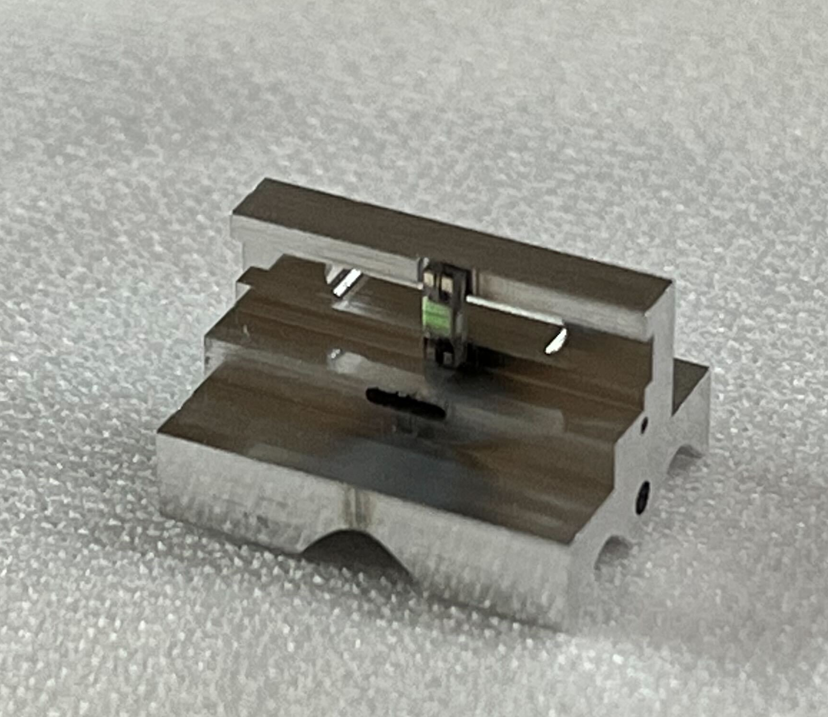
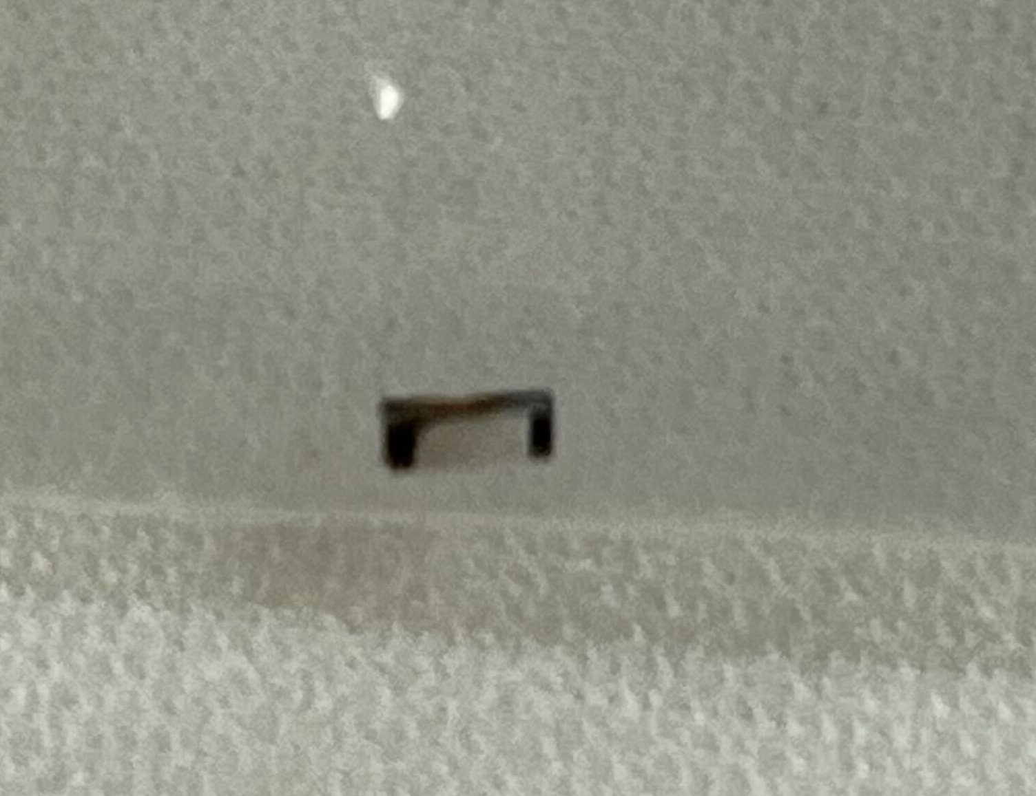
Old DLA holder

Slide 5
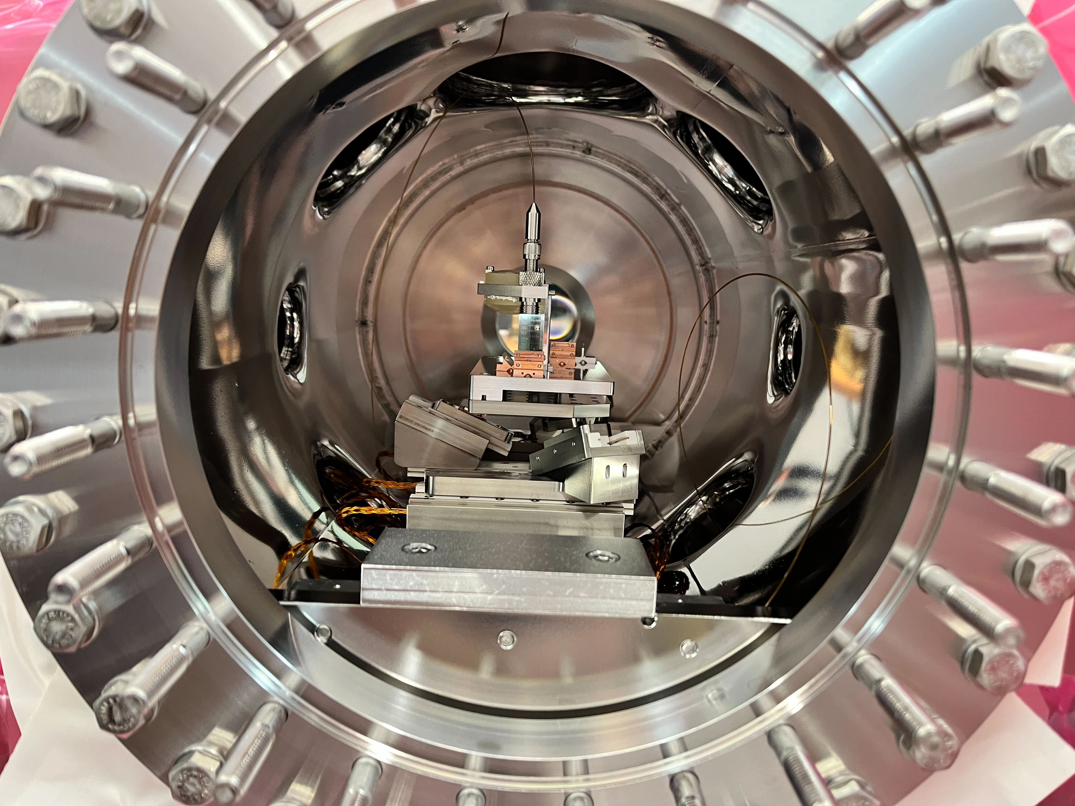

Slide 6
In the shadow:
MIN working on modulator software
MVS working on vacuum pump in the klystron hall (TWS1)
Cleaning – preparation for MT days and ARES Tour

Slide 7
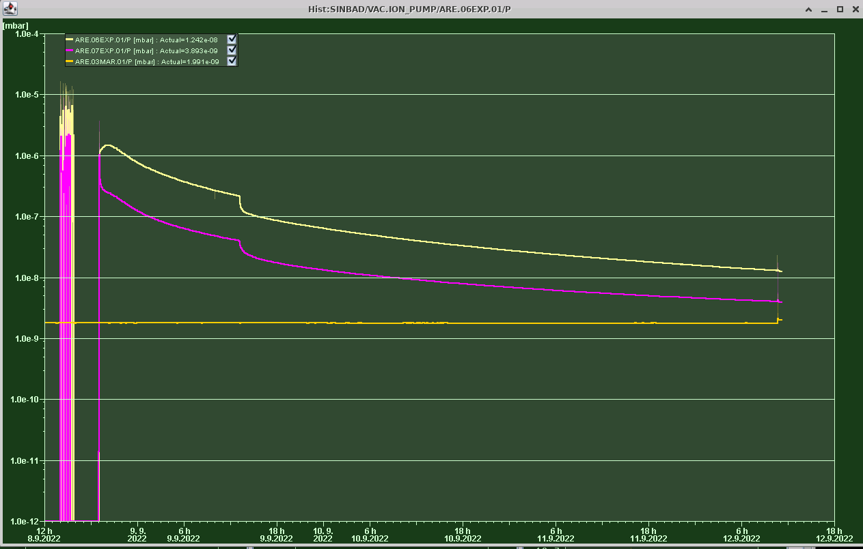
Plan for this week
Pump down.
Re-installation of timing setup
ACHIP week – show transmission
AA on WED confirmed??
2mu Laser Setup
High-level applications development - Orbit correction using BPM readings

Slide 8
Schedule
Week 37
Date | Schedule
12.09. | Tunnel open
13.09. | Frank Mayet
14.09. | Hannes Dinter
15.09. | Willi Kuropka
16.09. | Thomas Vinatier
If you want to learn or join the shift: please give the shift leader a call (BKR 2840 / SINBAD Box 2454)

