Slide 1
First EEHG Seeding at FLASH
Georgia Paraskaki on behalf of the Xseed team
11th MT ARD ST3 Meeting 2023, Dresden 06.07.2023
| FLASH Intro | External seeding schemes | Experimental results |
Outline:

Slide 2
The free electron user facility FLASH
Superconducting linac@1MHz burst, up to 8000 pulses/sec
Two self-amplified spontaneous emission (SASE) beamlines FLASH1 (fixed gap) and FLASH2
4-90 nm
R&D projects (Xseed & FFW)
Upgrade: FLASH2020+
Up to 1.25 GeV →up to 1.35GeV
Laser Heater
Bunch Compressor
1
| FLASH Intro | External seeding schemes | Experimental results |

Slide 3
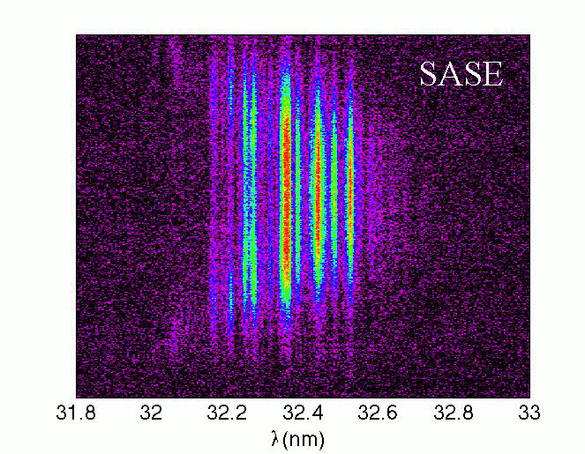
The Xseed experiment
Why Seeding?
Giannessi, Luca & Masciovecchio, Claudio. (2017).
FERMI: Present and future challenges. Applied Sciences.
7. 640. 10.3390/app7060640.
267nm@10Hz
SASE is based on the amplification of the initial fluctuations of the e-beam density and leads to:
Poor longitudinal coherence
Poor shot-to-shot stability
External seeding depends on an external e/m field that initiates the process in a deterministic way:
Full coherence
Shot-to-shot stability
2
| FLASH Intro | External seeding schemes | Experimental results |

Slide 4
The Xseed experiment
267nm@10Hz
Goal:
Exploring seeding techniques (HGHG and EEHG etc)
Preparing and gaining experience for the FLASH2020+ user facility
3
| FLASH Intro | External seeding schemes | Experimental results |

Slide 5
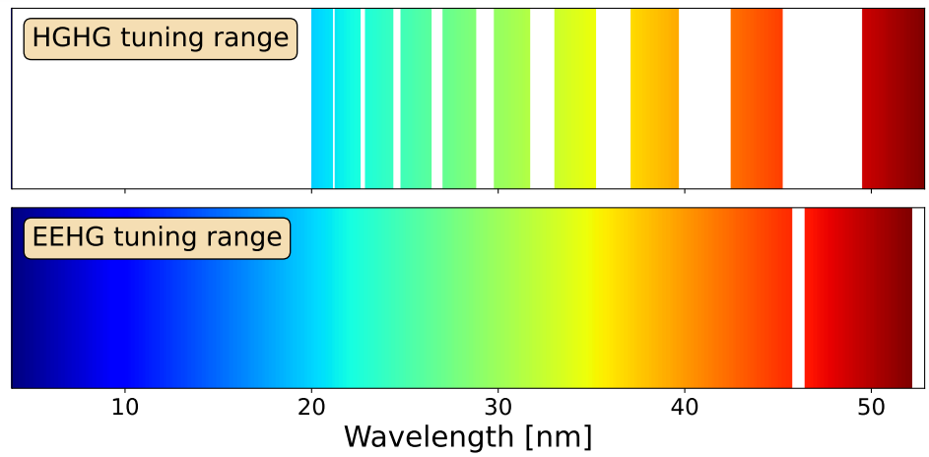
FLASH2020+ project: Seeding at FLASH1
Fully coherent soft x-ray pulses at 1MHz
Upgrade overview
Echo-Enabled Harmonic generation (EEHG) down to 4nm
Wavelength tunability with EEHG and HGHG 4nm - 60nm
First high rep. rate seeding worldwide at 1MHz
Current status
R&D for optimal lasers
Seed1: ~343nm, 100MW, 500fs
Seed2: ~297-317nm, 300MW, 50fs
4
| FLASH Intro | External seeding schemes | Experimental results |

Slide 6
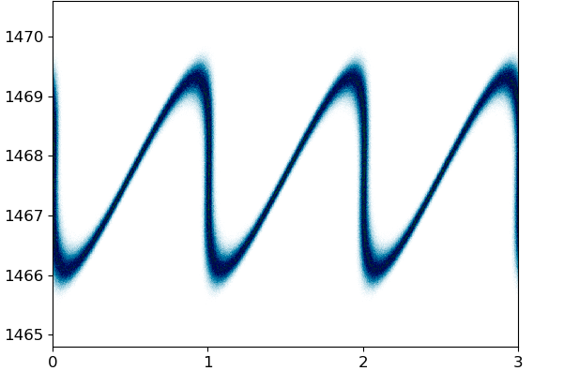
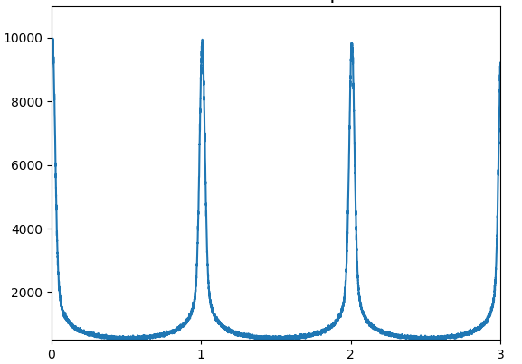
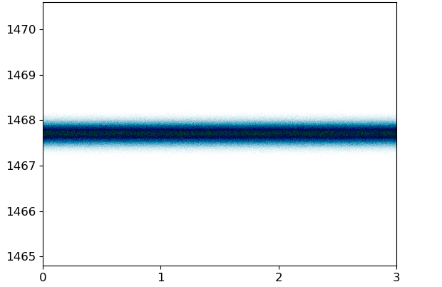
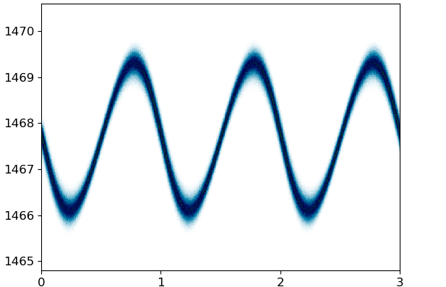
High-gain harmonic generation (HGHG)
HGHG was demonstrated in FLASH in 2015
→ Max harmonic ~ 15
!!! Energy spread !!!
Induced energy spread
γ
Electron density
s [λ_{seed}]
s [λ_{seed}]
Seed 1
Seed 2
γ
γ
s[λ_{seed}]
s [λ_{seed}]
5
| FLASH Intro | External seeding schemes | Experimental results |

Slide 7
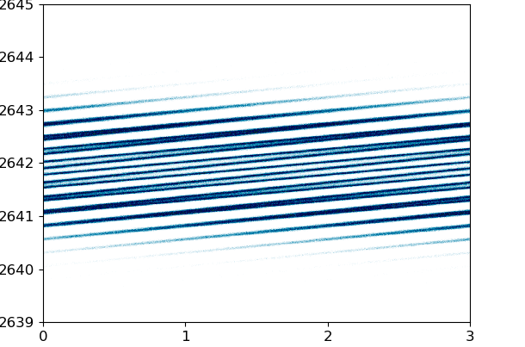
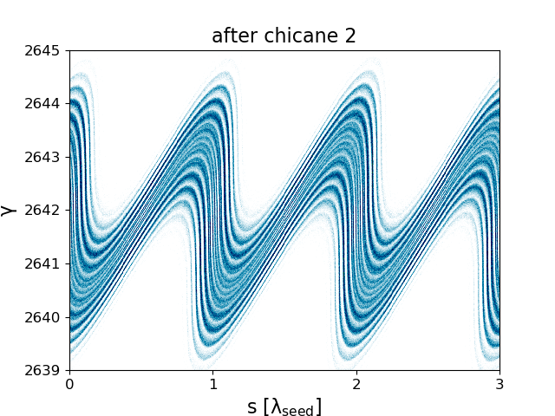
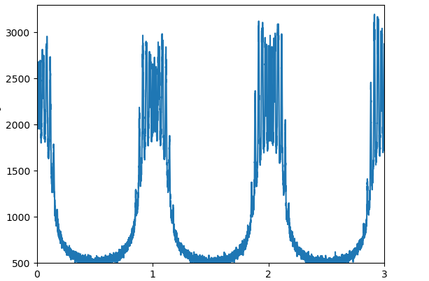
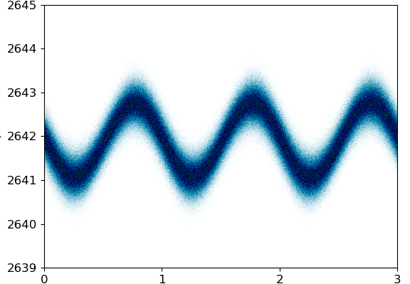
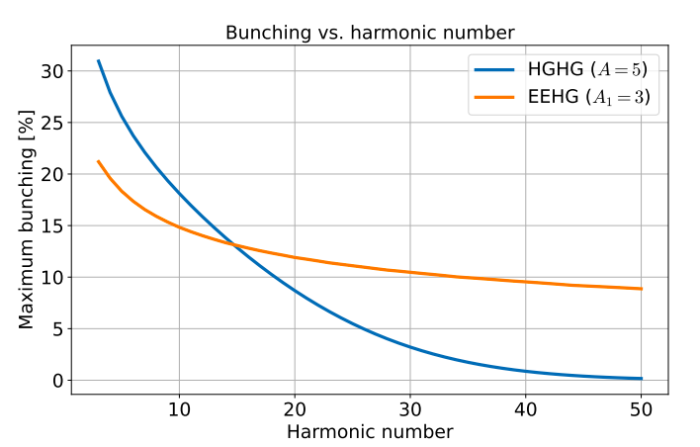
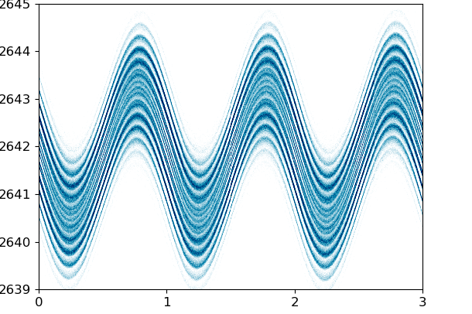
Echo-enabled harmonic generation (EEHG)
Highest harmonic possible?
γ
Energy spread not an issue anymore → Bunching practically limited to h~100
γ
Electron density
s[λ_{seed}]
s[λ_{seed}]
s[λ_{seed}]
Seed 1
Seed 2
γ
γ
s[λ_{seed}]
s[λ_{seed}]
6
| FLASH Intro | External seeding schemes | Experimental results |

Slide 8
First EEHG lasing at Xseed in March 2023
Initial conditions
Experimental conditions
Charge: 0.4 nC
Peak current: ~650 A
Energy: ~680 MeV
2 seed lasers @267nm and 10Hz
7
| FLASH Intro | External seeding schemes | Experimental results |

Slide 9
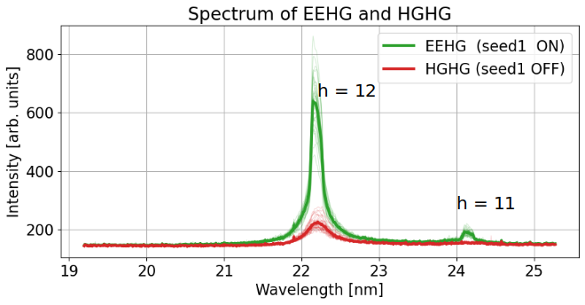
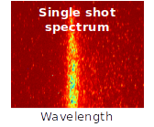
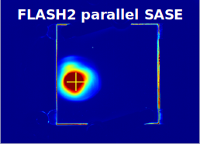
First EEHG lasing at Xseed in March 2023
EEHG and SASE in parallel
25nm
8
| FLASH Intro | External seeding schemes | Experimental results |

Slide 10
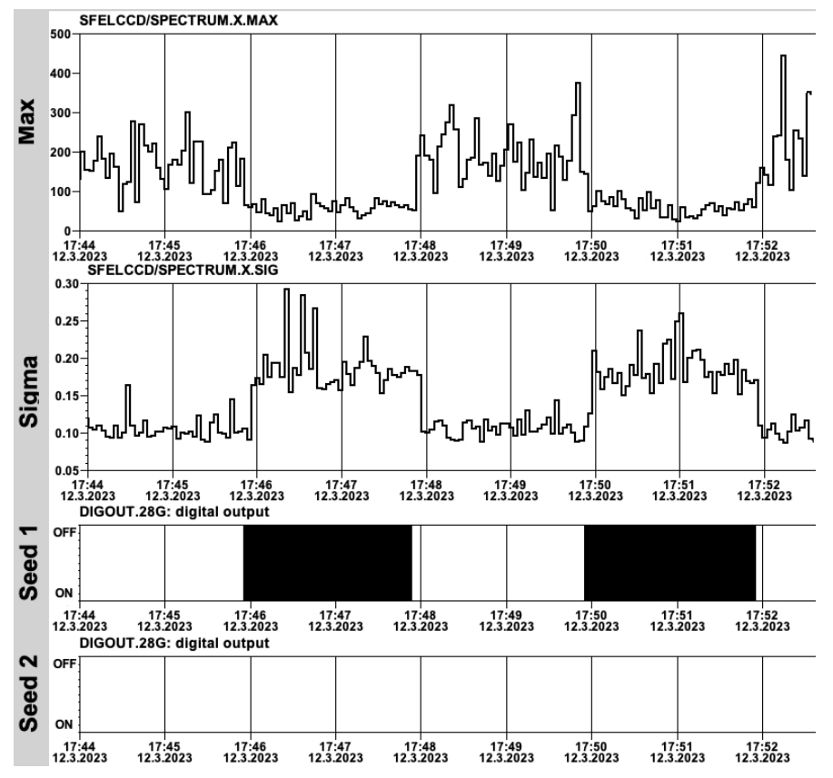
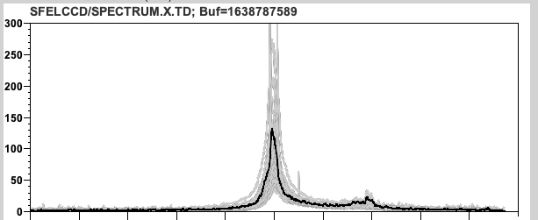
First EEHG lasing at Xseed in March 2023
Characterizing seeded radiation: 12th harmonic
EEHG signal has:
Smaller Bandwidth
Higher intensity
9
| FLASH Intro | External seeding schemes | Experimental results |

Slide 11
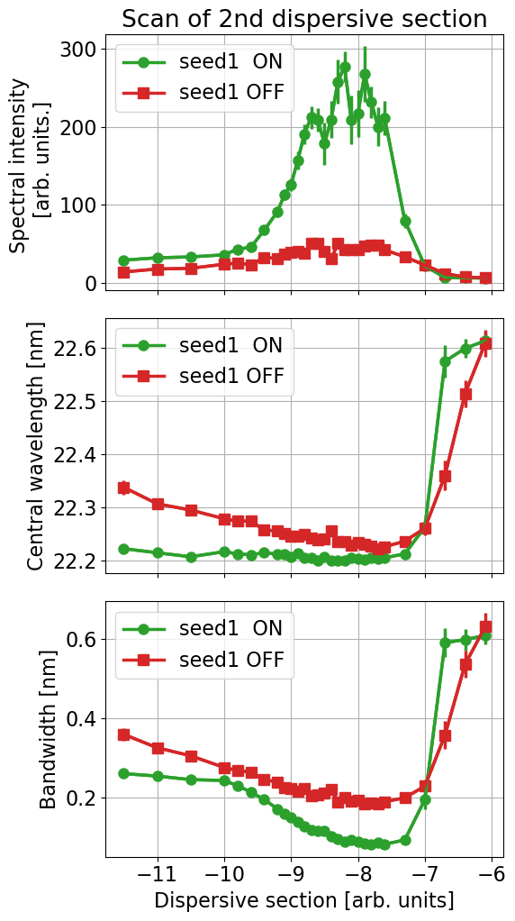
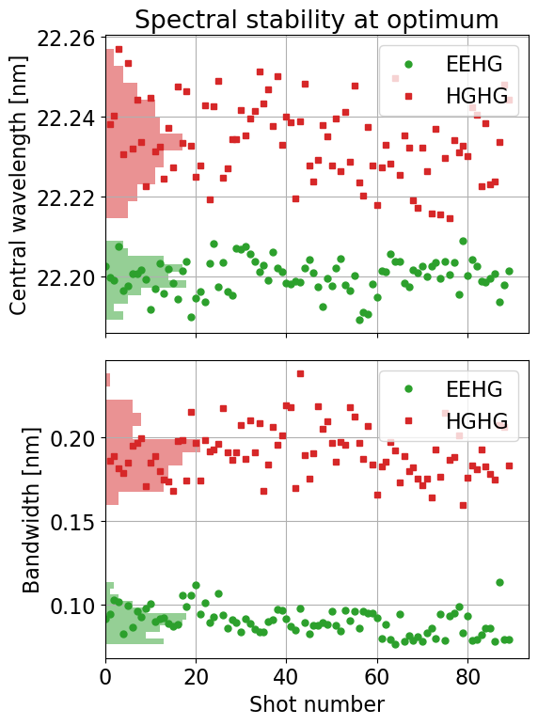
First EEHG lasing at Xseed in March 2023
Characterizing seeded radiation: 12th harmonic
EEHG signal has:
Smaller Bandwidth
Higher intensity
10
| FLASH Intro | External seeding schemes | Experimental results |

Slide 12
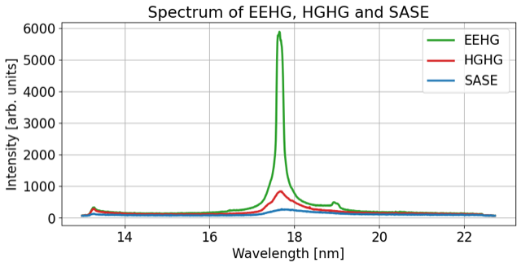
Reproducible EEHG lasing at Xseed
A week after, EEHG seeding was setup from scratch within 4 hrs
Harmonics 9-17 were setup, 15th harmonic was characterized
Seeding was achieved with different bunches of the bunch train
SASE in FLASH2 in parallel was optimized
11
| FLASH Intro | External seeding schemes | Experimental results |

Slide 13
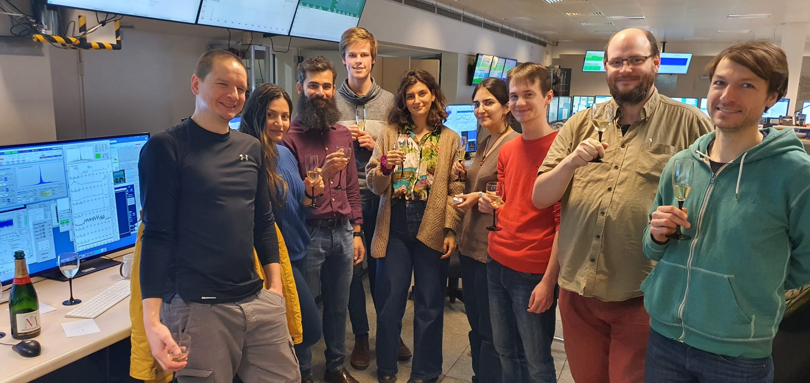
It’s a teamwork
Thank you for your attention! Questions?

Slide 14
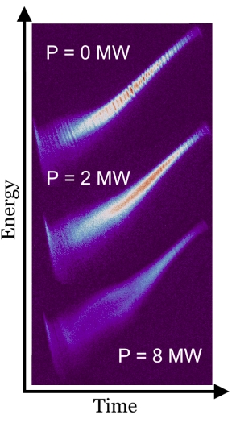
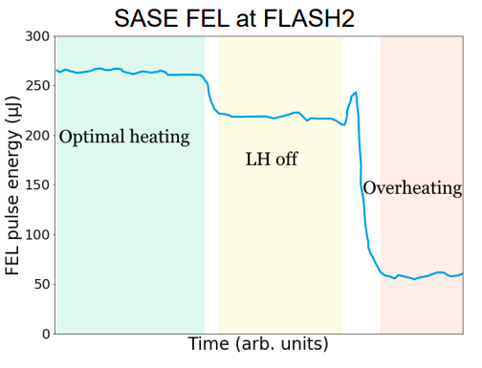
Future plans for Xseed in preparation for FLASH2020+
Laser Heater
Future plans: Investigate the effect on the seeded radiation and EEHG/HGHG signal → FLASH2020+ preparation
IPAC23
| FLASH Intro | External seeding schemes | Experimental results |

Slide 15
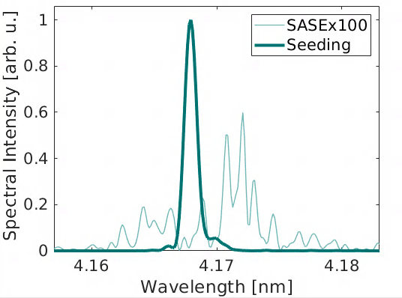
SASE vs Seeding
✔️ Wavelength tunability
✔️ Longitudinal coherence
✔️ Shot-to-shot stability
✔️ Shorter saturation length
✔️ Control over the FEL radiation properties
✔️ Synchronization of FEL pulse to seed laser
✔️ Hard x-rays possible
✔️ MHz repetition rate possible
❌ Poor longitudinal coherence
❌ Shot-to-shot fluctuations
❌ Highest repetition rate
❌ Shortest possible wavelength
❌ Wavelength tunability

Slide 16
FLASH2020+
Work in progress
New accelerating modules
Increasing energy (1.25 → 1.35 GeV)
Renew photocathode lasers
Increasing operation flexibility
Laser heater installation
Suppressing microbunching
Additional FLASH2 BC
Flexible compression schemes for simultaneous SASE-Seeding operation
Renew bunch compressors
Flexible compression schemes with variable R₅₆
Page 3

