Slide 1
Axions + LUXE
Experiments in Germany
KET Strategieworkshop 2022
Physikzentrum Bad Honnef
19. November 2022
Axel Lindner
DESY

Slide 2
Axions
A unique opportunity within the next 5-10 years
KET Strategieworkshop 2022
Physikzentrum Bad Honnef
19. November 2022
Axel Lindner
DESY
Sokolov, A.V., Ringwald, A.
Photophilic hadronic axion from
heavy magnetic monopoles.
J. High Energ. Phys. 2021, 123 (2021).
Germany is very strong in axion theory,
not addressed here.

Slide 3
Outline
Axions:
  A very brief motivation
Experimental axion searches:
  A subjective selection
Conclusions

Slide 4
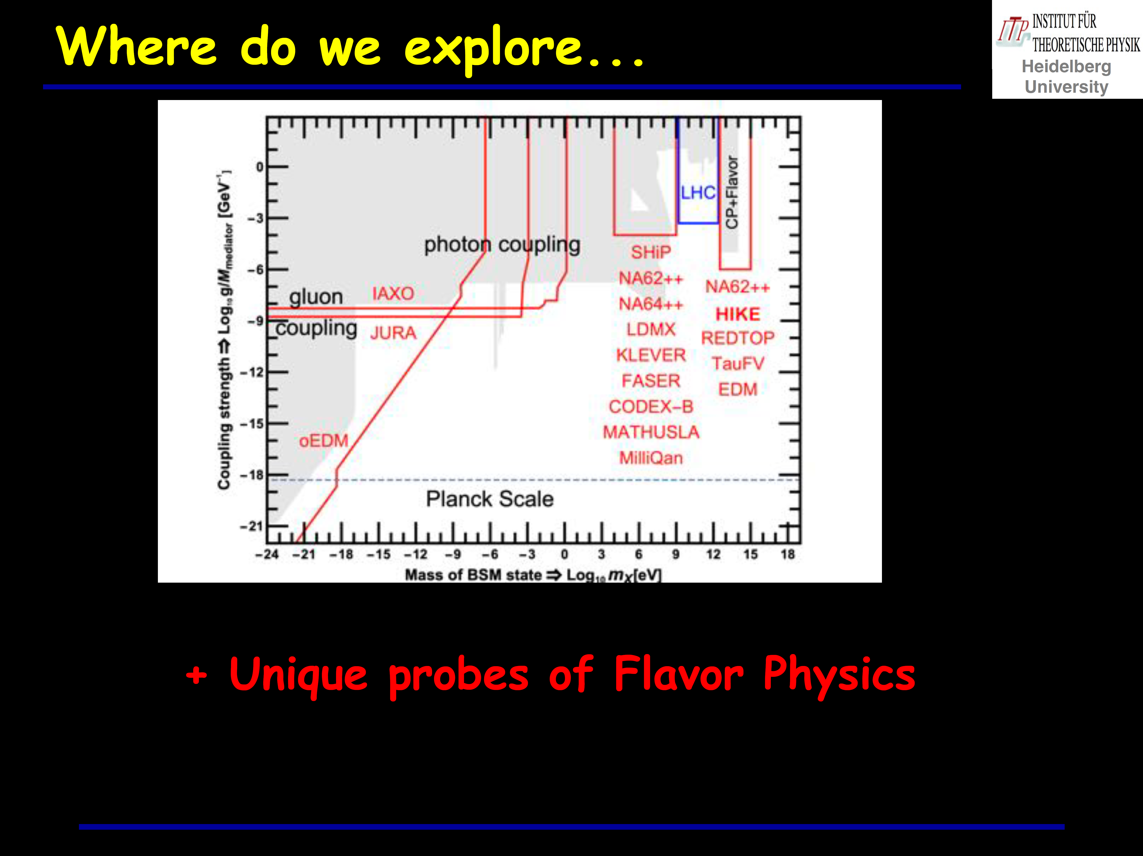
Outline
Axions:
  A very brief motivation
  See Jörg Jäckel’s presentation yesterday:

Slide 5
Axions and other WISPs in this presentation …
(a subjective selection)
are dark matter candidates, lifetime > age of the universe
and / or explain some puzzles from astrophysics, mass < keV
and / or solve the CP-problem in QCD. mass < keV
Disclaimer:
I will not always strictly distinguish between
axions (solving the CP-problem in QCD) and
axion-like-particles (ALPs).
Maybe a bit confusing:
ALPS is an experiment searching (also) for ALPs.

Slide 6
Axions and other WISPs in this presentation
Physics motivation
Axions to solve the riddle of CP-conservation in QCD or
the missing static electric dipole moments (EDM) of nucelons.
Experiments: EDM_{neutron} < 3⋅10⁻²⁶ e⋅cm; θ < 10⁻¹⁰
QCD conserves CP!

Slide 7
Axions and other WISPs in this presentation
Physics motivation
Axions to solve the riddle of CP-conservation in QCD or
the missing static electric dipole moments (EDM) of nucelons.
Experiments: EDM_{neutron} < 3⋅10⁻²⁶ e⋅cm; θ < 10⁻¹⁰
QCD conserves T symmetry!
The three quarks are perfectly aligned!

Slide 8
Axions
Couplings to the SM
Axions are a consequence of the
Peccei-Quinn symmetry to explain θ=0.
f_{a}: energy scale of PQ symmetry breaking
A. Mirizzi, Next Frontiers in the Search for Dark Matter, 2019

Slide 9
Axions
Couplings to the SM
Axions are a consequence of the
Peccei-Quinn symmetry to explain θ=0.
There might be more couplings to
Standard Model constituents.
These couplings depend on the
BSM models incorporating an
“invisible axion”.
Traditional benchmarks:
DFSZ (Dine, Fischler, Srednicki, Zhitniskii):
axions couple to fermions. E/N = 8/3
KSVZ (Kim, Shifman, Vainshetein, Zakharov):
axions couple to BSM quarks only. E/N = 0
A. Mirizzi, Next Frontiers in the Search for Dark Matter, 2019

Slide 10
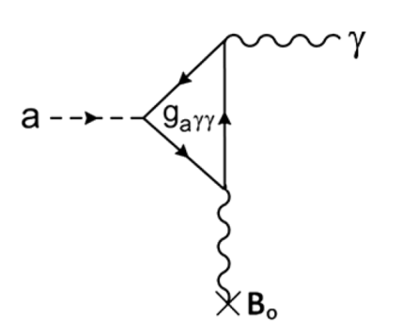
Axions
Couplings to the SM
Axions are a consequence of the
Peccei-Quinn symmetry to explain θ=0.
There might be more couplings to
Standard Model constituents.
These couplings depend on the
BSM models incorporating an
“invisible axion”.
Traditional benchmarks:
DFSZ (Dine, Fischler, Srednicki, Zhitniskii):
axions couple to fermions. E/N = 8/3
KSVZ (Kim, Shifman, Vainshetein, Zakharov):
axions couple to BSM quarks only. E/N = 0
In a background magnetic field:
axion photon mixing
A. Mirizzi, Next Frontiers in the Search for Dark Matter, 2019

Slide 11
Axions and other WISPs in this presentation
Physics motivation
Axions to solve the riddle of CP-conservation in QCD
Photon propagation in the universe
  Wiggles in spectra
  TeV photon transparency
  (new GRB 221009A)
ALPS II
BabyIAXO
Example:
Axion-like particles and GRB 221009A ,
S.V. Troitsky, 2210.09250 [astro-ph.HE]

Slide 12
Axions and other WISPs in this presentation
Physics motivation
Axions to solve the riddle of CP-conservation in QCD
Photon propagation in the universe
Excessive stellar cooling
ALPS II
BabyIAXO
Luca Di Luzio et al JCAP02(2022)035

Slide 13
Axions and other WISPs in this presentation
Physics motivation
Axions to solve the riddle of CP-conservation in QCD
Photon propagation in the universe
Excessive stellar cooling
Dark matter candidates
Report of the Topical Group
on Wave Dark Matter
for Snowmass 2021
2209.08125 [hep-ph]

Slide 14
Axions and other WISPs in this presentation
Physics motivation
Axions to solve the riddle of CP-conservation in QCD
Photon propagation in the universe
Excessive stellar cooling
Dark matter candidates
One new particle could explain it all!
Sokolov, A.V., Ringwald, A.
Photophilic hadronic axion from
heavy magnetic monopoles.
J. High Energ. Phys. 2021, 123 (2021).

Slide 15
Axions and other WISPs in this presentation
Physics motivation
Axions to solve the riddle of CP-conservation in QCD
Photon propagation in the universe
Excessive stellar cooling
Dark matter candidates, related to dark energy
BSM theory
  Axions and axion-like particles are expected from string-theory inspired models for example.
Energy reach: the above-mentioned phenomena address physics at energy scales
from roughly 10⁵ TeV to beyond 10⁹ TeV.
One of the most promising areas to look for physics beyond the standard model?

Slide 16
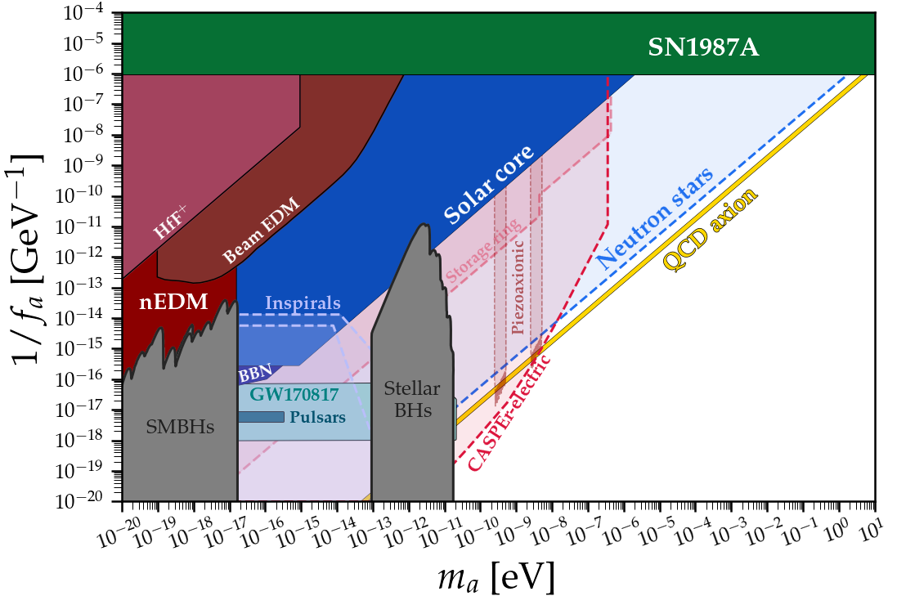
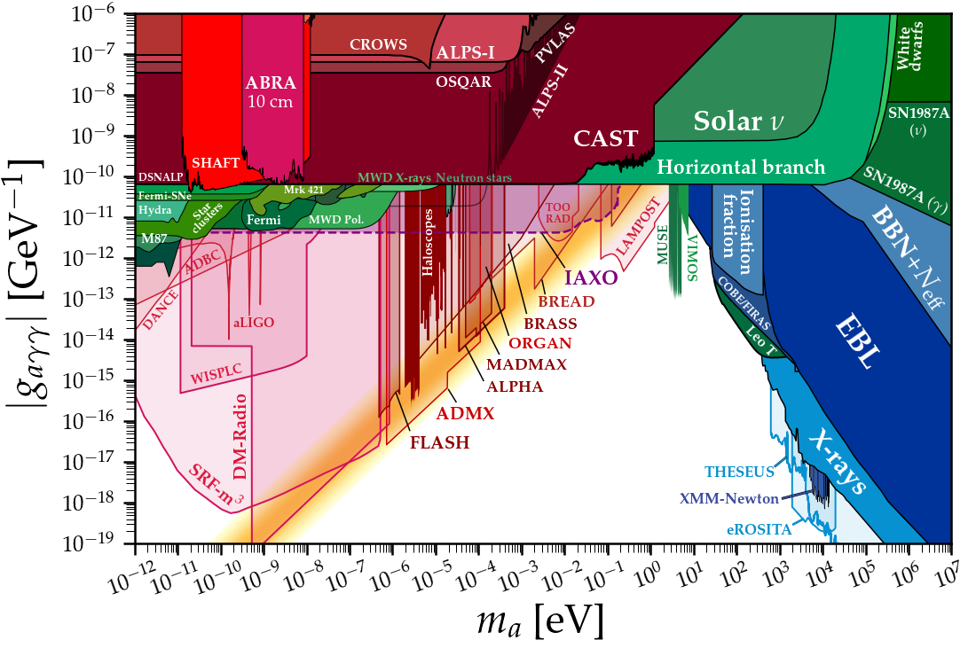
Axions: a huge parameter space to probe
Diversity of experiments is key!
More than 20 orders of mass to probe, different couplings to look for!
(PQ symmetry breaking energy scale)⁻¹ vs axion mass
axion-photon coupling vs axion mass
https://github.com/cajohare/AxionLimits

Slide 17
Outline
Axions:
  A very brief motivation.
Experimental axion searches:
  A subjective selection
Conclusions

Slide 18
Axion / WISP experiments: a selection
Subjective criteria
Remark 1:
One of the fascinations of experimental axion physics is the Nobel-prize-worth discovery potential of
“smaller-scale” projects at individual institutes and university groups.
Funding of such experiments is essential for axion physics and related technology developments.
In this presentation:
“Larger scale” experiments requiring some planning reliability.
Key contributions from German participants.
Significant contributions / interest from international partners.
Targeting directly WISP dark matter or WISP dark matter candidates:
  BSM physics energy scales roughly 10⁴ to beyond 10⁹ TeV.
  No accelerator based / beam-dump experiments.
Non-selected experiments might be equally well relevant for physics, but are / could be realized in a more non-strategic approach.
Which might not always be a disadvantage.

Slide 19
Axion / WISP experiments: a selection
Subjective criteria
In this presentation:
“Larger scale” experiments requiring some planning reliability.
Key contributions from German participants.
Significant contributions / interest from international partners.
Targeting directly WISP dark matter or WISP dark matter candidates:
  BSM physics energy scales roughly 10⁴ to beyond 10⁹ TeV.
  No accelerator based / beam-dump experiments.

Slide 20
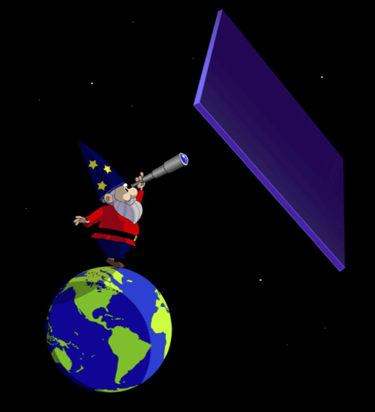




Axion / WISP experiments: a selection
Subjective criteria
In this presentation:
“Larger scale” experiments requiring some planning reliability.
Key contributions from German participants.
Significant contributions / interest from international partners.
Targeting directly WISP dark matter or WISP dark matter candidates:
  BSM physics energy scales roughly 10⁴ to beyond 10⁹ TeV.
  No accelerator based / beam-dump experiments.
GNOME
Remark 2:
I am not aware of an abroad WISP-experiment with strong (several institutes) German participation / interest.
Germany has the potential to become an attractor in experimental axion physics.
(Baby)

Slide 21
Axion / WISP experiments: a selection
Subjective criteria
In this presentation:
“Larger scale” experiments requiring some planning reliability.
Key contributions from German participants.
Significant contributions / interest from international partners.
Targeting directly WISP dark matter or WISP dark matter candidates:
  BSM physics energy scales roughly 10⁴ to beyond 10⁹ TeV.
  No accelerator based / beam-dump experiments.
GNOME
Remark 3:
I am a member of the collaborations
MADMAX, IAXO and ALPS II.
(Baby)

Slide 22
Jülich Electric Dipole Investigations
Dedicate storage ring to search for EDMs

Slide 23
Charge Particle Electric Dipole Moment
Dedicate storage ring to search for EDMs

Slide 24
JEDI / CPEDM
Dedicate storage ring to search for EDMs
What:
Static EDMs of p, d as a signature of BSM physics.
Oscillating EDMs as a signature of dark matter axions.
Axion-gluon coupling!
Courtesy H. Stroeher
arXiv:1710.05271 [hep-ex]

Slide 25
JEDI / CPEDM
Dedicate storage ring to search for EDMs
What:
Static EDMs of p, d as a signature of BSM physics.
Oscillating EDMs as a signature of dark matter axions.
Axion-gluon coupling!
How:
Dedicated storage ring.
  30 m diameter, MeV momentum range.
  Polarization, store 10¹⁰ particles for 1000 s.
Courtesy J. Pretz

Slide 26
JEDI / CPEDM
Dedicate storage ring to search for EDMs
What:
Static EDMs of p, d as a signature of BSM physics.
Oscillating EDMs as a signature of dark matter axions.
Axion-gluon coupling!
How:
Dedicated storage ring.
  ≈ 30 m diameter, MeV momentum range.
  Polarization, store 10¹⁰ particles for 1000 s.
Who:
FZJ, GSI, RWTH Aachen
>= 8 international partners

Slide 27
JEDI / CPEDM
Dedicate storage ring to search for EDMs
Status:
Successful tests at COSY: arXiv:2208.07293 [hep-ex]
Moving from FZJ to GSI / FAIR:
LoI “Towards experiments with polarized beams and targets at the GSI/FAIR storage rings”.
Research Infrastructure Concept Development proposal submitted to EU:
“Pathfinder Facility for a new Class of Precision Physics Storage Rings (PRESTO)”.
Next steps:
Prototype all-electric storage ring within the next 5 years (supported by CERN-PBC).
Establish Germany as the site for a dedicated storage ring?
Clear commitment by (at least) one Helmholtz center?

Slide 28
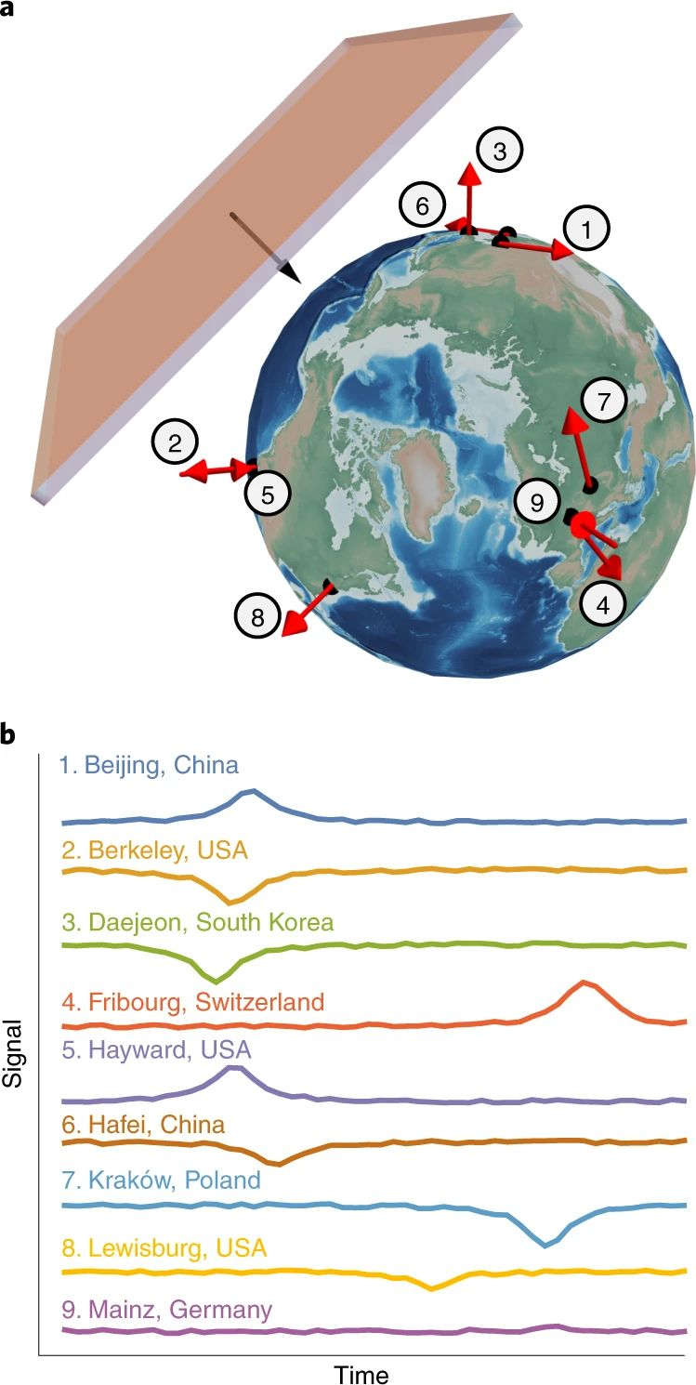
GNOME
GNOME
Global Network of Optical Magnetometers for Exotic physics searches
What:
Search for topological defect dark matter by monitoring
transient events like domain walls passing earth.
Nature Physics volume 17, pages 1396–1401 (2021)

Slide 29
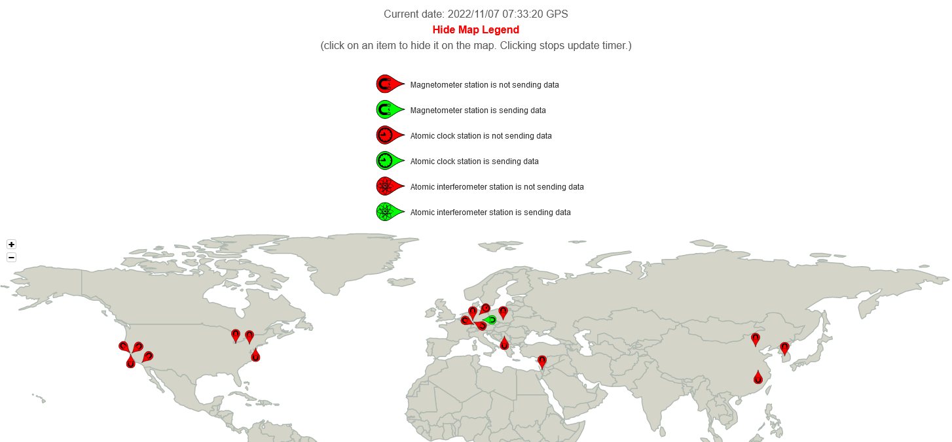
GNOME
GNOME
Global Network of Optical Magnetometers for Exotic physics searches
What:
Search for topological defect dark matter by monitoring
transient events like domain walls passing earth.
How:
Distributed network of sensors:
  Magnetometers
  Atomic clocks
  Atom interferometers
https://budker.uni-mainz.de/gnome/

Slide 30
GNOME
GNOME
Global Network of Optical Magnetometers for Exotic physics searches
What:
Search for topological defect dark matter by monitoring
transient events like domain walls passing earth.
How:
Distributed network of sensors:
  Magnetometers
  Atomic clocks
  Atom interferometers
Who:
JGU Mainz, HI Mainz-GSI, TUM, Leibniz Institute of Photonic Technology (Jena)
> 10 international partners

Slide 31
GNOME
GNOME
Global Network of Optical Magnetometers for Exotic physics searches
Status:
Network is up and (in principle) running.
First data have been published in Nature Physics volume 17, pages 1396–1401 (2021)
(data run 29 November to 22 December 2017).
Next steps:
Secure operation: data taking, data storage / handling and (timely) data analyses.
Further expand network.

Slide 32
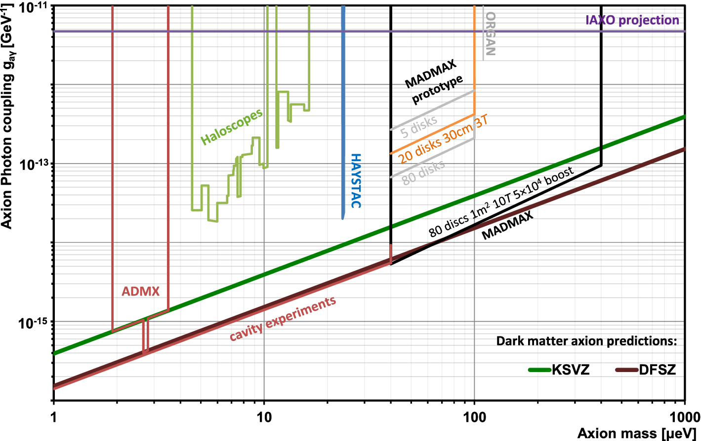
MAgnetized Disc and Mirror Axion eXperiment
Direct axion dark matter search
What:
Axion dark matter in the 100 µeV mass range, post-inflation
models and high mass region of pre-inflation models.
EPJC, volume 79, Article number: 186 (2019)

Slide 33
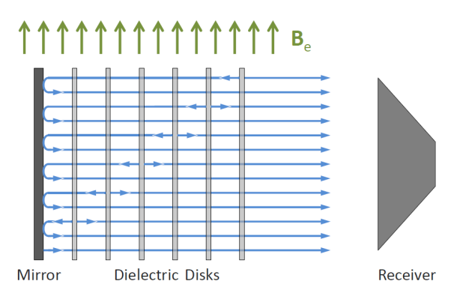
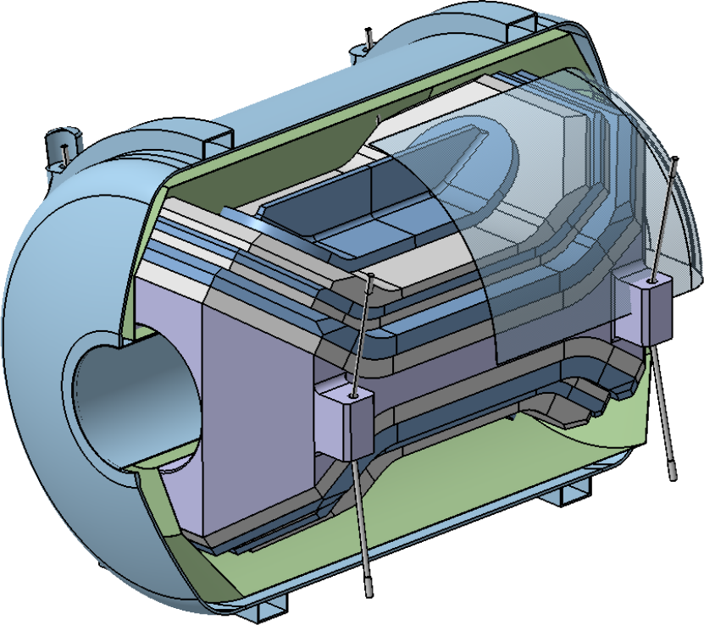
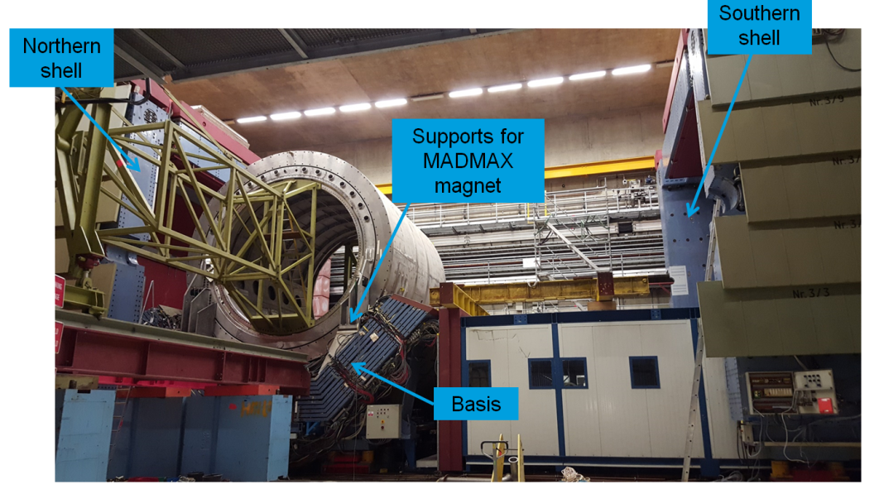
MAgnetized Disc and Mirror Axion eXperiment
Direct axion dark matter search
What:
Axion dark matter in the 100 µeV mass range, post-inflation
models and high mass region of pre-inflation models.
How:
Axion-photon conversion.
Dielectric booster of movable discs inside
a dedicate 10 T dipole magnet with 1m aperture,
to be placed in the H1 iron yoke at DESY in Hamburg.
JCAP 10 (2021) 034

Slide 34
MAgnetized Disc and Mirror Axion eXperiment
Direct axion dark matter search
What:
Axion dark matter in the 100 µeV mass range, post-inflation
models and high mass region of pre-inflation models.
How:
Axion-photon conversion.
Dielectric booster of movable discs inside
a dedicate 10 T dipole magnet with 1m aperture
to be placed in the H1 iron yoke at DESY in Hamburg.
Who:
RWTH Aachen, universities Hamburg and Tübingen, MPP, MPIfR and DESY.
French partners, support by CERN

Slide 35
MAgnetized Disc and Mirror Axion eXperiment
Direct axion dark matter search
Status:
Very substantial progress in the prototyping phase:
  Magnet (Saclay),
  Booster prototype tests (Munich, CERN, U. Hamburg, DESY),
  Calibration procedure developed.
CERN site qualified for dark matter search with prototype.
“Cryoplatform” at DESY to operate MADMAX (and other experiments) will be ready in 2025.
Next steps:
Secure prototyping phase beyond 2023.
Finalize magnet and booster design.
Prepare for start of construction in about 2026.

Slide 36
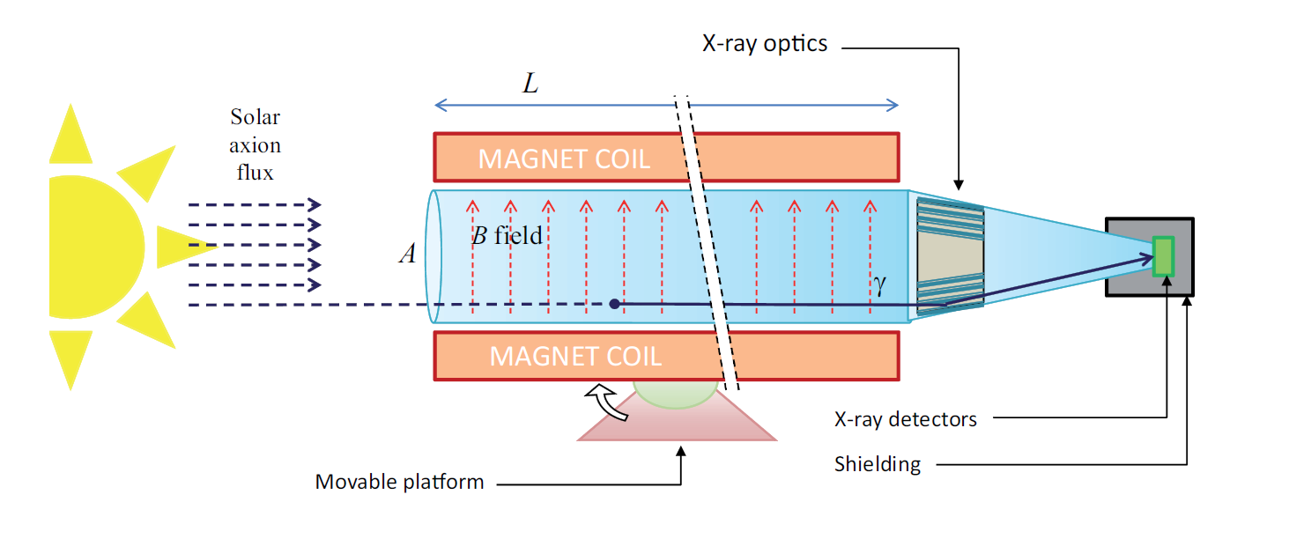
(Baby) International AXion Observatory
Looking for solar axions
What:
Looking for solar axions produced by axion-photon,
axion-electron, axion-nucleon couplings.
“Distinguishing Axion Models with IAXO”
J. Jaeckel, L.J. Thormaehlen, JCAP 03 (2019), 039

Slide 37
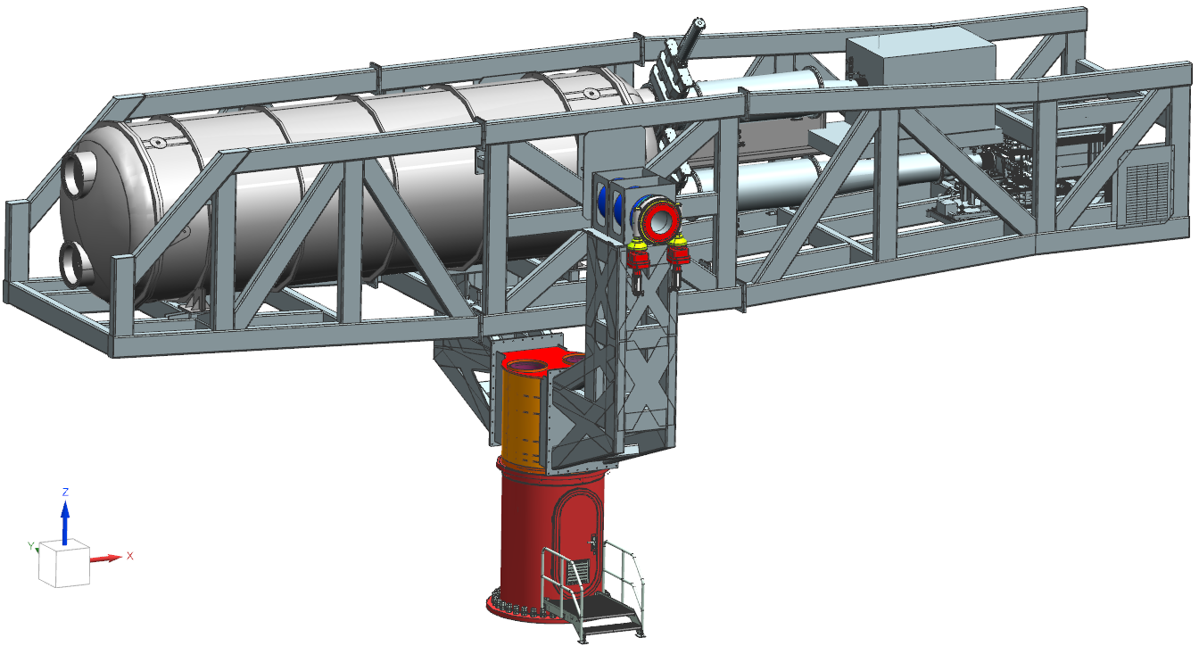
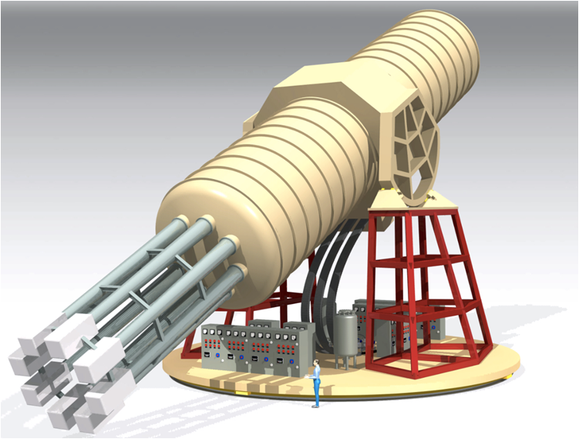
(Baby) International AXion Observatory
Looking for solar axions
What:
Looking for solar axions produced by axion-photon,
axion-electron, axion-nucleon couplings.
How:
BabyIAXO as a prototype stage with
axion-photon coupling sensitivity ≈ 4 times CAST.
to be placed in the HERA South hall at DESY in Hamburg.
120 tons,
21m long

Slide 38
(Baby) International AXion Observatory
Looking for solar axions
What:
Looking for solar axions produced by axion-photon,
axion-electron, axion-nucleon couplings.
How:
BabyIAXO as a prototype stage with
axion-photon coupling sensitivity ≈ 4 times CAST.
to be placed in the HERA South hall at DESY in Hamburg.
Who:
Universities Bonn, Hamburg, Heidelberg, Mainz, Siegen, TUM
DESY, MPE (coming), CERN
>12 international partners.

Slide 39
(Baby) International AXion Observatory
Looking for solar axions
Status of BabyIAXO:
Structure and drive system: design close to be finished, re-use positioner of CTA prototype telescope.
X-ray optics: one bore with XMM-Newton flight spare (loan from ESA), one custom-made.
Low-background detector: final tests of 1st detector generation (MicroMegas), other options in preparation.
Magnet: first conceptual design exist, CERN committed to further detail the layout,
but no Al-stabilized cable supplier available since Russian invasion in the Ukraine.
Next steps towards BabyIAXO:
CERN needs to finish magnet conceptual design.
CERN is looking for alternative cable providers (crucial also for many future detector magnets).
Re-work magnet timeline, magnet costs and funding.
Start construction as soon as a magnet timeline is available.
International funds, ERC funds and DESY funds approved already.

Slide 40
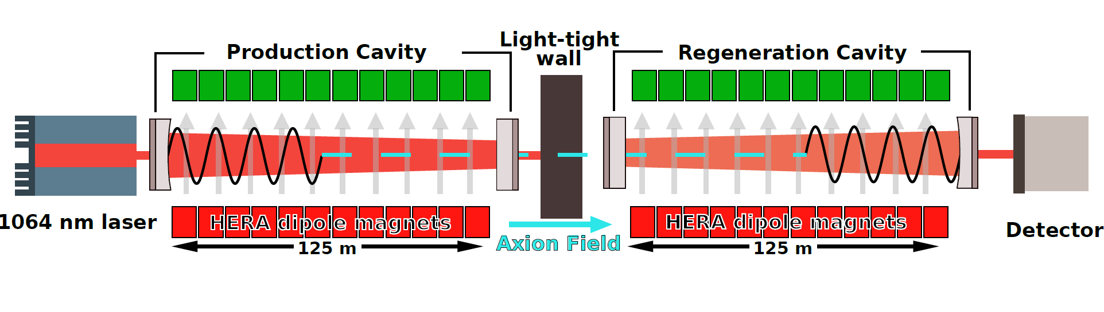
Any Light Particle Search II
Generate and detect axions in the lab
What:
Shining-light-through-a-wall via axion photon mixing.
Probe for axions motivated by astrophysics without
astrophysical and cosmological uncertainties.
2020

Slide 41
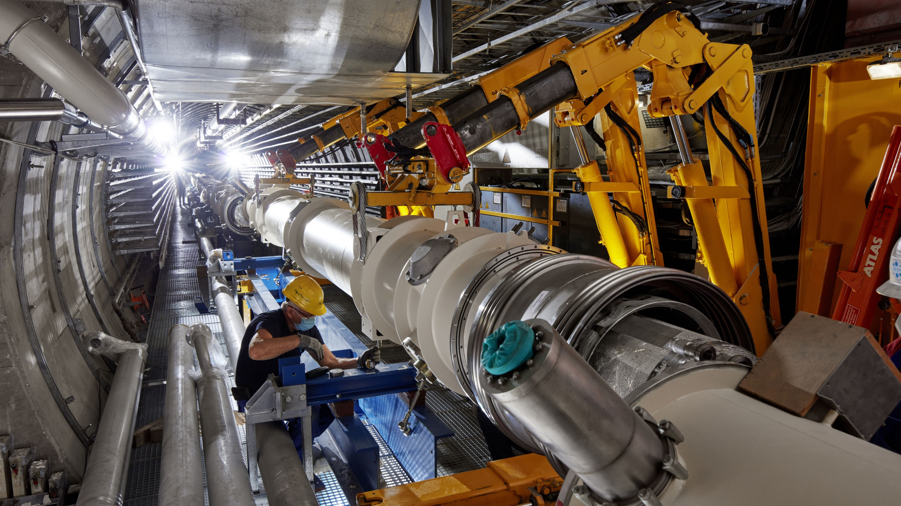
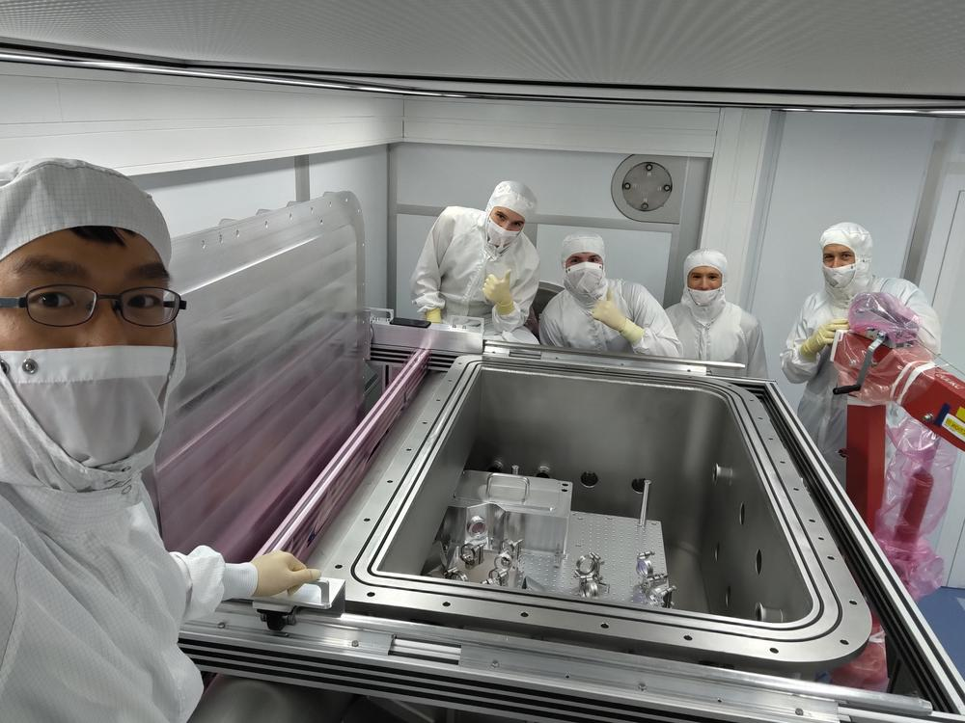
Any Light Particle Search II
Generate and detect axions in the lab
What:
Shining-light-through-a-wall via axion photon mixing.
Probe for axions motivated by astrophysics without
astrophysical and cosmological uncertainties.
How:
24 HERA dipole magnets and long-baseline precision
interferometry to reach an axion-photon coupling sensitivity
≈ 1000 times OSQAR / ALPS I.
located in the HERA North area at DESY in Hamburg.
10/2020

Slide 42
Any Light Particle Search II
Generate and detect axions in the lab
What:
Shining-light-through-a-wall via axion photon mixing.
Probe for axions motivated by astrophysics without
astrophysical and cosmological uncertainties.
How:
24 HERA dipole magnets and long-baseline precision
interferometry to reach an axion-photon coupling sensitivity
≈ 1000 times OSQAR / ALPS I.
located in the HERA North area at DESY in Hamburg.
Who:
Universities Hamburg, Hanover, Mainz, DESY, AEI Hanover
Universities of Cardiff and Florida (Gainesville).
10/2020

Slide 43
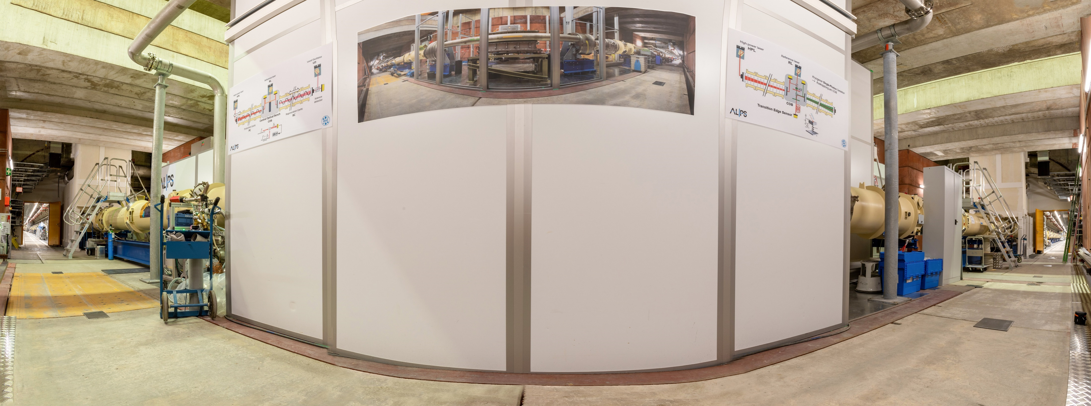
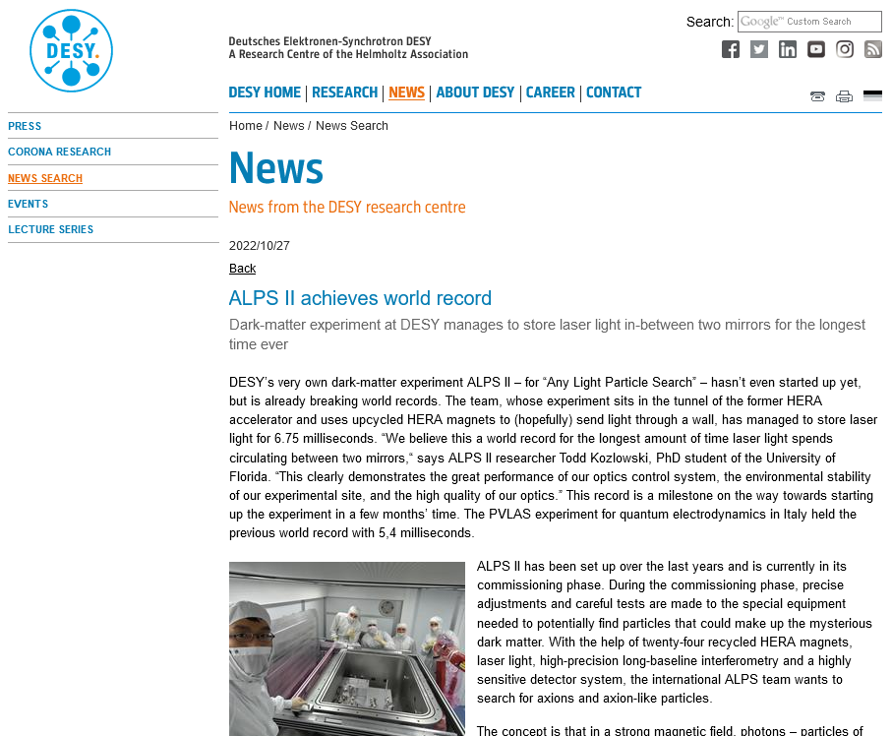
Any Light Particle Search II
Generate and detect axions in the lab
Status:
Installation completed, all systems operational.
Magnet string test operation very successful in 03/2022.
Optics commissioning progressing very smoothly
(including a word-record).
Next steps:
Secure operation phase:
  Initial science run in early 2023.
  Science run with full optical system in late 2023.
  Science run with upgraded optics in 2024.
Secure longer-term exploitation:
  Photon-counting science run, VMB, gravitational wave searches.
09/2022

Slide 44
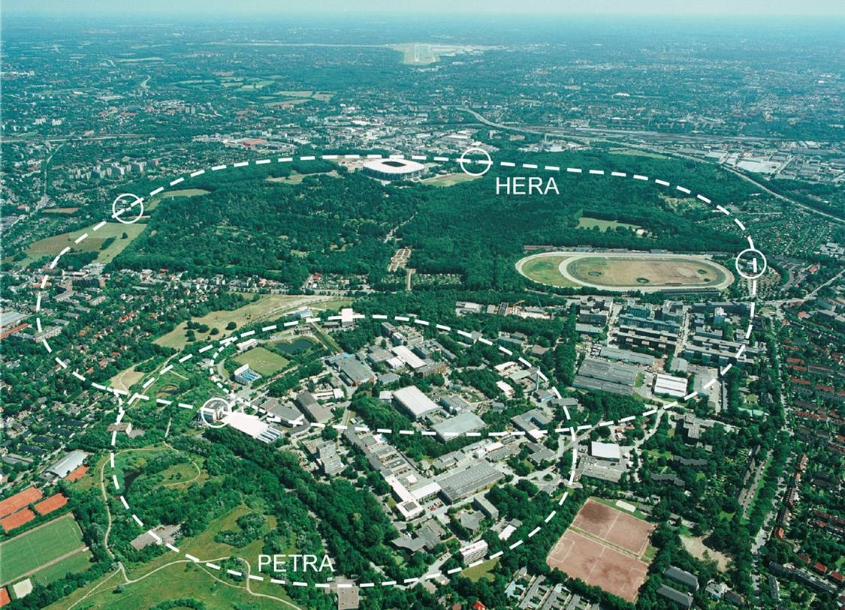
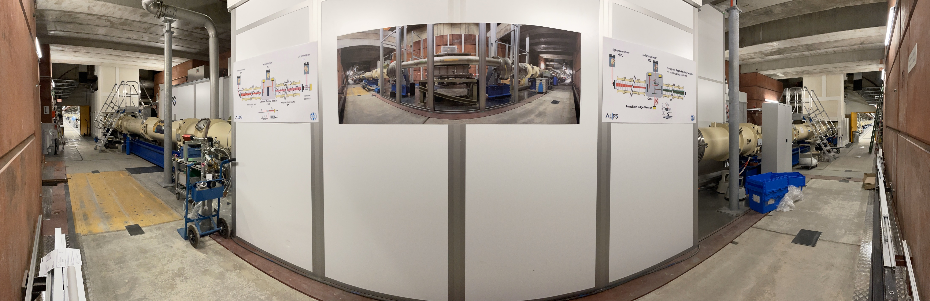
Infrastructure at DESY in Hamburg
Re-using HERA
DESY in about 2000
HERA experiments in about 2028

Slide 45
Axion Technologies
Examples, not exhaustive!
Cross-disciplinary:
Magnetometry.
Hyperpolarization.
X-ray optics.
High precision interferometry.
Accelerator and detector developments
Piezo-drive developments.
New materials.
Magnets!
…
Quantum sensing:
Single photon counting.
Quantum-limited signal amplification.
Sub-shotnoise signal amplification.
Cryogenic micro-calorimeters.
…

Slide 46
Outline
Axions:
  A very brief motivation.
Experimental axion searches:
  A subjective selection
Conclusions

Slide 47
Summary
Axions: a unique opportunity within the next 5-10 years
Physics case:
Multifaceted, but rather simple from an experimentalist’s point of view: just one axion might be the answer.
One of the best BSM scenario in reach of experimental tests.
Experiments in Germany:
World-leading, very diverse. The experiments presented require a somewhat strategic planning.
Cutting-edge technologies, partly combined with existing infrastructures and equipment.
Lot’s of enthusiasm by young (and older) physicists as well as in media.
We need to:
Secure construction and operation phases.
Secure participation of German university groups.

Slide 48
LUXE Experiment
KET Jahrestreffen & Strategie-Workshop 2022
T. Behnke, T. Ferber, B. Heinemann, R. Jacobs, J. List
08.11.2022

Slide 49
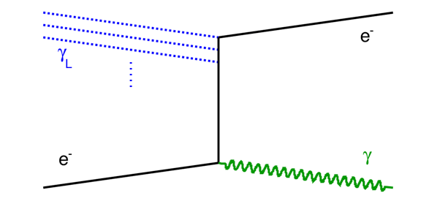
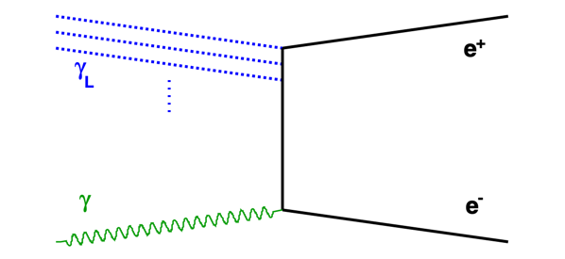
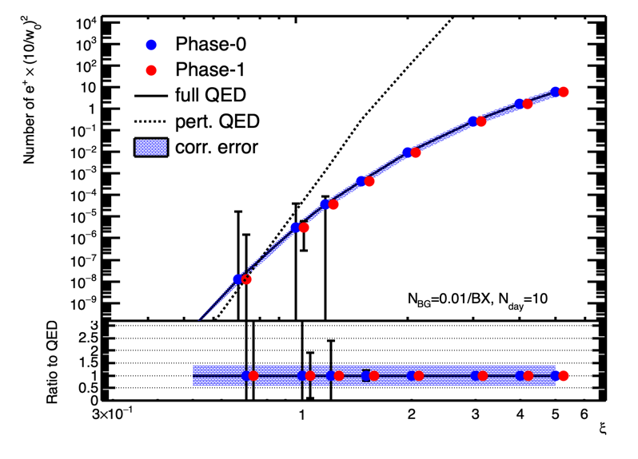
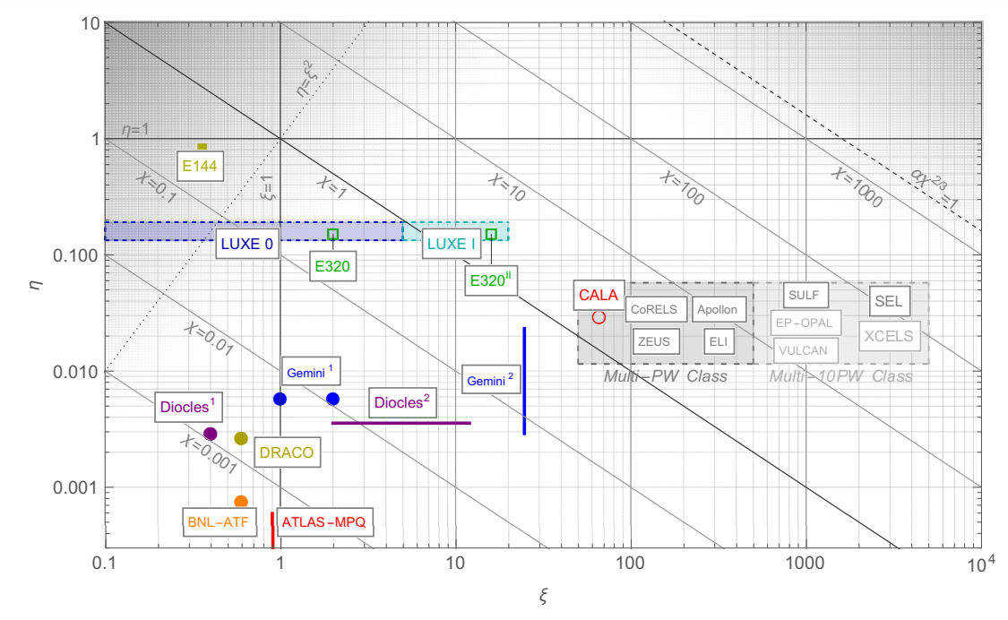


The LUXE Experiment
Study QED in new regime of strong fields, where
it becomes non-perturbative (Schwinger-Limit)
Vacuum becomes unstable, “decays“ into e⁺-e⁻-pairs
→ very interesting theoretically, never measured experimentally!
LUXE: interact high intensity laser beam with Eu.XFEL high energy
electron beam or secondary GeV photon beam
Unique features of LUXE:
  precision mapping of SFQED parameter space
  direct acces to non-linear pair production in photon-Laser collisions
Non-linear Compton Scattering
$$e^{−}+nγ_{L}→e^{−}+γ_{C}$$
Breit-Wheeler pair production
$$γ_{C}+nγ_{L}→e^{+}+e^{−}$$
ξ = “laser intensity parameter”
χ = “non-linearity parameter”
η = energy of the collision
Breit-Wheeler
Positron rate
LUXE physics goal: Precision study of transition from perturbative to non-perturbative QED

Slide 50
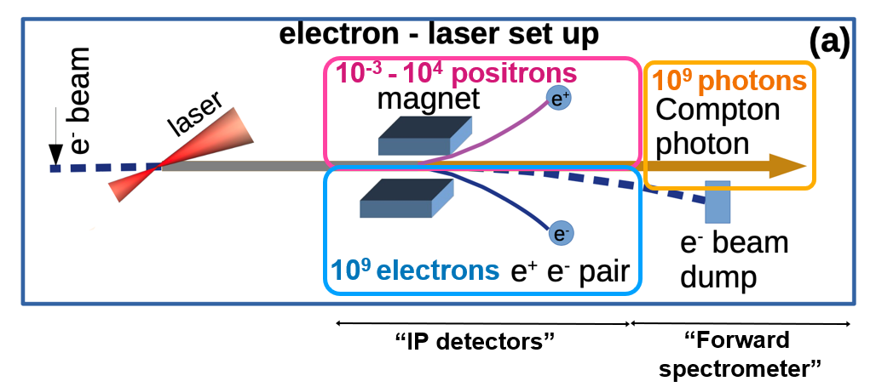
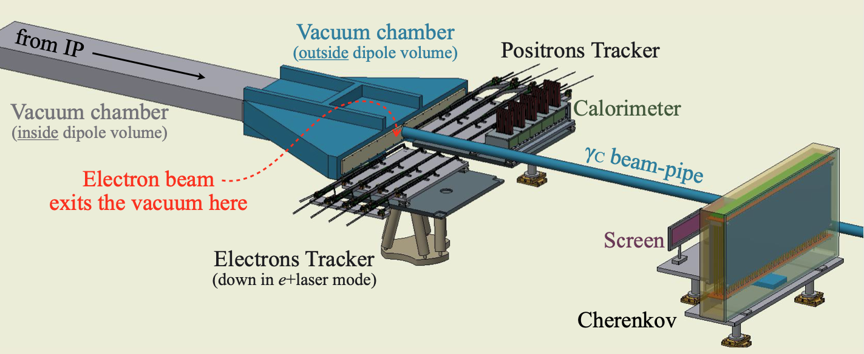
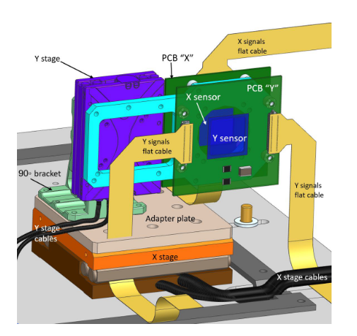
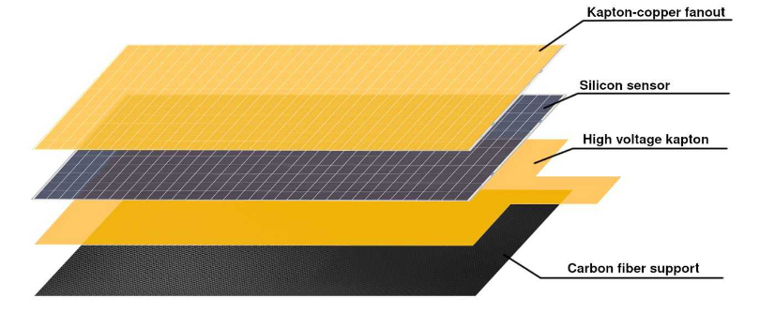
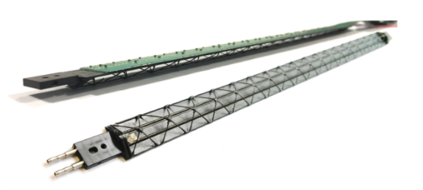
LUXE Particle Detectors
  Goal: Detection of electrons, positrons and photon
  fluxes and energy spectra
  Particle fluxes: ~0.01 e⁺ up to 10⁹ (e⁻ and ɣ) per laser collision!
  technologies in each location adapted to expected signal
  and background rates:
    e⁺: Pixel Tracker (Alpide technology),
    High-granularity GaAs-W Calorimeter
    e⁻: Scintillation Screen & Camera system,
    Cherenkov Detectors
    γ: Sapphire strip beam profiler,
    Conversion spectrometer (Screen & amp. Camera),
    Lead-glass flux monitors
  Foreseen reconstruction software: Key4HEP
  (developed for future colliders)
LUXE IP detectors
ALPIDE tracking detector stave
Gamma Beam Profiler
High-granularity ECAL layer
LUXE: interesting near-term application for detector technologies & software for future colliders!

Slide 51
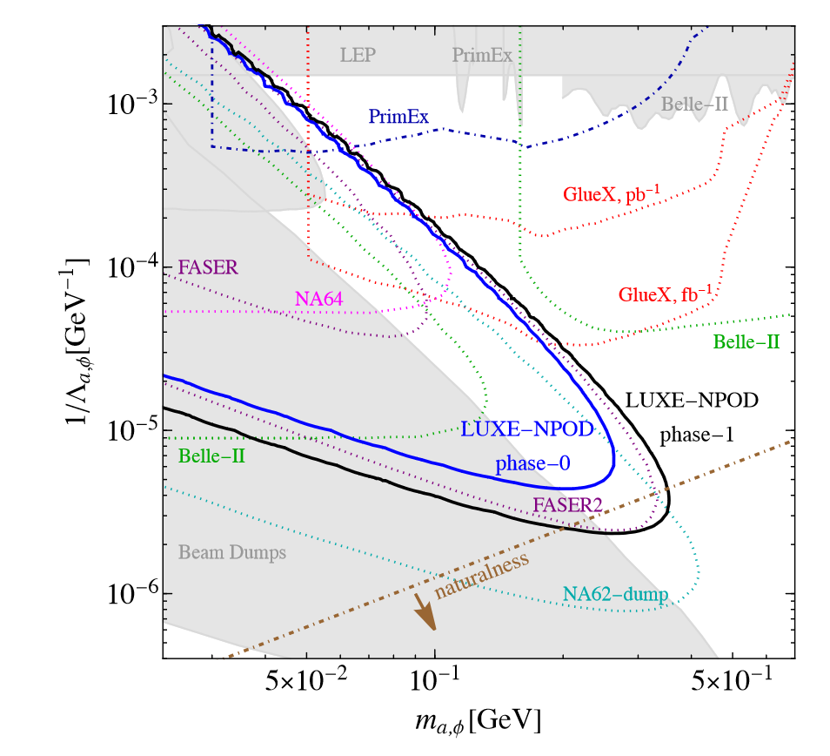
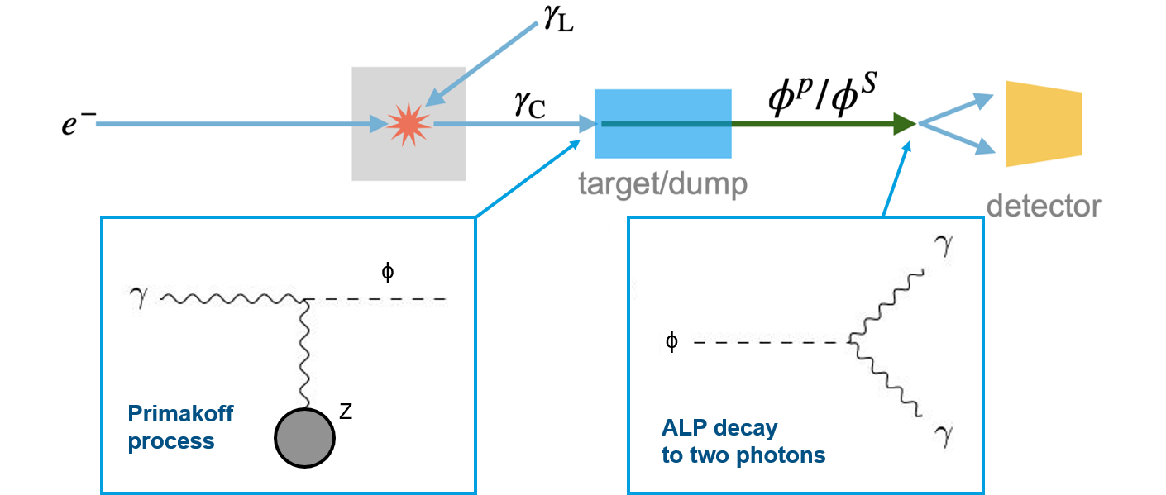

LUXE New Physics Search (LUXE-NPOD)
arXiv:2107.13554
  LUXE will produce a high-intensity photon beam through Compton Scattering
  → produce e.g. axion-like (ALPs) in photon beam-dump
  → detect via new particle decay to two photons
  Production of new particles also possible in primary electron/LASER interaction
  Conceptual design of photon detector with pointing capabilities ongoing
  → similar technologies applicable as e.g. in SHiP
Non-linear Compton Scattering
$$e^{−}+nγ_{L}→e^{−}+γ_{C}$$
LUXE-NPOD sensitivity to sub-GeV ALPs competitive with other experiments ongoing and in planning

Slide 52

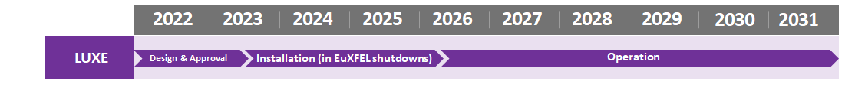
LUXE Status & Planning
CDR: EPJST. 230, 2445–2560 (2021)
LUXE initiated in 2017 (A. Ringwald, B. Heinemann)
LoI in 2019, CDR in 2021
2022: international collaboration with ~20 institutional members,
significant contributions to the experiment by external partners envisioned
At DESY, LUXE has been recognized as an opportunity and well aligned
with DESY’s mission
  Very positive scientific review by international committee in Spring 2022
  DESY critical decision process is being followed up for a full approval,
  CD 1 on 18/11/2022.
LUXE Schedule constraints from Eu.XFEL:
  Main experiment installation in EuXFEL shutdowns
  LUXE tunnel-usage limited by 2nd fan construction start (~mid-2030‘s)
Foresee four-year construction period, after which data-taking could start
→ depending on approval time-scale this could be as early as 2026
Extensive Material on detailed design and planning available, to be turned into TDR by end of 2022
Note: Schedule shifts relative to time of project approval
LUXE: exciting window of opportunity for a near-term new particle physics experiment
Open to new collaborators!

