Slide 1
ARES Operation Meeting
Summary of week 37 / 2022
Willi Kuropka, on behalf of the ARES crew

Slide 2
Short Summary
MON:
EA Timing setup installed in the tunnel, cleaning, tunnel closed
TUE:
Ramping up, ACHIP WP setup, timing setup tested, scanned for DLA R transmission
WED:
AutoAcc shift, beam position feedback using BPM, scanned for DLA L transmission
THU:
Optimized DLA transmission, some TWS1 RF station work by Ingo, checked timing setup
FRI:
Arrival time jitter measurement using TWS2 off-crest to induce correlated energy jitter

Slide 3
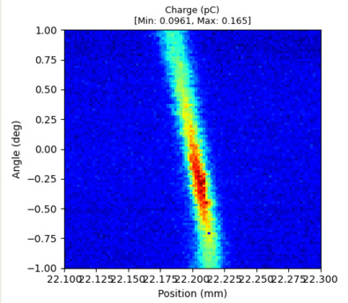
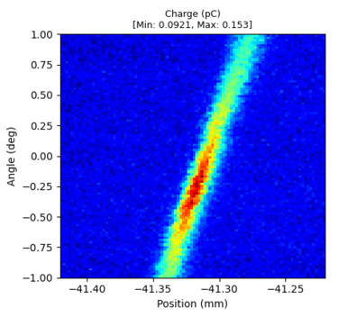
DLA transmission
Both DLAs have comparable transmission, beam trajectory changed between scans due to AA shift

Slide 4
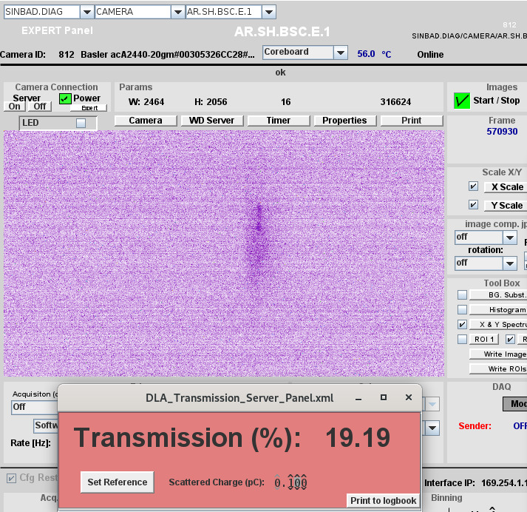
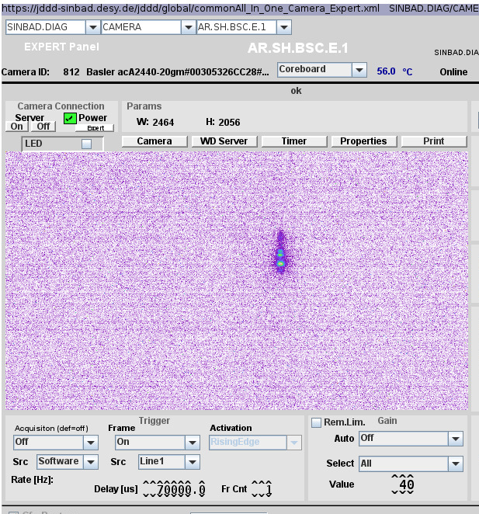

Slide 5
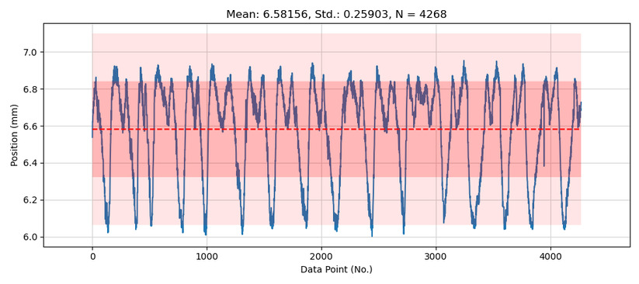
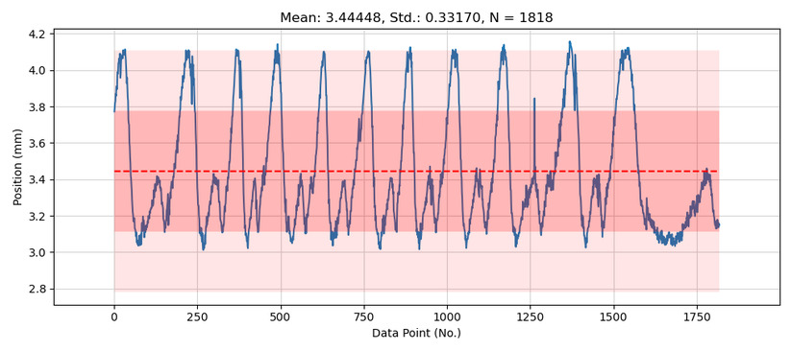
Position jitter
SHE2
DLE1

Slide 6
Plan for this week
Check equipment on laser table in tunnel
Check timing setup
2um beam line alignment, alignment to DLAs
Timing scans of laser and electrons, find time overlap – modulate the electron beam!
AutoAcc shift on Thursday

Slide 7
Schedule
Week 38
Date | Schedule
19.09. | Tunnel open
20.09. | Willi Kuropka
21.09. | Hannes Dinter
22.09. | Frank Mayet, Jan Kaiser
23.09. | Thomas Vinatier
If you want to learn or join the shift: please give the shift leader a call (BKR 2840 / SINBAD Box 2454)

