Slide 1
200 channel sensors
The sensor has been bonded in Pisa and arrived in Padova on 19 September 2022
INFN Padova
Sergii Vasiukov
21.09.2022

Slide 2
The results of a visual test of the condition of
the strips and contacts/bondings using an optical microscope
The all bindings look well.
A short circuit has been observed between strips number 33 and 34 (from the top of the board label)!
There is a lot of dust and lint on the detector surface.
The backside metallization has irregular thickness.

Slide 3
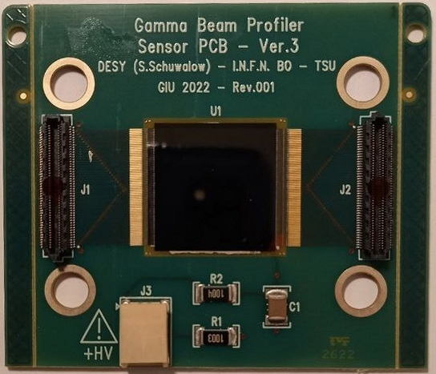
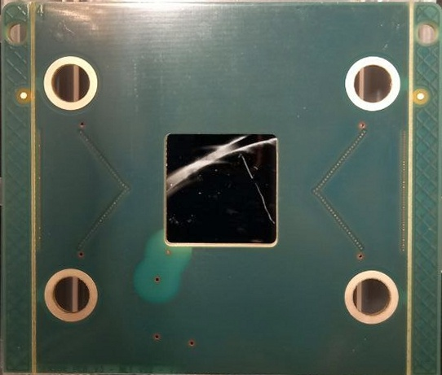
Front view
Back side

Slide 4
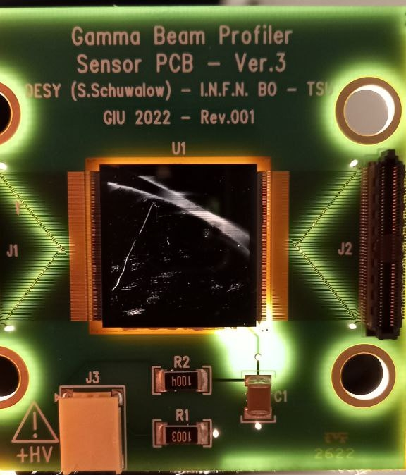
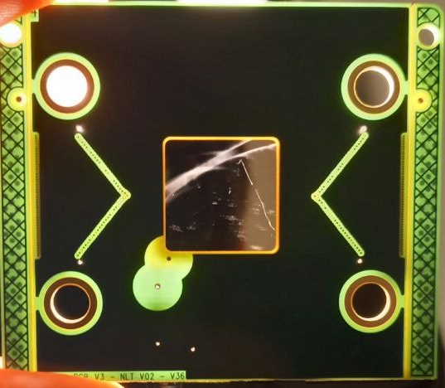
Front view (back illumination)
Back side (back illumination)

Slide 5
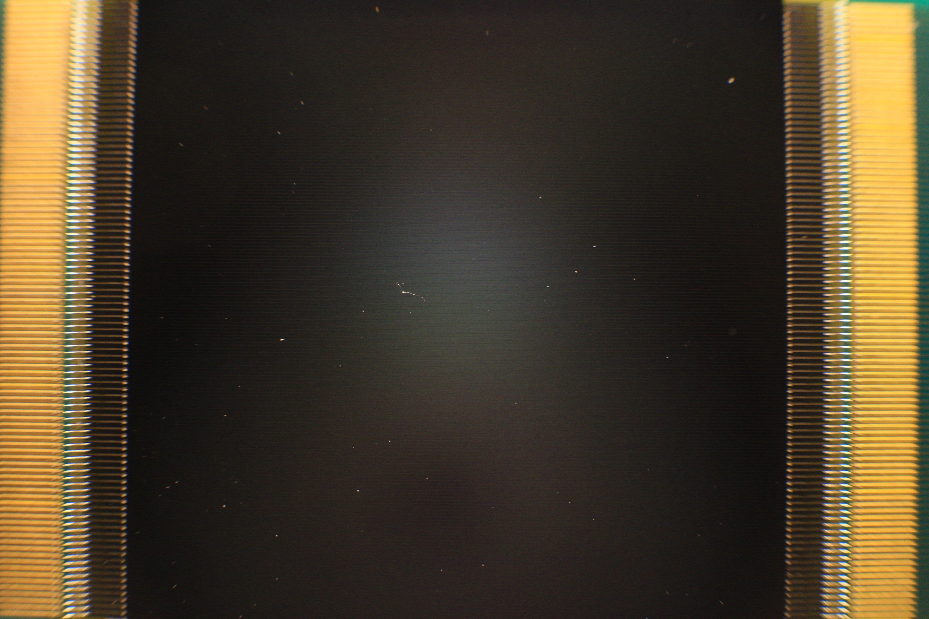
Output wires and strips bonding
Sapphire - Front view

Slide 6
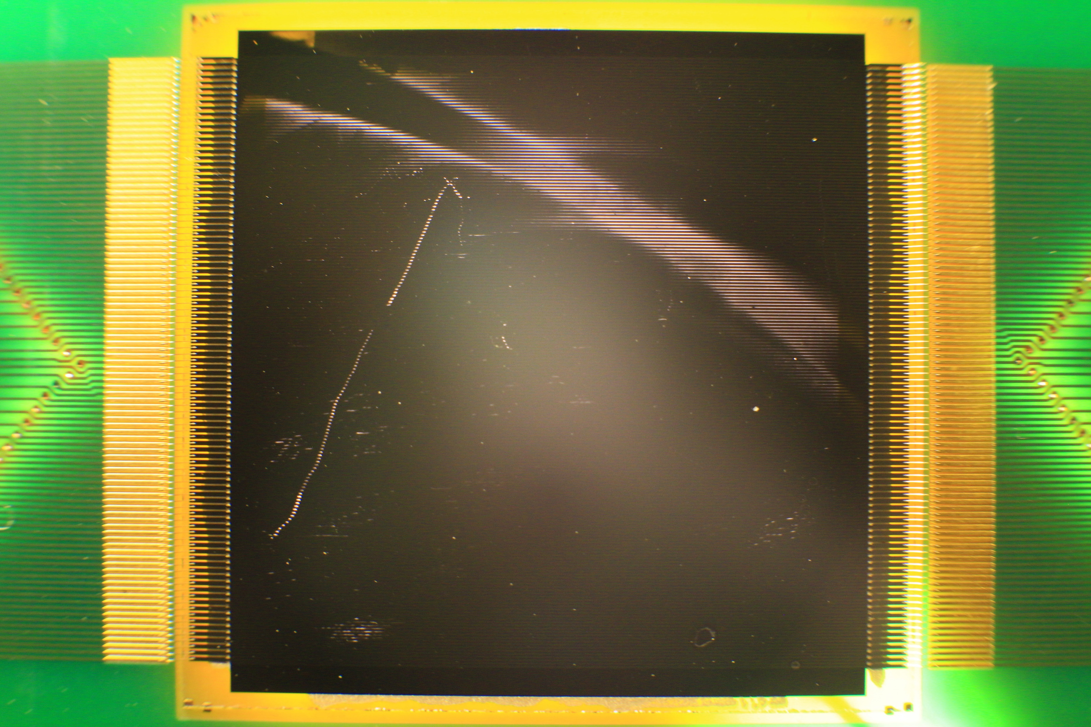
Front view (back illumination)

Slide 7
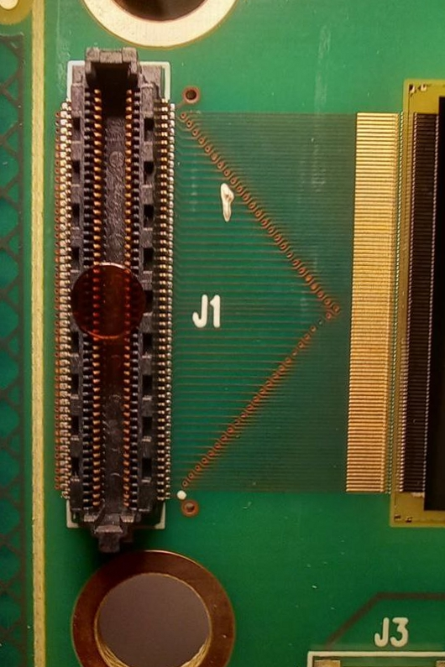
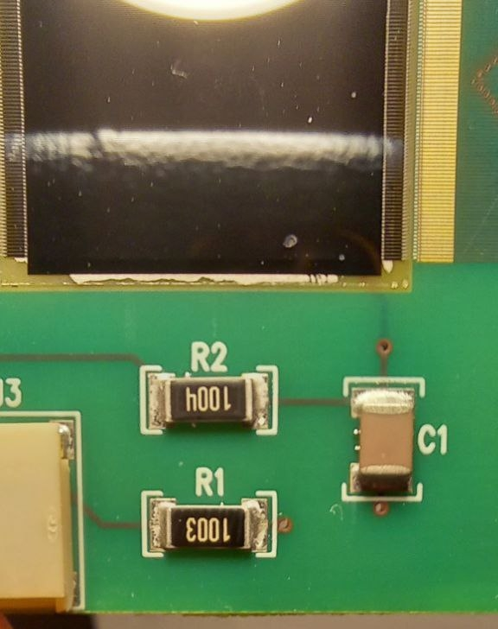
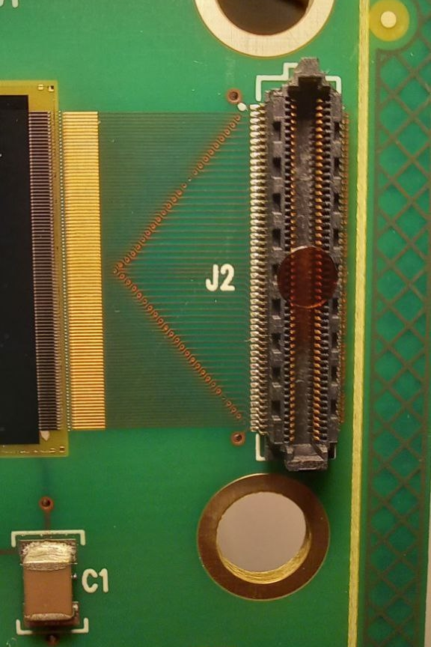
Plugs and electric elements

