Slide 1
Power Supply Tests
for LUXE Gamma Beam Profiler
INFN Padova
Sergii Vasiukov
21.09.2022

Slide 2
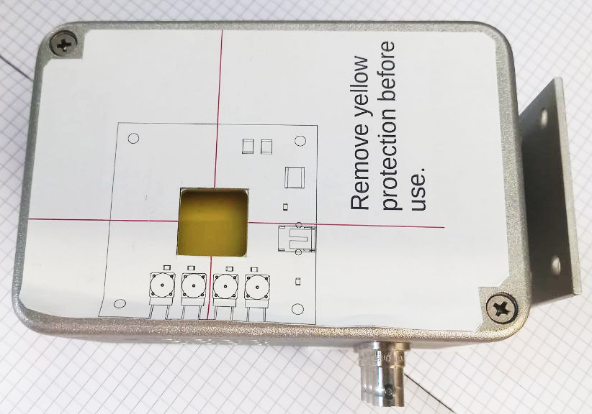
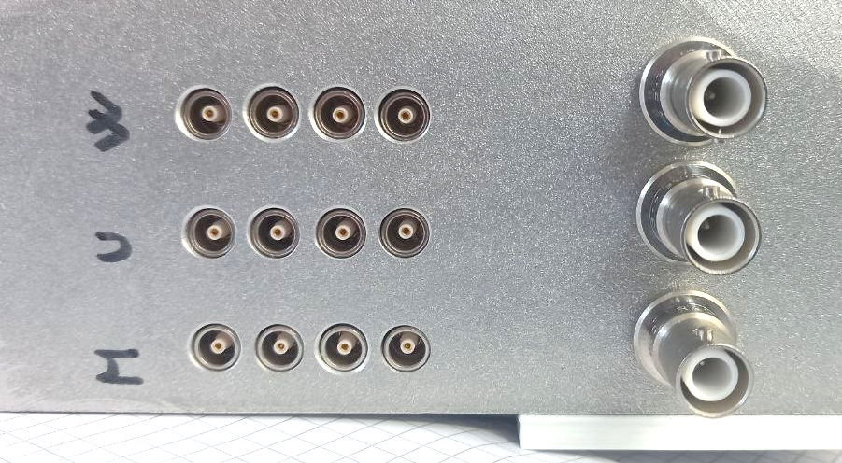
Gamma beam profiler as a load
Detector box
Beam
Assembly of three
detectors in one box.
The device contains the three different types of sapphire sensors:
W - “Wuppertal”
U - “University wafers”
M - “Monocrystal”
top view
Output Channels
4-channel GBP prototype
Sapphire Sensors
HV plugs
Wuppertal
University
200-channel GBP device
Monocrystal
side view

Slide 3
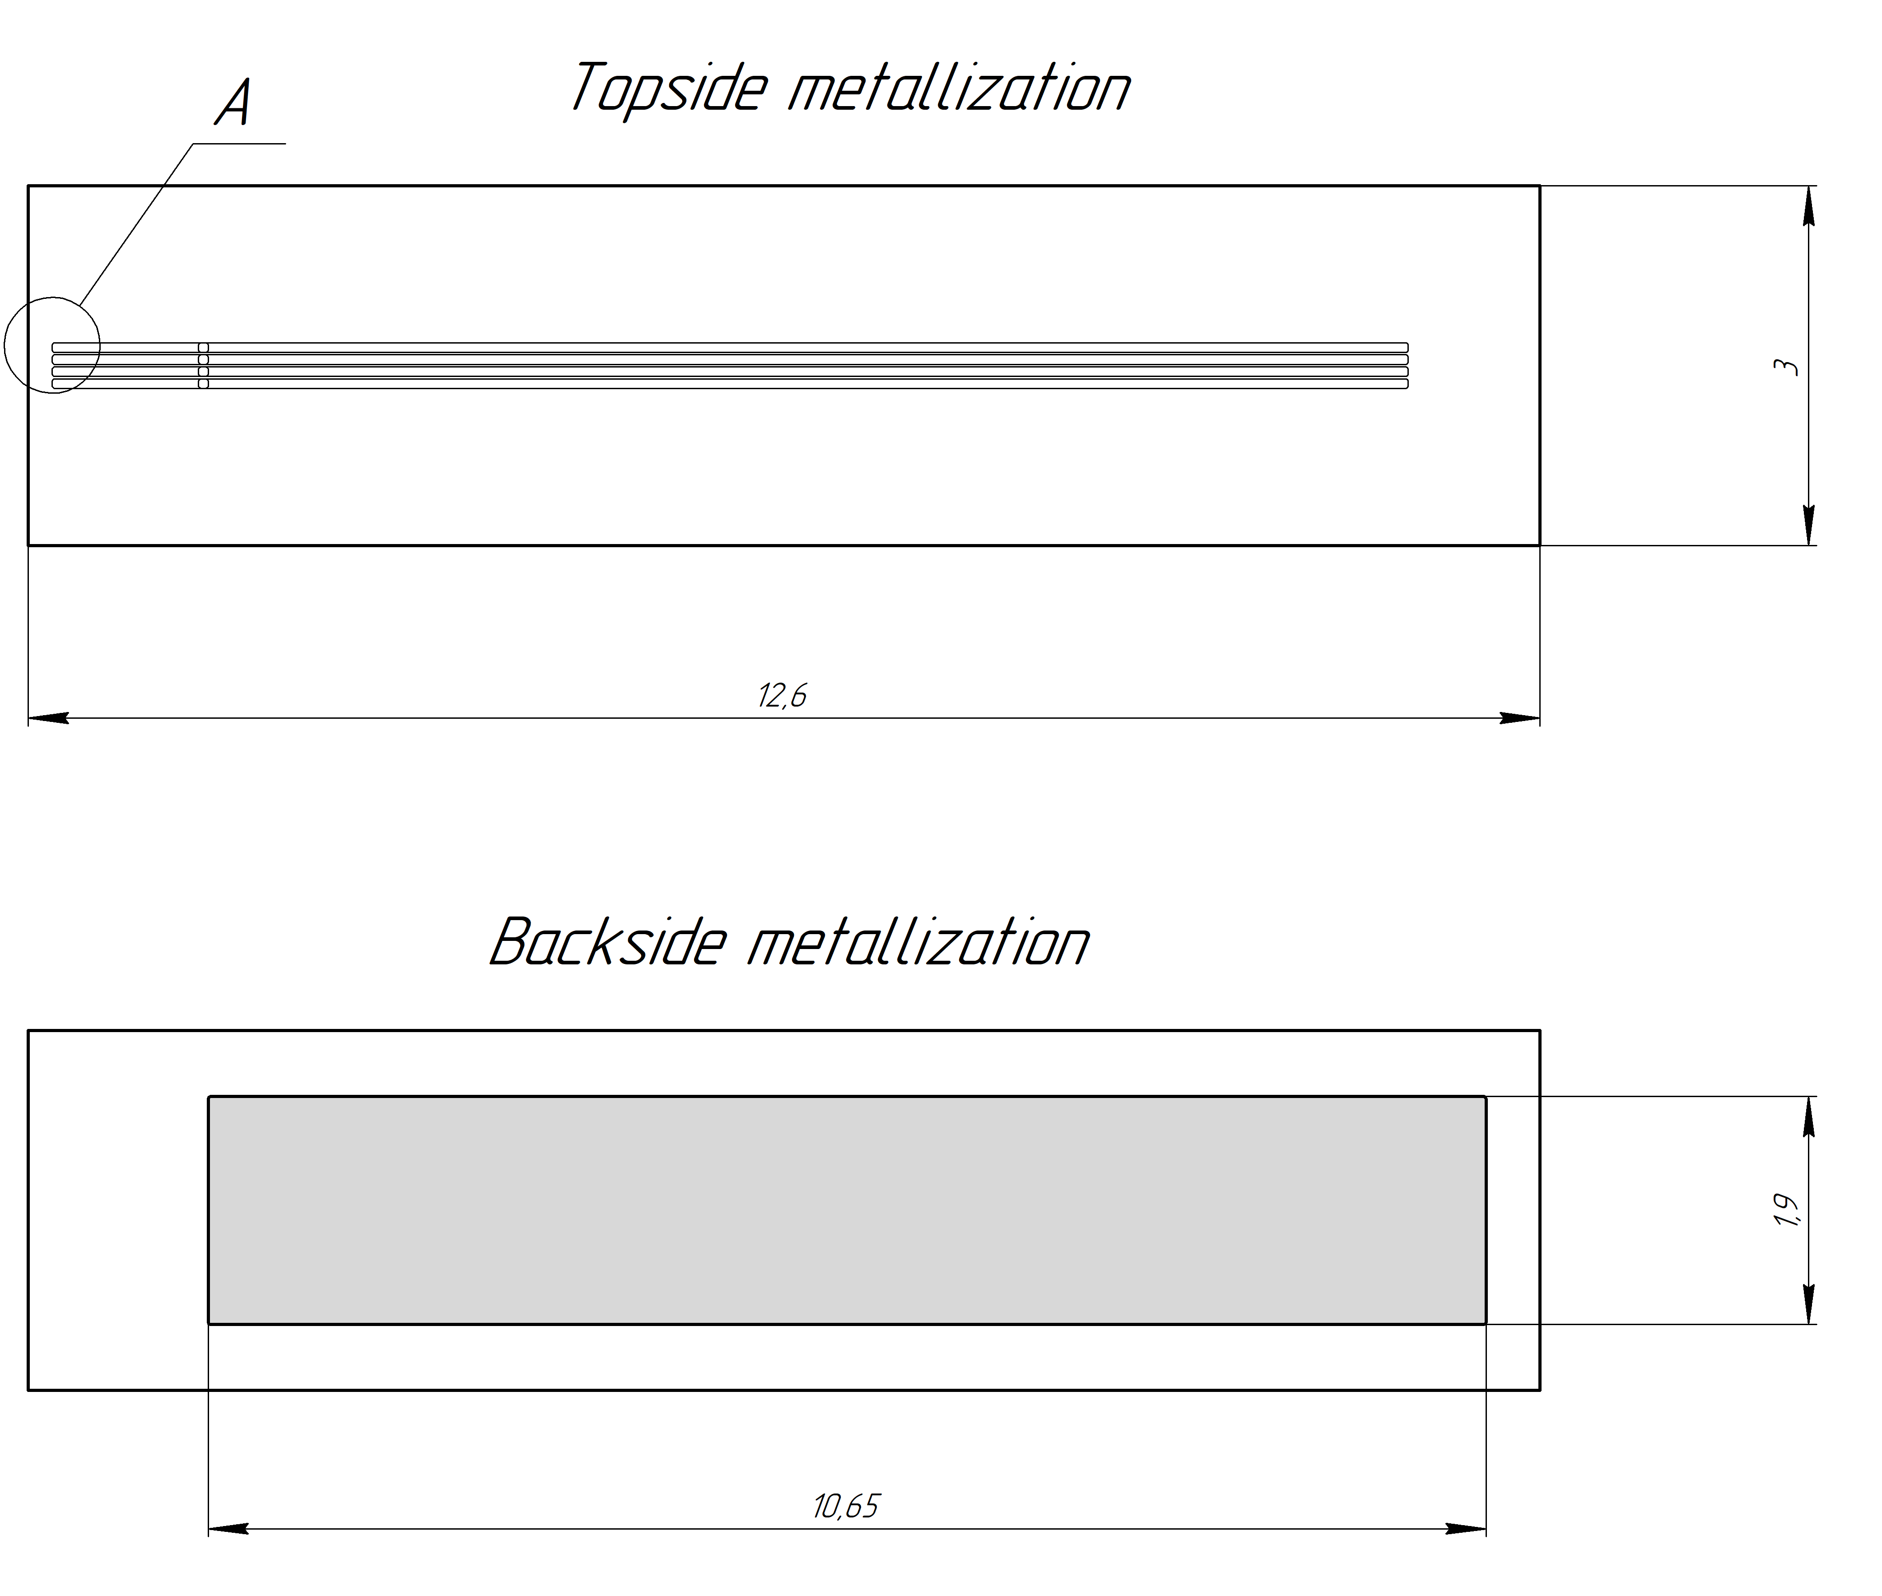
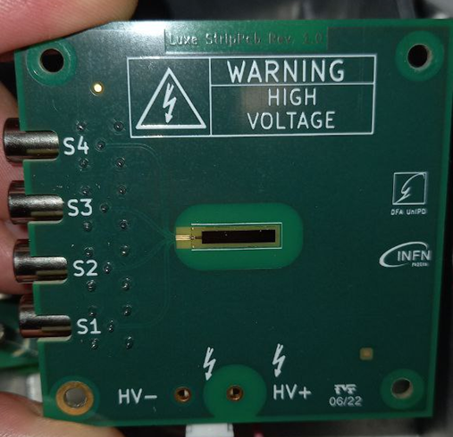
Gamma beam profiler as a load
Scheme and principle
Under ionizing radiation, a small current flows in the circuit at a bias voltage. The current gives information about the integral value of the radiation intensity. The signal in each channel gives the cross-section distribution of the beam intensity in the vertical or horizontal direction.
The goal is to reconstruct the beam profile and parameters.
1M Ohm
Bias voltage
+
1M Ohm
HV
Metallization
10nF
Sapphire
GND
GND
Strips
Ch 1
GND
Ch 2
GND
Ch 3
GND
Ch 4
1M Ohm
1M Ohm
1M Ohm
1M Ohm
GND
Sapphire-trips are non-ohmic contacts
1M Ohm
Beam
GND
GND
GND
GND

Slide 4
The minimum requests list
The bias voltage from 0 to 1.5 kV
The standard Ethernet or USB connections and protocols
High accuracy and stability of bias voltage
High accuracy and reliability of voltage and current monitors
More ???

Slide 5
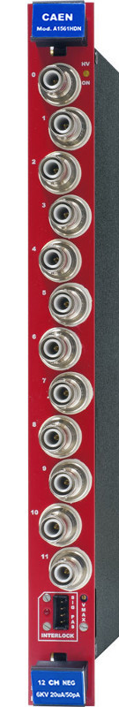
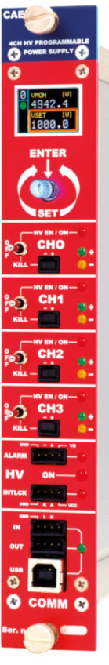
HV power supply module
The module under test
Standard module (for comparison)
A1561H
12 Channel 6 kV/20 µA
Common Floating Return Board
LAN/Ethernet interface
S/N 19804
N1471H
4 Ch Reversible 5.5 kV/20 µA
NIM HV Power Supply High Accuracy Module
USB interface
S/N 1021
The firmware version is 2.01 (an old release of 2013) and doesn’t include the current offset setting (ZC Detect and ZC Adjust).
Model | Channels Number | Max Output V | Max Output I | V_{set}/V_{mon} Resolution | I_{set}/I_{mon} Resolution
A1561H | 12 | 6000 V | 20 uA | 100 / 10 mV | 1 nA / 50 pA
N1471H | 4 | 5500 V | 20 uA | 100 mV | 0.5 nA / 50 pA
V_{mon} and I_{mon} are important parameters in our experiment

Slide 6
A1561H + SY5527LC test (no irradiation)
No offset correction
4200 pA
2250 pA
1750 pA
100 pA
I_{mon} Resolution
50 pA
Bias voltage affects the current monitor value. The current has never reached zero or negative value.
The current monitor value is close to the advertised accuracy of 50 pA at low bias voltage only.
The current offset correction does not completely solve the problem!

Slide 7


Power supply module – Feature No 1
The module under test
Standard module (for comparison)
A1561H
N1471H
The current slowly decreases even after 10 minutes!
The current reaches a minimum positive value of about a few nano amperes.
The current offset correction does not solve the problem at high bias voltage!
The current drops down to zero in ~10 sec, after reaching the inset HV value.
Only positive current value was observed.
The firmware doesn’t include the current offset setting (ZC Detect and ZC Adjust).

Slide 8
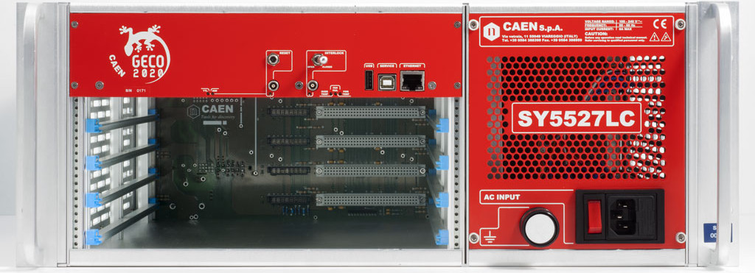
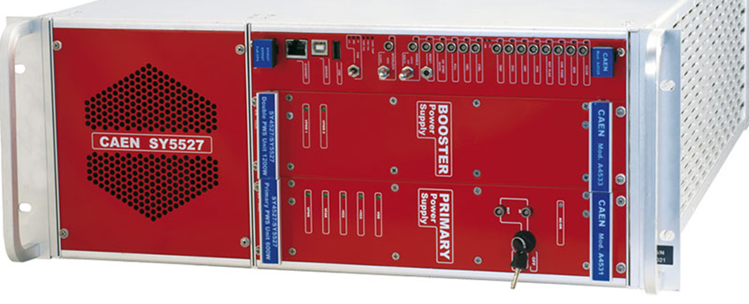
Primary module crate for A1561H – Feature No 2
The combination of HV power supply modules and Power Supply System
shows different current values for the same detector!
SY 5527 LC (Padova)
S/N 22458
A1561H module
S/N 19804
SY 5527 (CERN)
S/N 0398
The current has never reached zero or negative value.
Both positive and negative current values were observed.
Only positive
Positive and negative
N1471H module S/N 1021
Only positive current value or zero were observed.
Positive and zero

Slide 9
Questions list
How to measure the exact and real value of voltage and current?
How to make current and voltage measurements independent of other factors and settings?
What setting can guarantee measurement accuracy regardless of a module, crate, software, etc.?

