Slide 1
Test-beam 2022 Analysis
Ideas and proposals
Wolfgang Lohmann, DESY, BTU and RWTH

Slide 2
Strategy for data analysis
Since we have many data, we should set priorities,
to get some results soon, others later
Verify the readout. Urgent!
Analyse GaAs data with 5 GeV electron beam.
Analyse Calice data with 5 GeV electron beam.
Analyse data with tungsten absorber.
Prerequisites:
telescope track reconstruction works
Alignment done, residuals checked
Track quality creteria established

Slide 3
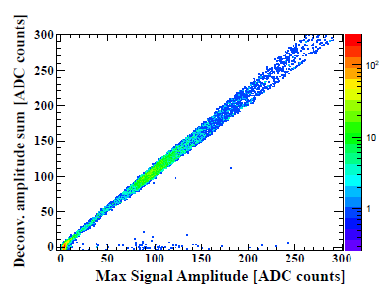
Strategy for data analysis
Verify the read out
Check communication with TLU
Check synchronization with telescope
Align the sensor with respect to the telescope
Make pad structure visible
Analysis of raw data (full read-out, without data reduction), measure S/N, emulate deconvolution.

Slide 4
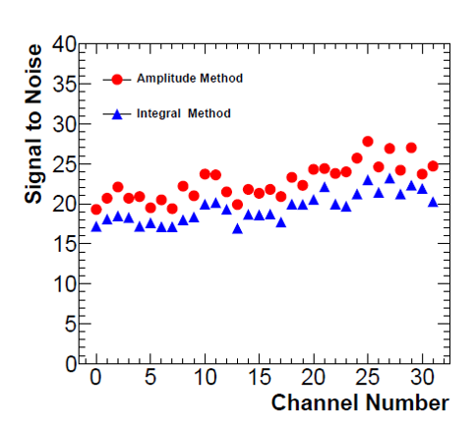
Strategy for data analysis
Analysis of GaAs data with 5 GeV beam
Precise alignment of telescope and sensor
Make pad structure visible
Measure signal size as function of the (absolute and relative) position over pads
Measure signal size in the border regions and between pads
Measure signal size in the area of the aluminum strips
Analyse cross talk
Potential publication !

Slide 5
Strategy for data analysis
Analysis of Calice sensors with 5 GeV beam
Same program as for GaAs sensors, with emphazise on response homogeeity
Important for LUXE ! At least a technical note for LUXE.

Slide 6
Strategy for data analysis
Analysis of data with tungsten absorber
Understand the response of the readout to larger signals, potential cross talk
Understand the response for “low gain”, define the overlap in amplitudes
Illustrate longitudinal and transversal shower profiles, compare with simulation and previous results (our first measurements of the shower tails)

Slide 7
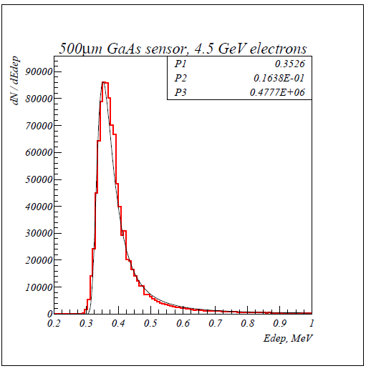
4.5 GeV electron beam,
500 μm sensor thickness
GEANT4 simulation
Estimated number of e/h pairs per μm GaAs for different electron energies,
In a 300 μm thick sensor this corresponds to 25000 electrons

