Slide 1
200 channel sensors
Current-voltage characteristic
Samtec - Lemo Adaptors
X-ray setup
INFN Padova
Sergii Vasiukov
05.10.2022

Slide 2
Current-voltage characteristic (CVC)
Linear CVC dependence from -1.5 to +1.5 kV.
High internal resistance R ~ 1.6 TΩ.
The electrical capacitance determines the inertia of the response.
To do list:
Check the CVC of 4 channel detectors (W, U, M).
Determine the time constant for charging/discharging the capacitance.

Slide 3
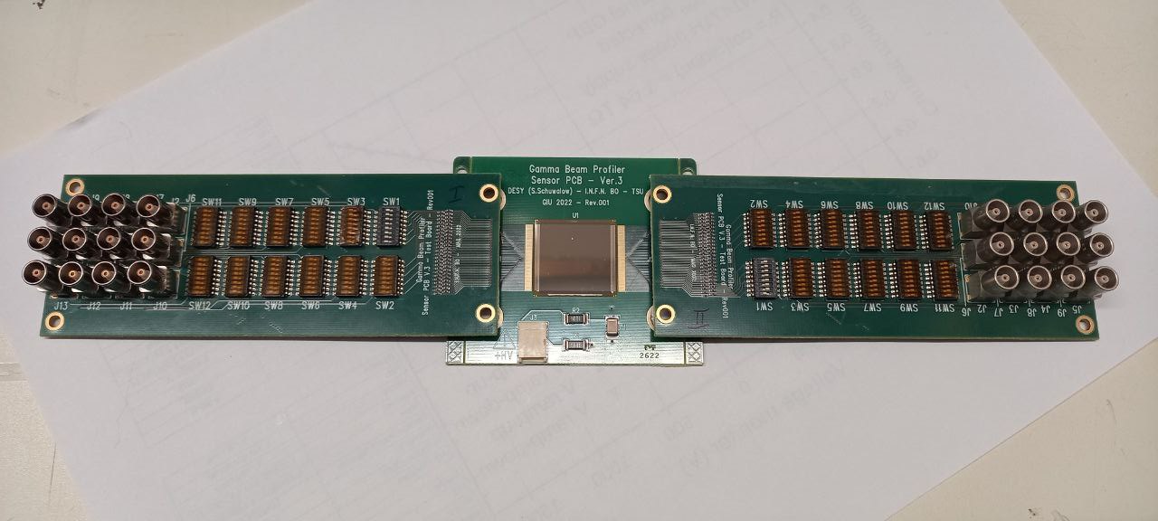
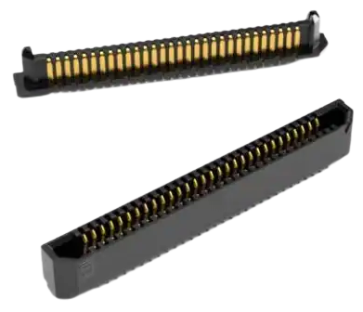
Samtec - Lemo Adaptors
12 channel output
12 channel output
GBP board
adaptor board
adaptor board
Switchers
Switchers
Samtec ERx6 Edge Rate Connectors
https://eu.mouser.com/new/samtec/samtec-erx6-edgerate-connectors/

Slide 4
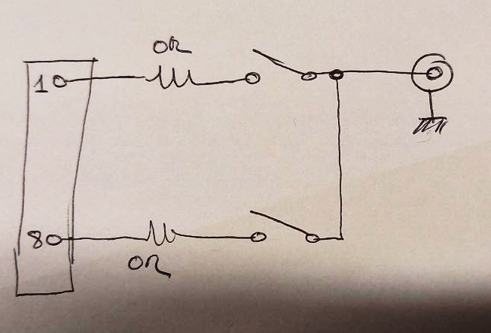
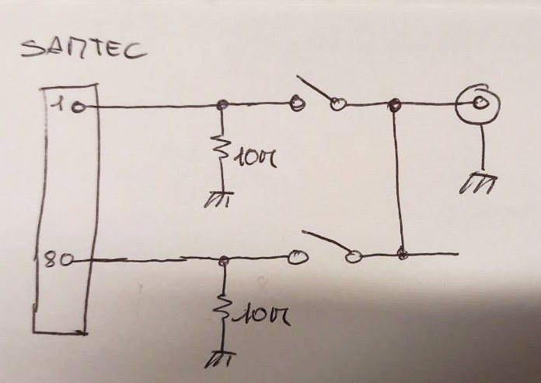
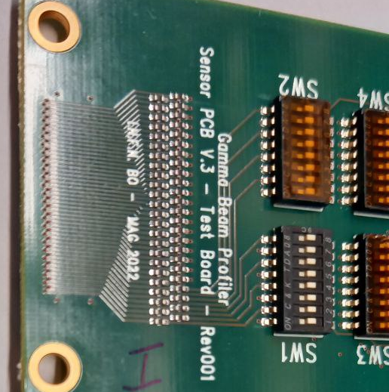
Samtec - Lemo Adaptors
Samtec
Switchers
Samtec
Switchers
Samtec
Switchers
available
expected
0.1 Ohm
To do list:
Solder shunt resistors between output and ground (done).
Adapter test: switches, noise in channels.

Slide 5
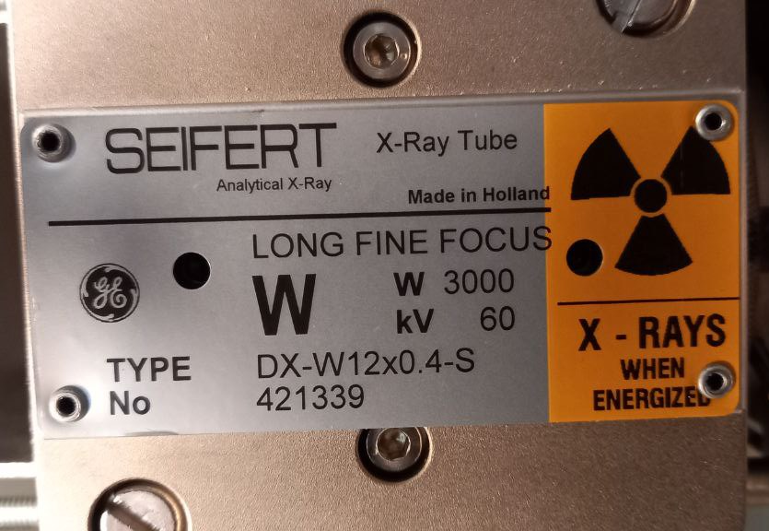
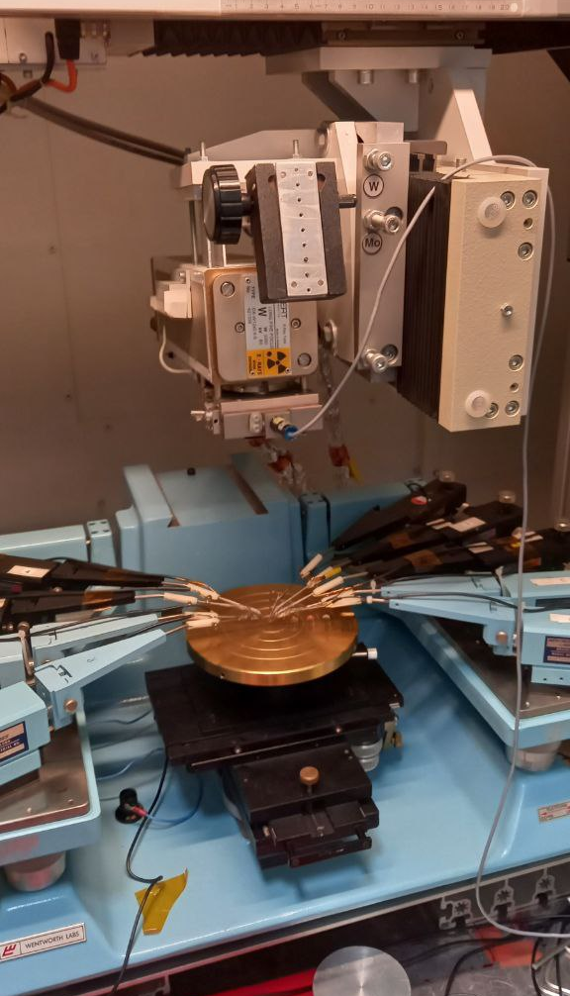
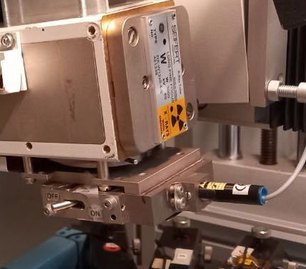
X-ray setup - Delay due to staff being covid positive
To do list:
Large (long) detector box.
Clean the X-ray machine work table
(permission need)
Install NIM crate, oscilloscope and all wires in the safe zone.
Installing the GBP on the table and alignment (permission need)

Slide 7
200 channel sensors
The sensor has been bonded in Pisa and arrived in Padova on 19 September 2022
INFN Padova
Sergii Vasiukov
21.09.2022

Slide 8
The results of a visual test of the condition of
the strips and contacts/bondings using an optical microscope
The all bindings look well.
A short circuit has been observed between strips number 33 and 34 (from the top of the board label)!
There is a lot of dust and lint on the detector surface.
The backside metallization has irregular thickness.

Slide 9
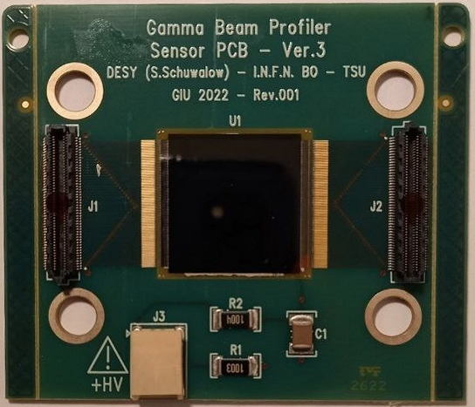
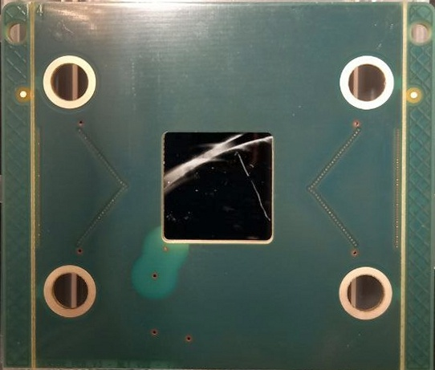
Front view
Back side

Slide 10
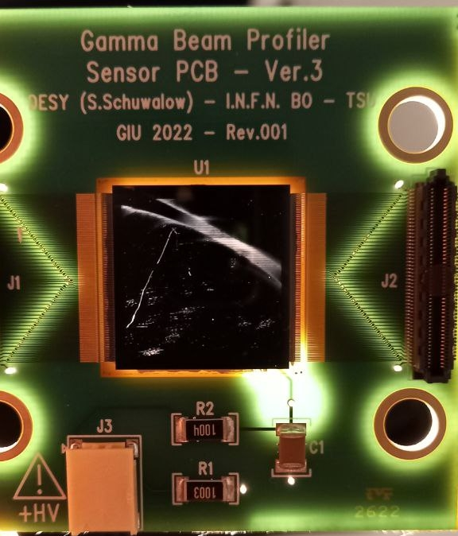
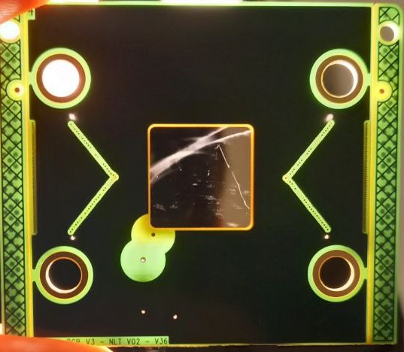
Front view (back illumination)
Back side (back illumination)

Slide 11
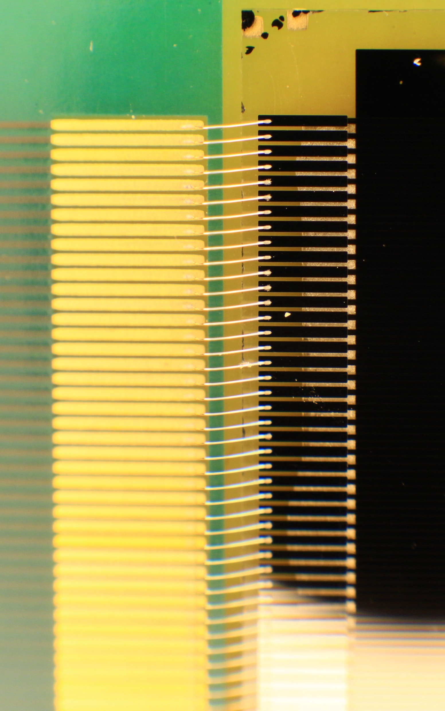
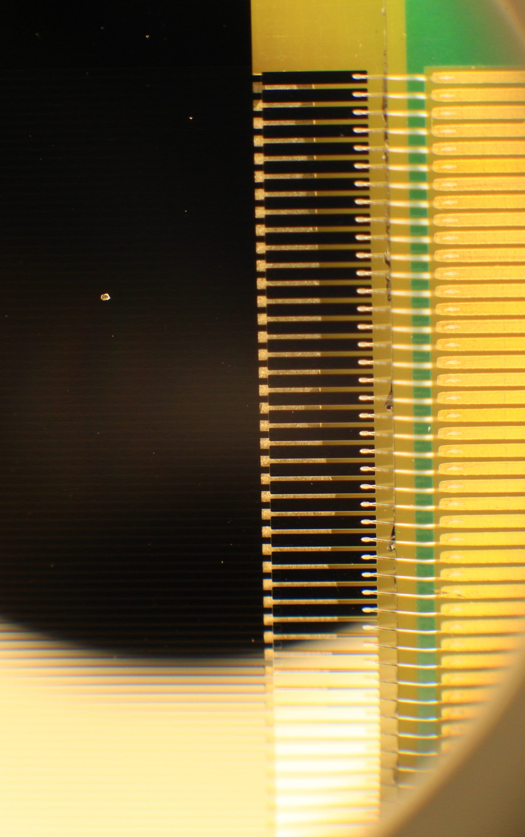
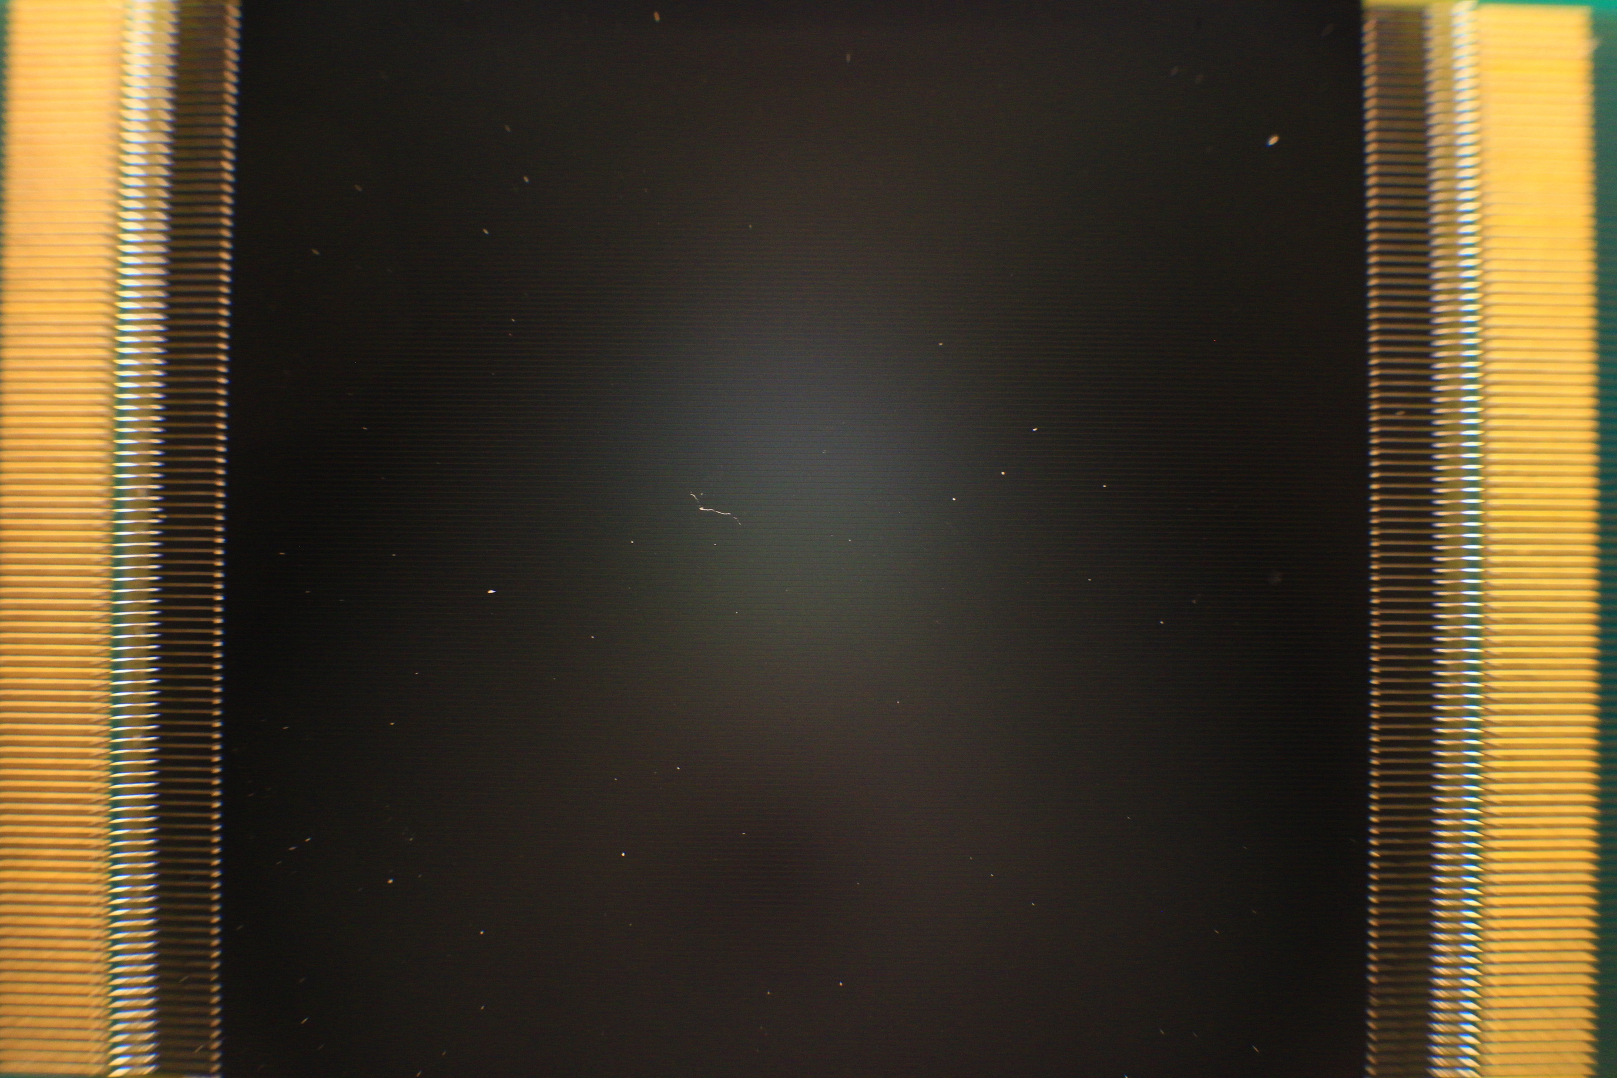
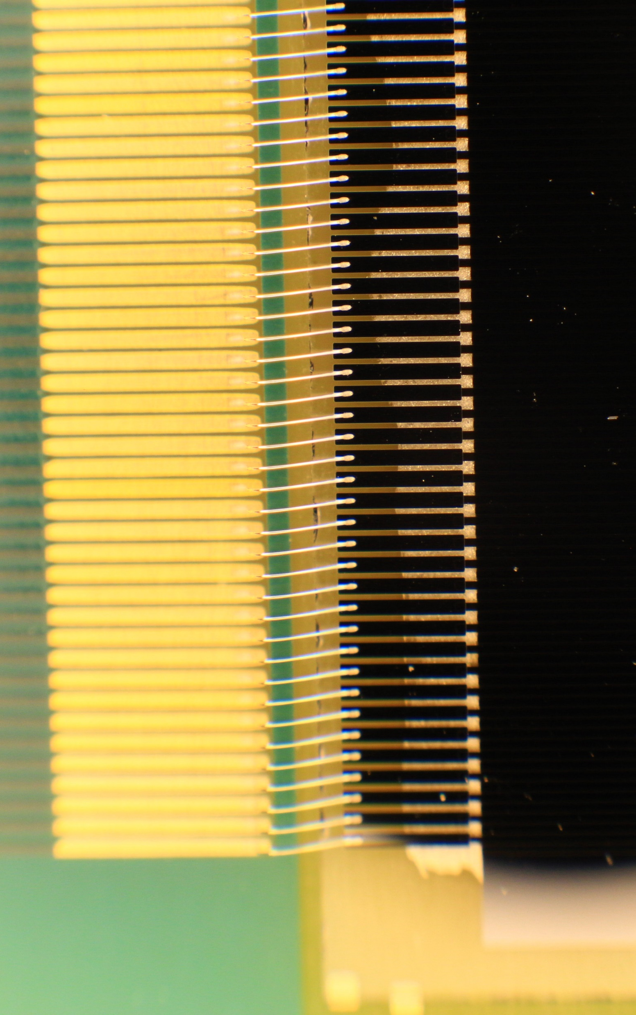
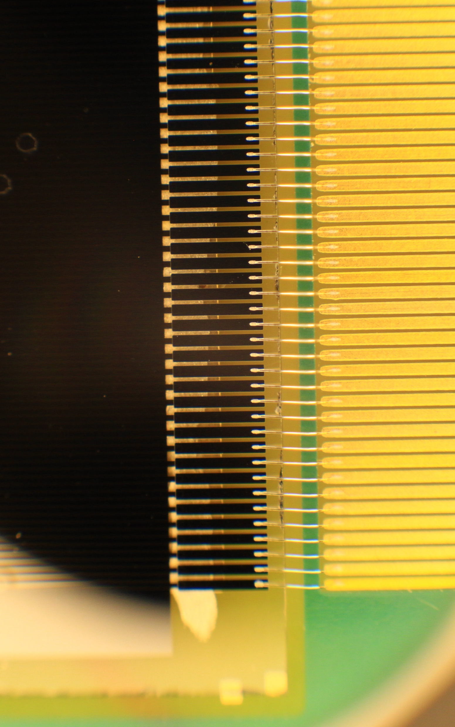
Output wires and strips bonding
Sapphire - Front view

Slide 12
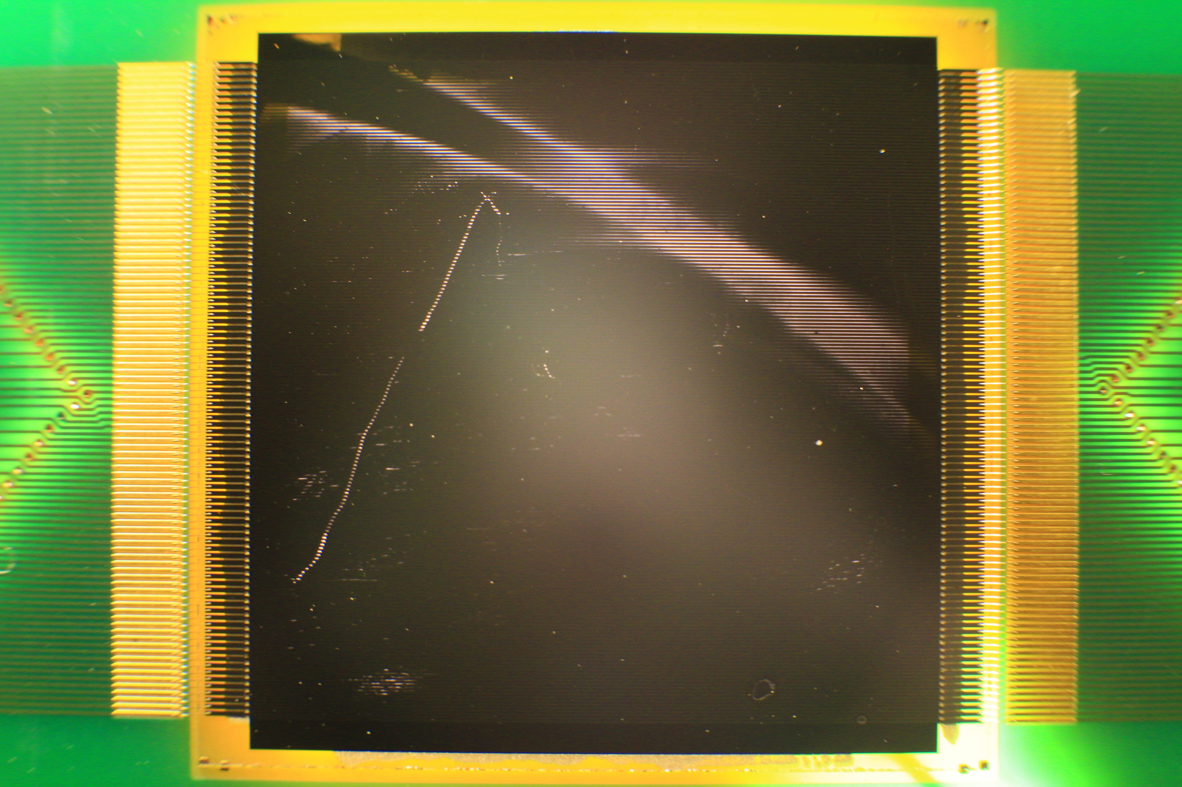
Front view (back illumination)

Slide 13
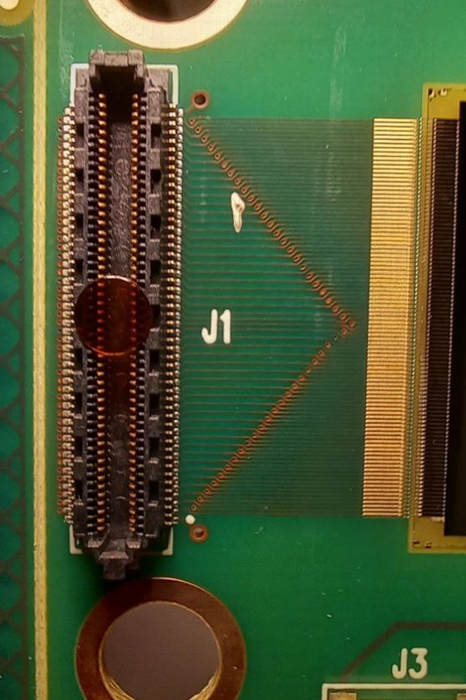
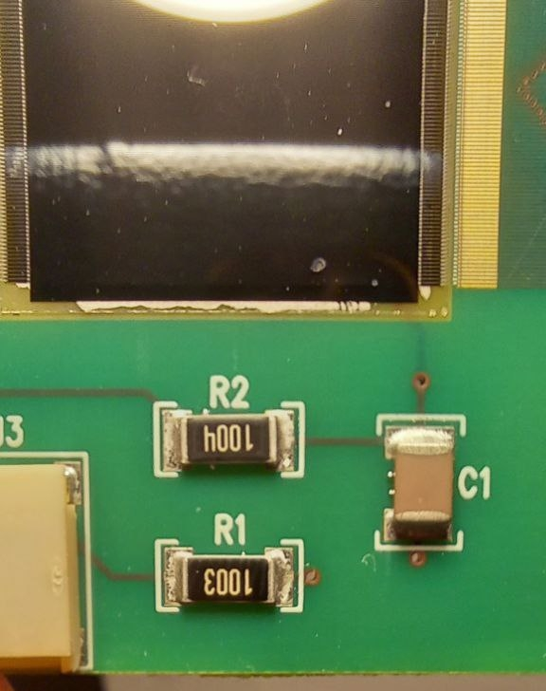
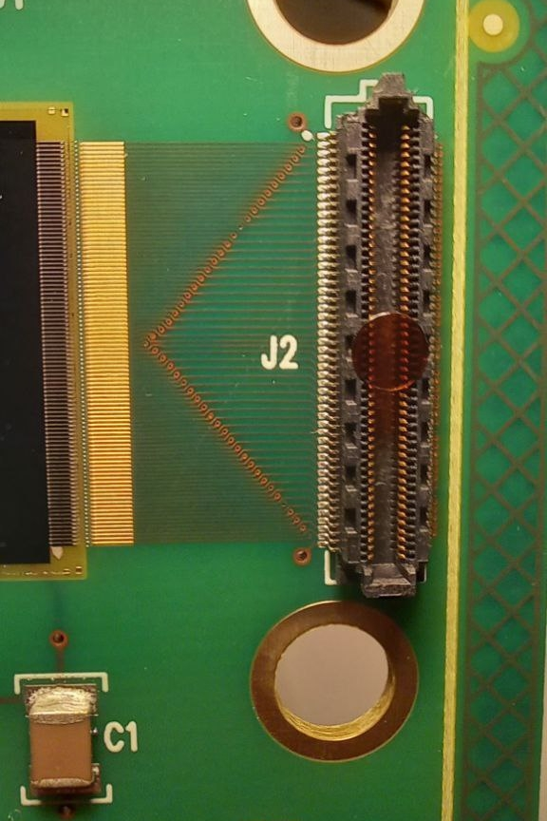
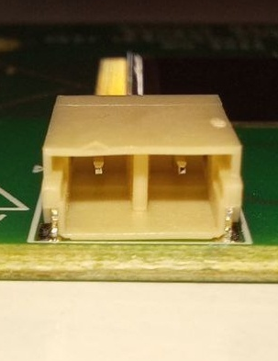
Plugs and electric elements

