Slide 1
Power Supply Tests
(A1561HDP has been fixed by CAEN experts)
INFN Padova
Sergii Vasiukov
12.10.2022

Slide 2
Current – Voltage Characteristic of the 200CH GBP – N1471H
Linear CVC dependence from -1.5 to +1.5 kV.
High internal resistance R ~ 1.6 TΩ.
The electrical capacitance determines the inertia of the response.
Request
Check the CVC by KEITHLEY Picoammeter
The script for automatic I–V measurement is being developed:
checking the linearity of the dependence of V(t) ramp-up/down;
test with a reference resistor.

Slide 3
Current – Voltage Characteristic of the 200CH GBP - KEITHLEY
Linear CVC dependence from -500 to +500 V.
High internal resistance R ~ 0.2 TΩ.
The different slope of the CVC may be due to the instability of the reference compensation of the picoammeter.
200 Channel GBP
KEITHLEY 6487 Picoammeter
R = cot(slope) ~ 0.2 TΩ

Slide 4
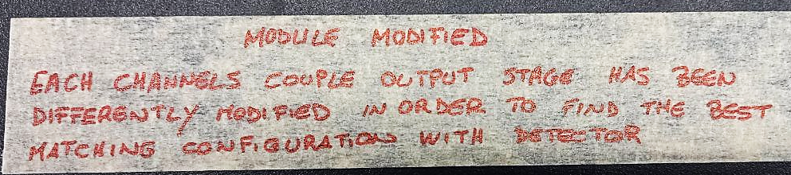
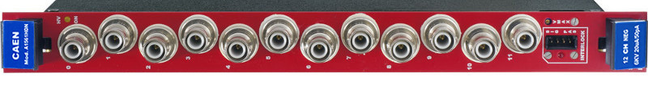
A1561HDP – the notes of CAEN experts
Module modified
Each channel coupled output stage has been differently modified in order to find the best hatching configuration with the detector.
CH0 – CH1 Not Modified Reference | CH2 – CH3 Group “A” | CH4 – CH5 Group “B” | CH6 – CH7 Group “C” | CH8 – CH9 Group “D” | CH10 – CH11 Group “E”

Slide 5
Current – Voltage Characteristic of the 200CH GBP – A1561HDP (modified)
Reference
Group A
Group B
Group C
Group D
Group E

