Slide 1
ARES Operation Meeting
Summary of week 40 / 2022
Frank Mayet, on behalf of the ARES crew

Slide 2
Summary of week 40
Mon. 3rd October | Tue. 4th October | Wed. 5th October | Thu. 6th October | Fri. 7th October
 | 2 µm laser setup upgrade (small breadboard) → Installed Basler camera with ND filters onto XY translation stage and integrated everything into DOOCS control system Hexapod scans to determine the laser beam angle (through the chamber) using the new setup | Installed a remote controllable beam blocker on the small breadboard (incl. DOOCS integration) ARES ramped up again STRIDENAS test in air ACHIP WP restored Timing scan with the electrons Laser alignment scans using the fully remote workflow | Timing scan with the 2 µm laser beam (56% pump → ~500 µJ) | Refined alignment of the spatial alignment of the 2 µm laser beam Discussing possible reasons and solutions for the timing problem
 |  |  | Laser pulse is ~180 µs off in time | Laser interlock panel next to the ARES entrance shows wrong info on the the interlock state (to be looked at on Monday)
Public holiday |  |  |  | Timing will be fixed on Monday using x2Timer settings on the laser side
Achievements
Difficulties
Notes

Slide 3
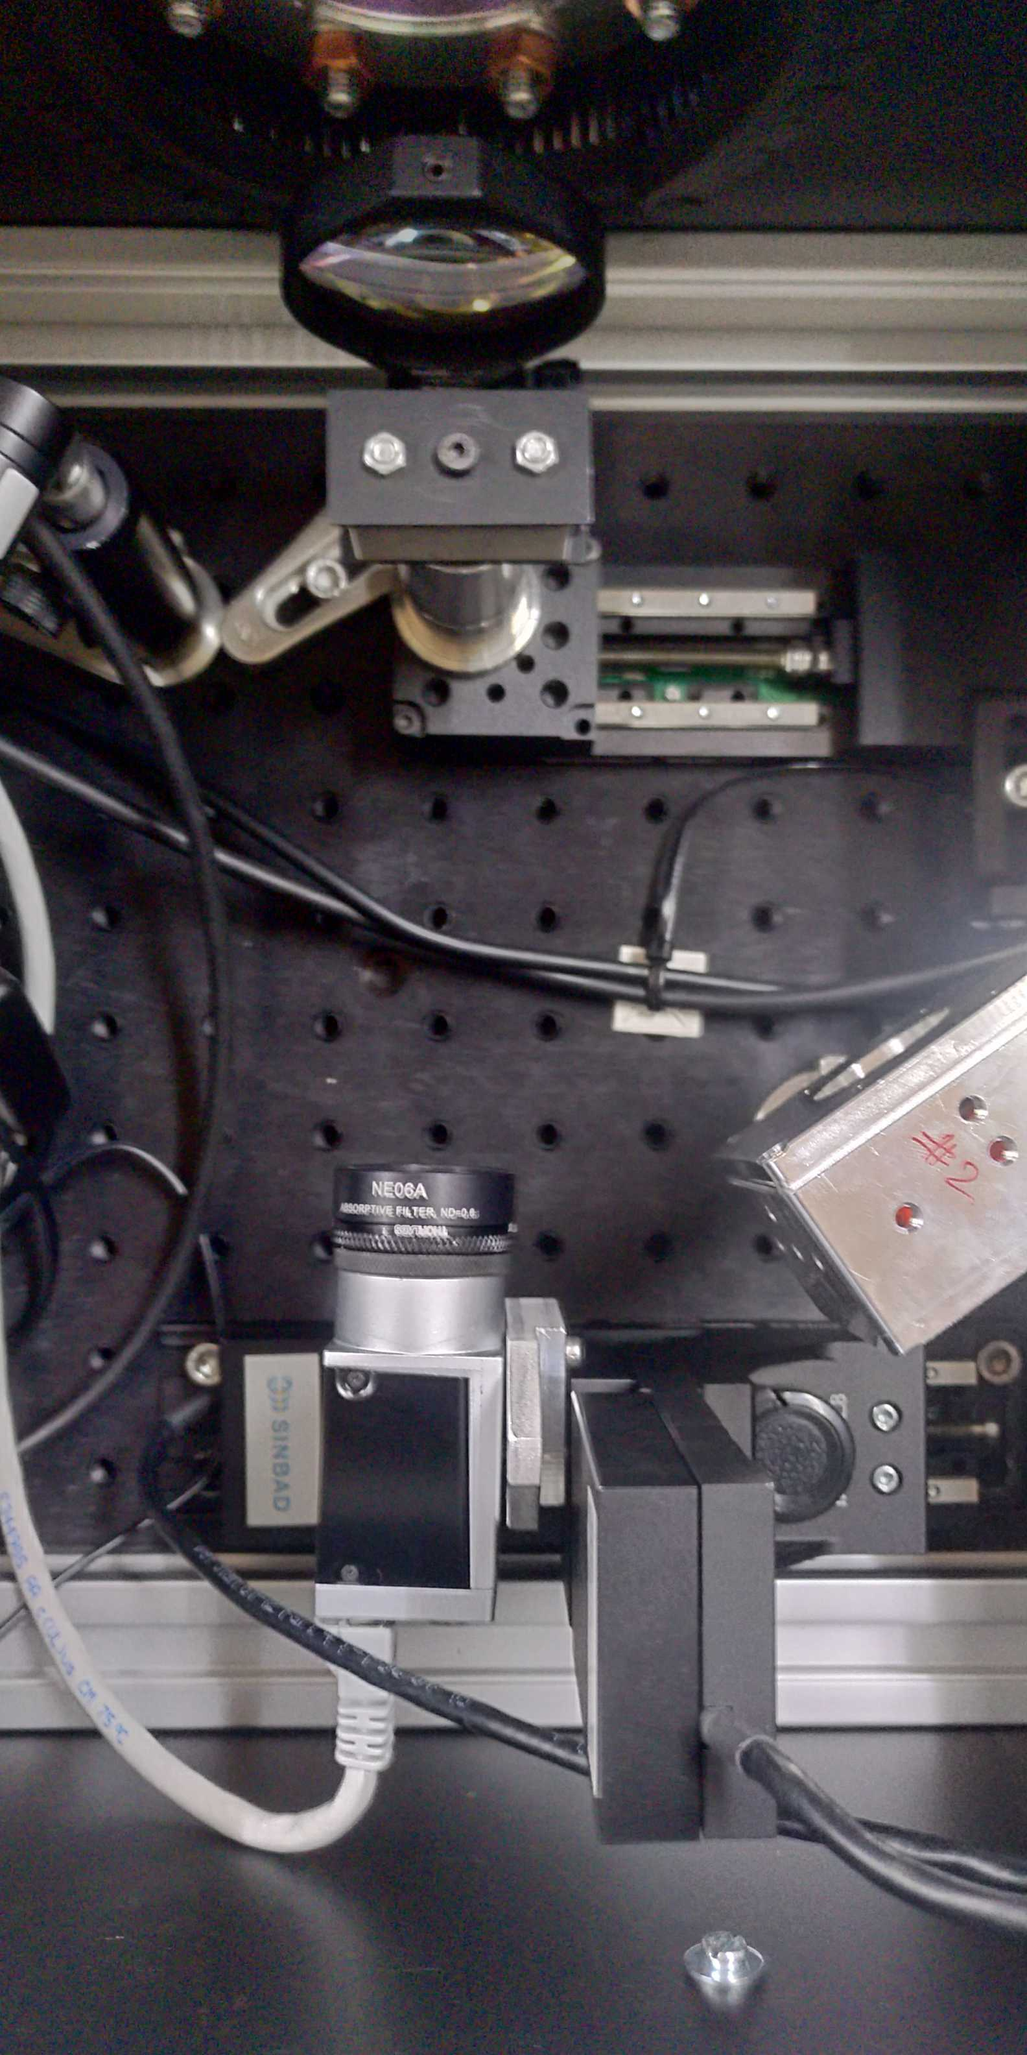
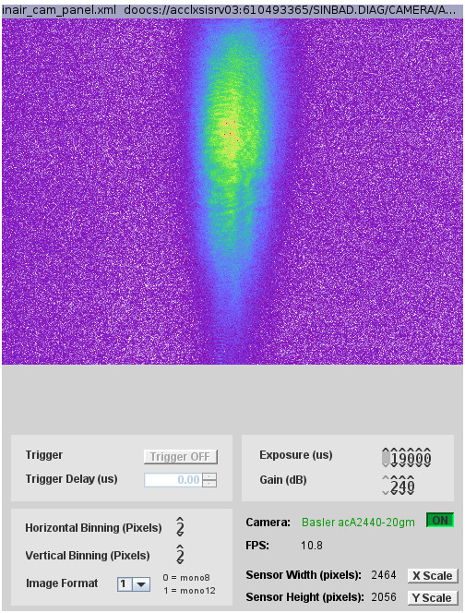
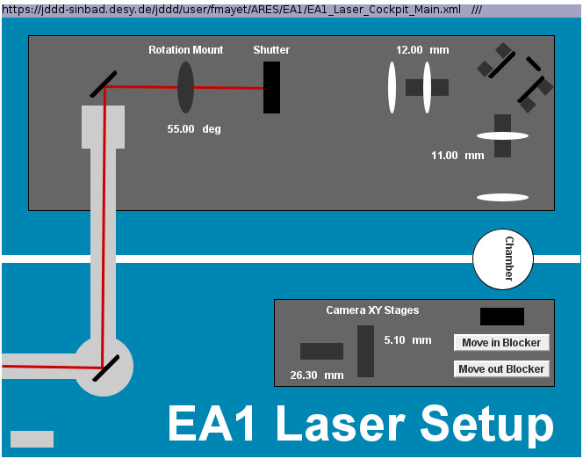
2 µm laser setup
New elements on the small breadboard
Beam blocker on linear stage
Diode for stray light
Basler camera on XY stage

Slide 4
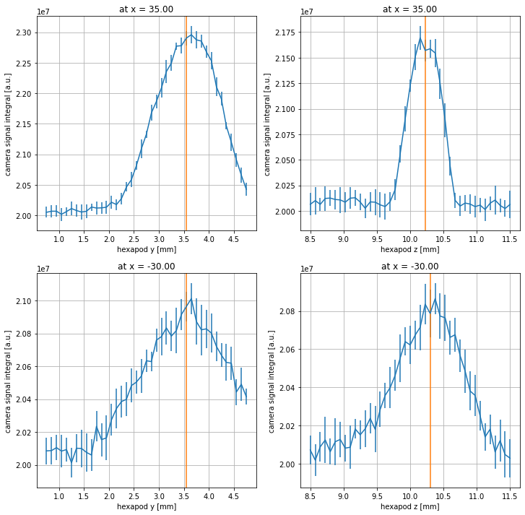
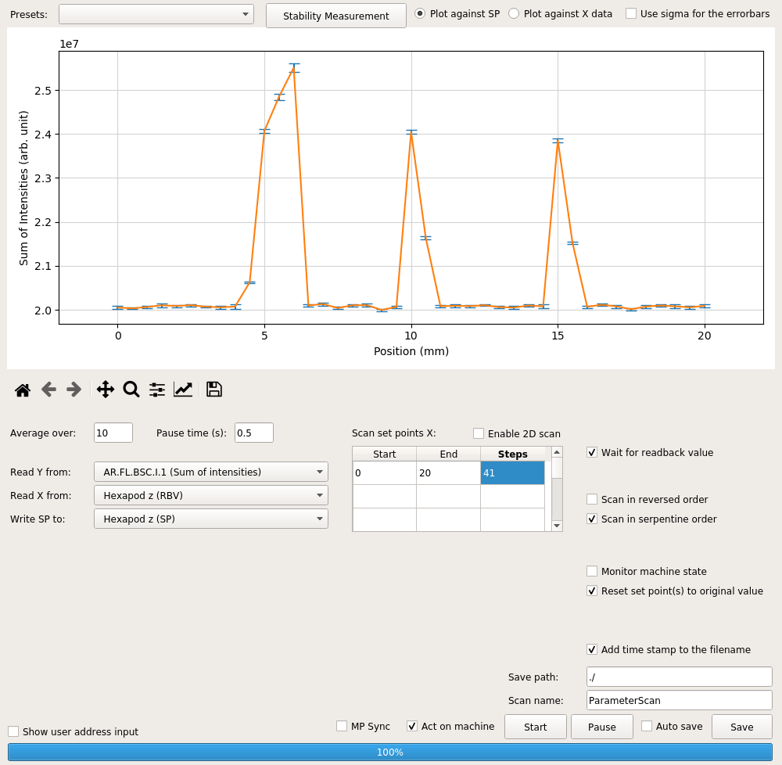
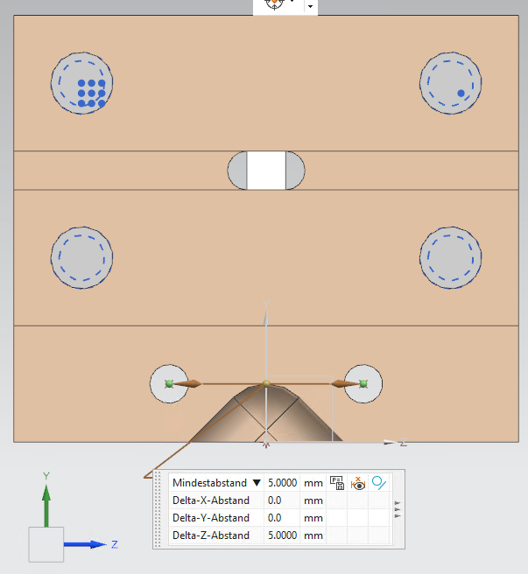
2 µm laser alignment
Angular alignment

Slide 5
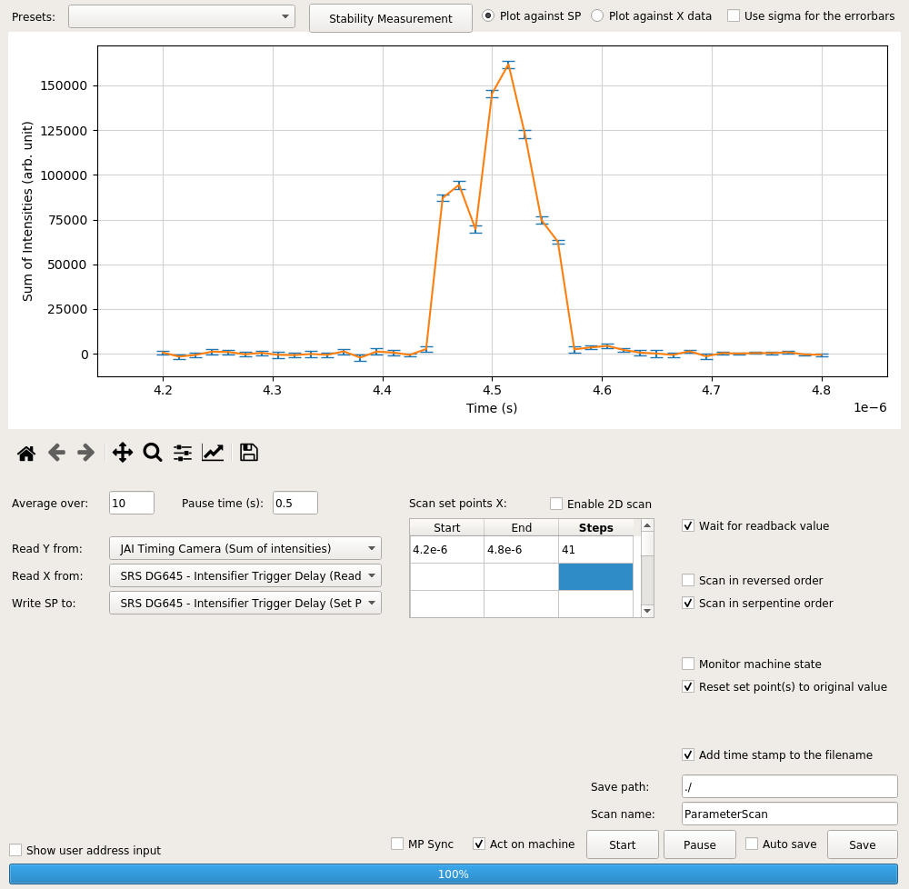
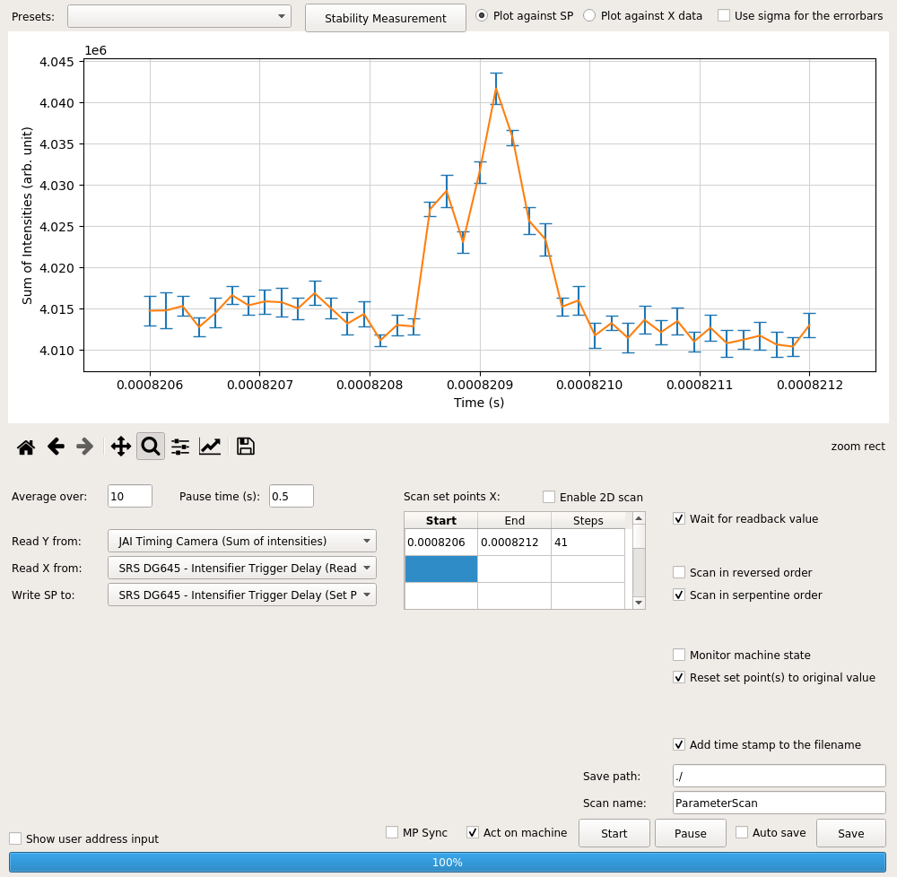
Timing scans
+820 µs, or -180 µs time difference! (laser at 1 kHz)
Signal shape given by the MCP gain ripple (electron and laser pulses are instantaneous in comparison)
100 ns gate pulse

Slide 6
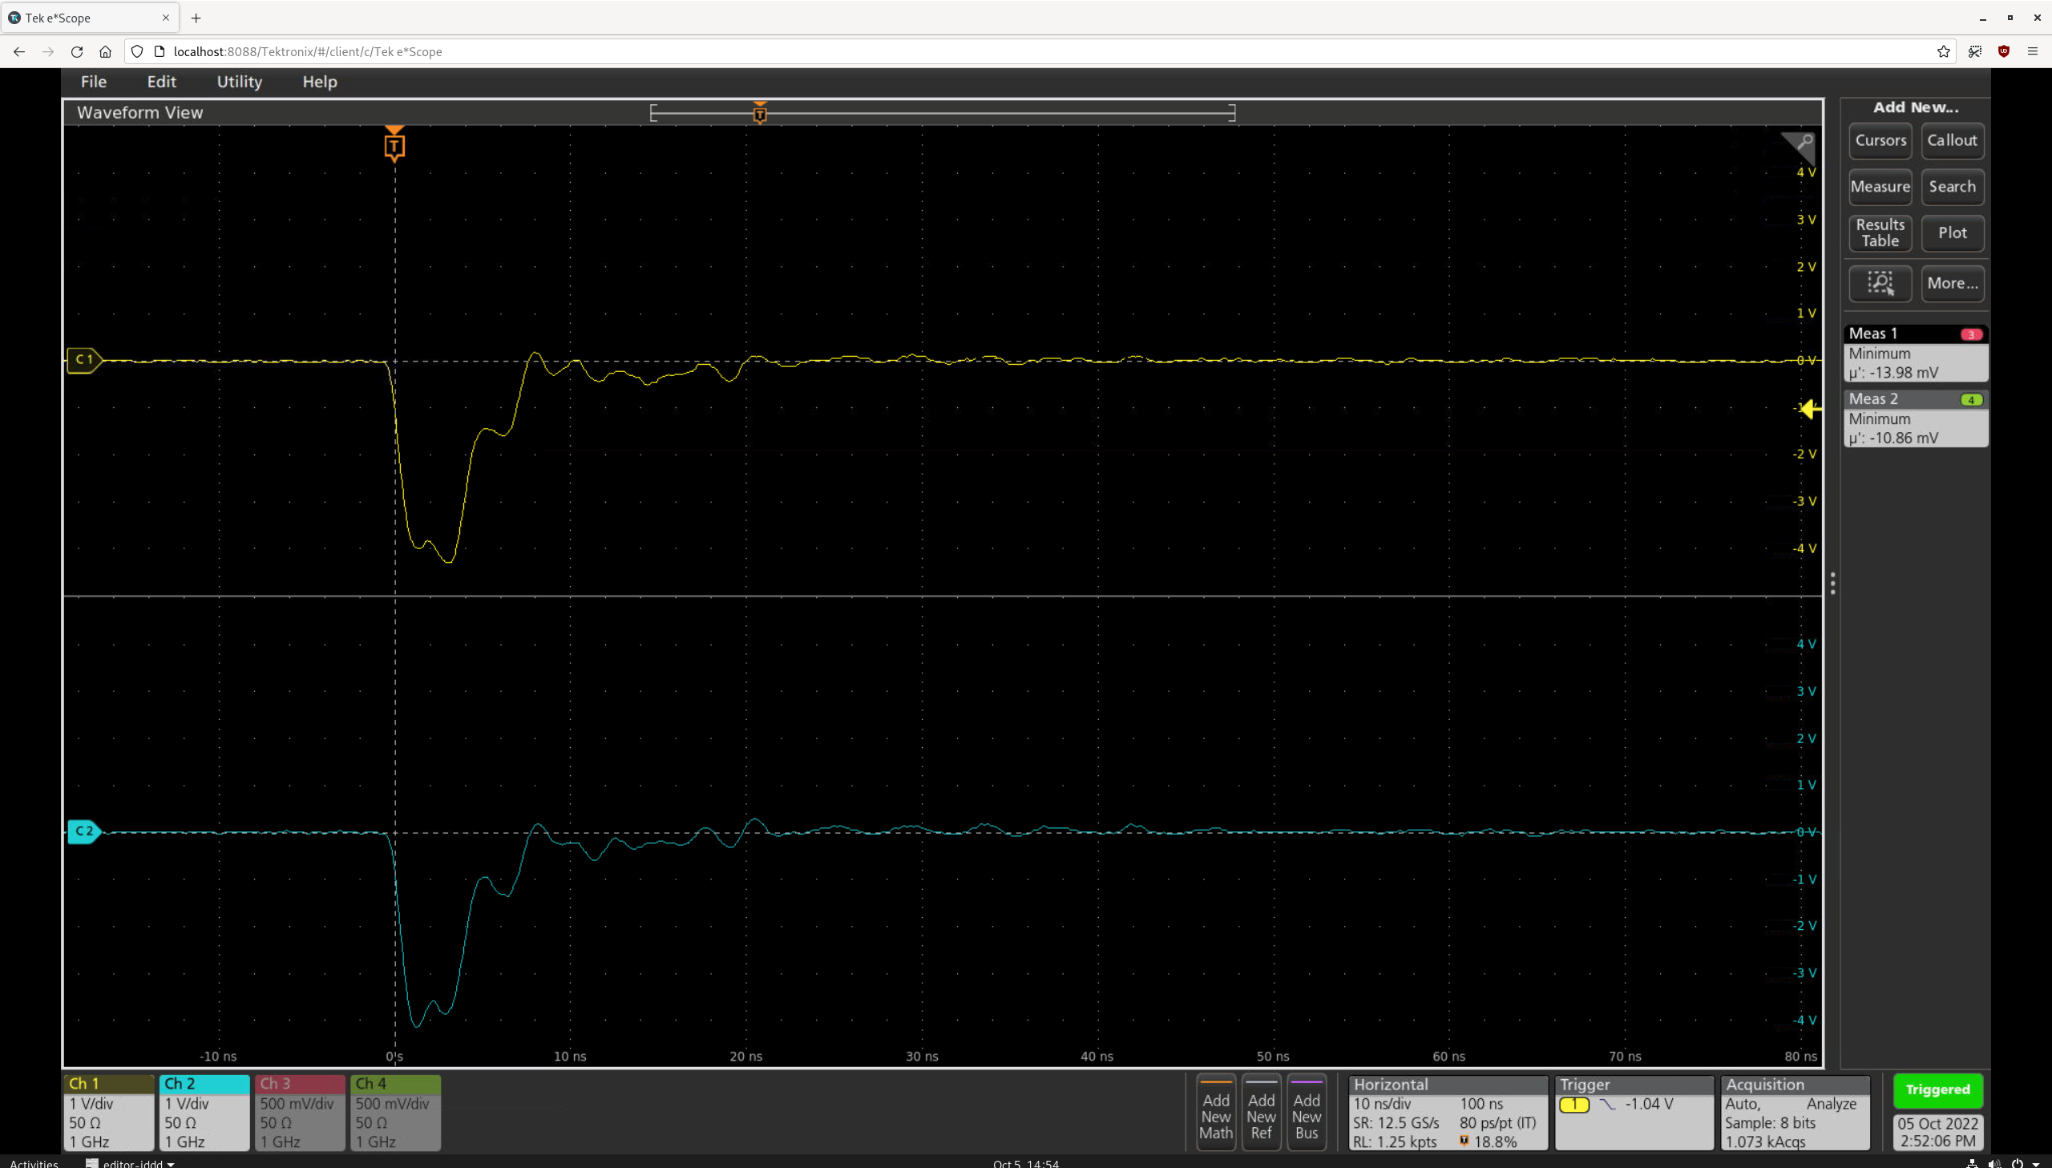
STRIDENAS test
Sensor at 300 V
In air

Slide 7
Plan
Week 41
Monday
  Tunnel open → Maintenance UPS, Cabling MDI+ZM (TDS mover system), MEA3 (laser interlock)
    Update on the UPS: The electronics “broke” during the maintenance and now we are waiting for a replacement. We do have a work around in place, which allows us to run the machine.
  2 µm laser timing
Tuesday
  ARES ramp up and TWS2 phase scan (Thomas) until lunch time
  Re-checking of laser alignment
  Optimizing electron beam alignment on the DLA
Wednesday
  Timing scans
Thursday
  Timing scans
Friday
  Timing scans

Slide 8
Schedule
Week 41
Date | Shift Leader
10.10. | -
11.10. | Thomas, Frank
12.10. | Hannes
13.10. | Willi
14.10. | Thomas
If you want to learn or join the shift: please give the shift leader a call (BKR 2840 / SINBAD Box 2454)

