Slide 1
Internal Smith-Purcell radiation from electron beams
Andrzej Szczepkowicz
University of Wroclaw

Slide 2
Talk outline
Radiation: diffraction, Smith–Purcell vs. internal Smith–Purcell, diffraction Cherenkov
Literature, some experiments and applications
Numerical simulations
Silicon grating
Si/SiO2 grating vs pure SiO2 grating
Resonant enhancement of radiation, structure eigenmodes
Problem of obtaining accurate radiation energy in concrete units
Time vs frequency domain, finite vs. infinite gratings
Analysis of energy flow using Poynting theorem

Slide 3
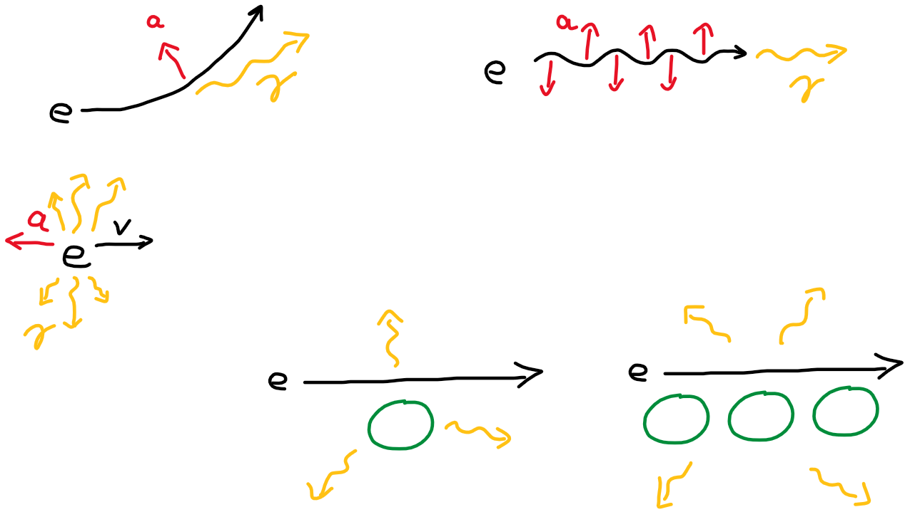
Radiation schemes from charged particles
“A charged particle moving in vacuum with constant velocity does not emit radiation”
acceleration
undulator r.
synchrotron r.
deceleration r.
diffracting bodies
No magnets needed
diffraction r. Smith–Purcell radiation

Slide 4
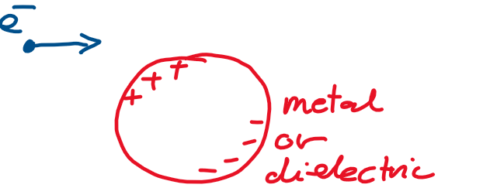
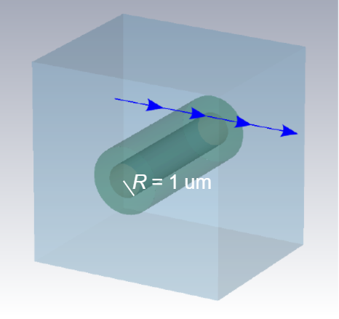
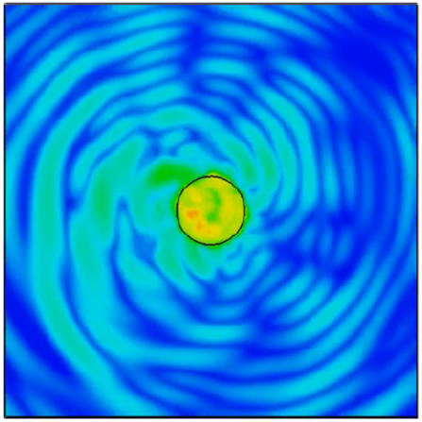
Diffraction radiation – where is the accelerating charge?
electromagnetic energy density
[simulation: Damian Śnieżek]
Dmytro Konakhovych, 2021 Damian Śnieżek, 2021
‹#›

Slide 5
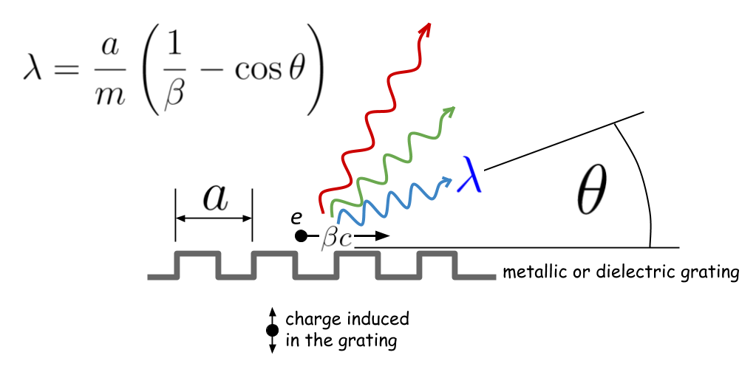
Smith–Purcell radiation for metallic grating
Experiment and explanation
If an electron passes close to the surface of a metal diffraction grating, the periodic motion of the charge induced in the grating causes electromagnetic radiation.
[Smith and Purcell 1953]

Slide 6
Electron induces polarization charge + + + – – –
Si Si Si Si Si Si Si Si Si Si
SiO2

Slide 7
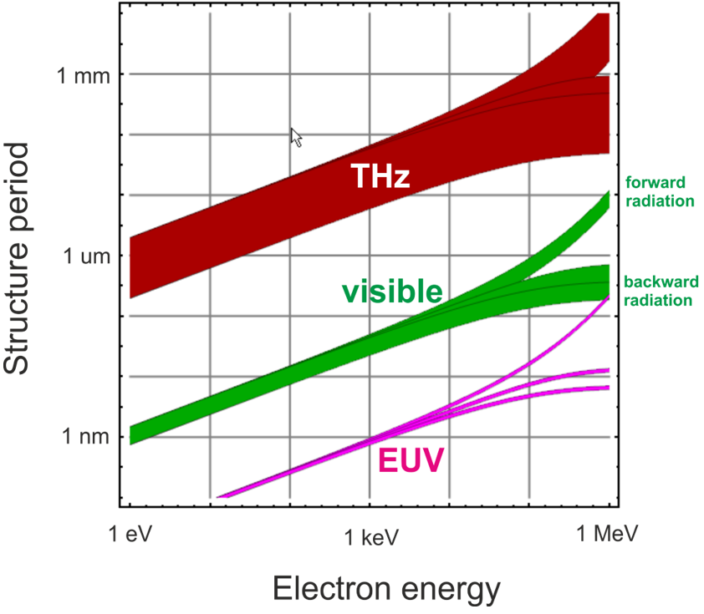
Smith–Purcell equation visualized
Available wavelength ranges

Slide 8
Radiated energy W vs. impact parameter d
Radiated energy
valid for diffraction radiation and Smith–Purcell radiation

Slide 9
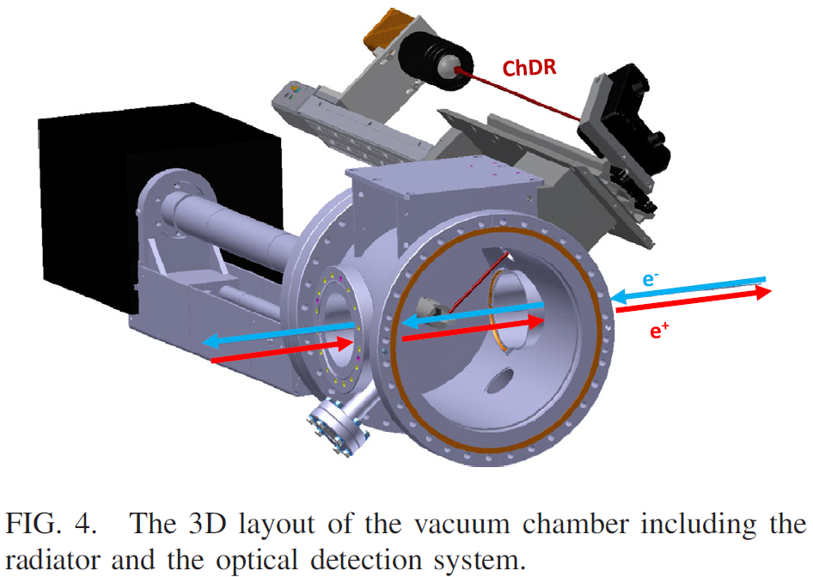
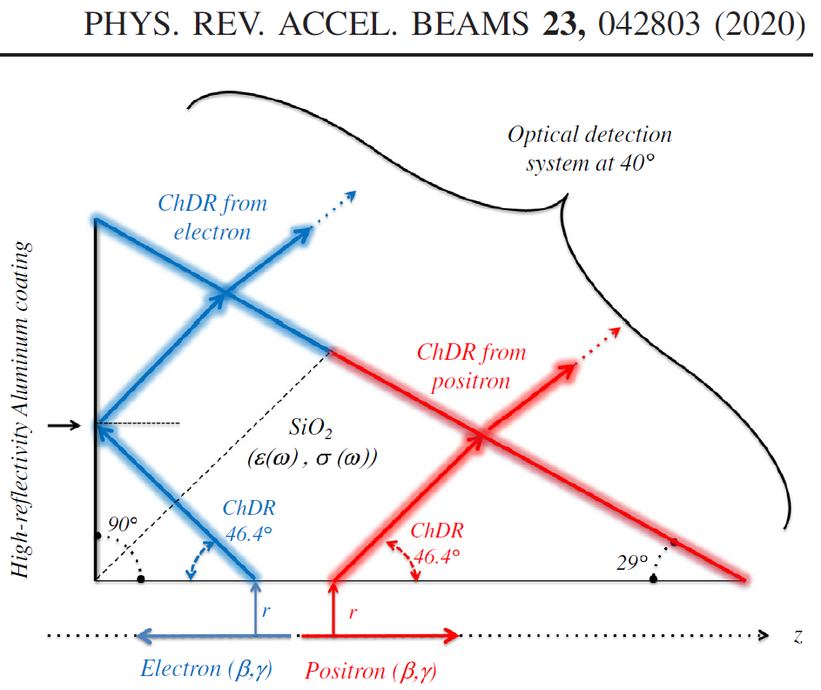
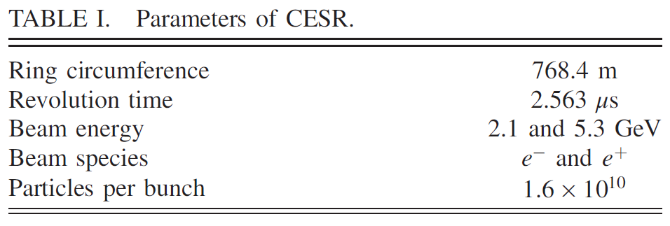
Beam position and profile measurement: Kieffer, Bartnik et al. 2020
Cherenkov diffraction radiation (SP radiation for m=0)
– fused silica
– optical and infrared CDR
– impact parameter ~2mm, visible radiation
CESR = Cornell Electron Storage Ring

Slide 10
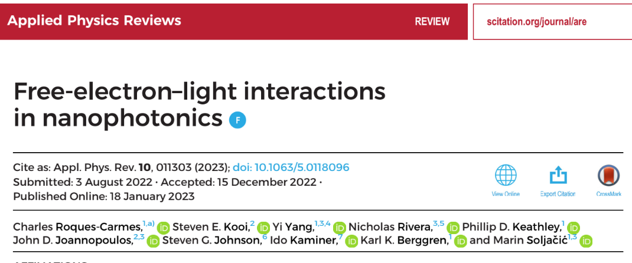
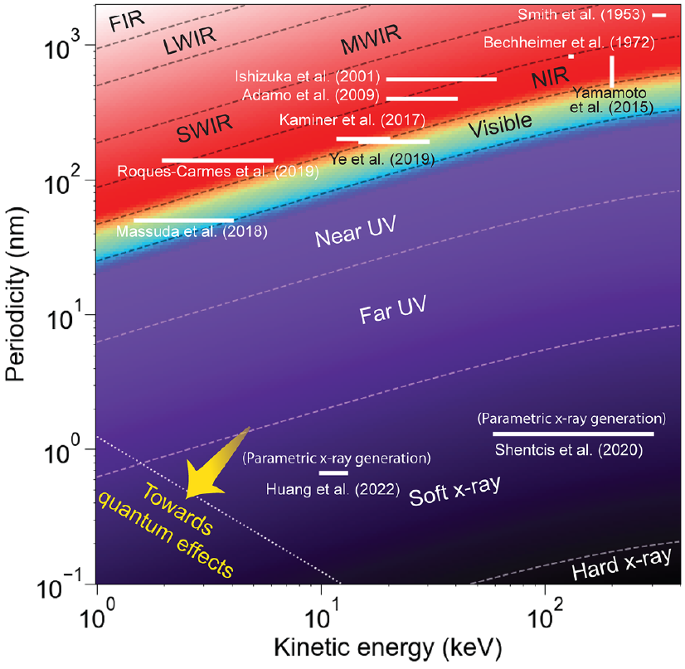
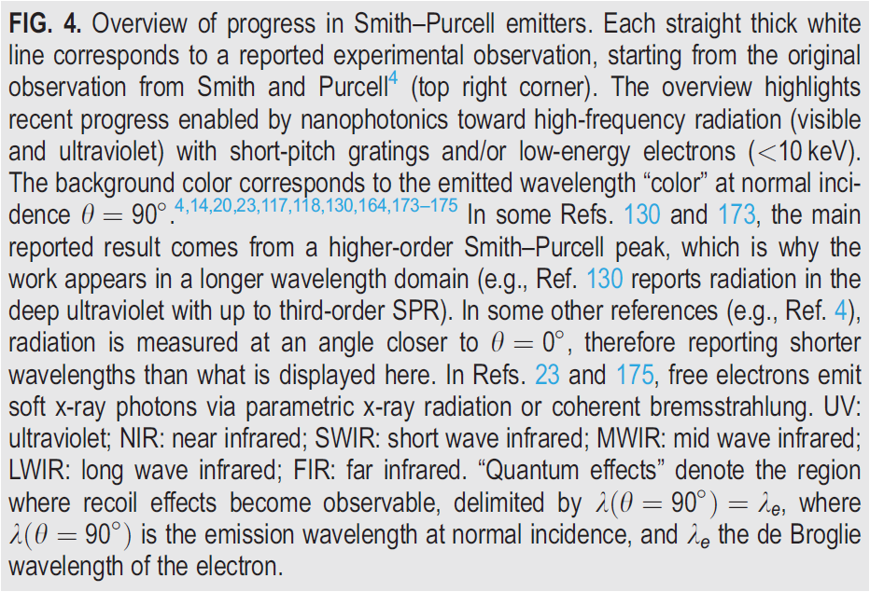

Slide 11
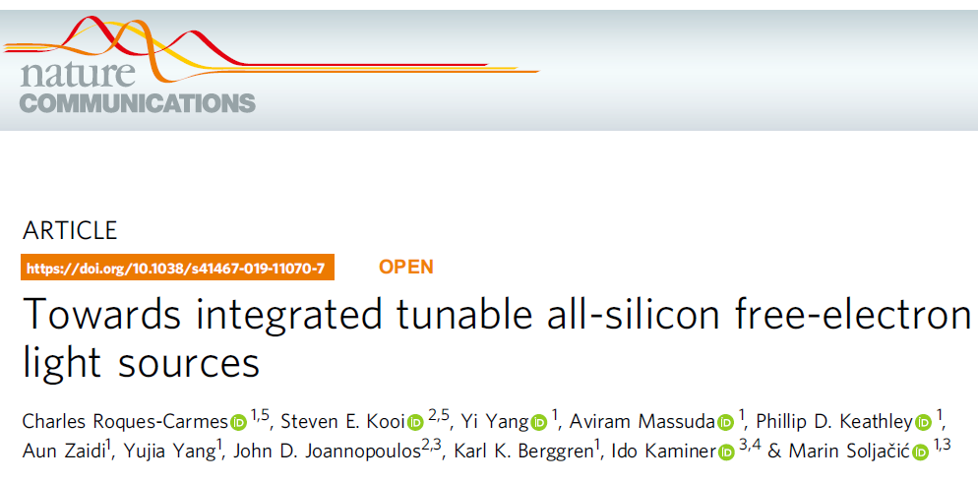
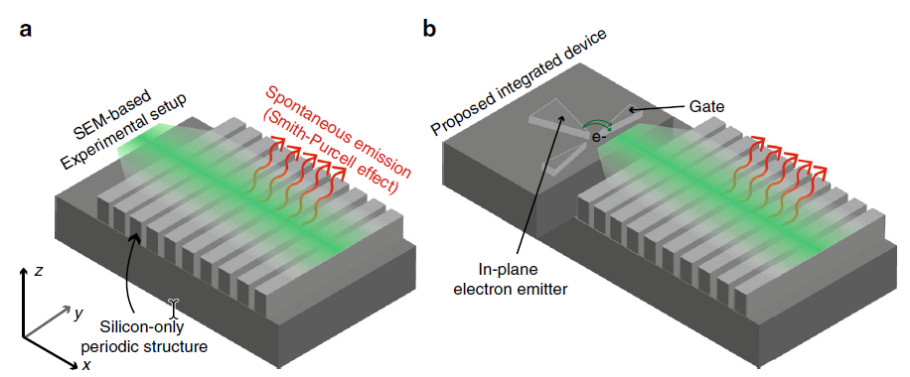
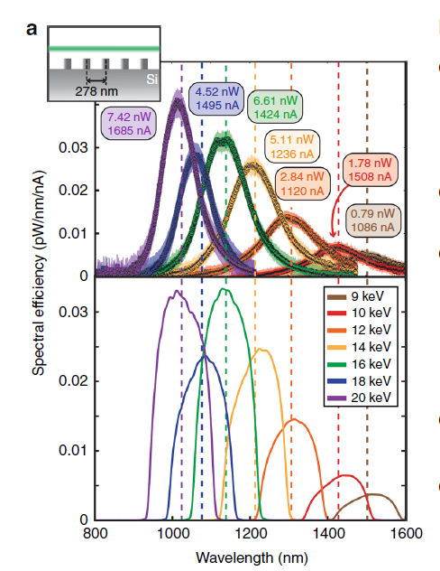

Slide 12
Electron and light in a dielectric structure
Diffraction radiation
Inverse Smith–Purcell
effect (optical accelerator)
Smith–Purcell radiation
e
e
e
e
‹#›

Slide 13
ACHIP collaboration

Slide 14
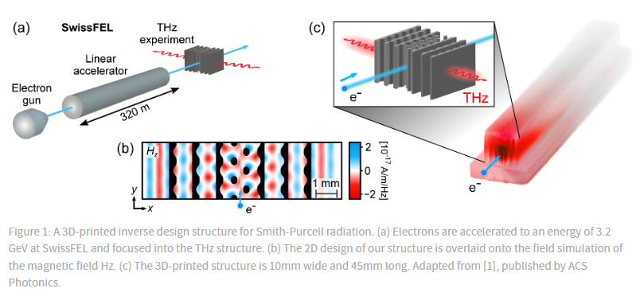
ACHIP collaboration

Slide 15
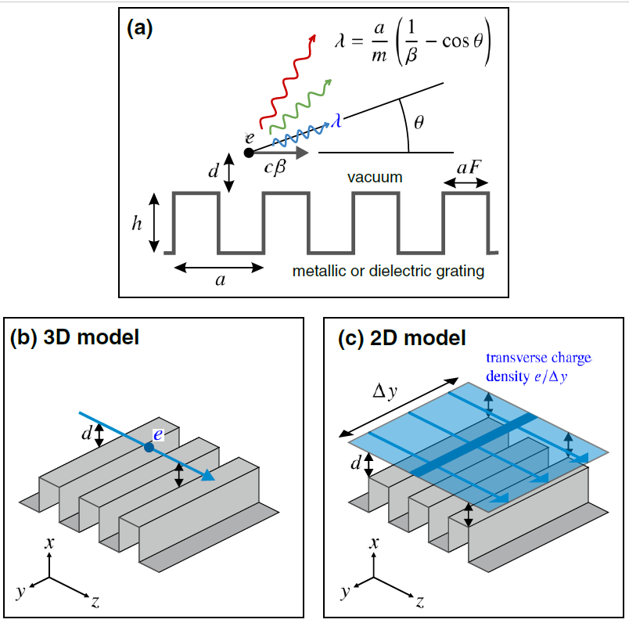
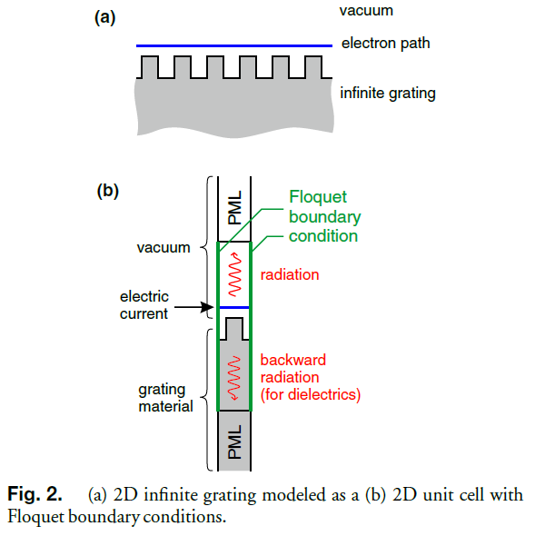
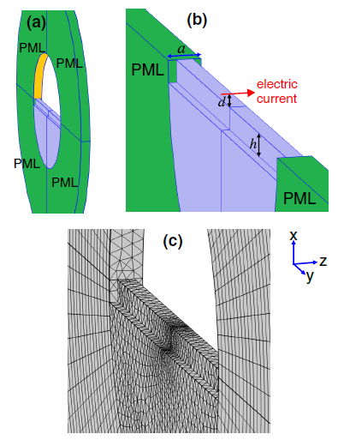
2D vs 3D numerical radiation models, frequency domain
infinite gratings
3D
2D
[Szczepkowicz Schachter England 2020]

Slide 16
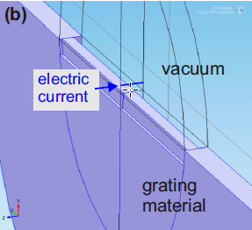
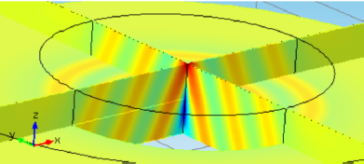
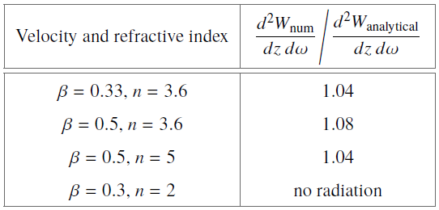
Verification of the frequency-domain numerical model
+ Conventional Cherenkov r. benchmark
+ make permittivity uniform
+ increase β or increase n (nβ>1)
+ compare with the Frank–Tamm formula
The model predicts radiation energy in concrete units
Arb. units
PML
[Szczepkowicz Schachter England 2020]
Frank–Tamm formula
‹#›

Slide 17
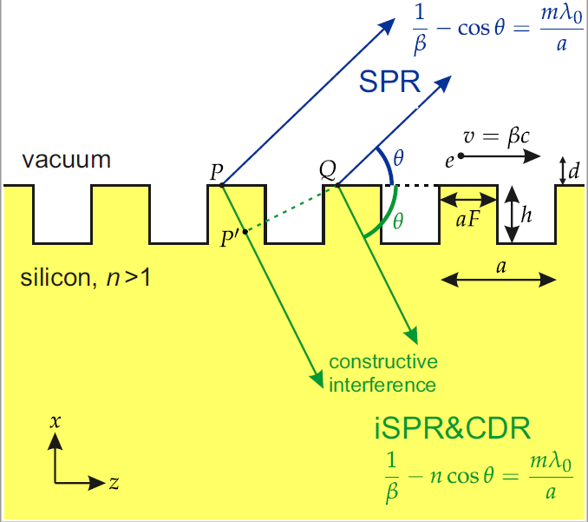
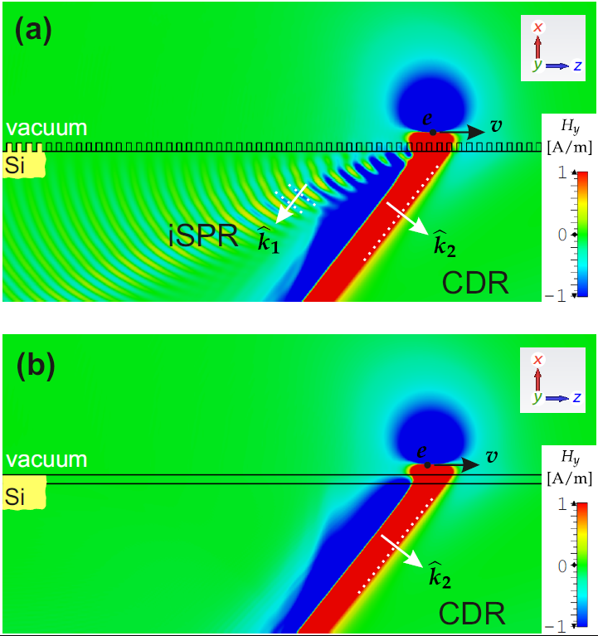
Internal Smith–Purcell radiation (iSPR) coexisting with CDR
m = 0 ⇔ Cherenkov ⇔ θ = θ_{Ch} – fixed angle
m = 1 ⇔ 1st order S–P ⇔ θ ∈ (0, θ_{Ch}) – can be optimized for different angles
iSPR: both signs of m possible
SPR into vacuum?
negligible!
Silicon grating
D. Konakhovych et al., arXiv:2105.07682 (2021)
‹#›
animations available

Slide 18
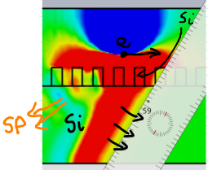
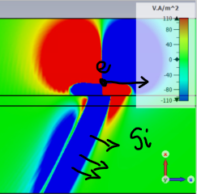
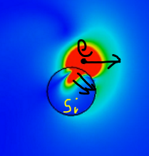
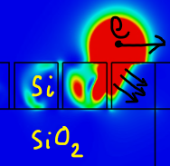
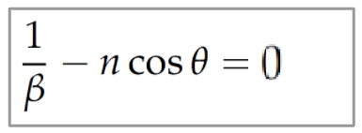
Cherenkov diffraction radiation wavefronts
Si grating
Si slab
Si rod
Si/SiO2 grating
Cherenkov angle is independent of lambda
For fixed energy and material, you cannot tune the angle of radiation
[simulations by Dmytro Konakhovych and Damian Śnieżek]

Slide 19
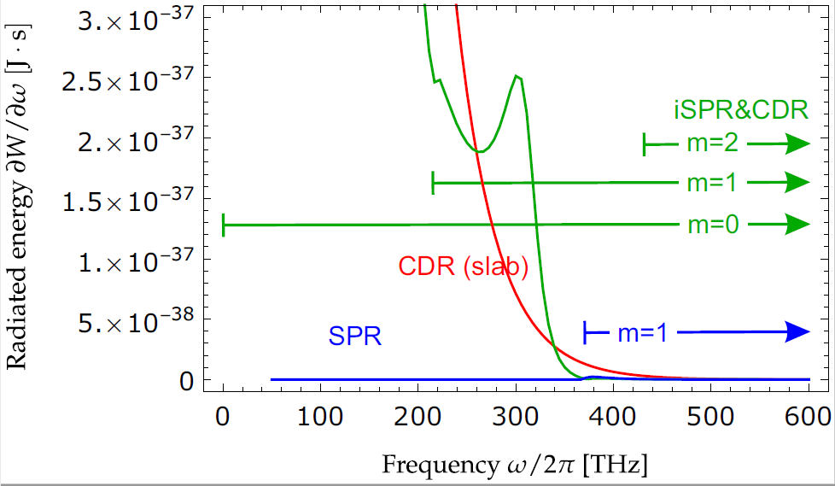
iSPR, the spectrum
[D. Konakhovych et al., arXiv:2105.07682 (2021)]

Slide 20
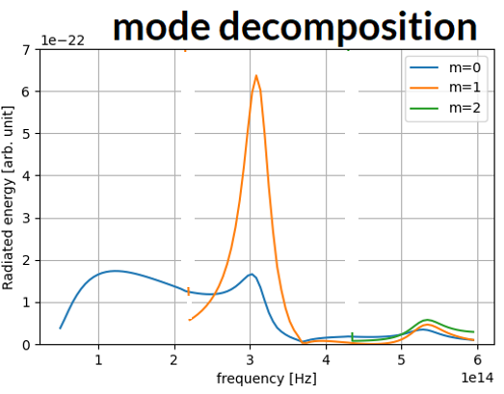
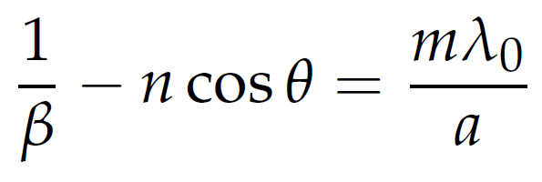
iSPR and CDR spectrum decomposed into radiation modes
In this particular example, it is interesting that Cherenkov diffraction mode, m=0, is enhanced around 300 THz. Even more enhanced is the internal Smith-Purcell m=1. So if one looks for maximum radiation around one frequency, the internal Smith Purcell mode appears much better compared to Cherenkov.
resonant Cherenkov?

Slide 21
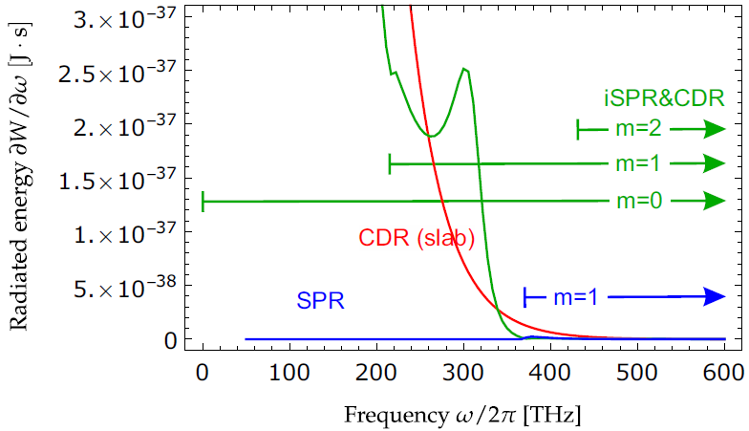
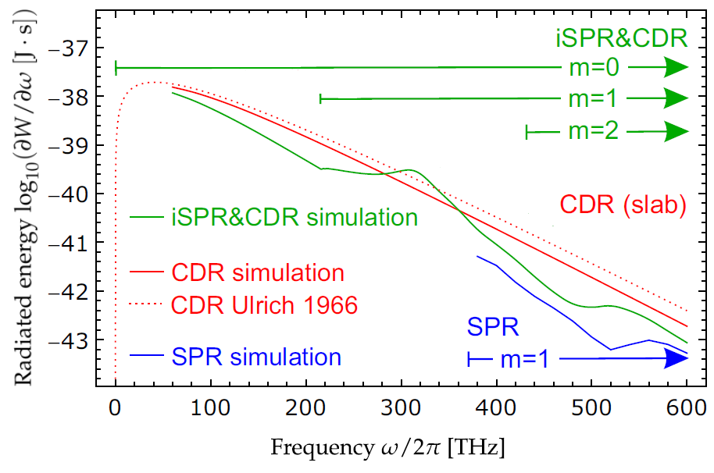
2D and 3D models yield similar results
2D peak 2.5E-37/609=4.1E-40 J·s 3D peak 2.8E-40 J·s

Slide 22
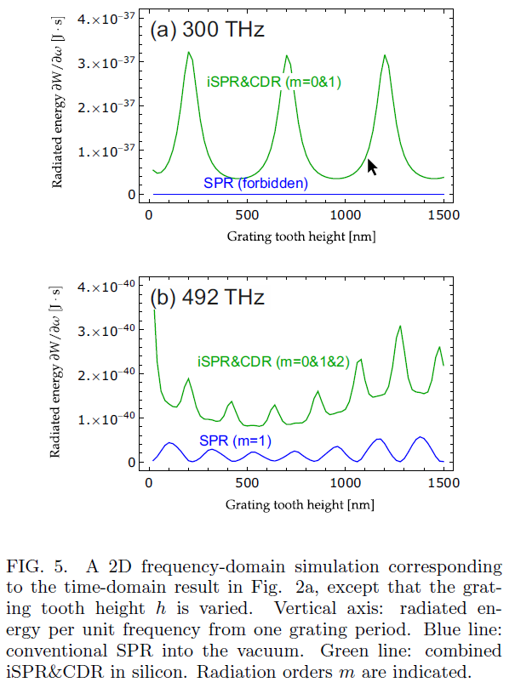
SPR and iSPR vs grating tooth height
anticorrelation of internal and external radiation
– would a photonic band diagram help?

Slide 23
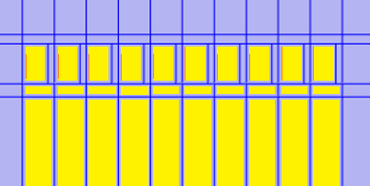
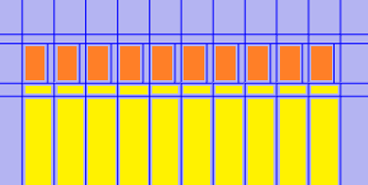
Resonant enhancement of iSPR
SiO2 and Si/SiO2 gratings
(30 keV electrons as before)
radiated energy per electron
Optimization for non-resonant structure (vacuum-SiO2)
55 meV
energy x 3
SiO2
Optimization for resonant structure (vacuum-Si-SiO2)
Si
energy
SiO2
0 meV
90 meV per electron (quantum efficiency 5%)

Slide 24
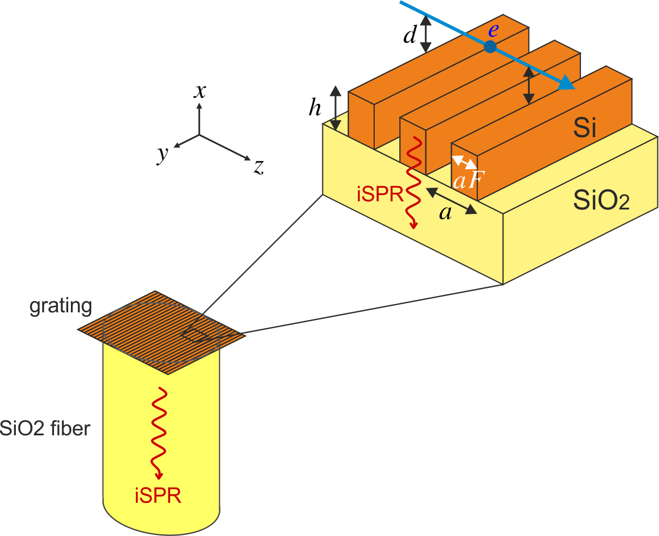
Fiber coupling of internal Smith–Purcell radiation
30 keV
d = 70 nm
a = 200 nm
λ⟂ = 731 nm
NA=0.22
clading
NA=1.06
vacuum
idea by Yenchieh Huang
core
200 μm diameter
}
200 μm / 240 nm
= 833 grating periods
± NA
idea by Dylan S. Black
Thorlabs FG200UEP

Slide 25
Radiation within numerical aperture
radiated energy per electron
Si
all direc-tions
energy
90 meV per electron (quantum efficiency 5%)
SiO2
55 meV
energy x 3
Si
energy
NA=1.06
42 meV per electron
SiO2
Si
16 meV per electron
NA=0.22
energy
SiO2
0 meV

Slide 26
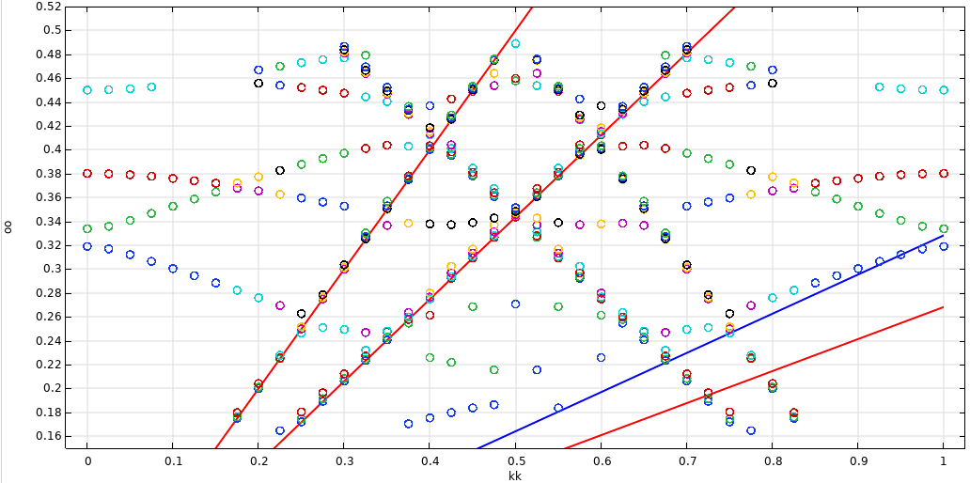
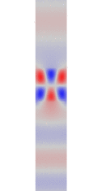
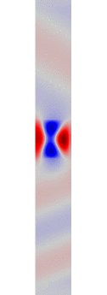
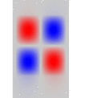
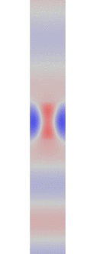
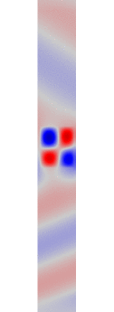
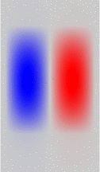
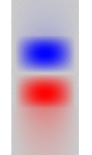
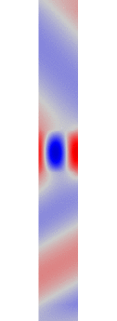
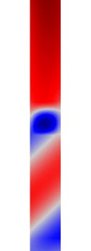
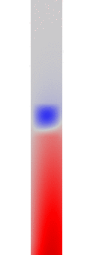
Reason for iSPR radiation enhancement?
light line – vacuum
light line – silica
radiating 2
Photonic band diagram, grating eigenmodes for (F=0.9, h=260 nm).
BIC2
radiating 1
0.334
0.319
electron line, 30kV
β=.32838
BIC1
light line – silicon

Slide 27
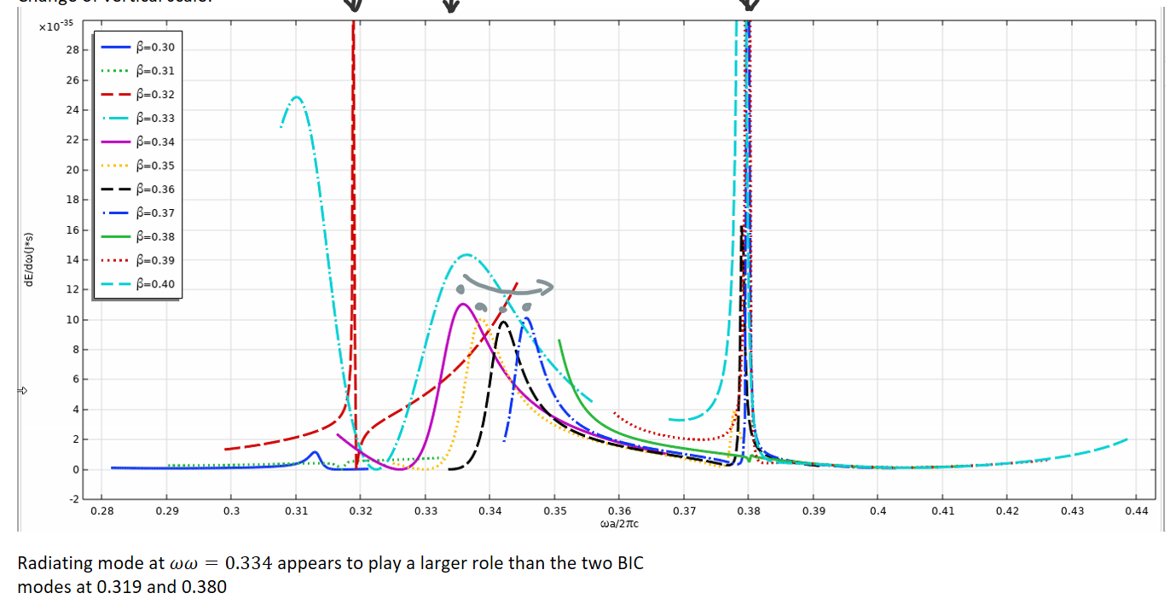
Reason for iSPR radiation enhancement?
Puzzle: Why is the (F=0.9, h=260 nm) grating so good?
Resonance of the electron with grating eigenmodes?
• Instead of β=0.328 (corresponding to 30 kV), I tried β=0.30, 0.31, … , 0.40.
• For each β, the frequency of the perpendicular SP radiation is different.
• For each β, the extent of the curve in ω corresponds to radiation captured within the aperture range 0.22 of the perpendicularly attached fiber.
• Area under the curve corresponds to captured energy
• Most energy is emitted around the frequency of an ordinary Q=24 mode (radiating mode)
Q=∞
Q=24
Q=∞
design
electron
energy
Energy per unit frequency
Normalized frequency

Slide 28
Accurate radiation energy for finite gratings?

Slide 29
Time vs. frequency domain simulations
radiation
radiation
Number of grating periods
1000
100
10
1
∞(Floquet b.c.)

Slide 30
Animations, time domain, guided energy
Si/SiO2, F.9h420

Slide 31
Track energy with Poynting’s theorem
All vacuum
Energy [meV]
V
Preliminary results
electric charge
Si/SiO2
Energy [meV]
Work in progress…
V

Slide 32
Summary: Internal Smith–Purcell radiation (iSPR)
SPR and iSPR (including Cherenkov) – highly tunable sources of electromagnetic radiation from charged particle beams travelling in vacuum near dielectric periodic structures
Frequency-domain simulation – fast, quantitative, benchmarked for …infinite… structures
Challange: similarly predict radiation from finite structures – more work needed – compare with slow time–domain simulations – track energy with Poynting theorem
Direct fiber coupling – simple and efficient way to capture iSPR
Grating eigenmodes, both high and low Q, enhance efficiency of SPR and iSPR, but optima for SPR and iSPR are different
CR benchmark
Thank you!

Slide 33
– – – – – – – – – – Supplementary slides – – – – – – – – – –

Slide 34
Near field of the electron

Slide 35
2D vs 3D optimization
e
70 nm
aF = ?
Si
h = ?
SiO2
a = 240 nm
λ0 = 731 nm
to optical fiber
0.1
efficiency
2D model
3D model
0.3
F
0.5
0.7
0.9
20
100
200
300
h [nm]

Slide 36
Inverse design
hollow regions and/or narrow slits “high duty”
Si
SiO2
to optical fiber
“Chimney constraint → high-fill-factor rectangular gratings”

Slide 37
Force on the particle

Slide 38
Radiation in 6 directions
SPR
along the grooves
along the electron trajectory
along the grooves
iSPR
‹#›

Slide 39
Energy decay in a Si/SiO2 grating
energy decay: 1 order of magnitude / 20fs
2.44 fs – characteristic time – time of flight over one unit cell = period of SP radiation in the perpendicular direction
w0=2pi/2.44fs=2.58E15 [1/s]
Q = 2.58E15[1/s]/1.15E14[1/s] = 22

Slide 40
Xxx

