Slide 1

6th Workshop on Applications of Dielectric Laser Accelerators
Novel Application of a Pulsed Electron Linear Accelerator as a Single Event Effects Simulator
Greg Allen, NASA JPL
In collaboration with Aerospace Corp.

Slide 2
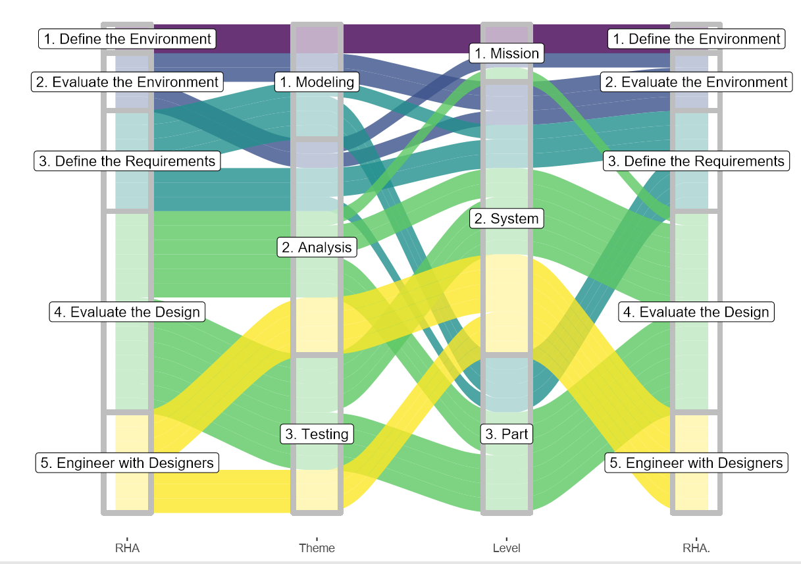
6th Workshop on Applications of Dielectric Laser Accelerators
RHA Philosophy
M.E.A.L. – Mission. Environment. Application. Lifetime.
The RHA process is laid out with interdependent activities. It may help to group these activities
by the type or “theme” of work (e.g., modeling, analysis, or testing), or to examine the “level” or
scope to which these activities can address information (e.g., mission, system, or part level).
Defining radiation requirements relies on modeling and model fidelity.
Radiation requirements exist at the system and part levels.
Testing and analysis may be conducted at the part level, but outcomes and engineering are most prevalent and defined at the system level.

Slide 3
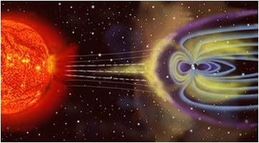
6th Workshop on Applications of Dielectric Laser Accelerators
Natural Space Environment Overview
Particle radiation – High-energy electrons, protons & heavy ions
  Solar
  Galactic cosmic rays (GCR)
  Trapped in magnetospheres
Plasma
  Ionosphere
  Plasmasphere – Magnetosphere
  Solar wind
Neutral gas particles
  Lower – atomic oxygen (AO)
  Higher – hydrogen & helium
Ultraviolet and X-ray
Micrometeoroids & orbital debris

Slide 4
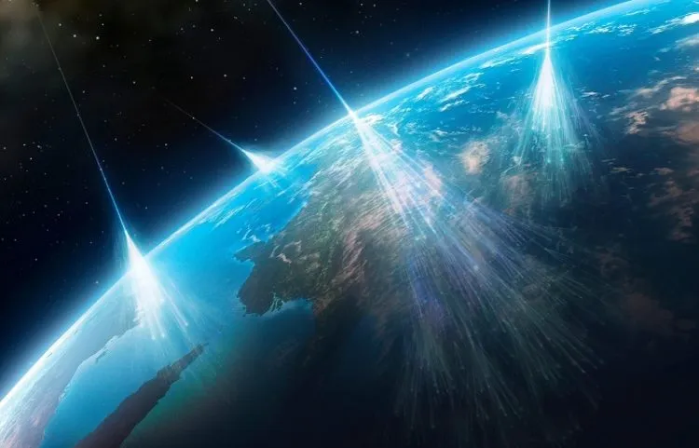
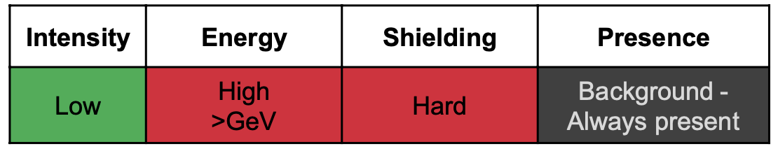
UC Berkeley Department of Nuclear Engineering's Spring 2023 Colloquia
Natural Space Environment: GCR

Slide 5
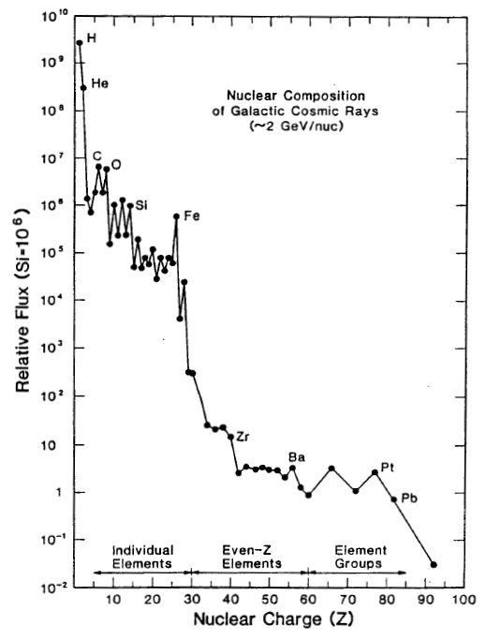
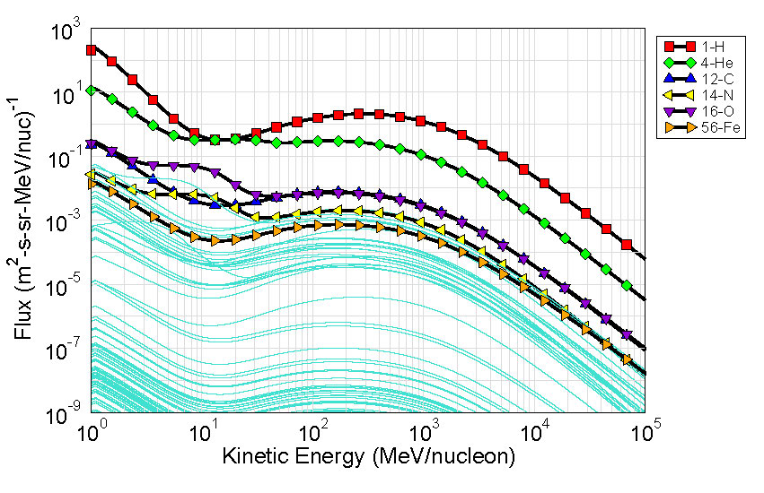
UC Berkeley Department of Nuclear Engineering's Spring 2023 Colloquia
Natural Space Environment: GCR
Nymmik 1992 Model, Geostationary Orbit
https://creme.isde.vanderbilt.edu/
R. A. Mewaldt, Adv. in Space Res., 1994.
Originate outside the solar system (e.g., supernovae)
Include all naturally-occurring elements
  Drops off rapidly for Z > 26 (iron)
Most energetic of all space environment radiation

Slide 6
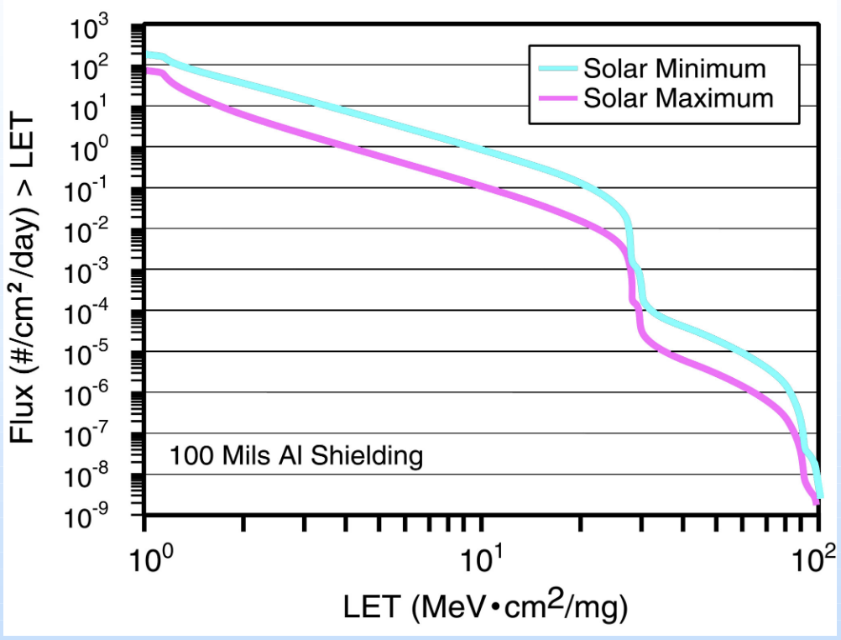
UC Berkeley Department of Nuclear Engineering's Spring 2023 Colloquia
Application of LET

Slide 7
UC Berkeley Department of Nuclear Engineering's Spring 2023 Colloquia
Breaking down radiation effects
Ionizing Radiation Effects
Total Ionizing Dose (TID)
Total Non-Ionizing Dose (TNID)
Single-Event Effects (SEE)
Non-Destructive
Destructive
Primarily high-energy protons and heavy ions

Slide 8
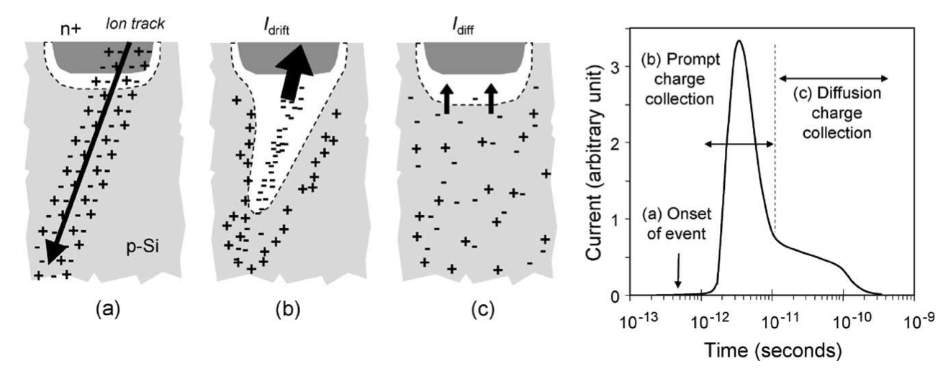
UC Berkeley Department of Nuclear Engineering's Spring 2023 Colloquia
SEE Mechanisms
When an ion passes through a conductor or semiconductor e.g. Si:
  Most charge deposition is compensated quickly through recombination, drift and diffusion.
  This is what causes SEE
  BUT, from a TID perspective charge isn’t accumulated or stored.
Image reproduced from Baumann: Radiation-Induced Soft Errors in Advanced Semiconductor Technologies

Slide 9
UC Berkeley Department of Nuclear Engineering's Spring 2023 Colloquia
Application of LET

Slide 10



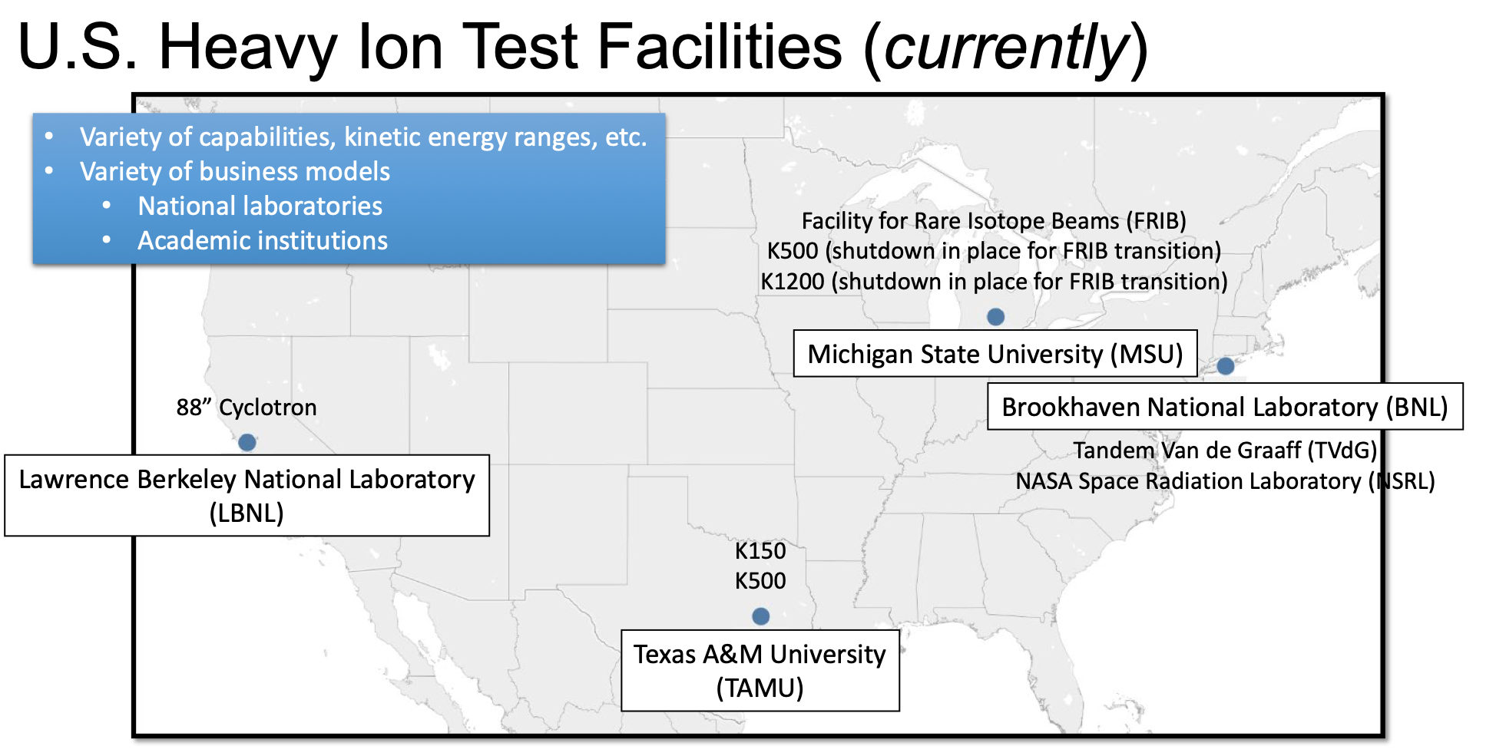
COLLABORATION IS NECESSARY
NASEM 2017-2018
AOA 2019
Agency-wide facility block buys
Key findings
• Growing use and tightening supply
• Infrastructure showing signs of strain
• Aging workforce in a domain that requires specialized training and skills
• Fast-moving technology
Points to / needs
• More organizational coordination
• Test facility sustainment & new investments
• Coupled with appropriate research & development
• Workforce development
Existing heavy ion SEE test facilities cannot meet current or future SEE test demand (~5000 hour/year gap)
Department of Defense efforts as well as U.S. Government and commercial space are driving significant increases in SEE testing demand
Current heavy ion accelerators for SEE testing at U.S. universities and Department of Energy labs have limited capacity and capability
NASA-DoD Collaborations:
Workforce Development
SEE Testing Advisement
Data Sharing
Common Part Testing
New Facility Shakeouts
SINGLE EVENT EFFECTS
RECENT ASSESSMENTS AND RESPONSES

Slide 11
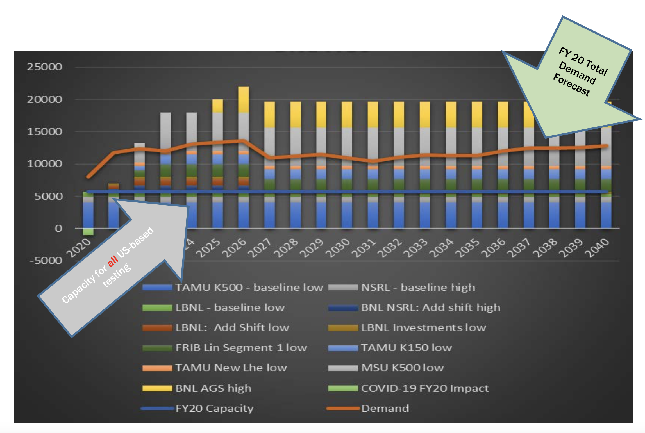
Accelerator Supply and Demand

Slide 12
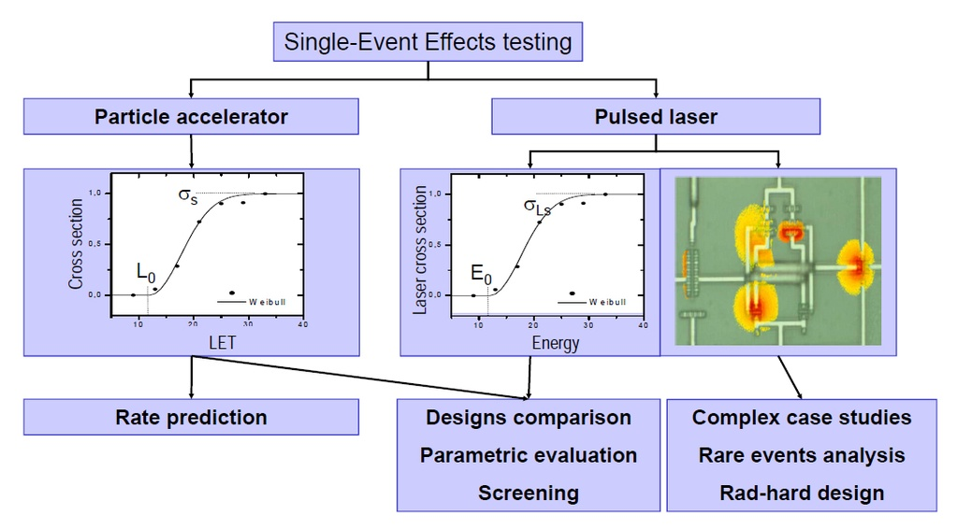
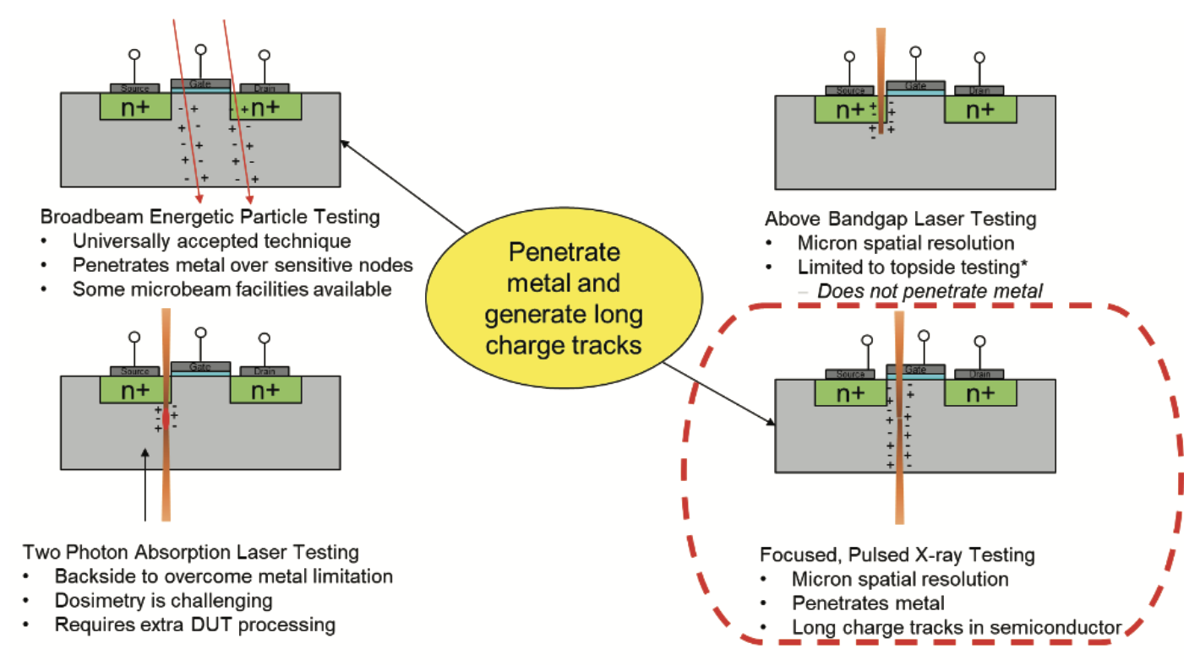
WRAP UP
Alternative Test Techniques
The Radiation Effects Community has developed a few alternative approaches to generate SEE
Pulsed Laser
Pulsed X-Ray
Pros:
Provides spatial correlation
Can be productized
Cons:
Charge track structure
Cannot penetrate through overlayers/packaging
Pros:
Similar ranges to terrestrial heavy ion facilities
Provides spatial correlation
Cons:
Dose effects
For required markings, please visit https://mh.jpl.nasa.gov

Slide 13
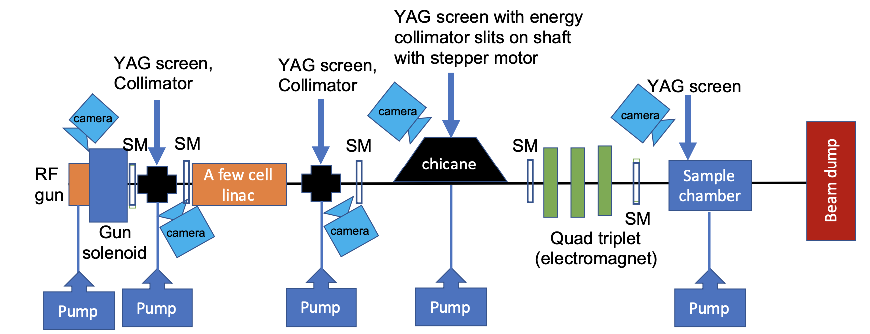
Proposed Alternative
Pulsed Electron Beam

Slide 14




Theme, project, mission, or org ID (optional)
Requirements
Duration
Energy/Range
Equivalent LET
Track Radius
Sub-picosecond
A relativistic particle travels a 1-micron distance in several femtoseconds
For either case (electron pulse or heavy ion), there is virtually no charge collection or charge-carrier recombination during this time, so all charge liberated at the beginning of the process is still present at the end .
A short bunch allows us to consider the energy deposition to scale linearly with n number of electrons. The number of electrons in a pulse can be adjusted to produce an equivalent LET for a pulse having any value up to a value at least as large as 100 MeV-cm²/mg and beyond
1 micron diameter
Large lateral dimensions of the semiconductor allow a track to expand by radial diffusion without being inhibited by dielectric structures.
Such radial diffusion expands an initially very narrow track (e.g. from a heavy ion) into a track having a 1-micron diameter in a few tens of picoseconds.
The 3-5 MeV electrons have ranges much longer than most heavy ions used for SEE tests.
Notes:
Also, for devices having large semiconductor structures, the total charge that will be collected at a junction is much greater than the charge collected during the first few tens of picoseconds, so there is little distinction between a very narrow track and a track that began with a one-micron diameter. This establishes an equivalence between pulsed electrons and heavy ions for devices satisfying the above requirement.

Slide 15
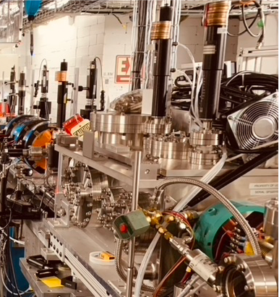


Next Steps
Energy/Dosimetry Calibration
Develop calibration experiments at existing e- LINAC facilities
Correlated Testing
Test simple devices in increasing complexity: Photodiode, linear devices, scaled memory, etc. Compare with existing heavy ion measurements characterized over LET
Modeling
Develop electron transport models to understand track structure through various materials
For required markings, please visit https://mh.jpl.nasa.gov

