Slide 1
Optimized Laser Pulses for Free Electron Lasers (OPAL-FEL)
Henrik Tünnermann and OPAL-FEL Team
Deutsches Elektronen-Synchrotron DESY, Notkestraße 85, 22607 Hamburg, Germany
HIR^3X: Helmholtz International Laboratory on Reliability, Repetition, Results at the most Advanced X-Ray Sources
Notes:
HIRX slac
erwähnen
Push for ai

Slide 2
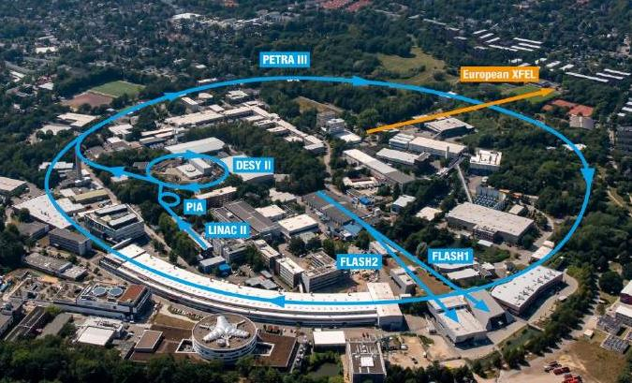
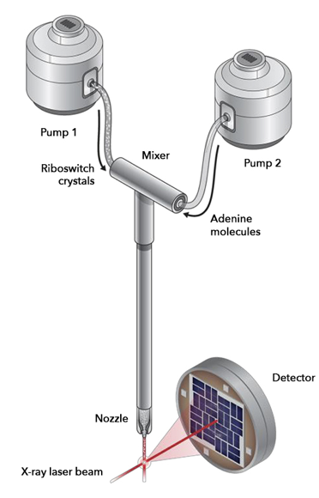
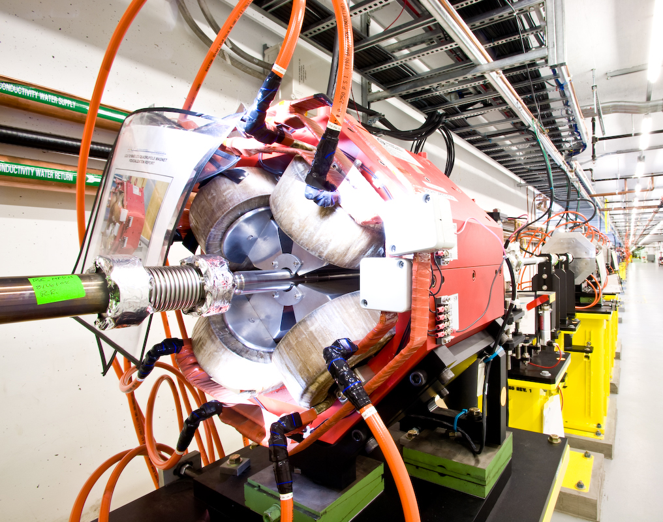
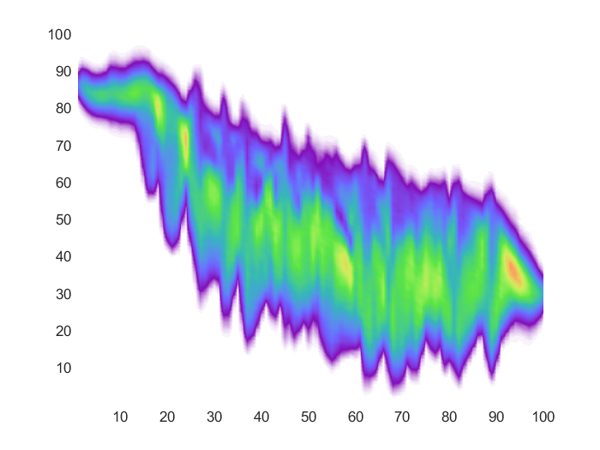
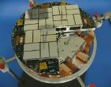
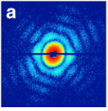
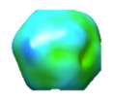
Artificial intelligence for FEL facilities?
DESY campus, Hamburg, Germany
Core research scope: Ultrafast studies of matter
Complex machines
Expand experimental capabilities
Reliability to be able to provide users the same conditions
High-speed sample delivery
Accelerator control
Accelerator diagnostics
Megapixel detector
X-ray diffraction pattern
Intensity map from multiple pulses
Interpretation of structure / dynamics
Femtosecond laser
Notes:
FEL erklärren xray free electron lasers und
Pump probe delta t usw.

Slide 3
Free Electron Lasers
Beye M., et al, “FLASH2020+ - upgrade of FLASH: conceptual design report” (2020), doi:10.3204/PUBDB-2020-00465
Notes:
FEL erklärren xray free electron lasers und
Pump probe delta t usw.

Slide 4
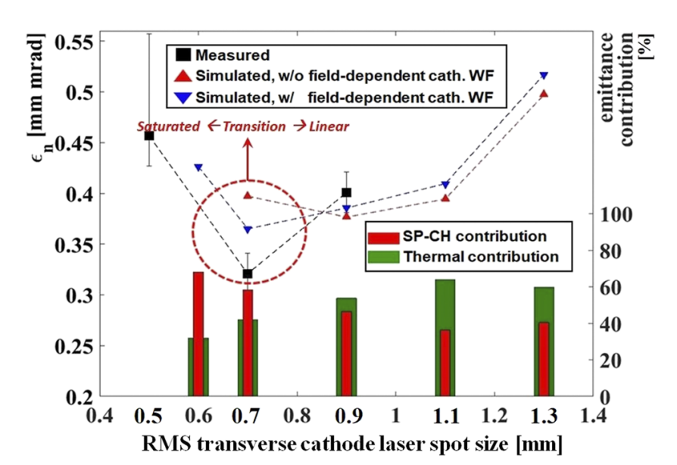
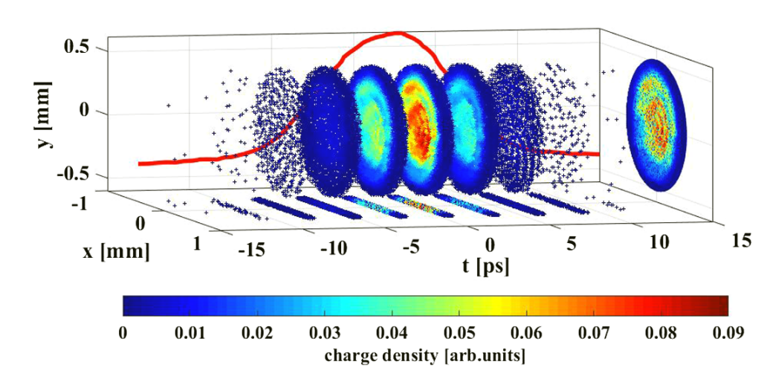
Emittance optimization in high brightness photoinjectors
Laser pulse shaping playing an essential role
Overall Emittance Budget:
measurement & simulation of transverse beam emittance in different photoemission regimes
Electron bunch generation at the photocathode depends on the drive laser profiles
Space-charge induced emittance contribution needs to be optimized in respect to cathode laser profiles
Electron Bunch Generation at the photocathode
AIP Advances 10, 035017 (2020)
PHYS. REV. ACCEL. BEAMS 23, 044201 (2020)

Slide 5
Core Idea
Goal: Optimize Emittance of Electron Gun
Experimental optimization: very costly (FEL beam time)
Theoretical:
Numerically expensive (~24h for runs with high resolution/many electrons)
Not completely accurate
Train neural network based on high fidelity theoretical model and have it interpolate
Can use experimental data to optimize model
Compare with simplified physical model
Use for ‘End-to-End’ Optimization

Slide 6
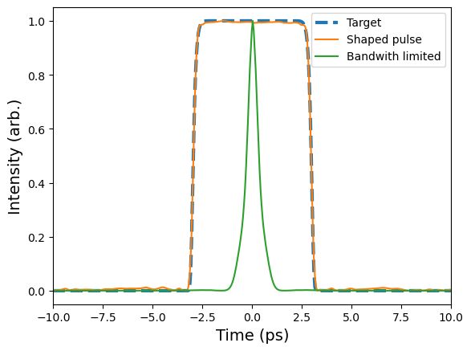
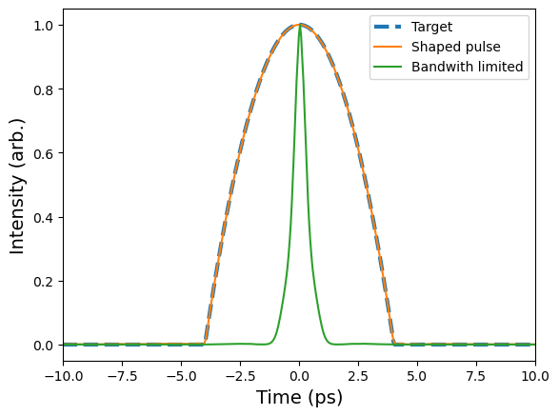
Temporal Shaping Lasesr Pulses

Slide 7
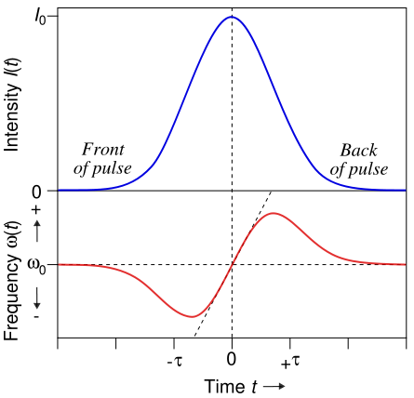
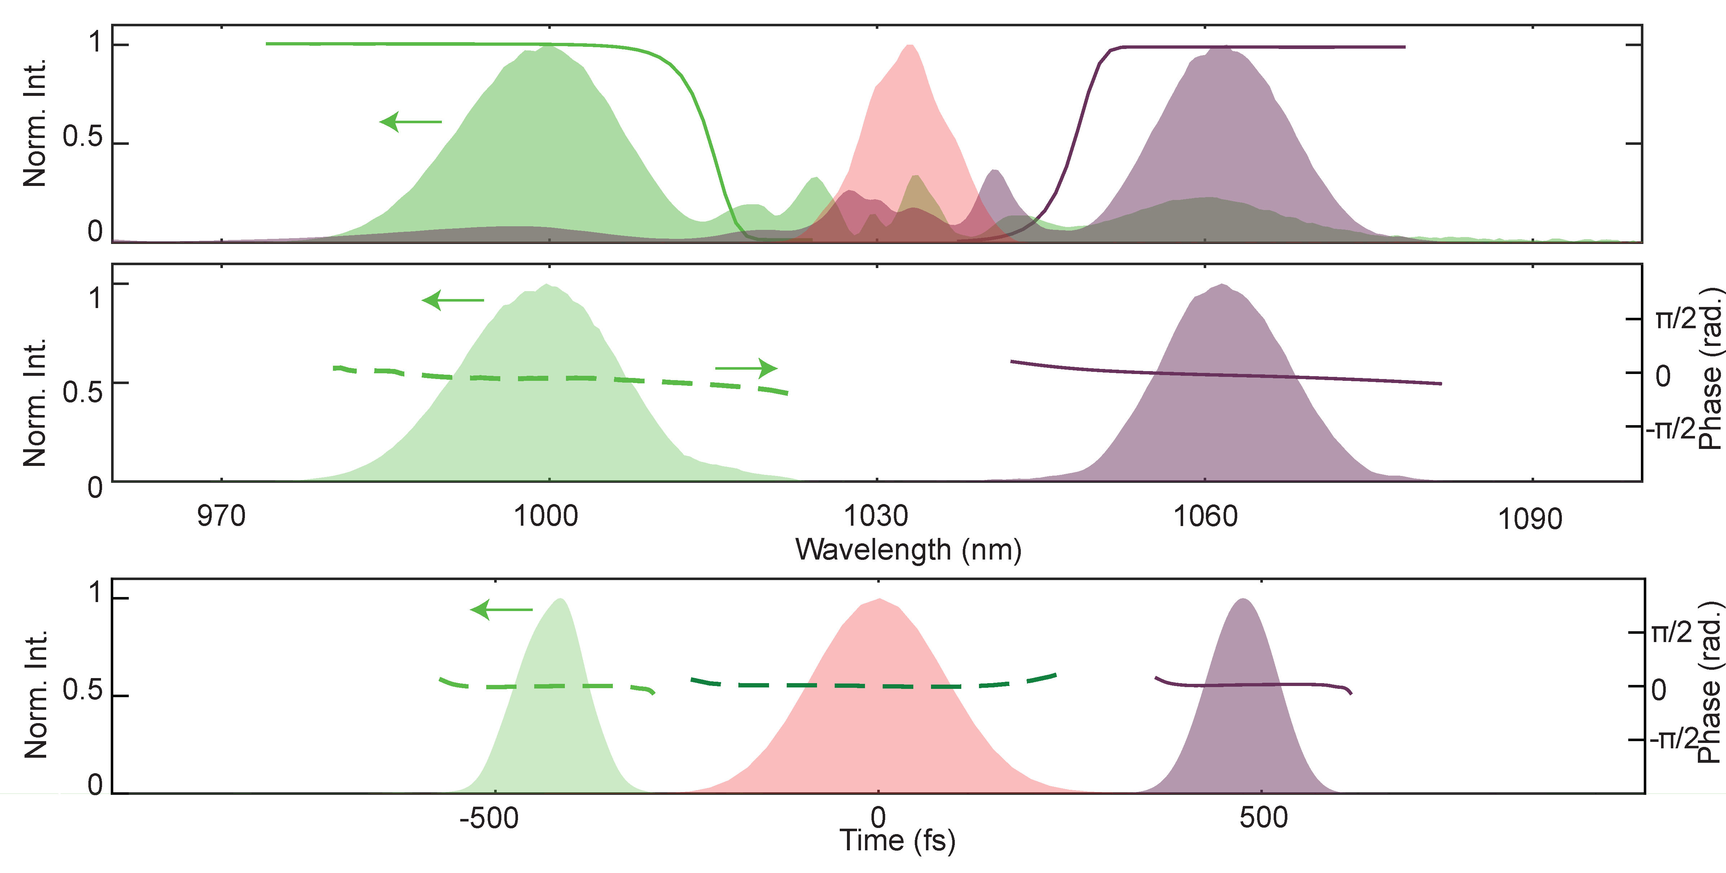
Other Uses of Pulse Shaping: Frequency Shifting

Slide 8
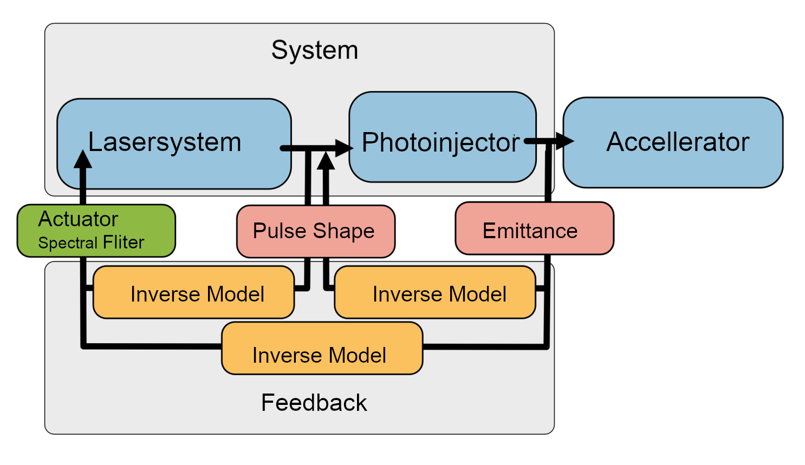
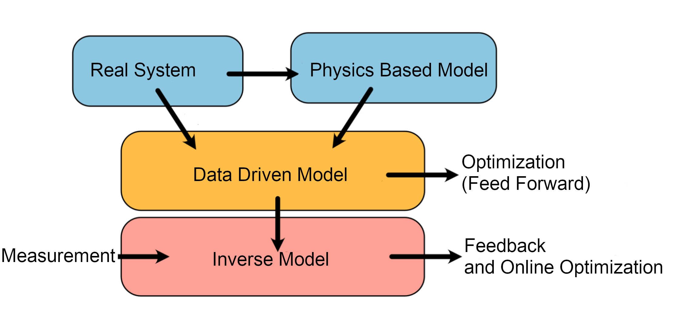
End to End

Slide 9
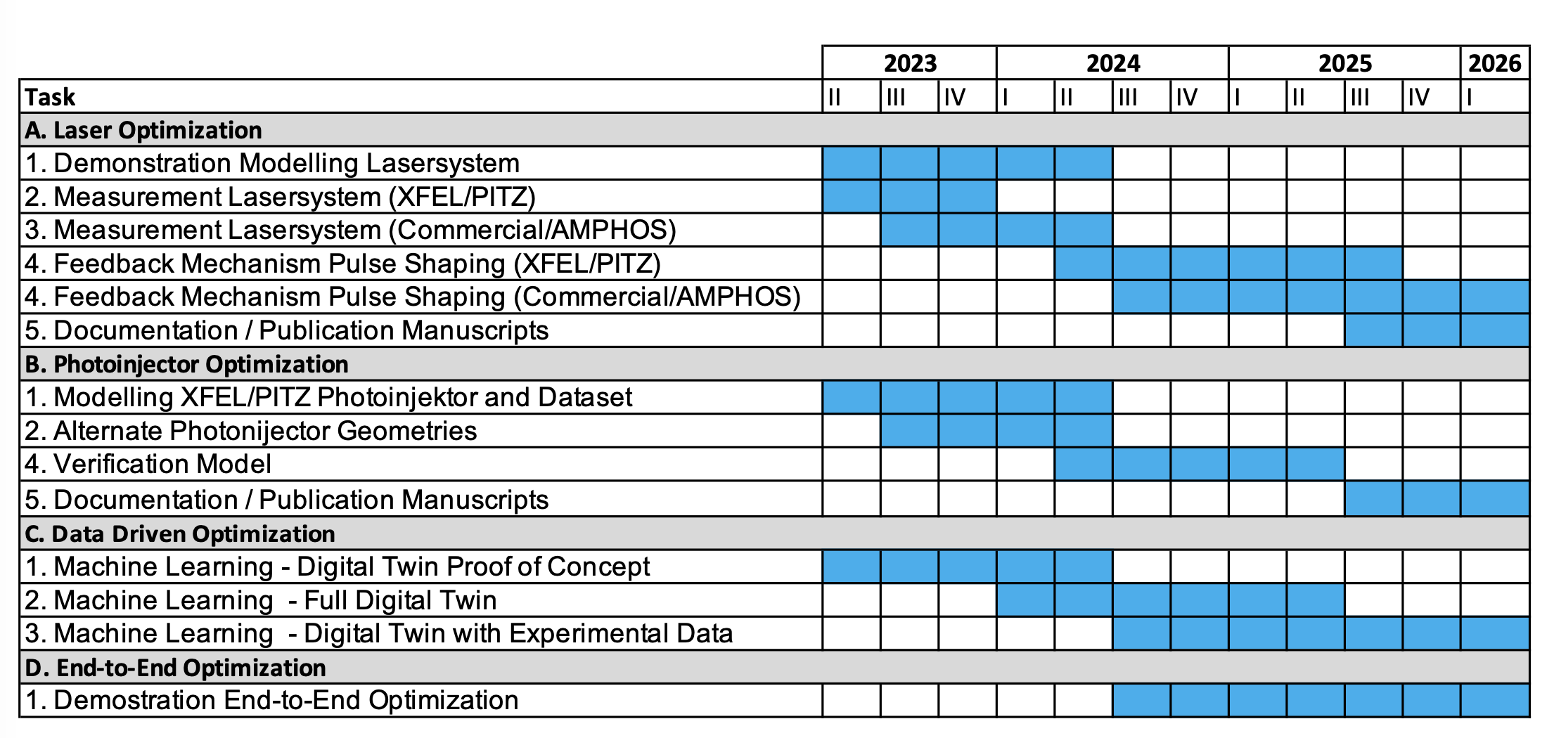
Timeline

Slide 10
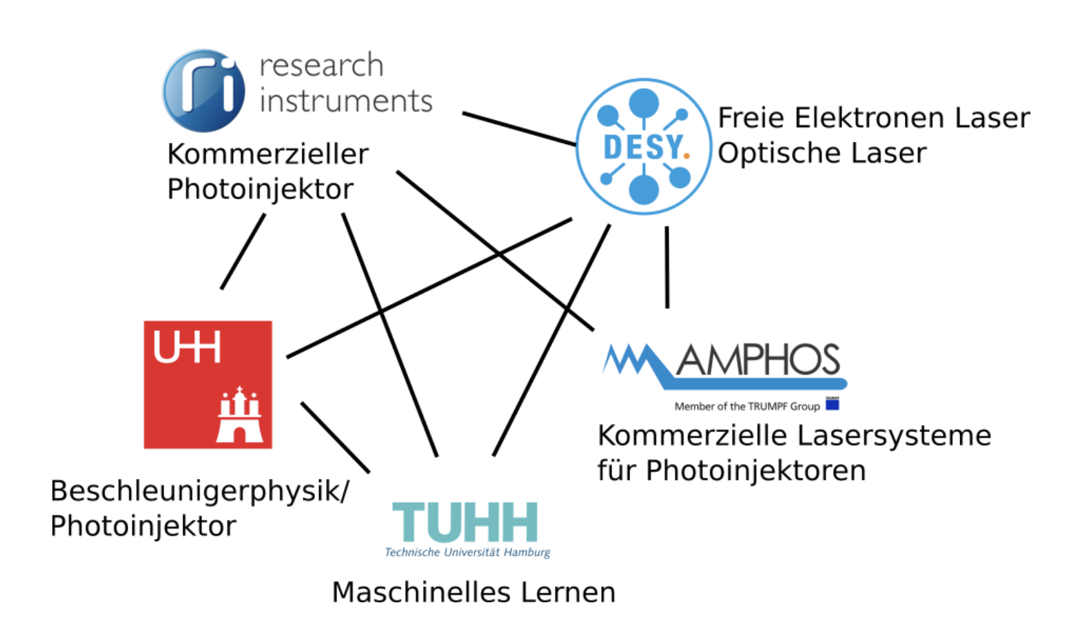
Thank You!

