Slide 1
Summary of simulations for a few advanced modes of operation at FLASH2020+
Georgia Paraskaki
Hamburg, 08-12-2022
3rd FLASH2020+ Start to End Simulation Workshop

Slide 2
Motivation
We have 1 million core hours left for projects besides core studies until May 2023
Core activities already covered in this and previous S2E workshops
A few “Beyond FLASH2020+” core activities will be reviewed today
We will discuss relevance to the S2E simulations of core activities
We will check progress and share results during the next S2E workshop in spring
Notes:
2.5MILLion total,

Slide 3
FLASH2020+
Simulation work in progress: Seeding
EEHG and HGHG simulations
Several working points with tapering
Effect of e-beam energy chirp
Effect of laser chirp
Effect of seed laser power jitter
Effect of CSR in chicanes
Divergence studies
Beyond FLASH2020+ core projects
Seeding with an optical klystron
Seeding with an optical cavity
on output FEL pulse

Slide 4
Outline
Seeding with an Optical Klystron
Have been working with E. Allaria, E. Ferrari and E. Schneidmiller
Seeding with an Optical cavity

Slide 5
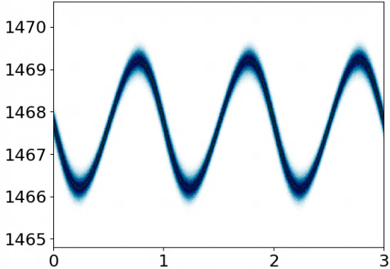
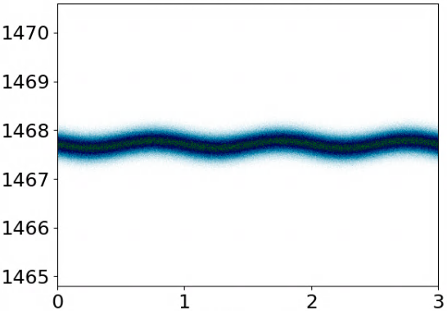
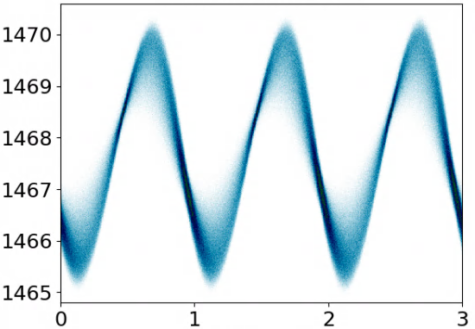
Seeding with an optical klystron
Beyond FLASH2020+
modulator
radiator
What can we achieve with the lower seed power?
Higher repetition rate
Shorter FEL output wavelength
Pulse shaping
Transportation, damage threshold
Easy setup (EEHG-like)
Standard HGHG
seed laser
γ
s[λ_{seed}]
modulator 1
modulator 2
radiator
Optical klystron based HGHG
seed laser
γ
γ
s[λ_{seed}]
s[λ_{seed}]

Slide 6
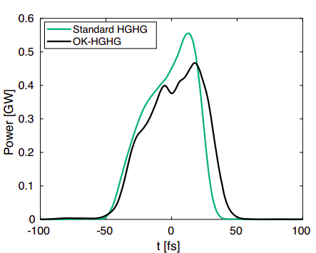
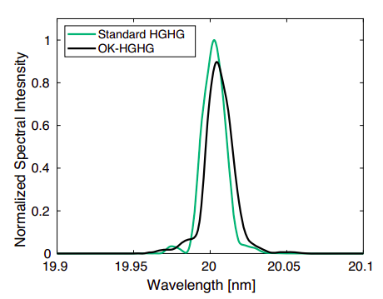
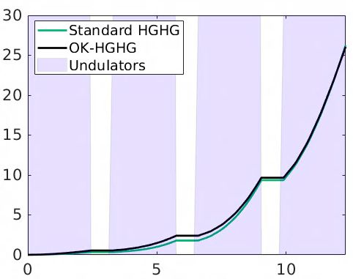
Seeding with an optical klystron
Simulated with Genesis 1.3 v4
Simulation results (300 nm → 20 nm)
Pulse Energy [μJ]
Power [GW]
Normalized Spectral Intensity
z [m]
t [fs]
Wavelength [nm]
 | Bunching | Energy spread @ end of modulator | FWHM relative BW | Pulse duration | Pulse energy | Seed laser peak power
Standard HGHG | 7% | 580.9 keV | 9·10⁻⁴ | 18.9 fs | 26.3 μJ | 61 MW
OK HGHG | 7% | 766.4 keV | 9.3·10⁻⁴ | 21.5 fs | 26 μJ | 0.17 MW
reduction factor of 360

Slide 7
The effect of electron beam energy chirp
Linear chirp - Quadratic chirp - Combined h.o. terms

Slide 8
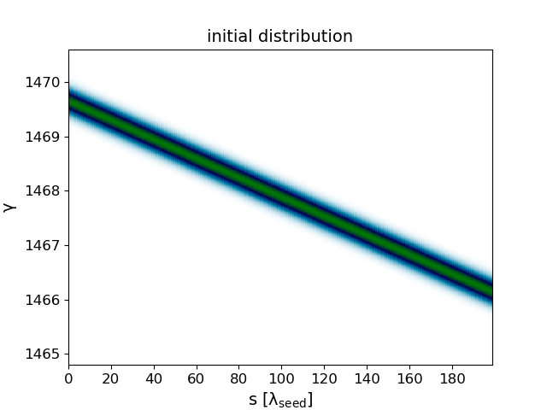
The effect of electron beam energy chirp
Linear chirp
Bunch compression
Wavelength compression in HGHG
s_{f} = s_{i} +R₅₆δ
δ = δ₀ + hs_{i}
H ∝ h
B ∝ R₅₆
→ C_{BC}⁻¹ = ds_{f}/ds_{i} = 1+ hR₅₆
→ C_{HGHG}⁻¹ = λ’_{HGHG}/λ_{HGHG} = 1+ HB
γ
γ
?
s[λ_{seed}]
s[λ_{seed}]

Slide 9
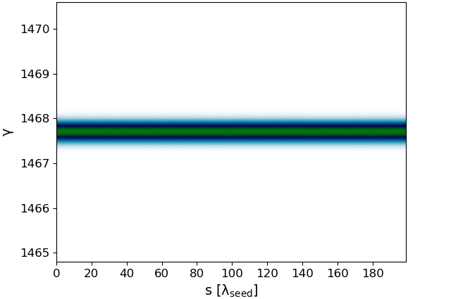
Effect of a linear energy chirp
OK HGHG - Initial distribution
Initial distribution
Without chirp
With chirp

Slide 10
Effect of a linear energy chirp
OK HGHG - Compression
1st compression
2nd compression

Slide 11
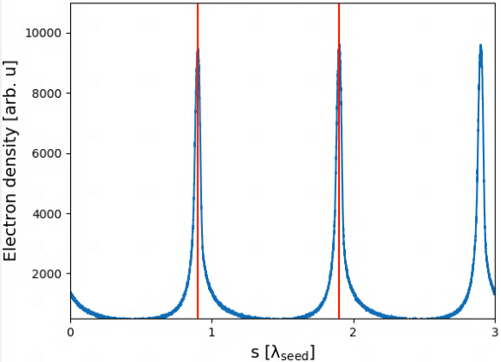
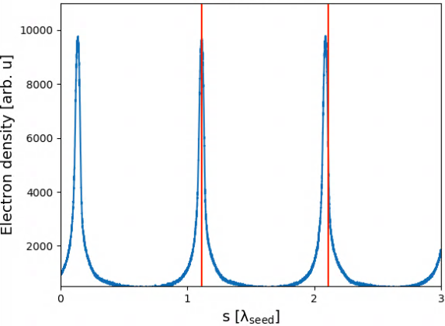
The effect of energy chirp
Linear chirp
After compression
Without chirp
With chirp
λ_{seed}
λ_{seed}

Slide 12
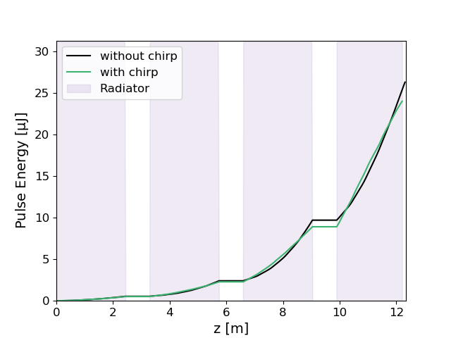
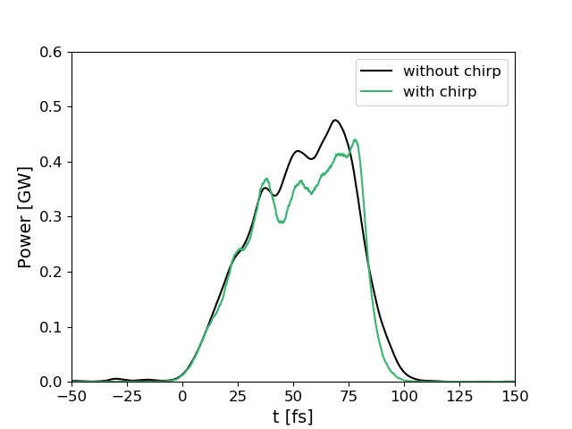
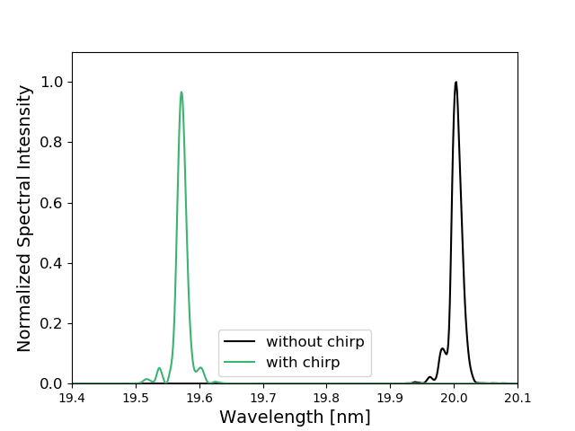
Optical klystron HGHG with a linear energy chirp
15th harmonic of 300 nm seed laser wavelength
2.15%
Pulse Energy [μJ]
Power [GW]
Normalized Spectral Intensity
z [m]
t [fs]
Wavelength [nm]

Slide 13
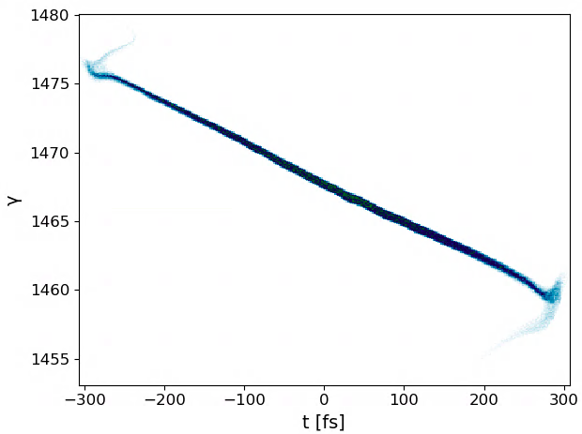
The effect of the energy chirp
Expected longitudinal phase space
FLASH2020+: expected profile from S2E
γ=c₀+c₁s+c₂s²+c₃s³
c₀=1467.7
c₁=-9.7e4m⁻¹
c₂=8.7e7m⁻²
c₃=5.9e11m⁻³

Slide 14
The effect of the energy chirp
Expected longitudinal phase space
FLASH2020+: expected profile from S2E
γ=c₀+c₁s+c₂s²+c₃s³
c₀=1467.7
c₁=-9.7e4m⁻¹→ set to 0
c₂=8.7e7m⁻²
c₃=5.9e11m⁻³→ set to 0

Slide 15
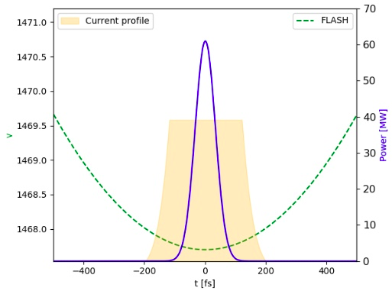
The effect of the energy chirp
Isolated quadratic chirp
γ=c₀+c₁s+c₂s²+c₃s³
c₀=1467.7
c₁=-9.7e4m⁻¹→ set to 0
c₂=8.7e7m⁻²
c₃=5.9e11m⁻³→ set to 0

Slide 16
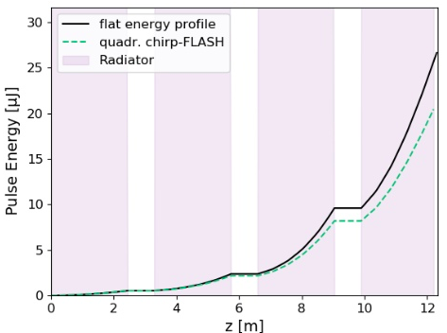
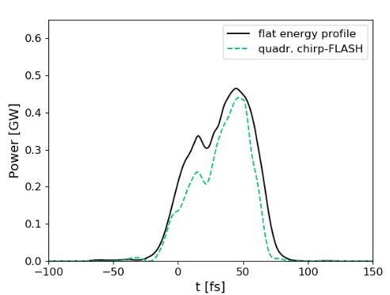
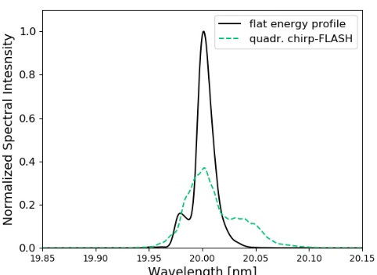
OK-HGHG output FEL: with FLASH isolated quadratic term

Slide 17
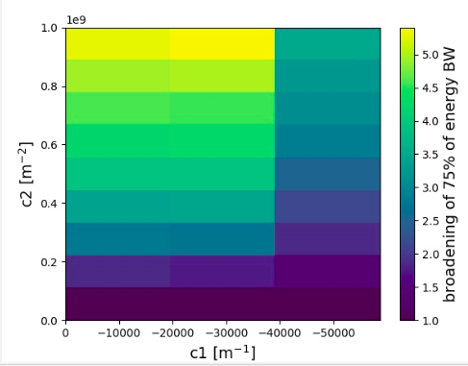
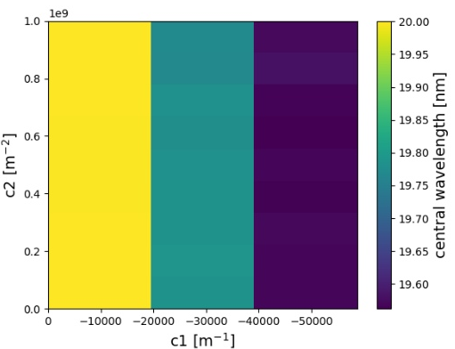
Upcoming studies: combine linear and quadratic terms
Reminder: c1=-30000m⁻¹ → h=-20m⁻¹

Slide 18
Seeding with an optical klystron
Proof of principle experiment at SXFEL:
J. Yan, Z. Gao, Z. Qi, K. Zhang, K. Zhou et al. Self-amplification of coherent energy modulation in seeded free-electron lasers. Phys. Rev. Lett., 126:084801, Feb 2021.
Possible experimental studies
Echo-enabled harmonic generation for user operation
Available set-up for HGHG optical klystron experiments
modulator 1
modulator 2
radiator

Slide 19
Relevance to core projects
The optimization shares many similarities with EEHG and HGHG
Working on chirp studies on all schemes allows cross-checking results & comparing benefits and weaknesses
Same S2E e-bunch (*highly interested in the 750MeV S2E e-bunch*)
OK-HGHG simulation can benefit from:
The S2E e-bunch to study imperfections
Handshaking between codes:
genesis ←→ elegant: simulate more accurately the chicanes
Beam manipulation scripts:
reslice e-bunch when necessary due to wavelength compression or due to different wavelength of seed2

Slide 20
Seeding with an optical cavity
The working principle
Modulator
Radiator
seed laser

Slide 21
Seeding with an optical cavity
The working principle
Modulator
Radiator
An optical cavity recirculates a low repetition rate seed laser pulse
Electron bunches get seeded at multi-MHz repetition-rate
Result → FEL radiation pulses with:
Longitudinal coherence ✔️
High repetition rate ✔️
Shorter wavelengths ✔️
Suitable for CW FELs ✔️

Slide 22
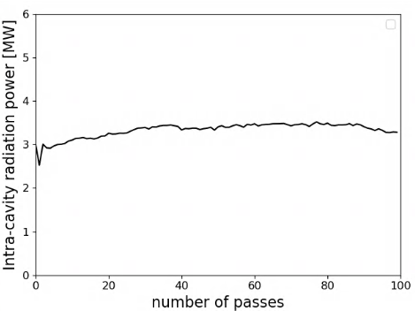
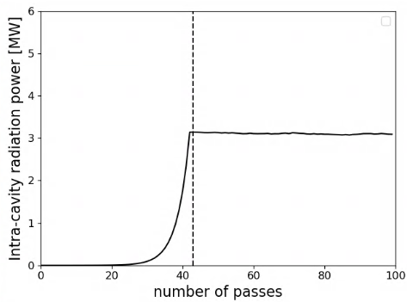
Seeding with an optical cavity
Two possibilities for the startup process
Modulator
Radiator
Starting with a low repetition rate seed laser
Starting from shot noise
steady-state
build-up
steady-state
✔️ Steady-state is reached fast
✔️ Control over final FEL pulse through seed
❌ Shortest wavelength and wavelength tunability depend on the seed
❌ Challenging incoupling of seed laser
✔️ Shortest wavelength independent of seed
✔️ Wavelength tunability depends only on mirrors
❌ Monochromator required
❌ Electron bunches required for “build-up”

Slide 23
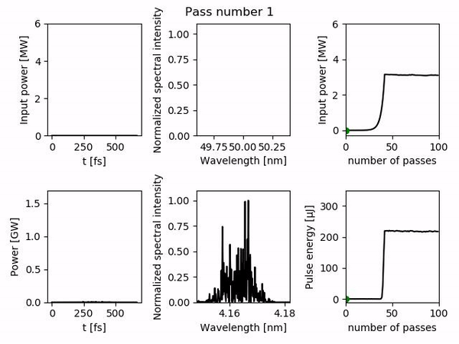
Simulation results: starting from shot-noise
Simulated with Genesis 1.3 v4 & ocelot
Intra-cavity field@50nm → output FEL@4.17nm
Page 11

Slide 24
A proof of principle experiment at FLASH
Joint project with University of Hamburg
3 MHz repetition rate - 13.5 nm fundamental wavelength
Modulator
Radiator
Image: DESY/Siegfried Schreiber

Slide 25
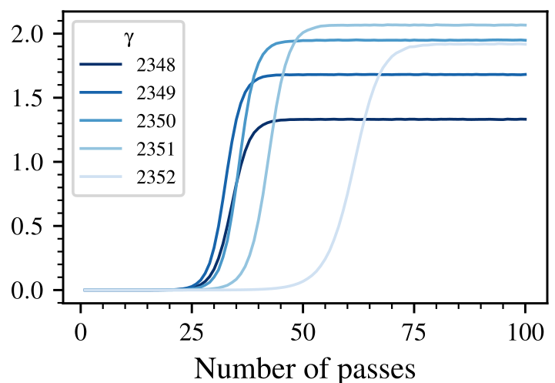
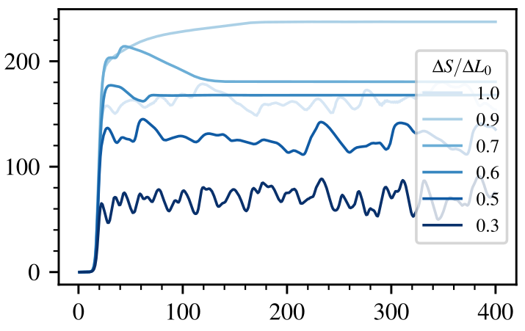
Plan 1: Use as direct source of radiation
with a monochromator
without a monochromator
Pulse energy in μJ
Peak power in GW
Number of passes
Number of passes
Master Thesis of Margarit Asatrian, “Simulation Studies on an XUV High-Gain FEL Oscillator at FLASH”

Slide 26
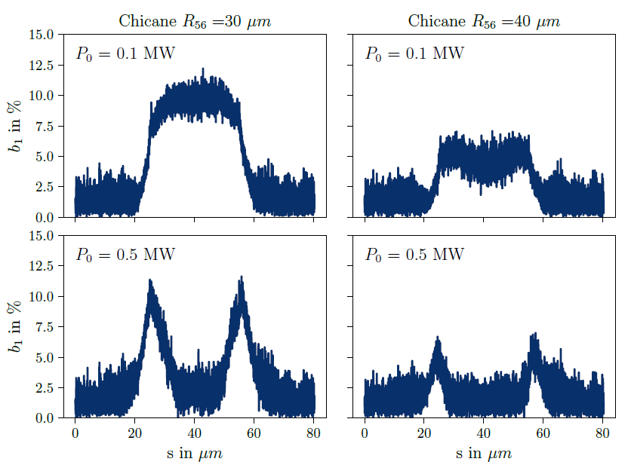
Plan 2: Modulate electrons & transfer bunching downstream
Challenges
Maintain a low power in modulator
Generate sufficient bunching with
Sufficient R₅₆ to place the mirror in the chicane
Maintain bunching up to radiator entrance (see A. Brynes et al., “Bunching evolution in drifts”, MOP01, FEL22)
Master Thesis of Margarit Asatrian, “Simulation Studies on an XUV High-Gain FEL Oscillator at FLASH”

Slide 27
Relevance to core projects
S2E beam is also important here to investigate possible showstoppers
Realistic laser fields are important to investigate the effect on the stability from pass to pass
Handshaking between field-related and e-beam-related codes is important
Post-processing of field file as a diagnostic tool from pass to pass

Slide 28
Summary
***Advanced schemes are naturally linked to the core projects of FLASH2020+***
Optimization between the different seeding schemes is comparable
Investigating extreme cases benefits all schemes
S2E e-bunch can be immediately used in all cases with no modifications and offer better insights
Handshaking between different codes can be applied in all cases
During next workshop in spring (tbd) we will share and review progress on “beyond FLASH2020+” core projects
Notes:
These schemes offer the possibility to FLASH to have special modes of operation

Slide 29
Questions?

