Slide 1
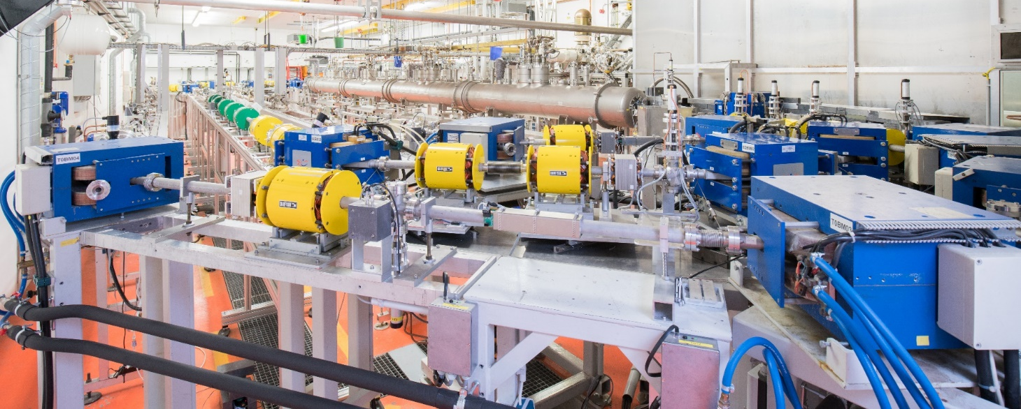





ANGELOTTI – IKP
Accelerators: the Next GEneration – materiaLs, cOmponents, sysTems and simulaTIons
Picture: Jan-Christoph Hartung
Work supported by DFG (GRK 2128, SFB 1245), BMBF (05H21RDRB1), State of Hesse (Cluster Project ELEMENTS and LOEWE Research Cluster Nuclear Photonics)

Slide 2
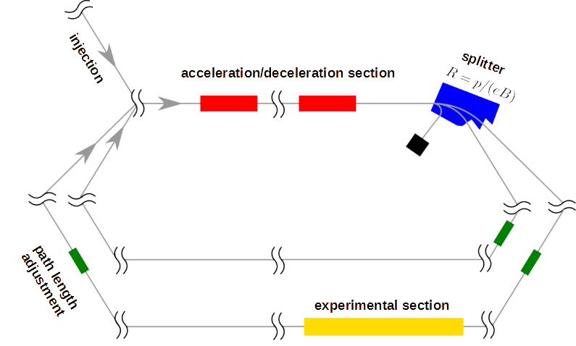

Challenges of Twofold ERL
Concept based on: R. Koscica et al., Phys. Rev. Accel. Beams 22, 091602 (2019)
Objective functions result from
splitter magnet ratio:
p_{I} : p_{F} : p_{S} =1 : 4.73 : 8.32
Degrees of freedom:
$$\vec{A},\vec{φ},\vec{L},{\vec{R}}_{56}$$

Slide 3
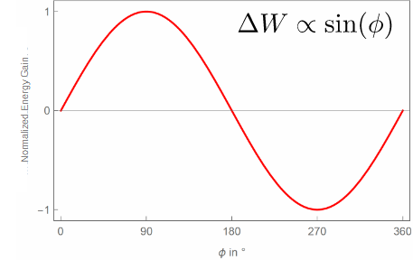
Phase Slippage
    Simplified model of energy gain

Slide 4
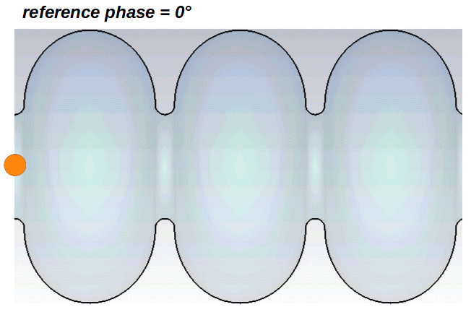
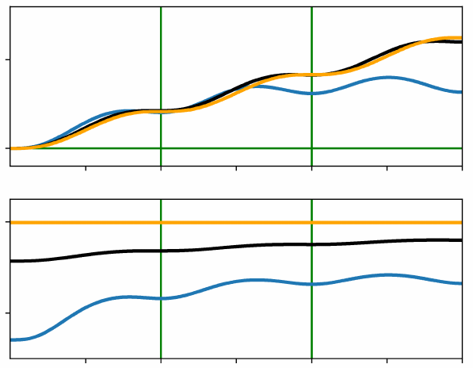
Phase Slippage
    Simplified model of energy gain
    More complex model of energy gain

Slide 5
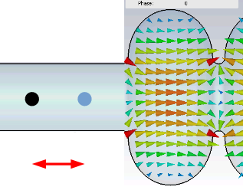
Phase Slippage
    Simplified model of energy gain
    More complex model of energy gain
    Speed changes along the cavity
    Influences interaction with
    alternating electric field
Numerical simulations
required

Slide 6
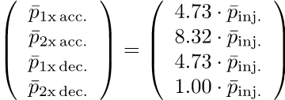
Longitudinal Targets and Degrees of Freedom

Slide 7
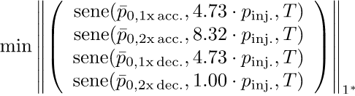
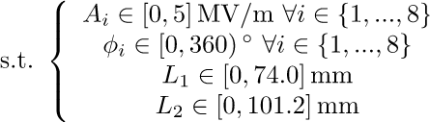

Longitudinal Targets and Degrees of Freedom

Slide 8
Longitudinal Targets and Degrees of Freedom

Slide 9

Longitudinal Targets and Degrees of Freedom

Slide 10
Longitudinal Targets and Degrees of Freedom
Code Availability:
F. Schliessmann et al., TUdatalib (2022), https://doi.org/10.48328/tudatalib-963

Slide 11
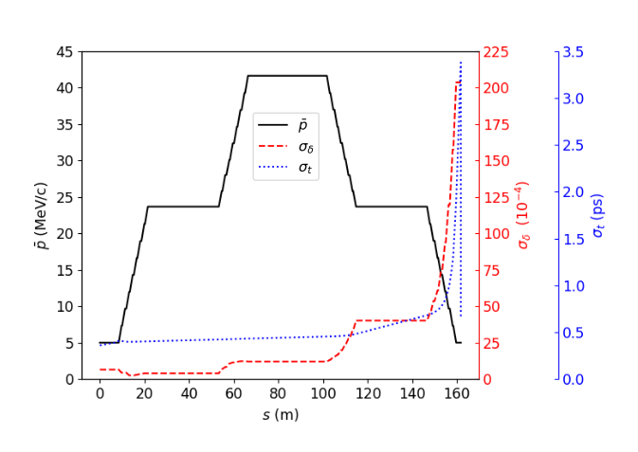
Solution for Longitudinal Quantities

Slide 12
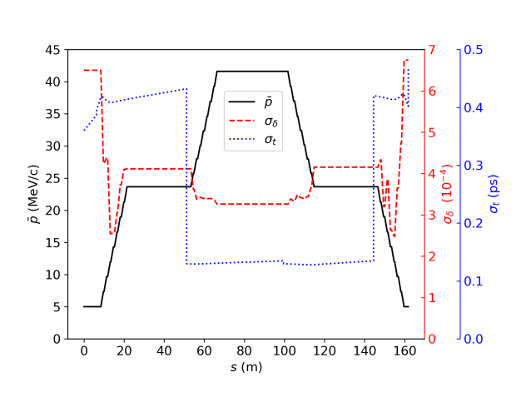
Solution for Longitudinal Quantities
and

Slide 13
Longitudinal Setup
LINAC Cavity | #1 | #2 | #3 | #4 | #5 | #6 | #7 | #8
Off-crest phase (°) (during 1st LINAC pass) | -9.7 | -5.7 | 13.2 | 4.0 | 6.1 | 7.2 | 5.6 | 3.2
Off-crest momentum gain (MeV/c) (during 1st LINAC pass) | 2.34 | 2.32 | 2.29 | 2.34 | 2.33 | 2.33 | 2.35 | 2.36
On-crest momentum gain (MeV/c) (during 1st LINAC pass) | 2.37 | 2.33 | 2.35 | 2.35 | 2.34 | 2.34 | 2.36 | 2.37
R_{56,I} = -0.01 m
R_{56,F} = +0.33 m
R_{56,S} = +0.18 m

Slide 14
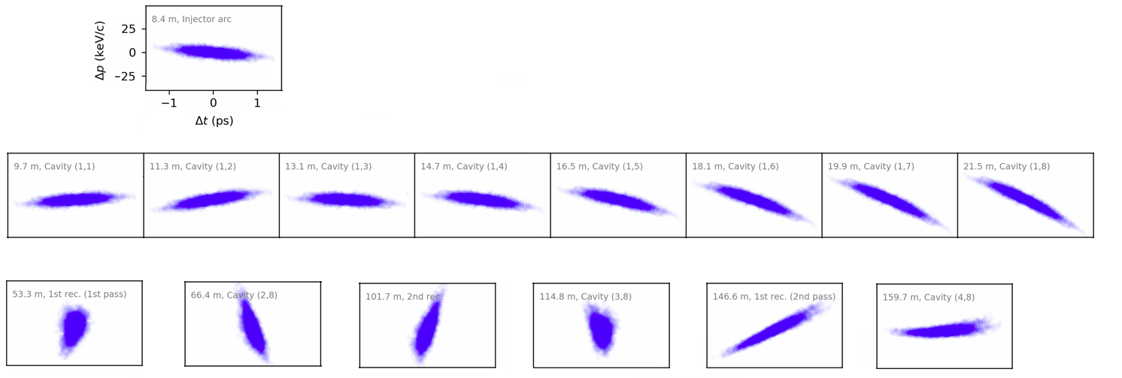
Longitudinal Phase Space

Slide 15
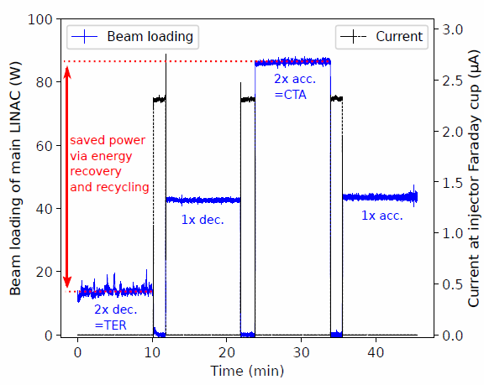
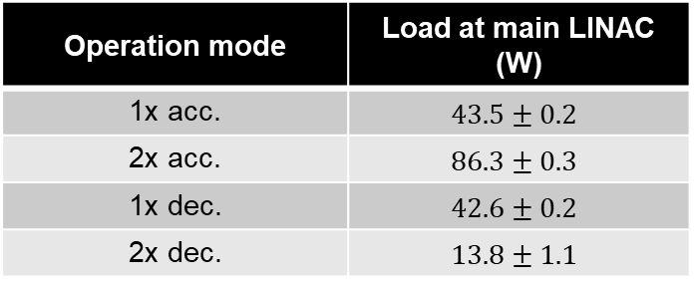
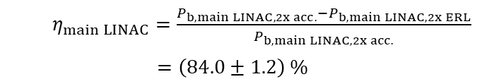
Twofold ERL Mode (August 2021)
Operation mode | Load at main LINAC (W)
1x acc. | $$43.5±0.2$$
2x acc. | $$86.3±0.3$$
1x dec. | $$42.6±0.2$$
2x dec. | $$13.8±1.1$$
Energy-recycling efficiency:
$η_{main LINAC}=\frac{P_{b,main LINAC,2x acc.}−P_{b,main LINAC,2x ERL}}{P_{b,main LINAC,2x acc.}}$
$=\left(84.0±1.2\right) \%$

Slide 16
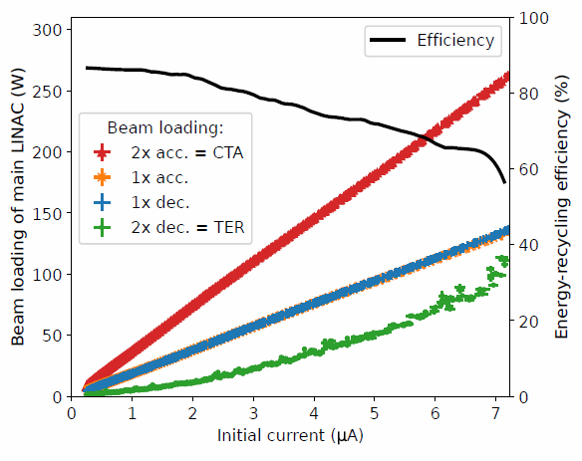

Twofold ERL Mode (August 2021)
${max(η}_{main LINAC})≈87 \%$

Slide 17
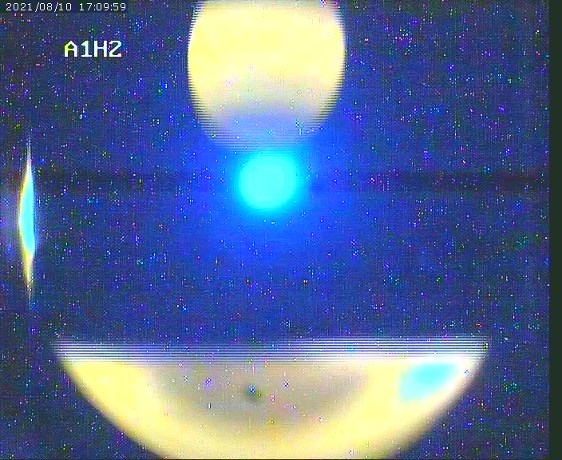
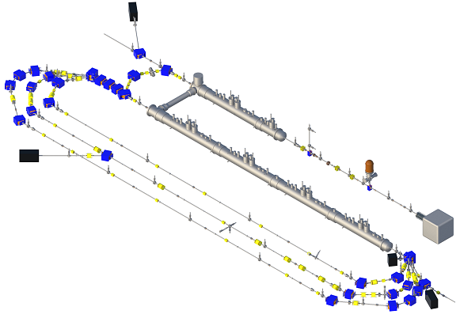
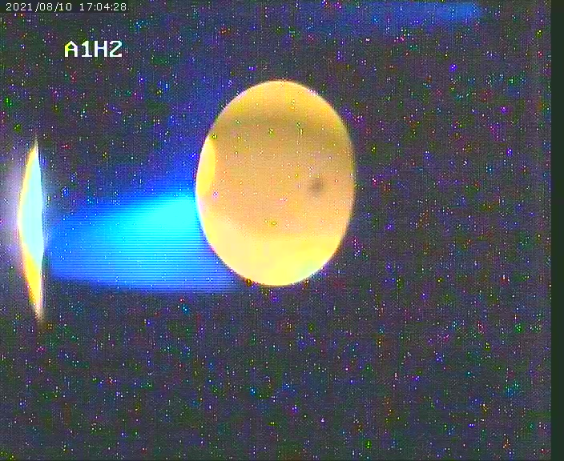
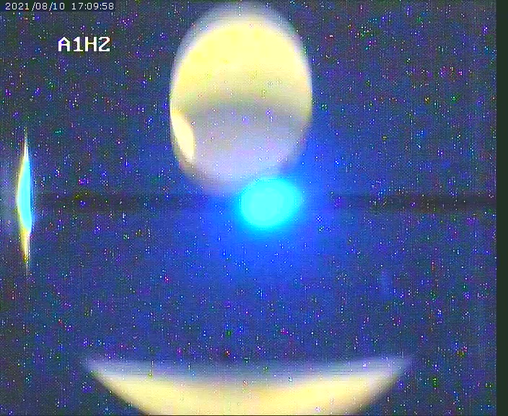
Limits of Transverse Tuning
3 cm
1x acc
2x dec
2x acc
1x dec

Slide 18
Instrumentation of Superimposing Beams
z
First Recirculation
Accelerated Beam
180°
180°
Decelerated Beam
3 GHz
6 GHz

Slide 19
Instrumentation of Superimposing Beams
(Non-)destructive position measurement for both beams simultaneously
Options
  Screen with hole
  Beam loss monitors
  Wire scanner
  6 GHz cavity BPM (double of fundamental frequency)
  3 GHz cavity BPM in combination with bunch trains
z
First Recirculation
Accelerated Beam
180°
180°
Decelerated Beam
3 GHz
6 GHz

Slide 20
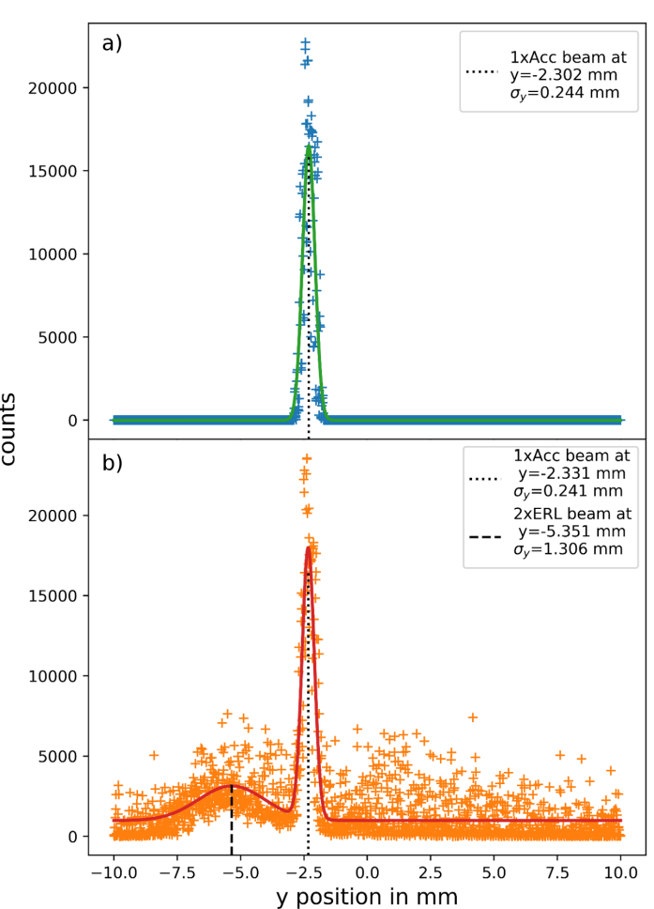
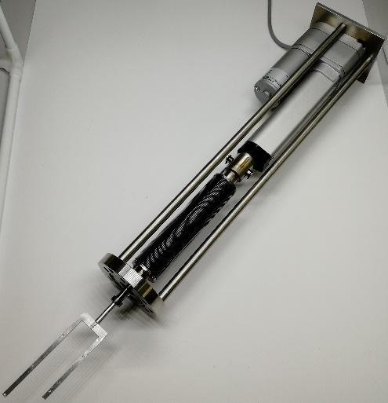
Wire Scanner
Measurement routine:
Measure single-accelerated beam alone
Measure both beams simultaneously
Substract (1) from (2)
Gain position of single-decelerated beam
Tuning of the first beam requires
re-calibration of the system
measurement time: ~ 10 sec.
10 cm
M. Dutine et al., Proc. of IPAC 2022, p. 254-256 (2022)

Slide 21
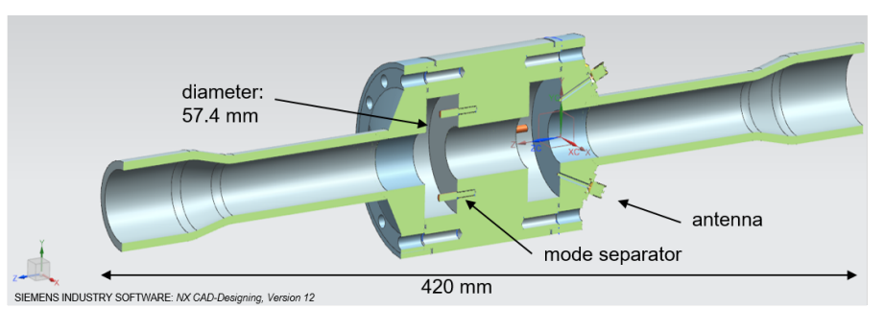
6 GHz Cavity BPM
Measurement routine:
Identical to wire scanner
Advantage: online measurement instead of defined measurement points
Tested at test stand
Read out electronics under development
Test with beam planned for 2023
Comparison to wire scanner
M. Dutine et al., Proc. of IPAC 2022, p. 254-256 (2022)

Slide 22
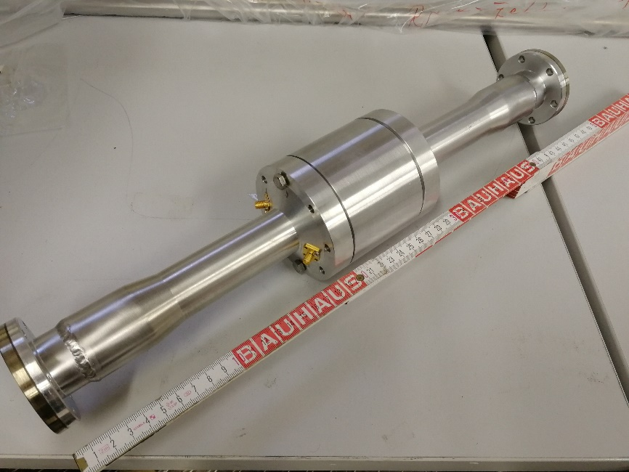
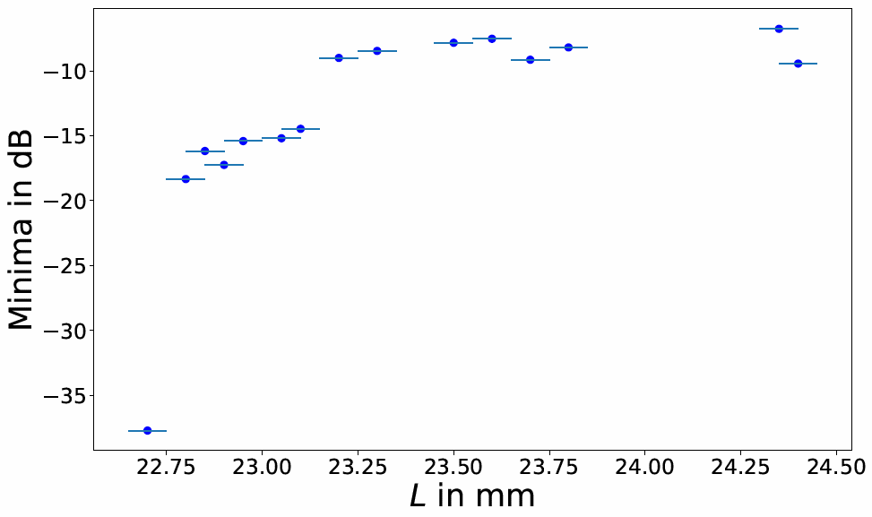
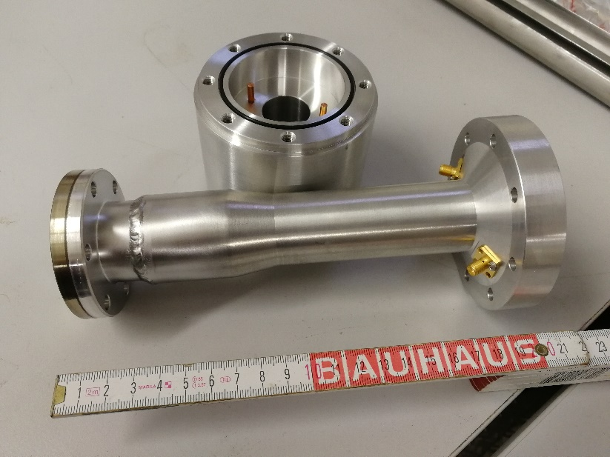
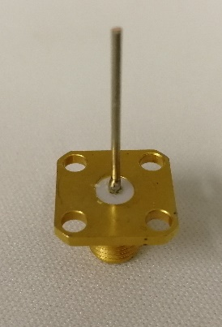
6 GHz Cavity BPM
courtesy of M. Dutine & A. Dimitrov

Slide 23
6 GHz Cavity BPM
courtesy of M. Dutine & A. Dimitrov

Slide 24
Summary
Twofold ERL mode at S-DALINAC with up to 87 % efficiency
Challenges of multi-turn energy-recovery:
    Low injection energy → Phase slippage
    Shared beam transport
Remedies:
        Numerical simulations
        Special diagnostic units

Slide 25
Thank you for your Attention.

Slide 26
Backup

Slide 27
Possible Threefold ERL Mode
Challenges:
4 → 6 superimposing beams in main LINAC section
1x → 2x two superimposing beams in recirculation beamlines
4 → 6 objectives for design momenta (i.e. +2 objective functions but only +1 degree of freedom (PLAS))

Slide 28
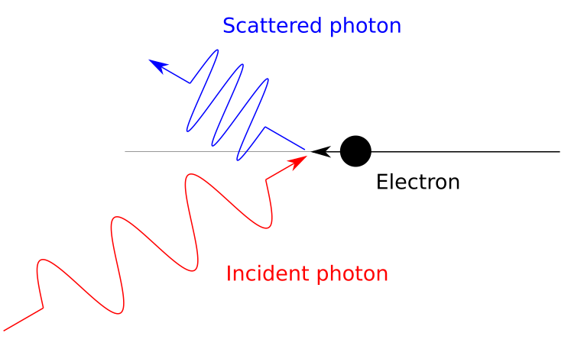
Compton backscattering at the S-DALINAC
can provide a quasi-monochromatic highly polarized X-ray beam
weak influence of electron beam due to small recoil and small Compton cross-section
➔ diagnostic tool for energy and energy spread

Slide 29
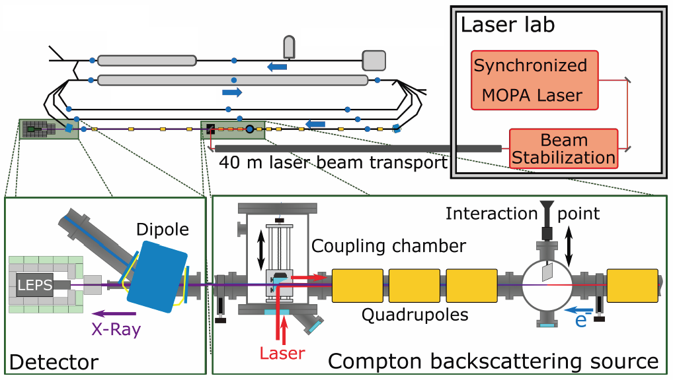
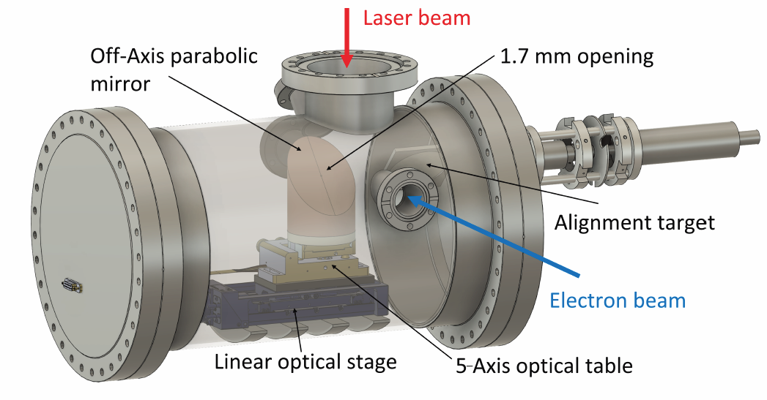
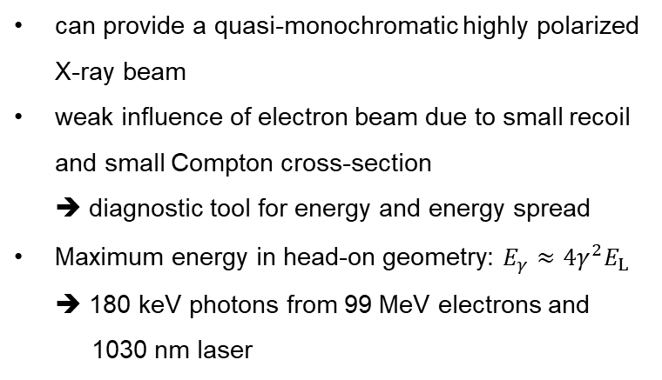
Compton backscattering at the S-DALINAC
can provide a quasi-monochromatic highly polarized X-ray beam
weak influence of electron beam due to small recoil and small Compton cross-section
➔ diagnostic tool for energy and energy spread
Maximum energy in head-on geometry: $E_{γ}≈4γ^{2}E_{L}$
➔ 180 keV photons from 99 MeV electrons and
1030 nm laser
Coupling Chamber Design:
M. Meier et al., Proc. of IPAC 2022, p. 1121-1124 (2022)

