Slide 1
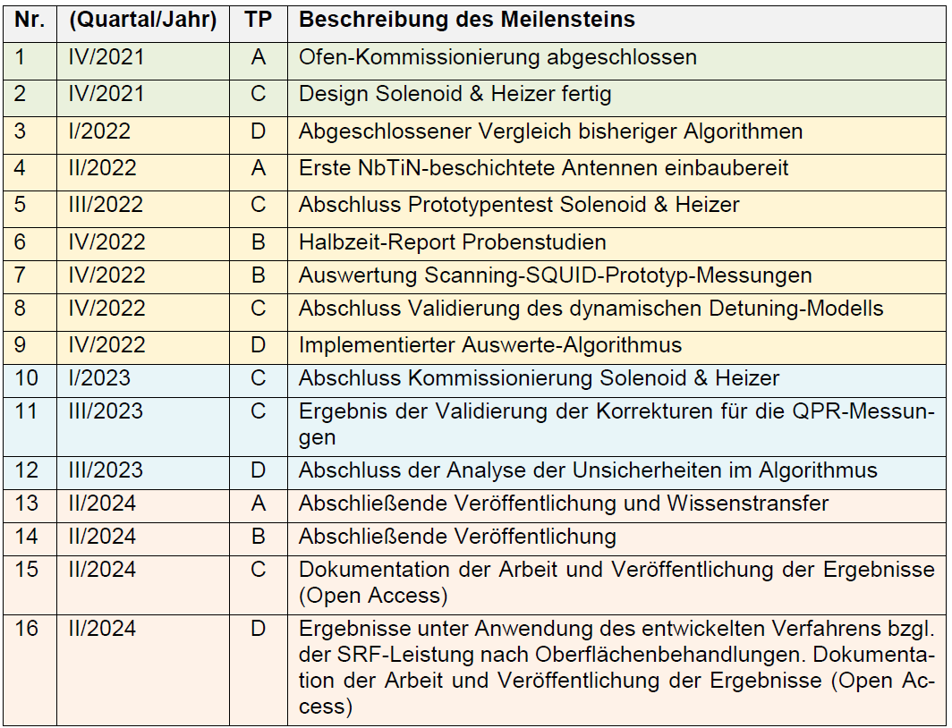
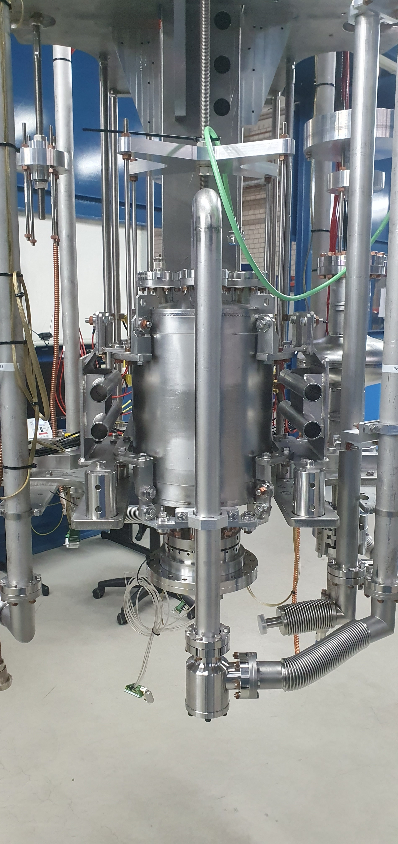
Status SCARPIA
Discussion ongoing with U Mainz – first tests planned Q1’23
[Wenskat et al., Physical Review B 106.9 (2022): 094516]
Swapped Method – Study ongoing, preliminary results published
Studies ongoing @ U Rostock – good collaboration in “QPR community”
QPR:
Talking about it since 2018.
First cooldown on Monday!

Slide 2




Effect of cavity treatments on niobium oxide layers
Rezvan Ghanbari, on behalf of SRF R&D Team
02.12.2022

Slide 3
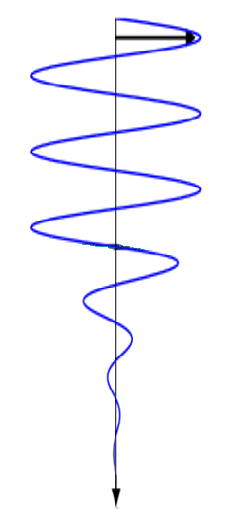


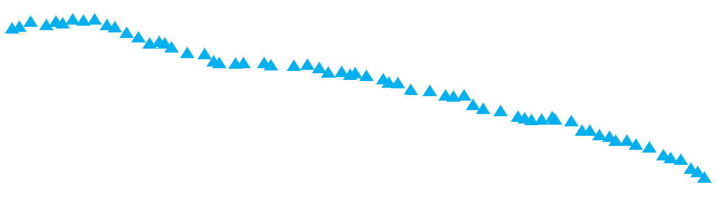







What is the role of oxide layers on the performance of cavities?
Surface analysis of several samples which is treated at DESY
include first set of Mid-T treated samples which is done with cavities at Zanon Research & Innovation Srl
L. Steder, et al., Medium Temperature treatments of superconductingradio frequency cavities at DESY, THPOGE 22
Nb oxides, nitrides, hydrides
Mid-T studies should achieve:
Mid-T
$${Nb}_{2}O_{5}$$
~5 nm
$${NbO}_{2}$$
R_{BCS} ≤ 6 nΩ
Anti-Q slope below 16MeV : dQ₀/dE_{acc} > 0
R_{res} ≤ 2 nΩ
$$Q_{0}$$
$$NbO$$
N-doping
$$Nb$$
+ O,N,H,C
Interstitials
~200 nm
which is defined by Mid-T studies at FNAL (In-situ) and IHEP and KEK (modified recipes in furnaces & with caps)
N-Infusion
120C-baking
Vacancies
Grain boundaries
[Posen, S., et al. Phys. Rev. Appl. 13.1 (2020): 014024.]
[Ito, H., et al. Prog. Theor. Exp. Phys. 2015 (2021).]
$$E_{acc}(MV/m)$$
[Zhou, Q., et al. Radiat. Detect. Technol. Methods 4.4 (2020): 507-512.]
Rezvan Ghanbari
TOSCA meeting 02.12.2022

Slide 4
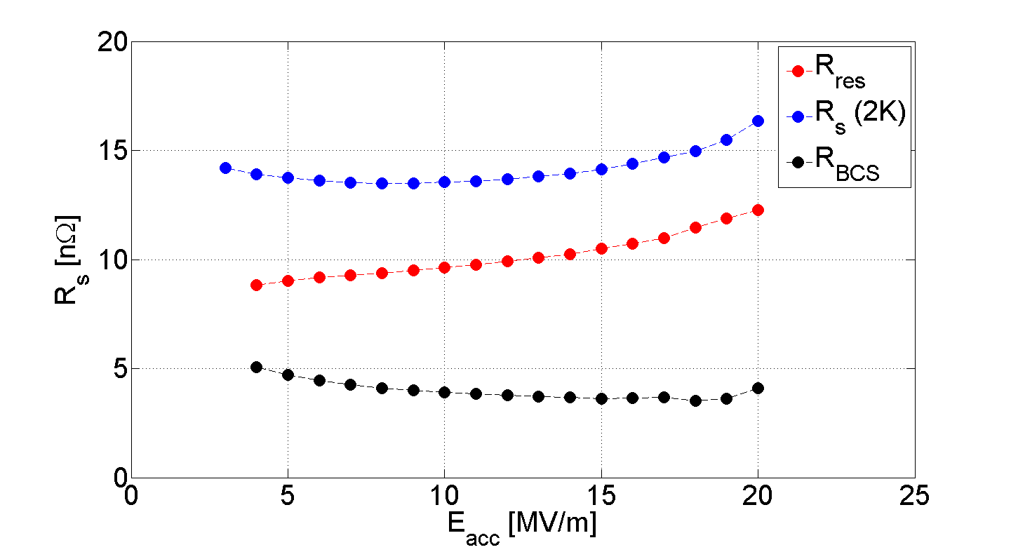

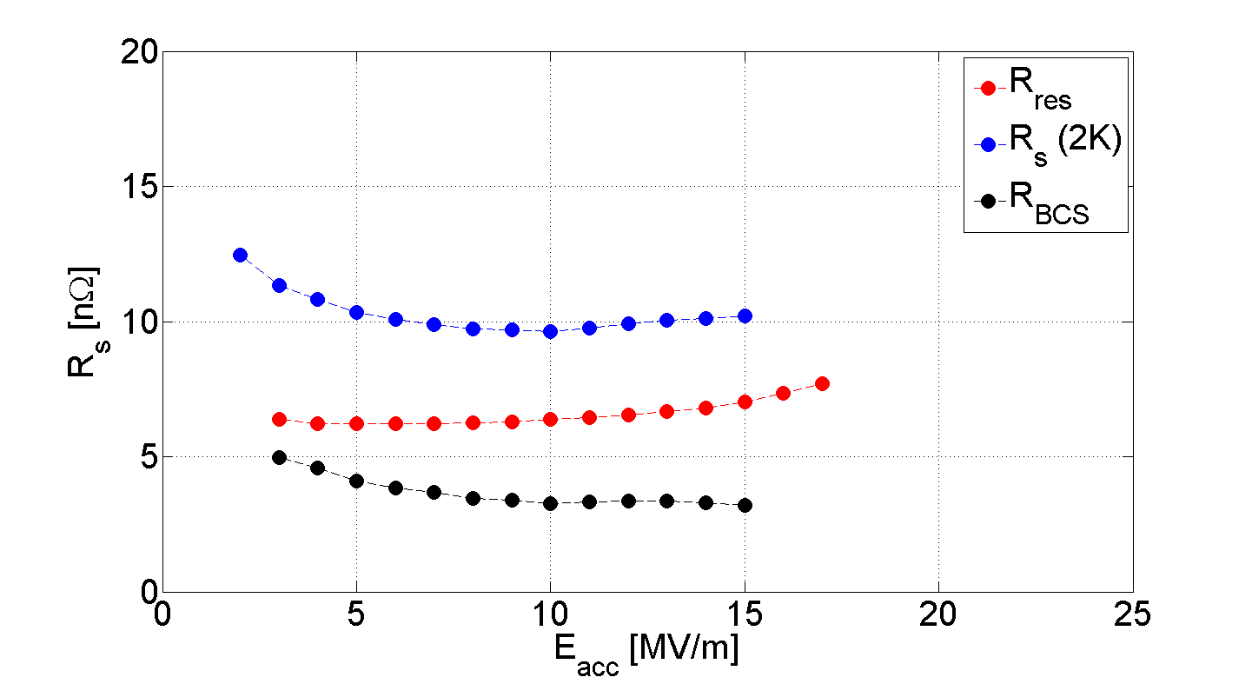
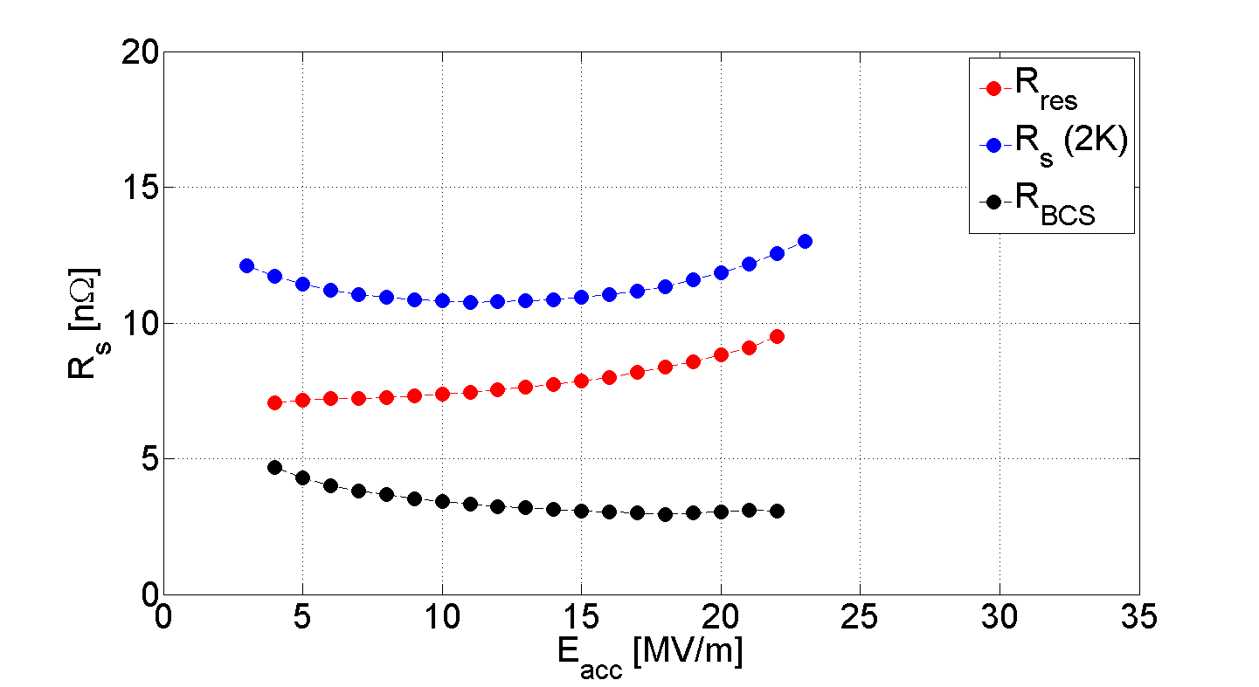








Caps
Anti-Q-slope seen but improvement “masked” by increased R_{res}
1DE9 has lowest R_{res}
300°C
Caps
Cavity 1AC2
Sample Niob 1
Cavity 1DE9
Sample Niob 2
$R_{res}$ is very different ($3−12 nΩ$)
$$∆R_{res}^{after−before}=5.7$$
$$∆R_{res}^{after−before}=1.0$$
1AC2 has significant increase in R_{res}
R_{BCS} ≤ 6 nΩ
Cavity 1DE7
Sample Niob 3
Cavity 1DE5
Sample Niob 4
Anti-Q slope
dR_{s}/dE_{acc} < 0
$$∆R_{res}^{after−before}=0.5$$
$$∆R_{res}^{after−before}=2.4$$
$$\sim$$
R_{res} ≤ 2 nΩ
120°C
Rezvan Ghanbari
TOSCA meeting 02.12.2022

Slide 5
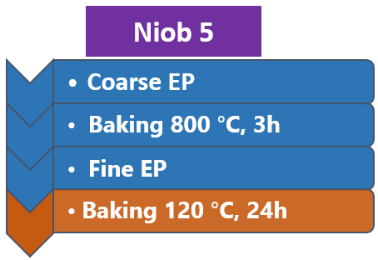
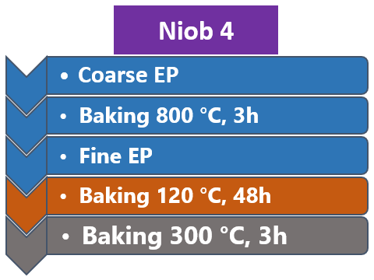
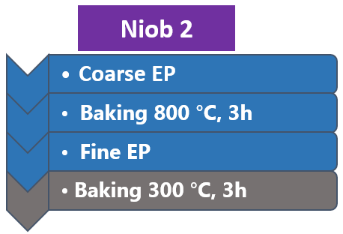
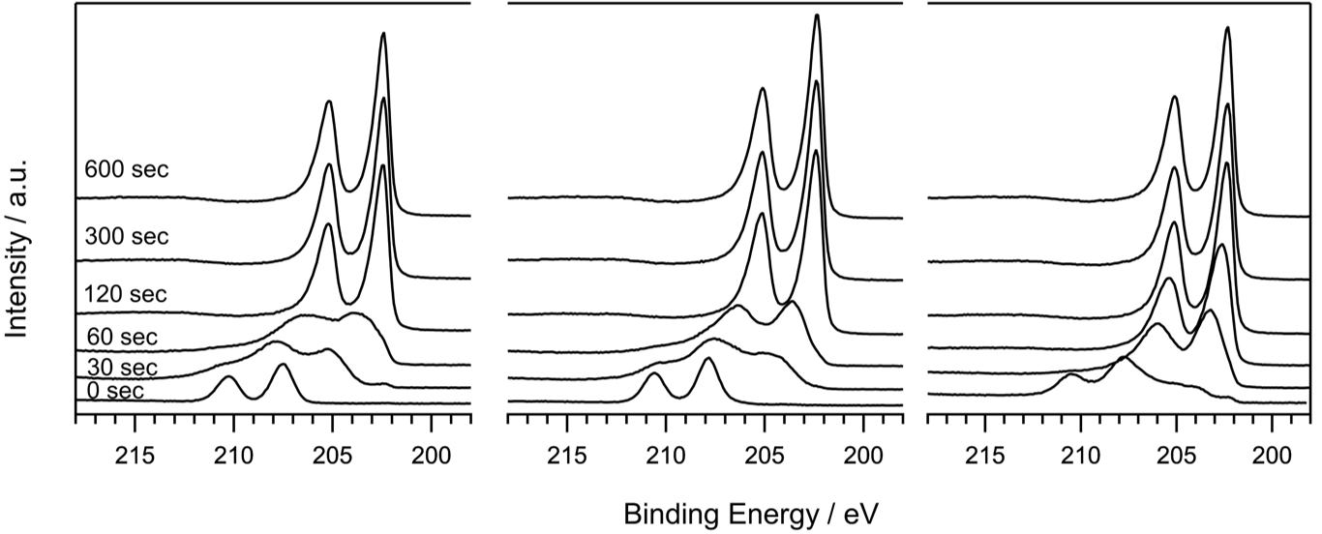
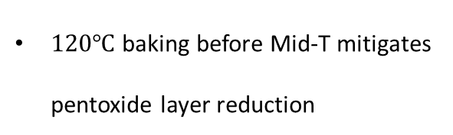
Pentoxide layer thickness reduces due to Mid-T treatment
X-Ray Photoelectron Spectroscopy
Niob 5
Reference
Niob 4
Cavity 1DE5
Niob 2
Cavity 1DE9
Pentoxide layer thicknesses:
Niob 2 << Niob 4 ≈ Niob 5
NbxO layer thicknesses:
Niob 2 > Niob 4 > Niob 5
Nb_{x}O
NbO
$120℃$baking before Mid-T mitigates pentoxide layer reduction
Nb₂O₅
Nb⁰
Etching depth
1DE9 performed better than 1DE5
less pentoxide means lower R_{res} ?
Rezvan Ghanbari
TOSCA meeting 02.12.2022

Slide 6
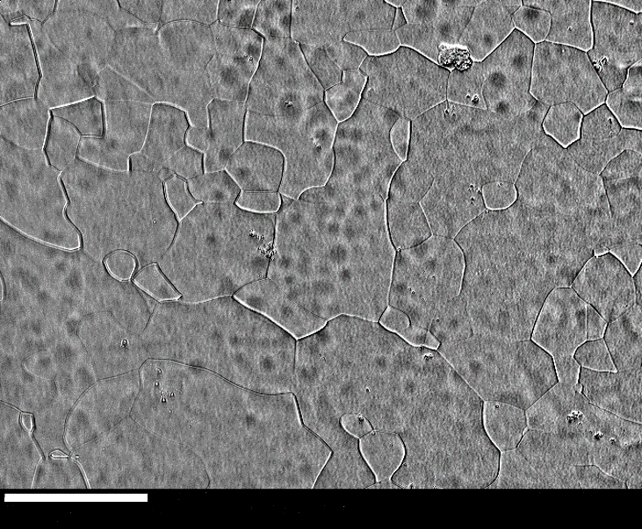
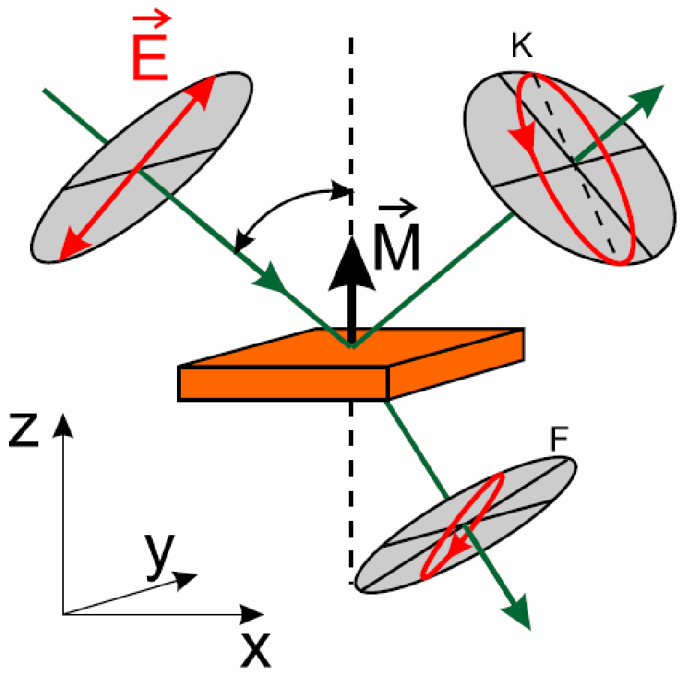
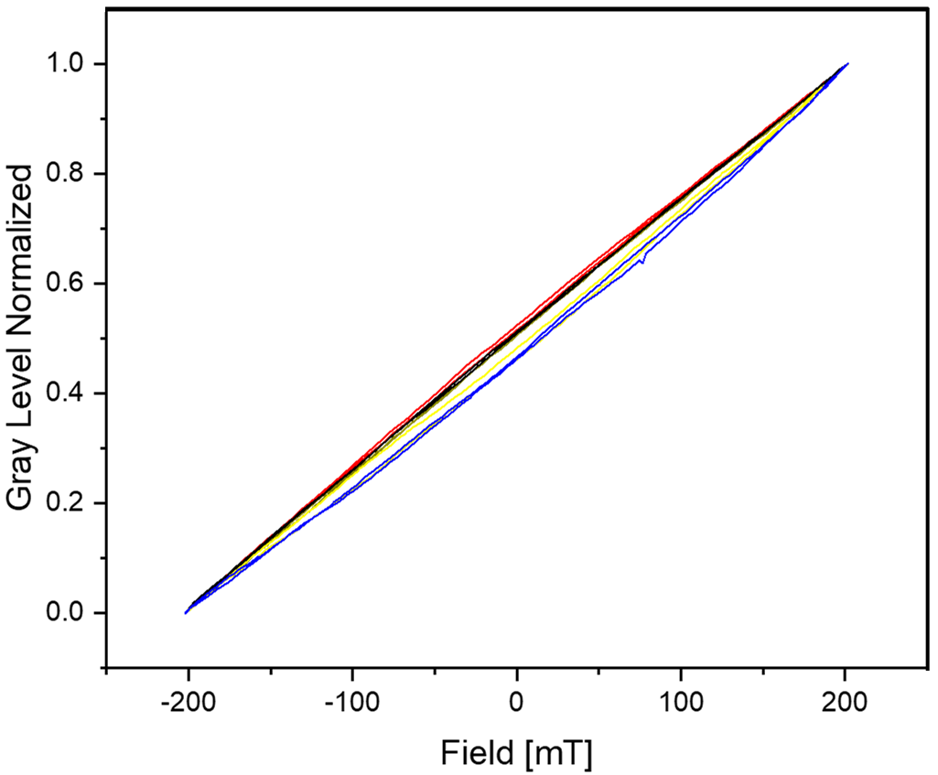

Oxide layer shows surface magnetism
Kerr microscopy & MOKE magnetometry
Niob 1
Cavity 1AC2
sensitive to magnetic fields within first 15nm
Imaging
Magnetic domains form in oxide layers
Magneto-orbital Kerr effect
100$μm$
Magnetic field: 201,73 mT
Niob 1
Niob 6
Niob 7
Niob 8
Niob 9
Remanence Curves
Different treatments, different Remanence magnetization
Faraday Effect Magnetic Cyrcular Dichroism
[Technische Universität Chemnitz, Physik, OHL, vl_sc/VL10.pdf]
Rezvan Ghanbari
TOSCA meeting 02.12.2022

Slide 7
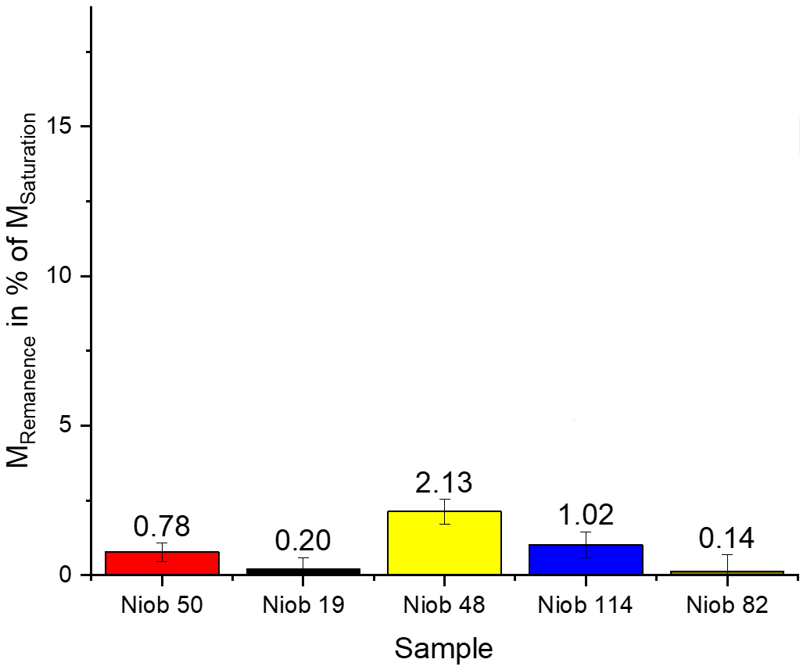
Oxide layer shows surface magnetism
Niob 6: $120℃$ baking (Reference)
Niob 7 & 9: N-Infusion treatment -> Significant decrease of magnetization. Why?
1st assumption: A thin N-monolayer is formed as a substrate for pentoxide regrowth
[Zhussupbekov, K., et al. SciRep 10 (2020): 3794]
2nd assumption: N-infusion reduce H-concentration near the surface -> weaker coupled magnetic impurities
[Esquinazi, P., et al. IEEE Trans. Mag. 49.8 (2013): 4668-4674]
Niob 1: Mid-T treatment (baked with cavity 1AC2 at $300℃$)
Higher remanence seen – fits to increase in $R_{res}$ of 1AC2 after anneal
Niob 8: Accidental baking at 10⁻⁴ mbar and $800℃$
Known from literature: pentoxide grows instead of dissolving
6
7
8
1
9
Rezvan Ghanbari
TOSCA meeting 02.12.2022

Slide 8
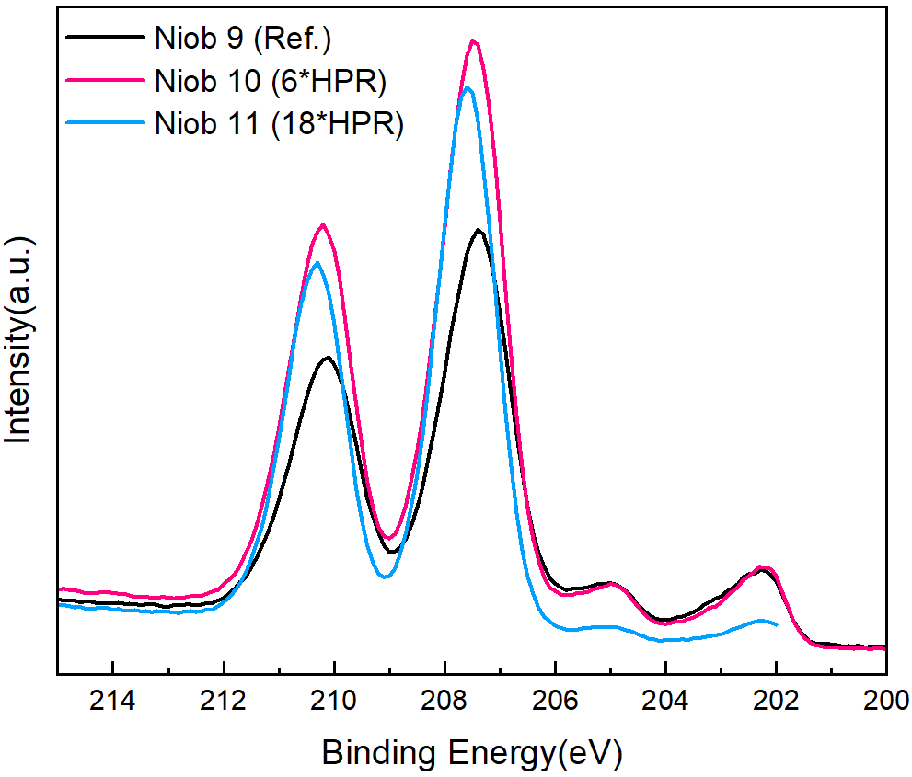
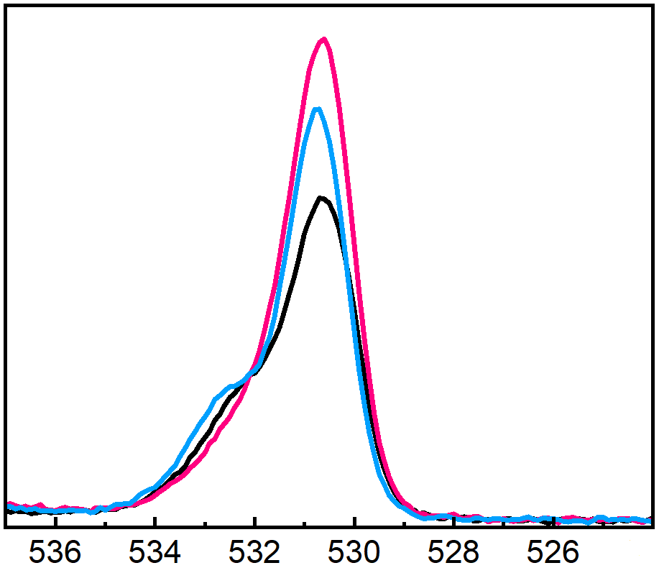




Extensive high pressure rinsing (HPR) grows thicker Nb₂O₅
X-Ray Photoelectron Spectroscopy
Course EP
Niob 10
$${Nb}^{5+}$$
$$O_{1s}$$
Thickness of pentoxide layer:
Niob 10 < Niob 11 << Niob 12
depends on amount of HPR cycles
Baking, 800C, 3h
Niob 11
Niob 12
Fine EP
$${Nb}_{3d}$$
Store under high pure ethanol
Reference
0 time HPR
Niob 10
Standard recipe
6 times HPR
Niob 11
18 times HPR Niob 12
Interstitial oxygen concentration after Mid-T annealing could depend on amount of HPR cycles
$${Nb}^{0}$$
Store under high pure ethanol
Penetrate up to 5nm
207.6 eV
XPS measurements
Store in air
Mid-T treatments
Pentoxide binding energy
[Dangwal Pandey, Arti, et al. Journal of materials science 53.14 (2018): 10411-10422]
SIMS measurement
Rezvan Ghanbari
TOSCA meeting 02.12.2022

Slide 9
Key insights
Pentoxide layer thicknesses reduce with Mid-T treatment
Magnetic domains observed in oxide layers
The higher remanence magnetization correlates to higher and not optimal residual resistance
Increase amount of high pressure rinsing cycles -> increase the thickness of pentoxide layer
Rezvan Ghanbari
TOSCA meeting 02.12.2022

Slide 10
Thank you for your attention !
Contacts at the meeting
We would like to thank
M. Aeschlimann (TUKL), C. Backes (TUKL), C. Bate, G. Deyu, A. Ermakov, M. Kohantorabi, N. Krupka, H. Noei, A. Dangwal Pandey, D. Reschke, N. Schäfer (TUDA), M. Stahl (TUKL), L. Steder, M. Wiencek, …
Rezvan Ghanbari
rezvan.ghanbari@desy.de
Dr. Marc Wenskat
marc.wenskat@desy.de
Prof. Wolfgang Hillert
Wolfgang.hillert@desy.de
Rezvan Ghanbari
TOSCA meeting 02.12.2022

