Slide 1

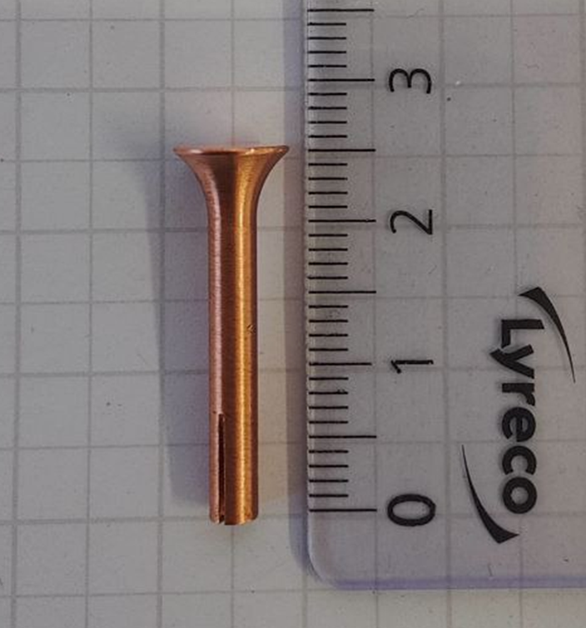
PALMIERI
Innovative aPproAches in technoLogy and beaM dynamIcs for
futurE RecIrculating SRF accelerators
Status of PALMIERI:
Test small Nb₃Sn and NbTiN systems for existing cavities
here: Nb₃Sn and NbTiN HOM antennas for MESA cavities

Slide 2
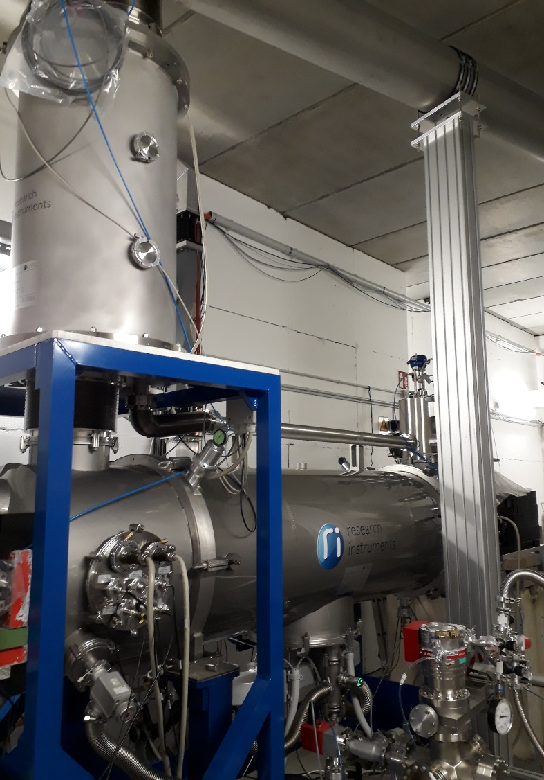
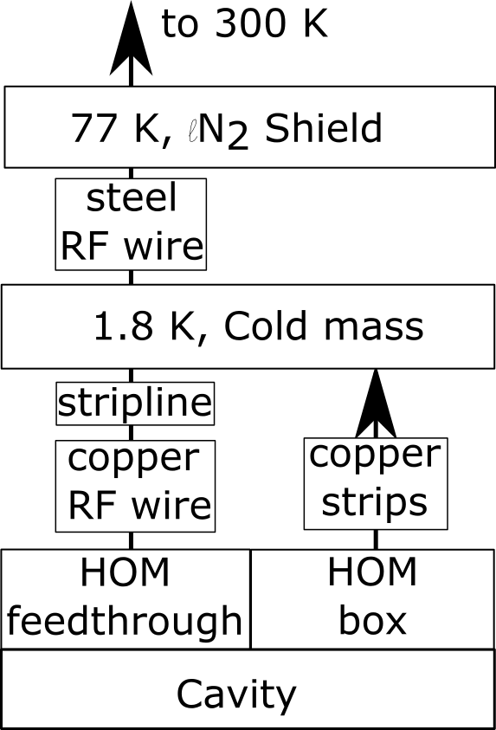
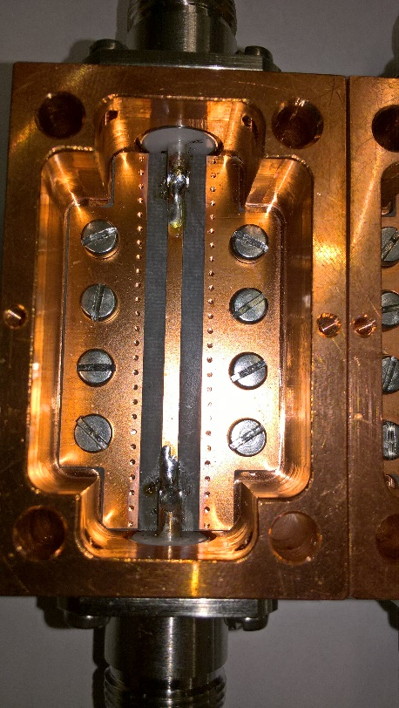
MESA Enhanced ELBE-type Cryomodules
Concern: Heating of the HOM-Antenna
Changes:
Sapphire windows at HOM feedthrough
Strip line in HOM cable for cooling
MCTL (LHe, GHe, LN2)
LHe/LN2 supply box
Cryomodule (2 XFEL Cavities @ 12.5 MV/m)

Slide 3
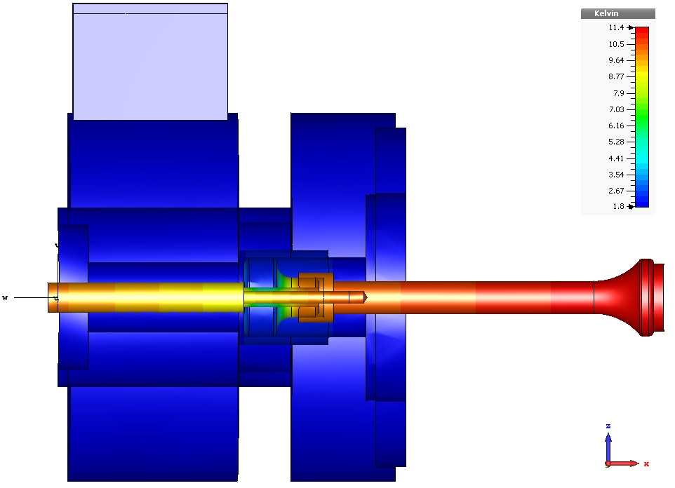
MESA Enhanced ELBE-type Cryomodules
Thermal calculations at HOM antenna:
  → Provide optimised thermal connection design to RI
  → Limitation by heat input
  from cable, need for heat sink
T / K
11.4
Only 1.25 W
heat deposition in
1.8 K LHe bath
per HOM coupler
in cryo budget
1.8
Picture: T. Stengler

Slide 4
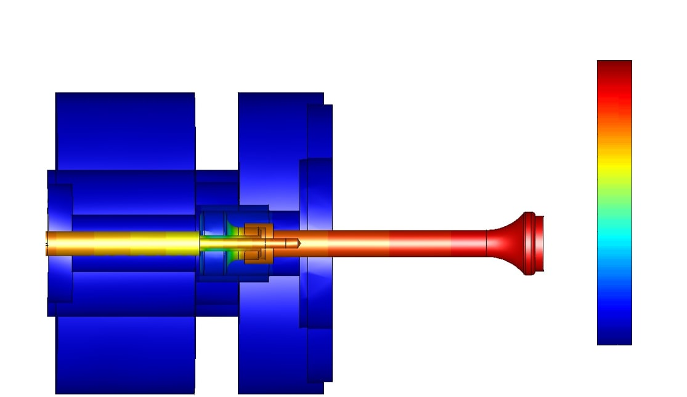
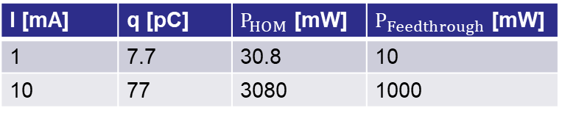
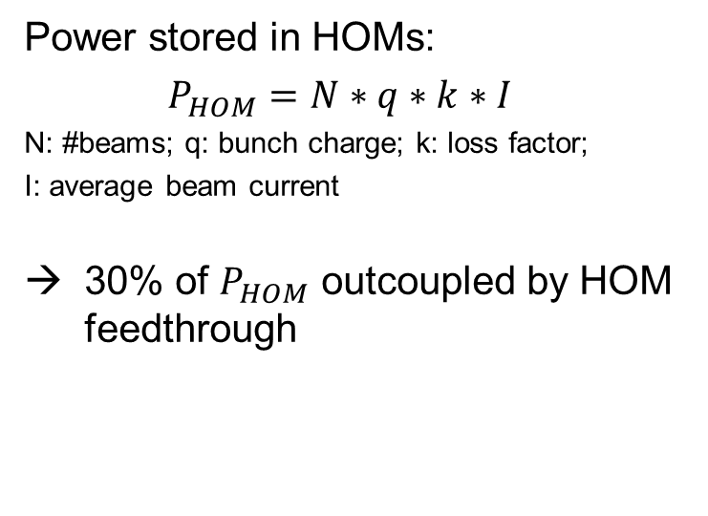

Simulation for MESA HOM Coupler
Power stored in HOMs:
$P_{HOM}=N∗q∗k∗I$
N: #beams; q: bunch charge; k: loss factor;
I: average beam current
30% of $P_{HOM}$ outcoupled by HOM feedthrough
100 mW load
11.4 K
1.8 K
Picture: T. Stengler
I [mA] | q [pC] | $P_{HOM}$ [mW] | $P_{Feedthrough}$ [mW]
1 | 7.7 | 30.8 | 10
10 | 77 | 3080 | 1000
HOM antenna coating with${Nb}_{3}Sn and NbTiN:$
→ Better HOM damping and higher $T_{C}$

Slide 5
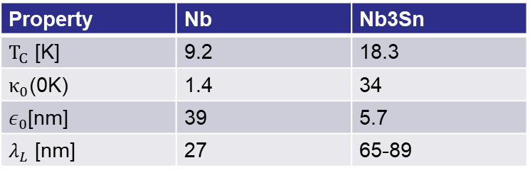
Goal for HOM Couplers
Goal:
Prevent quench of whole CM
How:
Antenna coating with Nb3SN and NbTiN
on Nb/Cu Antennas
100 mW load
11.4 K
1.8 K
Picture: T. Stengler
Property | Nb | Nb3Sn
$T_{C}$ [K] | 9.2 | 18.3
$κ_{0}$(0K) | 1.4 | 34
$ε_{0}$[nm] | 39 | 5.7
$λ_{L}$ [nm] | 27 | 65-89

Slide 6



Goal for HOM Couplers
Current HOM Antennas fulfil ERL at 1 mA
10 mA need enhanced HOM feedthrough
Ongoing CST Simulation
(Help from W. Ackermann from TEMF)
$$T_{NbTiN}=18.3 K$$
Coated
Antennas
$$T_{NbTiN}=15.3 K$$
$$T_{Nb}=9.2 K$$
DESY
1
10
Beam current
[mA]

Slide 7
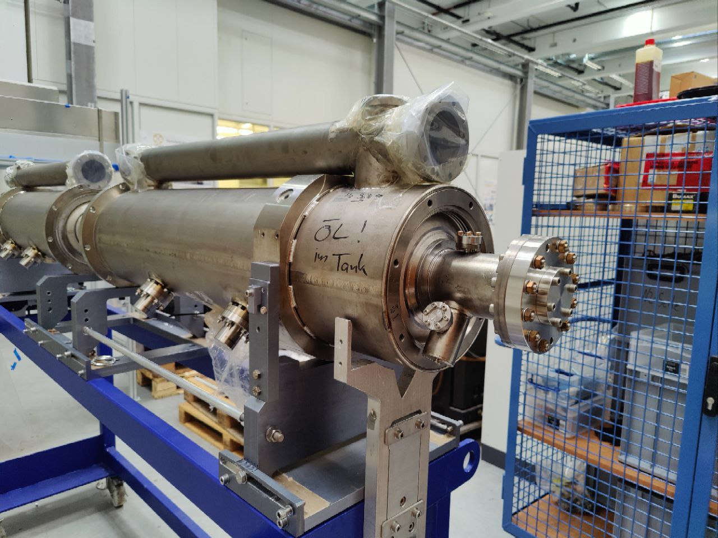
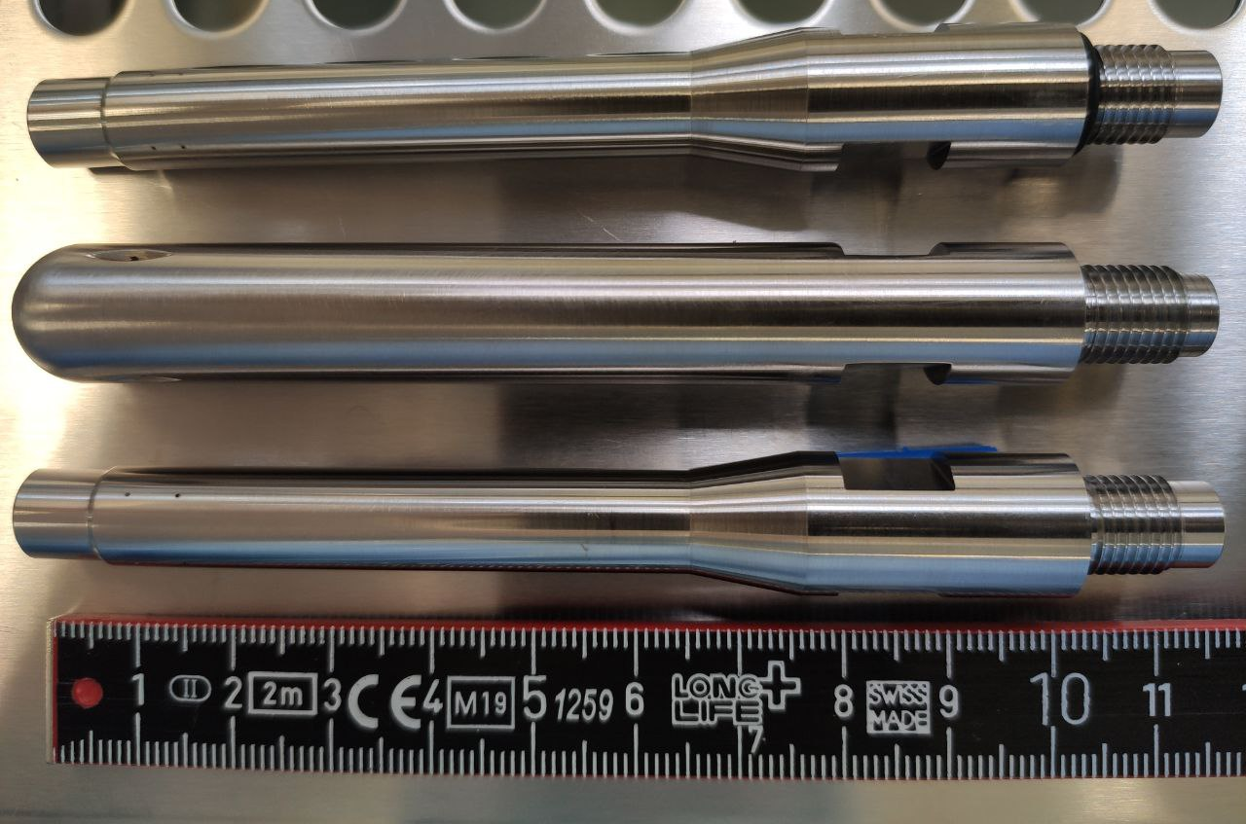
Refurbishment of ALICE module
MESA Enhanced ELBE-type Cryomodules (MEEC):
Helium port (Joule-Thomson valve)
Faster DESY/Saclay tuner (higher beam currents)
→ diameter of Helium tank changed
“New” HOM antennas
Cavity contamination leads to field emission @7 MV/m
→ Clean room treatment!
Delayed through long maintenance of the HPR this summer

Slide 8
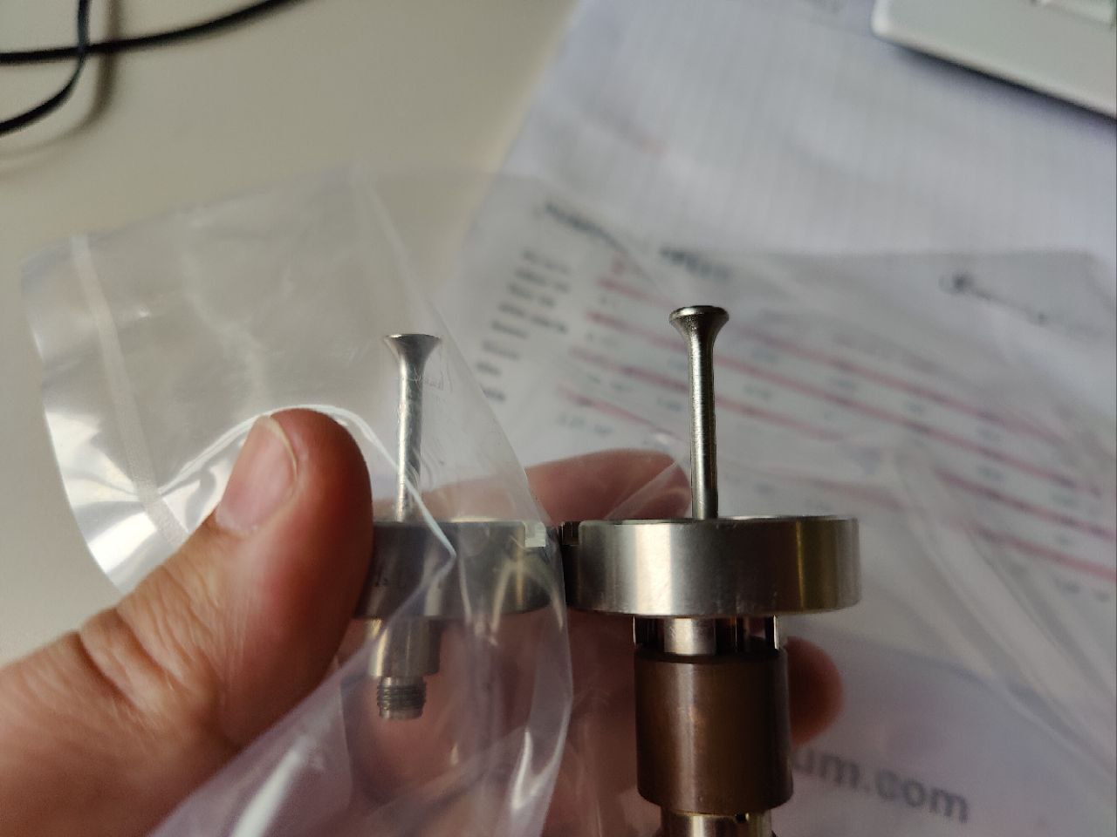
HOM Feedthroughts
DESY Design (right)
29.56 mm tip length
Design from RI (left)
Cyocera feedthrough with flange and antenna tip
25 mm tip length
Bakeout at max 300C

Slide 9
Timeline
→ behind schedule: first cold test planned spring 2023
cold test with coated antennes end of 2023

Slide 10
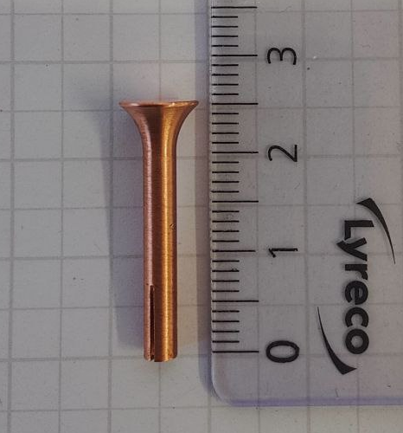
Outlook
Production of the first OFHC antennas
Studies of a bakeout at 400C/600C in HH
HPR treatment in March
First cold test in April
First cold test with coated antennas end of 2023

