Slide 1


TOSCA Collaboration Meeting
02. 12. 2022 @ TU Darmstadt
Wolfgang Hillert on behalf of:
Floria Tosca (singer)
Cesare Angelotti (escaped political prisoner) / TU Darmstadt
Baron Scarpia (chief of police) / Univ. Hamburg
Count Palmieri (involved in a mock execution) / J.G. Univ. Mainz
Marchesa Attavanti (Angelotti‘s sister) / Univ. Rostock
Mario Cavaradossi (painter) / B. Univ. Wuppertal

Slide 2
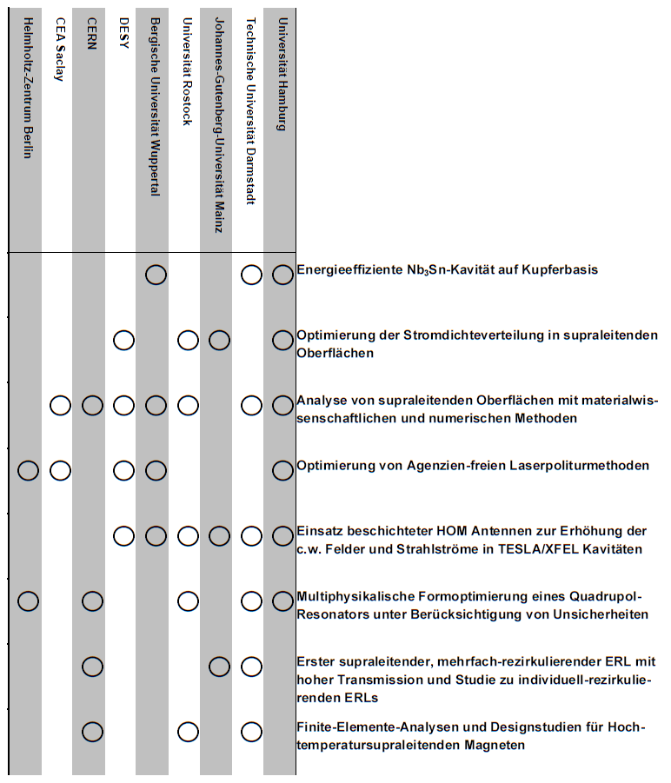
Overview work packages
Well advanced within project time
Looking forward to status reports today

Slide 3
TOSCA Network and Timetable
10:15 - 10:30 IKP
10:30 - 10:45 TEMF
10:45 - 11:00 ATFT
11:15 - 11:30
11:45 - 12:00
12:00 - 12:15
11:30 - 11:45

Slide 4
Upcoming conferences
IPAC (Venice, IT) – May 2023; Abstract deadline 7.12.
https://www.ipac23.org/
DPG Spring Meeting (Dresden) – March 2023; Abstract deadline 15.12.
https://smuk23.dpg-tagungen.de/
SRF (Grand Rapids, US) – June 2023; Abstract deadline 12.5.
https://indico.frib.msu.edu/event/25/page/144-general
TTC Workshop (FNAL, US) – December 2023
Other?

Slide 5
New timeline for BMBF Verbundsforschung
Aim is to give reviewer / PT / BMBF enough time to make all decisisions AND prepare and send Zuwendungsbescheid on time
Publication of call is planned for 1.4.2023
Proposal submission deadline is 1.7.2023
Project start stays at 1.7.2024
While working on the annual report for 2022, we have to start preparing the follow up proposal already!

