Slide 1
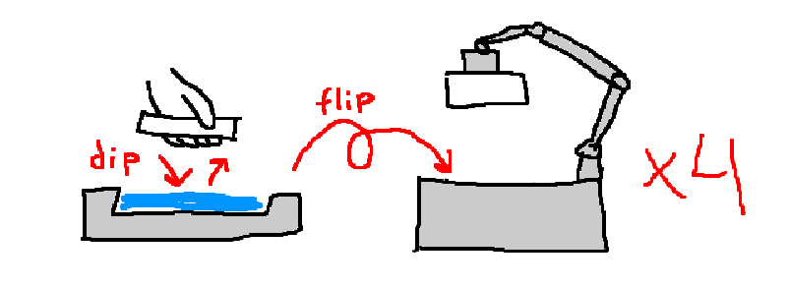
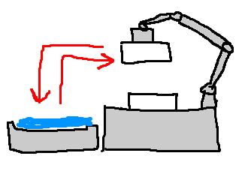
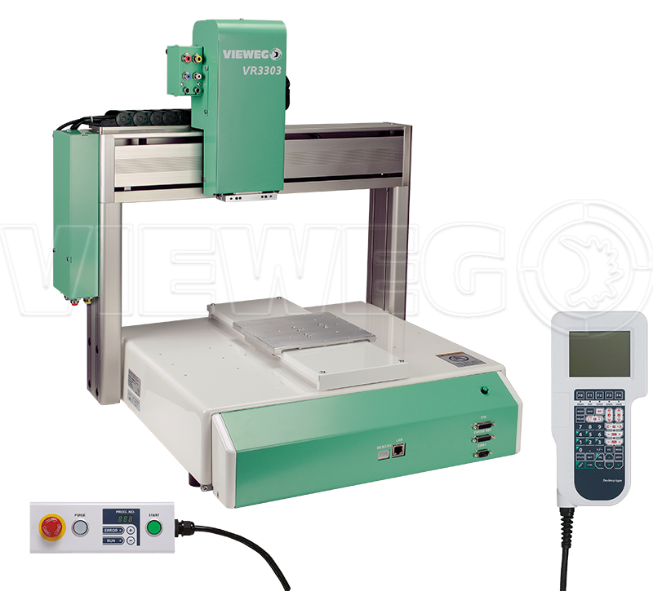
More automation for gluing
for CMS Phase 2 PS modules
Current assembly procedures rely on dipping stuff in glue, smeared on metal blocks:
preparing and cleaning these is labor-intensive
this step is not 100% reliable (stuff might just fall off)
this step is not 100% consistent
Instead, we might use the dispensing robot, that is more:
precise
repetitive
cool-looking
(but we still need to apply a bit of fast-curing epoxy by hand)
Glue application for stage 2 (spacers to upper sensor)
Glue application for stage 3 (lower sensor to spacers + upper sensor)
This guy.

Slide 2
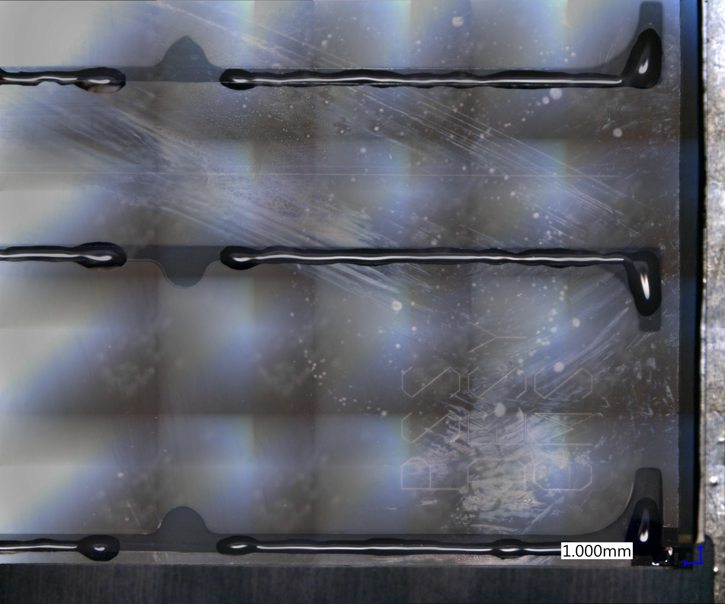
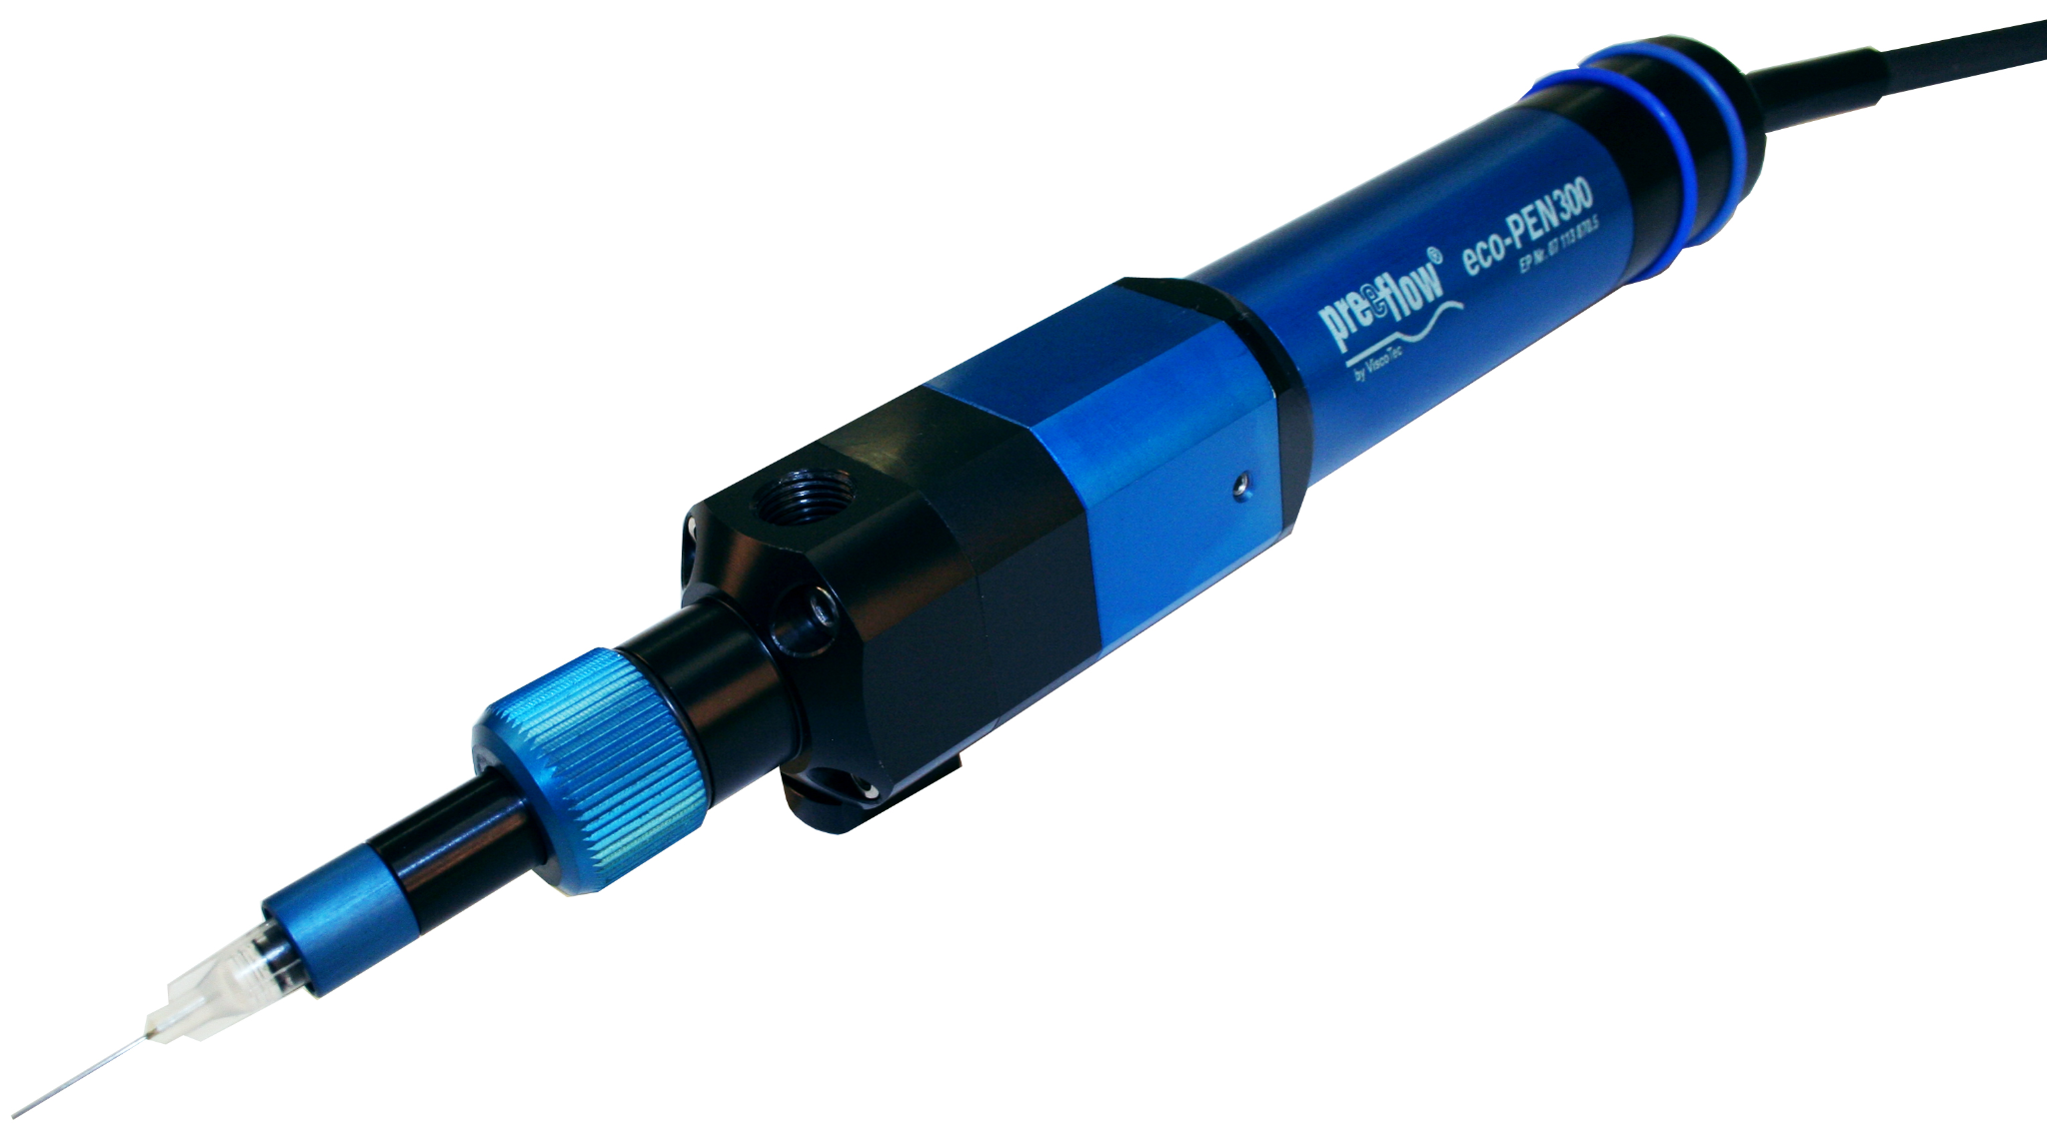
Current status of procedure implementation
aka scientists trying to do industrial stuff
Current dispensing system (syringe + pressurized air) is a bit fishy:
non-uniform flow, highly dependent on needle height
dripping glue -> height calibration issues
Advanced dispensing (mechanical screw-based volumetric dispenser)
is to be implemented and tested
Glue test pattern, applied on a complete glass dummy
This guy (soon).

