Slide 1

EAJADE –
Info and Formalities
EAJADE Kick-off Meeting
Thomas Schörner, Natalia Potylitsina-Kube
29/30 March 2023

Slide 2
Intro

Slide 3

2014
2023

Slide 4
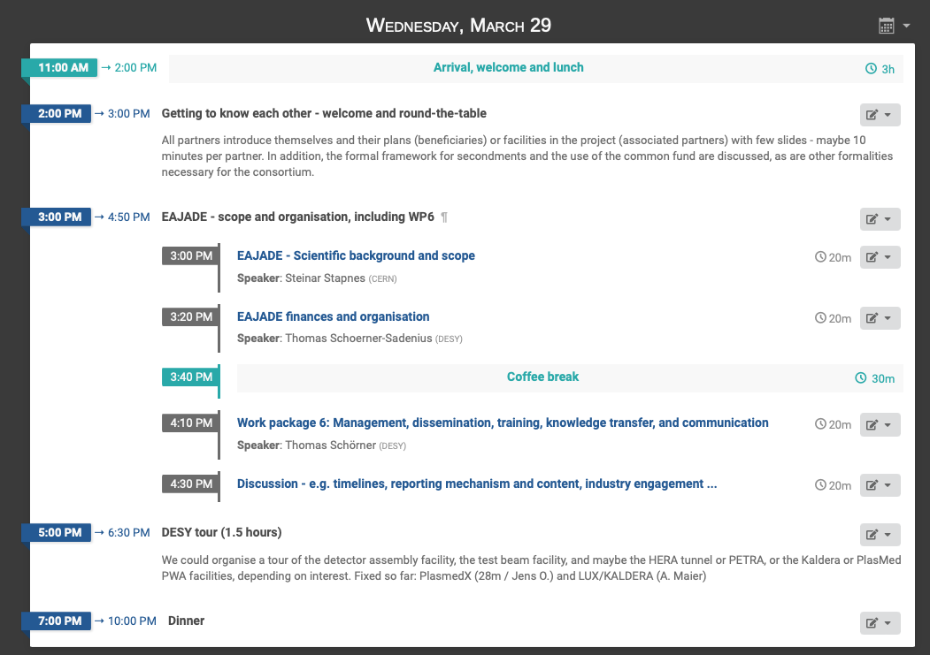
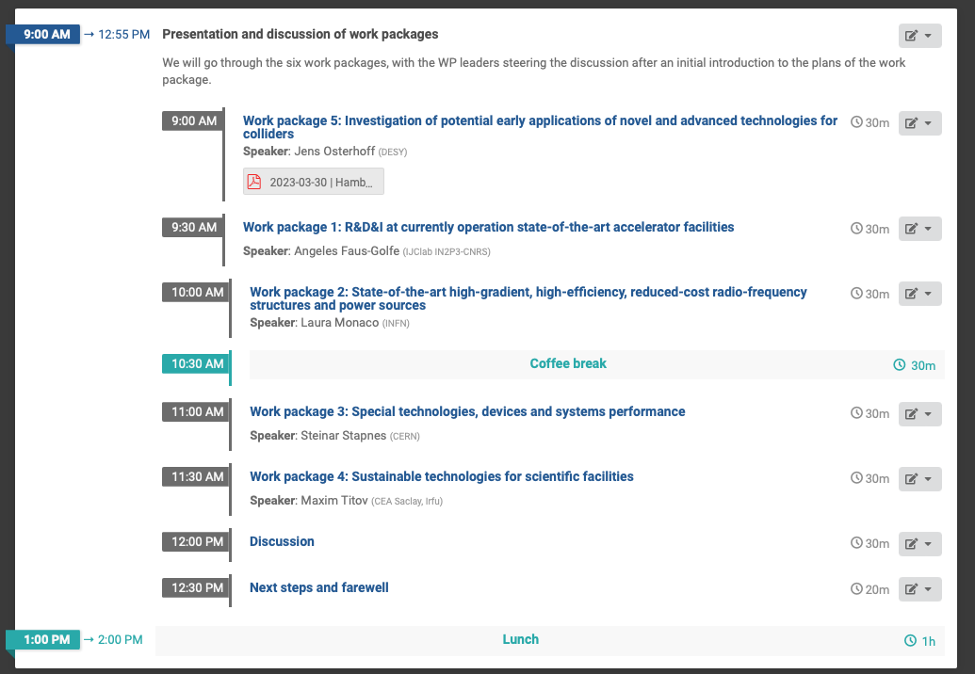
Agenda
for today and tomorrow

Slide 5
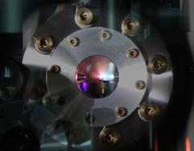
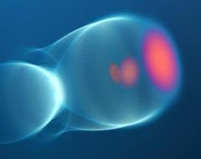
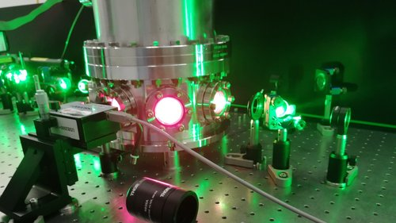
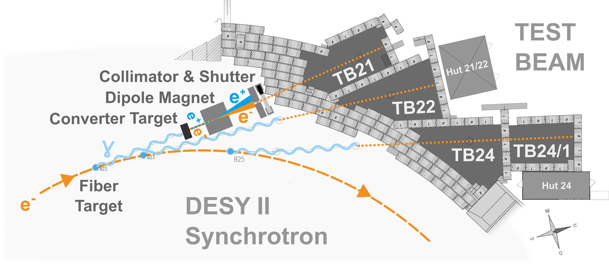
Guided Tours
Guided tours:
Plasmed X: compact LPWA X-ray source for medical imaging. Recently, succesful measurement of acceleration process in plasma without disturbing the process.
LUX beamline at KALDERA: KALDERA will deliver 100 TW peak power laser pulses at up to 1 kHz repetition rate at kW-level average power. LUX beamline to test merger of PWA with modern accelerator technology.
Testbeam facility at DESY II
S. Bohlen et al., Phys. Rev. Lett. 129, 244801
DOI: 10.1103/PhysRevLett.129.244801
Start here at 17:00 hrs.
Two slots a 45 min
PasmedX can take 4 a time
LUX can take 8
Testbeam can take 8
➔ Need to organise on the fly!
http://mls.desy.de
Notes:
HERA leider nicht – Tunnel geschlossen, Maschine kalt wegen ALPS II

Slide 6
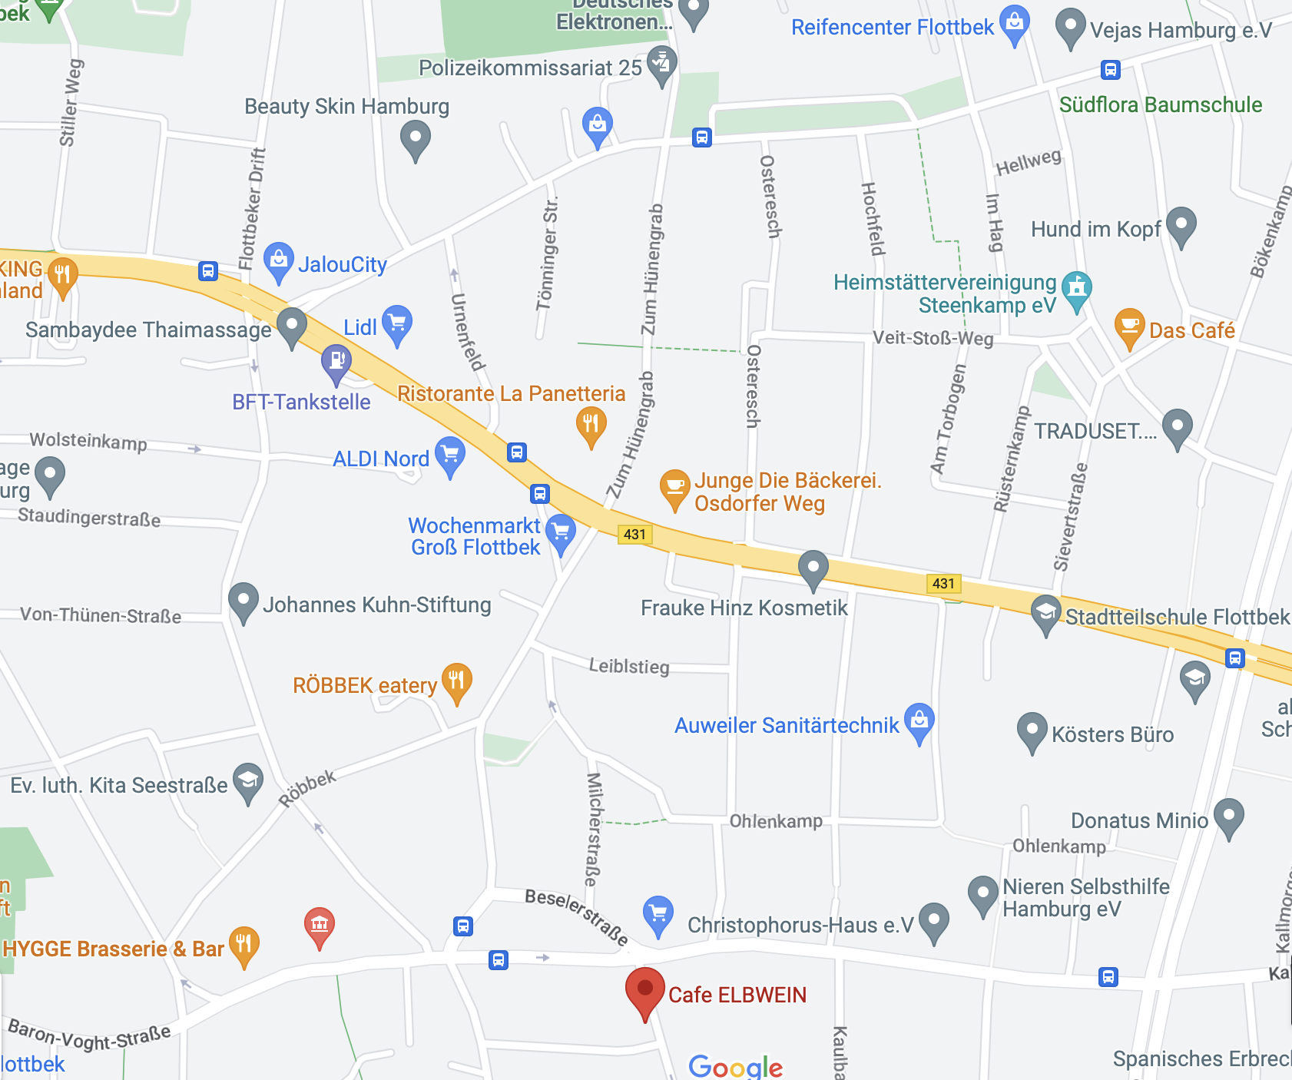
Dinner Tonight
At Cafe Elbwein
Beseler Str. 27 – in walking
distance from DESY
Start HERE at 18:40
Self-pay basis

Slide 7
Useful Organisational Stuff

Slide 8

Web Page
www.eajade.eu
… to be done …

Slide 9
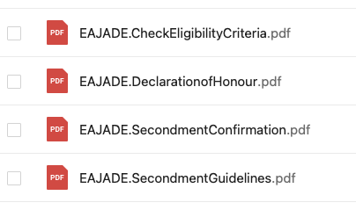
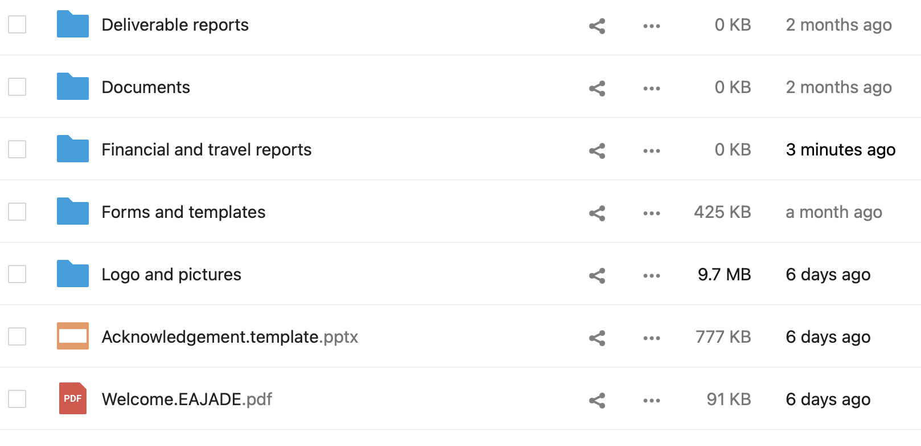
Material Collection
… in the DESY cloud
Shared public directory:
https://syncandshare.desy.de/index.php/s/7K8riPH2FMrmTKM
To come: information on receiving
institutions (housing, visa, safety etc.).
We can also grant individual permissions
for upload, editing etc. → let us know!

Slide 10
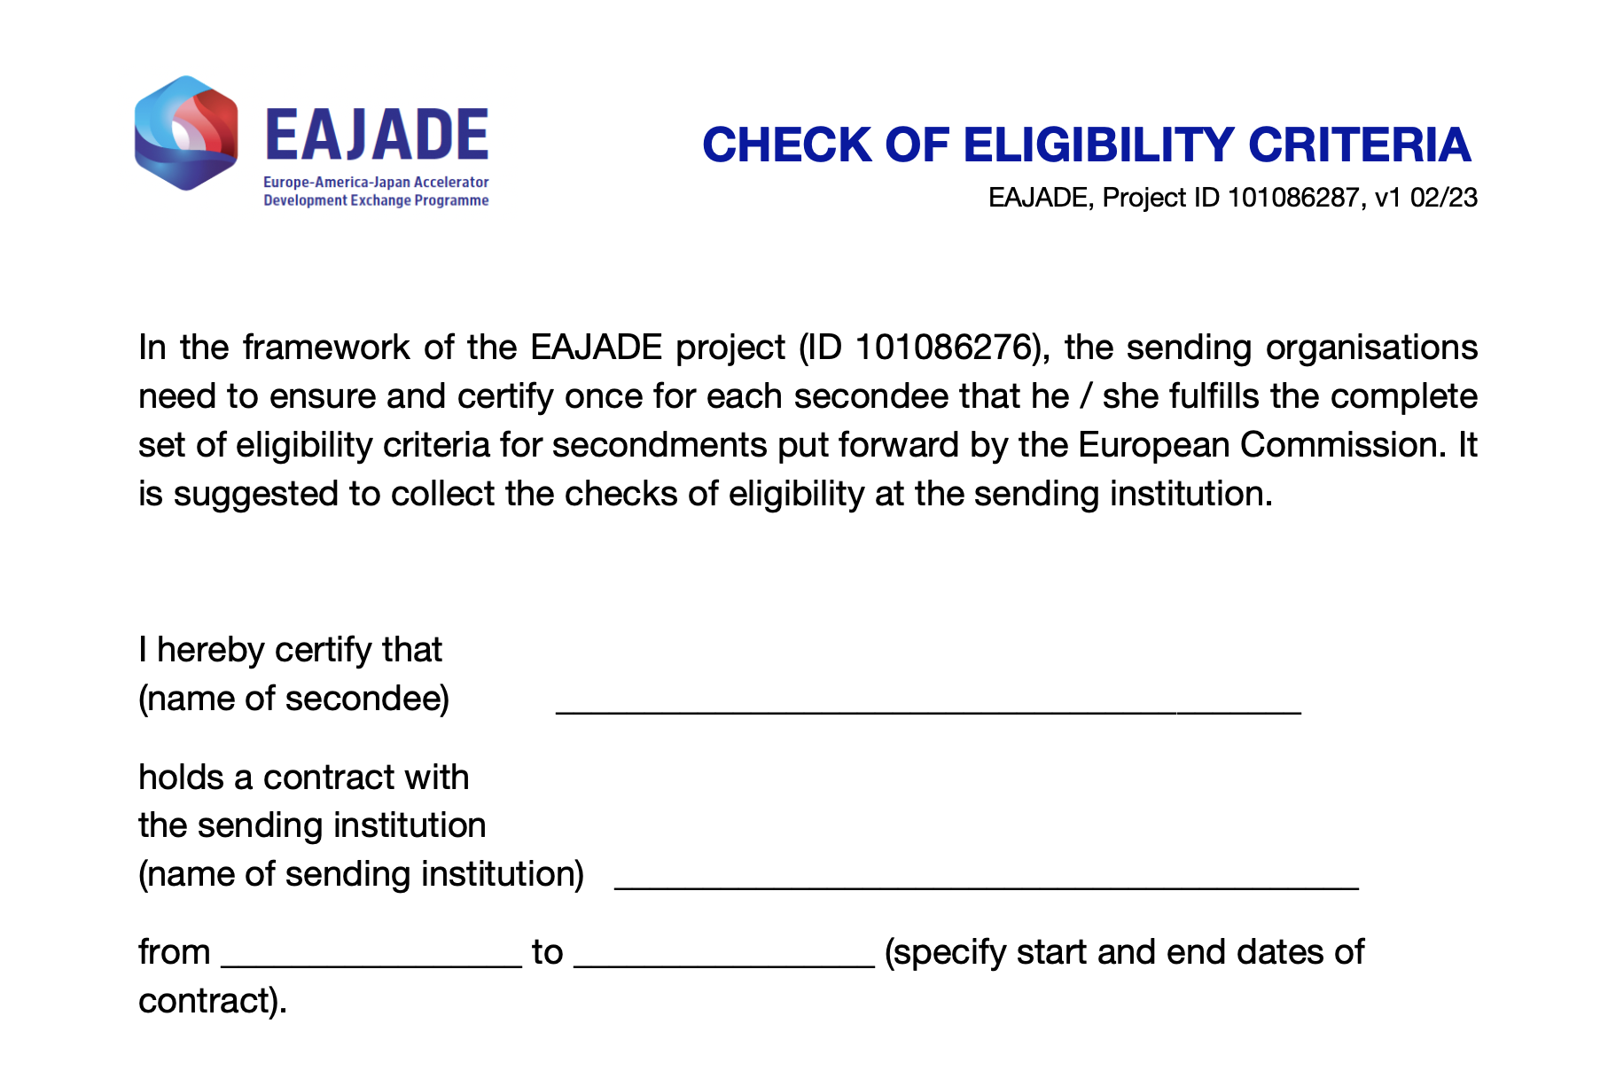
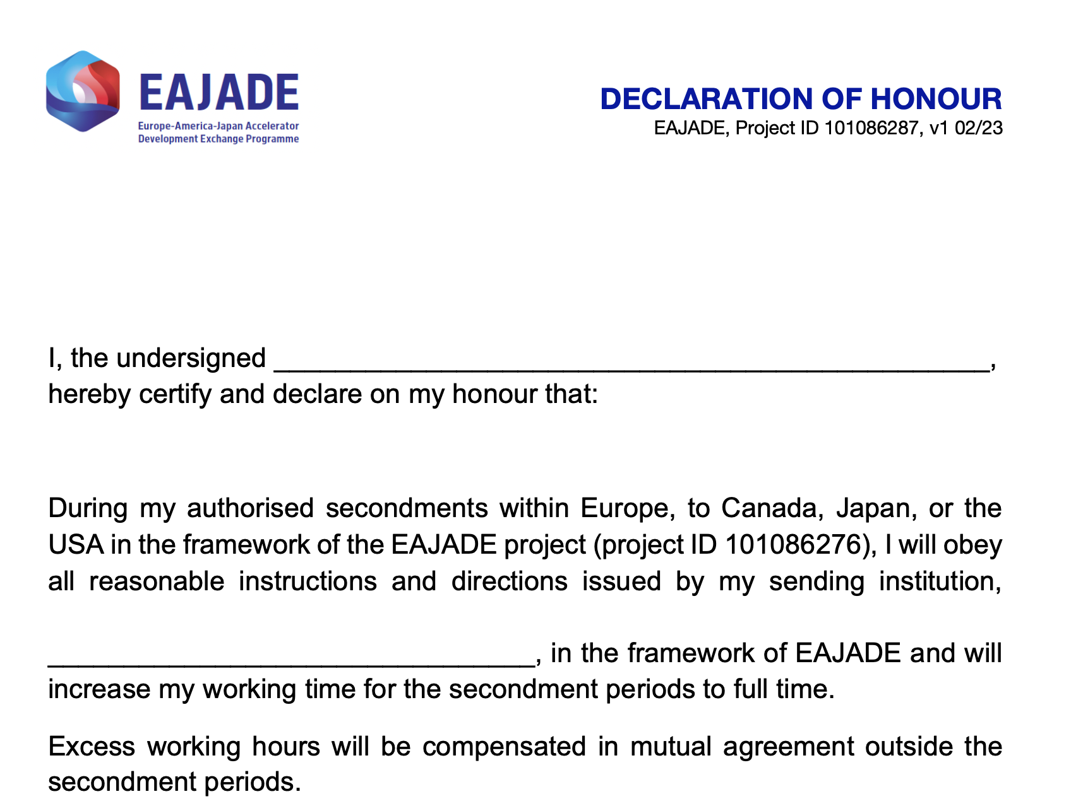
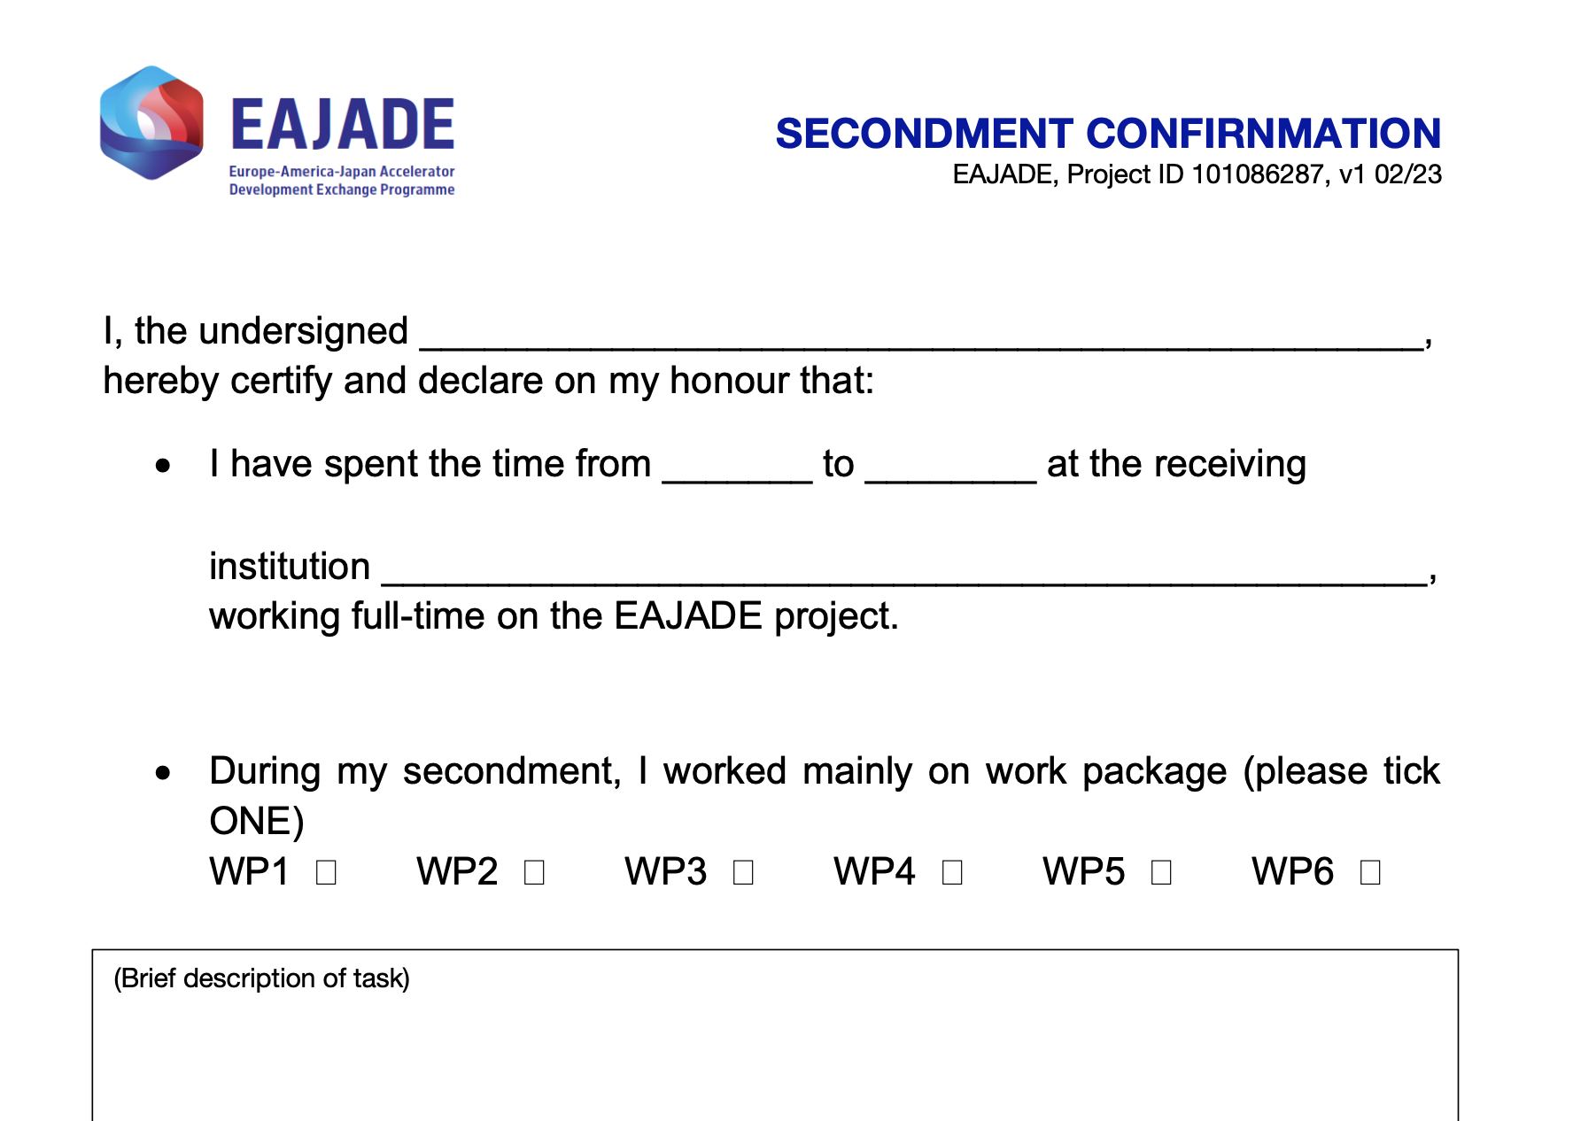
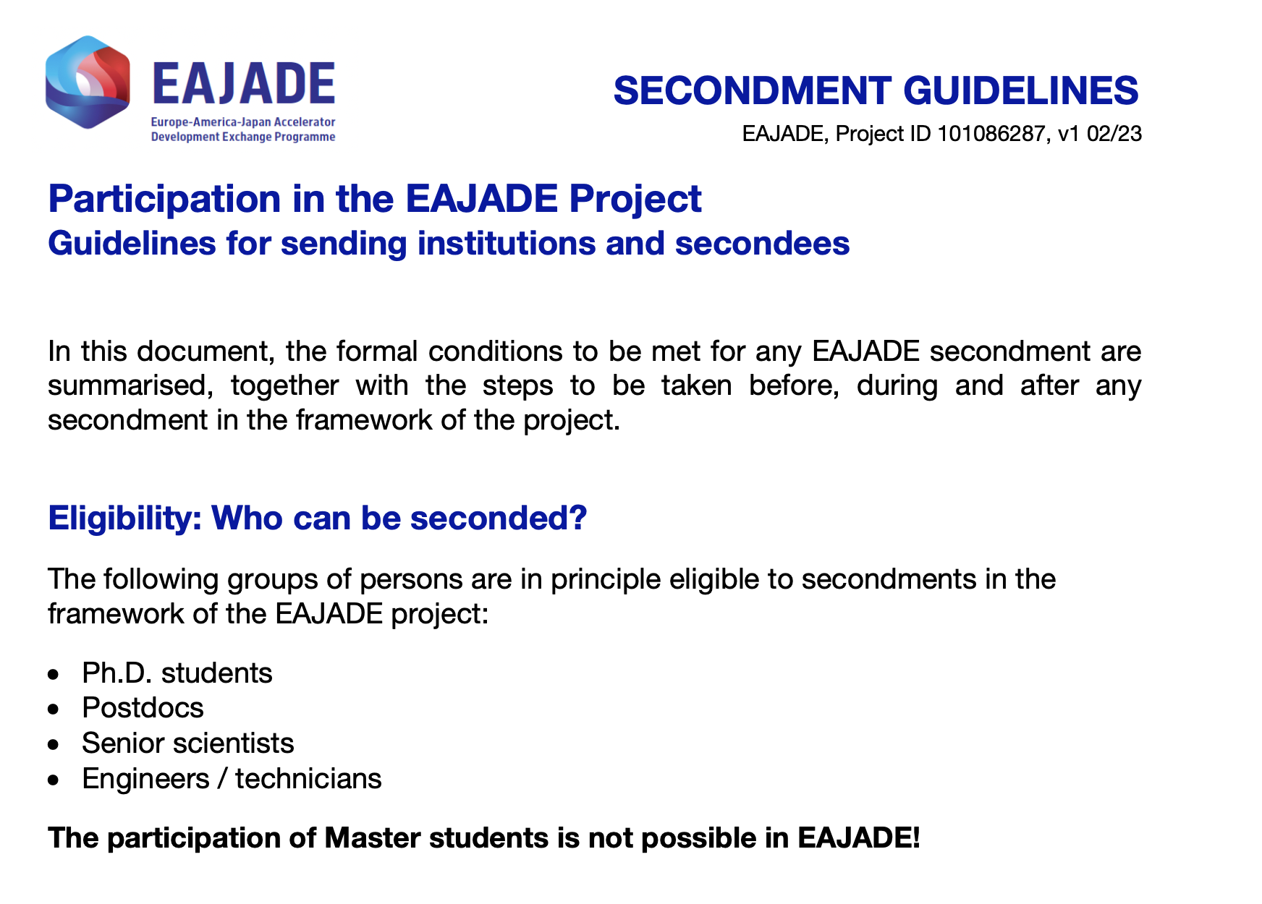
Material Collection
… in the DESY cloud

Slide 11



Logo
… in the DESY cloud

Slide 12


Acknowledgments in Talks and Papers
… for EAJADE support
Acknowledgement in publications
Please acknowledge the received EU funding in any publication which profited from EAJADE funding. We suggest the following acknowledgement text:
“This work was partially supported by the European Union’s Horizon Europe Marie Sklodowska-Curie Staff Exchanges programme under grant agreement no. 101086276.”
Acknowledgement in presentations
Presentations with EAJADE supported contents should also acknowledge the received EU support by showing the EU and EAJADE labels (see right side) and the text suggested below. A template slide is available via the cloud folder.
“This work was partially supported by the European Union’s Horizon Europe Marie Sklodowska-Curie Staff Exchanges programme under grant agreement no. 101086276.”

Slide 13
Talk Template
… for EAJADE
… will be done … ;-)

Slide 14
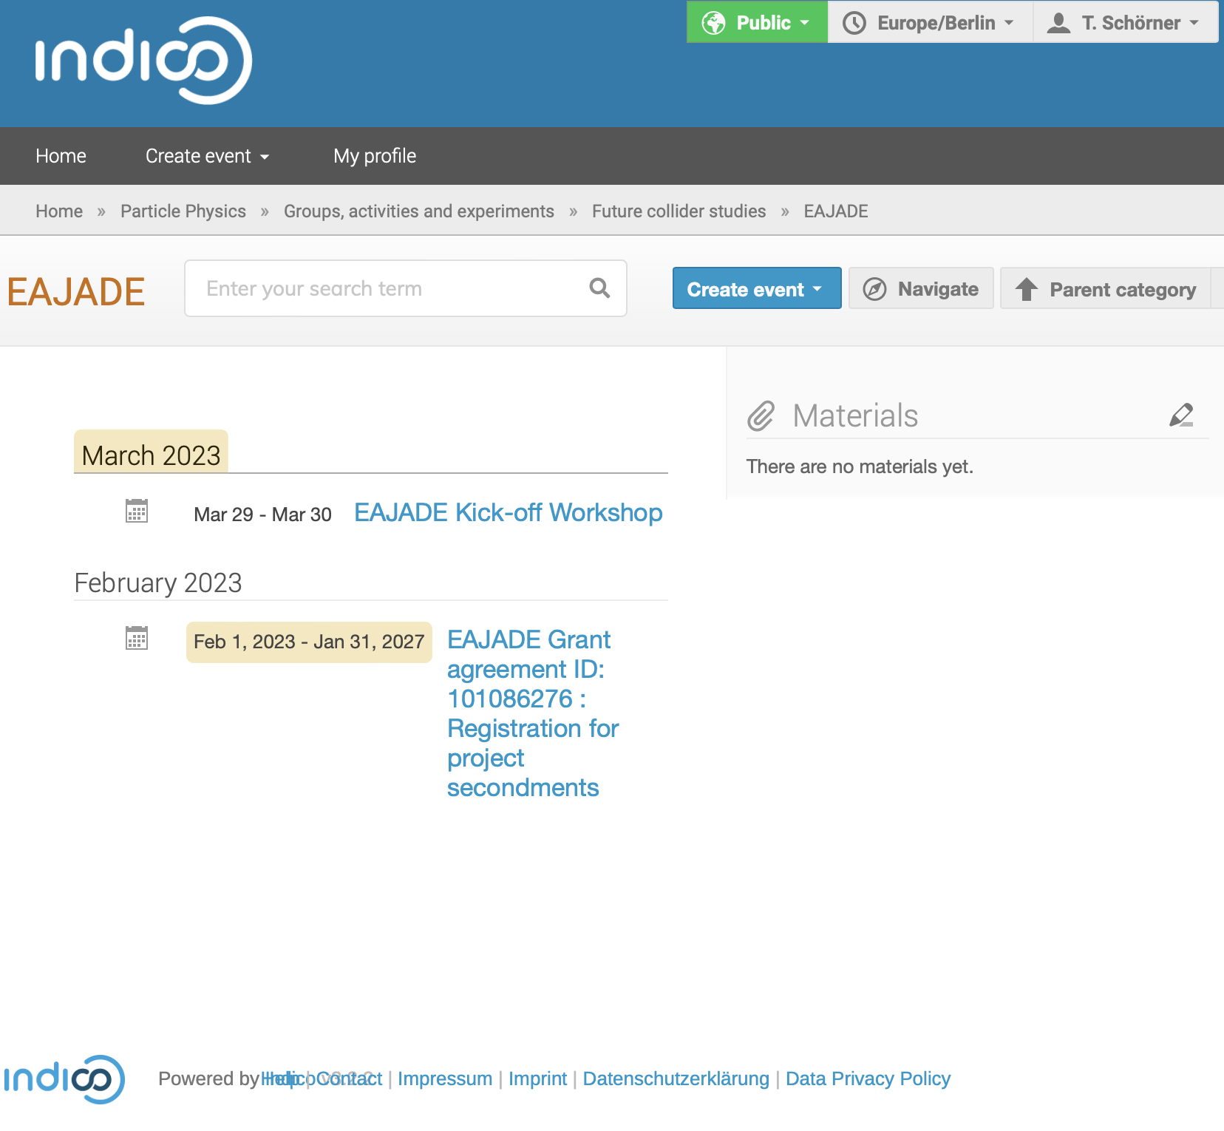
INDICO Page
… for EAJADE-related stuff
https://indico.desy.de/category/979/
Please also make reference to events to which
EAJADE somehow contributes (i.e. dummy entries
that point elsewhere or so).

Slide 15
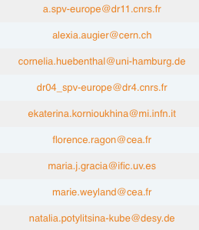
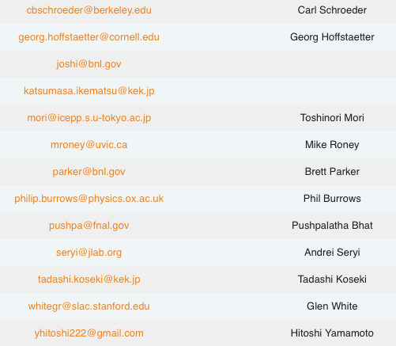
Email Lists
For the consortium
eajade-admin@desy.de Thomas & Natalia – DESY contact
eajade-beneficiaries@desy.de Admin contacts of beneficiaries
eajade-industrypartners@desy.de Contacts to our industry partners
eajade-partners@desy.de Pis at receiving (associated) partners
eajade-general@desy.de Everybody!
eajade-cb@desy.de Consortium Board
eajade-scb@desy.de Work package leaders

Slide 16
Beneficiaries
And members of the Consortium Board
Institution | PI
CEA | Enrico
CERN | Frank / Steinar
CNRS | Philip
DESY | Karsten
U Hamburg | Marc
CSIC / IFIC | Juan
INFN | Laura
(Oxford) | (Phil)
Science Coordinator: Steinar
Project Manager: Thomas

Slide 17
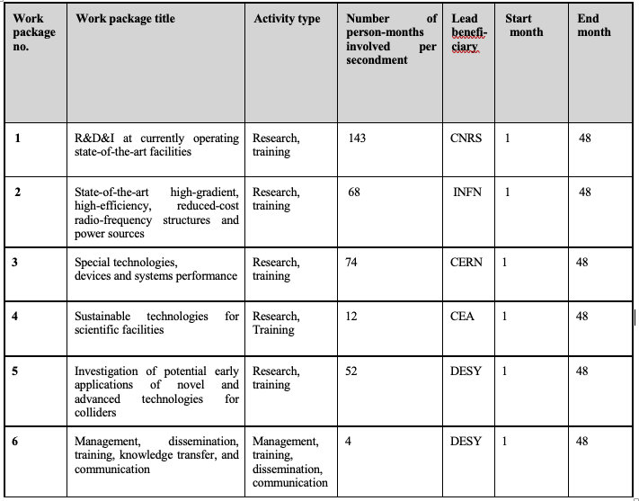
Work Packages
And menbers of the Scientific Coordination Board
Angeles
Laura
Steinar
Maxim
Jens
Thomas

Slide 18
Status of Consortium

Slide 19
Status of Consortium Agreement
Consortium agreement (CA) draft currently being finalised by DESY legal and EU departments. Expect sendout to partners soon.

Slide 20
Common Fund and Pre-financing Distribution
…taking into account 8% for common fund kept by DESY:
Note: Common Fund not yet contractually settled – tax issues discovered by DESY finance department. Expect solution on the time scale of 2 weeks or so.
 |  | A | B | C | D
Participant short name | Country | Total EU Contribution | Participant's share | Prefinancing (60% ot EC contribution) | 8 % for Common Fund | Payment to Beneficiary C - D
1-DESY | Germany | 193.200 | 13,82% | 115.920,00 | 9.273,60 | 106.646,40
2-CERN | Switzerland | 243.800 | 17,43% | 146.280,00 | 11.702,40 | 134.577,60
3-IFIC | Spain | 119.600 | 8,55% | 71.760,00 | 5.740,80 | 66.019,20
4-UHH | Germany | 115.000 | 8,22% | 69.000,00 | 5.520,00 | 63.480,00
5-INFN | Italy | 147.200 | 10,53% | 88.320,00 | 7.065,60 | 81.254,40
6-CEA | France | 124.200 | 8,88% | 74.520,00 | 5.961,60 | 68.558,40
7-CNRS | France | 455.400 | 32,57% | 273.240,00 | 21.859,20 | 251.380,80
 |  | 1.398.400 | 100,00% | 839.040,00 | 67.123,20 | 771.916,80

Slide 21
Travelling with EAJADE

Slide 22
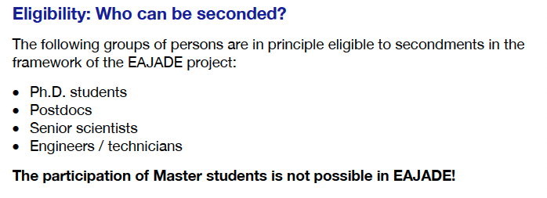
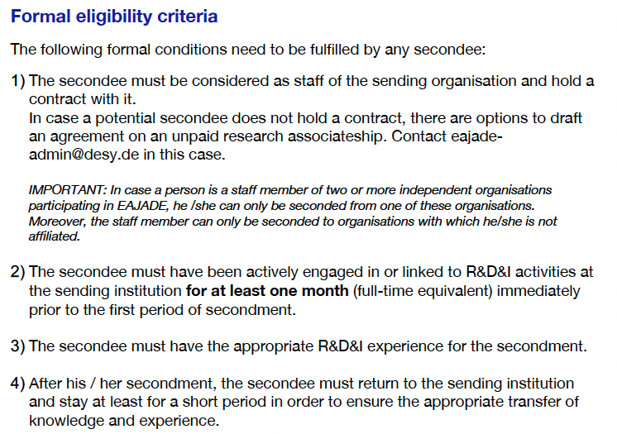
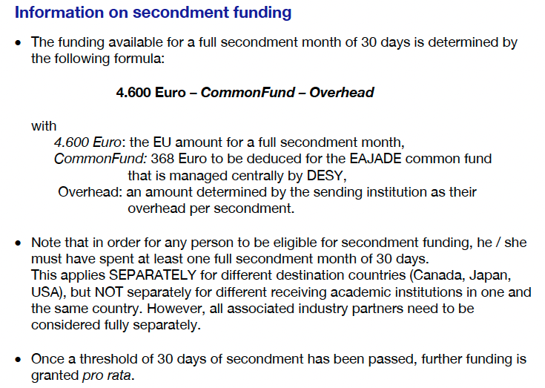

Travel Rules
From „Guidelines …“

Slide 23
Travel Planning
Organisational steps before, during and after a secondment
The following steps need to be taken in order to organize a secondment in the framework of EAJADE (In case of questions – turn to eajade-admin@desy.de):
The secondment needs to be agreed on with the leader of the EAJADE work package the secondment task is related to.
The formal conditions needs to be checked & certified by the sending institution’s principal investigator (see the Guidelines for sending institutions and secondees).
The secondee must register his / her trip at the project’s INDICO page (at least 2 weeks prior to the planned secondment): https://indico.desy.de/event/37930/
As soon as your secondment has been registered, the sending & receiving organisation PIs or supervisors will obtain a short notification with a) “Secondment Confirmation” for the receiving and b) confirmation of the eligibility for the sending organisation.
During his / her stay at the receiving organisation, the secondee must contact the receiving organisation’s EAJADE PI and ask for the “Secondment Confirmation” to be signed.
30 days after the end of the secondment, the sending organisation admin contact will be reminded to ensure the transfer of the secondment data into the continuous reporting EU portal (but also to confirm the initial data from Indico for us, for the general monitoring ).

Slide 24
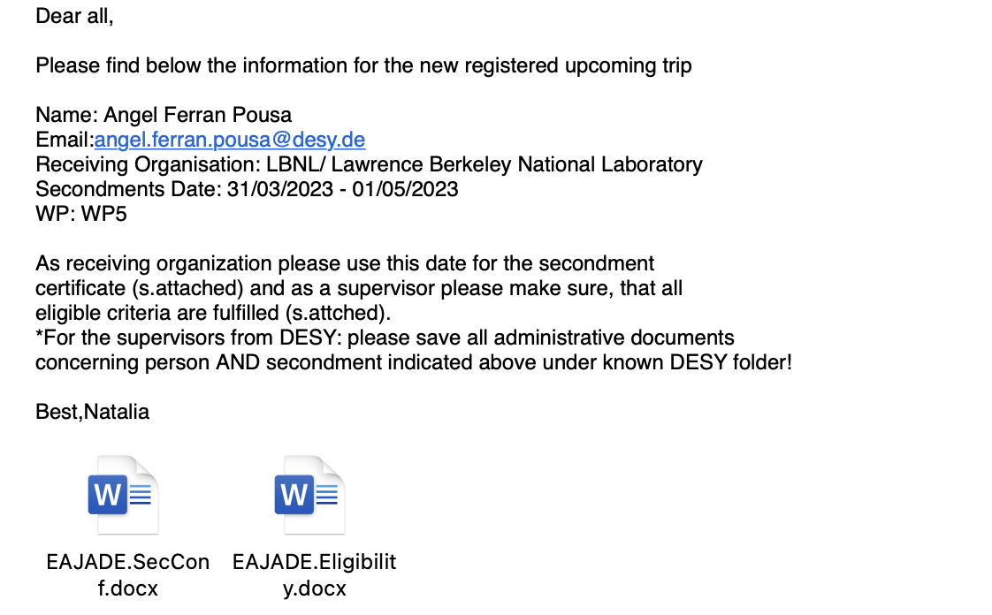
Travel Planning
Screenshot of registration mail to PI / supervisor and receiving institution PI

Slide 25
Travel Planning
… so far …
Our new plan, after small changes in IFIC (otherwise identical to ECAS numbers)
Total EU Contribution:
1.398.400 EUR
Total common fund:
111.872 EUR
To be found in shared folder → “Financial and travel reports”

Slide 26
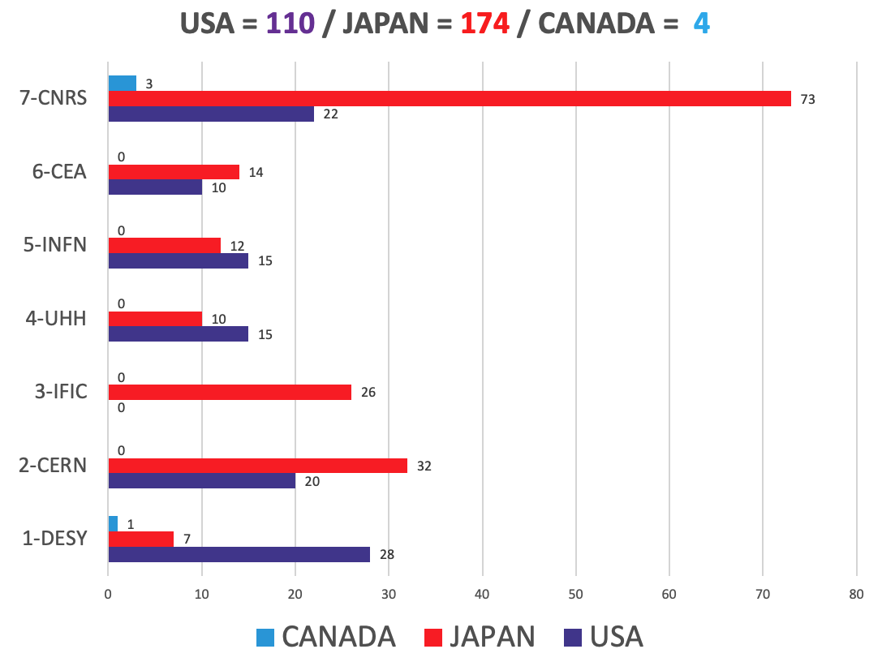
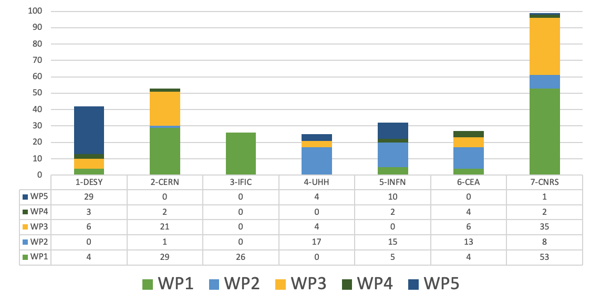
Overview of Travel Situation
To be found in shared folder → „Financial and travel reports“

Slide 27
Deliverables

Slide 28
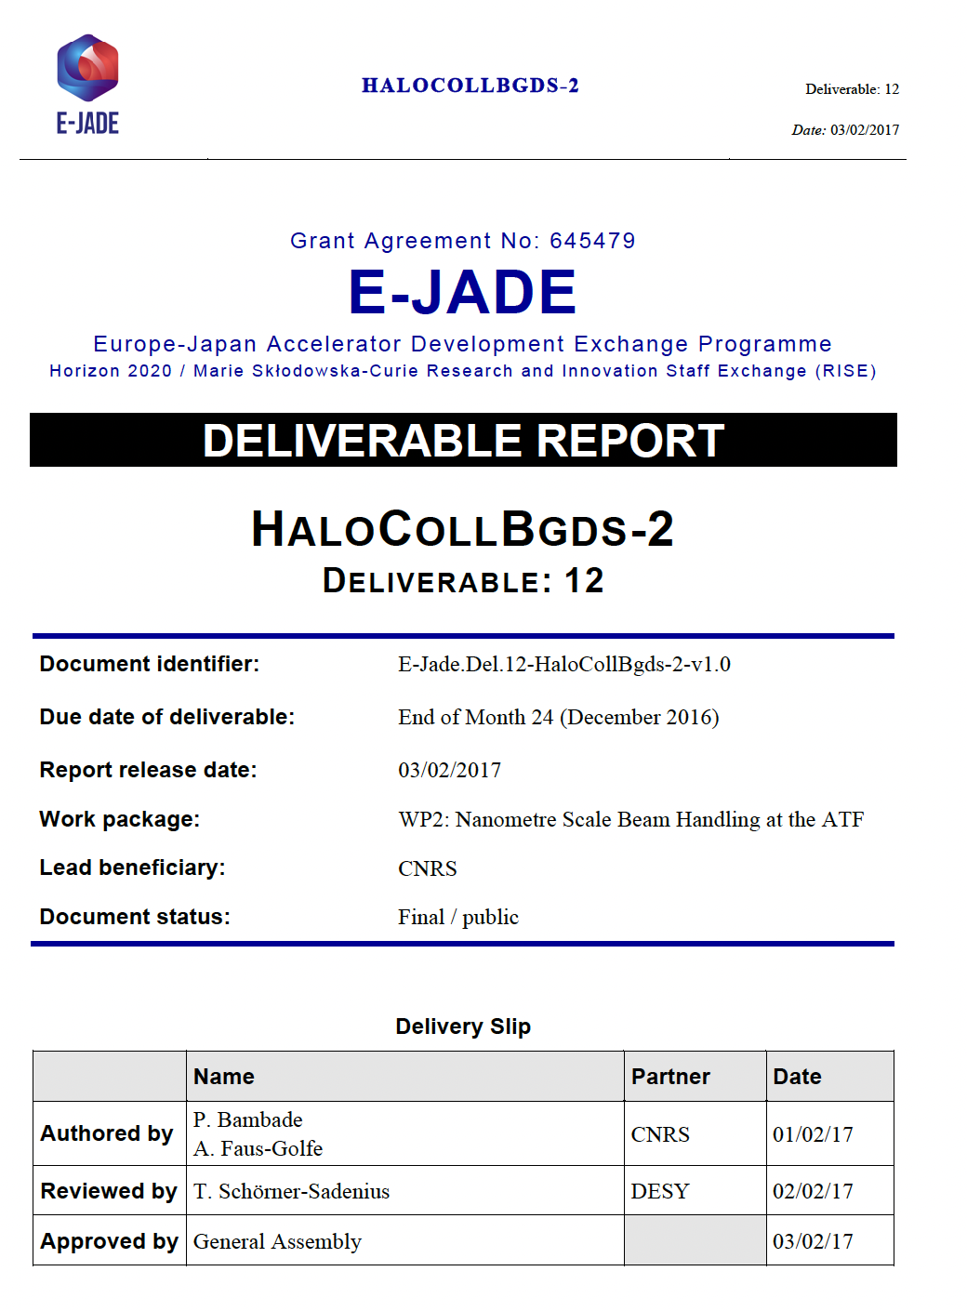
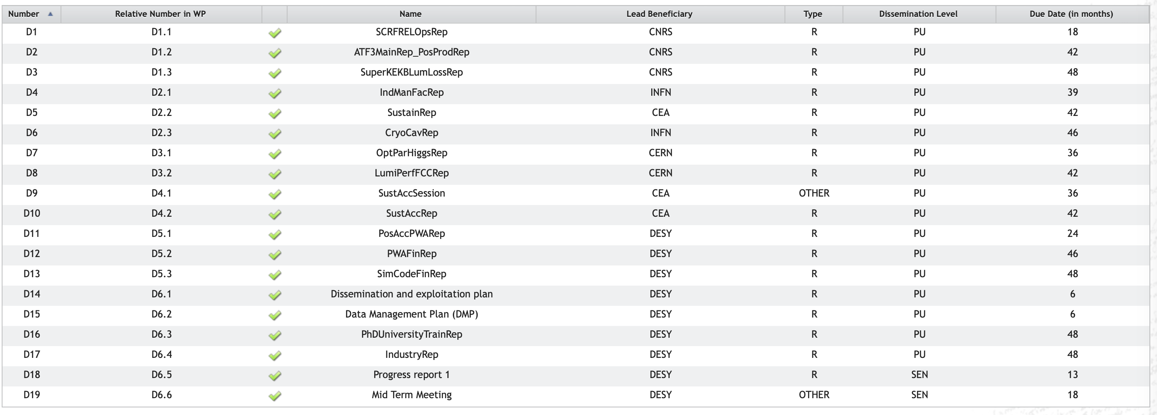
Deliverables
… and deliverable reports
A deliverable template will be provided soon!

Slide 29
Summary and Open Questions

Slide 30
Summary, Open Questions, Outlook
A few things to be done:
Clarify common fund
Sign consortium agreement
Build web site
Establish reporting mechanisms (deliverable report template etc.)
Exercise Natalia’s marvellous machinery
Fill WP 6 with life …
…
A few open questions towards the EU:
Question of country-wise collection of 30-day totals, or institute-wise?
Question on career development plan reporting in continuous reporting
…
EAJADE mostly set up – let’s start travelling and working on exciting projects! I am very much looking forward to collaborating with you over the next 4 years!

Slide 31
Thank you!
Thomas Schörner
DESY FH
E-Mail: thomas.schoerner@desy.de
Phone: +49 40 8998 3429
https://www.eajade.eu
E-Mail: eajade-admin@desy.de

Slide 32
Backup

