Slide 1

WP-2
High performance RF systems
L. Monaco and E. Cenni
30 March 2023, DESY
EAJADE – kickoff meeting

Slide 2
Outline
WP description
  Tasks
  Labs
  Months
Topics
Open Questions

Slide 3
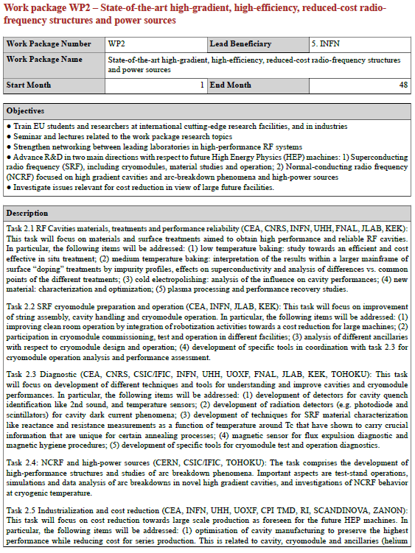
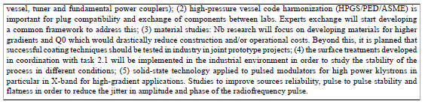
From updated Pivot table, in total 63 months
Participants:
CNRS (8), CEA (13), INFN (15), UHH (17), IFIC (9), CERN (1)
Task 2.5 will benefit from results obtained in other tasks, in term of cost reduction, sustainability, etc.
WP4 topics synergic with WP2 tasks

Slide 4

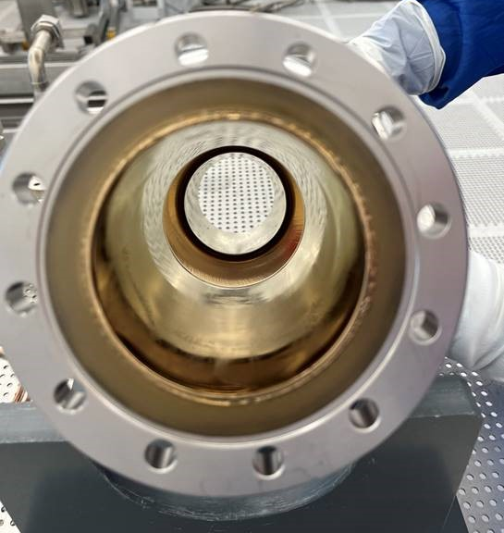



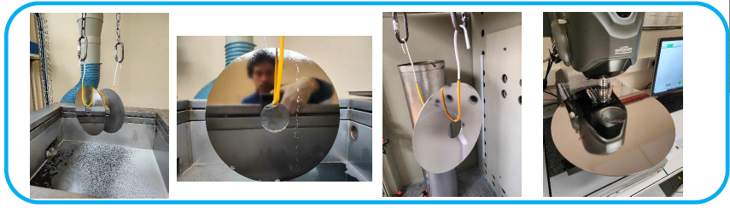

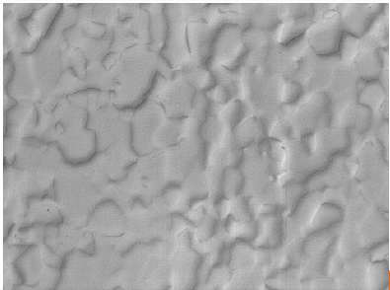
CEA activities
Tasks: 2.1, 2.5
Starting 2024
JLAB:
CRADA on SRF cavity development completed and under signature
(Planned cavity exchange).
FNAL:
Collaboration with SQMS through IIT for PCT measurements (1/2 PhD student funding).
KEK:
FJPPL: Collaboration on numerical simulations with T. Kubo.
1,3 GHz Nb cavity coated
with a nitride multilayer AlN/ NbTiN
A 2-steps method for polishing large Nb sheets has been developed with Lamplan company
Collaboration between IJCLab/CNRS, CEA and KEK

Slide 5
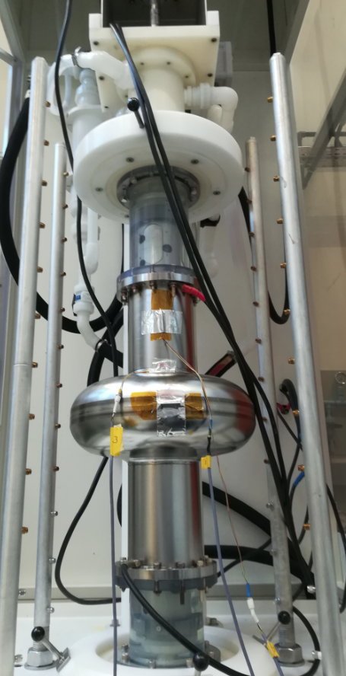
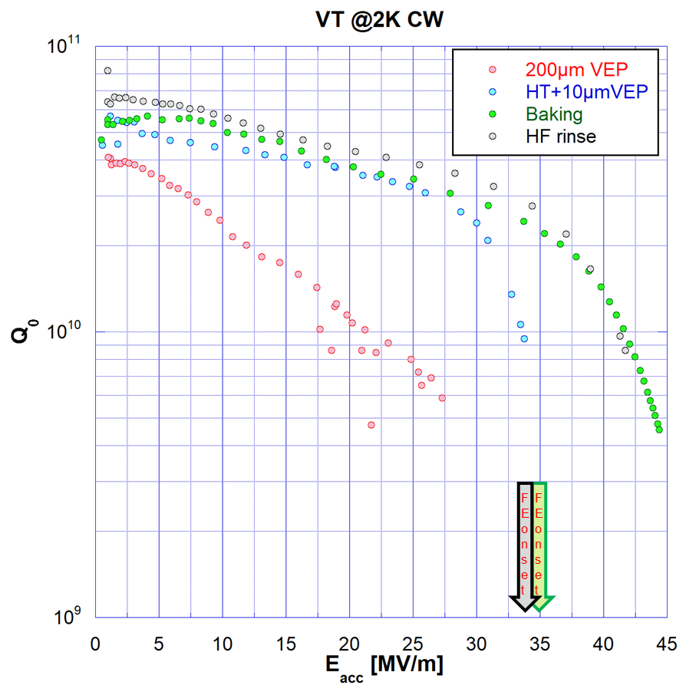

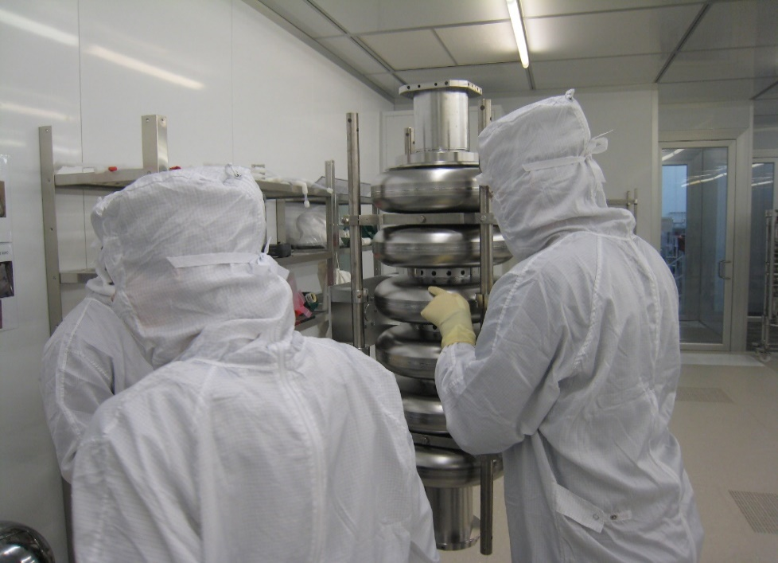
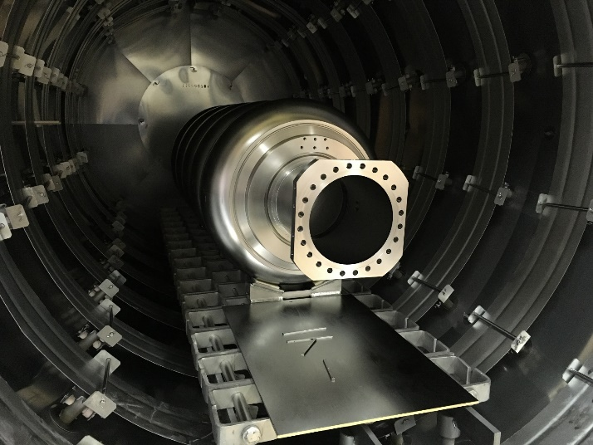


CEA activities
Tasks: 2.1, 2.5
Starting 2024
Bulk niobium studies (medium grain vs fine grain)
Electropolishing studies
Heat treatments development
Cavity testing in vertical cryostat
Courtesy Zanon
Industrialization process
Heat treatments

Slide 6
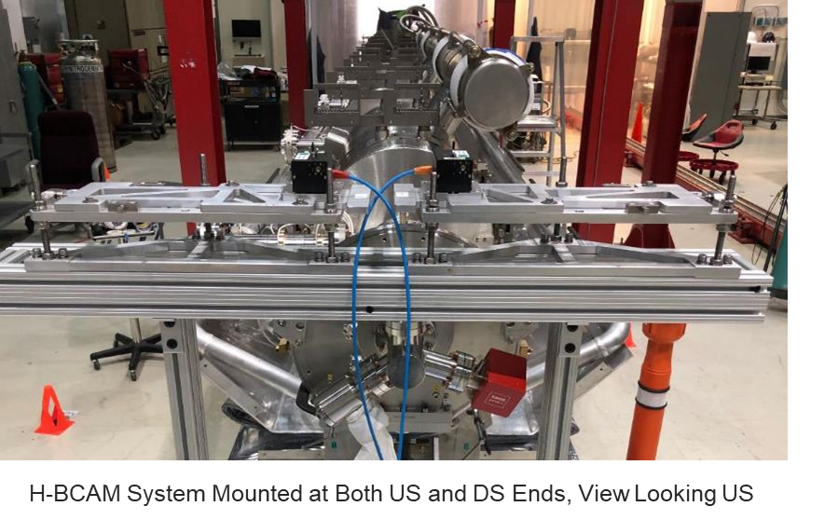
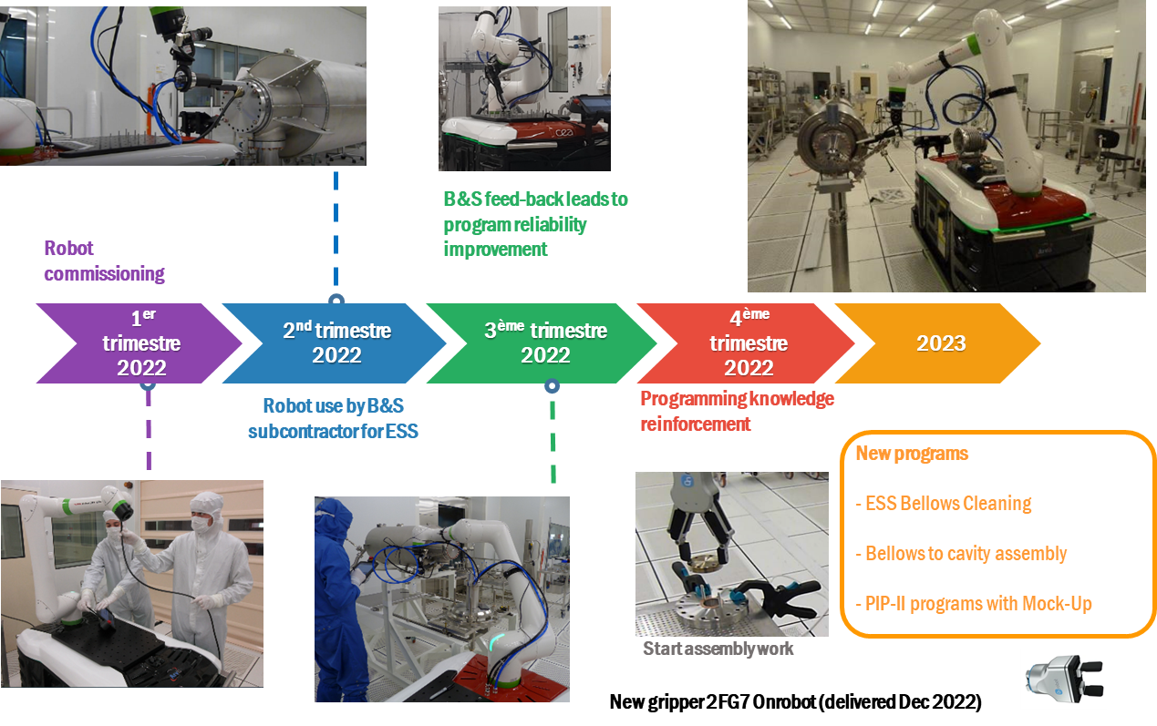
CEA activities
Tasks: 2.2, (2.5)
Starting 2024
Clean room Collaborative Robot (COBOT)
Computer vision for clean room operations
First issue addressed: reduce effort and hardship of flange cleaning
Feasibility study: with CEA/DRT,
SYB3 prototype (sept17-oct18)
Flanges leaning with Nitrogen blowing, CEA/DRT : commercial cobot (janv 20-mars 21)
Commercial cobot order and installation sept.21-mai 22

Slide 7
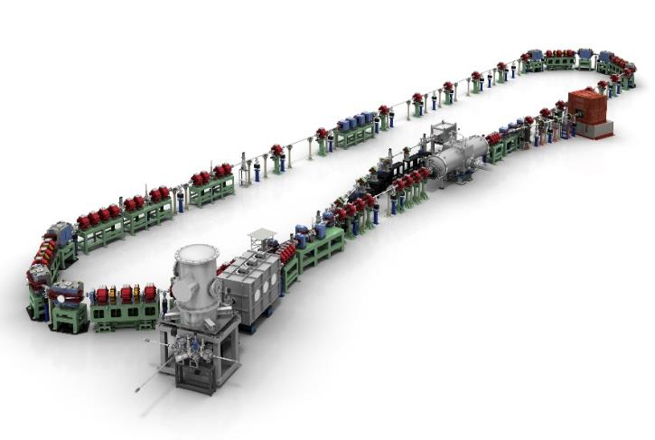
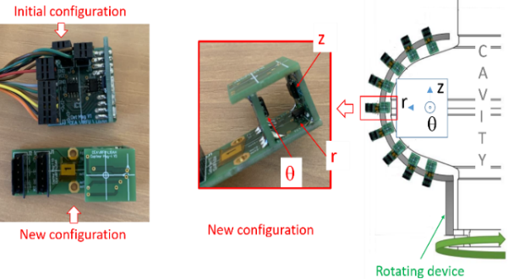
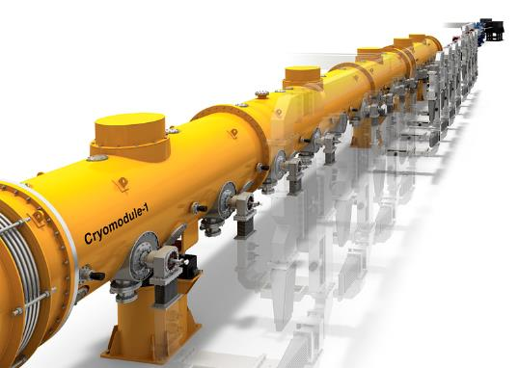
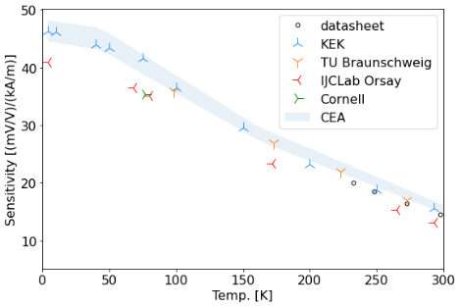
CEA activities
Tasks: 2.2, 2.3
Starting 2023
Collaboration topics:
Photon detector characterization (MPPC, Diodes and PM) readout implementation, for PSD, Multi Channel Analyzer
Detection system test on KEK/cERL (main linac and injector) and KEK/STF cryomodules.
Studying flux expulsion during superconducting cavities test increases the need for exhaustive magnetometric cartography.
The use of Anistropic Magneto Resistance (AMR) sensors, much cheaper than commercial fluxgates, allows the use of tens of sensors simultaneously.
cERL
STF (CM-1/CM-2a)

Slide 8
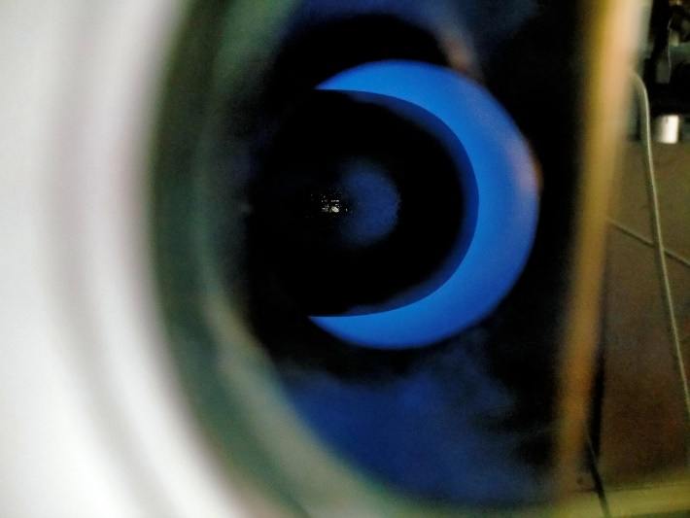
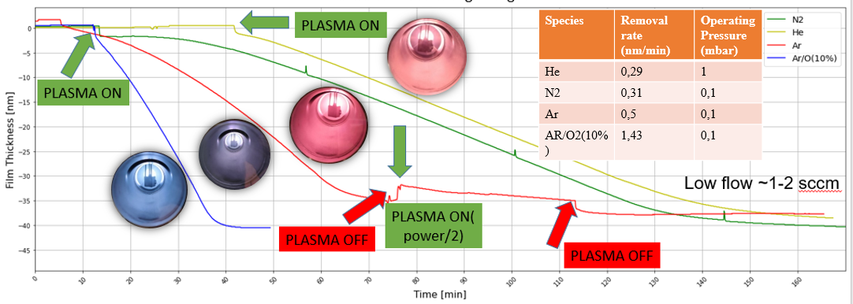
CNRS activities
Tasks: 2.1
Starting 2024
Collaboration topics:
IJCLab (CNRS) in collaboration with IRFU (CEA) are developping plasma processing technique for Spiral2 QWR and strong interests as well for spoke cavities especially to mitigate multipacting.
A M2 student starting in April, will continue as a PhD student and will be dedicated to these studies
Plasma processing is a very promising « in-situ » recovery treatment to mitigate field emission and multipacting problematics in SRF cavities
Efficiency demonstrated in elliptical cavities (SNS, Jlab, Fermilab) installed in cryomodules.
Several labs are transferring this technique to low beta structures (FRIB, FNAL, IJCLab, CEA-IRFU)
Discussions have been initiated to share lessons learned (in person visits extremly beneficial)
Collaboration between IJCLab/CNRS, CEA and FNAL
Plasma (Ar+O2) ignited in Spiral2 QWR
Study of plasma efficiency depending on gas @ IJCLab (O. Hryhorenko, B. Ourahmoune)

Slide 9
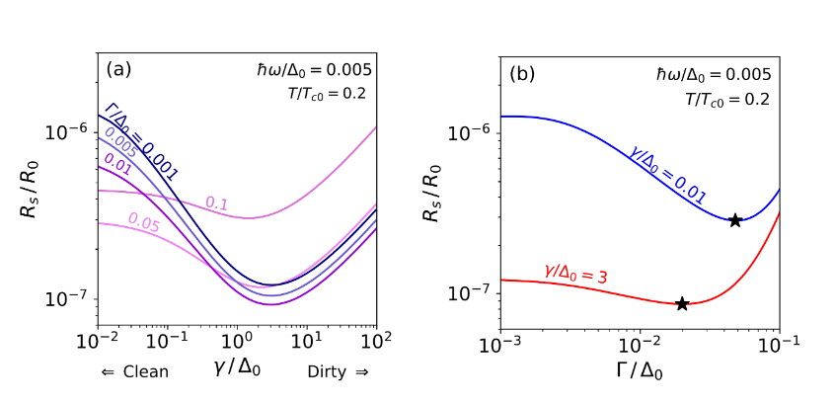
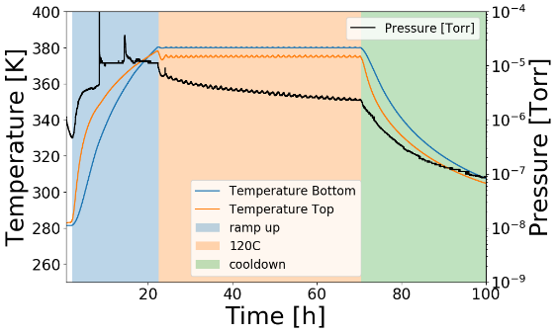
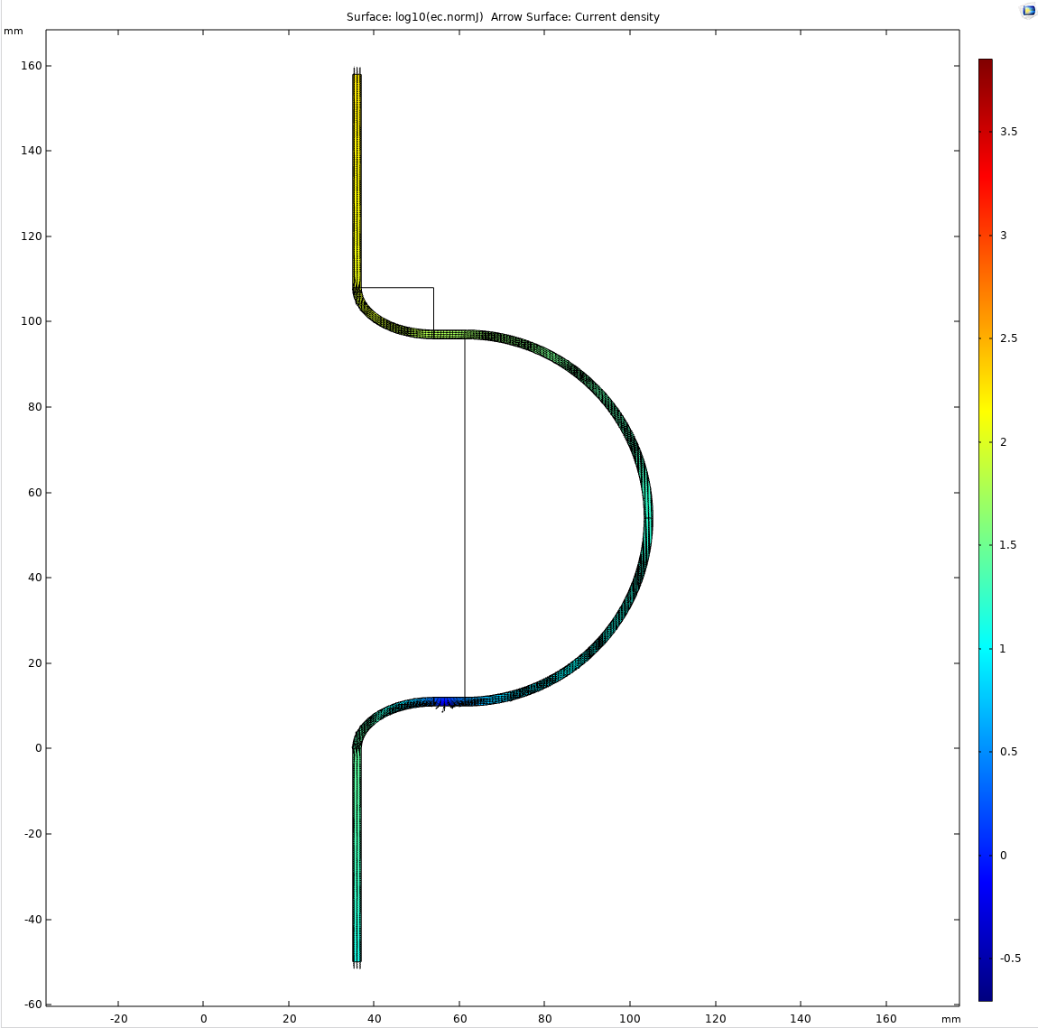
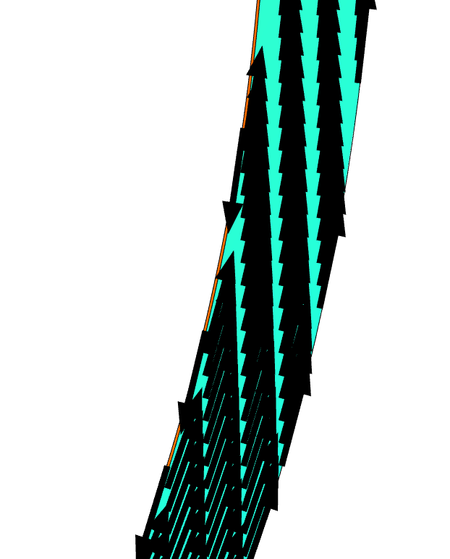
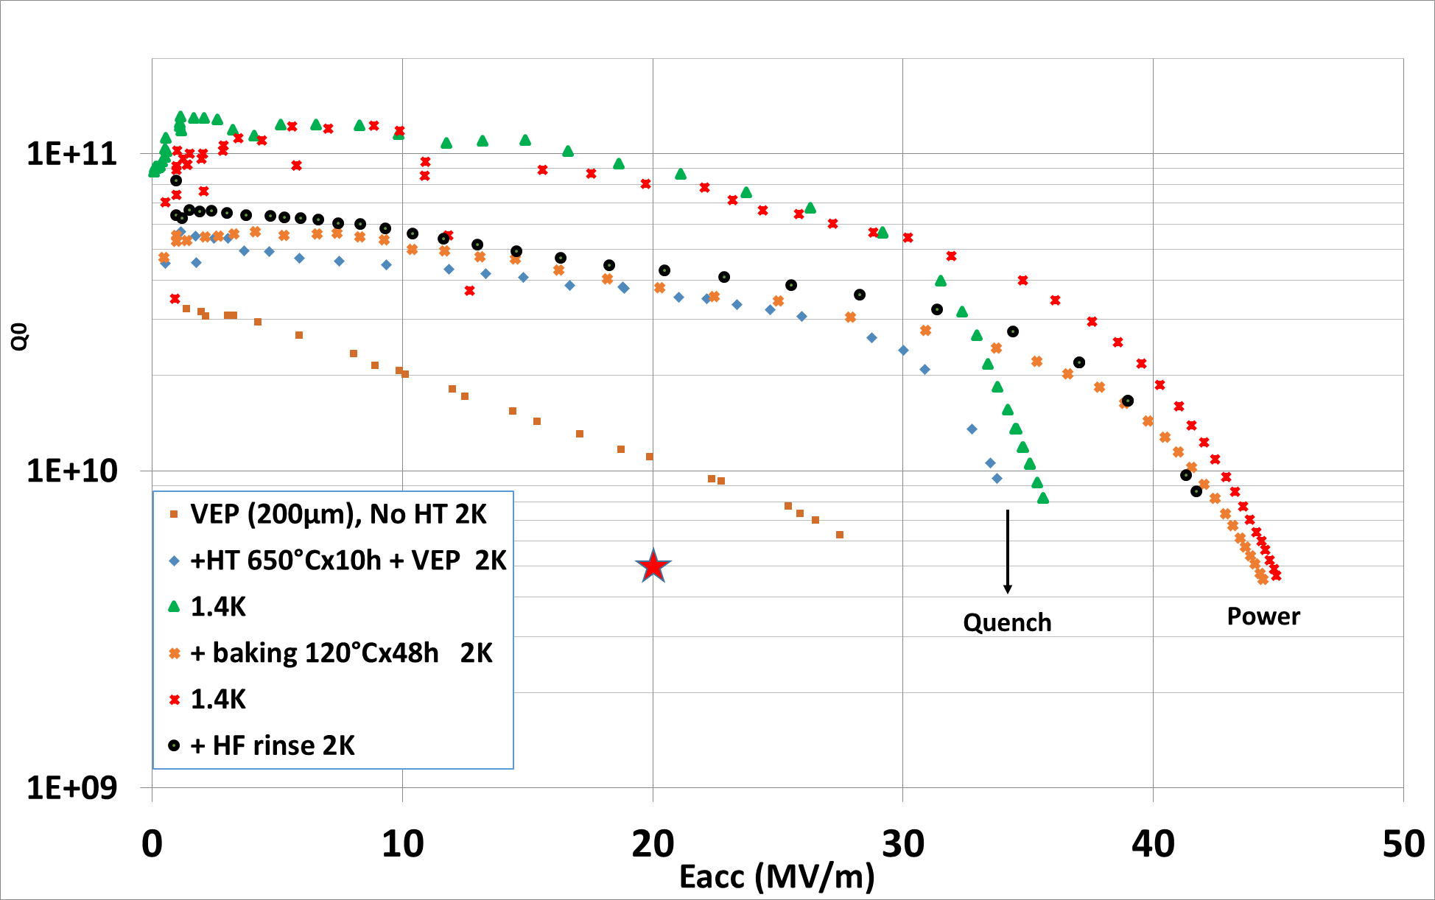
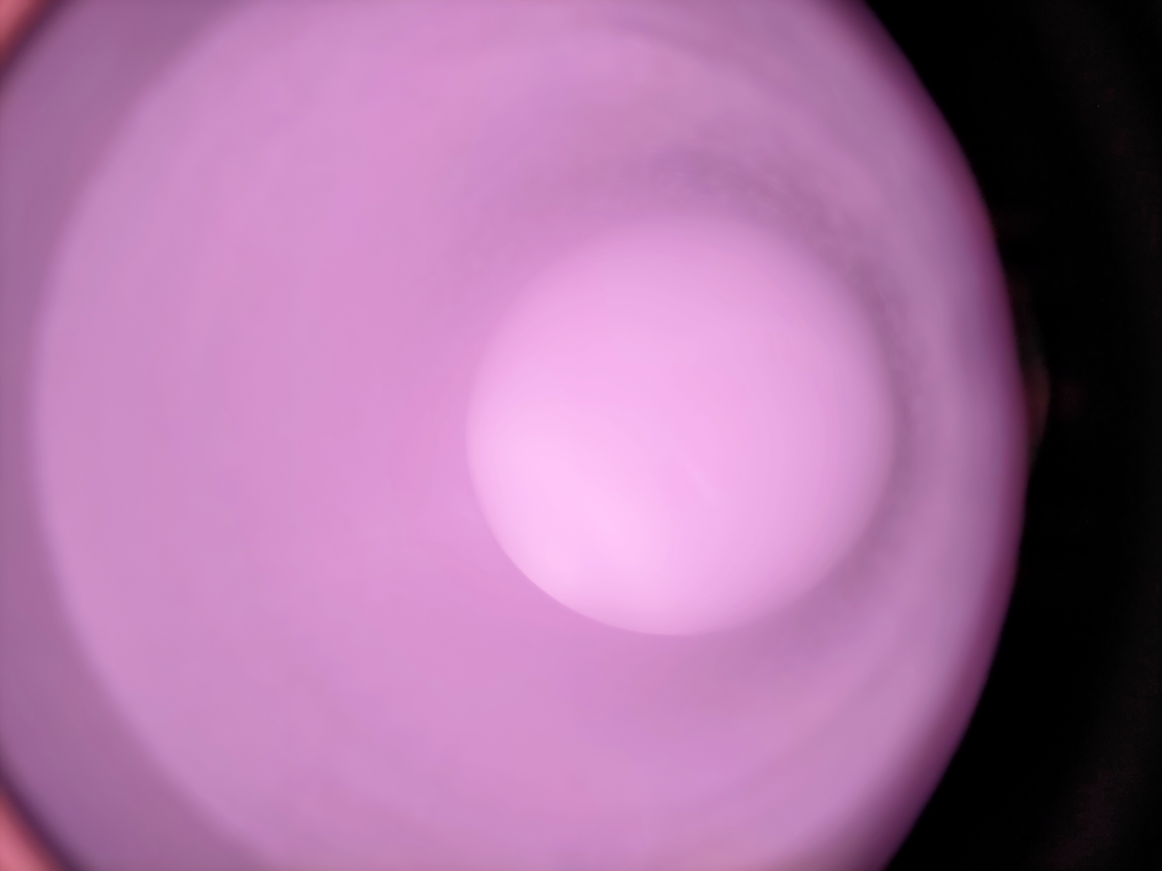
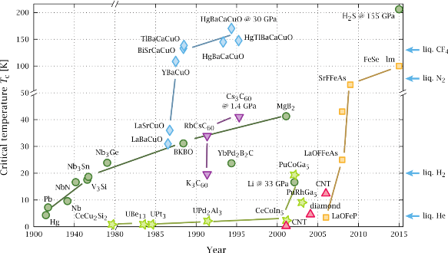
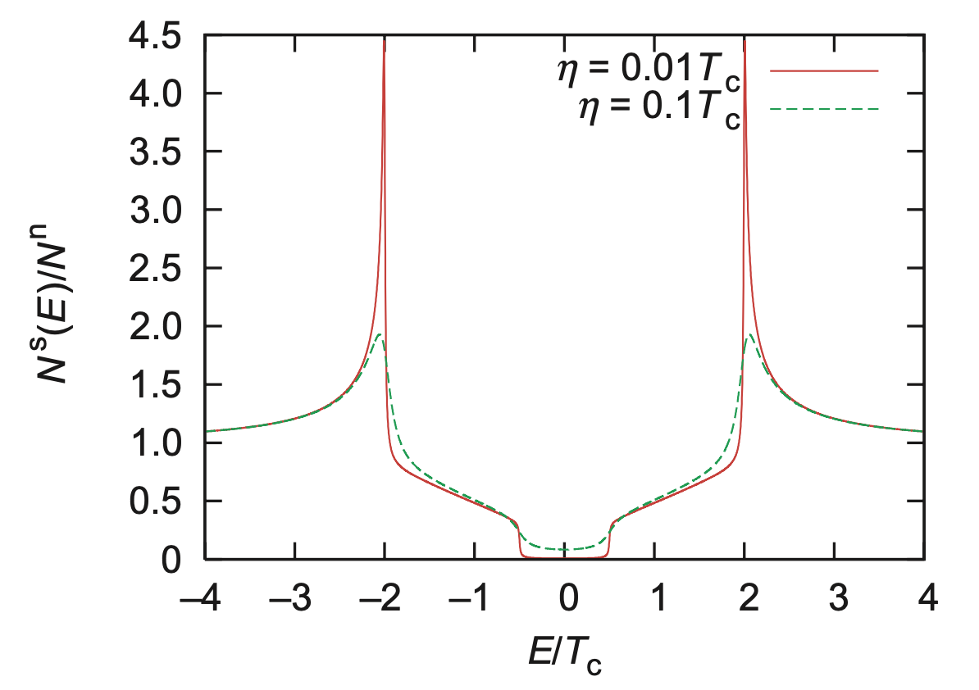
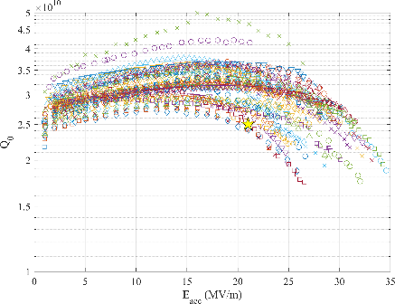
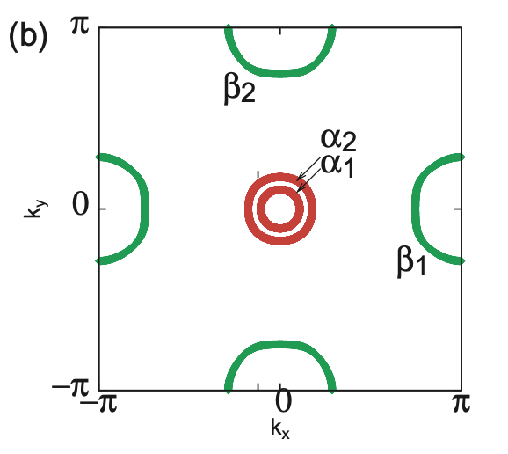
CNRS activities
Tasks: 2.1, 2.5
Starting 2023
Collaboration topics:
State-of-the-art surface treatment of bulk Nb
  In-depth discussions and hands-on activities in different laboratories to standardize the procedure of surface treatment and explore new methods
  More theoretical understandings beyond the engineering success
  → Innovation for future projects
Thin film SRF: beyond bulkn niobium
  Collaboration to understand and control the thermoelectric currents in Nb₃Sn/Nb and Nb/Cu cavities
  Exploration of new HTS with full-gap FeAs superconductors
Collaboration between CNRS and KEK
Low-T baking @ TRIUMF
Fundamental theory @ KEK
120C
MgB₂@ KEK & Los Alamos
Nb₃Sn/Nb@ Cornell & KEK
thermoelectric current @ Akira &KEK
Low-T baking @ CEA-Saclay
D. Hall PhD thesis
MgB₂
Al₂O₃-C
P. Kolb TTC2022
T. Tajima et al EPAC2006 MOPCH178
Plasma processing @ CNRS
N-doping @ FNAL & JLAB
HTS SRF (?) @ Akira & KEK
T. Tajima et al EPAC2006 MOPCH178
F. Eozenou et al TTC high-Q/high-G WG Sep 2022 LINAC22 THPOGE23
J. Maniscalco TTC high-G/high-Q WG meeting 09/08/2022
Y. Nagai et al 2008 New J. Phys. 10 103026

Slide 10


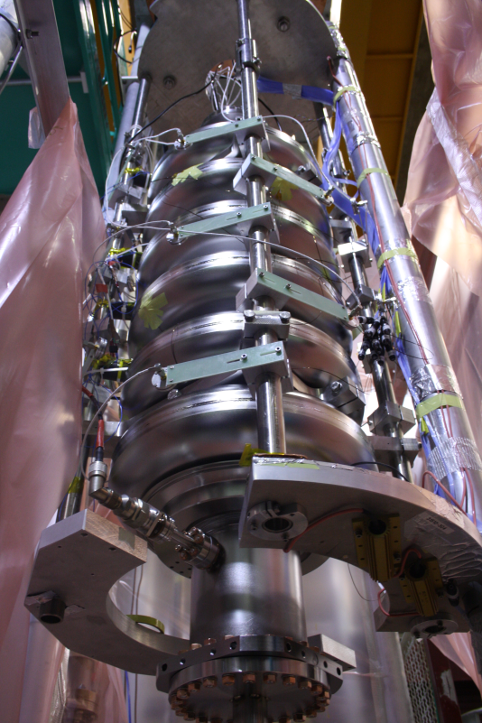
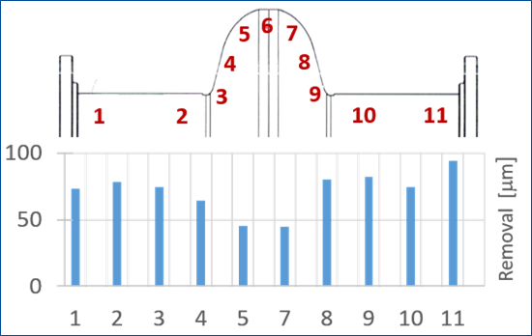
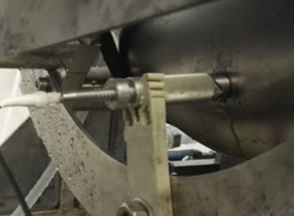
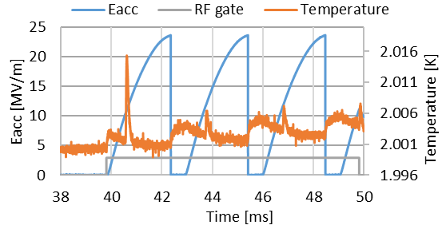
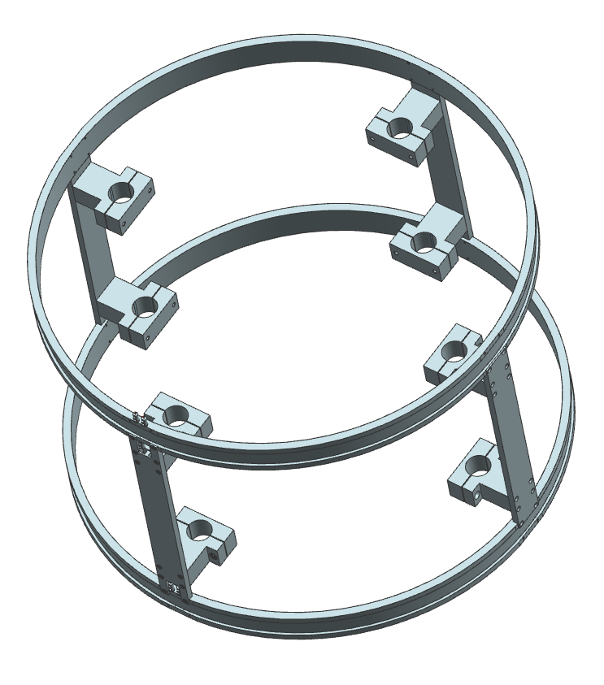
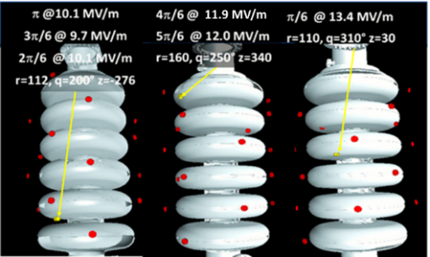
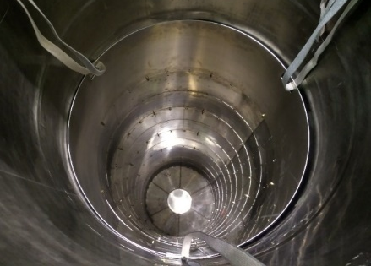
INFN activities
Tasks: 2.1, 2.3, 2.5
Starting 2023
Collaboration topics:
Treatments R&D for improvement (baking at different T, cold EP studies and optimization)
  Setup parameters for EP “warm” and “cold” in the framework of the PIP-II activities will be investigated towards high field operation
Diagnostic improvement
  2nd sound
  Thermometry (improve resolution)
  Photodiode and Scintillator
  (further develop reconstruction emitter source identification)
  Magnetic sensor and Helmotz coils for magnetic hygiene
Dedicated cryostat at LASA for single-cell studies at 2K
  Fast check of treatment and diagnostic improvement
  Fast cooldown and “zero” magnetic field
Use single cell cavities for Vertical Test infrastructures benchmarking (test harmonization)
ESS cavity on the LASA VT insert
On-line thickness monitor
during processing
Collaboration between INFN-LASA and FNAL/Jlab/KEK
CryoPerm inner magnetic shield
2nd Sound
Coil for regmanent field
compensation
Cernox sensor during quench at 22 MV/m

Slide 11
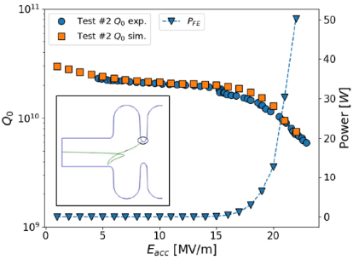
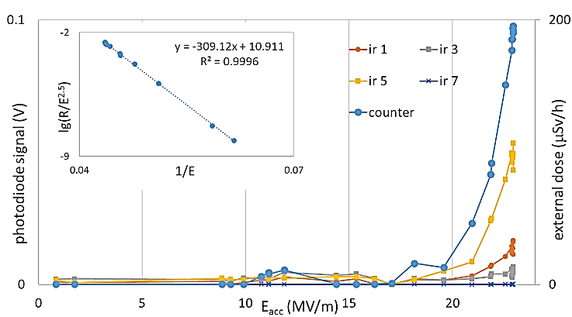
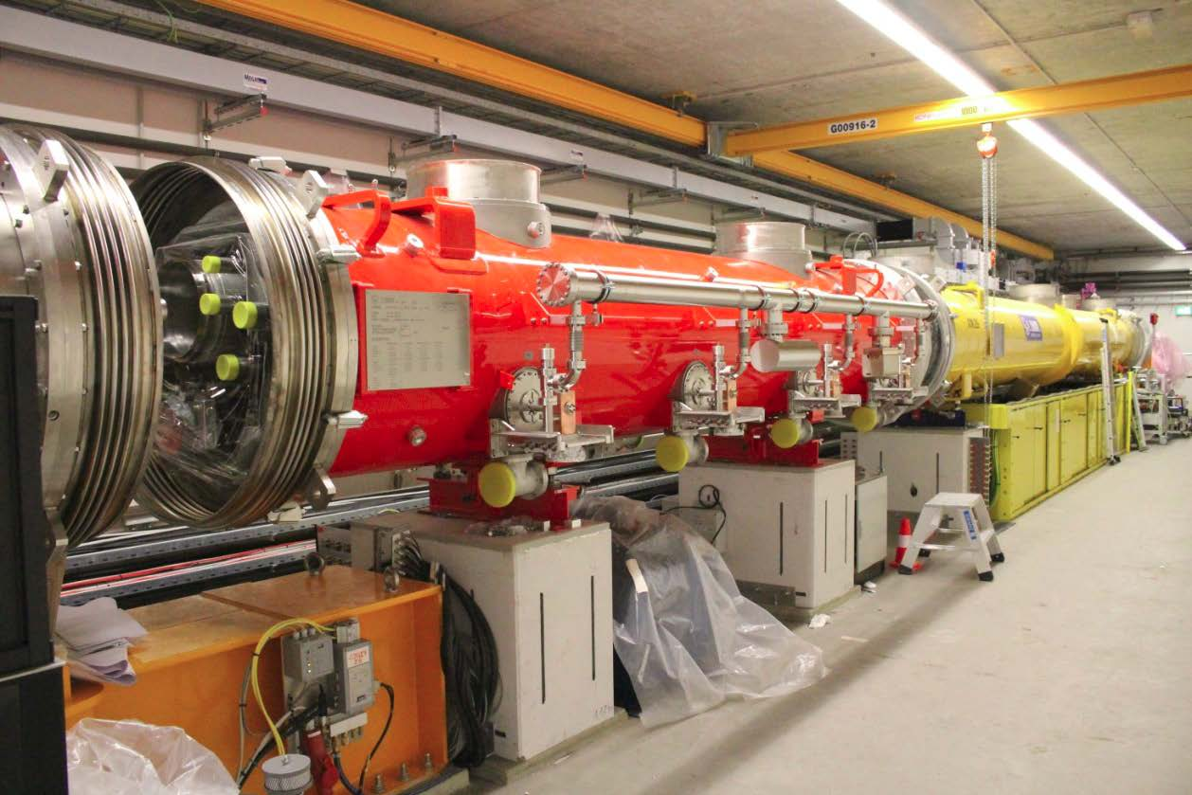
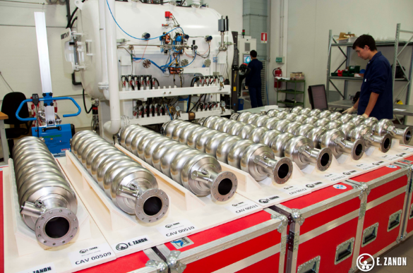
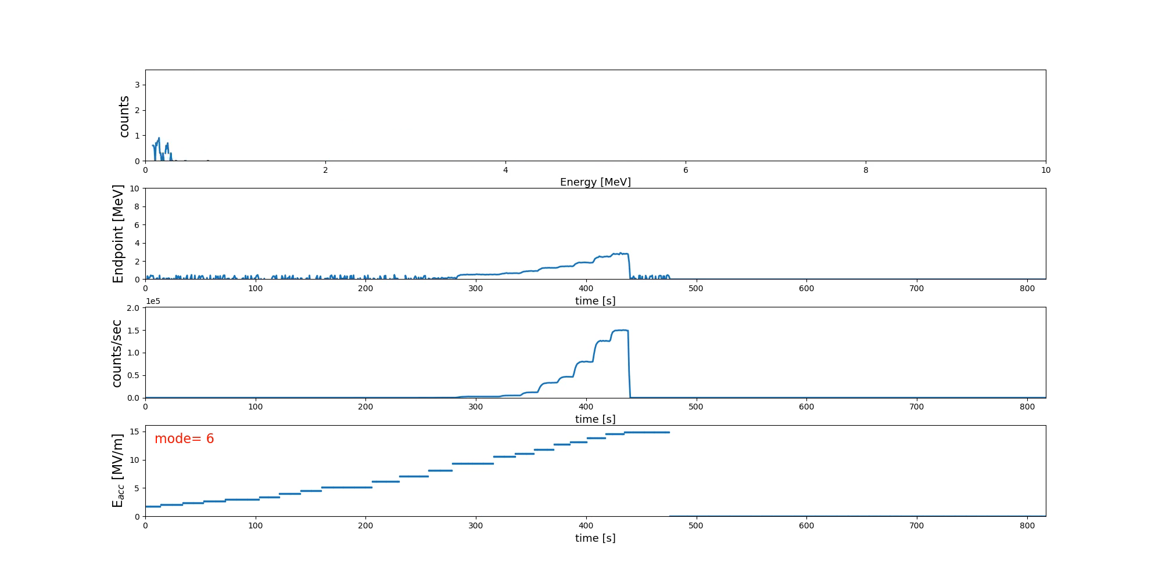
INFN activities
Tasks: 2.2, 2.3, 2.5
Starting 2023/24
Collaboration topics:
Cryomodule preparation and operation:
  Commissioning and operation in different facilities mainly devoted to field emission studies
  Extend FE model developed for cavities during VT
Industrialization and cost reduction:
  Migration from R&D to industrial production
  Pressure vessel code harmonization (HPGS/PED/ASME)
  Cost reduction: Mid Grain Nb vs Fine Grain Nb and HighQ/HighG recipes
FE reconstruction
Photodiode signals vs Eacc
Collaboration between INFN-LASA and FNAL/JLAB/KEK
Real-time Scintillator

Slide 12

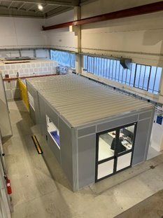
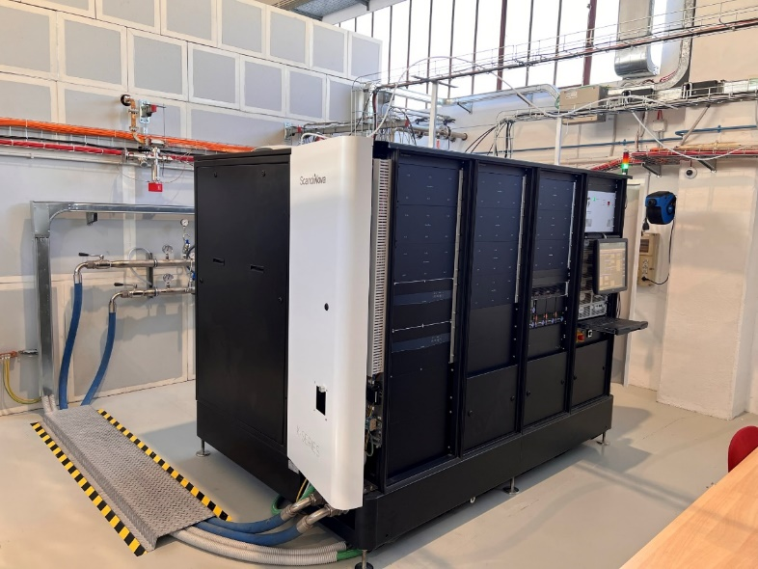
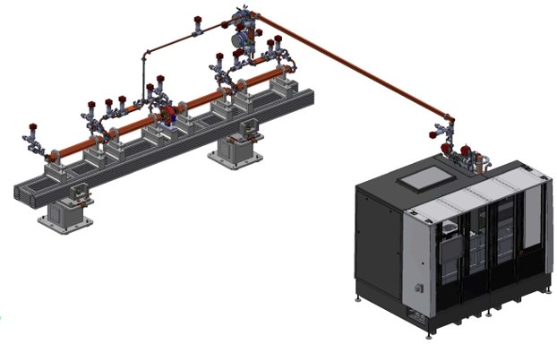
INFN activities
Tasks: 2.5
Starting 2023
R&D on advanced RF devices and power sources is a strategic activity for the future HEP infrastructure as well as for many other accelerator applications.
ScandiNova (Uppsala, SE) is the industrial partner for this development, and will provide the required modulator.
Collaboration topics:
INFN experts will support the development of the power stations to implement:
High repetition rate
Test of high efficiency klystrons
Improvement of video pulse shape and IGBTs control
Secondments in total: 1 person⋅months
Time profile: possible to spend ½ person⋅months in late 2023 / early 2024 for collaboration and tests of high rep rate modulators at ScandiNova (Uppsala, SE)
ScandiNova K400 modulator for the INFN Frascati high power X-band TEX facility
INFN Frascati X-band high power test stand «TEX»
K400 ScandiNova Modulator +
CPI VKX8311A klystron
Collaboration between INFN-LNF and ScandiNova
Eupraxia X-band
RF module

Slide 13

UHH activities
Tasks: 2.1, 2.3, (2.5)
Starting 2023
Some comments/criticalities on 2023 plans:
Candidates: “nationality” of the involved PhD student, lack of a candidate for the secondment
-> open PhD position.
Costs increase: two post-docs are planned to go to the US/Japan this year -> given the raise in plane ticket prices, we'll see how much we have to provide from other projects to make it work.
Anyhow….
Collaborations are going rather well, and all partners - especially the receiving partners - would really like to welcome students.
KEK
Plan is to joint efforts in term of „beyond Nb“ R&D to improve RF performance
UHH has a funded R&D project for „multilayer“ or S-I-S structures
KEK had a similar attempt on S-I-S some time ago but hit a roadblock
  → planned secondment of Postdoc for 1 month in Q3/Q4 2023
KEK has a unique set-up to measure H_{c1} of SRF samples & we will provide samples
  Open PhD Position not filled yet → planned secondment not possible, but measurements will be done

Slide 14
UHH activities
Tasks: 2.1, 2.3, (2.5)
Starting 2023
JLab
Two projects for joint R&D planned – both improves our diagnostic capabilities of SRF
  One project has fabrication delay – collaboration continues but secondment to JLab not helpful at the moment
  Other project has a good collaboration – but PhD student has problematic Nationality (Iran). DOE is currently processing our visit request. Outcome and duration unclear ☹
  → planned secondments this year not possible/reasonable, but collaboration continues
FNAL
Collaboration in many issues: material, diagnostics, general understanding of SRF
  Secondment of Postdoc planned end of 2023
But same problem as with Jlab with Nationality of PhD student
→ planned secondments this year only partially possible, but collaboration continues

Slide 15


CERN / IFIC activities
Task: 2.4
The purpose of this task is reported below:
IFIC (tasks 2.3/2.4), 9 months in total:
In the preparation phase -> take part of WP1 and WP2:
WP2: R&D in high-gradient structures, taking part in test-stand operation and dark current studies (task 2.3 and 2.4)
Actual status:
IFIC would prefer to focus on the WP1
Reason: due to the initial absence of SLAC in the EAJADE project, IFIC rescheduled and reassigned its manpower for R&D activities to the development, testing and operation of cavity BPMs, suitable for a potential ILC contribution, fully related to WP1.
To support this plan IFIC successfully applied and got some additional funds for this purpose.
How to proceed?
…from the point of view of deliverables, it could be managed since NCRF activities will be reported in Del 2.3 that will collect contributions from many other activities…

Slide 16
Tasks Overview
Task 2.1:
  UHH: from 2023 -> KEK; from 2024 (if possible) -> Jlab/FNAL
  CEA: from 2024 -> KEK/Jlab/FNAL
  CNRS: from 2023 -> KEK; from 2024 -> FNAL
  INFN: from 2023 -> Jlab/FNAL; from 2024 -> KEK
Task 2.2:
  CEA: from 2024 -> KEK/FNAL
  INFN: from 2024 -> Jlab/KEK
Task 2.3:
  UHH: from 2024 (if possible) -> KEK
  CEA: from 2023 -> KEK
  LASA: from 2023 -> FNAL/Jlab; from 2024 -> KEK
Task 2.4:
  To be discussed (IFIC)
Task 2.5:
  CEA: from 2024 -> ZRI
  CNRS: from 2024 -> KEK
  INFN: (½ month from Q4 2023 + ½ 2024) -> ScandiNova; from 2024 -> KEK/Jlab/FNAL

Slide 17
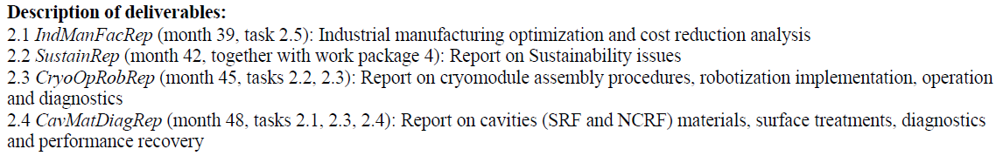
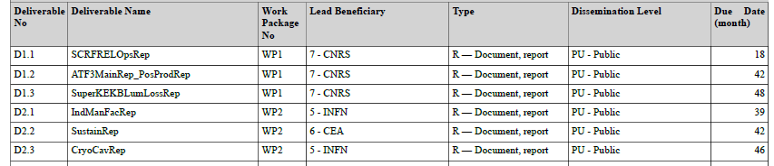
Deliverables & Time scale (2023)
Deliverables
Note: Deliverables 2.3&2.3 have been merged as D2.3 CryoCavRep (month 46, tasks 2.1, 2.2, 2.3, 2.4)
Task 2.1:
  UHH -> KEK, Postdoc 1 month, Q3/Q4 2023
  CRNS -> KEK, Staff 1 month, from Q4 2023
  INFN-LASA -> Jlab, Staff ½ month, from Q2/Q3 2023
Task 2.3:
  CEA -> KEK, staff 1 month, Q3 2023
Task 2.5:
  INFN -> Scandinova, staff ½ in Q4 2023 or Q1 2024

Slide 18
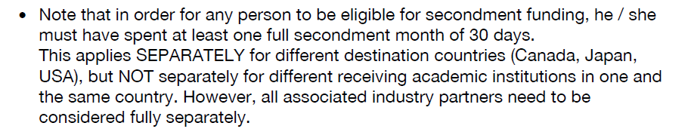
Open Questions
Could secondments be exchanged between different beneficiaries?
  e.g. INFN -> CEA
Could we clarify the “guide lines” criteria here below?
  e.g. 2 weeks JLAB+2 weeks FNAL OK
  2 weeks JLAB +2 weeks KEK NOT OK
Can months be exchanged between different WPs and receiving labs while keeping the same beneficiaries?
  e.g. INFN, 2 secondments from WP2 to WP5
  e.g. INFN, from LBNL to SLAC

Slide 19
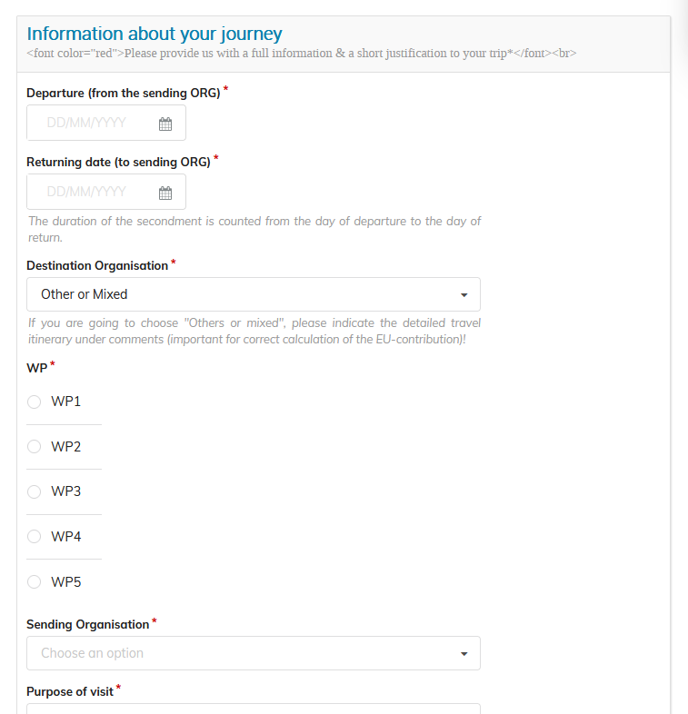
Open Questions
SLAC now is a receiving lab (at the beginning was taken out) -> request from LNF to move the destination from LBNL to SLAC: is it possible?
Do we have any constrains between the
departure/arrival date for a secondment?
Is it possible to “merge” a conference with
one “EAJADE secondment”?
  e.g. CNRS will do ½ month at FNAL for WP2,
  just after the SRF2023 (that will be in MSU)
  -> flight expenses and ½ months
  accommodation at FNAL paid by EAJADE?

Slide 20
Open Questions mainly on WP2
IFIC will concentrate its effort only WP1 (and no more on WP2), i.e. moving 9 months from WP2 to WP1: is it possible?
This movement will leave Task 2.4 almost empty (just 1 month from CERN) -> how to deal with Task 2.4?

