Slide 1
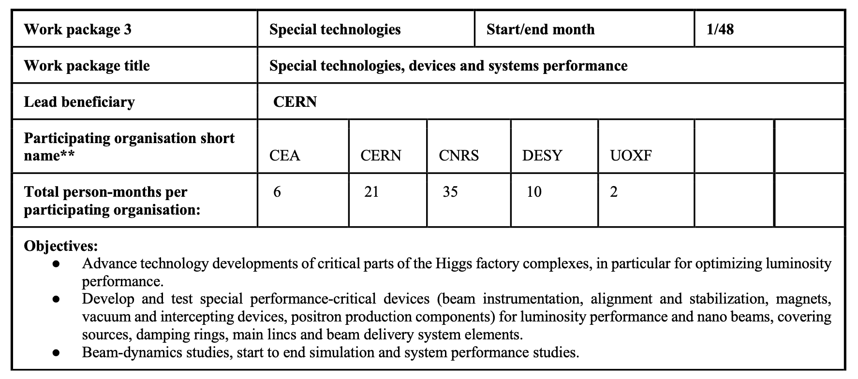
Some of these secondments are linked to testing of these technologies or models in existing facilities, in which case they could have been in WP1

Slide 2
Group by group
CNRS (35 PM):
FCC-ee at SuperKEKB, polarimetry, monitoring and optimisation of beam
BNL, IR magnets
ATF3, vibration and girder
CERN (21PM):
FCC-ee at SuperKEKB, IOTA and EIC, focus on MDI, collimation, background control, optics and polarisation (“software” studies)
CEA (6 PM):
SLAC and Fermilab: Specialised magnets
DESY (10 PM):
Victoria: Beam Dynamics
SuperKEKB/ATF3/BNL: Simulation studies
Fermilab: MDI
UOXF (2 PM):
ATF at KEK, hardware for LCs

Slide 3
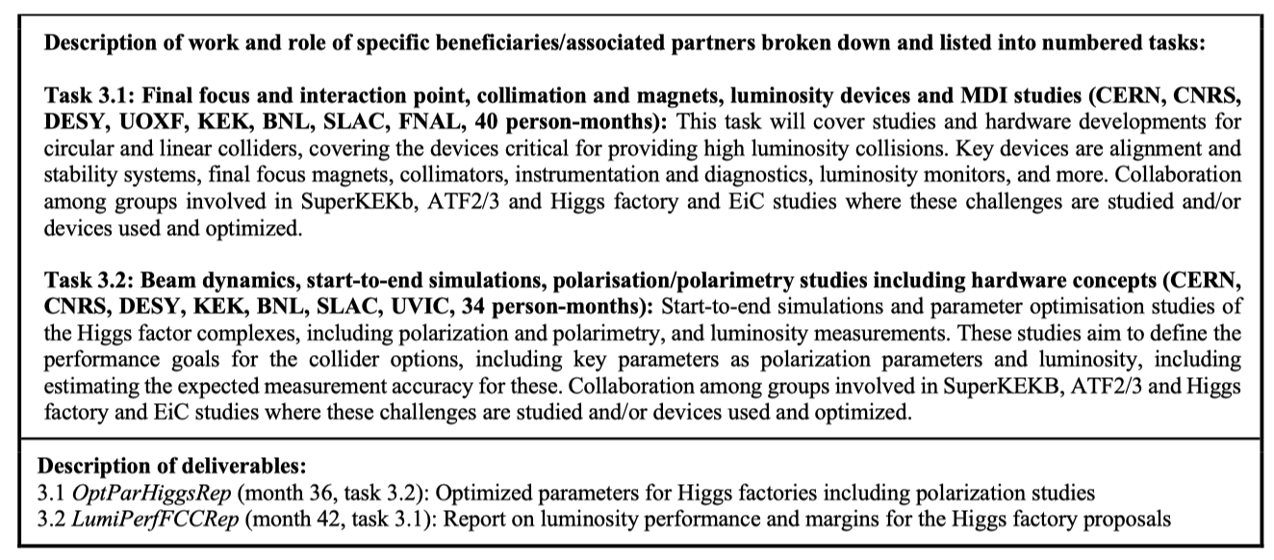

Slide 4
Next steps
Consolidate 2023 planning
Focus on first travels to each destination (procedures and contacts)
Check overlap and inconsistencies wrt WP1
Find WP3 responsible longer term

