Slide 1
EAJADE – Work Package 6 Management, Dissemination, Training, Knowledge Transfer, and Communication
EAJADE Kick-off Meeting
Thomas Schörner
29/30 March 2023

Slide 2
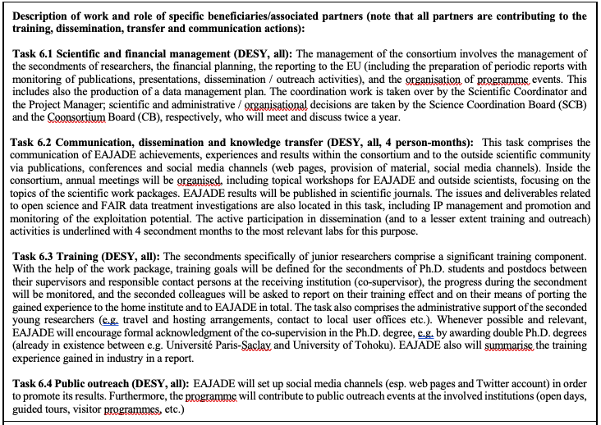
Summary
bablabla

Slide 3
Deliverables

Slide 4
Meetings
… of EAJADE committees
Consortium Board (Thomas)
→ question CERN: Frank Z. or Steinar?
Science Coordination Board (Steinar)
Both meet twice a year (once at annual meeting, and once more – at least this one probably virtually)
Suggest joint meetings, also with interested associated and industry partner representatives present → consider today’s meeting as combined SC and SCB meeting, will prepare minutes.
Funding-relevant decisions (e.g. on common fund) to be taken by beneficiaries (e.g. by CB) alone.

Slide 5
Training
… of junior EAJADE researchers
Training experience (quote from proposal)
EAJADE / WP6 will set up and monitor training goals for seconded Ph.D. students and postdocs
These secondees will be asked to report on their training effect and on the porting of their experience to their home institution / EAJADE in general.
Action items:
We need to organize administrative travel support for all secondees (information on housing, safety, visa etc. for the various receiving institutions).
EAJADE shall help to acknowledge double Ph.D. affiliation / co-supervision and joint degrees.
EAJADE will prepare an industry secondment experience report
We should take the training aspect serious and define “goals” for each secondment of junior researchers (and follow up).
→ Will prepare questionnaire on this, or relate it to INDICO registration page?
Additional ideas for training of young people:
Internship programme (→ common fund?)
Mentoring programme with small scientific projects to enrich the CVs (and our reporting)
Dedicated schools?
Masterclasses?
…
?
?

Slide 6
Events
(co)organised by EAJADE, or with EAJADE contributions
Which? How to contribute? What to contribute?
EAJADE annual meetings – do we want that? Do we attach it to conferences? Ideas?
CB and SCB meetings
Work package topical workshops?
…
Important: Let me know if you show anything related to EAJADE anywhere (e.g. the typical guided tours, days of open doors etc. stuff, or topical workshops).

Slide 7
Open and FAIR Data
And open science practices
Need to provide a data management plan for EAJADE results → will provide a questionnaire on their prospective data for each work package soon.

Slide 8
Publications
Is this an issue beyond acknowledgements?
Please report all publications and talks by you and your institute members that have / need / deserve an EAJADE acknowlwedgement to me for reporting purposes.

Slide 9
Outreach
What measures do we want / need? Who is willing to play along?
Web site eajade.eu
Twitter? Mastodon? (→ bundling of national information?)
Quarterly or 6-monthly Newsletter
Anything else?
Contributions to events? Which? How?
LCWS?
ILC / CLIC / FCC events?
Public fairs
…

Slide 10
Dissemination (and Outreach, and Training)
We (well, I) have 4 secondment months for this → good ideas?
We need to provide a dissemination and exploitation plan → any further ideas?

Slide 11
Summary
There are a few obvious action items for the work package
As a rule, we will try to rely as much as possible on activities in our field and our countries / home institutes as possible.
A lot relies on your input – please try to be proactive (or at least react to my requests ;-) )
Training
Topical workshops
Events
Publications
Dissemination
…
➔ You will get a mail asking for your input about every three months, structure into the above (and more) categories).

Slide 12
Thank you!
Thomas Schörner
DESY FH
E-Mail: thomas.schoerner@desy.de
Phone: +49 40 8998 3429
https://www.eajade.eu
E-Mail: eajade-admin@desy.de

Slide 13
Backup

