Slide 1
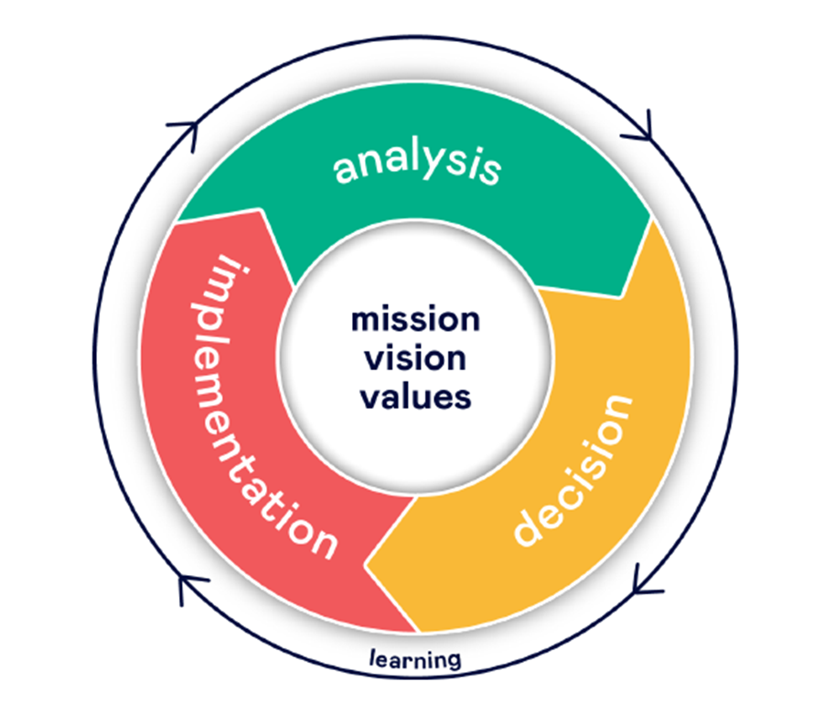
Detector R&D taskforce
Ties Behnke, Ingo Bloch, Doris Eckstein, Ingrid-Maria Gregor, Karsten Hansen, Friederike Januschek, Felix Sefkow, Marcel Stanitzki
Our Ambition:
Outstanding competence in our capability to design and build complex detector systems (60%)
Leadership in selected technological areas which are needed to address our science program (30%)
Retain a level of agility in the technologies and system aspects we work on to be able to identify quickly newly emerging areas of technologies and science relevant for detectors. (10%)
Our Uniqueness:
Demonstrated system competence
Access to technologies and services
Access to unique infrastructures: testbeam, DAF, …
Our Strategy:
Monolithic active Silicon Pixel Detectors: technological priority
Technological lead in SiPM – on – tile Systems
Detector integration center
Fast Data transfer: Silicon photonics
Expertise in key interconnect technologies
Expertise in other detector technologies: cryogenic detectors, others

Slide 2
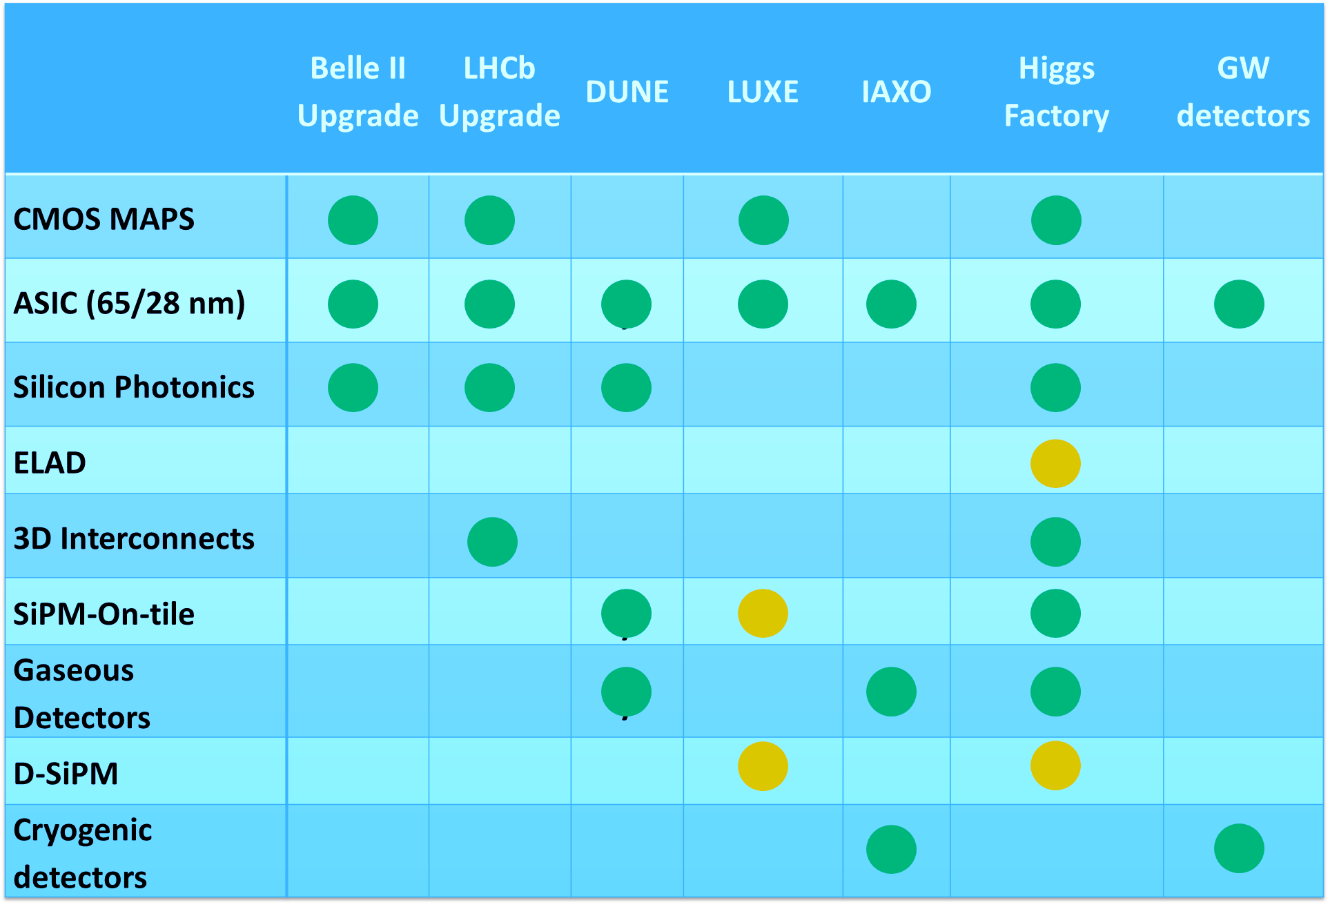
Opportunities
Connection to the FH strategy

Slide 3
Communication
Needs to be improved
Communication was an important point during August retreat:
Detector development spread around several groups: idifficult to be aware of all activities
Decision sometimes are not transparent – owing to the distributed structure of the effort
Proposed actions to be taken:
FH mailing list of detector development: FH.detector@desy.de
Organisational:
Detector day FH: bring together all players for a one day exchange event
“internes” detector forum: regular meeting to discuss DESY (FH) projects
Topical detector seminars (Silicon Seminar)
Instrumentation seminar: seminar with invited speakers (together with FS)
Forum for engineers/ technical issues/ etc
send e-mail to sympa@desy.de with subject: SUBSCRIBE FH.detector firstname name

Slide 4
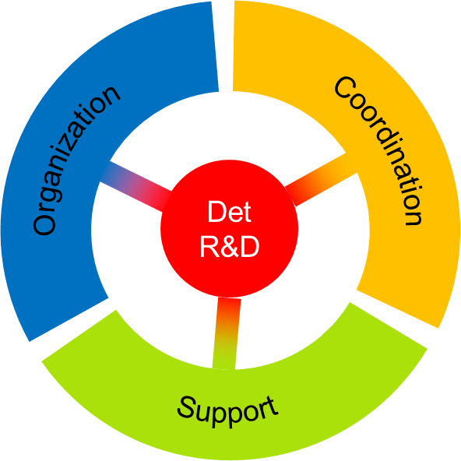
Structures
Forming a coherent strategy and structure
We propose to form a “Detector Technologies Platform” in FH
Coordination
Detector development across FH groups.
Finding priorities and posteriorities, embedded into the overall divisional strategy.
Ensure the connection to Helmholtz Programs
Organization/ Communication
Scientific events relevant for the platform
Funding applications
Engagement of students and postdocs, engineers, technicians
Support
Major detector development infrastructure
Setup and run a “detector hub” (HEP) at DESY

