Slide 1
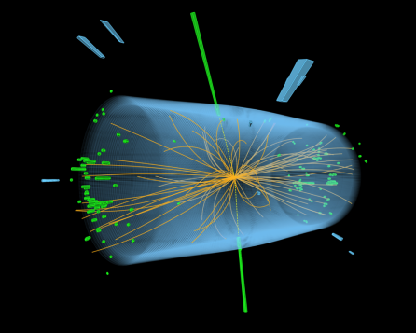
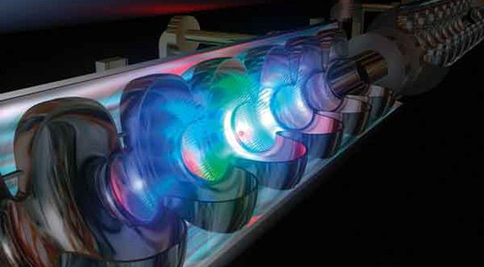
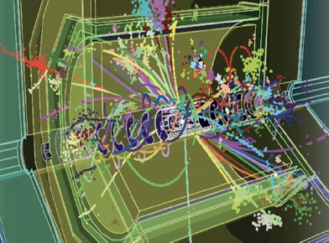
FutureColliders@DESY
FH discussion
Ties Behnke, Christophe Grojean, Benno List, Jenny List, Christian Schwanenberger.
With inputs from K. Behr, F.Blekman, A.Cardini, S.Diez, F. Gaede, A. Grohsjean, L.Hagge, S.Heim, A.Jafari, K.Krüger, T.Madlener, A.Maier, A.Martini, F.Meloni, A.Meyer, K.Mönig, G.Moortgat-Pick, K.Peters, J.Reuter, F.Sefkow, S.Spannagel, M.Stanitzki, K.Tackmann, G.Weiglein, A.Zimermmane-Santos
14 Dec 2022

Slide 2
Introduction
Our starting point
DESY is recognized as one of the world-wide leading players in future collider studies, comprising:
  Theory & MC generator development
  Physics potential
  Detector Technology R&D
  Detector Concepts and their physics-driven optimisation
  Machine-Detector Interface
  Software framework and algorithms for simulation, reconstruction and analysis
=> reflected in many leadership roles etc
Where do these future collider activities fit into the DESY strategy?
=> formed a small team, summarize state of discussion here.

Slide 3
Goals for a DESY-FH Future Collider Involvement
Towards a strategy
We want to propose a research programme for future colliders in HEP at DESY in the coming years that
  Produces relevant, high-quality scientific results
  Is attractive to young (and senior) scientists, offering international visibility and career opportunities
  Leverages on DESY’s strengths as a leading laboratory in HEP
  Exploits synergies between theory, software, detector and analysis groups
  Prepares DESY to make important / leading contributions to a future collider once it is known which project may go ahead
  Strengthens DESY as a hub for Germany’s HEP community
  Is aligned with the European Strategy for Particle Physics and with DESY’s strategic goals

Slide 4
Questions for a DESY-FH Future Collider Involvement
Five teams
PRESSING QUESTIONS: Within the coming five years, what are the most pressing questions that need to be answered in order to come to an international / European decision on the next collider project or at least a new European Strategy?
SYNERGIES: Given DESY’s / FH’s broad capabilities and experience in theory, computing, detectors, physics analysis and implementation of large projects, how can those be combined to achieve unique, outstanding and visible results?
INFRASTRUCTURE: How can DESY’s science infrastructure (test beam, computing facilities, detector laboratories, software development capabilities) be leveraged to achieve unique, outstanding and visible results?
RELATIONS How does a DESY / FH programme on future colliders relate to the overall DESY & Helmholtz strategy / mission? What will be the relationship of a DESY / FH programme on future colliders with the German, European and worldwide HEP community? How can the Higgs factory physics programme be explained to other branches of science (“discovery stories”)?
EARLY CAREER: What is required to make the future collider programme attractive for those who might actually see them take data, i.e. current early career researchers?

Slide 5
PRESSING QUESTIONS
For the next few years
What do we need to address in order to shape / contribute to the next European Strategy?
  What is the right machine?
  What is the relative importance of energy reach / ultimate precision?
  How can a next collider be built and operated in a sustainable way / at minimum cost for society?
How important is the timeliness of the next project (no gap to HL-LHC)?
How strong does a DESY effort need to be in order to have an impact?
  Accelerator?
  Experiment?
  Theory?
  Sustainability?
=> Input to all these questions is needed for the update of the European Strategy in 2025

Slide 6
Building Relations
Particle Physics
Science in General
Impact in Society
Excitement
Impact at DESY
Making the case beyond the pure science
FC is an important
part of our future
To answer the big questions we need an FC beyond LHC
FC is offering opportunities to our young people
A future collider
is a discovery machine
FC is not just a small
addition to LHC
FC open new horizons
FC pushes novel technologies
International visibility
of DESY
FC is central if DESY wants to be relevant in HEP
FC triggers new technologies
FC is an engineering gold mine
FC is a gold-mine for science harvest
FC attracts top brains to DESY
FC is a research
infrastructure
The word unites
behind one common
topic
FC is pushing technology
breakthroughs
FC is relevant for
other areas of science
and society
FC is exciting
FC is relevant
We communicate
FC with pictures
FC is an opportunity
which we cannot miss
FH scientist
technical
Scientists
Engineers
DESY&
Helmholtz
Managers
Politicians
BMBF
Interested public
Politicians
Notes:
A huge project like a future collider can only succeed if it carried by broad support from many different areas of society. We need to tell a story which is convincing to the scientist, meaningful for the politician and exciting for the general public. We need to start in our own community –only if our community fully stands behind FC, we have a chance. Centrally important is that we convince other scientists, that our goals are relevant, sound, and important. At DESY in particular, we need to make the point that a new facility like a FC will have a hugely positive impact on the overall DESY (and eventually Helmholtz) program and mission. Building such a support base at home, on the science and on the overall scope of the project, is an indispensable condition to then convince politics to support the project.All this needs to be accompanied / supported by a strong and convincing campaign to the general public, to transmit the relevance and excitement of the project.

Slide 7
Synergies & Infrastructure
Some concrete examples
Theory/experiment collaboration:
  Monte Carlo generators: add/validate (on data) new processes beyond NLO precision
  Define interesting models, measurements
  Use experience with generating large samples
  → make DESY German Hub for MC
Analysis and reconstruction software:
  Huge experience with analysis software developments (e.g. Key4HEP), but also reconstruction software (e.g. silicon tracking)
  → make DESY German Hub for software developments independent of detector design
Detector R&D, integration and construction:
  Large opportunities for synergies with calorimeters (e.g. HGCAL and CALICE), Silicon Detectors, DMAP technology, Gaseous detectors, ...
  Testbeam
  Experience in integration of large detectors
  in hardware and software
Algorithm developments:
  Large experience with developing algorithms at different experiments
  Particularly large experience with Machine Learning that can be utilized for developments
  → fruitful collaboration between different present and FC projects

Slide 8
EARLY CAREER
Impressions from discussions with ECRs
General Impressions
ECR see a future collider as their future
Involvement difficult in view of
  time constraints from ongoing experiments
  feeling of lack of support from supervisor
  “career suicide”
Scope & Topic: “dream big, act small”
well-defined small scope projects with clear prospects of timely publication within e.g. ~2 years, alone or in a collection of studies
for students: become a chapter of thesis
use synergies with main work area, e.g. same physics topic, same reconstruction technique, same detector technology, …
a starting point: joined supervision of summer (winter) students / bachelor students / master students between FTX and other groups
Sustainabillity
Many young (and older) people worried about energy consumption of future colliders.
Will politicians support such a project if energy prices remain high?
Causes lots of uncertainty for young researchers who doubt such a project will actually be implemented
Can we offer projects studying sustainability aspects of future colliders?

Slide 9
Preliminary Conclusions
A snapshot from the discussions so far
  Form a task force on communicating the physics case – in particular towards scientists in other fields
  Make Future Collider studies a transversal activity in FH: build a broad FC community in FH
    Foster informal exchange
    Support small, well-defined side projects
    E.g. supervision of summer / bachelor / master students
  DESY as German Hub for future collider studies
    In particular software, MC production, detector concepts
    Including training
Common Coffee area for whole FH department

Slide 10
Backup

Slide 11
Mentimeter questions
Suggestions for Thomas
How important do you consider it to have a Future Collider activity at DESY?
(on a scale from 0 (couldn’t care lessl)...10 (utmost importance) )
Would you be interested to contribute somehow (eg co-supervise or contribute otherwise to a small project)?
(on a scale from 0 (only over my dead body)...10 (where can I sign up) )
Should DESY play a hub role for future collider studies nationally and/or internationally?
(on a scale from 0 (never ever)...10 (absolutely))

Slide 12
List Jenny
FH/FTX
jenny.list@desy.de

