Slide 1
ARES Operation Meeting
Summary of week 44 / 2022
Frank Mayet, on behalf of the ARES crew

Slide 2
Summary of week 44
Mon. 31st October | Tue. 1st November | Wed. 2nd November | Thu. 3rd November | Fri. 4th November
 | Calibration of the first BPM and work on the new DOOCS server (MDI) Restoring the new ACHIP working point with the first two EA quads ACHIP laser alignment Restoring rough time overlap | Optimization of time overlap within 250 ps window Optimization of electron transmission (best visibility so far) Upgrade of the high energy spectrometer DOOCS server to support single spike filtering BPM commissioning | BPM commissioning Charge map of Mo cathode with 200 um aperture | PDE trajectory investigations (what happens if the beam is not centered in the TDS / enters the PDE with an offset/angle) → Can get offset up to ±0.7 MeV/c! BPM commissioning FL.I1 camera back online FL.I1 and EA.L1 cameras now work ain parallel
 |  | First and second Linux console cannot be rebooted properly (manual grub prompt) ACHIP pump laser faulty – needs repair / to be shipped to IPG Germany |  | BC BPM is not connected to electronics
Public holiday |  |  |  | Tunnel open over the weekend
Achievements
Difficulties
Notes

Slide 3
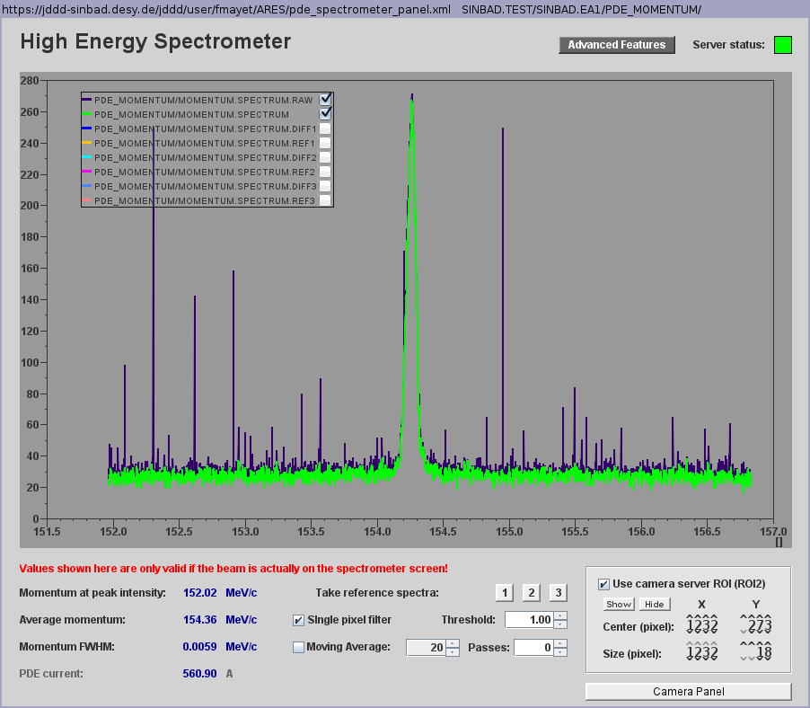
ACHIP
Left: Timing traces (aligned within <250 ps window)
Right: Server-side single spike filter for better modulation detection (HE Spec)

Slide 4
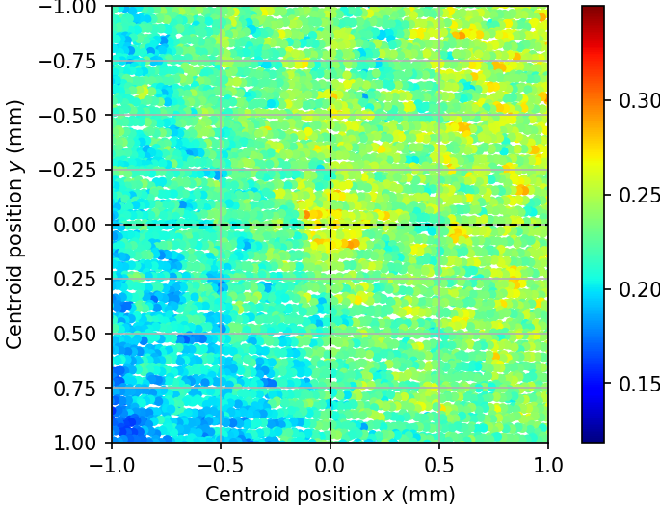
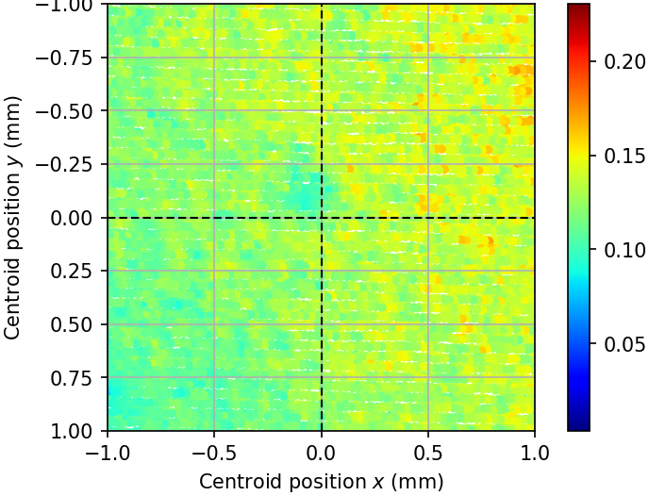
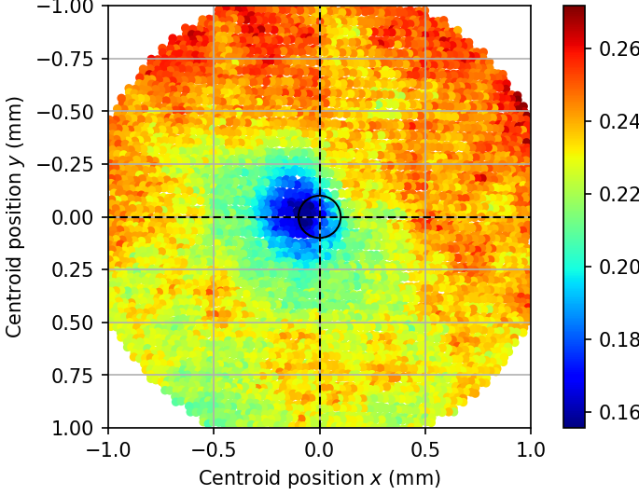
Charge Map
Fresh Mo cathode installed on 2022-06-14
2022-06-18
Aperture 50µm
Laser settings not documented
2022-07-22
Aperture 50µm
Pharos 60%, user attenuator 8000
2022-11-03
Aperture 200µm
Pharos 30%, user attenuator 8000
Note: Centroid position is relative to current laser alignment. Slight shifts (in the order of 100µm) possible between the plots.
Colour scales are different.

Slide 5
BPMs
Status
All BPMs except for the BC calibrated (800 fC max)
BC BPM needs to be connected to the electronics
MR BPMs most stable signal; DL BPMs show least stable signal (to be investigated)
Higher charge tests once the Cs₂Te cathode is installed (check if low charge calibration is suitable)
BPM readings visible on cockpit panel; new DOOCS server works

Slide 6
Plan
Week 45
Monday
  Tunnel open → UKE visit
Tuesday
  Morning: Cathode exchange (Cs₂Te)
  Tunnel to be closed at 11:00 → Careful ramp up; check dark charge, etc.
Wednesday
  Transport of 30-40 pC beam; Optimization for a “large uniform beam” at the end of the machine (dosimetry tests)
Thursday
  AutoAcc
Friday
  tbd

Slide 7
Schedule
Week 45
Date | Shift Leader
07.11. | -
08.11. | Hannes
09.11. | Frank / Thomas
10.11. | Frank
11.11. | Thomas
If you want to learn or join the shift: please give the shift leader a call (BKR 2840 / SINBAD Box 2454)

