Slide 1
GBP DAQ update

Slide 2
Trying to reproduce caen results
Scan accomplished using internal triggering on pulsed signal
Pulsing signal in width and amplitude
I also discovered that there is a 250 ns delay internally.
Sending the trigger a few ns before the sigal made it undetectable.
Increasing the hold delay from 200 to 300 ns allowed me to use the external trigger
No charge injection circuit used: study is in amplitude and width
Next step in this direction
Average LG values used, more analysis needed to study distribution

Slide 3
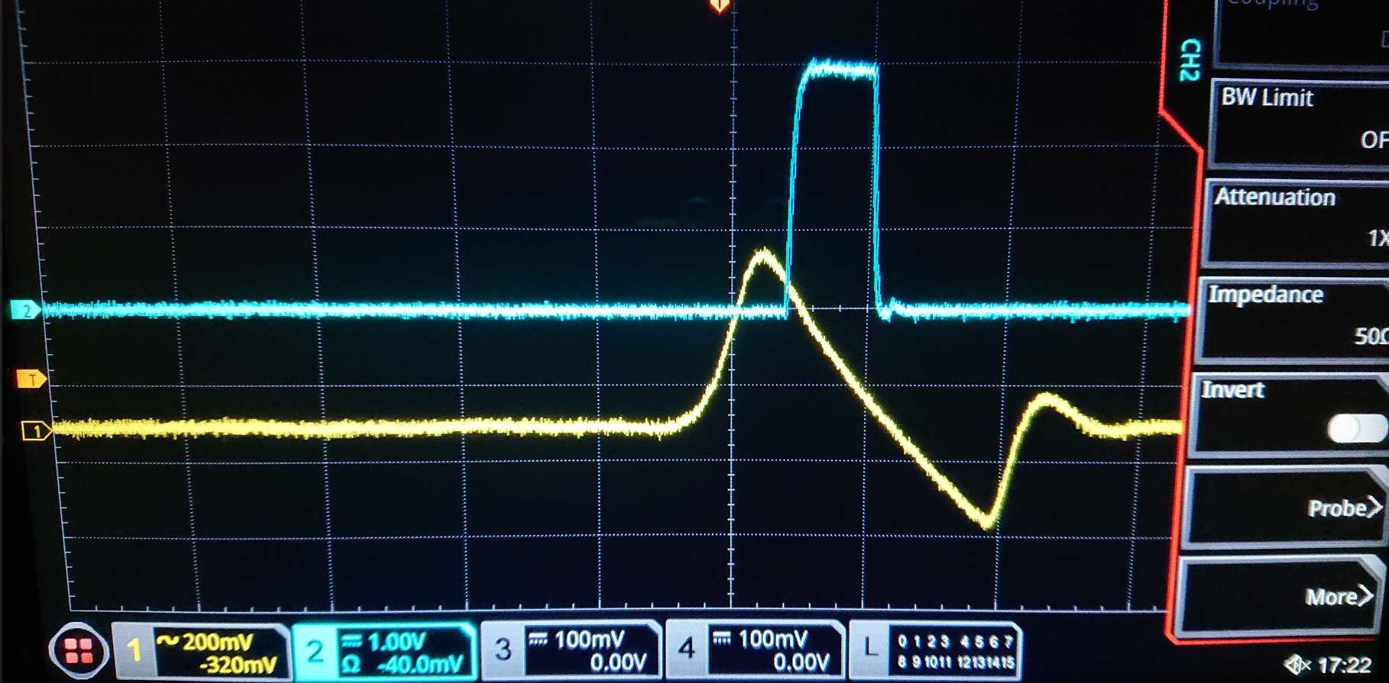
Fast shaper and internal trigger
Here the trigger is generated by an OR combination of all the 64 channels

Slide 4
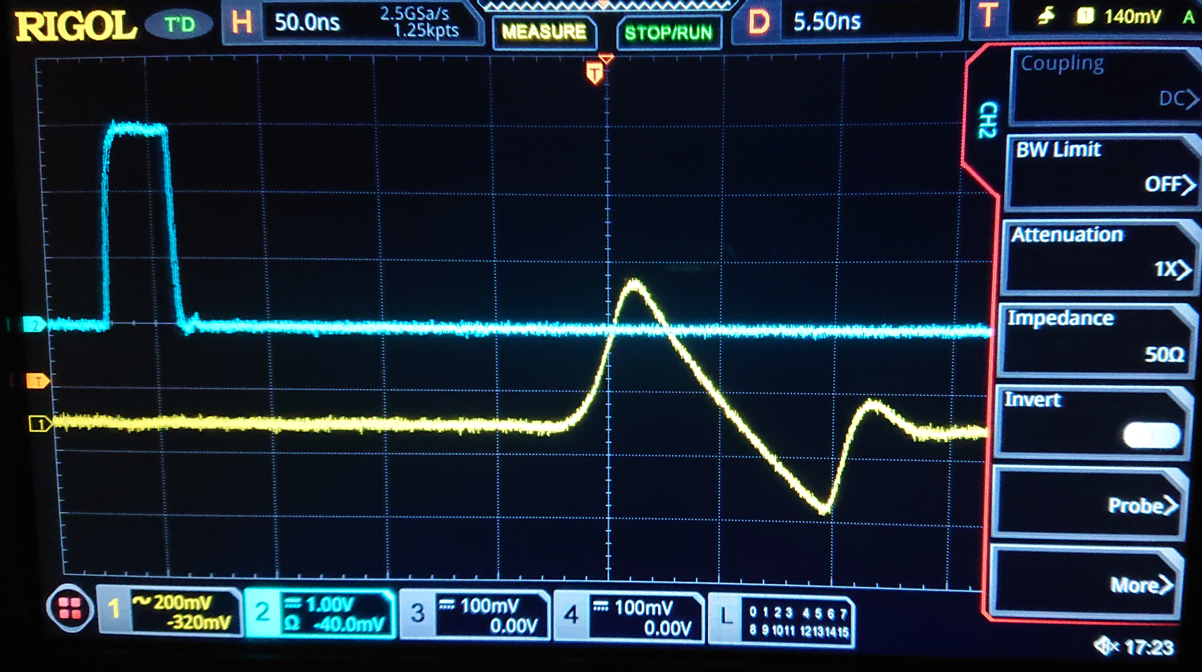
With the external trigger signal
Here the trigger is generated from an external TTL signal

Slide 5
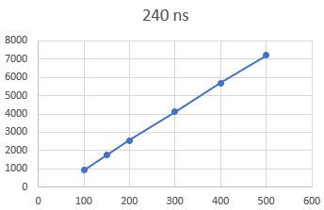
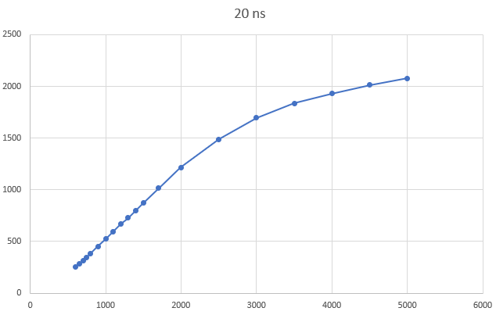
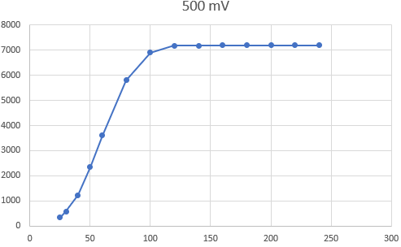
Linearity preliminary tests
Tests done with Low Gain amplifier at 40
Data acquired also with HG at 40
A (mV)
Width (ns)
A (mV)

Slide 6
Other updates
System tested using a very long ethernet cable (>25 m) without any issue
We can use a direct connection the testbeam area and have the laptop outside
Issue: this uses the ethernet input
The CAEN mainframe must be connected another way
Ideally it should be registered on the CERN network.
This allows it to be connected via wifi and run all in parallel
Tested OpenOPC library to work with python 3.11 on some cern machines that we have in the cern network and that connect with the CAEN crates
Tests using SiPM with LED pulsing ongoing, results still unclear.

Slide 7
Next steps
Reproduce the CAEN results
Complete the test using the SiPM array

