Slide 1
FLUKA studies with the 3 dumps update
Stewart Boogert, Kyle Fleck
21/11/2022 LUXE simulation meeting

Slide 2
Introduction
Need for FLUKA simulations
  Trusted for radioprotection
  Especially low energy hadronic processes
  Cross check of Geant4 simulations (lxsim)
  (Re-)start detailed dump simulations (G4/Fluka)
Excellent starting point from Kyle Fleck (QUB)
  Three configurations (elaser, glaser, nomagnet)
  Pyg4ometry converted GDML with hand added DEFAULTS, BEAM, BEAMPOS, MGNFIELD, USRBIN, USRBDX, RANDOMIZ, START
  Included small hand edits for Gamma detector
Improvements
  All shielding instrumented for neutron fluence
  Double- and cross-checked normalization
  New plotting to better compare with Sasha
  Binning for thermal neutrons in spectra
https://github.com/LUXEsoftware/lxflusim

Slide 3
Reminder slides

Slide 4
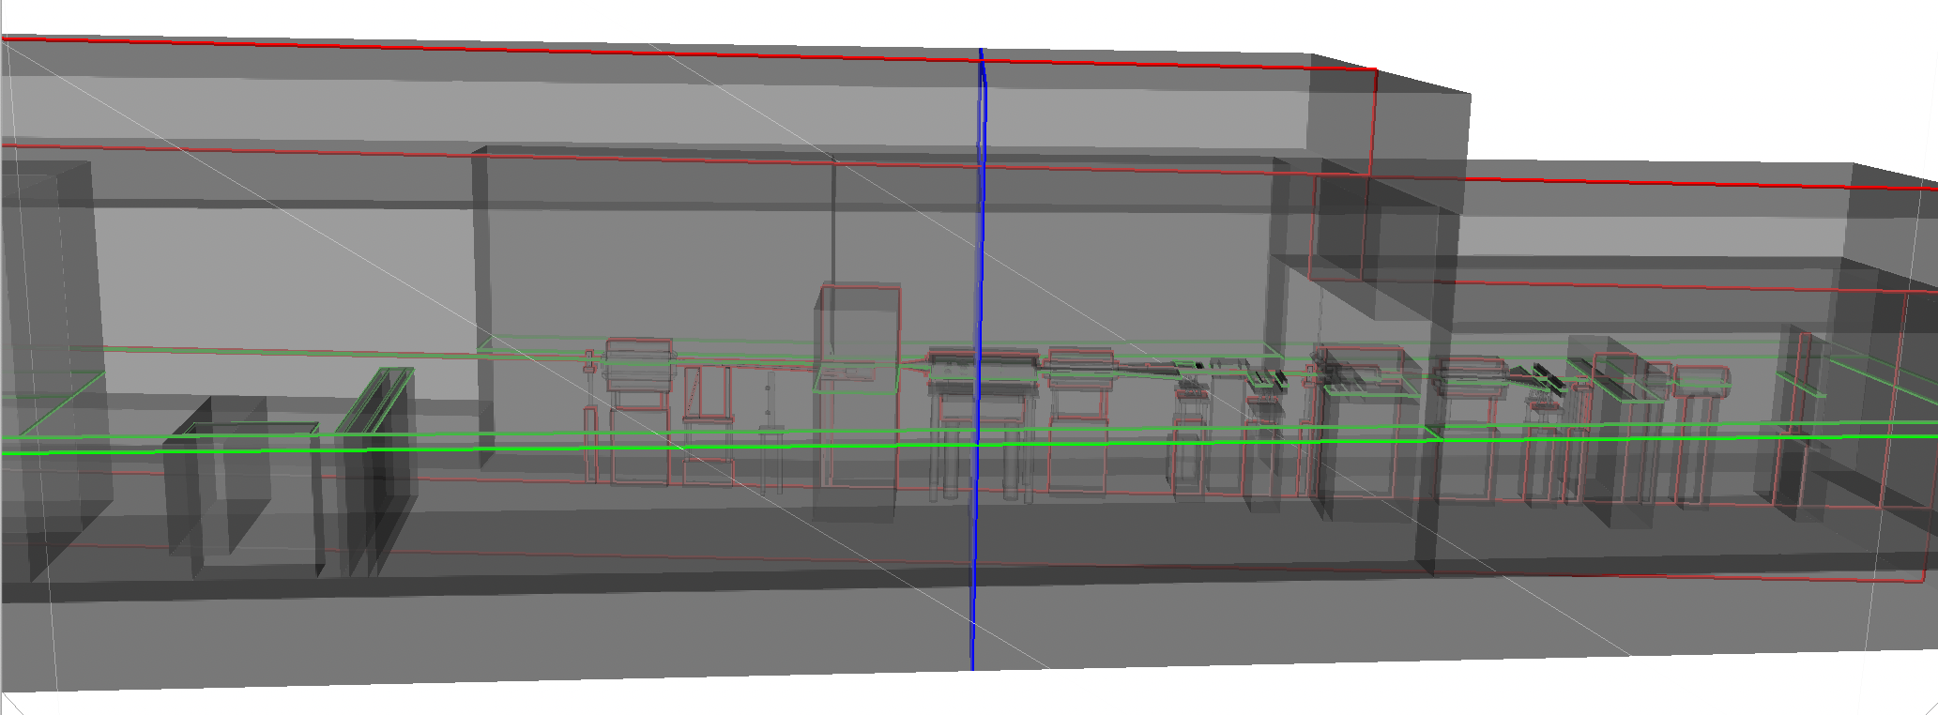
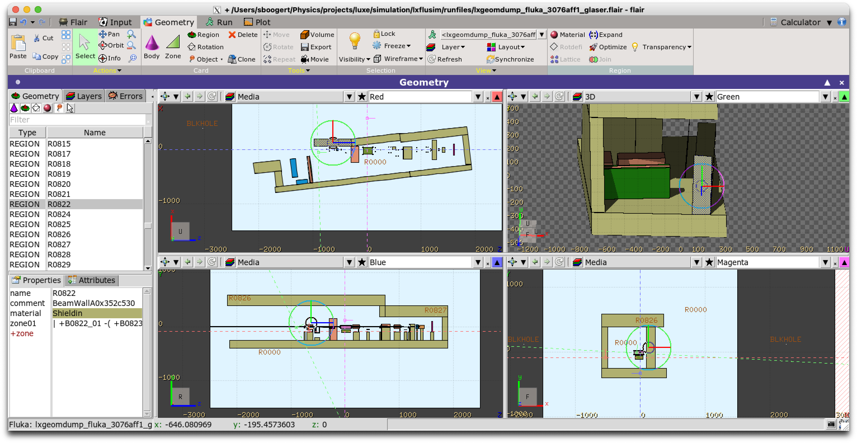
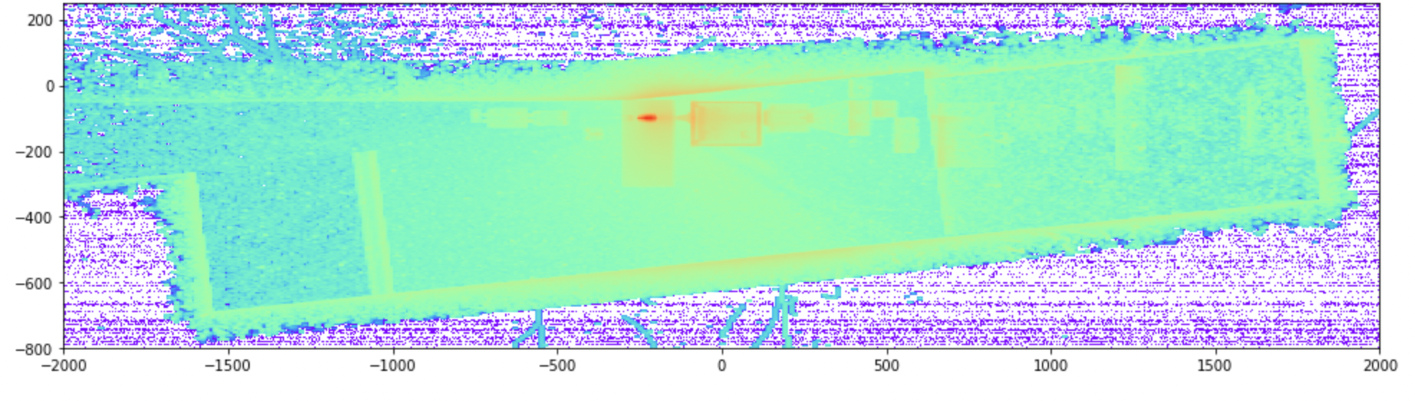
FLUKA workflow
GMDL/pyg4ometry
Run lxsim and generate GDML geometry
Convert lxsim GDML geometry to FLUKA
Augment with control cards (BEAM, BEAMPOS…etc)
Run FLUKA jobs
Merge output from all jobs (utilities provided by Fluka)
Plotting in matplotlib and/or VTK (pyvista)
  Output are 3d histograms or spectra.
  Binning x [-800,400], y [-250,250], z [-2000,2000], 400
Flair
Fluka output
https://bitbucket.org/jairhul/pyg4ometry/

Slide 5
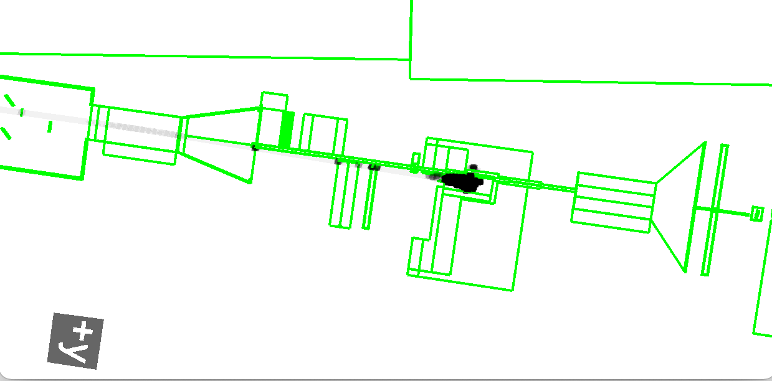
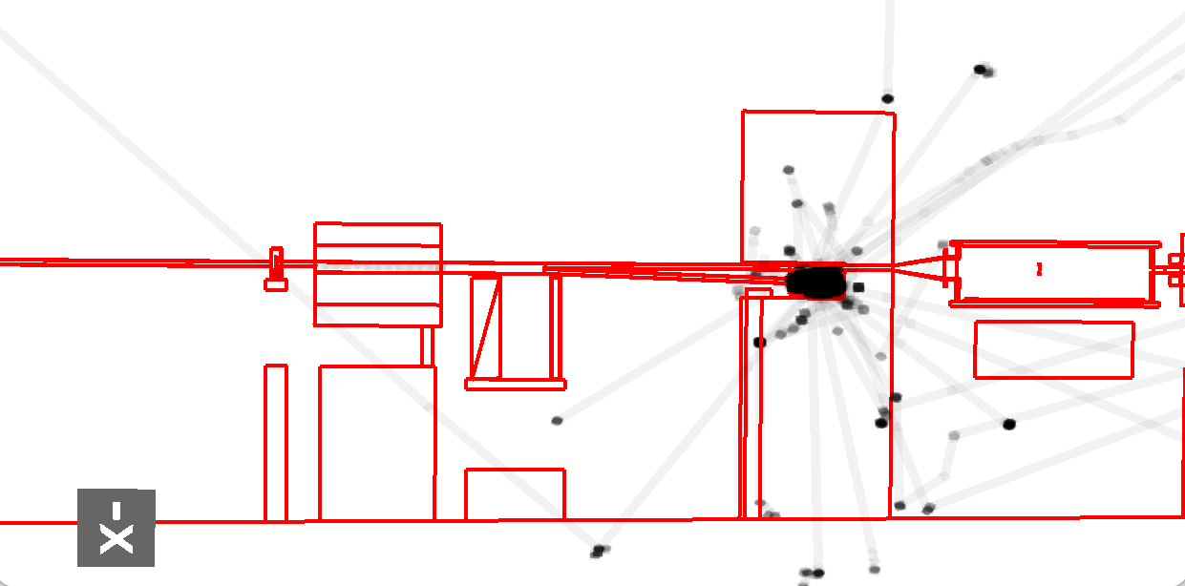
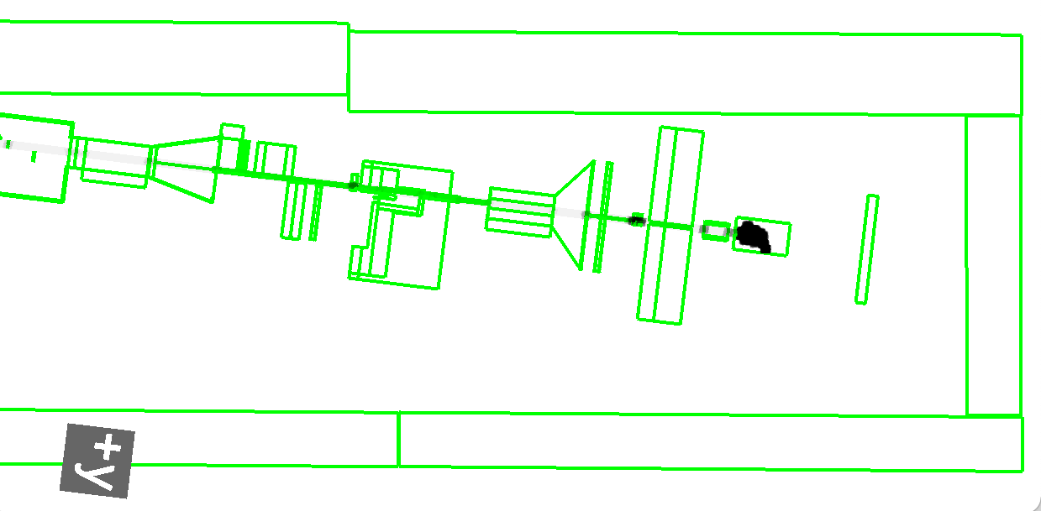
Model verification
Electron-laser
Geometry
  Very advanced conversion (written by me for another project)
  Flair (GUI for FLUKA) would indicate geometry errors (overlaps)
Materials
  Converted from Geant4 down to isotopic composition
  Hard to independently check (could with simplified models i.e a block of material in G4/Fluka)
Magnetic fields (3 important)
  Track test particles and dump all trajectories (see right)
Gamma-laser
No magnets

Slide 6
Scoring distribution comparison (g-laser)
Plan view of different scoring maps for g-laser configuration.
edep
gamma
em-edep
neutron
dose
proton
elec
muon-
pos
muon+

Slide 7
New stuff

Slide 8
New fluence plots (g-laser)
Find maximum fluence (or deposit) bin in 3D.
Project in 3 directions centered on maximum (likely to be dump)
Peak fluence of 8.7 x 10⁴ n/mm⁻² (bunch charge 1.5 x 10⁹ e⁻)

Slide 9
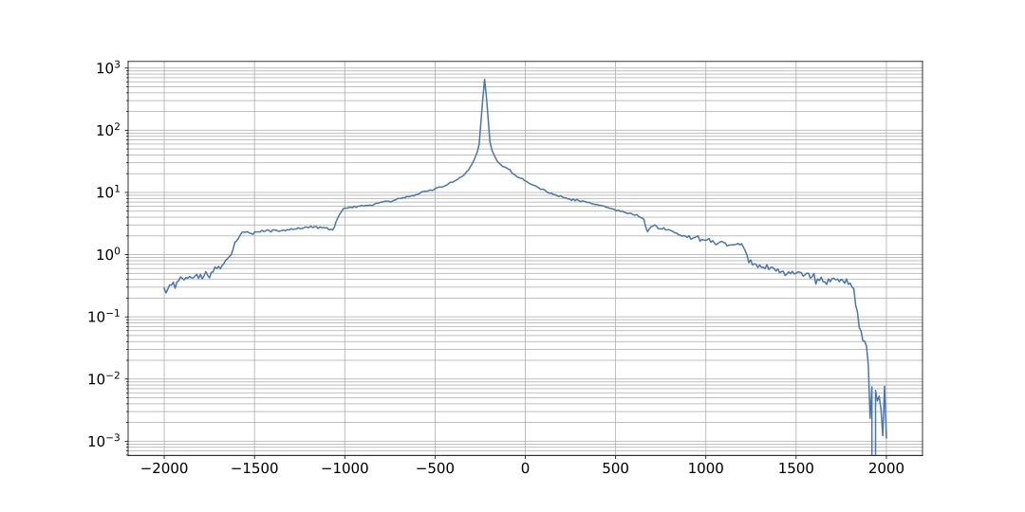
Neutron fluence along beam line
OB : https://indico.desy.de/event/36737/contributions/131734/attachments/78040/101079/glaser_background_sim_31102022.pdf
LXSIM/G4
FLUKA

Slide 10
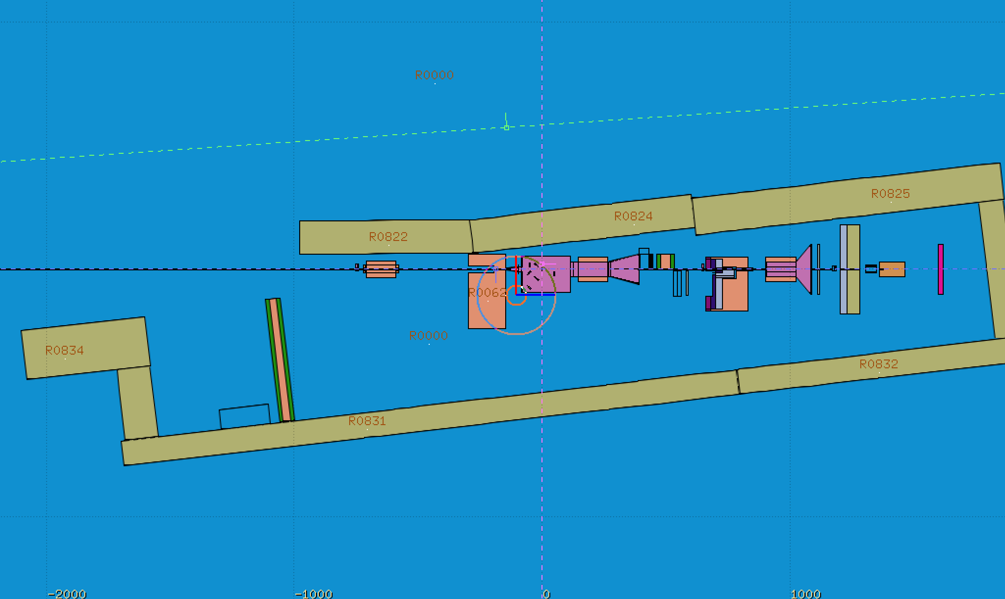
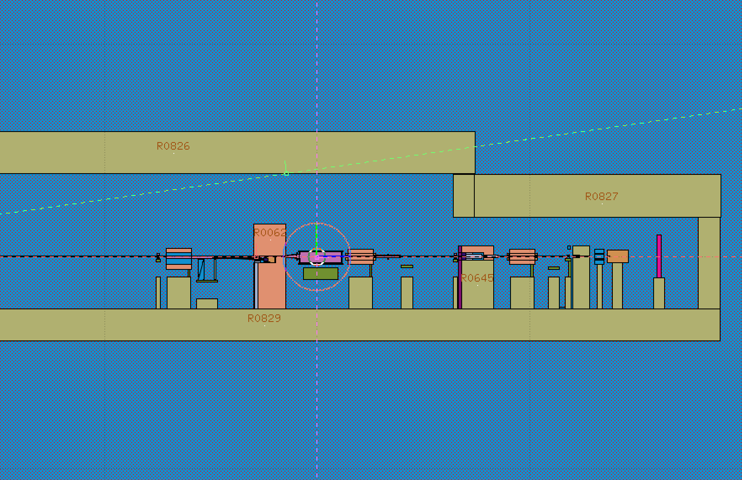
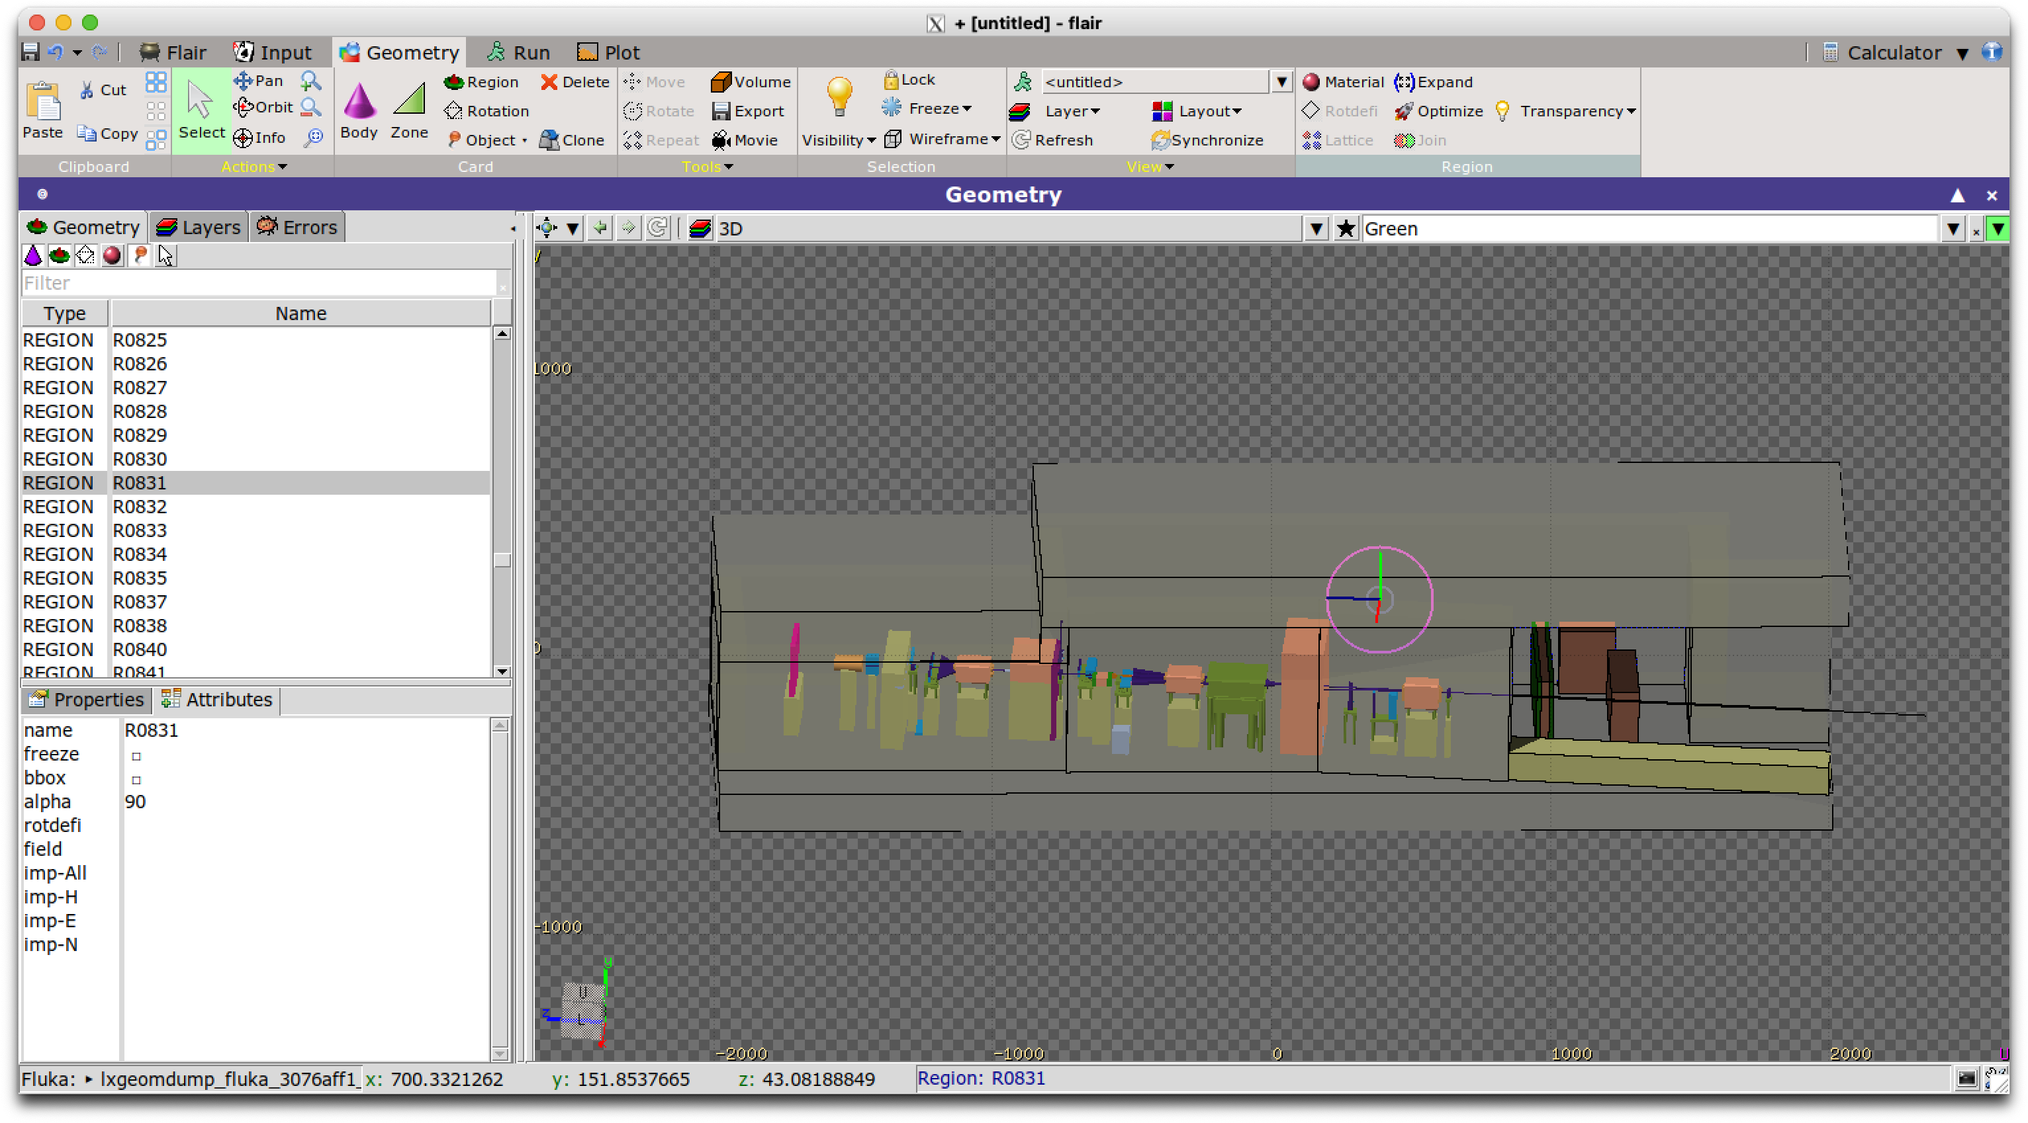
Locations sampled for neutron fluence
Plan
Elevation
W3
C1
W1
W2
c3
W8
W4
c2
W4
W7
W5
W6
F1
W1-8 : Walls
C1-3 : Ceiling
F1 : Floor
R1: XFEL dump rack
R1

Slide 11
Shielding wall spectra (g-laser)
W2
W3
C1
W1
c3
W8
W4
c2
W4
W7
W6
W5
F1
FLUKA

Slide 12
Neutron spectra (g-laser, XFEL dump rack)
OB : https://indico.desy.de/event/36737/contributions/131734/attachments/78040/101079/glaser_background_sim_31102022.pdf
LXSIM/G4
FLUKA

Slide 13
Summary
Presented neutron spectra for shielding and XFEL dump PCL racks
Normalisation between Geant4 and FLUKA looks reasonable
  Factors of order unity out
Other scoring maps not presented (electron, positron, photon, proton, muon etc)
Other configurations (e-laser and dump) not presented
Neutron distribution and spectra
  Some features not replicated
  Have lethargy distribution for all shielding blocks
Simulations are still running (no possibility of re-binning after run, a la Gean4/LXSIM)
  Bugs in floor and ceiling volumes selected
Time now for much more detailed LXSIM/FLUKA simulations

